Slide 1

Antenatal Assessment of
Fetal Wellbeing
3rd trimester

Slide 2
ANTENATAL ASSESSMENT OF
FETAL WELL BEING
Prenatal care is designed to ensure the well being of both the mother and the fetus

Slide 3
AIMS
To identify fetuses at risk of intrauterine hypoxia so that a permanent injury or death can be prevented by timely intervention.
To identify healthy fetuses among those suspected to be in problem on clinical evaluation so that an unnecessary intervention may be avoided.

Slide 4
Who?
Conditions placing the fetus at risk for intrauterine hypoxia :
  Hypertensive disorders
  DM
  Chronic renal disease
  Thrombophilia
  Postdate and post-term pregnancy
  Fetal growth restriction

Slide 5
Fetal movement counting
In presence of hypoxia :
FM decreased for several days and stop
approx 24-48 hrs prior to fetal demise
(attempt to save oxygen for more vital functions).
10 movements in 24 hours.
Kick charts
This occurs in 50% of cases of foetal demise but not all of them
= reassuring
If any significant change compared to previous number? Even if still >10 movements per day

Slide 6
Advantages
Cheap , good as a screening test
If FM is good ➔ hypoxia is very unlikely
Disadvantages
If used alone it may lead to unnecessary interventions : early iol , hospital admissions
Still births continue to occur with patients failing to report absence of noticeable FM.

Slide 7

Symphysis fundal height
Serial measurements are more effective than single.
SFH measurement after 24 wks has been taken to be equal in cms to the week of gestation
$±$2cm to 36 wks, and 3cms from 36-42 wks.
Reduced SFH measurements correctly identify only 25-50% of fetuses whose birth weight was
<10th centile.

Slide 8
Specific tests
1. CARDIOTOCOGRAPHY
(non stress test)
Antenatal CTG employs external(indirect methods of monitoring of fetal heart rate).

Slide 9
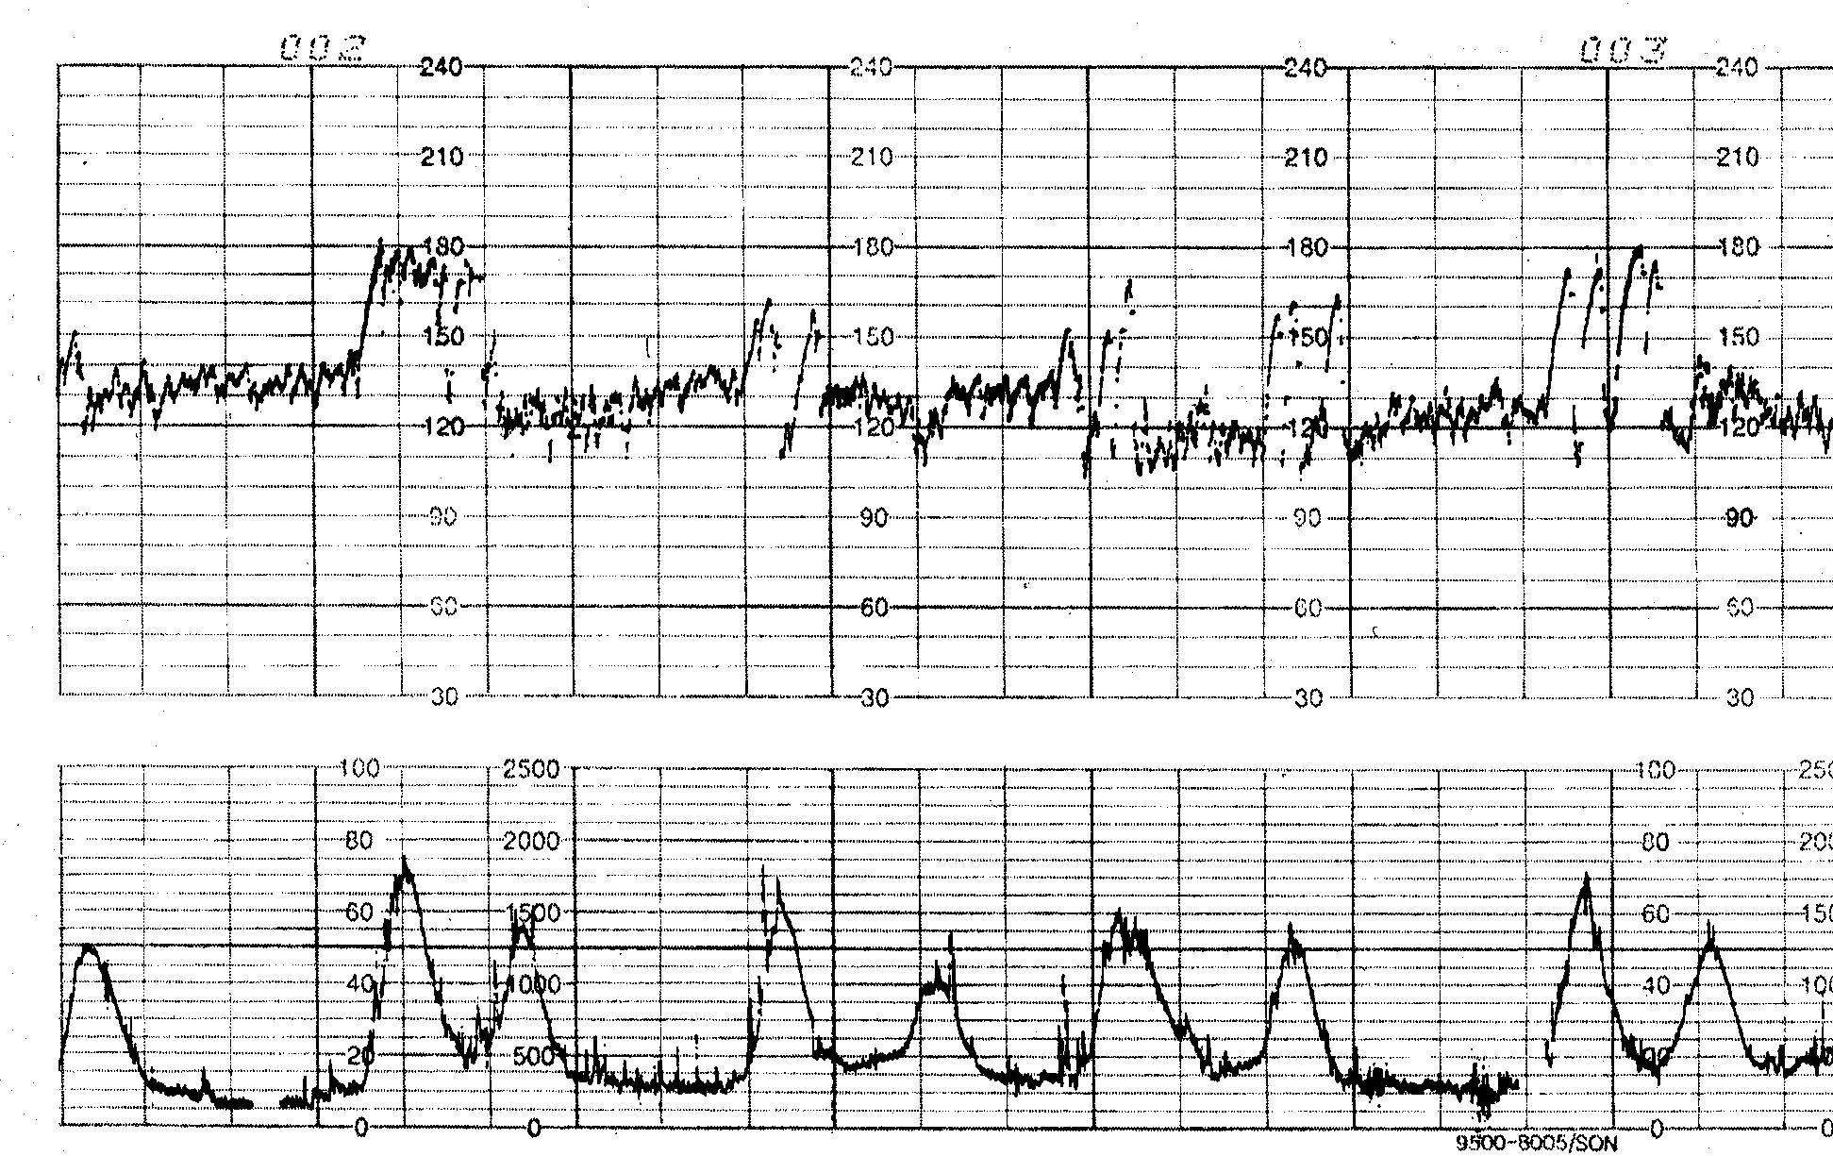

Slide 10
INTERPRETATION
Four variables of CTG:
¬
¬
¬
¬
Baseline FHR FHR variability Acceleration Deceleration
All 4 variables are affected by oxygen deficiency, making it a useful tool for diagnosis of antepartum fetal hypoxia. Fetal cardiac activity is controlled by both sympathetic & parasympathetic nervous system which accelerates and lowers it respectively.

Slide 11
The fetal nervous system matures between 28-32 wks
Before 28 wks CTG is relatively featureless & has high baseline FHR & reduced variability. With advancing gestation FHR slows down & variability increases.
After 28 wks fetus develops cycles of quiet – active sleep lasting for 60-70 min. Quiet sleep phase usually lasts for 20-30 min & characterized by absence of fetal movements & CTG exhibits absence of accelerations
and low FHR variability.
CTG VARIABLES
BASELINE FHR :
In late pregnancy b/w 110-150 bpm

Slide 12
FHR VARIABILITY :
variation of heart rate in successive beats.
5-25 bpm.
Reduced during hypoxia and quiet –sleep phase of baby, prematurity, maternal drugs like pethidine,diazepam & local anesthetics.
Reduced variability with decelerations should be taken
seriously.
= hypoxia

Slide 13
Acceleration: Increase in FHR of >15bpm which persists for >15sec associated with fetal movements, external stimuli or uterine contractions
Loss of accelerations is usually first sign of hypoxia but also absent in quite sleep phase of fetus.
Deceleration:
A drop in FHR of > 15bpm which persists for 15 sec or
more.
It’s a sign of hypoxia but also associated with maternal
supine hypotension syndrome. An isolated deceleration when transient has little clinical significance while recurrent decelerations specially in absence of uterine activity & with loss of beat to beat variability is sign of poor prognosis.

Slide 14
REACTIVE CTG:
Baseline FHR 110-150,
variability 5-25bpm,
2 accelerations in 30 mins
No decelerations.
SEQUENCE OF EVENTS IN HYPOXIA:
Absence of acceleration Loss of beat to beat variability appearance of deceleration

Slide 15
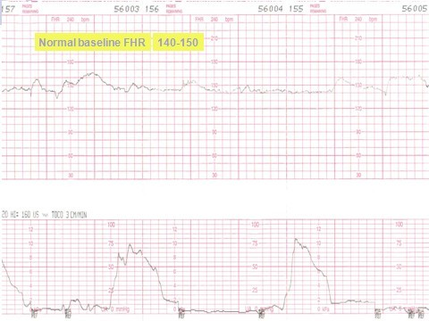

Slide 16
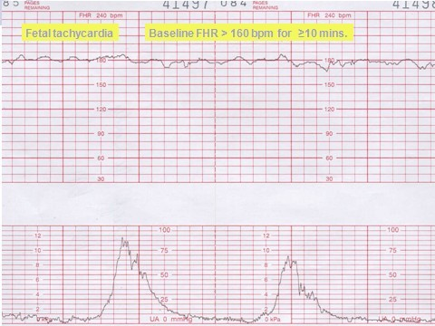
Baseline tachycardia

Slide 17
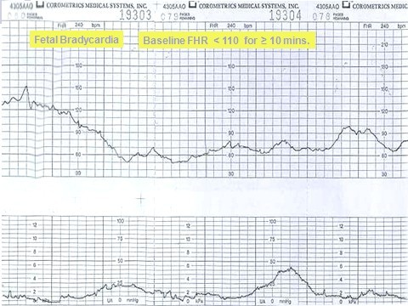
Baseline bradycardia

Slide 18
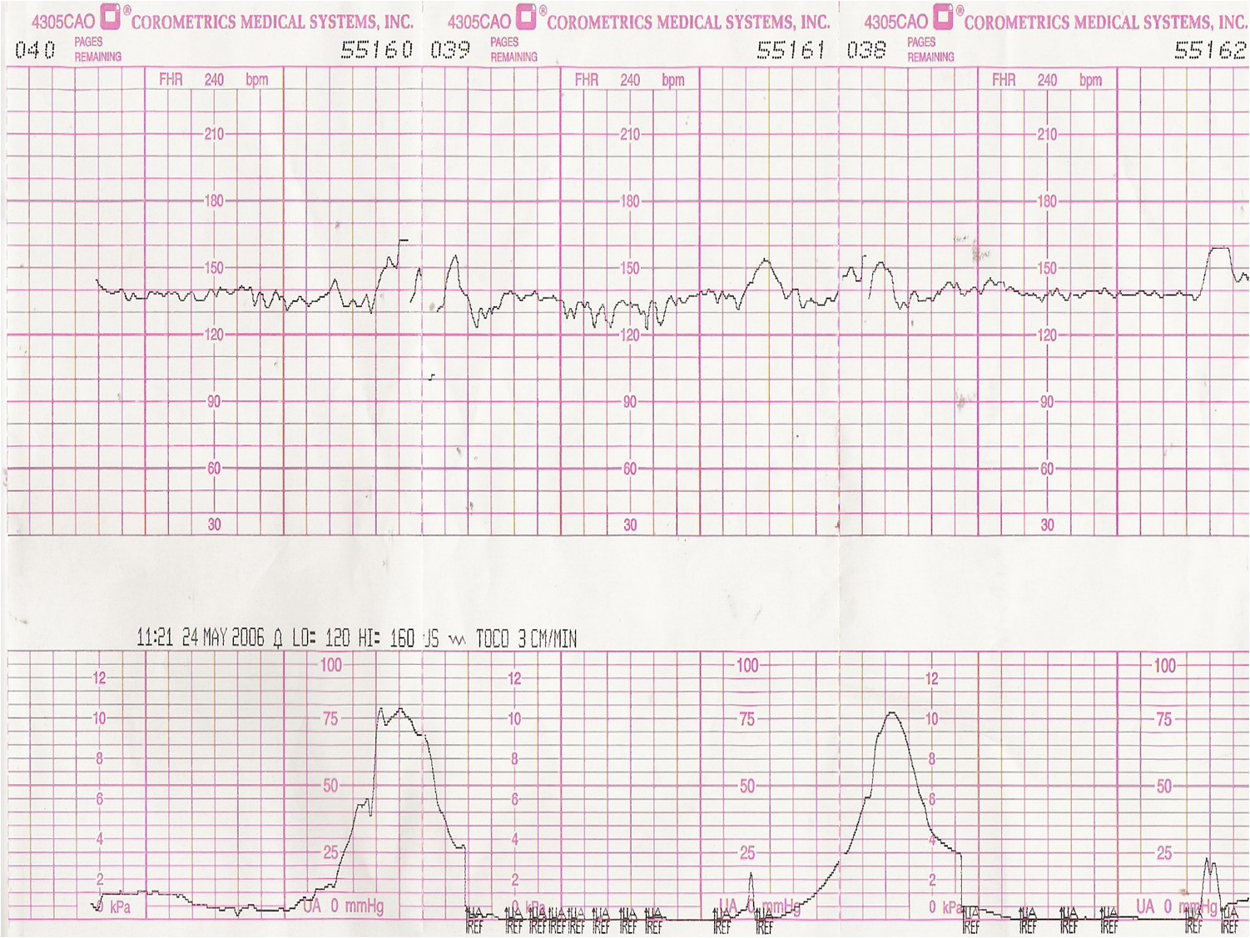
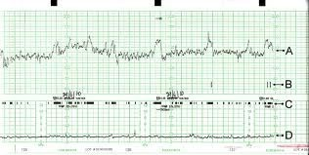
normal beat to beat variability

Slide 19
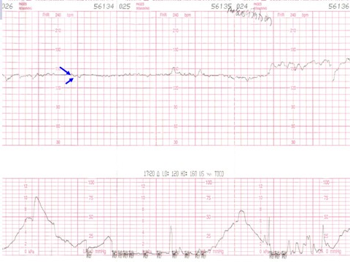
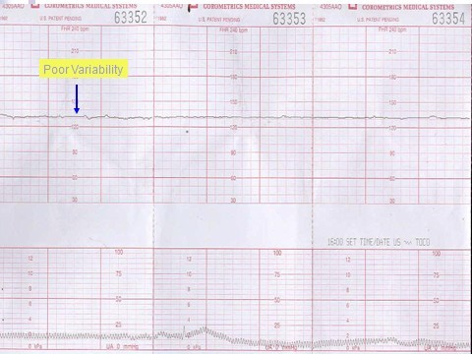
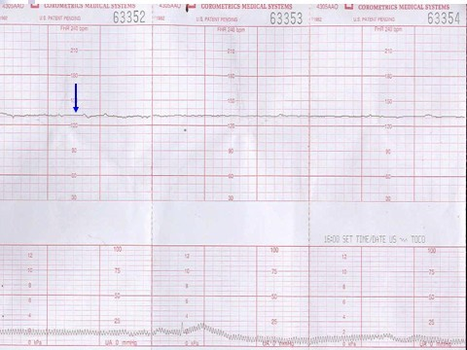
Poor or absent variability

Slide 20
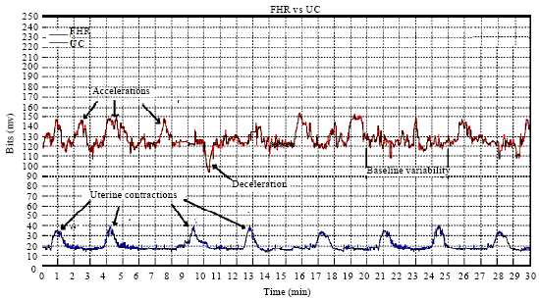
normal FHR accelerations with uterine
contractions

Slide 21
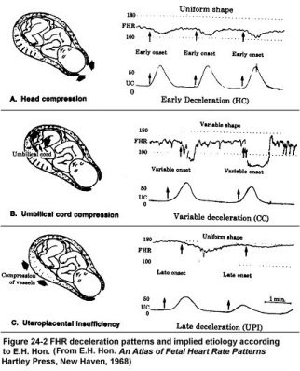
Decelerations
Early deceleration = start of deceleration with start of uterine contraction (mirror image)
Normal in 2nd stage of labour
Decelerations- transient slowing of FHR below the baseline level of more than 15 bpm and lasting for 15 s or more
Variable = may be with or without contraction
Late = after the peak of contraction
Most serious,, poor outcome

Slide 22
Antenatal CTG
Perinatal mortality: 6.2/1000
False positive rate: 50%
False negative rate: 3.2 / 1000
If hypoxia is present, we will most probably find abnormal CTG
Normal CTG almost always no hypoxia
If CTG is abnormal, only 50% actually have hypoxia

Slide 23

2- ULTRASOUND

Slide 24
Quick, non-invasive procedure, easy interpretation
Customised fetal growth charts (serial scans)
Liquor volume
Placental function
– Doppler study
Abnormal results correlate with increased risk of stillbirth and neonatal morbidity in selected pregnancies
To differentiate small for gestational age which is constitutional vs which is restricted growth
In high risk pregnancies, foetal growth & wellbeing assessment for the baby must be done on every antenatal visit – foetal biometry – starting from 26 GA

Slide 25
3- BIOPHYSICAL PROFILE
Described by Manning (1980)
The number of biophysical activities that could be recorded increased with real time ultrasound:
  Fetal movement (FM)
  Fetal tone (FT)
  Fetal breathing movements (FB)
  Amniotic fluid volume (AFV)

Slide 26
Variables measured
CTG: reactive – as described earlier.
FBM: present - at least 1 episode of at least 60 seconds duration (within a 30min period).
FM: present - at least 3 discrete episodes.
FT: normal - at least 1 episode of extension of extremities or spine with return to flexion.
AFV: normal – largest pocket of fluid greater than 2 cm in vertical diameter.

Slide 27
Scoring
Biophysical profile (BPP)
  Each variable
    When normal: 2
    When abnormal: 0
  Highest Score: 10, Lowest Score: 0
  Accuracy improved by increasing the number of variables assessed.
  Overall false negative rate: 0.6/1000

Slide 28

SEQUENCE OF EVENTS IN HYPOXIA
Non-reactive CTG
Absence of fetal breathing movement
Reduction or loss of FM
Loss of fetal tone
MODIFICATION
CTG with AFV

Slide 29


4- DOPPLER ULTRASOUND
Arteries used:
¬Umbilical artery
- middle cerebral artery
¬ ductus venosus
- Or maternal uterine artery (for risk pre-eclampsia or growth restriction)
In high risk pregnancies umbilical artery doppler improves perinatal outcome.
Requires foetal cardiologist
In low-risk pregnancies, it increases the false +ve rates

Slide 30
THANK YOU

