Slide 1
Systemic Response To Injury ​
Shahem Alboni
Laith Abu Ghoush
Emad Boaneh

Slide 2
Regarding post operative Hyperglycemic state of the patient, All are true except ?
Cytokines play a critical role in decrease insulin sensitivity
May develop as a result of decreased glucose uptake peripherally
C. Insulin infusion is a vital modality of management
Intensive Insulin infusion generally not preferable especially in ICU pt.
Conservative therapy means insulin administration when the blood glucose level exceeds a defined limit and discontinued when the level falls
All are avoidable factors that compound the response to injury, except?
A. Hyperthermia b. Heamorrage c. oedema d. Immobility e. starvation

Slide 3
BASIC CONCEPTS IN HOMEOSTASIS
The classical concepts of homeostasis and the response to injury are:
1- body systems act to maintain internal constancy.
2- Homeostasis: the co-ordinated physiological process which maintains most of the steady states of the organism’ (Walter Cannon)
3- responses to injury are, in general, beneficial to the host and allow healing/survival.

Slide 4
As a consequence of modern understanding of the metabolic response to injury, elective surgical practice seeks to reduce the need for a homeostatic response by minimising the primary insult

Slide 5
THE GRADED NATURE OF THE INJURY
RESPONSE
The response to injury is graded, the more severe the injury, the greater the response .
Thus, following elective surgery of intermediate severity, there may be a transient and modest rise in T, HR, RR, energy expenditure and peripheral WBC . Following major trauma/sepsis, these changes are accentuated, resulting in a systemic inflammatory response syndrome (SIRS), hypermetabolism, marked catabolism, shock and even multiple organ dysfunction (MODS).
Genetic variability plays a key role in determining the intensity of the inflammatory response.

Slide 6
Not only is the metabolic response graded, but it also evolves with time (In particular, the immunological sequelae of major injury evolve from a proinflammatory state driven primarily by the innate immune system (macrophages, neutrophils, dendritic cells) into a compensatory anti-inflammatory response syndrome (CARS) characterised by suppressed immunity and diminished resistance to infection.

Slide 7
MEDIATORS OF THE METABOLIC
RESPONSE TO INJURY
(CRH) from the hypothalamus increases (ACTH) release from the anterior pituitary, ACTH then acts on the adrenal to increase the secretion of cortisol

Slide 8
Cortisol effects :
Liver ----- Gluconeogensis ( increase in glucose level and decrease in the sensitivity of peripheral tissue to insulin Insulin resistance )
Muscles ----- Proteolysis and muscle wasting, to provide the relevant tissue with 'building blocks' for gluconeogenesis
Immunity ----- suppression

Slide 9
Circulating Factors critical in body’s response to injury :
Hormones : CRH, ACTH, cortisol & vasopressin .
Other hormones : GH, IGF-1, prolactin & TSH .
Cytokines : (IL-1), tumour necrosis factor alpha (TNF), IL-6 and IL-8 are produced within the first 24 hours and act directly on the hypothalamus to cause pyrexia.
Such cytokines also augment the hypothalamic stress response and act directly on skeletal muscle to induce proteolysis while inducing acute phase protein production in the liver.

Slide 10
MEDIATORS OF THE METABOLIC
RESPONSE TO INJURY
Hypothalamic activation of the sympathetic nervous system causes release of adrenalin and also stimulates release of glucagon.
Intravenous infusion of a cocktail of these ‘counter-regulatory’ hormones (glucagon, glucocorticoids and catecholamines) reproduces many aspects of the metabolic response to injury.
The innate immune system (principally macrophages) interacts in a complex manner with the adaptive immune system (T cells, B cells) in co-generating the metabolic response to injury .

Slide 11
Proinflammatory cytokines also play a complex role in the development of peripheral insulin resistance
Other important proinflammatory mediators include (NO) via inducible nitric oxide synthetase (iNOS)) and a variety of prostanoids (via cyclo-oxygenase-2 (Cox-2)).
Changes in organ function (e.g. renal hypoperfusion/impairment) may be induced by excessive vasoconstriction via endogenous factors such as endothelin-1.

Slide 12
Within inflamed tissue the duration and magnitude of acute inflammation as well as the return to homeostasis are influenced by a group of local mediators known as specialised pro-resolving mediators (SPM) that include essential fatty acid-derived lipoxins, resolvins, protectins and maresins

Slide 13
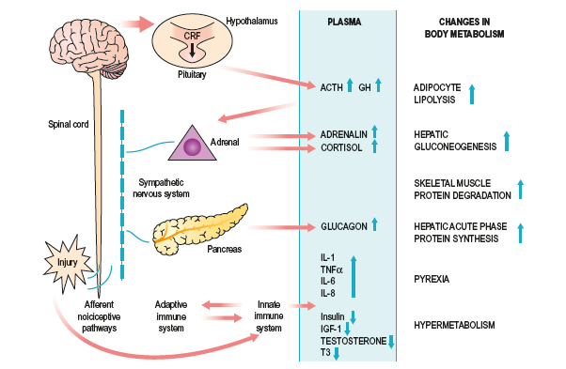
The integrated response to surgical injury (first 24–48 hours): there is a complex interplay between the neuroendocrine stress response and the proinflammatory cytokine response of the innate immune system.

Slide 14
Within hours of the upregulation of Proinflammatory cytokines, endogenous cytokine antagonists enter the circulation (e.g. (IL-1Ra) and TNFsoluble receptors (TNF-sR-55 and 75)) and act to control the proinflammatory response.
A complex further series of adaptive changes includes the development of a Th2-type counter inflammatory response (regulated by IL-4, -5, -9 and -13 and transforming growth factor beta (TGF)) which, if accentuated and prolonged in critical illness, is characterised as the CARS and results in immunosuppression and an increased susceptibility to opportunistic (nosocomial) infection

Slide 15
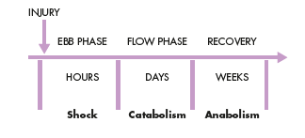
THE METABOLIC STRESS RESPONSE TO SURGERY AND TRAUMA: THE ‘EBB AND FLOW’ MODEL
In 1930, Sir David Cuthbertson divided the metabolic response to injury in humans into ‘ebb’ and ‘flow’ phases

Slide 16
Ebb phase begins at the time of injury and lasts for approximately 24–48 hours, characterised by hypovolaemia, decreased basal metabolic rate, reduced cardiac output, hypothermia and lactic acidosis
The predominant hormones regulating the ebb phase are catecholamines, cortisol and aldosterone (following activation of the renin–angiotensin system)
The main physiological role of the ebb phase is to conserve both circulating volume and energy stores for recovery and repair.

Slide 17
Following resuscitation, the ebb phase evolves into a hypermetabolic flow phase, which corresponds to SIRS. This phase involves the mobilisation of body energy stores for recovery and repair, and the subsequent replacement of lost or damaged tissue, characterised by tissue oedema (from vasodilatation and increased capillary leakage), increased basal metabolic rate (hypermetabolism), increased cardiac output, raised body temperature, leukocytosis, increased oxygen consumption and increased gluconeogenesis.

Slide 18
The flow phase may be subdivided into an initial catabolic phase, lasting approximately 3–10 days, followed by an anabolic phase, which may last for weeks if extensive recovery and repair are required following serious injury
During the catabolic phase, the increased production of counter-regulatory hormones (including catecholamines, cortisol, insulin and glucagon) and inflammatory cytokines (e.g. IL-1, IL-6 and TNF) results in significant fat and protein mobilisation, leading to significant weight loss and increased urinary nitrogen excretion. The increased production of insulin at this time is associated with significant insulin resistance and, therefore, injured patients often exhibit poor glycaemic control.

Slide 19
KEY CATABOLIC ELEMENTS OF THE FLOW PHASE
Hypermetabolism
The predominant cause appears to be a complex interaction between the central control of metabolic rate and peripheral energy utilization
several features of standard intensive care (including bed rest, paralysis, ventilation and external temperature regulation) counteract the hypermetabolic driving forces of the stress response

Slide 20
Alterations in skeletal muscle protein metabolism
During the catabolic phase of the stress response, muscle wasting occurs as a result of an increase in muscle protein degradation (via enzymatic pathways), coupled with a decrease in muscle protein synthesis. The major site of protein loss is peripheral skeletal muscle, and in the gut (reducing gut motility). Cardiac muscle appears to be mostly spared, Clinically, a patient with skeletal muscle wasting will experience asthenia, increased fatigue, reduced functional ability, decreased quality of life and an increased risk of morbidity and mortality

Slide 21
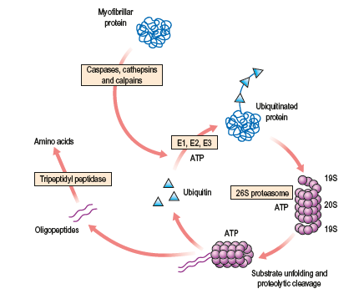
The predominant mechanism involved in the wasting of skeletal muscle is the ATP-dependent ubiquitin–proteasome pathway

Slide 22
Alterations in hepatic protein metabolism: the acute phase protein response
In response to inflammatory conditions, including surgery, trauma, sepsis, cancer or autoimmune conditions, circulating peipheral blood mononuclear cells secrete a range of Proinflammatory cytokines, including IL-1, IL-6 and TNF. These cytokines, in particular IL-6, promote the hepatic synthesis of postive acute phase proteins, e.g. fibrinogen and C-reactive protein (CRP). The acute phase protein response provides proteins important for recovery and repair, but only at the expense of valuable lean tissue and energy reserves.
In contrast to the positive acute phase reactants, the plasma concentrations of other liver export proteins (the negative acute phase reactants) fall acutely following injury, e.g. albumin. However, rather than represent a reduced hepatic synthesis rate, the fall in plasma concentration of negative acute phase reactants is thought principally to reflect increased transcapillary esape, secondary to an increase in microvascular permeability

Slide 23
Insulin resistance
Following surgery or trauma, postoperative hyperglycaemia develops as a result of increased glucose production combined with decreased glucose uptake in peripheral tissues. Decreased glucose uptake is a result of insulin resistance which is transiently induced within the stressed patient. Suggested mechanisms for this phenomenon include the action of Proinflammatory cytokines and the decreased responsiveness of insulin-regulated glucose transporter proteins. The degree of insulin resistance is proportional to the magnitude of the injurious process. Following routine upper abdominal surgery, insulin resistance may persist for approximately 2 weeks.
The mainstay of management of insulin resistance is intravenous insulin infusion

Slide 24
Postoperative patients with insulin resistance behave in a similar manner to individuals with type II diabetes mellitus.
Insulin infusions may be used in either an intensive approach (i.e. sliding scales are manipulated to normalize the blood glucose level) or a conservative approach (i.e. insulin is administered when the blood glucose level exceeds a defined limit and discontinued when the level falls). Studies of postoperatively ventilated patients in the intensive care unit (ICU) have suggested that maintenance of normal glucose levels using intensive insulin therapy can significantly reduce both morbidity and mortality .

Slide 25
CHANGES IN BODY COMPOSITION FOLLOWING INJURY
The main labile energy reserve in the body is fat, and the main labile protein reserve is skeletal muscle. While fat mass can be reduced without major detriment to function, loss of protein mass results not only in skeletal muscle wasting, but also depletion of visceral protein status .
Each 1 g of nitrogen is contained within 6.25 g of protein, which is contained in approximately 36 g of wet weight tissue. Thus, the loss of 1 g of nitrogen in urine is equivalent to the breakdown of 36 g of wet weight lean tissue.

Slide 26
A normal human ingests about 70–100 g protein per day, which is metabolized and excreted in urine as ammonia and urea (i.e. approximately 14 g N/day).
Body weight increases immediately on resuscitation with an expansion of extracellular water by 6–10 litres within 24 hours
This can be achieved by blocking the neuroendocrine stress response with epidural analgesia and providing early enteral feeding.
Moreover, the early fluid retention phase can be avoided by careful intraoperative management of fluid balance, with avoidance of excessive administration of intravenous saline

Slide 27
Avoidable factors that compound the response to injury
Continuing haemorrhage
Hypothermia
Tissue oedema
Tissue underperfusion
Starvation
Immobility

Slide 28
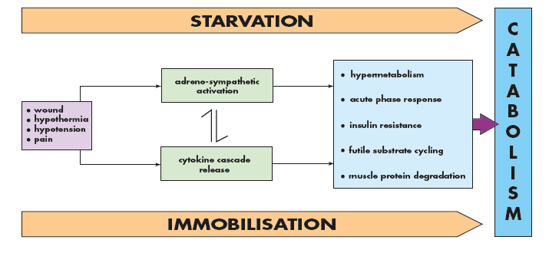
Factors that exacerbate the metabolic response to surgical injury

Slide 29
BLOOD
TRANSFUSION

Slide 30
Q 1 What are the Indications for blood transfusion ?
Q 2 What are the Complications of blood transfusion ?

Slide 31
Blood transfusion is the process of transferring blood or blood products into one's circulation intravenously.

Slide 32
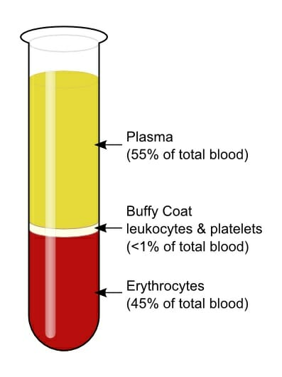

Slide 33
Blood is collected from donors who have been previously screened before donating, to exclude any donor whose blood may have the potential to harm the patient.
Each unit is tested for evidence of hepatitis B, hepatitis C, HIV and syphilis.
The blood is then processed into subcomponents.

Slide 34
Blood and blood products
Whole blood
Packed red cells
Fresh-frozen plasma (FFP)
Cryoprecipitate
Platelets
Prothrombin complex concentrates (PCC)

Slide 35
Whole blood
Whole blood is now rarely available in civilian practice as it is an inefficient use of the limited resource.
Packed red cells
Packed red blood cells are spun-down (Centrifugation) and concentrated packs of red blood cells.
1 unit brings up hemoglobin levels by about
1 g/dL

Slide 36
Fresh-frozen plasma (FFP)
rich in coagulation factors and is removed from fresh blood and stored. It is the first-line therapy in the treatment of coagulopathic haemorrhage .
Cryoprecipitate
is a supernatant precipitate of FFP and is rich in factor VIII and fibrinogen.
It is given in low fibrinogen states or factor VIII deficiency.

Slide 37
Platelets
Platelets are supplied as a pooled platelet concentrate .
Platelet transfusions are given to patients with thrombocytopenia or with platelet dysfunction who are bleeding or undergoing surgery.

Slide 38
Prothrombin complex concentrates
(PCC) are highly purified concentrates prepared from pooled plasma. They contain factors II, IX and X. Factor VII may be included or produced separately.
It is indicated for the emergency reversal of anticoagulant (warfarin) therapy in uncontrolled haemorrhage.

Slide 39
Autologous blood
It is possible for patients undergoing elective surgery to pre-donate their own blood up to 3 weeks before surgery for retransfusion during the operation.

Slide 40
Indications for blood transfusion
acute blood loss ; to replace circulating volume and maintain oxygen delivery
perioperative anaemia ; to ensure adequate oxygen delivery during the perioperative phase
symptomatic chronic anaemia

Slide 41
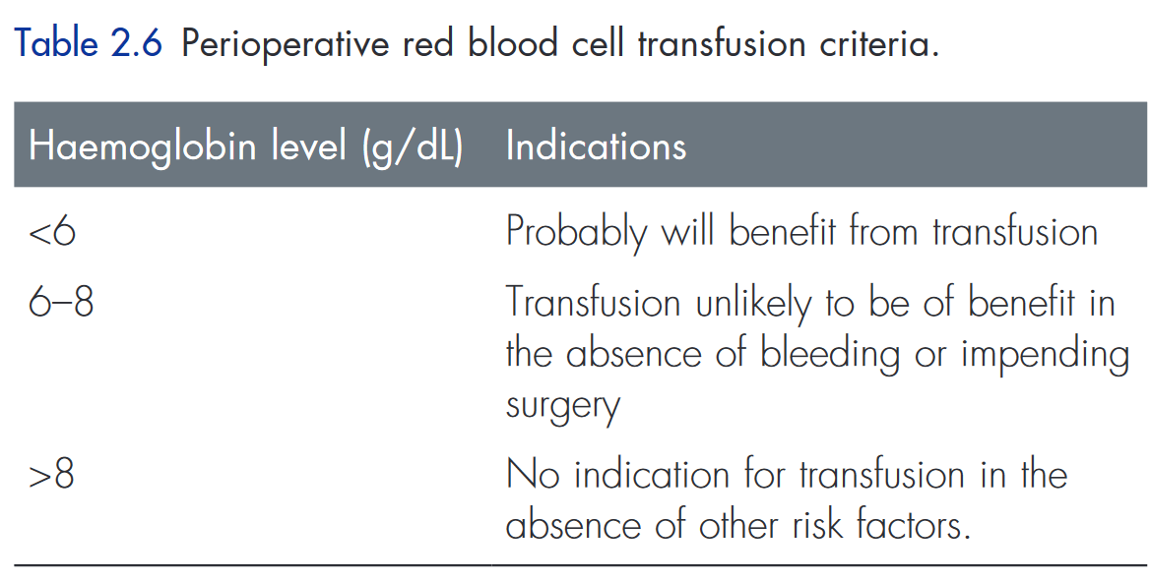
Transfusion trigger

Slide 42
Blood groups
Human red cells have on their cell surface many different antigens. Two groups of antigens are of major importance in surgical practice – the ABO and rhesus systems.

Slide 43
ABO system
These are strongly antigenic and are associated with naturally occurring antibodies in the serum.
The system consists of three allelic genes – A, B and O which control synthesis of enzymes that add carbohydrate residues to cell surface glycoproteins.
A and B genes add specific residues while O gene is an amorph and does not transform the glycoprotein.

Slide 44
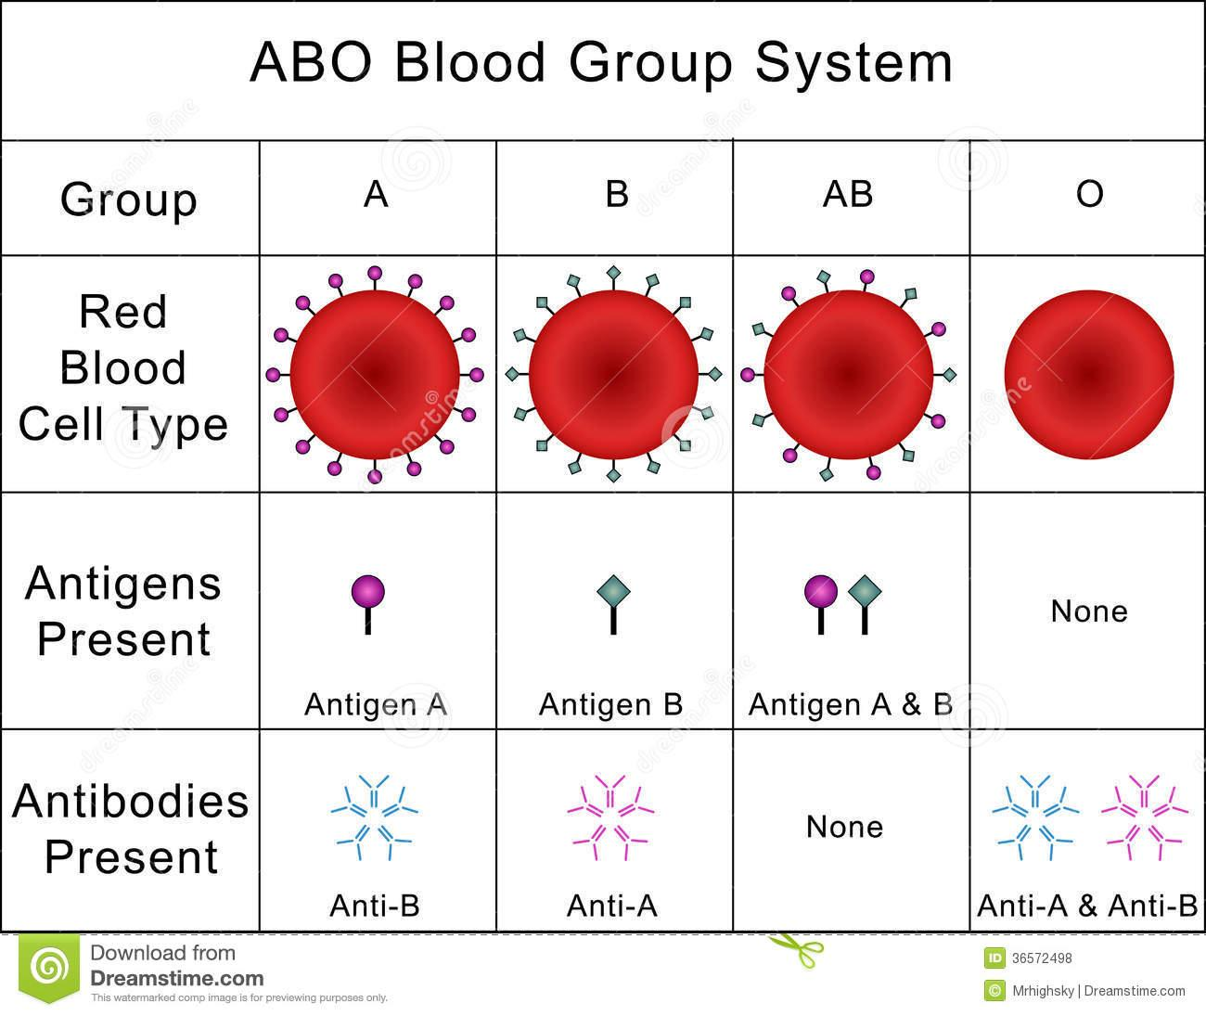

Slide 45
Blood group O is the universal donor type as it contains no antigens to provoke a reaction. Conversely, group AB individuals are ‘universal recipients’ and can receive any ABO blood type as they have no circulating antibodies.

Slide 46
Rhesus system
The rhesus D [Rh(D)] antigen is strongly antigenic and is present in approximately 85% of the population in the UK.
Antibodies to the D antigen are not naturally present in the serum of the remaining 15% of individuals, but their formation may be stimulated by the transfusion of Rh positive red cells, or acquired during delivery of a Rh(D) positive baby.
Acquired antibodies are capable, during pregnancy, of crossing the placenta and, if present in a Rh(D)-negative mother, may cause severe haemolytic anaemia and even death (hydrops fetalis) in a Rh(D)+positive fetus in utero.

Slide 47
Transfusion reactions
Incompatibility Hemolytic Transfusion reactions
If antibodies present in the recipient’s serum are incompatible with the donor’s cells, a transfusion reaction will result. This usually takes the form of an acute haemolytic reaction. Severe immune-related transfusion reactions due to ABO incompatibility result in potentially fatal complement-mediated intravascular haemolysis and multiple organ failure.

Slide 48
AHTR
Acute (Immediate)
occur within 24 hours of the transfusion
S&S :
  fever , rigors ,
  abdominal, back, flank, or chest pain
Intravscular hemolysis
activate the coagulation cascade via factor XII .
can lead to DIC and kidney damage.
Treatment
  discontinuation of the transfusion
  IV Fluid
  supportive care

Slide 49
Cross-matching
To prevent transfusion reactions, all transfusions are preceded by ABO and rhesus typing of both donor and recipient blood to ensure compatibility.
The recipient’s serum is then mixed with the donor’s cells to confirm ABO compatibility and to test for rhesus and any other blood group antigen–antibody reaction.
Where blood must be given emergently, group O (universal donor) blood is given (O− to females, O+ to males).

Slide 50
You should check the patient details against the prescription and the label of the donor blood.
In addition, the donor blood serial number should also be checked against the issue slip for that patient.

Slide 51
Complications of blood transfusion
Complications from blood transfusion can be categorised as those arising from :
a single transfusion
massive transfusion

Slide 52
Complications from a single transfusion
• incompatibility haemolytic transfusion reaction
• febrile transfusion reaction
• allergic reaction
• infection– bacterial infection (usually due to faulty storage)– hepatitis– HIV– malaria
• air embolism
• thrombophlebitis
• transfusion-related acute lung injury (usually from FFP)

Slide 53
Febrile transfusion reactions
are non-haemolytic and are usually caused by a graft-versus-host response from leukocytes in transfused components.
Such reactions are associated with fever, chills or rigors.
The blood transfusion should be stopped immediately.
This form of transfusion reaction is rare with leukodepleted blood.

Slide 54
transfusion-related acute lung injury (TRALI)
characterized by the acute onset of non-cardiogenic pulmonary edema following transfusion of blood products.
The typical presentation is :
dyspnea, severe hypoxemia, hypotension, and fever that develop within 6 hours after transfusion.
Supportive care is the mainstay of therapy in TRALI.

Slide 55
Complications from massive transfusion
• coagulopathy
• hypocalcaemia
• hyper / hypokalaemia
• hypothermia
• iron overload

