Slide 1
SHOCK

Slide 2
DEFINITION
Shock is a systemic state of low tissue perfusion which is inadequate for normal cellular respiration.

Slide 3
SHOCK
EARLY
LATE
HYPOPERFUSION
ORGAN ISCHEMIA AND REPERFUSION
DEATH

Slide 4
PATHOPHYSIOLOGY
1- cellular
With insufficient delivery of oxygen and glucose, cells switch from aerobic to anaerobic metabolism. Anaerobic respiration increases lactic acid .
After cell exhaustion failure of anaerobic respiration and cell death ensues by autodigestive enzymes and cell contents are released into the circulation leading to hyperkalemia

Slide 5
…
2- microvascular
hypoxia
edema
Acidosis
Leaky endothelium
complement and neutrophiles
Immune and coagulation
ORS & cytokines

Slide 6
…
3- systematic
CVS : decrease in preload and afterload lead to activation of baroreceptors and increased catecholamines (tachycardia and systematic vasoconstriction)
RS : compensatory respiratory alkalosis by increasing respiratory rate and minute ventilation
Renal : low perfusion – low filtration (GFR) – low urine output
low blood pressure – activation of RAAS – sodium and water retention
Endocrine : ADH release –vasoconstriction and reabsorption of water
cortisol release from adrenal cortex contributing to sodium and water reabsorption
and sensitizes the cells to catecholamines
GI. : decreased blood flow hypoactive bowel sounds

Slide 7
….
4- reperfusion injury
Acid and pottasium load that has built up can lead to myocardial depression and hypotension
and further injury due to flushing of cellular and humeral response elements ( complement and neutrophiles )

Slide 8
Severity of Shock
 | Compensated compensatory mechanisms are effective and homeostais is maintained | Decompensated Compensatory mechanisms start to fail continued decreased cellular perfusion and altered capillary permeability are the hallmarks of this. stage |  |  | Irreversable Death is. Inevitable
 |  | Mild | Moderate | Severe | No response to vasopressors Myocardial depression and loss of responsiveness Due to improper resuscitation or severe shock
Lactic acidosis | + | ++ | ++ | +++
UOP | normal | Normal | - ( <.5 ml/kg/hr) | -- ( 0 ml/kg/hr)
consciousnous | normal | Mild anxiety. | Drowsy | comatose
RR | normal | Increased | Increased | labored
PR | Mild increase | Increased | Increased | Increased
BP | Normal | Normal But decreased pulse pressure | Mild decrease | Hypotensive
Key labs | Glu (I) PH (I) PaO2(D) PaCO2 (D) | Liver enzymes (I) thrombocytopenia bleeding times (I) |  |  | Glu (D), ammonia (I), K(I), PH (D)

Slide 9
Limitations to accuracy :
1- BP: young people may have a normal BP despite profound shock due to vasoconstriction and stroke volume also elderly who are hypertensive may be normotensive relative to normal readings
2- PR : affected by beta blockers use and in patients with penetrating trauma where there is hemorrhage with little tissue damage may have paradoxical tachycardia
3- cool extremeties and poor CR are not found in septic shock

Slide 10
Types of shock
1- hypovolemic shock : most common type of shock ( decreased intravascular volume)
COP | Decreased
Vascular resistance | Increased
Venous pressure | Decreased
Mixed venous saturation | Decreased : increased oxygen extraction by the cells
Base deficit | Increased

Slide 11
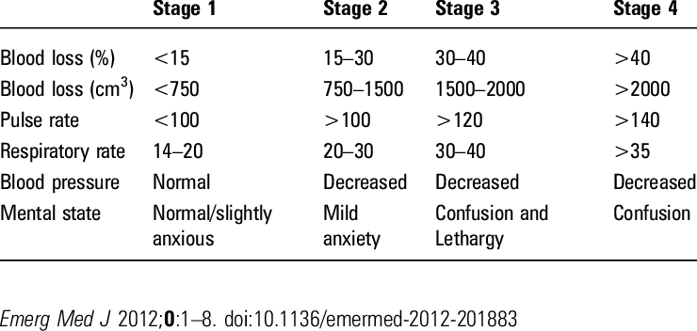
Stages of hypovolemic shock

Slide 12
Causes :
1- hemorrhagic
A- external bleeding ( wounds)
B- internal bleeding ( hemothorax, hemoperitoneum)
C- exteriorization of internal bleeding ( melena, hematemesis, hemoptysis)
2- non haemorrhagic :
A- poor fluid intake (dehydration)
B- more fluid loss (diarrhea, vomiting, renal losses)
C- increased evaporation (overheated enviroment, burns)
D- third spacing : in bowel obstruction and pancreatitis

Slide 13
Management
Correct underlying cause : in patients who are actively bleeding it’s counterproductive to start fluid therapy without controlling the site of hemorrhage. Increasing blood pressure merely increases bleeding from the site while fluid therapy cools the patient and dilutes available coagulation factors
Warm fluids
Supportive therapy with vasopressors
Nursing care :
ensure a patent airway
IV access Access should be through short, wide-bore catheters that allow rapid infusion of fluids as necessary.
O2
modified trendelenberg position
vitals every 5 minutes

Slide 14
FLUID THERAPY :
there’s no ideal resuscitation fluid.
there’s no overt difference between crystalloids and colloids which are more expensive with worse side effect profiles.
Moreover there’s no oxygen carrying capacity of crystalloids and colloids so if the patient is bleeding the ideal replacement is blood
Hypotonic solutions (dextrose etc.) are poor volume expanders and should not be used in the treatment of shock unless the deficit is free water loss (eg. diabetes insipidus) or patients are sodium overloaded (eg. cirrhosis)

Slide 15
Dynamic fluid response :
After initial bolus of fluid ( 250-500ml/5-10 mins) the cardiovascular response is assessed through BP, CVP, HR.
Responders have an improvement in their cardiovascular status which is sustained. These patients are not actively losing fluid but require filling to a normal volume status.
Transient responders have an improvement which then reverts to the previous state over the next 10–20 minutes. These patients have moderate ongoing fluid losses (either overt hemorrhage or further fluid shifts reducing intravascular volume).
Non-responders are severely volume depleted and are likely to have major ongoing loss of intravascular volume, usually through persistent uncontrolled hemorrhage.

Slide 16
End point of ressucitation:
Using normal pulse, bp and UOP as an indicator to stop reessucitation may lead to occult hypoperfusion (state of normal vital signs and continued under perfusion) it is manifested only by a persistent lactic acidosis and low mixed venous oxygen saturation so …
Resuscitation algorithms directed at correcting global perfusion end points (base deficit, lactate, mixed venous oxygen saturation) rather than traditional end points have been shown to improve mortality and morbidity in high-risk surgical patients

Slide 17
Vasopressors and ionotropic support:
Vasopressor or inotropic therapy is not indicated as first-line therapy in hypovolemia
administration of these agents in the absence of adequate preload rapidly leads to decreased coronary perfusion and depletion of myocardial oxygen reserves. Administration of inotropic or chronotropic agents to an empty heart will rapidly and permanently deplete the myocardium of oxygen stores and dramatically reduce diastolic filling and therefore coronary perfusion. Patients will enter the unresuscitatable stage of shock as the myocardium becomes progressively more ischaemic and unresponsive to resuscitative attempts.

Slide 18
2-cardiogenic shock : primary failure of heart to pump blood
COP | Decreased
Vascular resistance | Increased
Venous pressure | Increased ( associated with pulmonary and systemic edema)
Mixed venous saturation | Decreased
Base deficit | Increased

Slide 19
Causes :
1- MI, dysrythmias, vulvar heart disease, cardiomyopathy
2- myocardial depression :
A- endogenous : most likely due to endotoxins from bacteria
B- exogenous : drug abuse and pharmaceutical agents

Slide 20
Management:
Correct dysrythmias
Drug therapy
nitrates
ionotropes In cardiogenic shock, or where myocardial depression com- plicated a shock state (e.g. severe septic shock with low cardiac output), inotropic therapy may be required to increase cardiac output and therefore oxygen delivery. The inodilator dobutamine is the agent of choice.
diuretics
beta blockers

Slide 21
3- obstructive : decreased preload due to mechanical obstruction of filling
COP | Decreased
Vascular resistance | Increased
Venous pressure | Increased
Mixed venous saturation | Decreased
Base deficit | Increased

Slide 22
Causes :
1- cardiac temponade
2- pneumothorax
3- massive pulmonary embolus
4- air emboli

Slide 23
Management :
Pain relief and referral to CCU
Bed rest and O2 adminestration
ECG monitoring
Drugs like ionotropic vasodialators
Specific
tension pneumothorax : needle aspiration at 2nd intercostal space along midclavicular line
pulmonary embolism : high flow oxygen intubation
temponade : pericordiocentesis

Slide 24
Management
General strategy :
Assessment
Analysis
Planning/implentation of intervention : If there is initial doubt about the cause of shock, it is safer to assume the cause is hypovolemia and begin with fluid resuscitation, and then assess the response.
Evaluation and ngoing monitoring
Documentation of interventions
Age related considerations

Slide 25
assessment and analysis
Monitor vitals - ECG
Monitor mental status - chest Xray.
Monitor lab values - continuous pulse oximetry.
ABGs and lactate
CBC : RBC normal HCT decrease HGB increase
Coagulation panel : PTT/PT/INR/ D-dimer
Troponin/ CKMB / BUN / TCK
Glucose initially elevated then decrease after glycogen depletion

Slide 26
Evaluation and ongoing monitoring
The minimum standard for monitoring of the patient in shock is continuous heart rate and oxygen saturation monitoring, frequent non-invasive blood pressure monitoring and hourly urine output measurements. Most patients will need more aggressive invasive monitoring, including central venous pressure and invasive blood pressure monitoring
monitoring
cardiovascular
Systemic and organs perfusion

Slide 27
CARDIOVASCULAR:
Cardiovascular monitoring at a minimum should include continuous heart rate (ECG), oxygen saturation and pulse waveform and non-invasive blood pressure. Patients whose state of shock is not rapidly corrected with a small amount of fluid should have central venous pressure monitoring and continuous blood pressure monitoring through an arterial line
1- CVP
There’s no normal cvp we monitor the response after fluid bolus for 10-20 mins
The normal CVP response is a rise of 2–5 cmH2O which gradually drifts back to the original level over 10–20 minutes. Patients with no change in their CVP are empty and require further fluid resuscitation. Patients with a large, sustained rise in CVP have high preload and an element of cardiac insufficiency or volume overload.

Slide 28
2- COP
A- invasive : pulmonary artery catheter
B- noninvasive: Doppler ultra- sound, pulse waveform analysis and indicator dilution methods
allows not only assessment of the cardiac output but also the systemic vascular resistance and, depending on the technique used, end diastolic volume (preload) and blood volume. Early consideration should be given to instituting cardiac output monitoring on patients who require vasopressor or inotropic support.

Slide 29
Systemic and organ perfusion
Systemic perfusion :
- base deficit and lactate
importance : diagnosis, monitoring, prognosis (Patients with a base deficit over 6 mmol/L have a much higher morbidity and mortality than those with no metabolic acidosis.), end point of resuscitation
how ? : measured from arterial blood gas analyses (the frequency of measurements is limited, and they do not provide minute-to-minute data )

Slide 30
Mixed venous oxygen saturation: normal = 50-70 percent
How ? : Accurate measurement is via analysis of blood drawn from a long central line placed in the right atrium , Estimations can be made from blood drawn from lines in the superior vena cava, but these values will be slightly higher

Slide 31
techniques that provide information regarding perfusion of specific tissue beds :
Muscles : near infrared spectroscopy
tissue oxygenation electrode
Gut : sublingual capnometry
gut mucosal PH
laser doppler flowmetry
kidney : UOP
Brain : consciousness
Tissue oxygen electrode
Near-infrared spectroscopy

Slide 32
Distributive shock
A type of shock in which Inadequate organ perfusion is accompanied by vascular dilatation with hypotension, low systemic vascular resistance, inadequate afterload and a resulting abnormally high cardiac output.
Includes :
1- anaphylactic shock
2 - septic shock
3- neurogenic shock

Slide 33
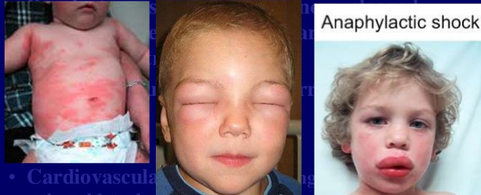
Anaphylactic Shock
Exposure to previous sensitized antigen diffuse hypersensitivity reaction
histamine production vasodilatation , bronchospasm and edema .
Antigen examples : 1- food 2-Insect stings 3- drugs : Penicillin
Specific sign:
– circulatory: Significant and sudden drop in BP and Tachycardia
– cautanous :Frequent coetaneous signs: rash,erythema,itching, urticaria, angioedema
– Respiratory signs: dyspnoea, stridor ,wheezing

Slide 34
Treatment
1- Ensure adequate airway and maintain O2
2-Remove the source of allergy
3- drug therapy
Epinephrine 0.3-1 ml of 1:1000 concentration immediately intramuscular This can reduce the severity of the allergic reaction.
Repeat at 5–10-min intervals if initial response is inadequate
May need anti histamine intravenously
Steroids
supportive care :
1- Nebulised β2-agonists
IV fluids
Oxygen

Slide 35
Septic shock
Septic shock is the most common cause of distributive shock. Caused by an overwhelming systemic infection resulting in vasodilation leading to hypotension. The primary infection is most commonly caused by bacteria, but also may be by fungi, viruses or parasites.
Sepsis can rang from infection and bacteremia to sepsis and septic shock, which can lead to multiple organ dysfunction syndrome (MODS) and death.
The systemic inflammatory response syndrome (SIRS) is no longer included in the definition since it is not always caused by infection .
sepsis
Septic shock
Infection
SIRS

Slide 36
Early sepsis
there is no formal definition of early sepsis ,However, Infection and bacteremia may be early forms of infection that can progress to sepsis
Infection and bacteremia — All patients with infection or bacteremia are at risk of developing sepsis and represent early phases in the continuum of sepsis severity:
●Infection is defined as the invasion of normally sterile tissue by organisms resulting in infectious pathology.
●Bacteremia is the presence of viable bacteria in the blood.

Slide 37
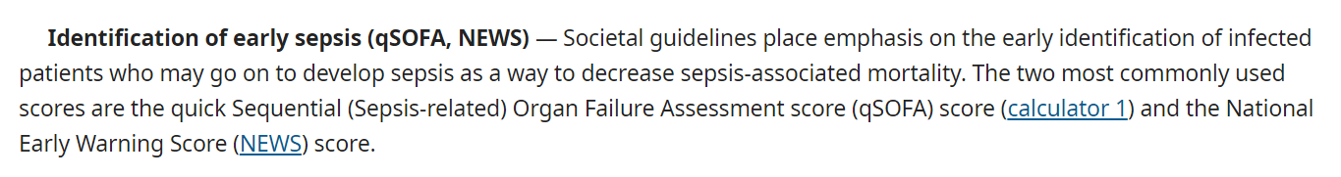
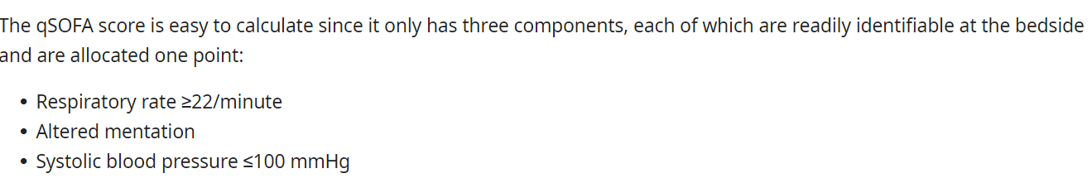
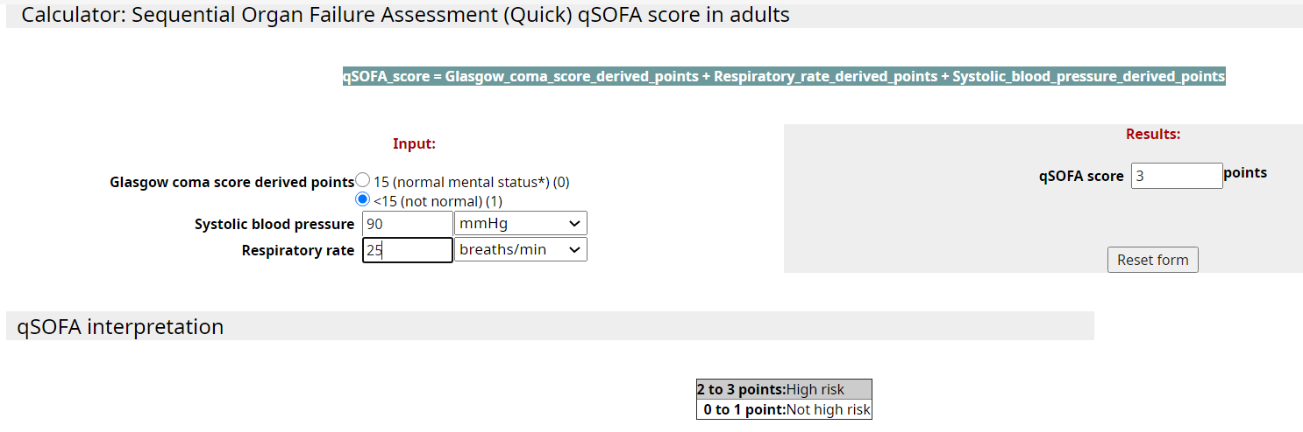

Slide 38
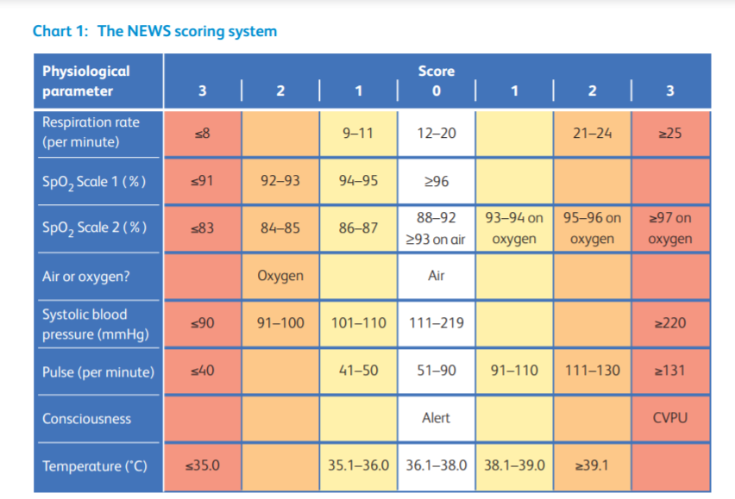
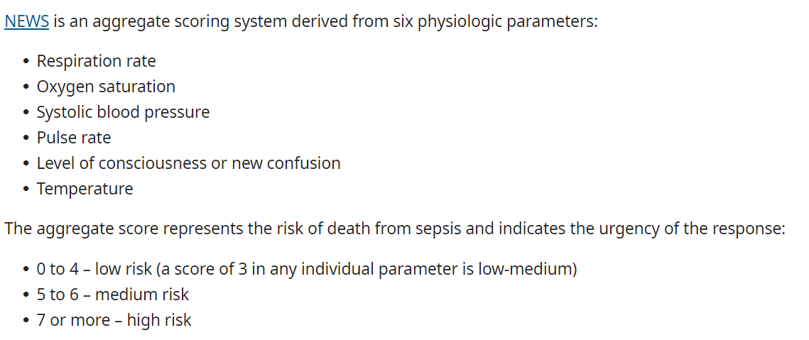

Slide 39
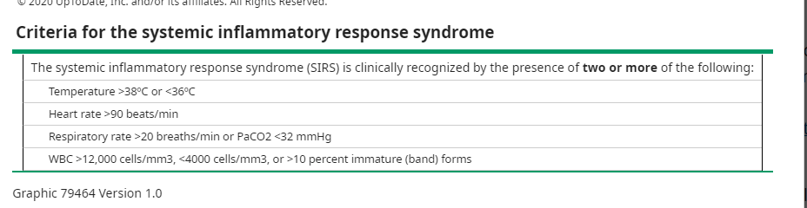
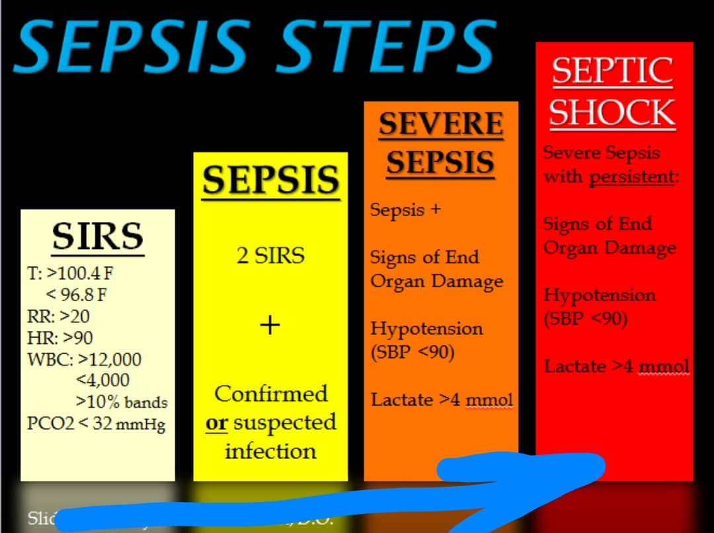
SIRS: form of dysregulated inflammation
-SIRS may occur in several conditions related, or not, to infection
-Noninfectious conditions classically associated with SIRS include autoimmune disorders, pancreatitis, vasculitis, thromboembolism, burns, or surgery.

Slide 40
Third International Consensus Definitions for Sepsis and Septic Shock
Sepsis : Patients with suspected infection who have 2 or more of:
• Hypotension – systolic blood pressure < 100 mmHg
• Altered mental status – Glasgow Coma Scale score ≤ 14
• Tachypnoea – respiratory rate ≥ 22 breaths/min
Sepsis can also be diagnosed by suspected infection and an increase
of ≥ 2 points on the Sequential Organ Failure Assessment (SOFA) score
Septic shock : Sepsis and both of (after fluid resuscitation):
1. Persistent hypotension requiring vasopressors to maintain a MAP
> 65 mmHg
2. Serum lactate > 2 mmol/L (18 mg/dL)

Slide 41
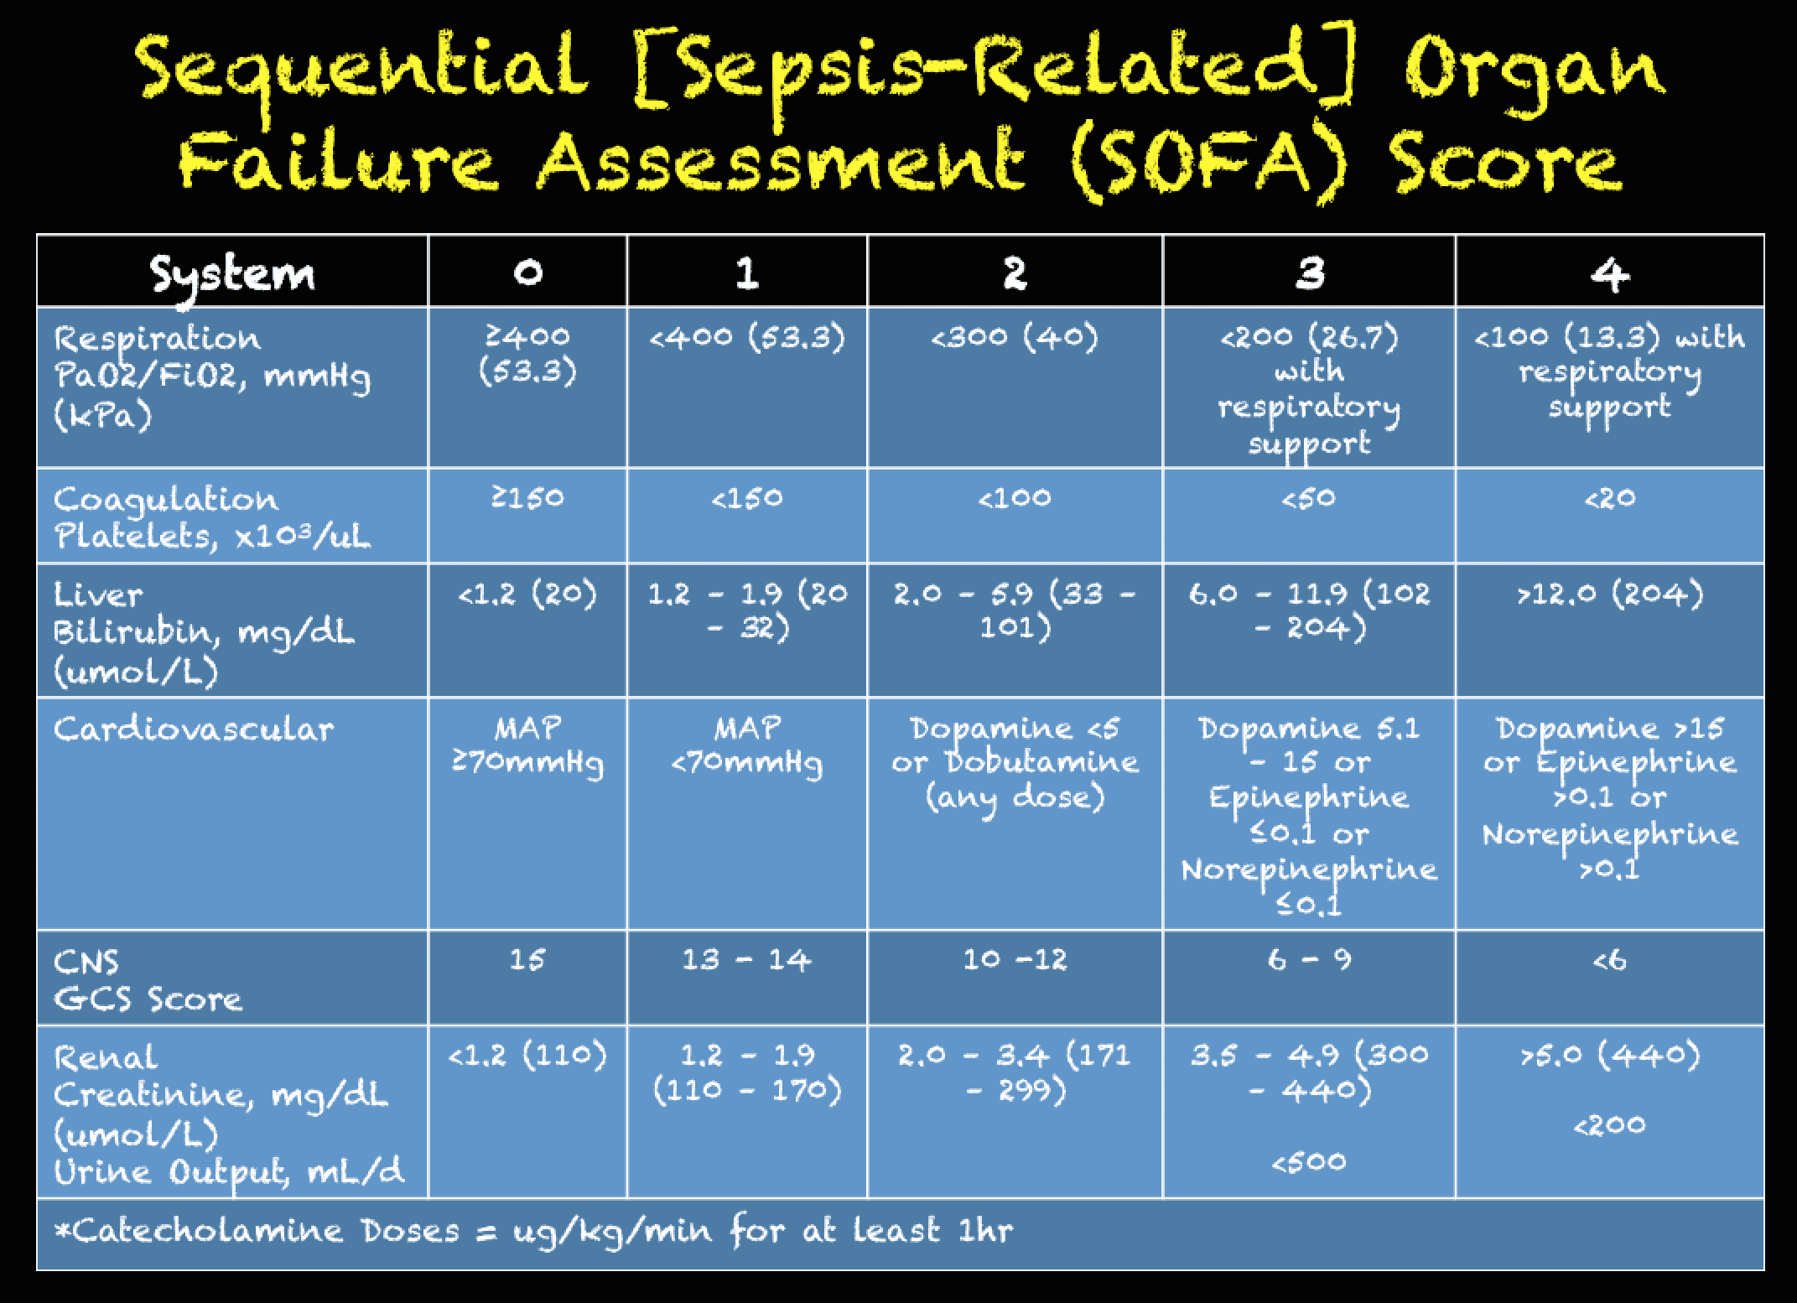
SOFA score
The sequential organ failure assessment score (SOFA score), previously known as the sepsis-related organ failure assessment score, is used to track a person's status during the stay in an intensive care unit (ICU) to determine the extent of a person's organ function or rate of failure.
- The score is based on six different scores one each for the respiratory(PaO2) ,CV(MAP) , hepatic(bilirubin) , coagulation (platlets),renal (creatinine) and nuerological system(GCS

Slide 42
Symptoms and signs
Symptoms and signs specific to an infectious source (eg, cough and dyspnea may suggest pneumonia, pain and purulent exudate in a surgical wound may suggest an underlying abscess).
●Arterial hypotension (eg, systolic blood pressure [SBP] <90 mmHg, mean arterial pressure [MAP] <70 mmHg, an SBP decrease >40 mmHg, or less than two standard deviations below normal for age). Because a sphygmomanometer may be unreliable in hypotensive patients, an arterial catheter may be needed
●Temperature >38.3 or <36ºC.
●Heart rate >90 beats/min or more than two standard deviations above the normal value for age.
Tachypnea, respiratory rate >20 breaths/minute.

Slide 43
●Signs of end-organ perfusion:
•Warm, flushed skin may be present in the early phases of sepsis. As sepsis progresses to shock, the skin may become cool due to redirection of blood flow to core organs. Decreased capillary refill, cyanosis, or mottling may indicate shock.
•Additional signs of hypoperfusion include altered mental status, obtundation or restlessness, and oliguria or anuria.
•Ileus or absent bowel sounds are often an end-stage sign of hypoperfusion

Slide 44
Laboratory signs
— Similarly, laboratory features are nonspecific and may be associated with abnormalities due to the underlying cause of sepsis or to tissue hypoperfusion or organ dysfunction from sepsis. They include the following:
Leukocytosis (white blood cell [WBC] count >12,000 microL–1) or leukopenia (WBC count <4000 microL–1)
Normal WBC count with greater than 10 percent immature forms.
Hyperglycemia (plasma glucose >140 mg/dL or 7.7 mmol/L) in the absence of diabetes.
Plasma C-reactive protein more than two standard deviations above the normal value.
Arterial hypoxemia (arterial oxygen tension [PaO2]/fraction of inspired oxygen [FiO2] <300).
Acute oliguria (urine output <0.5 mL/kg/hour for at least two hours despite adequate fluid resuscitation).
Creatinine increase >0.5 mg/dL or 44.2 micromol/L.

Slide 45
Coagulation abnormalities (international normalized ratio [INR] >1.5 or activated partial thromboplastin time [aPTT] >60 seconds).
●Thrombocytopenia (platelet count <100,000 microL–1).
●Hyperbilirubinemia (plasma total bilirubin >4 mg/dL or 70 micromol/L).
●Adrenal insufficiency (eg, hyponatremia, hyperkalemia), and the euthyroid sick syndrome can also be found in sepsis.
●Hyperlactatemia (higher than the laboratory upper limit of normal) – An elevated serum lactate (eg, >2 mmol/L) can be a manifestation of organ hypoperfusion in the presence or absence of hypotension and is an important component of the initial evaluation, since elevated lactate is associated with poor prognosis . A serum lactate level ≥4 mmol/L is consistent with, but not diagnostic of, septic shock.
Additional laboratory studies that help characterize the severity of sepsis include a low platelet count, and elevated international normalized ratio, creatinine, and bilirubin. Although arterial and venous lactate correlate, arterial lactate measurements are more accurate and preferred.

Slide 46
Imaging — There are no radiologic signs that are specific to the identification of sepsis other than those associated with infection in a specific site (eg, pneumonia on chest radiography, fluid collection on computed tomography of the abdomen).
Microbiology — The identification of an organism in culture in a patient who fulfills the definition of sepsis (see 'Sepsis' above) is highly supportive of the diagnosis of sepsis but is not necessary. The rationale behind its lack of inclusion in the diagnostic criteria for sepsis is that a culprit organism is frequently not identified in up to 50 percent of patients who present with sepsis .Blood cultures are also frequently negative with one study reporting positive blood cultures in 31.4 percent of patients prior to the administration of antimicrobials

Slide 47
IMMEDIATE EVALUATION AND MANAGEMENT
The sepsis six :
1. Deliver high-flow oxygen
2. Take blood cultures
3. Administer intravenous antibiotics
4. Measure serum lactate and send full blood count
5. Start intravenous fluid replacement
6. Commence accurate measurement of urine output

Slide 48
Stabilize respiration
-Securing the airway (if indicated) and correcting hypoxemia
Supplemental oxygen should be supplied to all patients with sepsis and oxygenation should be monitored continuously with pulse oximetry
-Intubation and mechanical ventilation may be required to support the increased work of breathing that typically accompanies sepsis, or for airway protection since encephalopathy and a depressed level of consciousness frequently complicate sepsis

Slide 49
Establish venous access
Venous access should be established as soon as possible in patients with suspected sepsis.
While peripheral venous access may be sufficient in some patients, particularly for initial resuscitation, the majority will require central venous access at some point during their course.
However, the insertion of a central line should not delay the administration of resuscitative fluids and antibiotics.
A central venous catheter (CVC) can be used to infuse intravenous fluids, medications (particularly vasopressors), and blood products, as well as to draw blood for frequent laboratory studies. While a CVC can be used to monitor the therapeutic response by measuring the central venous pressure (CVP) and the central venous oxyhemoglobin saturation (ScvO2)

Slide 50
Initial investigations
Quickly obtaining the following is preferable (within 45 minutes of presentation) but should not delay the administration of fluids and antibiotics:
-Complete blood counts with differential, chemistries, liver function tests, and coagulation studies including D-dimer level. Results from these studies may support the diagnosis, indicate the severity of sepsis, and provide baseline to follow the therapeutic response.
-Serum lactate – An elevated serum lactate (eg, >2 mmol/L or greater than the laboratory upper limit of normal) may indicate the severity of sepsis and is used to follow the therapeutic response
-Peripheral blood cultures (aerobic and anaerobic cultures from at least two different sites), urinalysis, and microbiologic cultures from suspected sources (eg, sputum, urine, intravascular catheter, wound or surgical site, body fluids) from readily accessible sites. Drawing blood for cultures through an indwelling or central intravascular catheter should be avoided whenever possible, since ports are frequently colonized with skin flora, thereby increasing the likelihood of a false-positive blood culture. If blood cultures are drawn from an intravenous line, a second specimen should be drawn from a peripheral venipuncture site.

Slide 51
-Arterial blood gas (ABG) analysis – ABGs may reveal acidosis, hypoxemia, or hypercapnia.
-Imaging targeted at the suspected site of infection is warranted (eg, chest radiography, computed tomography of chest and/or abdomen).

Slide 52
INITIAL RESUSCITATIVE THERAPY
The cornerstone of initial resuscitation is the rapid restoration of perfusion and the early administration of antibiotics
Tissue perfusion is predominantly achieved by the aggressive administration of intravenous fluids (IVF), usually crystalloids (balanced crystalloids or normal saline) given at 30 mL/kg (actual body weight), started by one hour and completed within the first three hours following presentation
Empiric antibiotic therapy is targeted at the suspected organism(s) and site(s) of infection and preferably administered within the first hour.

Slide 53
Intravenous fluids (first three hours)
Volume — Intravascular hypovolemia is typical and may be severe in sepsis. Rapid, large volume infusions of IVF (30 mL/kg) are indicated as initial therapy for severe sepsis or septic shock, unless there is convincing evidence of significant pulmonary edema.
Choice of fluid — Evidence from randomized trials and meta-analyses have found no convincing difference between using albumin solutions and crystalloid solutions (eg, normal saline, Ringer's lactate) in the treatment of sepsis or septic shock
In our practice, we generally use a crystalloid solution instead of albumin solution because of the lack of clear benefit and higher cost of albumin.

Slide 54
Treating metabolic acidosis
-The role of exogenous bicarbonate therapy in patients with lactic acidosis is controversial. Most experts believe that it is appropriate to use bicarbonate in acutely ill patients with profound lactic acidosis that has generated an arterial pH less than 7.1 and a serum bicarbonate of 6 mEq/L or less. Such severe acidemia may produce hemodynamic instability as a result of reduced left ventricular contractility, arterial vasodilation, and impaired responsiveness to catecholamines

Slide 55
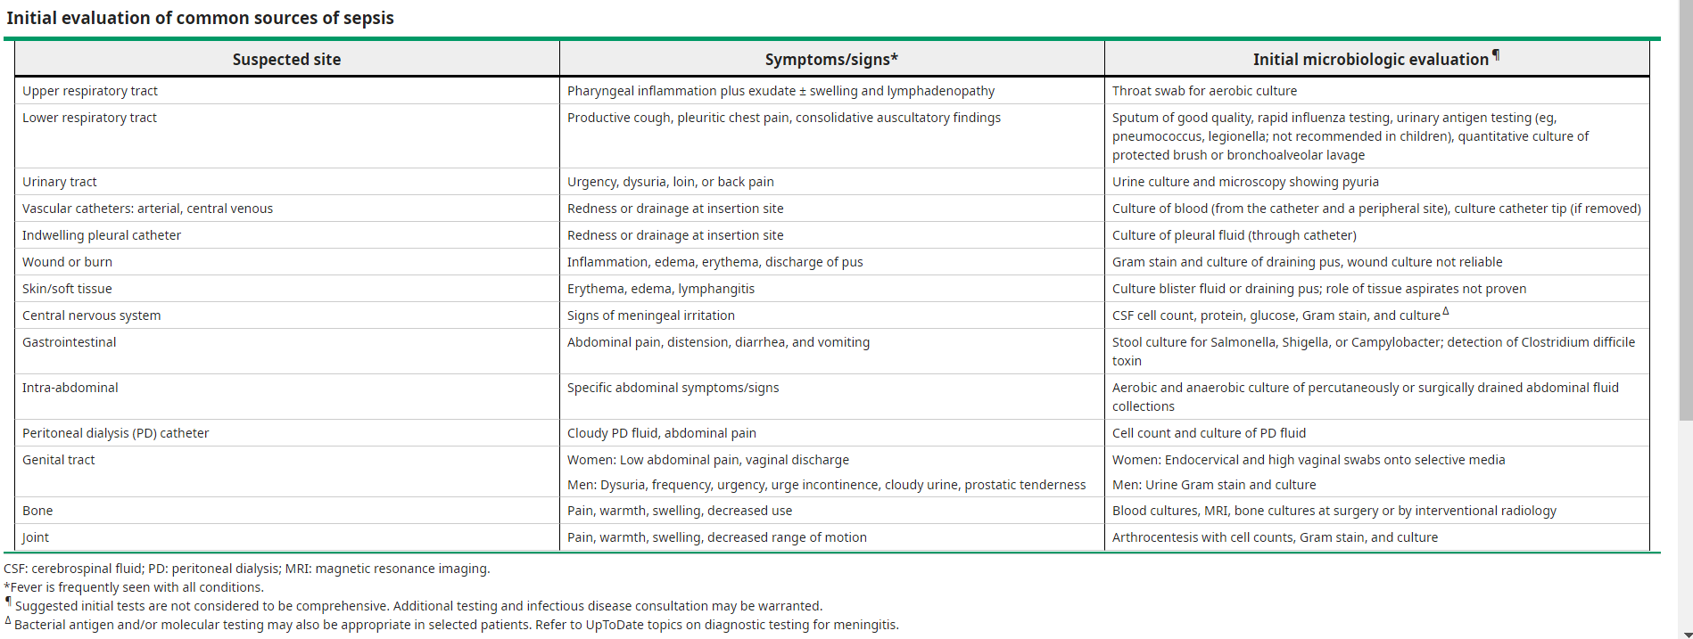
Empiric antibiotic therapy (first hour)

Slide 56
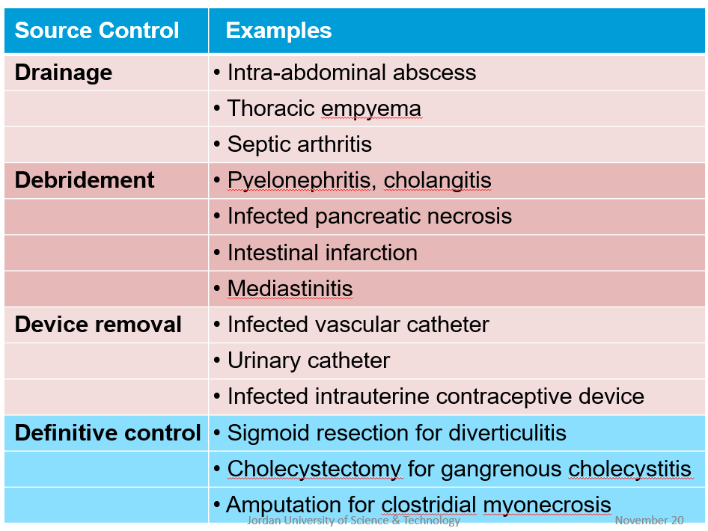

Slide 57
Choosing a regimen
- most patients with sepsis without shock, we recommend empiric broad spectrum therapy with one or more antimicrobials to cover all likely pathogens
-Many patients with septic shock, particularly those suspected to have gram negative sepsis, should receive combination therapy with at least two antimicrobials from two different classes (ie, combination therapy) depending on the organisms that are considered likely pathogens
Duration – The duration of antibiotics should be individualized. For most patients, the duration of therapy is typically 7 to 10 days

Slide 58
PATIENTS WHO FAIL INITIAL THERAPY
Patients having persistent hypoperfusion despite adequate fluid resuscitation and antimicrobial treatment should be reassessed for fluid responsiveness, adequacy of the antimicrobial regimen and septic focus , as well as the accuracy of the diagnosis of sepsis and/or its source and the possibility that unexpected complications or coexisting problems have occurred (eg, pneumothorax following CVC insertion)
Other options for treatment of persistent hypoperfusion such as the use of vasopressors, glucocorticoids, inotropic therapy, and blood transfusion

Slide 59
Vasopressors
Maintain MAP ≥ 65 mm Hg.
Norepinephrine or dopamine centrally administered are the initial vasopressors of choice.
Use epinephrine as the first alternative agent in septic shock when BP is poorly responsive to norepinephrine or dopamine.
In patients requiring vasopressors, insert an arterial catheter as soon as practical.

Slide 60
Glucocorticoids — Guidelines recommend against the routine use of glucocorticoids in patients with sepsis. However, corticosteroid therapy is appropriate in patients with septic shock that is refractory to adequate fluid resuscitation and vasopressor administration
Inotropic therapy — A trial of inotropic therapy may be warranted in patients who fail to respond to adequate fluids and vasopressors, particularly those who also have diminished cardiac output

Slide 61
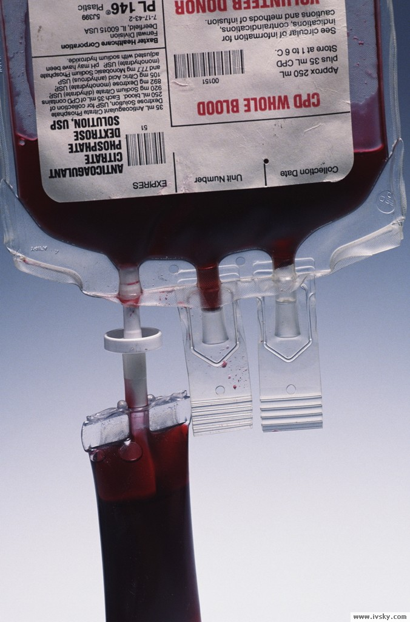
Red blood cell transfusions
Give RBC when Hb < 7.0 g/dl to target HB 7.0–9.0 g/dl in adults.
-Exceptions include suspicion of concurrent hemorrhagic shock or active myocardial

Slide 62
SUPPORTIVE THERAPIES
Nutrition
Stress ulcer prophylaxis
Neuromuscular blocking agents
Venous thromboembolism prophylaxis
Intensive insulin therapy =Keep blood glucose < 150 mg/dl
External cooling or antipyretics

Slide 63
Neurogenic Shock
Occure secondary to spinal cord injuries from vertebral body fractures of the cervical or high thoracic region that disrupt sympathetic regulation of peripheral vascular tone (there is failure of sympathetic outflow and adequate vascular tone)
The classic symptoms include a slow heart rate due to loss of cardiac sympathetic tone and warm skin due to dilation of the peripheral blood vessels.
Low blood pressure occurs due to decreased systemic vascular resistance as a result of lacking sympathetic tone which in turn causes pools of blood staying within the extremities and not being redirected to the core body. The slowed heart rate results from unopposed vagal tone activity.

Slide 64
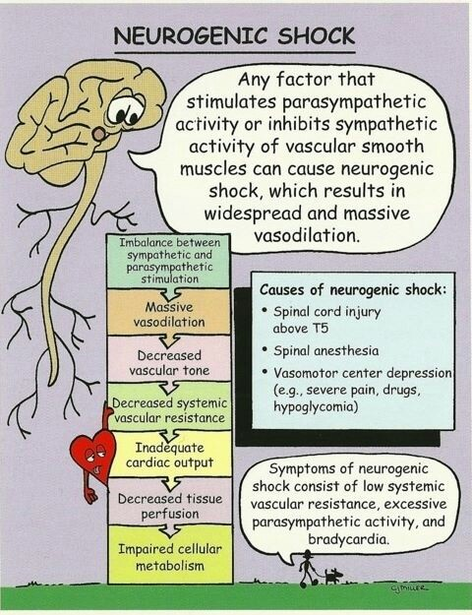

Slide 65
result in bradycardia, hypotension, cardiac dysrhythmias, reduced cardiac output, and decreased peripheral vascular resistance.
The classic description of neurogenic shock consists of decreased blood pressure associated with bradycardia (absence of reflexive tachycardia due to disrupted sympathetic discharge), warm extremities (loss of peripheral vasoconstriction), motor and sensory deficits indicative of a spinal cord injury, and radiographic evidence of a vertebral column fracture.

Slide 66
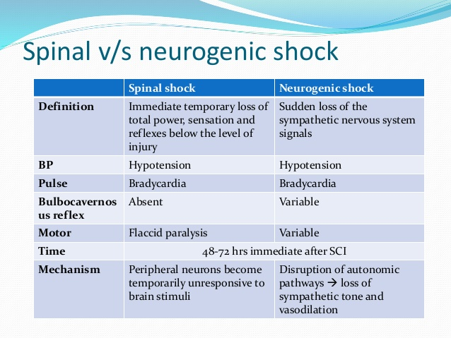

Slide 67
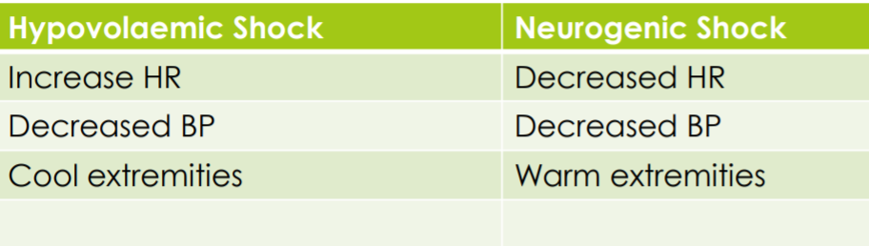

Slide 68
Management:
1. Hypotension ;
1. crystalloid (250mL boluses) and IVI – may not improve BP despite massive infusion (beware fluid overload and pulmonary oedema)
2. vasopressors eg noradrenaline, dopamine - after trial of volume replacement to Maintain organ perfusion.
Consider CVP monitoring

Slide 69
2. Bradycardia
1. atropine
2. avoid over vagal stimulation with suction/NGT and ETT placement

Slide 70
Done by : toleen jaber yazeed hussein

