Slide 1
Wound healing
Razan Rahahleh
Aya Abdullah

Slide 2
Introduction
Wound healing is defined as a mechanism where the body attempts to restore the integrity of the injured part .
Filling the gap that is caused by injury and tissue destruction followed by reconstruction of the tissue continuity.

Slide 3
Wound healing
The wound-healing process consists of four highly integrated and overlapping phases: hemostasis, inflammation, proliferation, and tissue remodeling or resolution.
These phases and their bio physiological functions must occur in the proper sequence, at a specific time, and continue for a specific duration at an optimal intensity .
There are many factors that can affect wound healing which interfere with one or more phases in this process, thus causing improper or impaired tissue repair.

Slide 4
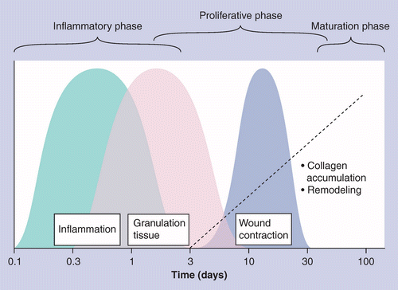

Slide 5
Normal wound healing
Wound healing is mainly divided into three phases that can overlap:
1: the inflammatory phase
2: the proliferative phase
3: the remodeling phase
In addition some classifications include haemostatic phase which occurs before the inflammatory phase .

Slide 6
Inflammatory phase
for 2-3 days
The body reacts to bleeding by vasoconstriction and thrombus formation to limit the blood loss .
Macrophages remove the destroyed tissue and microorganisms, and they regulate the fibroblast activity in the proliferative phase .

Slide 7
Inflammatory phase (Cont.)
The platelets stick to the damaged epithelial lining of vessels, they release adenosine diphosphate (ADP) which cause thrombocytic aggregates to fill the wound .
After the bleeding stops, the platelets then release platelet derived growth factor, platelet factor IV, and transforming growth factor beta, which attract inflammatory cells like polymorphonuclear lymphocytes (PMN) and macrophages .
Platelets and the local injured tissue also release vasoactive amines, such as histamine and prostaglandins, to increase vascular permeability and aid the infiltration of the inflammatory cells .

Slide 8
Proliferative phase
Lasts from the third day to the third week
Consists mainly of fibroblast activity with the production of collagen and ground substance (glycosaminoglycans and proteoglycans) .
Involves the growth of new blood vessels (angioneogenesis) .
Re-epithelialisation of the wound surface .

Slide 9
Proliferative phase (Cont.)
In the early part of this phase the wound tissue formed is called granulation tissue .
In the later part due to increased collagen, there is an increase in the tensile strength of the wound .
At this phase the collagen is mostly deposited at a random fashion and consists of type III collagen .

Slide 10
Remodeling phase
Characterized by maturation of the collagen type III where it is replaced with collagen type I until a ratio of 4:1 is achieved .
There is realignment of collagen fibers, and decreased wound vascularity and wound contraction .

Slide 11
FACTORS AFFECTING WOUND HEALING
Multiple factors can lead to impaired wound healing. In general terms, the factors that influence repair can be categorized into local and systemic. Local factors are those that directly influence the characteristics of the wound itself, while systemic factors are the overall health or disease state of the individual that affect his or her ability to heal.

Slide 12
Local factors:
Oxygenation
Oxygen is important for cell metabolism, especially energy production by means of ATP, and is critical for nearly all wound-healing processes. It prevents wounds from infection, induces angiogenesis, increases keratinocyte differentiation, migration, and re-epithelialization, enhances fibroblast proliferation and collagen synthesis, and promotes wound contraction .

Slide 13
oxygenation
In normal wound after the initial hypoxia progressive microcapillary neovascularization takes place and oxygen supply is restored .
But in case of injury or any systemic condition including advancing age and diabetics can create impaired vascular flow, thus setting the stage for poor tissue oxygenation resulting in impaired healing
Due to this prolonged hypoxia delays healing process chronic wounds are formed.

Slide 14
Infection
Once skin is injured microorganisms that are
normally sequestered at the skin surface
obtain access to the underlying tissues .
• Inflammation is normal part of wound
healing and is important to removal of
Contaminating microorganisms .
• In absence of effective decontamination
inflammation is prolonged , since microbial
clearance is incomplete .

Slide 15
Systemic factors
Age .
The elderly population (people over 60 years of age) is growing faster than any other age group. and increased age is a major risk factor for impaired wound healing.
Delayed wound healing in the aged is associated with an altered inflammatory response, such as delayed T-cell infiltration into the wound area with alterations in chemokine production and reduced macrophage phagocytic capacity .

Slide 16
Systemic factors
Sex Hormones in Aged Individuals .
Sex hormones play a role in age-related wound-healing deficits. Compared with aged females, aged males have been shown to have delayed healing of acute wounds. A partial explanation for this is that the female estrogens (estrone and 17β-estradiol), male androgens (testosterone and 5α-dihydrotestosterone, DHT), and their steroid precursor dehydroepiandrosterone (DHEA) appear to have significant effects on the wound-healing process .

Slide 17
Systemic factors
Diabetes .
Several dysregulated cellular functions are involved in diabetic wounds, such as defective T-cell immunity, defects in leukocyte chemotaxis, phagocytosis, and bactericidal capacity, and dysfunctions of fibroblasts and epidermal cells. These defects are responsible for inadequate bacterial clearance and delayed or impaired repair in individuals with diabetes.
The neuropathy that occurs in diabetic individuals probably also contributes to impaired wound healing.

Slide 18
Systemic factors
Medications .
Alcoholism and smoking .
Immunocompromised conditions: cancer, radiation therapy, AIDS .
Stress

Slide 19
Healing process
Wound closure and healing is classified into primary, secondary, and tertiary intention .
In the treatment we aim to achieve healing by primary intention and so reduce the inflammatory and proliferative responses .

Slide 20
Types of wound healing
1. healing by primary intention (wounds with
opposed edges )
2. healing by secondary intention (wounds with separated edges ) .

Slide 21
Primary intention
Healing by primary intention occurs when there is apposition of the wound edges and minimal surrounding tissue trauma .
This type cause the least inflammation and leave minimal scar .

Slide 22
Healing of wound with following characteristics:
Clean and uninfected .
Surgically incised .
Without much loss of cells and tissue .
Wounds with opposed edges .
Edges of wound are approximated by surgical sutures.
Primary union .

Slide 23
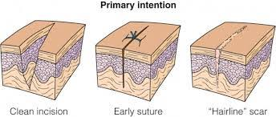

Slide 24
Secondary intention
Healing by secondary intention has increased inflammation and proliferation, and it leaves a poor scar .
In this type wounds are left open and allowed to heal by granulation, contraction, and epithelialisation .

Slide 25
Healing by secondary intension :
Wounds with separated edges .
Secondary union .
When there is more extensive loss of cells
tissue Regeneration of parenchymal cells can’t completely reconstitute the original architecture.
Abundant granulation tissue grows in from the margin to complete the repair .

Slide 26
DEFFERANCE BETWEEN HEALING BY PRIMARY AND SEONDARY INTENTION Secondary
healing differs from primary healing in several
respects:
Inflammatory reaction is more intense .
Much larger amounts of granulation tissue are formed .
Wound contraction occurs in large surface.
wounds Substantial scar formation and thinning of the epidermis occurs.

Slide 27
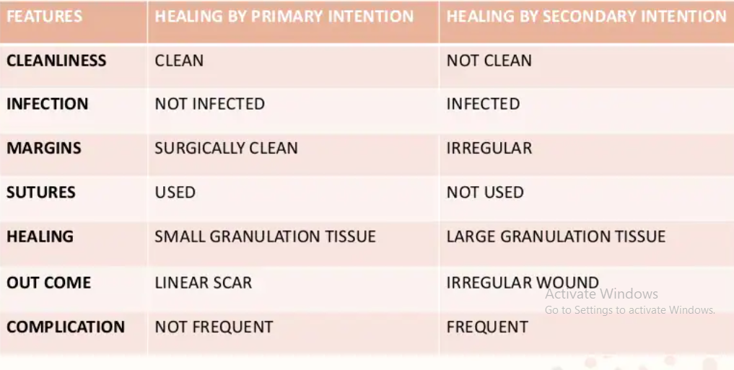
DEFFERANCE BETWEEN HEALING BY PRIMARY AND SEONDARY INTENTION Secondary :

Slide 28
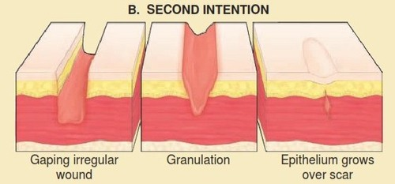

Slide 29
Tertiary intention
Also called delayed primary intention, the wound is initially left open and the edges are not opposed immediately .
can be necessary in contaminated wounds .
Result in a scar that is less satisfactory than scars that result from primary intention .

Slide 30
