Slide 1
Management of Burn
Wasan Al-Dalabeeh
Aamal AlHami
Saba’ AbuShamma

Slide 2
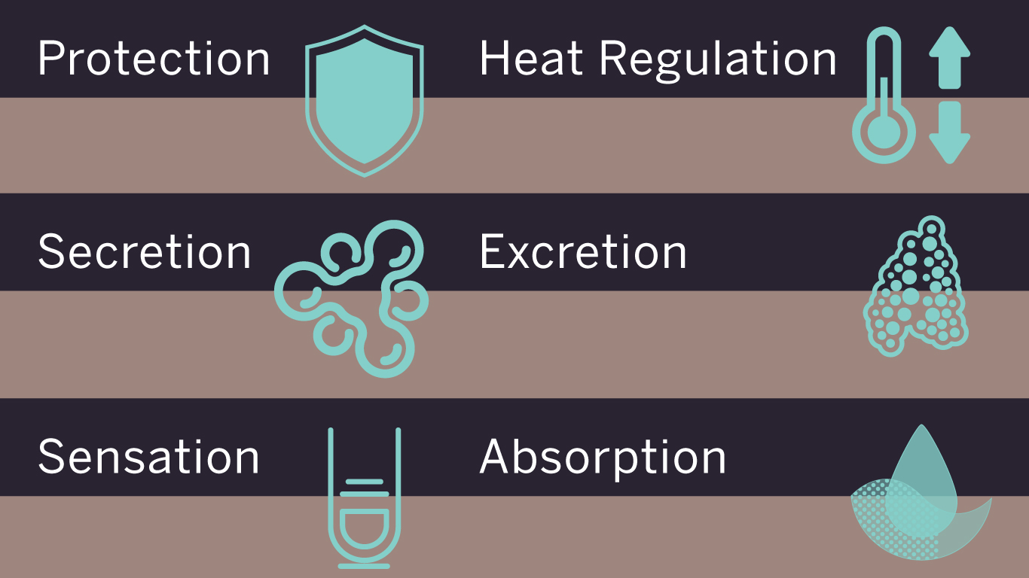
Skin is the largest organ

Slide 3
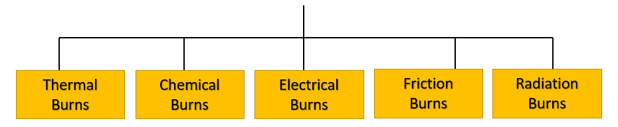
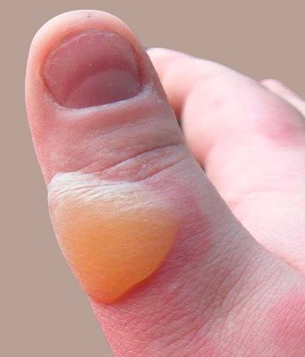
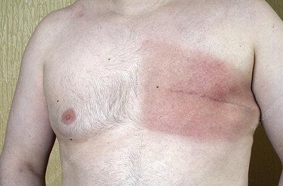
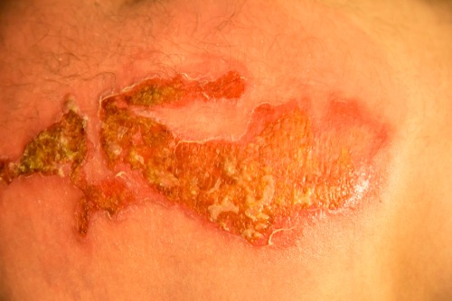
Burn injury to skin

Slide 4
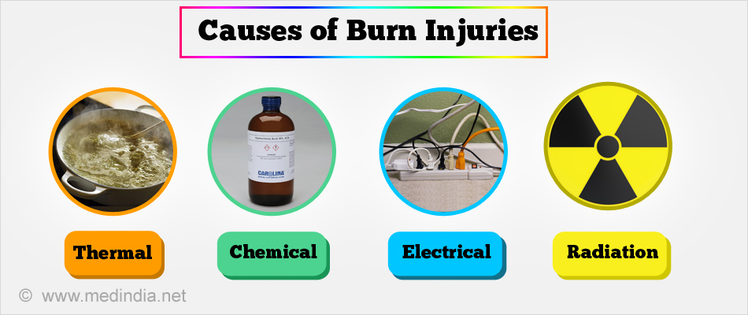

Slide 5
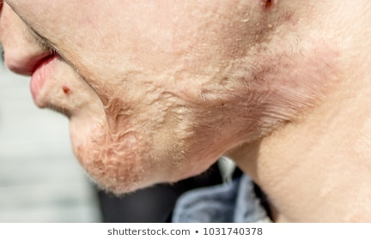
Burn complications
Airway obstruction
Inhalation injuries
Fluid loss
Hypovolemic shock
Compartment syndrome
Limb ischemia
Infection.
Intestinal changes .
Bad scar .

Slide 6
Burn care requires a specialized multi-disciplinary team

Slide 7

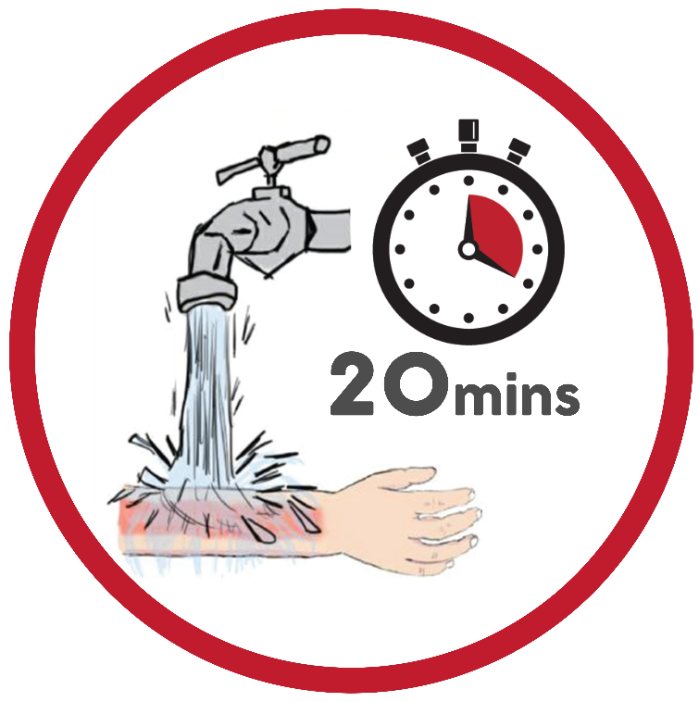
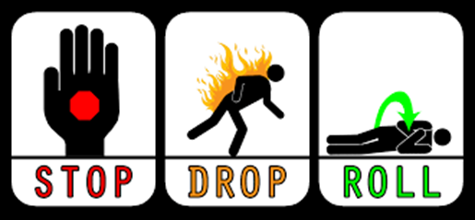

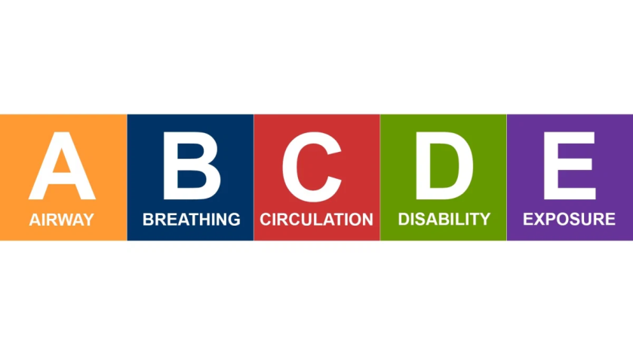

Slide 8

pre-hospital care
• Ensure rescuer safety.
• Stop the burning process . Stop, drop and roll
• Check for other injuries, ABC + rapid secondary survey .
Pain relief
Cool the burn wound
should occur for a minimum of 10 minutes and is effective up to 1 hour after the burn injury.
oxygen Anyone involved in a fire in an enclosed space should receive oxygen, especially if there is an altered level of consciousness.
• Elevate Sitting a patient up
Elevation of burned limbs will reduce swelling and discomfort

Slide 9
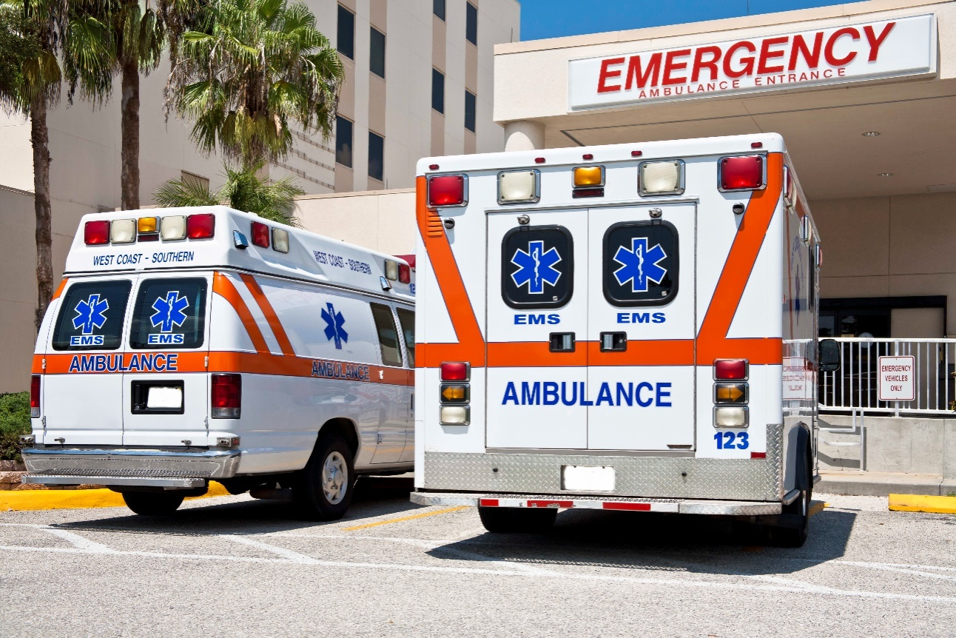
At theHospital

Slide 10
Initial Assessment
1. Mechanism of Injury
2. Associated Injuries
3. Patient Age
4. State of Health

Slide 11
Airway
Endotracheal tube until the swelling subside << 48 h
Supraglottic tissue edema progresses over the fi rst 12 hours and can obstruct the airway rapidly
The larynx protects subglottic tissue from direct thermal injury but not from injury due to inhaled toxic gases.
Physical signs include hoarseness, stridor, facial burns, singed facial hair, expectoration of carbonaceous sputum, and presence of carbon in the oropharynx.

Slide 12
HISTORY & EARLY SIGNS :
HX of inhalation of hot gases such as in a house or car fire (enclosed spaces).
PE - blisters on the hard palate
- burned nasal mucosa and loss of all the hair in the nose .
the most valuable signs are the
- presence of deep burns around the mouth and in the neck.
Acute cricothyroidotomy

Slide 13
Breathing
Effort
Depth of respiration
Auscultation of breath sounds
Wheezing → - Inhalation Injury – Aspiration of gastric contents

Slide 14
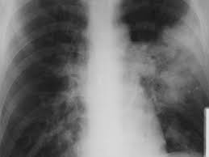
Breathing
1- Inhalation injuries
Physiotherapy , nebulizers and warm humidified oxygen
Monitor respiratory rate , blood gases
Deteriorate !! positive pressure , ICU .
2- thermal injuries to the lower airway steam

Slide 15
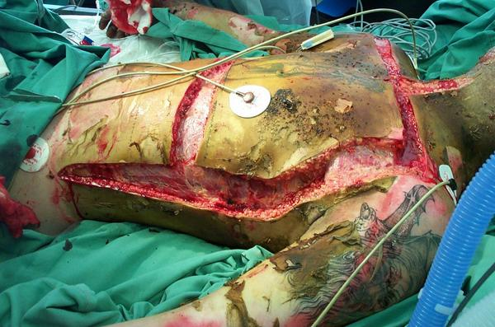
3- metabolic poisoning
Carboxyhaemoglobin levels raised
above 10% must be treated with high inspired oxygen for 24
hours to speed its displacement from haemoglobin
4- Mechanical block
Escharatomy

Slide 16
Circulation
** Aggressive and prompt fluid resuscitation **
Risk of hypovolemic shock due to dynamic fl uid shifts from the intravascular compartment to the interstitium, and exudative and evaporative water loss from the burn injury.
Exposure
Remove all clothing and jewelry

Slide 17

CRITERIA ??

Slide 18
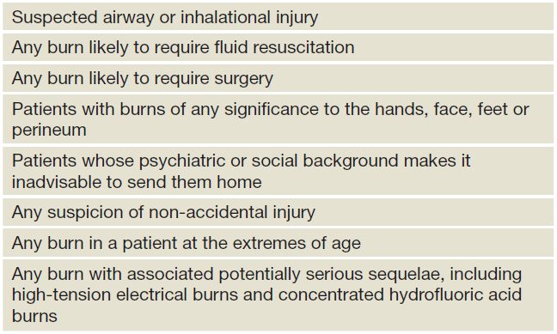
The criteria for acute admission to a burns unit.

Slide 19
ASSESSMENT OF THE BURN WOUND

Slide 20
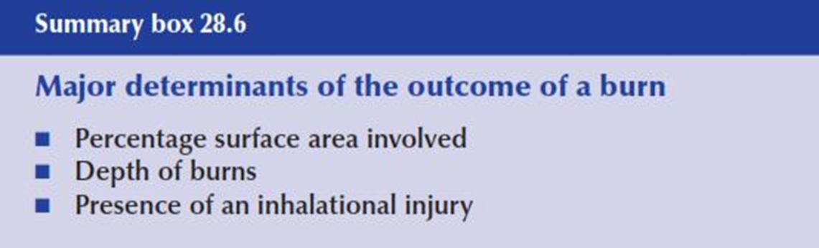

Slide 21
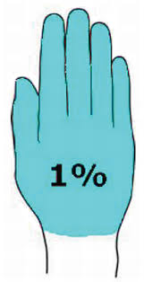
Assessing size
1- the size of the patient’s whole hand for small areas
Equals 1% of BSA
TBSA= total body surface areas
The palm rule = the patients palm accounts for approximately 1% of TBSA, used for estimating small burns

Slide 22
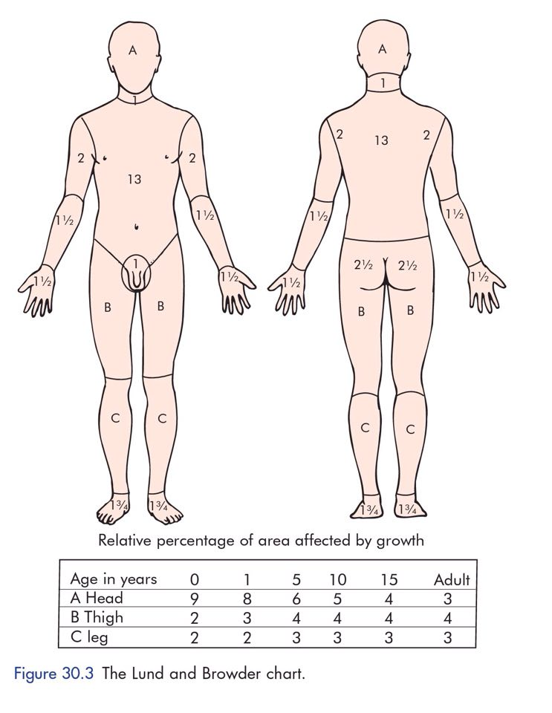
2-Draw the burn on a Lund and Browder chart
which maps out the percentage TBSA of sections of our anatomy.
It also takes into account different proportional body surface area in children according to age

Slide 23
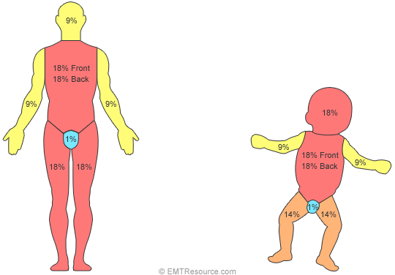
3-The rule of nines :
- each upper limb is 9
- each lower limb 18
- The torso 18 each side
- head and neck 9

Slide 24
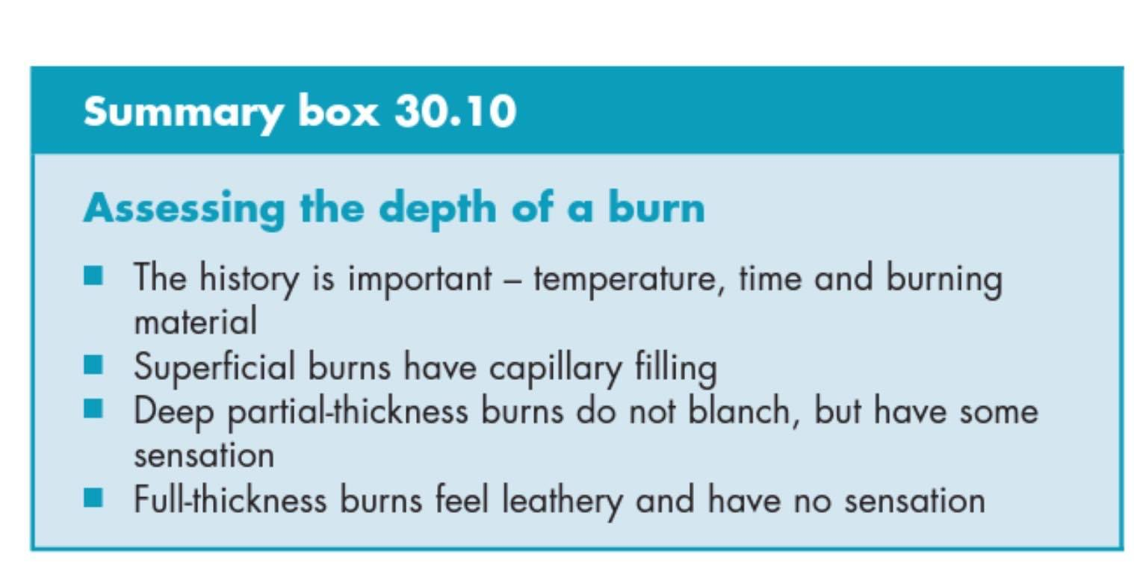
Assessing depth:
Burns should be classified and managed based on which layer of skin to which they
extend

Slide 25
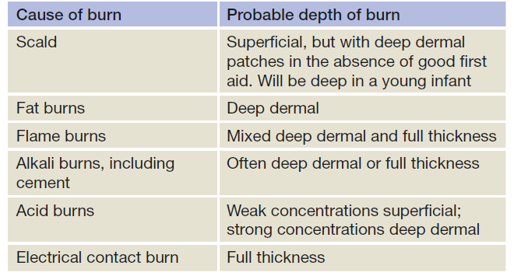
DEPTH VS CAUSE

Slide 26
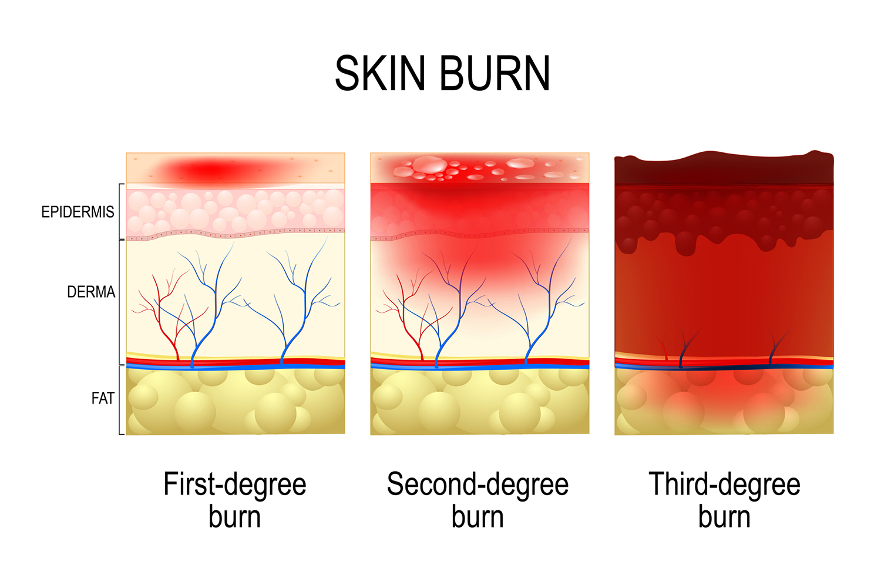

Slide 27
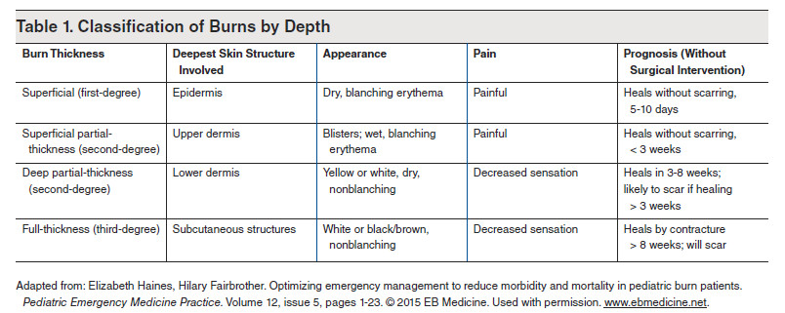

Slide 28
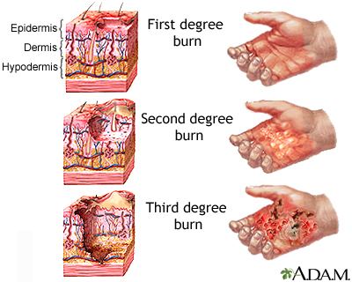

Slide 29
MANAGEMENT
Resuscitation
Oxygen. should be provided to patients with all but the most minor injuries. A 100% oxygen high-humidity facemask for those with possible inhalation injury assists the patient’s expectoration from dry airways and treats carbon monoxide poisoning.
2. Intravenous access.
All adult patients with burns of 15% or greater or children with burns over 10% TBSA
require intravenous fluids. Two large peripheral venous catheters should be started immediately to provide circulatory volume support.
3. Fluid . Improved survival in the era of modern burn care is largely attributable to early and aggressive volume resuscitation. Fluid resuscitation based on standard formula.

Slide 30
Parkland Formula :-
The estimated crystalloid requirement for the first 24 hours after injury is calculated on the basis of patient weight (determined early after the burn as a baseline) and BSA burn percentage.
Lactated Ringer solution volume in the first 24 hours =
4 mL × %BSA (second-, third-, and fourth-degree burns only) × body weight (kg).
One-half of the calculated volume is given in the first 8 hours after injury, and the remaining volume is infused over the next 16 hours with adjustments being made as clinical conditions and size/depth of burns evolve.

Slide 31
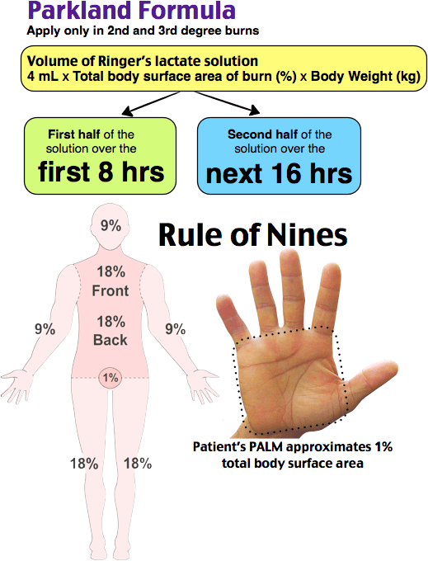
How?

Slide 32
Example ; adult 100kg , has 20% of his body surface are burn , how much fluid he need ?
4*100*20 = 8000ml
gives him 4 liter in first 8 hour

Slide 33
TYPES OF FLUID USED
1-Crystalloid resuscitation:
Ringer’s lactate is the most commonly used crystalloid.
2-Hypertonic saline
*Hypertonic saline has been effective in treating burns shock.
*It produces hyperosmolarity and hypernatraemia. This reduces the shift of intracellular water to the extracellular space.
*Advantages include less tissue oedema and a resultant decrease in escharotomies and intubations
3-Colloid resuscitation:
Some studies show they should be avoided as an intravenous therapy until after the first 24 hours postburn, at which time capillary leak diminishes.
Next 24 hours: Begin colloid infusion of 5% albumin 0.3–1 ml/kg/% burn/16 per hour

Slide 34
In children, maintenance ﬂuid must also be given to compensate for ongoing evaporative losses and quickly depleted glycogen stores
This is normally dextrose–saline given as follows (maintenance in children)
• 100 ml/kg for 24 hours for the first 10 kg;
• 50 ml/kg for the next 10 kg;
• 20 ml/kg for 24 hours for each kilogram over 20 kg body weight.

Slide 35
Monitoring of resuscitation
1-The key to monitoring of resuscitation is urine output.
should be between : 0.5-1 ml/kg/hr Adults
1-1.5 ml/kg/hr Children
2-Normal pulse rate
3-Normal Blood Pressure
If the urine output is inadequate and the patient is showing signs of hypoperfusion (restlessness with tachycardia, cool peripheries and a high hematocrit), then a bolus of 10 ml /kg should be given.
*It is important that patients are not over resuscitated, and urine output in excess of 2 ml/kg/ hour should signal a decrease in the rate of infusion.

Slide 36
Treatment depending on the degree
First degree burns: keep clean + topical antibiotic(neomycin) + pain meds.
Second degree burns: Remove blisters, apply antibiotic ointment (usually Silvadene®) and dressing, pain meds, Most second-degree burns do not require skin grafting (epidermis grows from hair follicles and from margins) . Newer treatment can be used as well:
1. Biobrane® (silicone artificial epidermis—temporary)
2. Silverlon® (silver ion dressings)
Third degree burns: Early excision of eschar (within first week postburn) and STSG.

Slide 37
Management of the Burn Wound
1) Early irrigation and Debridement with N.S and sterile instrument .
2) Analgesia : All burn patients need good analgesia (IV morphine). Apply cold saline soaks for analgesia if burns are < 25% BSA (watch for hypothermia).
3) Topical antimicrobial agent
4) Dressing
5) +/- tetanus +/- H2 blocker (curling’s ulcer)

Slide 38
Topical antimicrobial agent
The most common organisms causing burn wound infection are : staph aureus , strep group A , Pseudomonas a. and Fungi

Slide 39
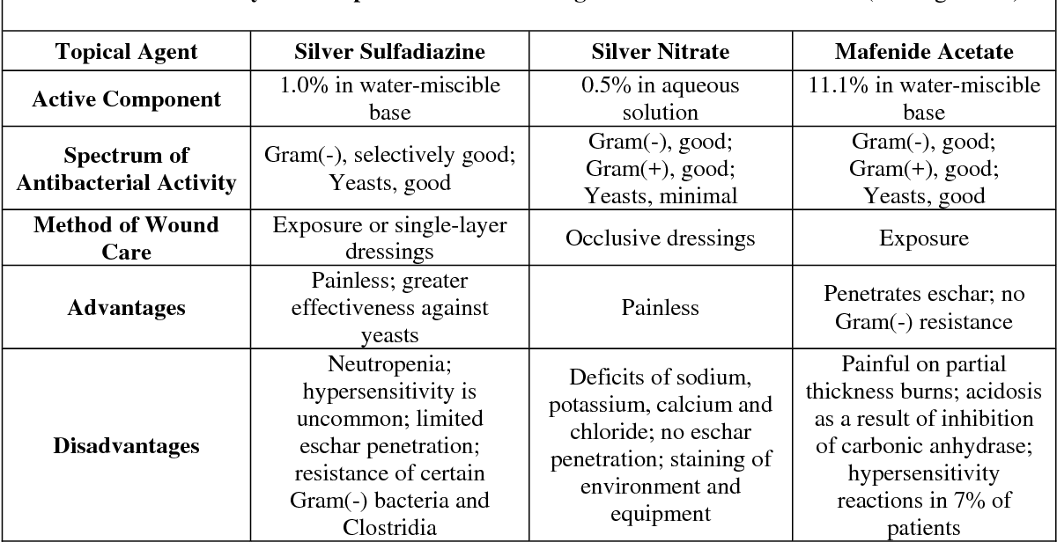

Slide 40
Nutrition
Any adult with a burn greater than 15% (10% in children) of TBSA has an increased nutritional requirement.
All Patients with burns of 20% of TBSA or greater should receive a Nasogastric tube.
(early feeding should start within 6 hours of the Injury to reduce gut mucosal damage.)
(to prevent aspiration pneumonia caused by paralytic ileus and vomiting)
.

Slide 41
6) Monitoring and control of infection
Burns patients are immunocompromised .
Swabs should be taken regularly
A rise in WBC count, thrombocytosis and increased catabolism are warnings of infection , most common discoloration of burn eschar.

Slide 42
Escharotomy if needed :
It is a surgical incision through the eschar into the subcutaneous tissues to allow the extremity to continue to swell without compressing the underlying blood vessels.
Areas of concern: Circumferential burns of extremities or thorax .
Indications:
Impending or established vascular compromise of the extremities or digits.
Impending or established respiratory compromise due to circumferential torso burns

Slide 43
Fasciotomy
Escharotomy may fail, especially when the burn is from high-voltage electrical injury or is associated with soft tissue, bone, or vascular injury.
If compartment syndrome persists after escharotomy, incision of the fascia is also required.
General anesthesia is required.

Slide 44
Operative Treatment
-Any deep partial-thickness and full-thickness burns, except those that are less than about 4 cm2
, need surgery.
■ 1-The anaesthetist needs to be ready for significant blood loss
■ 2-Topical adrenaline reduces bleeding
■3- All burnt tissue needs to be excised
4-Stable cover, permanent (stsg)or temporary, should be applied at once to reduce burn load

Slide 45
MANAGEMENT OF ELECTRICAL INJURY
Don’t become the next victim
Wounds are greater than surface burn
ABC’s
Arrhythmias >>
{cardiac monitoring if history of LOC or ECG abnormalities}
Rhabdomyolysis >> ARF

Slide 46
TREATMENT OF CHEMICAL BURNS
Wear gloves and protective clothing
Remove saturated clothing
Brush skin if agent is a powder
Irrigate, irrigate, irrigate!
copious lavage with water
*Then identify the chemical and assess the risks of absorption

Slide 47
So
Abcd
Fluid
Tetanus
H blocker
Wound care1- dressing 2- topical antibiotic 3- assessment for compartment or infection .

