Slide 1

Fluid and Electrolytes Management in a Surgical Patient

Slide 2
Normal fluid distribution
*Water forms about 60% of total body weight in men and 55% in women. (Females have greater % of adipose tissue)
*Approximately for a 70 kg male (60% of TBW):
• 2/3 is intracellular (40%)
• 1/3 extracellular (20%)
( 5% plasma + 15% interstitial space or extravascular )
*Proteins constitute 15% of the body weight
( 50% intracellular , 50% extracellular”plasma” )

Slide 3
TBW
ECF
Interstitial fluid
Plasma
(intravascular)
ICF

Slide 4
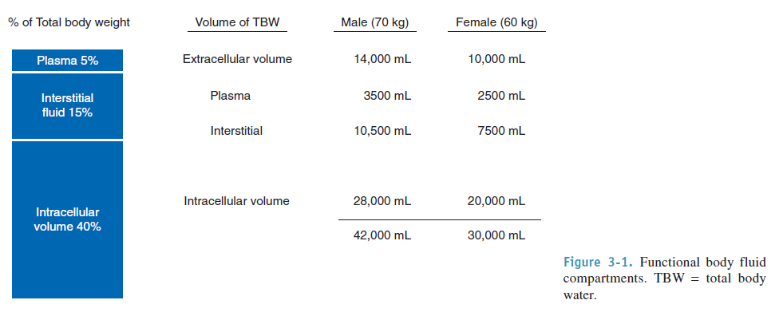

Slide 5
Emphasis on Surgical Patients
Extracellular volume deficit is the most common fluid disorder in surgical patients.
Acute or chronic
Acute volume deficit is associated with cardiovascular and central nervous system signs
chronic deficits display tissue signs, such as a decrease in skin turgor and sunken eyes

Slide 6
Crystalloids
Vs.
Colloids
??!

Slide 7
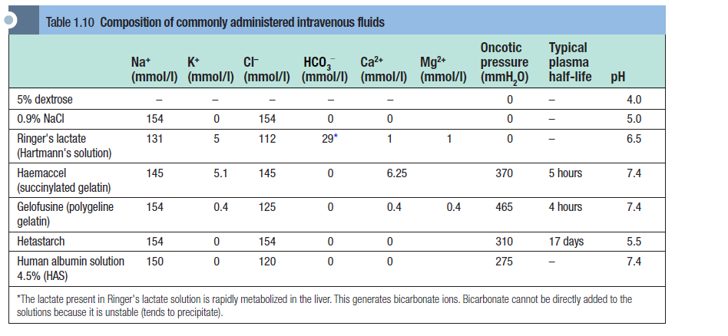

Slide 8
Crystalloid
=Solutions of inorganic ions and small organic molecules dissolved in water
-The main solute is either glucose or sodium
chloride (saline) and the solutions may be isotonic,
hypotonic or hypertonic with respect to plasma
-Used for volume expansion, maintenance infusion and correction of electrolyte disturbances.
#Crystalloids with an ionic composition close to
that of plasma may be referred to as “balanced” or
“physiological”.

Slide 9
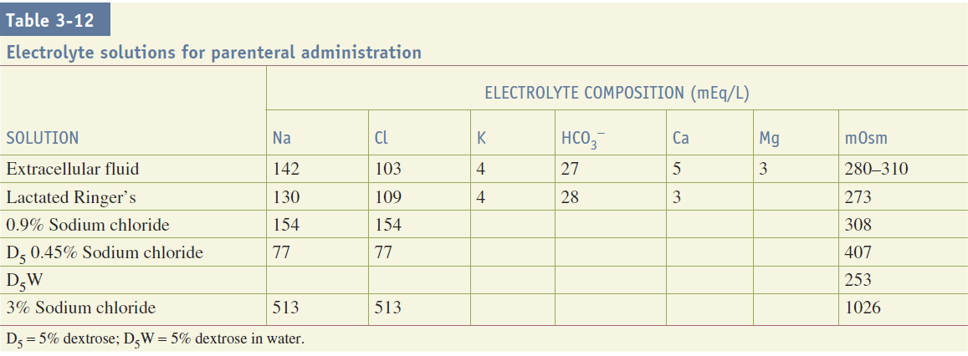

Slide 10
1) Hypotonic solutions
Dextrose 5% contains 5 g of dextrose (d-glucose) per 100 ml of
water.
-This glucose is rapidly metabolized and the remaining free water distributes rapidly and evenly throughout the body's fluid compartments.
-So, shortly after the intravenous administration of 1000 ml 5% dextrose solution:
about 670 ml of water will be added to the intracellular fluid compartment (IFC)
and about 330 ml of water to the extracellular fluid compartment (EFC), of which about 70 ml will be intravascular(10%)
Dextrose solutions are therefore have a little value as resuscitation fluids to expand intravascular volume.

Slide 11
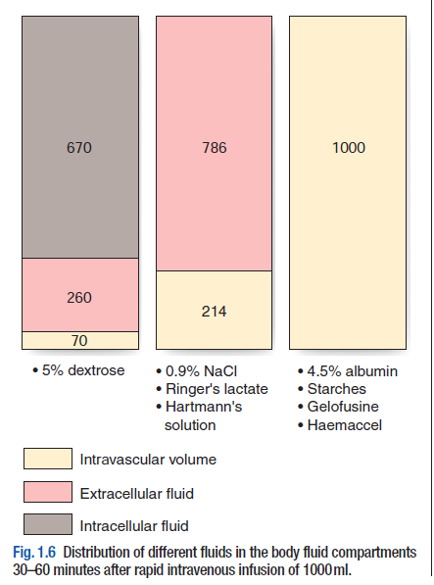

Slide 12
2) Isotonic solutions
Sodium chloride 0.9% and Hartmann's solution :
are isotonic solutions of electrolytes in water.
-Sodium chloride 0.9% (also known as normal saline) contains 9 g of sodium chloride dissolved in 1000 ml of water
-Hartmann's solution (Ringer lactate) has a more physiological composition, containing lactate, potassium and calcium in addition to sodium and chloride ions.
-Both normal saline and Hartmann's solution have an osmolality similar to that of extracellular fluid (about 300 mOsm/l) and after intravenous administration they distribute rapidly throughout the ECF compartment.
-Only 25% remain intravascular. -No change in ICF volume

Slide 13
→ Isotonic crystalloids are appropriate for correcting EFC losses (e.g. gastrointestinal tract or sweating)
and for the initial resuscitation of intravascular volume, although only about 25% remains in the intravascular space after redistribution (often less than 30–60 minutes).

Slide 14
3) Hypertonic solutions
-eg: 3% NS (normal saline)
-Hypertonic saline solutions induce a shift of fluid from the IFC to the EFC so reducing tissues fluid and increasing intravascular volume and serum sodium concentration.
-Potential indications include the treatment of cerebral oedema and raised intracranial pressure, hyponatraemic seizures and ‘small volume’ resuscitation of hypovolaemic shock or burns

Slide 15
Colloids
=High Molecular Weight substances, unable to pass through semi permeable membrane → Remains confined to intra-vascular compartment and thus generating oncotic pressure
-Colloid solutions used in clinical practice for fluid therapy are divided into :
1) the semi-synthetic colloids :gelatins, dextrans and hydroxyethyl starches
2) the naturally occurring human plasma derivatives : human albumin solutions, fresh frozen plasma, and immunoglobulin solution.
*Most colloid solutions are presented with the colloid molecules dissolved in isotonic saline or isotonic glucose, hypertonic saline and isotonic balanced or “physiological” electrolyte solutions are also used.
Decrease tissue edema.

Slide 16
Colloids
-When administered, colloid remains largely within the intravascular space until the colloid particles are removed by the reticuloendothelial system.
-The intravascular half-life is usually between 6 and 24 hours and such solutions are therefore appropriate for fluid resuscitation. Thereafter, the electrolyte-containing solution distributes throughout the EFC.
-Synthetic colloids are more expensive than crystalloids
and have variable side effect profiles.
-Recognized risks include coagulopathy (used in surgeries) , reticuloendothelial system dysfunction, pruritus and anaphylactic reactions.
HES (Hydroxyethyl starch) in particular appears associated with a risk of renal failure when used for resuscitation in patients with septic shock.
Notes:
Hydroxyethyl starch

Slide 17
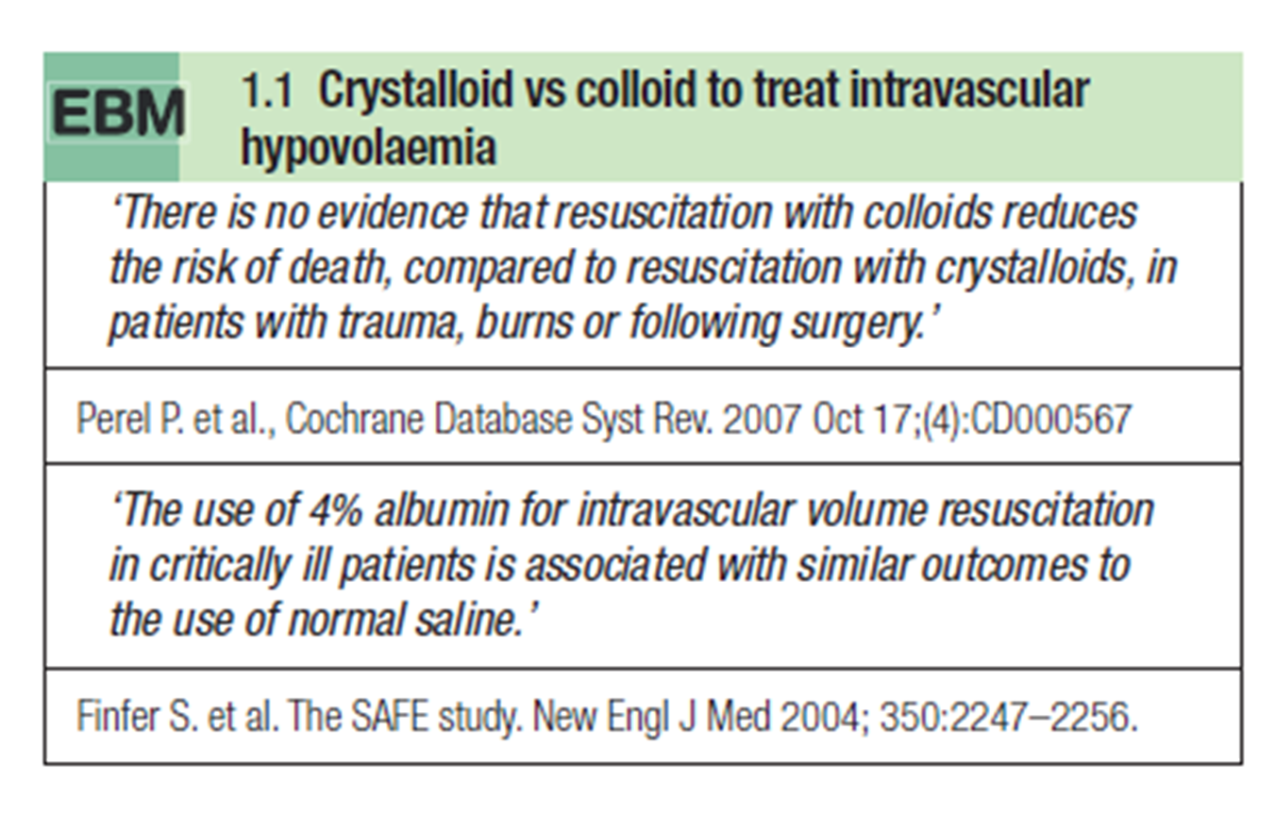
-The theoretical advantage of colloids over crystalloids is that, as they remain in the intravascular space for several hours → more prompt restoration of tissue perfusion → smaller volumes are required.
→ However, overall, current evidence suggests that crystalloid and colloid are equally effective for the correction of hypovolaemia (EBM 1.1).

Slide 18
Maintenance fluid requirements
Maintenance fluids can be calculated using the following formula:
For the first 0 to 10 kg → Give 100 mL/kg per day
For the next 10 to 20 kg → Give an additional 50 mL/kg per day
For weight > 20 kg → Give 20 mL/kg per day
E.g.: 70 Kg patient
1st 10 Kg 1000 ml
2nd 10 Kg 500 ml
All the rest 1000 ml
Total Maintenance fluid requirements per day = 2500 ml
( 2500/24= 104 ml/hour)

Slide 19
Maintenance fluid requirements
Under normal conditions, adult daily sodium requirements (80 mmol) may be provided by the administration of 500–1000 ml of 0.9% sodium chloride.
The remaining water requirement to maintain fluid balance is typically provided as 5% dextrose.
Daily potassium requirements (60–80 mmol) are usually met by adding potassium chloride KCl to maintenance fluids, but the amount added can be titrated to measured plasma concentrations.
Potassium should not be administered at a rate greater than 10–20 mmol/h except in severe potassium deficiency and, in practice, 20 mmol are added to alternate 500 ml bags of fluid

Slide 20
Treatment of postoperative
hypovolaemia and/or hypotension
-Hypovolaemia is common in the postoperative period and may present with one or more of the following:
tachycardia, cold extremities, pallor, clammy skin, collapsed peripheral veins, oliguria and/or hypotension.
-Hypotension is more likely in hypovolaemic patients receiving epidural analgesia as the associated sympathetic blockade disrupts compensatory vasoconstriction.
-Intravascular volume should be rapidly restored with a series of fluid boluses (e.g. 250– 500 ml) with the clinical response being assessed after each bolus .

Slide 21
Electrolyte Abnormalities
And Correction

Slide 22
Sodium Abnormalities
Normal person consumes 3-5g of NaCl daily
Sodium balance is maintained mainly by the kidneys
Normal Na Concentration: 135 – 145 mmol/L.
Serum Na concentration is inversely proportional to total body water .Therefore, abnormalities in TBW are reflected by abnormalities in serum Na.

Slide 23
Hyponatremia
A low serum Na occurs when there is excess of extracellular water relative to Na .
In acute drop : 120-130 may produce symptoms
In chronic hypoNa : symptomatic 110-120 mEq/L.
The first step is to repeat the test to exclude lab error then calculate the Plasma osmolality to determine if it is:
1-hypertonic hypoNa : as in hyperglycemia (osmotic substance)
2- isotonic hypoNa (pseudohyponatremia) : as in hyperlipidemia or increased proteins in the serum
3- hypotonic hypoNa : in which you have to assess volume status because it is classified according to the ECV.
Notes:
فعليًا
The first step is to calculate the osmolality to determine if it is:
1-hypertonic hypoNa : as in hyperglycemia
2- isotonic hypoNa : as in hyperlipidemia pr increased proteins in the serum
3- hypotonic hypoNa : in which you have to assess volume status bz it is classified according to the ECV … etc.

Slide 24
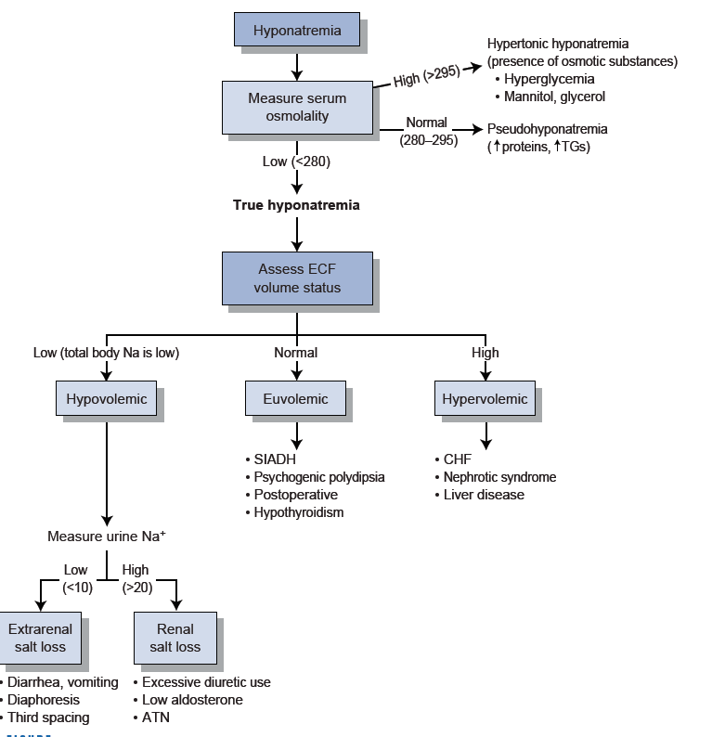
Notes:
Una = urinary sodium

Slide 25
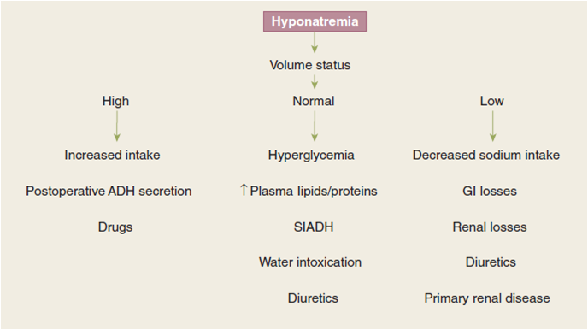
Dilutional
Depletional
Edematous state : CHF, LF, RF
(Primary Polydipsia)
HypoKalemia
Notes:
In edematous state > there is retention for both water and Na > but disproportionate accumulation of water results in hypoNa.
Pseudohyponatremia : Normal TBW and Total body Sodium Are not changed ,mostly secondary to hyperglycemia or increased plasma lipids and proteins.
Hypokalemia can result in hypoNa due to cellular exchange of Na and K .
SIADH :characterized by hypoosmolality , hypoNa , low urine output w/ increased urinary Na , and euvolemia .. As seen in RS and CNS disorders.

Slide 26
Signs and Symptoms
Body System | Hyponatremia
CNS | Headache, confusion, hyper/ hypoactive deep tendon reflexes, seizures, coma, increased intracranial pressure
Musculoskeletal | Weakness, fatigue, muscle cramps, twitching
GIT | Anorexia, nausea, vomiting, watery diarrhea
CVS | Hypertension & bradycardia if significant increase in intracranial pressure
Tissue | Lacrimation, salivation
Renal | Oliguria
Notes:
The symptoms predominantly neurological.

Slide 27
Hyponatremia Correction
1- If Hypovolemic HypoNa: give 0.9%NS .
2- Other types: mostly treated by water restriction.
3- If severe(<110) or neurologic symptoms : 3% NS (hypertonic saline)
Correction should be slowly
(The rate of correction shouldn’t exceed 12meq/L /day OR 0.5mEq/l/h )
→Rapid correction can result in Central pontine demyelination. (Locked-in syndrome)
Notes:
Brain adaptation : free osmoles e.g inisetol , osmolarity normal in brain >rapid correction > hyperosmolarity > shrinkage of cells esp myelin sheath
signs :dysphagia , dysarthria , acute paralysis

Slide 28
Hypernatremia
Hypernatremia (Na+ > 145 mmol/l)
results from either
1- loss of free water or
2- gain of sodium in excess of water

Slide 29
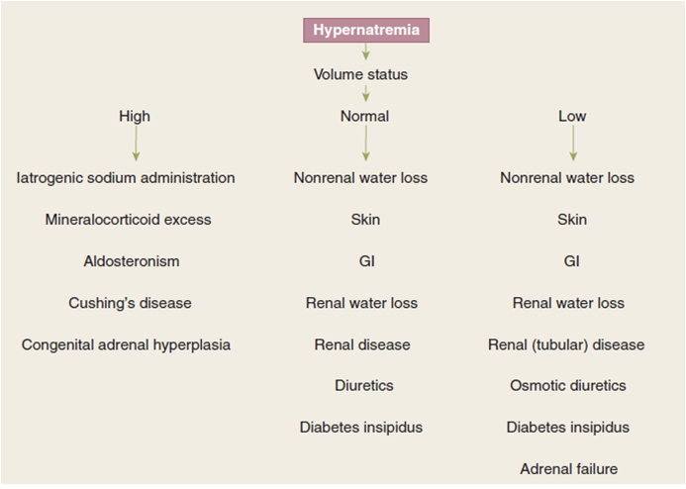
(Hypertonic saline)
(Sweating and burns )
(Conn’s)
Notes:
People with hypervolemic hyperNa : present with bradycardia and HTN
While those with Hypovolemic hyperNa : Hypotension and tachycardia .

Slide 30
Signs and Symptoms
Hypernatremia | Body System
Restlessness, lethargy, ataxia, irritability, tonic spasm, delirium, seizures, coma | CNS
Weakness | Musculoskeletal
Tachycardia, hypotension, syncope | Cardiovascular
Dry sticky mucus membranes, red swollen tongue, decreased saliva and tears | Tissue
Oliguria | Renal
Fever | Metabolic
Notes:
Mostly it is neurological manifestations .
Symptoms are related to hyperosmolarity resulting in cellular dehydration

Slide 31
Hypernatremia Correction
Treat associated water deficit first.
In Hypovolemic Hypernatremic patients:
1- Restore the volume with normal saline.
2- Once adequate volume achieved (hemodynamic stable)
> Replacement of free water (WD) using a hypotonic fluid .
(TBW = 60% × body wt)
*RAPID correction can lead to brain edema and herniation*
In Hypervolemic Hypernatremic :
Give loop diuretic.
Water deficit (L) =
(Serum Na – 140)/140 x TBW
Notes:
WD = water deficit
One half of WD is corrected over the first 24h and the rest over the following 2-3 days.

Slide 32
Phosphorus Abnormalities
Phosphorus is the primary intracellular divalent anion and is abundant in metabolically active cells
ECF contains less than 1% of total body stores.
Normal level : 2.5 - 4.5 mg/dL
Phosphorus balance is regulated by a number of hormones that also control calcium metabolism.
It is necessary to produce (ATP)
Predominantly excreted through the kidneys.
Notes:
Adults consume 800-1000g of phosphorus daily .

Slide 33
Hyperphosphatemia
#Etiology :
1- Decreased urinary excretion :
Renal impairment
Hypoparathyroidism or hyperthyroidism also can decrease urinary excretion of phosphorus .
2- Increased intake
Excessive phosphate administration (phosphorus-containing laxatives)
3- Increased release of endogenous phosphorus.
With cell destruction (rhabdomyolysis, tumor lysis syndrome, hemolysis, sepsis, etc) , Acidosis , Insulin deficiency .
4- Post operative hypoparathyroidism.

Slide 34
#Signs and Symptoms :
Most cases are asymptomatic.
In the short term, include hypocalcemia and tetany.
In contrast, soft tissue calcification and secondary hyperparathyroidism occur with chronicity .

Slide 35
Hypophosphatemia
#Etiology:
1- Decrease phosphorus intake
Malnutrition or malabsorption.
2- Intracellular shift of phosphorus
Respiratory alkalosis, insulin therapy, refeeding syndrome*
3- Increase urinary excretion
Acidosis , alkalosis , acetazolamide .
4- Decrease intestinal phosphate absorption
Vit D deficiency , malabsorption, use of phosphate binders .
Notes:
(refeeding syndrome) as a result of the incorporation of phosphorus into rapidly dividing cells.

Slide 36
#Signs and Symptoms :
Mild to Moderate hypophatemia : Asymptomatic
Sever ( < 1 mg/dL)
  Respiratory muscle dysfunction
  Muscle weakness and paralysis
  Cardiac dysfunction
Notes:
No ATP > decreased metabolic processes > no energy .

Slide 37
Hyperphosphatemia Correction
Eliminate the phosphorus source
Remove phosphorus from the circulation:
  hydration and diuresis (acetazolamide)
  Phosphate binders (aluminum hydroxide)
Correct any coexisting hypocalcemia.
Dialysis : in extreme conditions
Hypophosphatemia Correction
In Moderate to sever : Replace with I.V. potassium phosphorus or sodium phosphorus .
Notes:
Risks of intravenous phosphate therapy include hyperphosphatemia, hypocalcemia, hypotension, hyperkalemia (with potassium phosphate), hypomagnesemia, hyperosmolality, metastatic calcification, and renal failure.

Slide 38
Potassium Abnormalities
It’s the major Intracellular cation
Only 2% of total body K located in ECF.
Normal serum concentration : 3.5 – 5.3 mmol/L
90% of K is Renally excreted .
10% In stool .

Slide 39
Hyperkalemia
# Etiology :
(1) Increased intake
K+ supplementation
Blood transfusion
(2) Shift from IC to EC space
Acidosis
Rapid rise of EC osmolality (hyperglycemia or manitol)
Endogenous load / destruction: hemolysis, rhabdomyolysis, crush injury, GIT hemorrhage
Beta-Blocker * Digitalis
(3) Impaired excretion
K+ sparing diuretics
Renal insufficiency / failure
Notes:
Blood test that shows active GI bleeding --- BUN

Slide 40
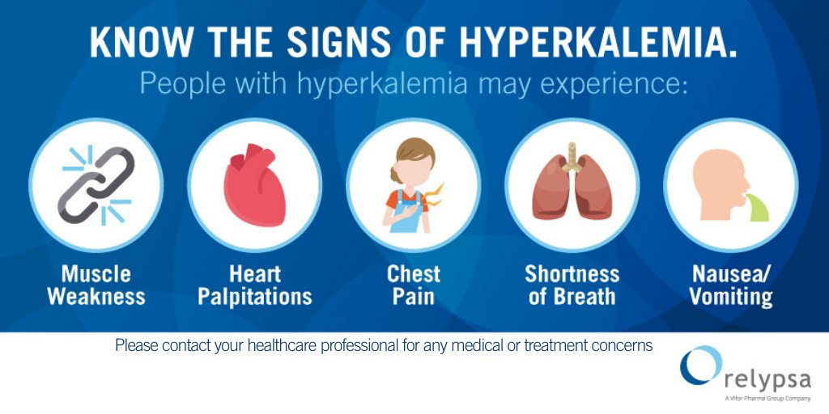
Symptoms of Hyperkalemia
→Mild : Asymptomatic . (K+ < 6 mmol/l)
→Sever : >6.5 mmol/L
(1) Gastrointestinal
Nausea , vomiting , colic , diarrhea.
(2) Neuromuscular
Hyper/HypoReflexia, weakness, paralysis , Respiratory failure.
(3) Cardiovascular
Arrhythmias , Arrest.
ECG changes (peaked T wave, flattened P wave, prolonged PR interval, widened QRS complex, ventricular fibrillation)

Slide 41
Hyperkalemia Correction:
→Mild :
Treated with reduction K intake
You can add loop diuretic and
Stop any medication that may cause hyperKalemia .
→Sever : ……

Slide 42
The Goals Of The Therapy :
1- Protect the cells from the effects of ↑ K+ ( Counteract cardiac effect ) :
Calcium gluconate 5 – 10 ml of 10% solution
2- Shifting K+ from EC to IC space :
Glucose 1 ampule of 50% dextrose and regular insulin 5 – 10 units I.V.
Salbutamol inhaler .
Bicarbonate 1 ampule I.V.
3- Reducing total body Potassium ( K+ Removal ) :
Kayexalate
Oral administration is 15 – 30 g in 50 – 100 ml of 20% sorbitol
Rectal administration is 50 g in 200 ml 20% sorbitol
Hydration with normal saline and loopdiuretic
Dialysis
Notes:
*K > 7 meq , ECG changes ---- calcium gluconate .
*Ca gluconate antagonises the effect of K on cardiac cells.
*Salbutamol : Beta agonist .
*Kayexalate ( Na polysterene sulphate plus sorbitol ) > exchange between Na and K then bind to sorbitol and excreted through feces.
*Dialysis : in case of sever not resolving hyperK or in the presence of renal failure .

Slide 43
Hypokalemia
Etiology of Hypokalemia
(1) Inadequate intake (rare)
Dietary, potassium free i.v. fluids, potassium-deficit TPN
(2) Excessive potassium Excretion
Hyperaldosteronisn
Medications (loop diuretics)
(3) Losses
GIT (diarrhea, vomiting, NGT)
Renal loss
Burns
(4) Intracellular shift
Metabolic alkalosis, insulin therapy, Refeeding syndrome
Notes:
persistant vomitting ---- 1) direct loss of K , 2) volume depletion ---- renal ( Na and water retention , k excretion ) , 3) metabolic alkalosis ( H+ out , K in )

Slide 44
Symptoms of Hypokalemia
Mild : Asymptomatic
Sever : < 3mmol/L
(1) Gastrointestinal
Ileus & constipation
(2) Neuromuscular
Decreased reflexes, fatigue, weakness, paralysis
(3) Cardiovascular
Arrest
ECG changes (Ectopy , T wave depression ,U wave)
Notes:
Symptoms mostly Cardiovascular

Slide 45
Hypokalemia Correction :
1- Mild or asymptomatic : ORAL repletion with potassium chloride
2- I.V repletion :
If required , not more than 10 mEq/h in unmonitored setting .
Can be increased to 40 mEq/h when accompanied by continuous ECG monitoring .
*Remember to correct hypomagnesemia first if present*
Notes:
IV Potasium is very irritant .

Slide 46
Calcium Abnormalities
99% of Ca is stored in bones and 1% circulates in blood
Normal Serum Calcium : 8.5 – 10.5 mg/dL
Serum Calcium exists in 3 forms:
(1)- Ionized (50%)
(2)- Protein bound (40%)
(3)- Complex with phosphate and other anions (10%)
Only free ionized Ca is physiologically active
Normal Ionized Ca level : 4.6 – 5.1 mg/dL
Notes:
Daily Ca intake 500-1000 mg daily .

Slide 47
Normal Ca metabolism is under the influence of PTH and Vit D .
When measuring the total serum Ca, the albumin concentration should be taken in consideration.
((Each 1 g/dL reduction in serum albumin will lower the total serum Ca by 0.8 mg/dL , w/o affecting the ionized Ca conc. ))
Unlike changes in albumin, changes in pH affect the ionized Ca concentration.
(( Acidosis decreases protein binding, thereby increasing the ionized Ca .
While alkalosis increases protein binding , which decreases ionized Ca levels. ))
Notes:
PTH promotes calcium resorption from bone and reclamation of calcium from the glomerular fi ltrate. Vitamin D increases calcium absorption from the intestinal tract.

Slide 48
Hypercalcemia
Increase in Ionized Ca or Total Serum Ca.
The Ionized Ca fraction is responsible for the neuromuscular stability and can be measured directly.
Hypercalcemia Etiology :
Primary hyperparathyroidism (outpatient)
Malignancy (associated bony metastasis or due to secretion of parathyroid hormone-related protein) (hospitalized patients)

Slide 49
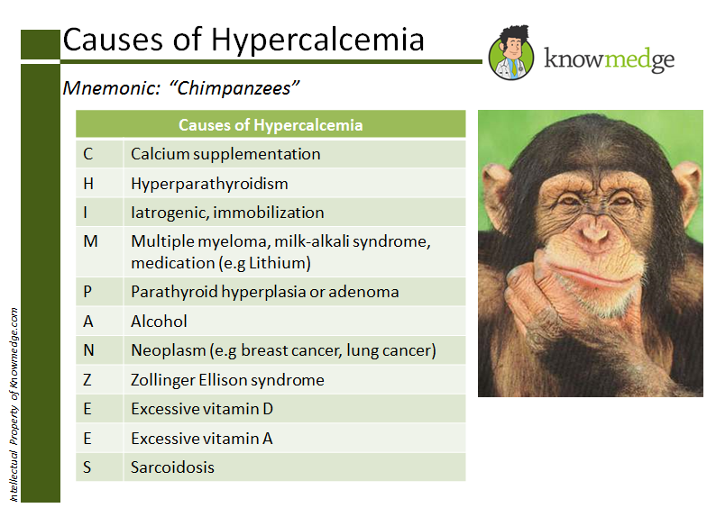
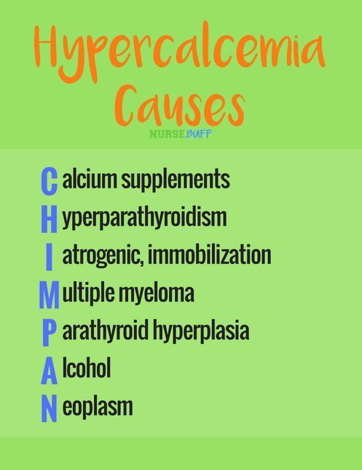

Thiazide
Mets

Slide 50
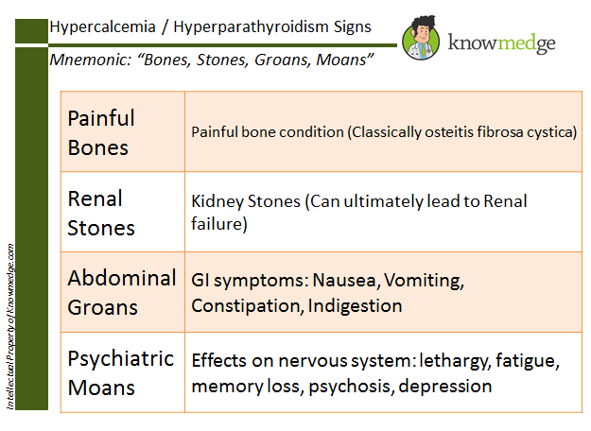
Signs And Symptoms :
Mild : Asymptomatic
Sever :
-Cardiac Effect:
HTN and
QT interval
Shortening.
Notes:
HTN : bz Ca work on Vascular Smooth muscle causing increase in peripheral resistance .
Short QT : due to decreased activity of depolarization ( decrease the time for Ca entry – plateau-) .

Slide 51
Hypocalcemia
Etiology:
1- Calcium Sequestration:
-Pancreatitis
-Massive Blood transfusion with citrate binding.
-Rhabdomyolysis and Tumor-lysis syndrome
-Massive soft tissue infections (necrotizing fasciitis)
-Increased osteoblastic activity as in prostate or breast ca.
2- Vit D deficiency
-Renal failure
3- Hypoparathyroidism
4-Post parathyroidectomy or thyroidectomy .
5-Abnormalities in Mg
Notes:
Mg depletion impairs PTH secretion and function .

Slide 52
Signs and Symptoms
Symptoms don’t occur until ionized fraction falls below 2.5 mg/dL .
(1) Neuromuscular
Hyperactive reflexes, Stridor , Tetany, Parasthesia, carpopedal spasm, seizures .
(2) Cardiovascular
Arrhythmias , Heart failure due to decreased cardiac contractility.
(3) ECG changes
Prolonged QT interval, T-wave inversion, heart block, ventricular fibrillation.
Notes:
Hypocalcemia is the primary cause of tetany. Low ionized calcium levels in the extracellular fluid increase the permeability of neuronal membranes to sodium ion, causing a progressive depolarization, which increases the possibility of action potentials.This occurs because calcium ions interact with the exterior surface of sodium channels in the plasma membrane of nerve cells. When calcium ions are absent the voltage level required to open voltage gated sodium channels is significantly altered (less excitation is required).[7] If the plasma Ca2+ decreases to less than 50% of the normal value of 9.4 mg/dl, action potentials may be spontaneously generated, causing contraction of peripheral skeletal muscles

Slide 53
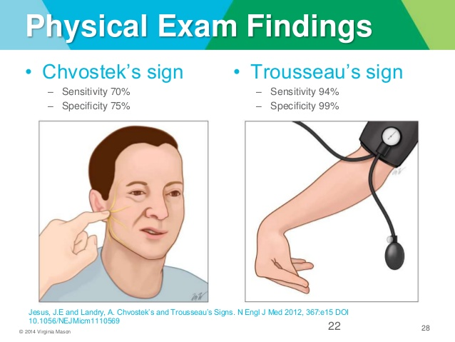
Chevostek’s sign: Twitching resulting from taping over the facial nerve
Trousseau’s sign: Spasm resulting from pressure applied to the nerves and vessels of the upper extremity, as when obtaining BP)
Notes:
Trousseau’s results in :
1- adduction of the thumb
2- Flexion at MCP joint
3- Extension at interphalengeal joint
4- Wrist flexion

Slide 54
Hypercalcemia Correction
If mild ( <12 ) : Calcium restriction and treat the underlying disorder.
If more sever:
  NS with Loop Diuretics
  Salmon calcitonin .
Hypocalcemia Correction
Asymptomatic: can be treated with oral or I.V. Ca Ca carbonate and Ca gluconate
Symptomatic: should be treated by I.V. Ca Ca chloride (10 ml calcium of 10% calcium gluconate within first 10 min then maintenance with 1-2 ml/h) .
Don’t forget to check the levels of Mg, Phosphorus, K
Notes:
NS= Normal saline
#Other lines of ttt for hyperCa is calcitonin > in malignancy or primary hyperparathyroidism.
# Calcium ttt for hypOcalcemia :
ORAL: you have Ca carbonate and Ca gluconate
IV: Ca chloride have contains three times more of elemental calcium than Ca gluconate.

Slide 55
Magnesium Abnormalities
Mg is the 4th most common mineral in the body and is found primarily in the intracellular compartment
Normal Range : 1.3 – 2.2 mEq/L.
Of the fraction found in the EC space, 1/3rd is bound to serum albumin, therefore, serum Mg is poor indicator of total body stores in the presence of hypoalbuminemia
The kidneys play the major role in regulating Mg .
Mg should be maintained at the upper limit of normal > to prevent QT interval prolongation and arrythmias.
Notes:
Normal dietary intake is approximately 20 mEq (240) daily and is excreted in both feces and urine.
To prevent hypomg in a hospitalized pt : give 0.35-0.45 mEq/L/Kg of Mg daily.

Slide 56
Hypermagnesemia
Rare,
Can be seen with impaired renal function
Causes:
1- Iatrogenic : Excess intake (TPN, Mg containing laxatives & antacids).
2- Renal failure .
Mild Hypermagnesemia : Asymptomatic

Slide 57
Symptoms of Hypermagnesemia
(Sever >8mEq/L)
(1) Gastrointestinal
Nausea & vomiting
(2) Neuromuscular
Decreased reflexes, Weakness of muscles, lethargy
(3) Cardiovascular
Hypotension & sinus bradycardia ,Arrest
(4) ECG changes
Similar to those seen in hyperkalemia.
(Prolonged PR, QRS, QT intervals).

Slide 58
Hypomagnesemia
Causes:
(1) Poor intake (Rare)
Starvation, alcoholism, prolonged use of I.V. fluid & TPN with inadequate supplementation of Mg.
(2) Increased renal excretion
(alcohol, most diuretics as loop , primary hyperaldosteronism , Drugs as amphoterecin B, aminoglycosides or cyclosporine )
(3) GIT losses (diarrhea)
Malabsorption, acute pancreatitis, diabetic ketoacidosis.
(4) Shift from EC to IC space
With MI , alcohol withdrawal, or after receiving glucose saline .
(5) Post parathyroidectomy .
Notes:
**Common problem in hospitalized patients ( ICU) .
**Most cases are due to renal or GI losses.
**After parathyroidectomy for hyperparathyroidism, the redeposition of calcium and Mg 2 + in bone may cause dramatic hypocalcemia and hypomagnesemia

Slide 59
Symptoms of Hypomagnesemia
(1) Neuromuscular
Neuromuscular and nervous system hyperactivity & symptoms similar to those Hypocalcemia.
(2) Cardiovascular
Arrhythmias (As Hypokalemia)
(3) ECG changes
Prolonged QT & PR intervals, ST segment depression, flattening or inversion of P waves.
Notes:
Symptoms of hypomagnesemia are predominantly neuromuscular and cardiovascular

Slide 60
Hypomagnesemia is usually accompanied by hypokalemia and hypophosphatemia.
Hypomagnesemia is important not only for its direct effects on the nervous system but also because it can produce hypocalcemia and leads to persistent hypokalemia.
When hypokalemia or hypocalcemia coexist with hypomagnesemia, Mg should be aggressively replaced to assist in restoring K or Ca homeostasis.

Slide 61
Hypermagnesemia Correction
prevent exogenous sources
Calcium gluconate 10%
Normal saline with loop diuretics
Dialysis
Hypomagnesemia Correction
Mild/Asymptomatic : Oral supplement.
Sever ( <1 mEq/L) / Symptomatic: IV MgSO4
Notes:
*HyperMg:
Ca Gluconate : (10-20ml over 5-10 min IV) in the presence of lifethreatining symptoms to antagonize the effects of Mg 2 + .
*A 0.9% NaCl (250 to 500 mL/hour) infusion with loop diuretic (furosemide, 20 mg intravenously every 4 to 6 hours) in the patient with intact renal function promotes renal elimination
*Dialysis is the definitive therapy in the presence of intractable symptomatic hypermagnesemia.
# HypoMg :
In cases of life-threatening arrhythmias, 1 to 2 g (8 to 16 mEq) of MgSO 4 can be administered over 5 minutes, followed by a continuous infusion of 1 to 2 g/ hour for the next several hours. The infusion subsequently can be reduced to 0.5 to 1 g/hour for maintenance.
→ In case of oral ttt > Magnesium oxide / magnesium gluconate / magnesium chloride.

Slide 62
Thank You !

