Slide 1
COMMON ENDOCRINE PTHOLOGIES

Slide 2
The normal parathyroid gland weighs up to 50 mg with a characteristic orange/brown color.
Most adults have four parathyroid glands but supernumerary glands occur.
Superior gland comes from 4th pharyngeal pouch.
Inferior gland comes from 3rd pharyngeal pouch.

Slide 3
Usually these glands are posterior to the thyroid glands but are not attached to it.
Superior parathyroid glands have more constant location because of their embryological origin (4th pharyngeal pouch ).
The inferior parathyroid glands have more risk of developing ectopic location because of the longer pathway of migration from its embryological origin (3rd pharyngeal pouch).

Slide 4
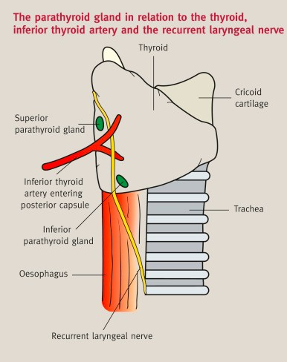
usually the location of the parathyroid glands is at the intersection between the recurrent laryngeal nerve and the inferior thyroid artery , the superior ones are 1 cm above this point, dorsal to the nerve , the inferior ones on the other hand is 1 com below this point and ventral to the nerve.

Slide 5
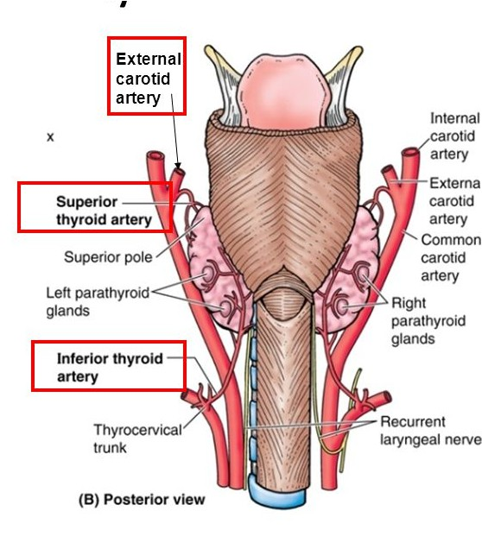
Blood Supply
Shares the same blood supply, venous drainage, and lymphatic drainage as the thyroid gland
Inferior thyroid artery
Collateral blood supply is delivered by superior thyroid artery

Slide 6
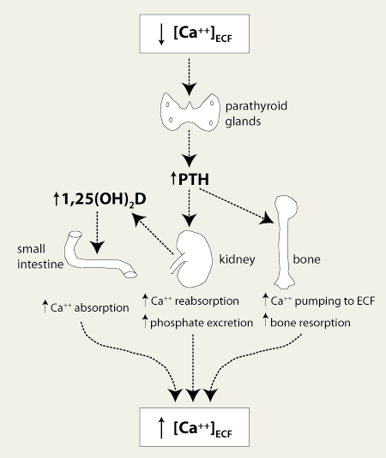
Physiology
Calcium Homeostasis
▪
▪
▪
mainly parathyroid gland vitamin D
calcitonin
▪
Ionized 50%
Bound to albumin 40% Bound to anions 10%
Parathyroid glands ➔ Chief cells ➔ Parathyroid hormone (PTH)
Calcitonin secreted by the thyroid gland is responsible for lowering serum Ca++ level
▪
▪

Slide 7
Pathology
Hypo-parathyroidism >> (post-Thyroid surgery, Congenital).
hyper-parathyroidism.
a.Primary. b.Secondary. c.Tertiary.

Slide 8
Hypoparathyroidism
Hypoparathyroidism = hypocalcemia
Q) What is the most common cause?
Iatrogenic!
Mostly iatrogenic; post thyroidectomy, usually total thyroidectomy
It is either due to an injury to the glands itself, an injury to the superior or inferior thyroid artery leading to an ischemic injury, or accidental removal when the gland is adherent to the thyroid capsule

Slide 9
Types of hyperparathyroidism :
▪
Primary hyperparathyroidism.
Secondary hyperparathyroidism.
Tertiary hyperparathyroidism.

Slide 10
Primary Hyperparathyroidism
Primary lesion leading to hyperfunctioning and thus hypercalcemia
1) Single gland adenoma, the most common 2)parathyroid gland hyperplasia, this is seen in MEN1 and MEN 2 A ( multiple endocrine neoplasia syndrome) ¬ Least common cause is ca of the gland.
4) Parathyroid gland carcinoma, the least common
If we measure the PTH and serum Ca++, what
would the result be?
  High PTH and high serum Ca++
(normal PTH = 10-65 pg/mL, normal serum Ca++ = 8.5-10.2 mg/dL)

Slide 11
A pt has 12mg/dl calcium levels and 300 mg/dl PTH >> primary hyperparathyroidism , what is the
management ?
▪
▪
I need to determine the cause and localize the lesion , so I do two things :
Ultrasonography
Sestamibi scan : nuclear scanning of the parathyroid
▪
▪
▪
▪
The diseased parathyroid gland will have increased uptake > And this allows me to know what parathyroid gland of the four glands is diseased without the need to open the neck to detect the diseased ones.
- sensitivity is high , so if it detected right inferior gland lesion, we remove it.
▪

Slide 12
Primary Hyperparathyroidism
▪
It is best treated by surgically removing the abnormal gland by the minimally invasive video assisted parathyroidectomy procedure (MIVAP)
Check PTH level intraoperatively after removing the diseased gland
▪
▪
Usually inherited alone in autosomal dominant or as part of a syndrome; MEN
Treated by removing all three glands and half of the fourth or removing all four and implant one either in brachioradialis or sternocleidomastoid
▪
Is it possible to have a primary four gland disease?
  Yes, but never due to adenoma. It’s called
hyperplasia

Slide 13
How would you make sure intraoperatively that you have removed al the diseased glands ?
T1/2 of PTH is 5 minutes
So measure it after 1 half life :
If normal (10-55) >> close
If decreased by 50% (from 200 to 100 for example ) wait for another 5 minutes ( it should decrease by
another 50%)
You have the right to wait for 4 half lives till the PTH normalize

Slide 14

Indications of Surgery in Asymptomatic Primary Hyperparathyroidism
Serum Ca++: 1.0 mg/dL or more above upper normal limit
Skeletal:
  BMD by DXA: T-score <–2.5 (osteoporosis) and/or
  Vertebral fracture
Renal:
GFR <60 mL/min
24-h urine Ca++ >400 mg/dL and increased stone risk
Presence of nephrolithiasis or nephrocalcinosis
Age: <50 years
▪
▪
▪
Guidelines for the management of asymptomatic primary hyperparathyroidism: summary statement from the Fourth International Workshop. J Clin Endocrinol Metab 2014; 99:3561

Slide 15
Secondary Hyperparathyroidism
Compensatory event due to low levels of Ca++
Q) What are the most and second most common
A) Chronic renal failure and Vitamin D deficiency, respectively
Q) If we measure the PTH and serum Ca++, what would the result be?
A) High PTH and normal or low serum Ca++
causes?

Slide 16
Indications of Surgery in Secondary Hyperparathyroidism
▪
▪
▪
Patient preference
Medical observation not possible
Symptomatic patients with PTH >800 pg/mL despite optimal medical therapy
Hypercalcemia and hyperphosphatemia
Symptoms of bone pain, pruritus, and pathological fractures
Calciphylaxis (calcific uremic arteriolopathy)
Asymptomatic patients
Selected ESRD patients with PTH
>1000 pg/mL that is refractory to medical therapy (depending on age and comorbidities)
▪
Secondary and Tertiary Hyperparathyroidism, State of the Art Surgical Management. Susan C. Pitt, Rebecca S. Sippel, Herbert Chen. 2009 Oct; 89(5): 1227–1239

Slide 17
Tertiary Hyperparathyroidism
Secondary hyperparathyroidism that gets corrected
Q) Example?
Chronic renal failure patients to whom you transplant a new kidney.
A patient has secondary hyperparathyroidism due to renal failure , then the patient had kidney transplant but then the compensatory process cannot make negative feedback inhibition to restore normal state so there will be autonomous activation of the parathyroid glands.

Slide 18
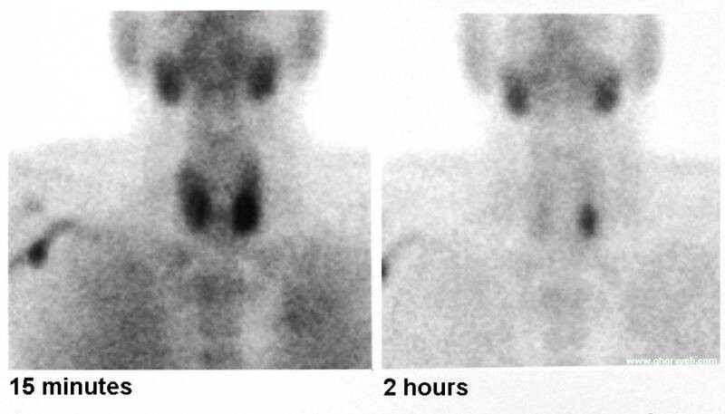
Investigations
Serum Ca++, Vitamin D, PTH, and KFT.
Neck U/S
+
Sestamibi scan

Slide 19
Things to remember
May be 3, 4, 5, or 6 glands
95% cure in primary
3% ectopic
2-3% double adenomas
85% of missed glands are in the neck

Slide 20
Where are the missed glands?
Para-oesophageal 28%
Mediastinal 26%
Intra-thymic 24%
Intra-thyroidal 11%
Carotid sheath 9%
High cervical 2%

Slide 21
Is there a four gland disease ?
Yes , it is termed hyperplasia and only seen in AD familial hyperparathyroidism or MEN1 , MEN2A syndromes
RX: subtotal parathyroidectomy or total with implantation of a small piece in the forearm or the SCM.

Slide 22
Don’t forget MEN!
MEN I
MEN IIa
MEN IIb

Slide 23
Don’t forget MEN!
MEN I:
Pituitary,Pancreas,Parathyroid
MEN IIa:
MTC, Pheochromocytoma, Parathyroid
MEN IIb:
MTC,Pheochromcytoma,Neurofibroma

Slide 24
Thank you *-*

