Slide 1
PEDIATRIC SURGICAL EMERGENCIES
Othman Badran
Aya Hassan
Roa’a Ghanem

Slide 2
is a life threating condition for which immediate surgical intervention is the only way to solve the problem successfully.

Slide 3
Acute Scrotum
Acutely painful +/- swelling +/- red scrotum
Causes:
▪ Testicular Torsion
▪ Epididymo-orchitis (commonest for postpubertal boys)
Torsion of Appendages
▪ Other conditions e.g. Incarcerated hernia

Slide 4
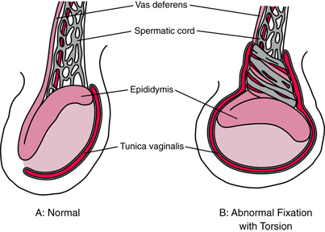
Torsion of the testis
Testicular torsion is when the spermatic cord to a testicle twists, cutting off the blood supply
most common in peripubertal (12-18 years) but may occur at any age, including the perinatal period
risk factors: undescended testicle, bell clapper’s deformity.

Slide 5
Symptoms
acute onset of diffuse testicular pain , vomiting
Signs
Swollen, red hemiscrotum , affected testis may have a horizontal lie, lies higher than contralateral testis
absent or decreased cremasteric reflex
Negative Prehn's sign: no pain relief with lifting the affected testicle
Fever and urinary symptoms are absent((Their presence is more indicative of epididymitis))

Slide 6
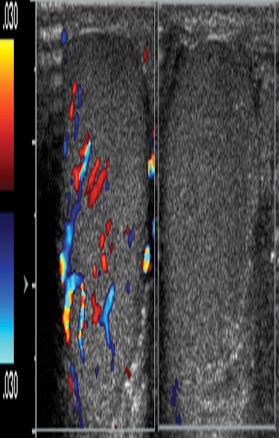
Investigations
Doppler ultrasound scan of the scrotum :
absence of blood flow in the twisted testicle
Timing is critical 4 - 6 hours ▪ Exploration if any doubt
Ttt:
Surgical treatment , untwist and fixation , asses viability
Orchiopexy for contralateral testis
If more than 12 hours, it is likely to be non-viable and may need orchiectomy

Slide 7
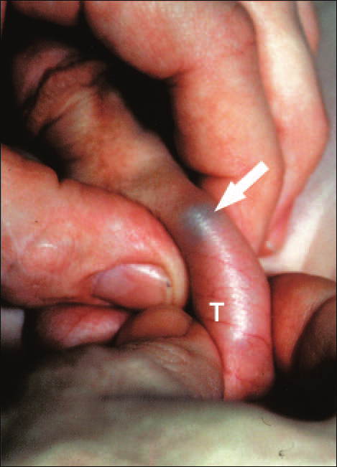
Torsion of the appendage of the testis
occurs in children aged 7-14 years.
poses no threat to health
  The pain is located in the superior pole of the testicle. focal point of pain on the testicle is uncommon in complete testicular torsion.
Systemic symptoms are absent. Nausea and vomiting
Blue dot sign
Vertical orintation of the
testes is preserved
cremasteric reflex is usually
intact

Slide 8
Doppler ultrasound
normal blood flow to the testis
treated conservatively; NSAIDs and ice are the mainstays of therapy
operative if torsion cannot be excluded

Slide 9
Epididymo-orchitis inflammation of epididymis & Testis due to infection or trauma ( Chlamydia trachomatis and Neisseria gonorrhoeae )
14 and 35 years of age are most often affected
Gradual onset of pain in a hemiscrotum
Commonly associated with fever and UTI (urinary symptoms )
Pain relief by elevation of hemiscrotum Prehn’s sign
The cremasteric reflex remains normal
Doppler Scan: Excessive blood flow
treated conservatively with antibiotics and anti-inflammatory drugs

Slide 10
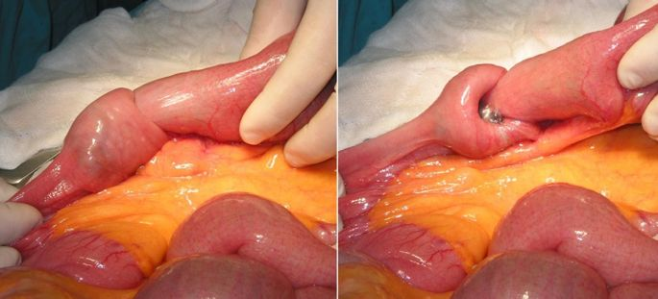
Intussusception
• Telescoping of bowel
It refers to the condition whereby a proximal segment of intestine becomes drawn into the lumen of the adjacent distal bowel.
Most common cause of small bowel obstruction in toddlers
Most common site (ileo-cecal)

Slide 11
Caused usually by:
– Hypertrophied Peyer Patches (submucosal lymphoid tissue) due to prior viral infection
Idiopathic intussusception occurs in children between the ages of approximately 6 and 24 months of age. Beyond this age group, one should consider the possibility that a pathologic lead point may be present. These include polyps, malignant tumors such as lymphoma, enteric duplication cysts, or Meckel’s diverticulum

Slide 12
Presentation
A previously healthy child, who suddenly comes with acute abdominal
pain (colicky in nature). The pain lasts for seconds then disappears, then
appears again. In between the
attacks, the child is healthy looking.
Blood in the stool (Redcurrant jelly stool).
Alternating Lethargy and irritability
Vomiting

Slide 13
o Diagnosis:
▪ Clinical features: the typical presentation is a previously healthy child with
acute attack of colicky abdominal pain associated with vomiting and blood
in the stool
▪ Plain X-ray: first investigation to exclude intestinal obstruction
▪ Ultrasound: to show two lumens inside each other
▪ Barium enema: diagnostic as well as therapeutic

Slide 14
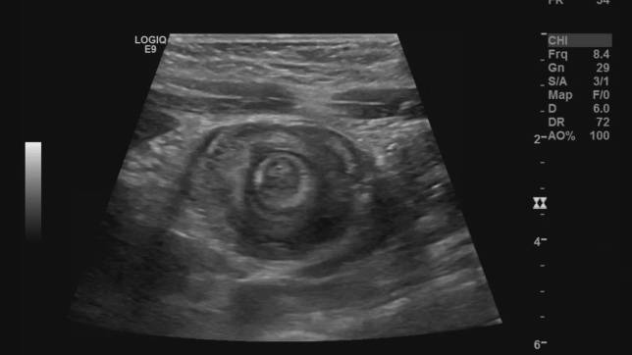
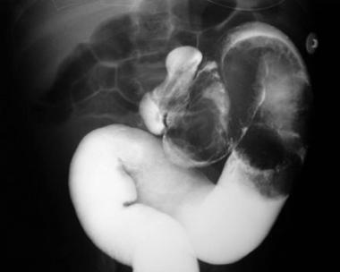
Target sign
Contrast enema for diagnosis and treatment

Slide 15
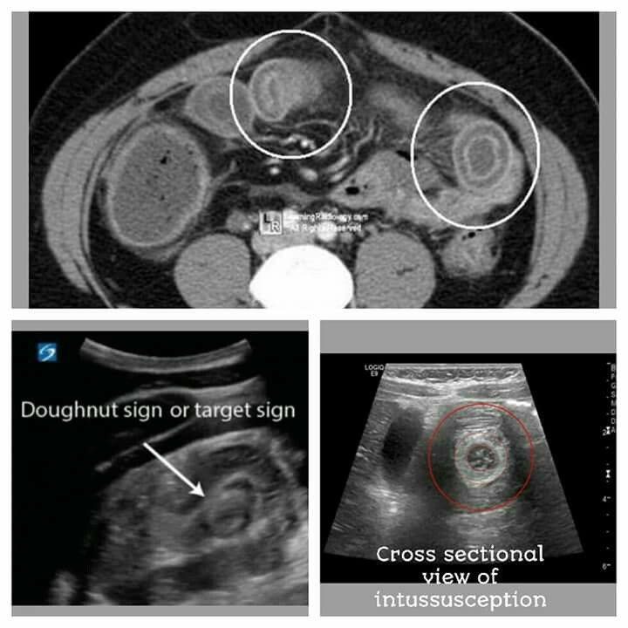

Slide 16
MANAGEMENT
.Intial steps: nasogastric decompression and fluid resuscitation
Nonsurgical management (performed under continuous ultrasound or fluoroscopic guidance) ^{[7]}
Air enema: treatment of choice
gas is introduced through a
catheter under pressure control. Pressure does not exceed
90-110 mmHg. The pressure introduced distally to
proximally will reduce the intussuception
  Hydrostatic reduction: normal saline (or water-soluble contrast enema)

Slide 17
Operative:
o Indications:
▪ Peritonitis
▪ Sepsis
▪ failure of the conservative treatment
▪ Recurrence (5%)
▪ When there is a leading point
o Procedure:
▪ Manual reduction of Intussuception.
▪ Look for a leading point
▪ Resection if:
• unable to reduce the lntussuception
• there is a gangrenous bowel segment
• presence of a leading point.
o Prognosis
▪ In infants: Excellent
▪ Older age: depends on the underlying pathology.

Slide 18
Necrotizing Enterocolitis
Disorder involving inflammation and ischemic necrosis of intestinal walls. ( progressive disease )
NEC may involve single or multiple segments of the intestine, most commonly the terminal ileum, followed by the colon
Necrotizing enterocolitis (NEC) is the most frequent and lethal gastrointestinal disorder affecting the intestine of the stressed, preterm neonate.
Over 25,000 cases of NEC are reported annually.
The overall mortality ranges between 10% and 50% (inversely related to gestational age and birth weight).
Males = Females

Slide 19
Multiple risk factors have been associated with the development of NEC.
Prematurity
VLBW Infants
Enteral Feeding
Bacterial overgrowth
Hyperosmolarity of solution

Slide 20
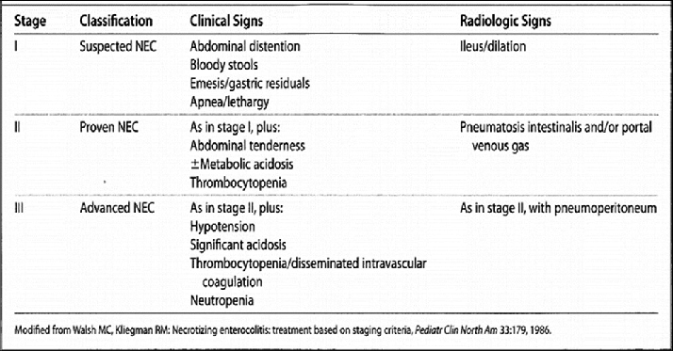
bell's criteria for necrotising enterocolitis

Slide 21
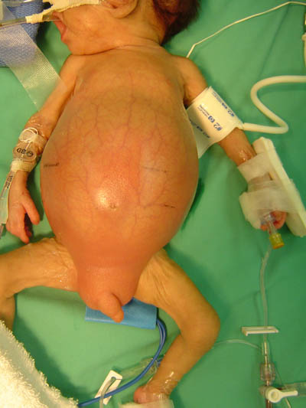
Clinical findings
Dull, dusky-colored, distended abdomen
• Symptoms of sepsis (temp instability, poor perfusion, lethargy)
• Large, bilious residuals
• Bloody stool
• Hypoactive/absent bowel sounds
• Abdominal tenderness

Slide 22
Initial work up
Labs: Findings associated with NEC
• CBC – Thrombocytopenia – Neutropenia (<1500/microL) –poor prognosis
• DIC panel (PT/INR, PTT, Fibrinogen, D-dimer)
– Elevated PT/INR, PTT, D-dimer
– Decreased Fibrinogen
• BMP (may have values similar to those found in sepsis)
– Hyponatremia (<130)
– Hyperglycemia
– Hyperkalemia
• Blood gas – Metabolic acidosis
• Blood culture
• Fecal occult blood test

Slide 23
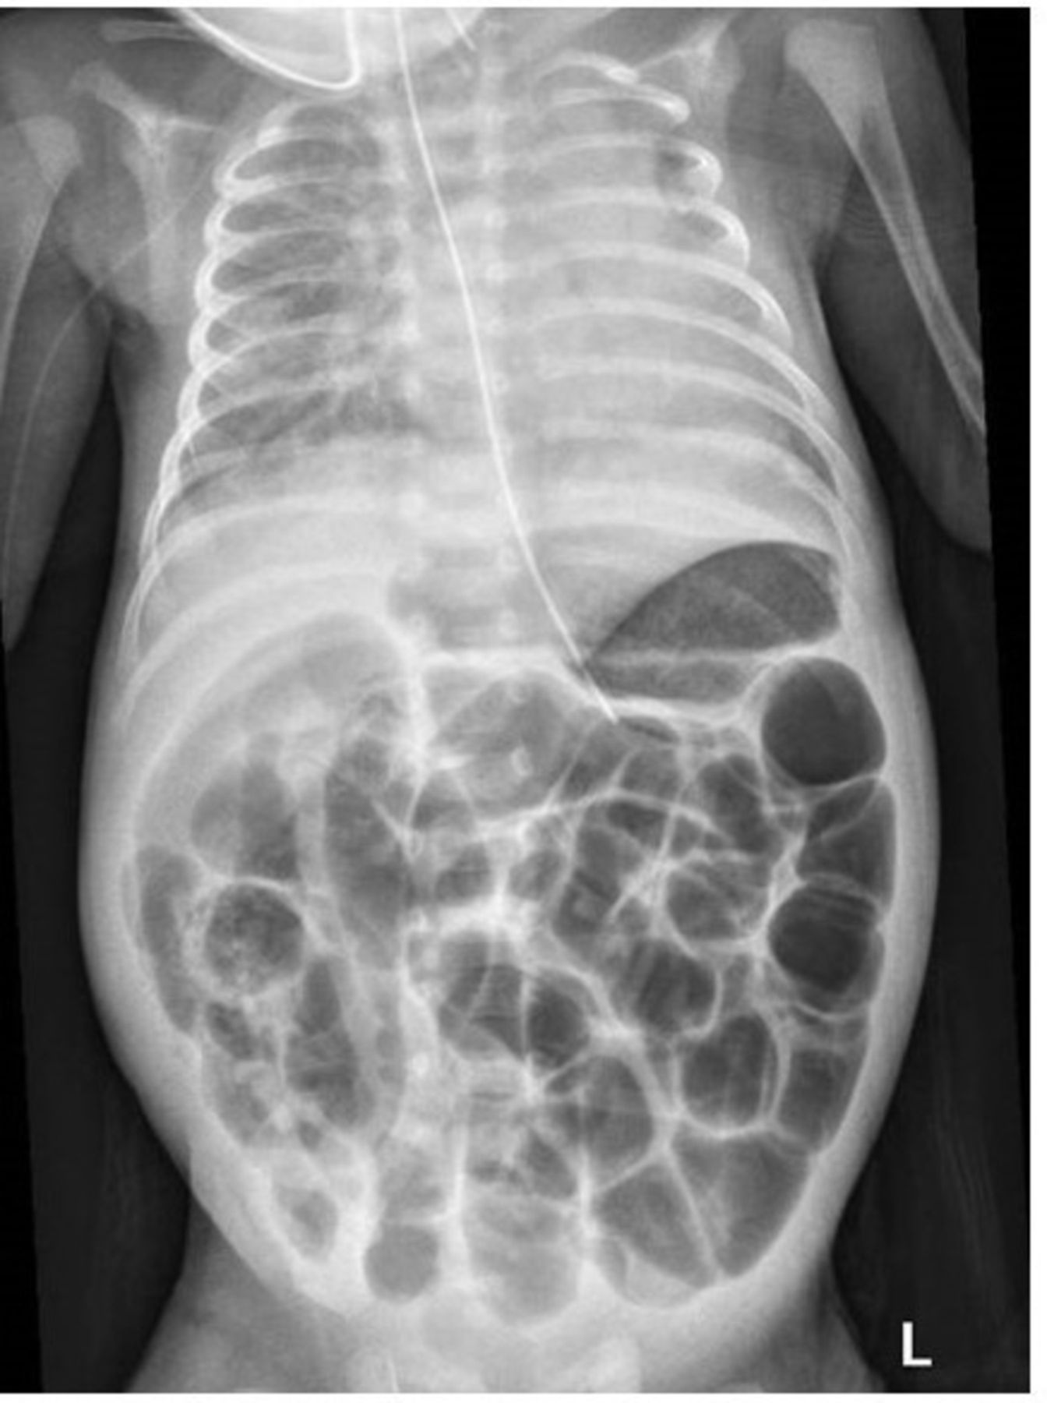
Abdominal radiography
The mainstay of diagnostic imaging
An AP and a left lateral decubitus view are essential for initial evaluation
Should be performed serially at 6-hour or greater intervals, depending on presentation acuity and clinical course, to assess disease progression
If the infant does not tolerate being moved and pneumoperitoneum is suspected, a supine cross-table lateral view is substituted.
Pneumatosis intestinalis – Pathognomic of NEC

Slide 24
Medical management (10-14 days)
Make NPO, start on IVF (consider TPN).
• Insertion of nasogastric tube to suction for decompression
• Empiric antibiotics – Ampicillin, gentamicin – Clindamycin and/or flagyl are often added for severe cases
• Cardiovasculatory/pulmonary support as needed
• Pediatric surgery consultation
• Lab/radiologic monitoring:
– Q6-8 hours while patient remains acutely ill
• Check urine output every 1-2 hours – If low, give 10-20ml/kg/hr NS

Slide 25
Surgical management
• Absolute indication for surgery
– Pneumoperitoneum
• Relative indication for surgery
– failure to improve
– progressive thrombocytopenia
– Portal vein gas
– Severe peritonitis
• Surgical intervention
– Peritoneal drainage
– Laparotomy with resection of affected bowel.

Slide 26
Prognosis
With aggressive treatment and earlier diagnosis, 70-80% of infants survive.
• Infants requiring surgical intervention have a higher mortality rate
• About half of survivors have no long-term sequelae.
• Long term sequelae:
– Stunted growth
– Short gut syndrome / intestinal adhesions (in patients requiring extensive resection.
– ELBW and infants with extreme prematurity may also have developmental delay

Slide 27


