Slide 1



Approach to head and neck masses

Slide 2

THE HISTORY OF SWELLINGS IN THE NECK
Age, sex, work ..
Duration
Painful or Painless?
Progression?
Associated URTI
Trauma ? Recent bites?
Discharge or epistaxis ?
Local symptoms
Systemic symptoms
Personal or Family history?
Ca history other places?

Slide 3
THE EXAMINATION OF SWELLINGS IN THE NECK
Mass Examination
Site and number
Shape and size
Color
Temperature
Tenderness
Composition and consistency
Relations to muscles, trachea and hyoid bone
Pulsatile ? Bruit ?
Change with swallowing ?
General examination

Slide 4
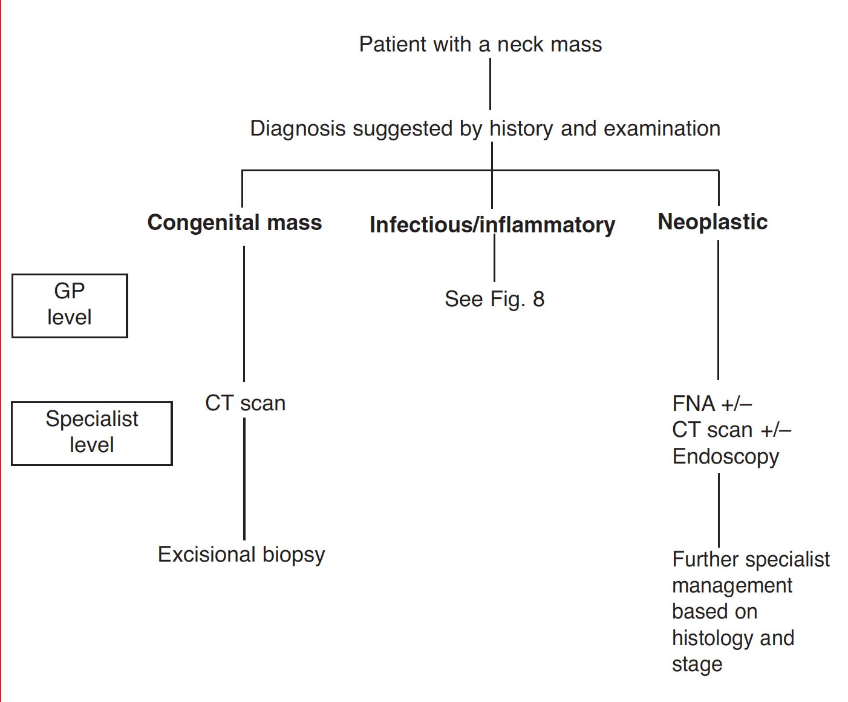

Slide 5
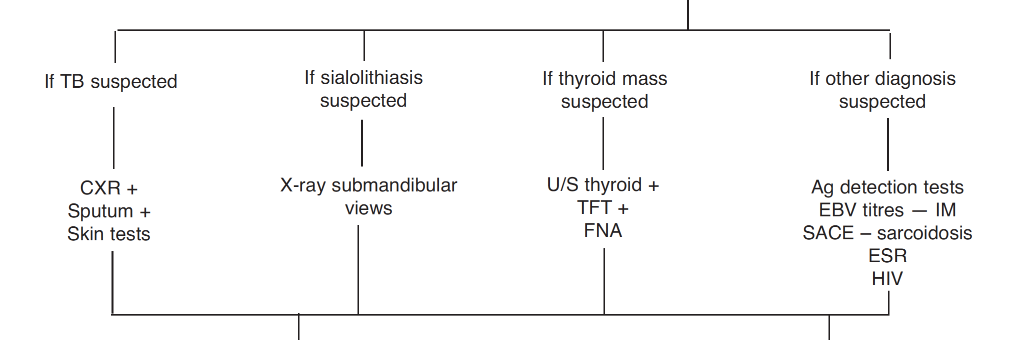

Slide 6




Know 2 things: Exclude 2 things:
OUR APPROACH
Anatomy, major structures & LNs of the neck
Infectious Masses
Pathologies that may arise
from each structure
Malignant Masses
Categorize into :
Congenital
Inflammatory
Neoplastic
Other

Slide 7
Other Masses
Vascular masses
Traumatic masses
Metabolic masses and Auto-imune conditions
Thyroid gland masses
Salivary gland masses
ParaPharyngeal masses

Slide 8

QUICK ANATOMICAL REVIEW

Slide 9

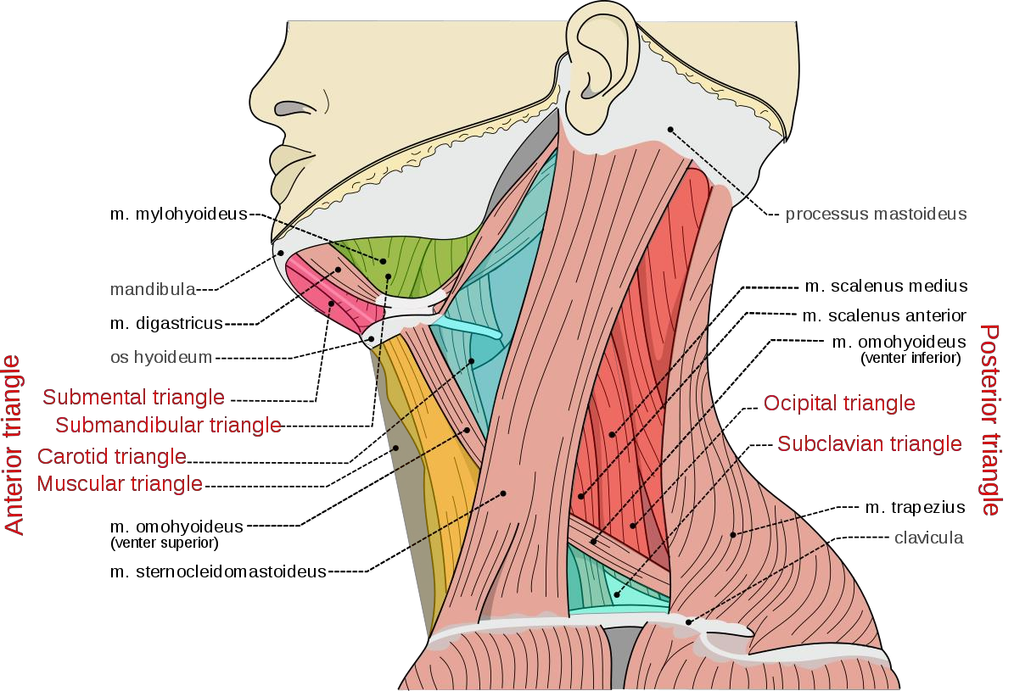


Slide 10
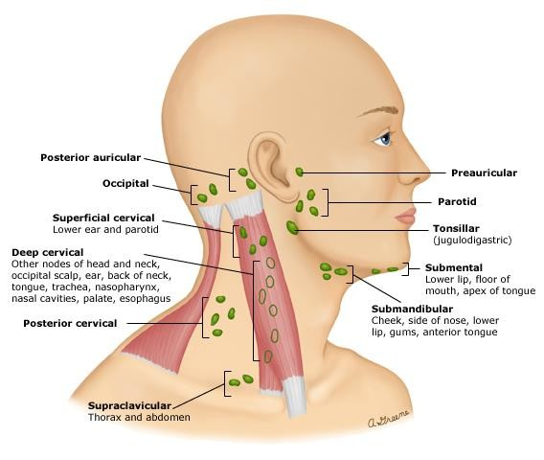

Slide 11
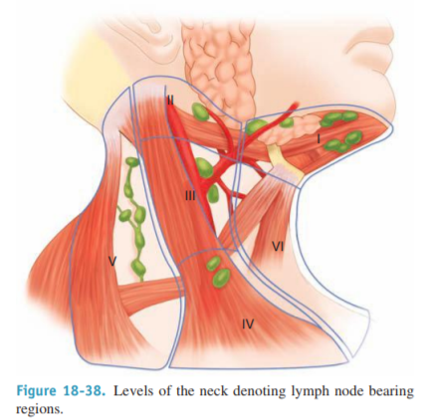


Slide 12

EXCLUDE OR TREAT BACTERIAL INFECTION
Infectious etiologies of a neck mass are suspected based on a history of the mass developing within a few days or weeks of an upper respiratory infection, dental infection, trauma, travel, or exposure to certain animals, or based on one of the following physical findings :
Warmth or erythema of the overlying skin, swelling or tenderness to palpation of the mass.
Fever, tachycardia, or other systemic signs of infection.
Rhinorrhea, odynophagia, otalgia, odontalgia, or other symptoms of a head and neck infection.

Slide 13
EXCLUDE MALIGNANCY
Malignancy is the greatest concern in adult patients with a
neck mass.
A malignant neck mass should be suspected based on the following "stand-alone" features detected by the initial history and physical exam :
History
Lack of an infectious etiology
Physical examination:
Size >1.5 cm
Duration of ≥2 weeks or unknown
Firm texture to palpation
Fixed or reduced mobility
Ulceration of overlying skin

Slide 14
The most common cause of a swelling in the neck is an enlarged lymph gland, and the most common causes of such enlargement are infection and secondary tumour deposits.

Slide 15
Superficial multiple swelling

Slide 16
CERVICAL LYMPHADENOPATHY
Enlargement of the cervical lymph glands is the most common cause of a swelling in the neck.
The diagnosis of lymphoadenopathy caused by systemic illness such as glandular fever, toxoplasmosis and sarcoidosis depends on finding lymphoadenopathy elsewhere, on other evidence of the underlying disease and on special blood tests

Slide 17
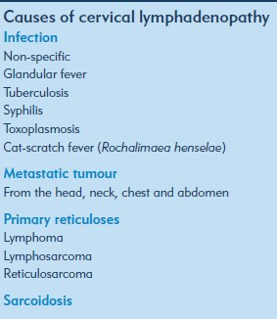

Slide 18


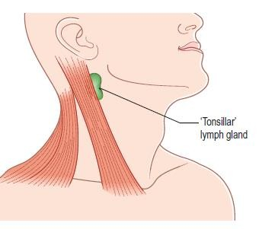
NON-SPECIFIC CERVICAL INFLAMMATORY
LYMPHADENOPATHY
Non-specific inflammatory lymphadenopathy commonly follow recurrent bouts of tonsillitis, especially if the attack have been treated inadequately.
Reactive viral lymphadenopathy is the most common cause of cervical lymphadenopathy, especially in children. Typically, viral lymphadenopathy arises in the setting of routine upper respiratory infections caused by adenovirus, rhinovirus, or enterovirus.

Slide 19
On history and physical examination
AGE : When associated with tonsillitis, the majority of ages below 10 years, other reactive conditions can occur at any age
Local symptoms : painful lump just below the angle of the jaw, the child may snore at night, have difficulty in breathing,have nasal speech because of tonsillar and adenoid hyperplasia
Systemic symptoms : when the lump is tender the patient often feels ill, has a sore throat and pyrexia

Slide 20
Examination
Position Lymph from the tonsils drains to the upper deep cervical lymph glands. The gland just below and deep to the angle of the mandible is often called the tonsillar gland
Tenderness If the infection is active, the enlarged glands will be tender.
Shape and size The tonsillar gland is usually spherical and approximately 1–2 cm in diameter. It is rarely bigger than this.
Composition and relations Each gland is firm in consistency, solid, discrete, tender and not very mobile.
Local tissues The tonsils are likely to be enlarged and hyperaemic. Pus may be seen exuding from the surface crypts.
General examination Look for the presence of enlarged lymph glands elsewhere. None should be enlarged.

Slide 21
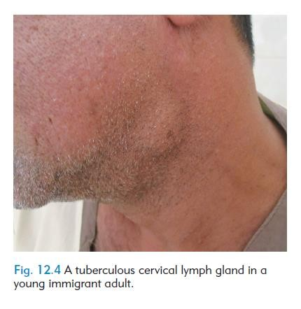
TUBERCULOUS CERVICAL LYMPHADENITIS
The human tubercle bacillus can enter the body via the tonsils, and from there move to the cervical lymph glands.
The upper deep cervical glands are most often affected. There is no generalized infection, so there is little systemic disturbance of health

Slide 22
On history and physical examination
Age and ethnic groups Tuberculosis lymphadenitis is common in children, young adults and the elderly
Symptoms The patient complains of a lump in the neck. This appears gradually with or without pain. The pain can be intense if the glands grow rapidly and necrosis.
Systemic symptoms are unusual in the young, but the elderly sometimes have anorexia and slight weight loss.
If the glands break down into an abscess, the swelling increases in size, becomes more painful, and the patient notices discoloration of the overlying skin.

Slide 23
On examination
The signs of tuberculosis lymphadenitis
Position The upper and middle deep cervical glands are most often involved
Temperature The mass of glands does not feel hot.
Tenderness The glands are often slightly tender, but pain is not a prominent feature.
Color If there is no abscess present, the overlying skin should look normal.
Shape, size and consistency In the early stages, the glands are firm, discrete and between 1 and 2 cm in diameter
General examination In tuberculosis lymphadenitis, there are often no systemic abnormalities, but when a tuberculosis abscess develops, there may be tachycardia, pyrexia, anorexia and general malaise.

Slide 24
CARCINOMATOUS LYMPH GLANDS
Malignant metastatic deposits in the cervical lymph glands are the most common cause of cervical lymphadenopathy in adults.
The primary tumour is most often in the buccal cavity (tongue, lips and mucous membrane) and larynx, but every possible primary site must be examined when cervical glands are enlarged by secondary deposits, including the skin.

Slide 25

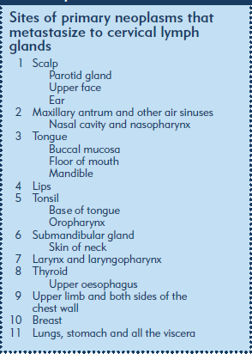
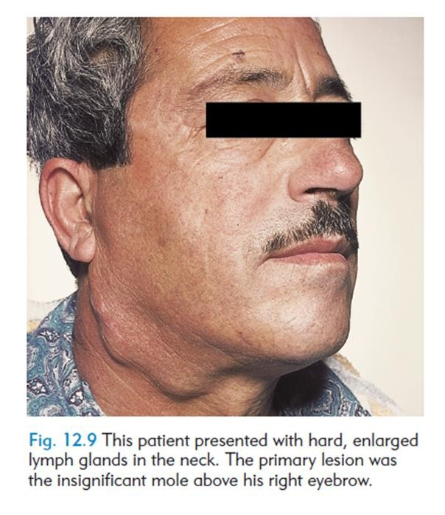

Slide 26
On history and physical examination
Age : Most head and neck cancers occur in patients over the age of 50 years.
Sex : Most of the head and neck cancers, other than those of the thyroid, are more common in males than females.
Local symptoms: The patient complains of a painless lump in the neck.
General symptoms: The patient may have symptoms from the primary lesion in the head or neck, such as a sore tongue, a hoarse voice or a separate lump in the neck such as in the thyroid or salivary glands.

Slide 27
On examination
Site: The site of the affected glands gives a crude indication of the site of the primary. Lesions above the hyoid bone drain to the upper deep cervical glands. The larynx and thyroid drain to the middle and lower deep cervical glands. An enlarged supraclavicular lymph gland commonly indicates intra-abdominal or thoracic disease.
Color The overlying skin is a normal color unless the mass is so large that it stretches or infiltrates the skin, which makes it pale or blotchy red .
Temperature The skin temperature will be normal unless the tumor is very vascular.
Tenderness Glands containing secondary deposits are usually not tender.
Shape and size Glands containing metastases vary in size and shape. At first the glands are smooth, discrete and vary in size. As they grow, they may coalesce into one large mass.

Slide 28
Composition : Glands containing tumour are hard, often stony hard.
Relations : The glands are tethered to the surrounding structures, so they can usually be moved in a transverse direction but not vertically. Secondary cancer is more common in the glands of the anterior than the posterior triangle.
General examination Examine all the sites that might contain the primary lesion in particular:
● the skin of the scalp, the ear and the external auditory meatus;
● the lips, tongue, buccal mucous membrane and tonsils;
● the nose, maxillary antra and nasopharynx;
● the thyroid gland; ● the salivary glands;
● the skin of the upper limb;
● the breasts;
● the lungs;
● the stomach, pancreas, ovaries and testes.

Slide 29
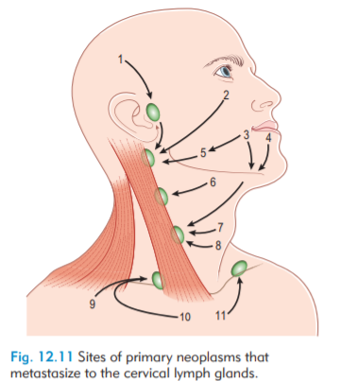
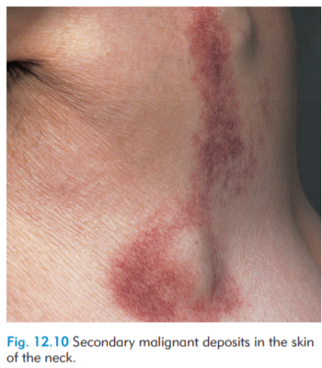

Slide 30
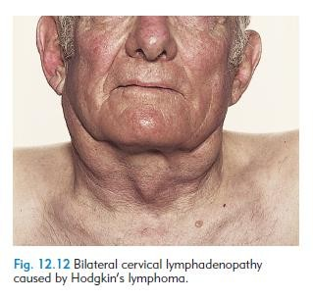
PRIMARY NEOPLASMS OF THE LYMPH GLANDS
The most common primary tumour of lymphoid tissue is malignant lymphoma.
There are many histological varieties, but they are often loosely divided into Hodgkin’s and non-Hodgkin’s lymphoma.

Slide 31
Deep anterior triangle swelling don’t move with swallowing

Slide 32

BRANCHIAL CYST
Branchial cleft cysts are congenital epithelial cysts, which arise on the lateral part of the neck from a failure of obliteration of the second branchial cleft in embryonic development.
It is lined with squamous epithelium, but there are often patches of lymphoid tissue in the wall that are connected with the other lymph tissue in the neck and can become infected.

Slide 33
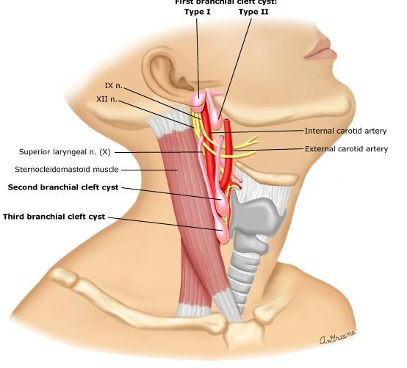
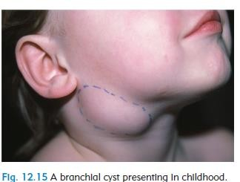

Slide 34
On history and physical examination
Age Although these cysts are present at birth. The majority present between the ages of 15 and 25 years.
Sex Males and females are equally affected.
Symptoms The common presenting complaint is a painless swelling in the upper lateral part of the neck. pain usually caused by infection in the lymphoid tissue in the cyst wall .A severe throbbing pain, exacerbated by moving the neck and opening the mouth, develops if the contents of the cyst become infected and purulent.
General effects These cysts have no systemic effects and are not associated with any other congenital abnormality.

Slide 35
On physical examination
Position A branchial cyst lies along the anterior edge of the upper third of the sternomastoid muscle and bulges forwards
Colour and tenderness The overlying skin may be reddened and tender if the cyst is inflamed.
Shape The cyst is usually ovoid.
Size Most branchial cysts are between 5 and 10 cm long.
Surface Their surface is smooth and the edge distinct.
Composition The consistency varies with the tension of the cyst. Most cysts are tense. They are dull to percussion.
The lump fluctuates, but this sign is not always easy to elicit.
Such cysts may transilluminate

Slide 36

Secondary infections can occur, producing enlargement, cellulitis, and neck abscess If the cyst becomes infected, it becomes erythematous and tender.
Management of branchial cleft cysts begins with controlling infection, if present. Once the infection has resolved, the mass and its cleft are usually excised to prevent future problems.

Slide 37
CAROTID BODY TUMOR
The carotid body, which originates in the neural crest, is important in the body's acute adaptation to fluctuating concentrations of oxygen, carbon dioxide, and pH.
Paragangliomas of the carotid body are highly vascular, slowly growing typically benign tumors that can present as a neck mass.
Carotid body tumors are often pulsatile and a bruit can be heard on auscultation.
These tumors develop within the adventitia of the medial
aspect of the carotid bifurcation.

Slide 38
On history and physical examination
Age between the ages of 40 and 60 years.
Symptoms The common presentation is a painless, slowly growing lump. The patient may notice that the lump pulsates,
Development The lump grows so slowly that many patients ignore it for many years.
Multiplicity Carotid body tumors may be bilateral.

Slide 39
On physical examination
Position Carotid body tumors are found in the upper part of the anterior triangle of the neck, level with the hyoid bone and beneath the anterior edge of the sternomastoid muscle
Tenderness, color and temperature These tumors are not tender or hot, and the overlying skin should be normal.
Shape The lump is initially spherical but, as it grows, it becomes irregular in shape, often narrower at its lower end, where it is situated in the bifurcation of the common carotid artery.
Size Carotid body tumours may vary from 2–3 cm to 10 cm in diameter.
Composition The majority of these tumours are solid and hard. They are dull to percussion and do not fluctuate .They are often called potato tumours because of their consistency and shape .

Slide 40
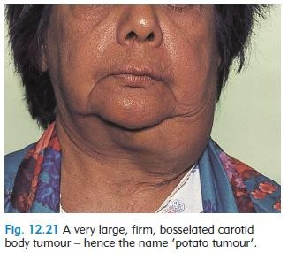

Slide 41
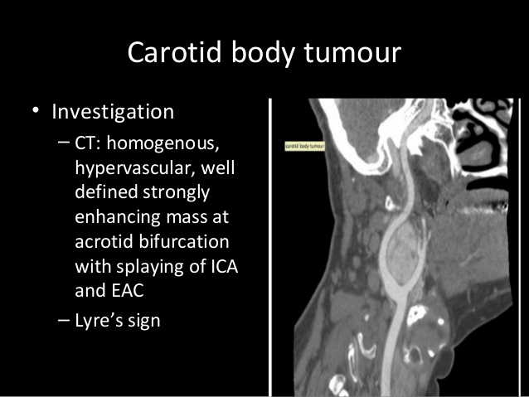
Diagnosis is usually made based o characteristic features demonstrated on MRI/MRA imaging (salt and pepper appearance)

Slide 42
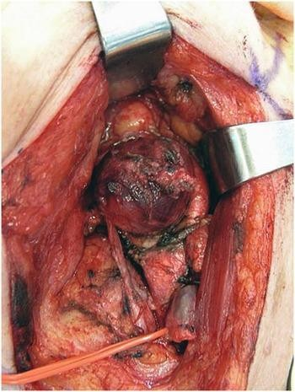
surgery is usually the treatment modality of choice for younger, healthier patients with carotid body tumors (CBTs), and radiotherapy is reserved for the elderly, patients who are poor surgical candidates.

Slide 43
Deep posterior triangle swelling

Slide 44

CYSTIC HYGROMA
(Lymph cyst, lymphocele, lymphangioma)
A cystic hygroma is a congenital collection of lymphatic sacs that contain clear, colourless lymph.
They are probably derived from clusters of lymph channels that failed, during intrauterine development, to connect with and become normal lymphatic pathways.
Lymph cysts commonly occur near the root of the arm and the leg (i.e. in the anatomical junctions between the limbs and head and the trunk).

Slide 45
On history and physical examination
Age The majority of cystic hygromas present at birth or within the first few years of life, but they may stay empty until infection or trauma in adult life causes them to fill up and become visible.
Symptoms The only symptom is the complaint about the lump and disfigurement caused by the cyst.

Slide 46
On physical examination
Position Cystic hygromas are commonly found around the base of the usually in the posterior triangle, but they can be very big and occupy the whole of the subcutaneous tissue of one side of the neck.
Temperature and tenderness They are not hot or tender, and the overlying skin is normal.
Shape A cystic hygroma is a mixture of soft unilocular and multilocular cysts, so the whole mass looks lobulated and flattened.
Size Small cysts are a few centimetres and larger.
Surface If the cysts are close to the skin, it may be possible to feel a distinct surface. Deep cysts feel smooth, their edges are often indistinct.
Composition Cystic hygromas are soft and dull to percussion. They fluctuate easily, but their distinctive physical sign is a translucence.

Slide 47
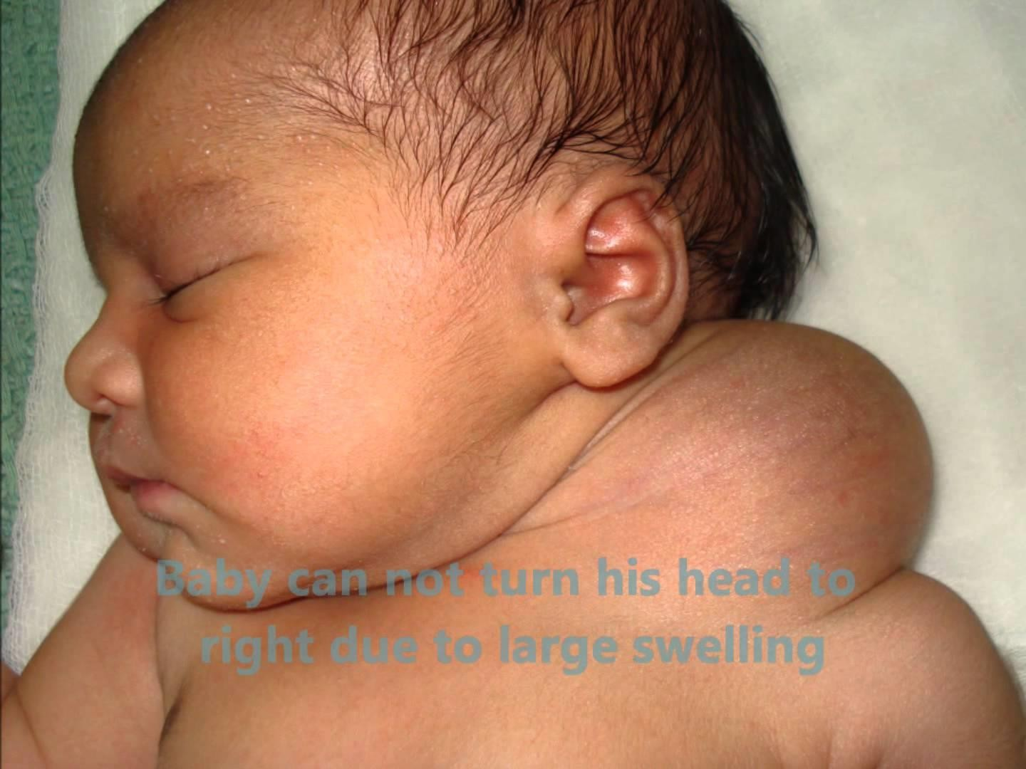
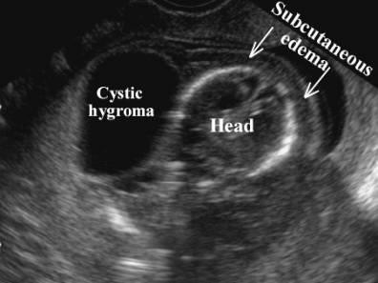

Slide 48
PHARYNGEAL POUCH (ZENKER'S DIVERTICULUM)
A pharyngeal pouch is a ‘pulsion’ diverticulum of the pharynx through the gap between the horizontal fibres of the cricopharyngeus muscle below and the inferior constrictor muscle above.

Slide 49
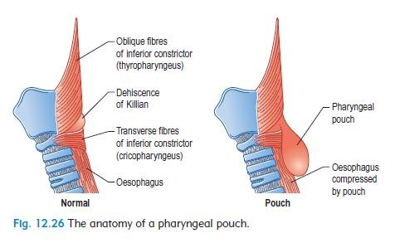

Slide 50
Pharyngeal pouches appear in middle and old age.
They are more common in males than in females.
Patients often have a long history of halitosis and recurrent sore throats before noticing the common presenting symptom of regurgitation of food.
Regurgitation at night causes bouts of coughing and choking, and if pieces of food are inhaled a lung abscess may develop.
As the pouch grows, it presses on the oesophagus and causes dysphagia.
By the time these symptoms become severe, the patient notes a swelling in the neck.

Slide 51

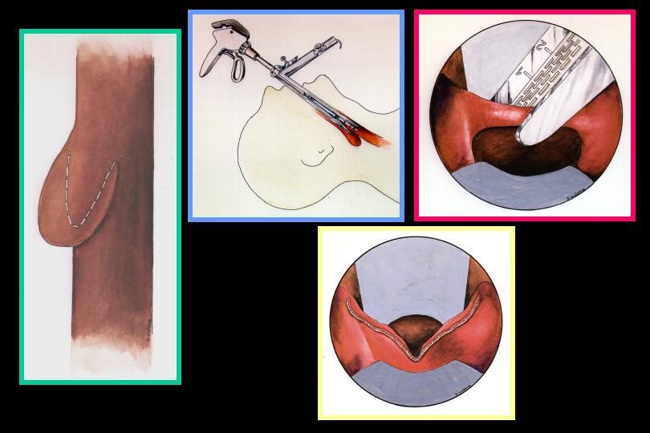
Diagnosis made by hx and PE.
Investigations include, barium swallow and upper endoscopy.
Treatment:
  Cricopharyngeal myotomy and diverticulectomy.
  more recently, endoscopic stapling.

