Slide 1
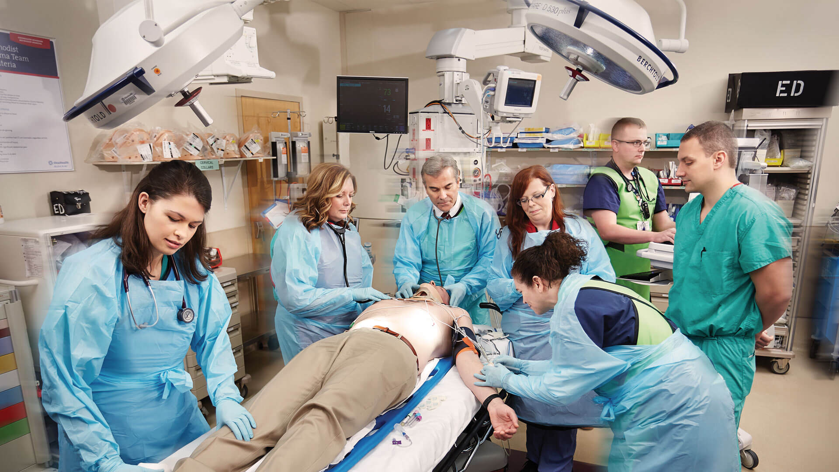
Approach to trauma patient
Esra’a omar daoud
Farah khalid Alrawabdeh

Slide 2
Objectives
The importance of prehospital and hospital preparation
The initial assessment of a multiply injured patient, using the correct sequence of priorities.
Principles of the primary survey
The management techniques employed during the primary assessment and stabilization of a multiply injured patient.
Identify the components of a secondary survey, including adjuncts that may be appropriate during its performance.
Explain the importance of teamwork in the initial assessment of trauma patients.

Slide 3
DEFINITION OF TRAUMA
Trauma originates from the Greek word meaning ‘wound’. It implies that a physical force exerted on a person has led to a physical injury
Types of external injury include chemical, thermal, ionising radiation and, most frequently, those of mechanical origin.

Slide 4
importance
Injury deaths worldwide have been estimated at more than 5 million in 2000. By 2020, injury may advance to become the second or third leading cause of death in all age groups.
Injury does not discriminate based on age, race, sex, or economic status. It is the leading cause of death in persons aged one through 44 years in most developed countries and is assuming a more prominent position in lower-income nations as infectious diseases are eradicated.
Motor vehicle crashes (MVCs) account for the majority of injuries and deaths worldwide.
Deaths from firearms are a particular problem in the United States, Norway, Palestine, and France. The mortality rate in the United States from guns approaches the rate due to vehicular trauma for the age group of 15 to 24 years: 13.7 versus 16.2 per 100,000 population.

Slide 5
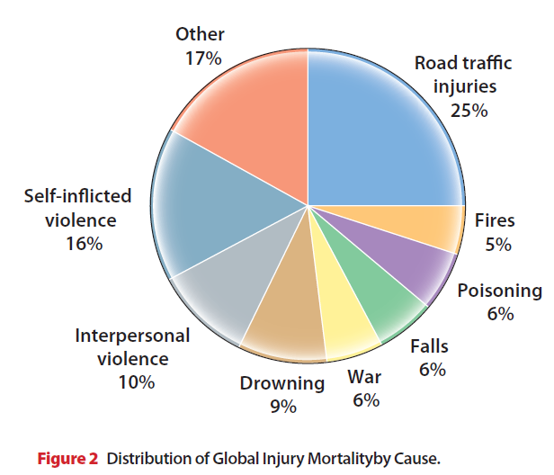

Slide 6
BIOMECHANICS OF INJURY
It is important to realize that at its most basic level injuries result from deformation of tissues that results in damage. In general, injuries can be categorized as penetrating (sharp objects or firearms) or blunt.
There are clearly differences between these mechanisms that must be kept in mind while evaluating the patient. Penetrating trauma causes injury to the objects that are in the path of the foreign body, whereas blunt trauma causes damage either through crush or shear forces. The diagnostic and management approach is therefore very different.
Traumatic injuries may range from small lesions to life-threatening multi-organ injury. In order to achieve the best possible outcomes while decreasing the risk of undetected injuries, the management of trauma patients requires a highly systematic approach.

Slide 7
Trimodal Death Distribution
The frequency of deaths after injury follows a trimodal distribution.
The first peak of this distribution occurs within seconds to minutes after injury. During this early period, deaths generally result from lacerations of the brain, brain stem, high spinal cord, heart, aorta, and other large blood vessels. Very few of these patients can be salvaged due to the severity of their injuries. Salvage after injury during this peak can be achieved only in certain large urban areas where rapid prehospital care and transport are available. Only prevention can significantly reduce this peak of traumatic deaths.

Slide 8
The second peak occurs within minutes to several hours following injury. The TEAM Program focuses primarily on this period. Deaths occurring during this period are usually due to subdural and epidural hematomas,hemopneumothorax, ruptured spleen, lacerations of the liver, pelvic fractures, and/or other multiple injuries associated with significant blood loss. The “first hour” of care after injury focuses on rapid assessment and resuscitation, which are the hallmarks of trauma evaluation and management. The concept of the “golden hour” emphasizes the urgency of successful management in order to optimize outcome of the injured patien and is not intended to imply a “fixed” time period of 60 minutes.

Slide 9
In the third peak, occurring several days to weeks after the initial injury, death is most often due to sepsis and multiple organ system failure. Care provided during each of the preceding time periods affects outcome during this stage. Thus, the first and every subsequent individual caring for the injured patient have a direct effect on long-term outcome.

Slide 10
The Advanced Trauma Life Support (ATLS) program has put together a systematic, concise approach to the care of a trauma patient.
The ATLS program provides participants with a safe, reliable method for immediate management of the injured patient and the basic knowledge necessary to:
1. Assess the patient’s condition rapidly and accurately
2. Resuscitate and stabilize the patient according to priority
3. Determine if the patient’s needs exceed a facility’s capacity
4. Arrange appropriately for the patient’s interhospital transfer (who, what, when, and how)
5. Assure that optimum care is provided and that the level of care does not deteriorate at any point during the evaluation, resuscitation, or transfer process.

Slide 11
There are six underlying precepts of trauma evaluation and management. The most important of these precepts is to treat the greatest threat to life first.
Second, the lack of a definitive diagnosis should never impede the application of an indicated treatment, and a detailed history is not essential to begin the evaluation of an acutely injured patient.
Third is the need for a physiologic approach to the evaluation and treatment of the injured.
The fourth is that injury kills in certain reproducible time frames. Thus, time is of the essence.
The fifth is to do no further harm.
The sixth is teamwork. Teamwork (multidisciplinary team members) is required for TEAM to succeed.

Slide 12
TEAM principles
Treat greatest threat to life first
Definitive diagnosis less important
Physiologic approach
Time is of the essence
Do no further harm
Teamwork required for TEAM to succeed

Slide 13
Initial Assessment
When treating injured patients, clinicians rapidly assess injuries and institute life-preserving therapy. Because timing is crucial, a systematic approach that can be rapidly and accurately applied is essential. This approach, termed the “initial assessment,” includes the following elements:
Preparation (Pre-hospital and hospital)
Triage – mostly in mass causalities
Primary survey (ABCDEs) with immediate resuscitation of patients with life-threatening injuries
Adjuncts to the primary survey and resuscitation
Secondary survey (head-to-toe evaluation and patient history)
Adjuncts to the secondary survey
Continued post-resuscitation monitoring and reevaluation
Definitive care

Slide 14
Prehospital Phase
Coordination with the prehospital agency and personnel can greatly expedite the treatment in the field.
The prehospital system should be set up such that the receiving hospital is notified before the prehospital personnel transport the patient from the scene.
This allows mobilization of the hospital’s Trauma Team members so that all necessary personnel and resources are present in the emergency department at the time of the patient’s arrival.
Emphasis in the prehospital phase should be placed on airway maintenance, support of breathing, control of external bleeding and shock, immobilization of the patient, and immediate transport to the closest appropriate facility, preferably a verified trauma center. Every effort should be made to minimize scene time.
Emphasis also should be placed on obtaining and reporting information needed for triage at the hospital, for example, time of injury, events related to the injury, and patient history. The mechanisms of injury may suggest the degree of injury as well as specific injuries for which the patient must be evaluated.

Slide 15
Inhospital Phase
Advanced planning for the trauma patient’s arrival is essential. Ideally, a resuscitation area should be available for trauma patients.
Proper airway equipment (laryngoscopes, endotracheal tubes, and so on) should be organized, tested, and strategically placed where it is immediately accessible.
Warmed intravenous crystalloid solutions (for example, Ringer’s lactate) should be available and ready for infusion when the patient arrives.
Appropriate monitoring capabilities should be immediately available. A method to summon extra medical assistance should be in place. A means to ensure prompt response by laboratory and radiology personnel is necessary.

Slide 16
Transfer agreements with a verified trauma center should be pre-established and operational.
All personnel who have contact with the patient must be protected from communicable diseases. Most prominent among these diseases are hepatitis and human immunodeficiency virus (HIV) infection.
The Centers for Disease Control and Prevention (CDC) and other health agencies strongly recommend the use of standard precautions (for example, cap, face mask, eye protection, water-impervious gown/apron, leggings, and gloves) when coming in contact with body fluids.

Slide 17
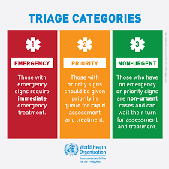
Triage
Triage is an active process that takes into account multiple factors with the goal of transporting the patient to the correct trauma center in the shortest amount of time.
Treatment is rendered based on the ABC priorities (Airway with cervical spine protection, Breathing with life-threatening chest injury management, and Circulation with hemorrhage control), as outlined later in this document. Other factors considered in the triage process are severity of injuries; salvageability; and available resources, including time, personnel, and operating rooms.

Slide 18
The Centers for Disease Control and Prevention have published guidelines helping to facilitate proper triage of injured patients.
The implementation of these guidelines is key to preventing both underand overtriage of the acutely injured patient.
Undertriage is the practice of sending an acutely injured patient to a lower than needed tier in the trauma system. This leads to prolongation to definitive care for injuries, multiple transfers to identify the correct level of care, and overall worse care of the patient.
Overtriage is transferring a patient to a highest-level trauma system when their injuries do not warrant that level of care. This allocates scarce resources to patients who ultimately do not need them, and as such may prevent those who need that resource appropriately from getting it.

Slide 19
Two types of triage situations usually exist;
A. Multiple Casualty Incidents
The number of patients and the severity of their injuries do not exceed the ability of the facility to rendercare. In this situation, Patients with life-threatening injuries are treated first. This allows available resources to be used in a manner that does the most good for the largest number of injured patients.
B. Mass Casualty Incidents
The number of patients and the severity of their injuries exceed the capability of the facility and staff. In this situation, those patients with the greatest chance of survival, and requiring the least expenditure of time, equipment, supplies, and personnel, are managed first.

Slide 20
Primary Survey
Patients are assessed and their treatment priorities established based on the degree of life threat posed by their injuries, their vital signs, and the injury mechanism. These priorities are the same for all injured patients, including adult, pediatric, pregnant, and geriatric patients.
Patient management must consist of a rapid primary evaluation, resuscitation of vital functions, a more detailed secondary assessment, and finally, the initiation of definitive care.

Slide 21
This process constitutes the ABCDEs of trauma care and identifies life-threatening conditions by adhering to this sequence:
Airway maintenance with cervical spine protection.
Breathing with life-threatening chest injury management.
Circulation with hemorrhage control.
Disability: Brief neurologic examination with intracranial mass lesion recognition.
Exposure / Environmental with maintenance of normal body temperature.

Slide 22
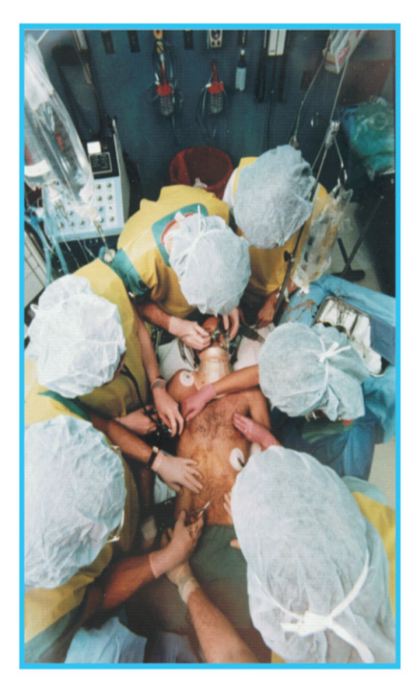
The trauma team
TEAM: trauma evaluation and management.
“TEAM” also is an acronym for “Together Everyone Achieves More.”
The team should consist of:
A. The team leader manages the primary and secondary surveys, ensuring linkage between evaluation and management.
B. The airway manager focuses on providing and maintaining a patent airway, ventilation, and oxygenation.
C. The nurse collects specific data, for example, vital signs, as needed for trauma evaluation and management, and monitors activity in the resuscitation room.
D. The assistants perform specific tasks, such as removing the patient’s clothing, inserting intravenous catheters,
administering fluids, and obtaining blood and urinary specimens.

Slide 23
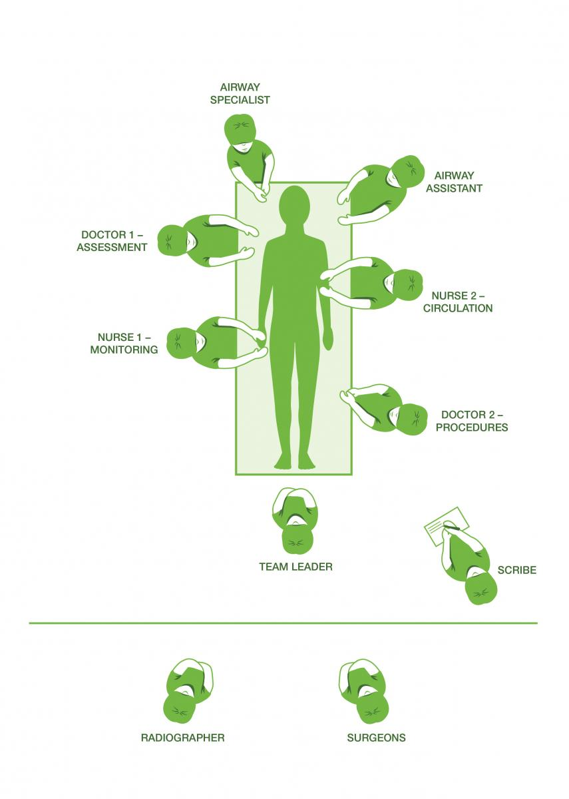

Slide 24
During the primary survey, life-threatening conditions are identified and management is instituted simultaneously.
Within 10 seconds it is possible to asses the critical nature of injuries sustained by the trauma patient ( quick assessment) This is done by:
(a) Identifying yourself
(b) Asking patient his/her name
(c) Asking the patient what happened
An appropriate response suggests that the patient has:
(a) A patent airway
(b) Sufficient air reserve to permit speech
(c) Sufficient perfusion to preserve cerebration
(d) Clear sensorium
An inappropriate response suggests urgent problems affecting A, B, C, or D requiring urgent intervention(s).

Slide 25
Special Considerations
Pediatric patient
Trauma is the leading cause of death in the pediatric patient, immature features of the child and a vigorous compensatory response to major trauma.
priorities for the care of the pediatric patient are the same as for adults. In managing the airway and ventilation, it must be remembered that the larynx is cephalad and anterior and that the trachea is relatively short, making intubation more difficult.
The mobile mediastinum and pliable chest wall result in greater susceptibility to tension pneumothorax and pulmonary contusions.
Although volume resuscitation is less often needed in the
pediatric trauma patient because head injuries are more common than torso injuries, intraosseous vascular access is more likely to be required in the pediatric trauma patient.

Slide 26
The response to volume loss, vital signs,and urinary output also are dependent on the size of the child.
Although the quantities of blood, fluids, and medications; the size of the child; the degree and rapidity of heat loss; and injury patterns may differ, assessment and management priorities are identical.
Outcome depends on early aggressive care.

Slide 27
Pregnant patients
the anatomical and physiological changes in these patients modify response to injury
We need Early recognition of pregnancy by history or by palpation of the abdomen for the gravid uterus and laboratory tests for B-HCG
They need continuous fetal assessment
Always 1st priority is maternal resuscitation
And the outcome depends on early and aggressive management and care

Slide 28
Geriatric patients
In elderly patients trauma consider the 5th leading causing of death
That’s probably due to the diminished physiological reserve and, the high rate of co-morbidities and the medications they take .
Also studies showed that elderly men are more likely to have trauma than women .

Slide 29
Airway Maintenance with Cervical Spine Protection
1. Airway maintenance:
Every effort should be made to promptly identify airway compromise and secure a patent airway. Upon initial evaluation of the trauma patient, the airway should be assessed first to ascertain patency. This rapid assessment for signs of airway obstruction should include inspection for foreign bodies and facial, mandibular, or tracheal/laryngeal fractures , Snoring, gurgling, stridor, hoarseness, and rocking chest wall motions are indicative of airway obstruction.
Measures to establish a patent airway should be instituted while protecting the cervical spine.

Slide 30
Initially, simple measures such as the chin lift or modified jaw thrust maneuver may achieve this task.
Airway suctioning is then performed as necessary to clear excessive secretions, using a large-caliber suction catheter. Particulate matter is removed, if present, using a finger sweep or forceps.
A nasopharyngeal airway may initially establish and maintain airway patency in the conscious patient. If the patient is unconscious and has no gag reflex, an oropharyngeal airway may be helpful temporarily. However, a definitive airway should be established if there is any doubt about the patient’s ability to maintain airway integrity .

Slide 31
A definitive airway is defined as a secured tube in the trachea with the cuff inflated and the tube connected to some form of oxygen-enriched assisted ventilation.
Definitive control of the airway in patients who have compromised airways due to mechanical factors, who have ventilatory problems, or who are unconscious is achieved by endotracheal intubation, either nasally or orally (nasal intubation is contraindicated in the presence of basal skull fracture).
This procedure should be accomplished with continuous protection of the cervical spine.
Severe head-injury patients with an altered level of consciousness or a Glasgow Coma Scale (GCS) Score of eight or less usually require the placement of a definitive airway.
The finding of nonpurposeful motor responses strongly suggests the need for definitive airway management.
A surgical airway (cricothyroidotomy) should be performed if oro- or nasotracheal intubation is contraindicated or cannot be accomplished..

Slide 32
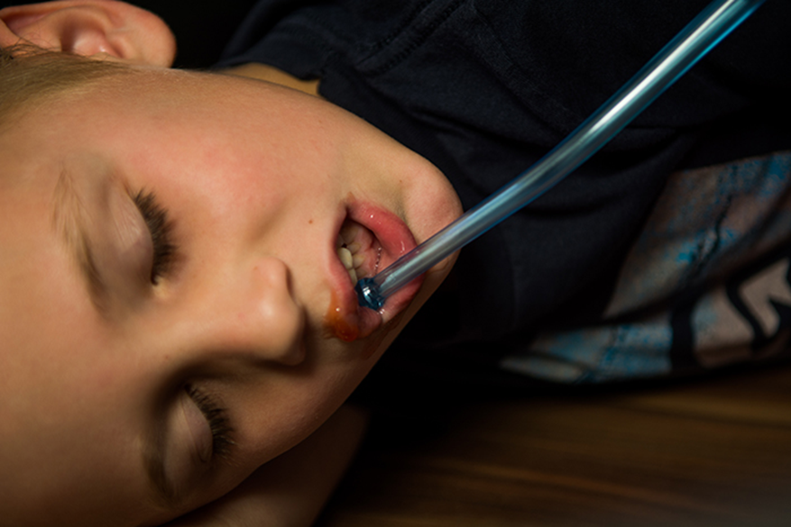
Suctioning and removal of foreign material obstructing the airway

Slide 33
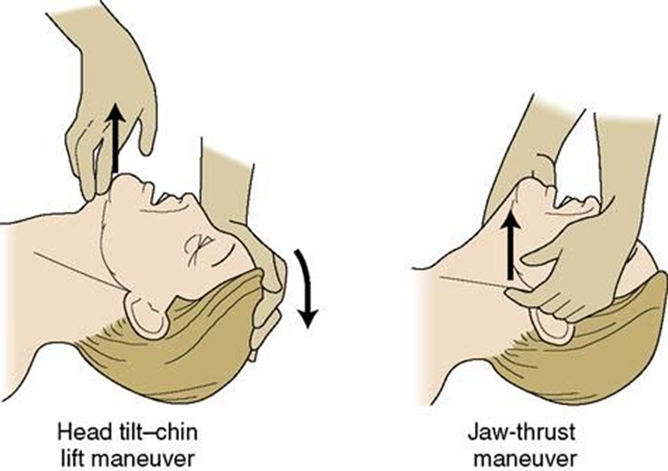
Simple maneuvers

Slide 34
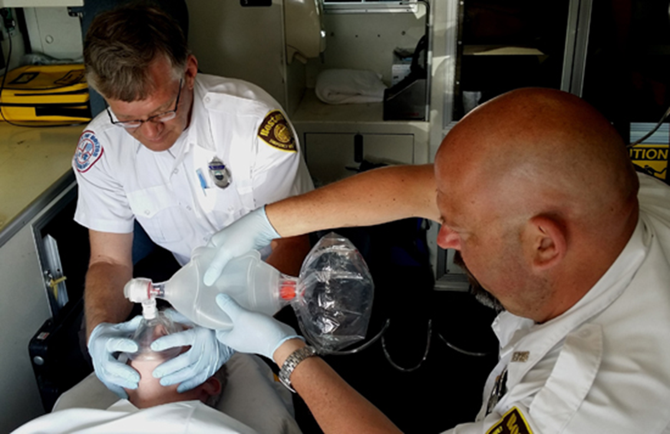
Bag-Valve-Mask

Slide 35
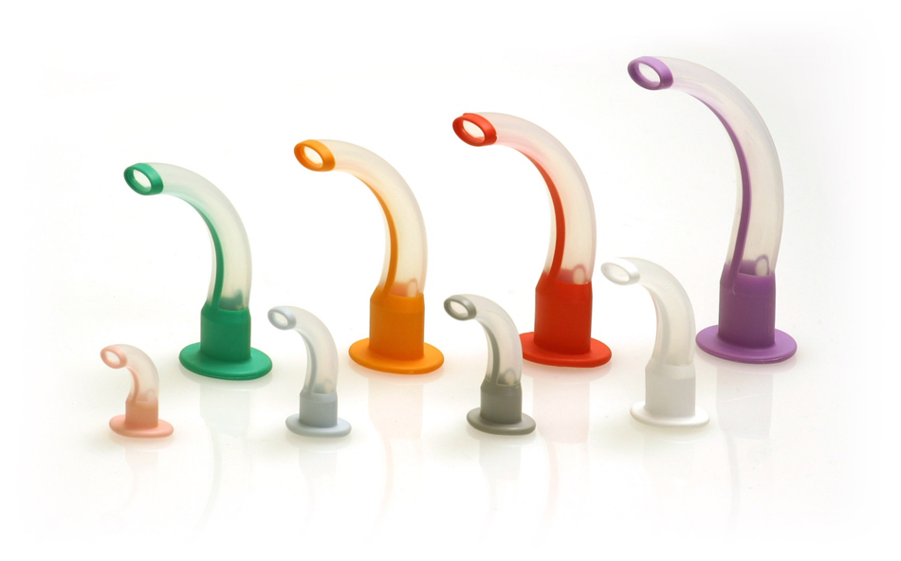
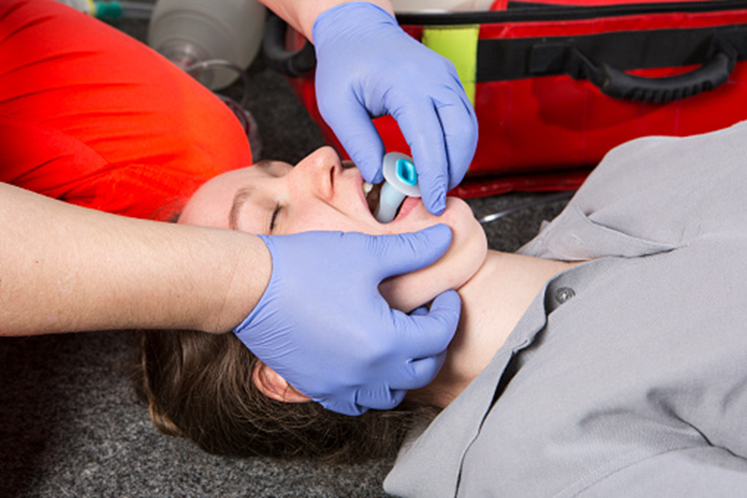
Oropharyngeal airway

Slide 36
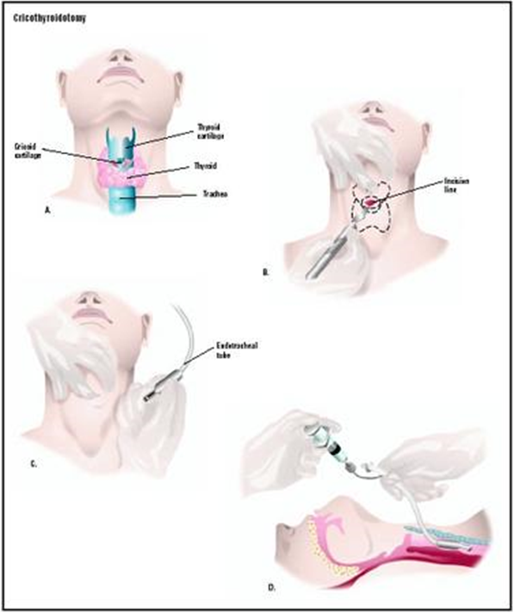
Cricothyroidotomy

Slide 37
2. Cervical spine protection
While assessing and managing the patient’s airway, great care should be taken to prevent excessive movement of the cervical spine
The patient’s head and neck should not be hyperextended,hyperflexed, or rotated to establish and maintain the airway.
Protection of the patient’s spinal cord with manual, inline immobilization followed by the application of appropriate immobilization devices should be accomplished.
If immobilizing devices must be removed temporarily, the neutral position of the patient’s head and neck should be reinstituted with manual, inline immobilization by one member of the trauma team.
Cervical spine X-rays or CT Scan may be obtained to confirm or exclude injury once immediate or potentially life-threatening conditions have been addressed.

Slide 38
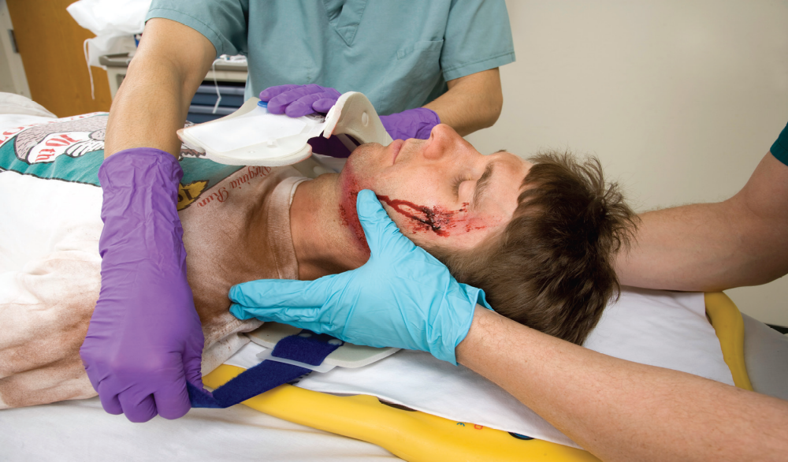
Remember: Assume a cervical spine injury in any patient with multisystem trauma, especially with an altered level of consciousness or a blunt injury above the clavicle.

Slide 39
Breathing and Ventilation
The patient’s chest should be exposed to adequately assess chest wall excursion. Auscultation should be performed to assure gas flow in the lungs.
Adequacy of ventilation should be assessed through observation of chest wall mechanics, that is, accessory muscle use and ventilatory rate.
Percussion may suggest the presence of air or blood in the chest.
Visual inspection and palpation may detect injuries to the chest wall that may compromise ventilation.
Injuries that may acutely impair ventilation are tension pneumothorax, flail chest with pulmonary contusion, massive hemothorax, and open pneumothorax. These injuries should be identified in the primary survey.
Remember, a tension pneumothorax is a clinical diagnosis and not a radiologic diagnosis

Slide 40
Every injured patient should receive supplemental oxygen to achieve optimal oxygenation. If not intubated and if the patient is breathing spontaneously, the patient should have oxygen administered by a nonrebreathing mask to achieve optimal oxygenation. If intubated, the patient should have oxygen delivered by, and ventilations assisted with, a bag-valve reservoir device. This process should be followed by mechanical ventilation after excluding a pneumothorax, which will require a tube thoracotomy. The use of the pulse oximeter is valuable in monitoring adequate hemoglobin oxygen saturation.
Tube thoracostomy is required in the definitive control of the following, immediately life-threatening chest injuries.
1. Tension pneumothorax, after needle decompression
2. Open pneumothorax, after placement of an occlusive dressing over the wound
3. Massive hemothorax with simultaneous restoration of blood volume

Slide 41
Circulation with Hemorrhage Control
The trauma patient in shock should be considered to be in hemorrhagic shock until proven otherwise.
Hemorrhage must be identified and stopped as soon as possible.
External bleeding is controlled by direct pressure and Internal hemorrhage may require operative intervention.
Internal sources of hemorrhage may be the chest, abdomen, pelvis, or retroperitoneum.
If the shock is nonhemorrhagic, then obstructive causes of shock (for example, tension pneumothorax and cardiac tamponade), must be considered.
Hypotension with bradycardia should suggest the presence of neurogenic shock.
Although septic shock occurs in trauma, it is usually a late manifestation.

Slide 42
The initial step in managing shock in the injured patient is to recognize its presence.
The initial diagnosis is based on clinical appreciation of the presence of inadequate organ perfusion and tissue oxygenation instead of the presence of hypotension.
Ideally, the diagnosis of shock should be made prior to the development of obvious hypotension.
The elements of clinical observation that yield key information within seconds are level of consciousness, skin color, and pulse.

Slide 43
Level of consciousness
When circulating blood volume is reduced, cerebral perfusion may be critically impaired, resulting in altered levels of consciousness. However, a conscious patient also may have lost a significant amount of blood.
Skin color and capillary refill
Skin color can be helpful in evaluating the hypovolemic injured patient. A patient with normal capillary refill (<2 seconds) and pink skin, especially in the face and extremities, is rarely critically hypovolemic after injury. Conversely, the ashen, gray skin of the face and the white skin of the exsanguinated extremities are ominous signs of hypovolemia.

Slide 44
Pulse
An easily accessible central pulse (femoral or carotid, or in an infant, brachial), should be assessed bilaterally for quality, rate, and regularity.
A rapid, thready pulse is usually a sign of hypovolemia, but may have other causes as well.
A normal pulse rate does not assure that the patient is normovolemic.
Absent central pulses, not attributable to local factors, signify the need for immediate resuscitative action to control hemorrhage and restore depleted blood volume and effective cardiac output if death is to be avoided.

Slide 45
Bleeding
Bleeding should be considered external or internal.
External hemorrhage is identified by physical examination and promptly controlled by direct pressure in the primary survey.
The combination of history, physical examination, and chest X ray with focused assessment sonography in trauma (FAST) and X rays of the pelvis frequently identify the source of internal hemorrhage.
The first and the most critical step in hemorrhagic shock management is to identify and stop the bleeding.
The second vitally important step in shock management, after hemorrhage is controlled, is to restore circulating blood volume.

Slide 46
A minimum of two large-caliber intravenous catheters (IVs) should be established.
Establishment of upper extremity peripheral intravenous access is preferred.
Whereas other peripheral lines, cutdowns, and central venous lines should be utilized as necessary in accordance with the skill level of the doctor caring for the patient.
When establishing the intravenous lines, blood should be drawn for type and crossmatch and for baseline hematology studies, including a pregnancy test for all females of childbearing age.

Slide 47
Intravenous fluid therapy with a balanced salt solution should be initiated. Ringer’s lactate solution or normal saline is the initial crystalloid solution and should be administered rapidly.
Such bolus intravenous therapy may require the administration of 2 to 3 liters of solution within minutes to achieve an appropriate patient response in the adult patient.
All intravenous solutions should be warmed either by storage in a warm environment (37° to 40°C or 98.6° to 104°F) or by fluid warming devices.
However, if the patient responds only transiently to fluid replacement or remains unresponsive to bolus intravenous therapy, type-specific blood may be administered as necessary.
If blood loss continues this should be controlled by operative intervention.

Slide 48
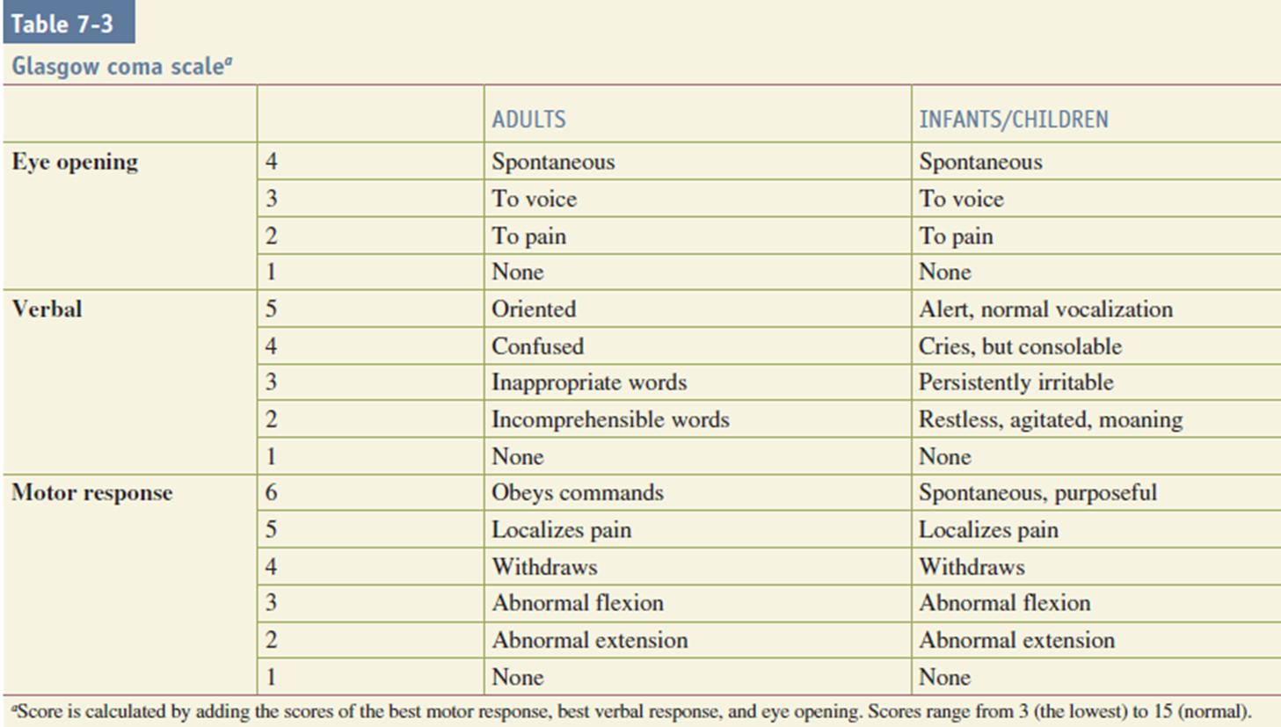
Disability (Neurological Status)
After circulatory assessment and management, a rapid neurologic evaluation is performed. This neurologic evaluation establishes the patient’s level of consciousness as well as pupillary size and reaction.
The Glasgow Coma Scale (GCS) Score provides a quick measure of the level of consciousness.

Slide 49
The GCS Score is the sum of these three, with the best possible score being 15 and the worst possible score being 3.
A decrease in the level of consciousness may indicate decreased cerebral oxygenation and/or perfusion (secondary brain injury), or it may be due to direct brain injury (primary brain injury).
An altered level of consciousness indicates the need for immediate reevaluation of the patient’s oxygenation, ventilation, and perfusion status.
Prevention of secondary brain injury by maintenance of oxygenation, ventilation, and perfusion is the main goal of initial resuscitation of the brain-injured patient.
Alcohol and/or other drugs also may alter the patient’s level of consciousness.

Slide 50
If hypoxia and hypovolemia are excluded(secondary injury), changes in the level of consciousness should be considered to be of traumatic central nervous system origin(primary injury) until proven otherwise.
Early CT scan and neurosurgical consultation are absolutely essential in the management of the brain-injured patient.
A unilaterally dilated pupil is an ominous sign that indicates the presence of a mass lesion, usually an expanding intracranial hematoma.
The lucid interval commonly associated with acute epidural hematoma is an example of a situation where the patient will “talk and die.” Frequent neurologic reevaluation can prevent this problem by allowing early detection of changes.

Slide 51
Exposure/Environmental Control
The patient should be completely undressed, usually by cutting off the clothes to facilitate thorough examination and assessment.
After the patient’s clothing is removed and assessment is completed, it is imperative to cover the patient with warm blankets or an external warming device to prevent hypothermia in the emergency department.
Intravenous fluids should be warmed before infusion, and a warm environment should be maintained.
It is the patient’s body temperature which is most important, not the comfort of the health care providers.
Efforts to rewarm the patient and to prevent hypothermia should be considered as important as any other component of the primary survey or resuscitation phase!

Slide 52
Adjuncts to Primary Survey
A. Urinary and Gastric Catheters
Urinary catheters
Urinary output is a sensitive indicator of the volume status of the patient and reflects renal perfusion. Monitoring of urinary output is best accomplished by the insertion of an indwelling bladder catheter.
Transurethral bladder catheterization is contraindicated in patients in whom urethral injury is suspected.
Urethral injury should be suspected if there is :
Blood at the penile meatus, (2) perineal ecchymosis, (3) scrotal hematoma, (4) a high-riding or nonpalpable prostate, or (5) a pelvic fracture.
Therefore, the urinary catheter should not be inserted before an examination of the rectum and genitalia if the mechanism of injury suggests the possibility of urethral injury.

Slide 53
2. Gastric catheters
A gastric tube is indicated to reduce stomach distention and decrease the risk of aspiration.
Blood in the gastric aspirate may represent oropharyngeal (swallowed) blood, traumatic insertion, or actual injury to the upper digestive tract.
If a cribriform plate fracture, basilar skull fracture, or maxillofacial trauma is suspected or present, the gastric tube should be inserted orally to prevent intracranial passage.

Slide 54
B. Monitoring
1. Ventilatory rate and arterial blood gases (ABG’s) should be used to monitor the adequacy of the patient’s airway and breathing.
2.Pulse oximetry is a valuable adjunct for monitoring injured patients. The pulse oximeter measures the oxygen saturation of hemoglobin colorimetrically, but does not measure ventilation or the partial pressure of oxygen.
3. Blood pressure should be measured serially and recorded.
4. Electrocardiographic (ECG) monitoring of all trauma patients is required. Dysrhythmias, including unexplained tachycardia, atrial fibrillation, premature ventricular contractions, and pulseless electrical activity may indicate cardiac tamponade, tension pneumothorax, and/or profound hypovolemia.

Slide 55
C. X rays and Diagnostic Studies
The anteroposterior (AP) chest film and an AP pelvis film may provide information that can guide resuscitation efforts of the patient with blunt trauma.
A lateral cervical spine X-ray or CT scan should be obtained with a portable X ray unit during the secondary survey on any patient who may have a cervical spine injury.
Essential diagnostic X-rays should not be avoided in the pregnant patient.(risk - benefit assessment)
Diagnostic peritoneal lavage (DPL) and focused assessment sonography in trauma (FAST) are useful tools for the quick detection of occult intraabdominal bleeding.
FAST is more rapid and less invasive, but operator dependent.
A CT scan of the abdomen is more specific than FAST, but because it requires moving the patient to the CT scan suite, it is only appropriate when the patient’s hemodynamics have been normalized.

Slide 56
Secondary survey
IT starts after :
primary survey completed
resuscitation in process
ABCDEs reassessed
vital functions returning to normal

Slide 57
Secondary survey
The secondary survey is a head-to-toe evaluation of the trauma patient, that is, a complete history and physical examination, including a reassessment of all vital sign and each region of the body is completely examined.
In this survey a complete neurologic examination is performed, including a GCS Score determination, if not done during the primary survey.
During this evaluation, indicated X rays (for example, X rays pertinent to the sites of suspected injury) are obtained.
Special procedures—for example, specific radiologic evaluations and laboratory studies—also are performed during this time.
The secondary assessment might well be summarized as “tubes and fingers in every orifice.”

Slide 58
Secondary survey - History
Every complete medical assessment should include a history of the mechanism of injury.
Many times such a history cannot be obtained from the patient so, prehospital personnel and family must be consulted to obtain information that may enhance an understanding of the patient’s physiologic state.
Secondary survey history mnemonics is AMPLE which is :
Allergies
Medications currently used
Past illnesses/Pregnancy
Last meal
Events/Environment related to the injury

Slide 59
Mechanism of injury
Blunt trauma
Blunt trauma results from automobile collisions, falls, and other transportation-, recreation-,and occupation-related injuries.
Important information to obtain about automobile collisions includes seat belt usage, airbag deployment, steering wheel deformation, direction of impact, damage to the automobile in terms of major deformation or intrusion into the passenger compartment, and ejection of the passenger from the vehicle.
2. Penetrating trauma
Injuries from penetrating trauma (firearms, stabbings, and impaling objects) are seen around the world.
Factors determining the type and extent of injury and subsequent management include the region of the body injured, the organs in proximity to the path of the penetrating object, and the velocity of the missile. Therefore, the velocity, caliber, presumed path of the bullet, and the distance from weapon to wounded may provide important clues to the extent of injury.

Slide 60
3. Injuries due to burns and cold
Burn injury
Inhalational injury: intubate and administer 100% oxygen.
Administer 2-4ml/kg/%BSA burn in 24 hours (+ maintenance in children)
Monitor urinary output
Expose and prevent hypothermia
Chemical burns: brush and irrigate

Slide 61
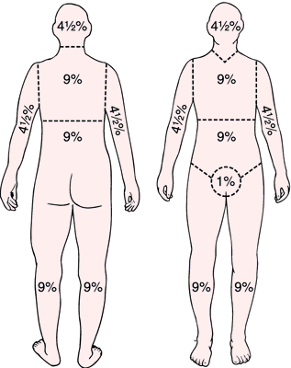
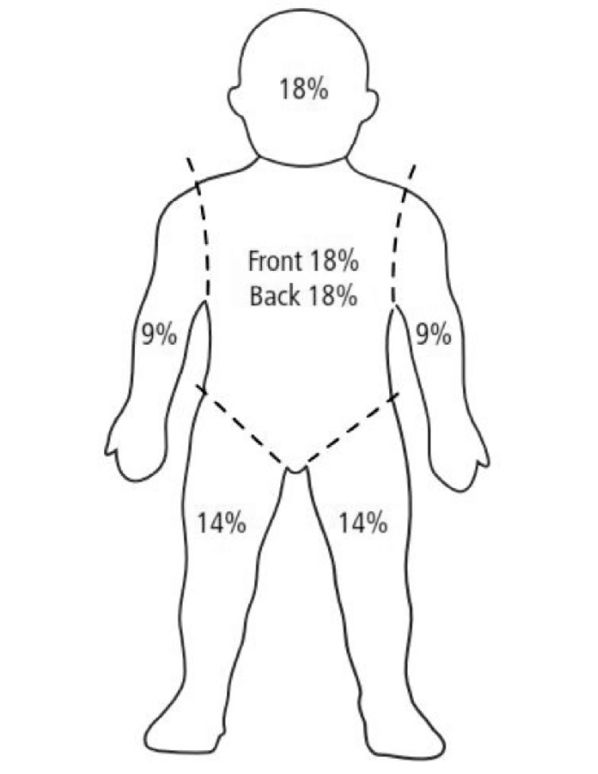
Rule of nine
Adult Pediatric

Slide 62
cold injury
The most significant local cold injury is frostbite because of its associated risk of tissue or limb loss.
Frostbite treatment requires removal from the cold environment, rapid rewarming with moist heat (water tank at 40ºC [104ºF]), and waiting for demarcation before debridement.
The most significant generalized cold injury is hypothermia (core temperature less than 35ºC [95ºF]) because of its major systemic effects, which can be lethal.
Hypothermia treatment also requires removal from the cold environment, the use of warming devices that may be passive or active, while monitoring temperature, hemodynamics, and coagulation parameters.
The patient cannot be pronounced dead until warming techniques are instituted and the patient’s core temperature is reversed.

Slide 63
Secondary survey – Physical examination
Should be performed in the following sequence:
Head > maxillofacial structures cervical spine and neck > chest > abdomen and pelvis > perineum/rectum/genetalia > musculoskeletal system > neurological system.
Head
Look for lacerations, contusions, and evidence of fractures
Complete neurologic exam
GCS score determination.
Reevaluate the eyes for:
Visual acuity.
Pupillary size.
Hemorrhage of the conjunctiva and/or fundi.
Penetrating injury.
Contact lenses (remove before edema occurs).
Dislocation of the lens.
Ocular entrapment – ocular mobility.

Slide 64
Maxillofacial
Maxillofacial trauma not associated with airway obstruction or major bleeding should be treated only after the patient is stabilized completely and life-threatening injuries have been managed.
Palpate all bony structures.
Assess any occlusion.
Do an intra-oral examination.
Assess soft tissues
Patients with fractures of the mid-face may have a fracture of the cribriform plate. For these patients, gastric intubation should be performed via the oral route not nasal route to avoid entry to the brain .

Slide 65
Cervical spine and neck
Examination of the neck includes inspection, palpation, and auscultation.
Cervical spine tenderness, subcutaneous emphysema, tracheal deviation, and laryngeal fracture may be discovered on a detailed examination.
The carotid arteries should be palpated and auscultated for bruits.
Evaluation may include radiographic series and/or CT spine.
CT Angiography, Angiography, or Duplex Ultrasonography – suspicion for cervical vascular injury.
Wounds that extend through the platysma should not be explored manually, probed with instruments, or treated by individuals in the ED who are not trained to manage such injuries.
complete motor and sensory exams
reflexes

Slide 66
Chest
A complete evaluation of the chest wall requires palpation of the entire chest cage, including the clavicles, ribs, and sternum.
Significant chest injury may be manifested by pain, dyspnea, or hypoxia.
Evaluation includes auscultation of the chest and a chest X ray.
Distant heart sounds and narrow pulse pressure may indicate cardiac tamponade.
Decreased breath sounds, hyperresonance to percussion, and shock may be the only indications of tension pneumothorax and the need for immediate chest decompression, which should have been identified and treated during the primary survey.
Contusions and hematomas of the chest wall - occult injury.

Slide 67
Abdomen and Pelvis:
Injuries must be identified and treated aggressively with Close observation and frequent reevaluation of the abdomen.
Ecchymosis over the iliac wings, pubis, labia, or scrotum.
Patients with:
Unexplained hypotension.
neurologic injury.
impaired sensorium secondary to alcohol and/or other drugs.
Equivocal abdominal findings.
Those patients are candidate for DPL / abdominal U/S.
If stable then CT of the abdomen.

Slide 68
Fractures of the pelvis or the lower rib cage may also hinder accurate diagnostic examination of the abdomen , because pain in these areas may be elected when palpating the abdomen .
Excessive manipulation of pelvis should be avoided
The AP pelvic x-ray should be used as a guide for identification of pelvic fracture which can be associated with significant amount of blood loss
Some organs are difficult to be seen even with CT scan
The knowledge of the mechanism of the injury along the high index of suspicion injuries is required

Slide 69
Perineum, Rectum, and Vagina:
Contusions, hematomas, lacerations, and urethral bleeding.
Rectal examination for:
Presence of blood within the bowel lumen, integrity of the rectal wall , a high riding prostate , the presence of pelvic fractures , quality of sphincter tone and before placing urinary Cather ( its mandatory if we suspect a urethral injury ).
Female urethral injury when present( although uncommon) its difficult to be detected .
Pregnancy tests – for all childbearing age females .

Slide 70
Musculoskeletal System:
Significant extremity injuries can exist without fractures being evident on examination or x-rays.
The musculoskeletal examination is not complete without an examination of the patient’s back.
Although most of MSS injuries are treated during secondary survey but some of them must be treated in primary survey as life-threatening haemorrhages and limb-threatening injuries lead to ischemia or compartment syndrome

Slide 71
Thoracic and lumber spinal injuries ,as well as neurogenic injuries must be considered based on physical findings and mechanism of injuries
Other injuries may mask the physical findings of spinal injuries , which may go unsuspected unless the doctor obtain the appropriate x-ray
Fractures to small bones of hands and foot are discovered during secondary survey in the emergency department .
Impaired sensation and /or voluntary muscle contractions may be due to ischemia including compartment syndrome

Slide 72
Neurological System
The neurological examination include motor , sensory examination and the continuous evaluation of patient’s level of consciousness for any deterioration in patient’s status and pupillary size and response.
Early consultation with neurosurgeon is required for patients with neurological injuries .
ICP should also be monitored because any changes in it can lead to secondary brain injury.

Slide 73
AND THE MOST IMPORTANT POINT IS THAT WE HAVE TO KEEP THE ENTIRE PATIENTS’ BODY IMMOBILE AND IF WE NEED TO TRANSFER THEM WE USE A LONG SPINE BOARD , A SIMIRIGID CERVICAL COLLAR AND/OR OTHER CERVICAL IMMOBALIZITION DEVICES UNTIL SPINAL INJURY CAN BE EXLUDED .

Slide 74
Adjuncts to the secondary survey
Additional x-ray examinations of the spine and extremities.
CT scans of the head, chest, abdomen, and spine.
Contrast urography and angiography.
Transesophageal ultrasound.
Bronchoscopy.
Esophagoscopy.
These specialized tests should not be performed until the patient has been carefully examined and his or her hemodynamic status has been normalized because they need the patient to be mobilized to other areas of hospital .

Slide 75
Re-evaluation
The trauma patient must be continuously reevaluated after each step in primary and secondary survey to assure that occult or other injuries ( not previously identified ) are not overlooked or dismissed and to discover adverse changes from previously noted findings and to detect patients deterioration status early .
We need continuous monitoring of :
Vital signs.
Oxygen saturation.
Urinary output. For adult patient we need to keep it from ( 0.5-1 ml/kg/hr)and for pediatrics ( 1 ml/kg/hr)
Periodic ABG analyses.
End-tidal CO2.
Relief of severe pain is an important part of treatment for trauma patients and in pain management we usually give patients opiates and anxiolytics .

Slide 76
References
TEAM student manual 2nd edition for the CD.
Greenfield's surgery scientific principles and practice.

Slide 77
Thank you

