Slide 1
Introduction to Breast Cancer
Pathology and Difference between DCIS & LCIS
By: Loulwa Al-Othman

Slide 2
What is Breast Cancer?
Breast cancer is a disease in which cells in the breast grow uncontrollably. There are different kinds of breast cancer. The kind of breast cancer depends on which cells in the breast turn into cancer.
Breast Tumors are either:
Malignant→ Cancerous
Benign→ Non-Cancerous

Slide 3
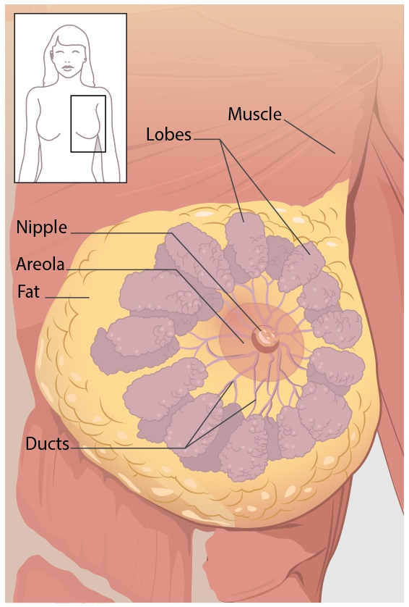
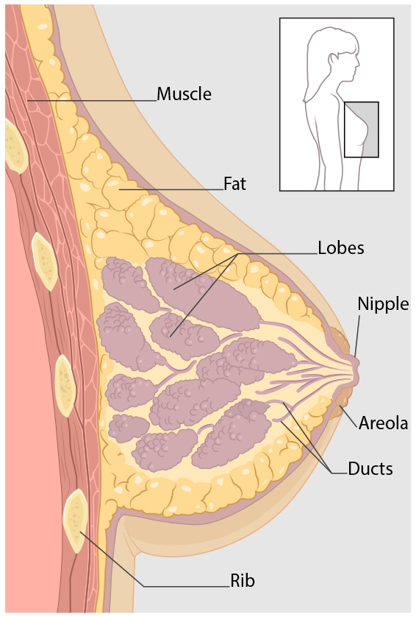
Anatomy of the Breast
Breast cancer can begin in different parts of the breast.
A breast is made up of three main parts: lobules, ducts, and connective tissue.
The lobules are the glands that produce milk. The ducts are tubes that carry milk to the nipple. The connective tissue (which consists of fibrous and fatty tissue) surrounds and holds everything together. Most breast cancers begin in the ducts or lobules.

Slide 4
Types of Breast Cancer
- Ductal Carcinoma In Situ (DCIS)
- Invasive Ductal Carcinoma (IDC)
- Lobular Carcinoma In Situ (LCIS)
- Invasive Lobular Cancer (ILC)
- Triple Negative Breast Cancer
- Inflammatory Breast Cancer (IBC)
- Metastatic Breast Cancer

Slide 5
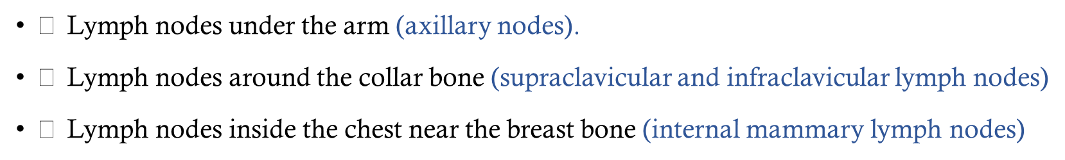
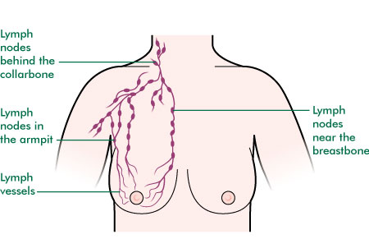
Lymphatic Drainage of the Breast

Slide 6
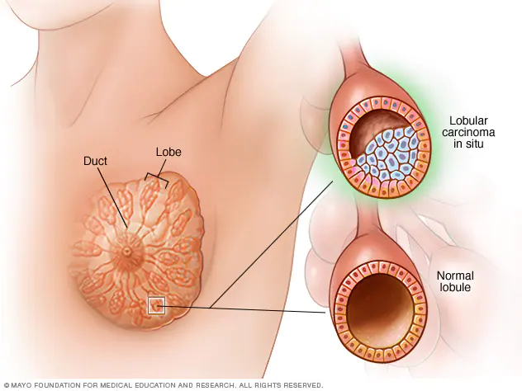
Difference between DCIS & LCIS:
LCIS or “Lobular Carcinoma in Situ” is a type of breast change that is sometimes seen when a breast biopsy is done. LCIS is considered lobular neoplasia and is also known as atypical lobular hyperplasia (ALH). In LCIS, cells that look like cancer cells are growing in the lining of the milk-producing glands of the breast (called the lobules), but they don't invade through the wall of the lobules.
LCIS

Slide 7
LCIS continued..
The diagnosis of LCIS suggests an increase risk of developing breast cancer in the future.
LCIS can be managed through ongoing monitoring chemo prevention using hormone blockers or preventative surgery.
LCIS is considered a marker for increased breast cancer risk in either breast, much like family history.
LCIS may develop invasive ductal or lobular carcinoma .
Mean age of diagnosis 45 – 52 years . More common in Pre-menopausal patients
It could take up to 15 years interval to develop cancer.
Pleomorphic LCIS: is a varying shape and this type is more than a precancer usually treated w/ surgery.

Slide 8
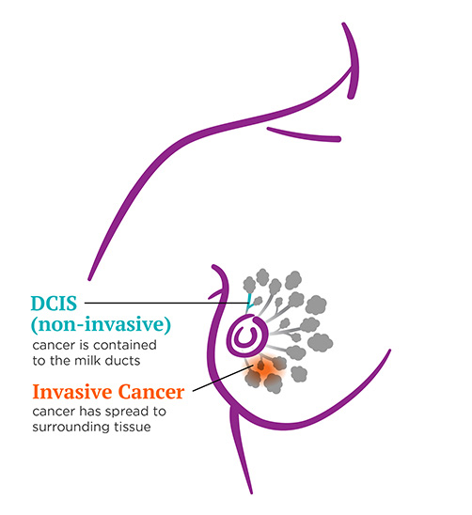
DCIS or “Ductal Carcinoma in Situ”
DCIS refers to abnormal changes in the cells that line the duct.
DCIS is non-life threatening, but if left untreated the abnormal cells may keep on changing and spread out of the duct and into the surrounding tissue→ when this happens it’s called invasive breast cancer.
It’s the most common pre – malignant lesion for Breast Cancer = stage 0

Slide 9
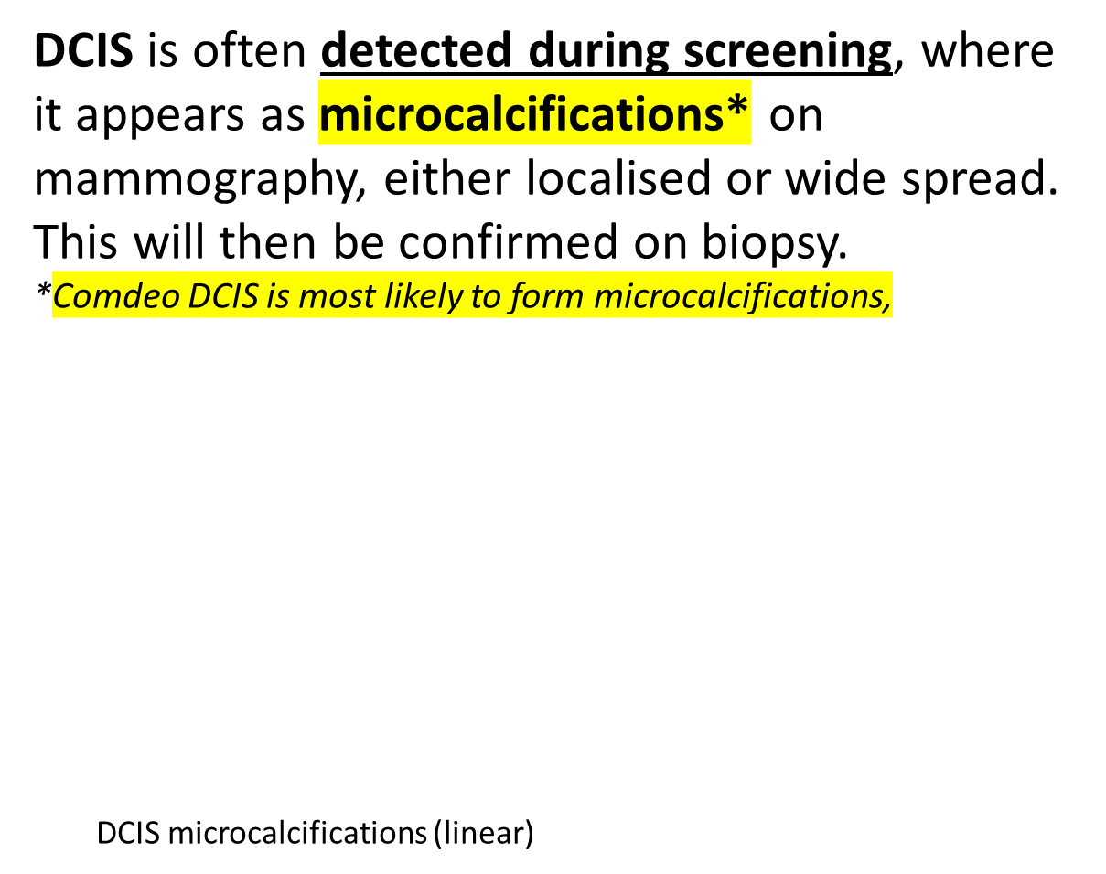
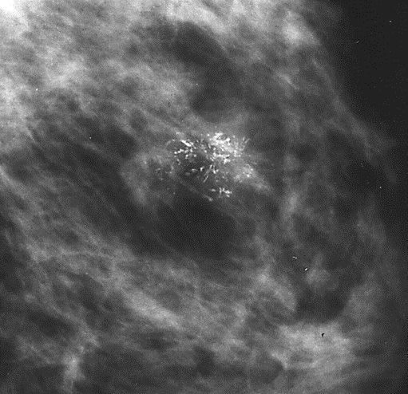
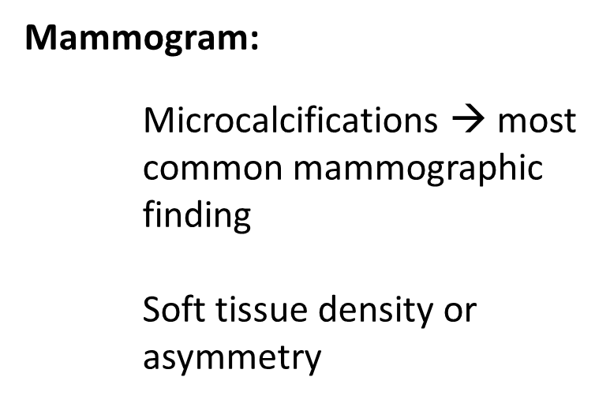

Investigations

Slide 10
Symptoms of DCIS
DCIS doesn't typically have any signs or symptoms. However, DCIS can sometimes cause signs such as:
A breast lump
Bloody nipple discharge
DCIS is usually found on a mammogram and appears as small clusters of calcifications that have irregular shapes and sizes.

Slide 11
Risk Factors of DCIS
Factors that may increase your risk of DCIS include:
Increasing age(30-49 yrs)
Personal history of benign breast disease, such as atypical hyperplasia
Family history of breast cancer
No previous pregnancies
Having your first baby after age 30
Having your first period before age 12
Beginning menopause after age 55
Genetic mutations that increase the risk of breast cancer, such as those in the breast cancer genes BRCA1 and BRCA2

Slide 12
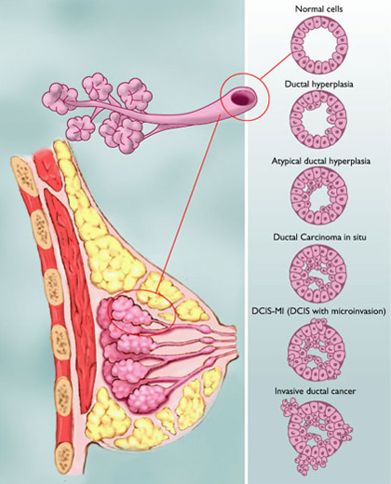
Pathology, Types and Grades of DCIS
All DCIS is considered stage 0 breast cancer — the earliest stage possible. "Stage" describes how far the cancer has spread beyond the site of the original tumor. DCIS can be any size and be located in any number of areas inside the breast.
Knowing the type and grade of DCIS determines the most suitable treatment.
The image shows the range of possible findings, from normal cells all the way to invasive ductal cancer.

Slide 13
Transition of DCIS:
- Normal cells
- Ductal hyperplasia or "overgrowth" means that too many cells are present.
- Atypical ductal hyperplasia means that there are too many cells (hyperplasia) and they are starting to take on an abnormal appearance (atypical or "not typical").
- Ductal carcinoma in situ (DCIS) means that there are too many cells and they have the features of cancer, but they are still confined to the inside the duct. (DCIS is stage 0 breast cancer.)
- DCIS-MI (DCIS with microinvasion) means that a few of the cancer cells have started to break through the wall of the duct. DCIS-MI is stage I breast cancer.
- Invasive ductal cancer (IDC) means that the cancer cells have broken beyond the breast duct. The breast cancer is no longer a DCIS but an invasive ductal carcinoma, the most common type of breast cancer. IDC can be diagnosed at any stage from I-IV.

Slide 14
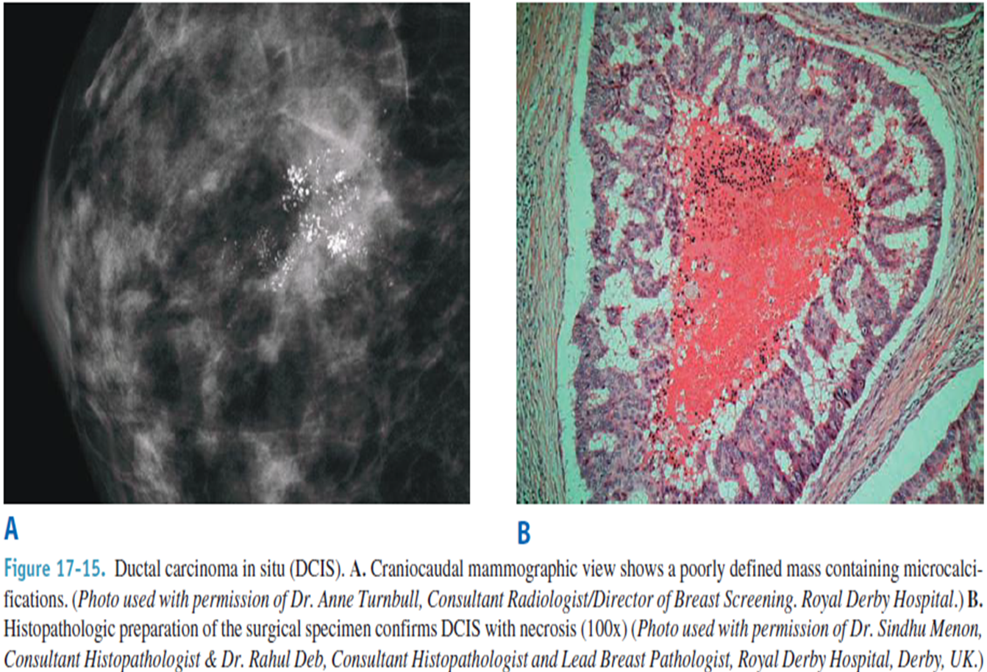


Slide 15
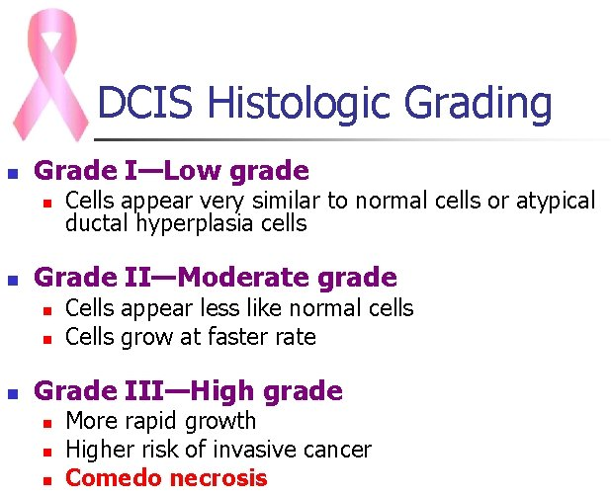
Staging of DCIS
There are three grades of DCIS:
low or grade I; moderate or grade II; and high or grade III.
The lower the grade, the more closely the cancer cells resemble normal breast cells and the more slowly they grow. Sometimes it's difficult to figure out where the cells are on in the range from normal to abnormal. If the cells are in between grades, they may be called "borderline."

Slide 16
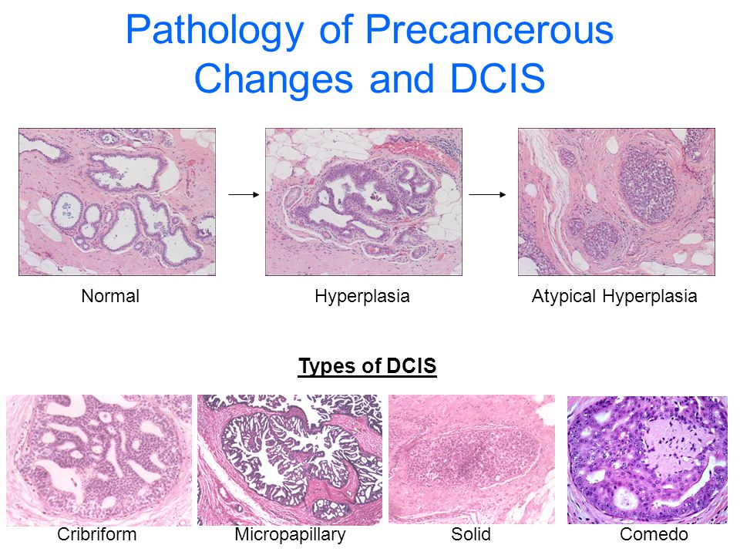

Slide 17
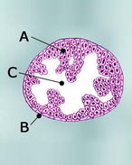
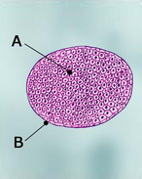
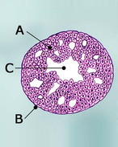
There are different patterns of low-grade and moderate-grade DCIS:
Papillary DCIS: The cancer cells are arranged in a finger-like pattern within the ducts. If the cells are very small, they are called micropapillary.
Solid DCIS: Cancer cells completely fill the affected breast ducts.
Cribriform DCIS: There are gaps between cancer cells in the affected breast ducts (like the pattern of holes in Swiss cheese).

Slide 18
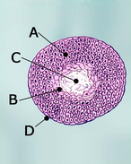
Grade III (high-grade) DCIS
High-grade DCIS is sometimes described as "comedo" or "comedo necrosis." Comedo refers to areas of dead (necrotic) cancer cells, which build up inside the tumor. When cancer cells grow quickly, some cells don’t get enough nourishment. These starved cells can die off, leaving areas of necrosis.
People with high-grade DCIS have a higher risk of invasive cancer, either when the DCIS is diagnosed or at some point in the future. They also have an increased risk of the cancer coming back earlier — within the first 5 years rather than after 5 years.

Slide 19
Recurrence / invasive cancer progression associated with :
  large size cells – in High grade DCIS
  Presence of Comedo
  Positive margins
  Microinvasion through the BM, not exceeding 1 mm can occur.
  DCIS specific mortality is very low (1% - 2.6%)
  Local recurrence range from 11-31% ( high grade > low grade by 20% )

Slide 20
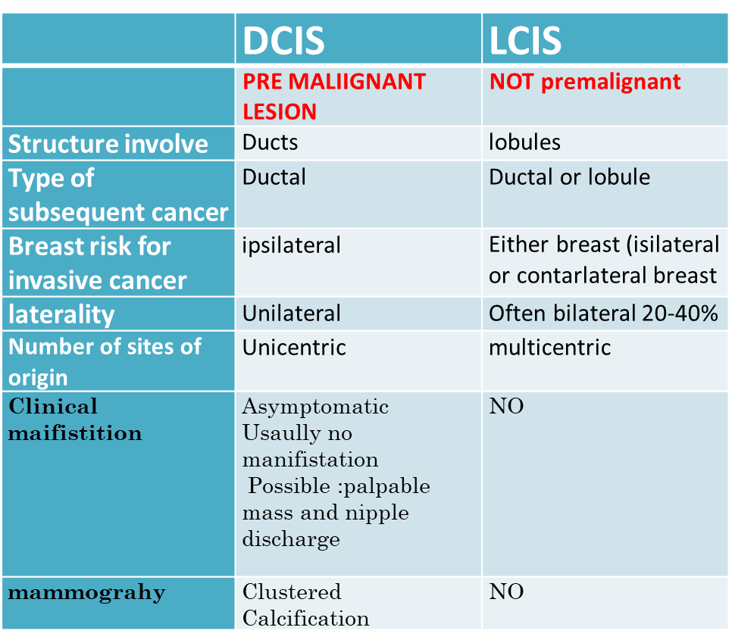

Slide 21
A correlation between ductal proliferative lesions and risk of breast cancer
Usual ductal hyperplasia (UDH) | 1.5-2 fold
Atypical ductal hyperplasia (ADH) | 4-5 folds
Ductal carcinoma in situ (DCIS) | 9-10 folds

Slide 22
Treatment , prognosis and survival rate of breast cancer
Nouf alnafisi 1538910
Sara alnafisi 1538911
Supervisor
Dr Mahmoud al balas

Slide 23
Breast Cancer Prognosis
The overall 5-year relative survival for breast cancer patients from the time period of
2003–2009 from 18 SEER geographic areas was 89.2%.
The 5-year relative survival by race was reported to be 90.4% for White women and 78.7% for black women.
The 5-year survival rate for patients with localized disease (61% of patients) is 98.6%; for patients with regional disease (32% of patients), 84.4%; and for patients with distant metastatic disease (5% of patients), 24.3%.

Slide 24
Incidence : Most common non-skin cancer in women in U.S.
Mortality: 2nd leading cancer killer among women after lung is number 1.
1 in 8 women will be diagnosed with breast cancer in her life.
Incidence is highly elevated in Higher socio-economic status
The main RF for BC is female gender.
the 2nd RF for BC is advanced age .
Having > 2 – 4 risk factors increase the chance of having BC.
Having one RF doesn’t mean that the woman will have BC and every one should know her risk factors

Slide 25
Treatment selection
The type of breast cancer
The stage and grade of the breast cancer - how large the tumor is, whether or not it has spread
Whether or not the cancer cells are sensitive to hormones
The patient's overall health
The age of the patient
The patient's own preferences

Slide 26
Staging of breast cancer
The TNM staging system
This system takes into account:
the tumor size and spread (T),
whether the cancer has spread to lymph nodes (N) and
whether it has spread to distant organs (M) for metastasis

Slide 27
The TNM staging system
Stage 0 cancer means that the cancer is limited to the inside of the milk duct and is a non-invasive cancer. The treatment approaches for these non-invasive breast tumors are often different from the treatment of invasive breast cancer. Stage 0 breast tumors include ductal carcinoma in situ (DCIS). Lobular carcinoma in situ (LCIS) used to be categorized as Stage 0 but this has been changed, because it is not cancer, but does indicate a higher risk of breast cancer
Stage I: These breast cancers are still relatively small and either have not spread to the lymph nodes or have only a tiny area of cancer spread in the sentinel lymph node (the first lymph node to which cancer is likely to spread).
Stage II: These breast cancers are larger than stage I cancers and/or have spread to a few nearby lymph nodes.

Slide 28
The TNM staging system
Stage III: These tumors are larger or are growing into nearby tissues (the skin over the breast or the muscle underneath), or they have spread to many nearby lymph nodes.
Stage IV cancers have spread beyond the breast and nearby lymph nodes to other parts of the body. Treatment for stage IV breast cancer is usually a systemic (drug) therapy.
Recurrent breast cancer : Cancer is called recurrent when it comes back after treatment . Recurrence can be local (in the same breast or in the surgery scar), regional (in nearby lymph nodes), or in a distant area. Treatment for recurrent breast cancer depends on where the cancer recurs and what treatments you’ve had before.

Slide 29
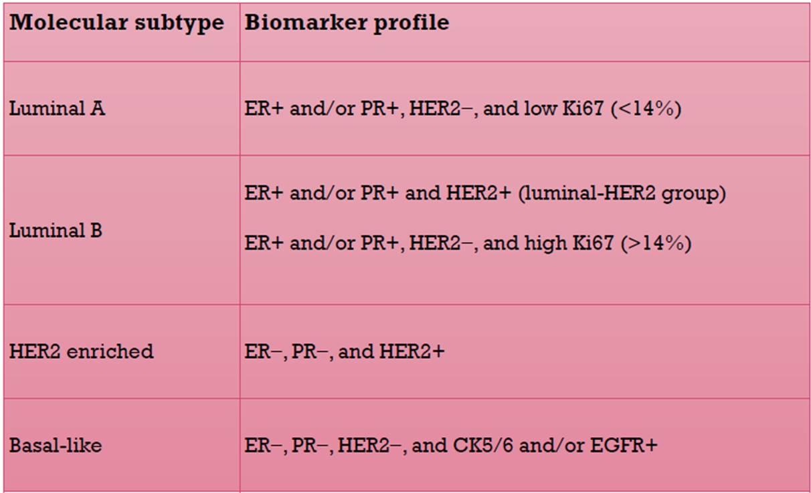
Molecular Subtypes of Breast Cancer
Luminal A cancers
are low-grade,
grow slowly and have the best prognosis
Luminal B cancers
grow slightly faster than luminal A cancers
prognosis is slightly worse.
grow faster than luminal cancers
associated with a poorer prognosis
Triple-negative/ basal like
more common in women with BRCA1 gene mutations. and can have a worse prognosis

Slide 30
Triple-negative breast cancer cells don’t have estrogen or progesterone receptors and also don’t have too much of the protein. HER2 Triple-negative breast cancers grow and spread faster than most other types of breast cancer. Because the cancer cells don’t have hormone receptors, hormone therapy is not helpful in treating these cancers. And because they don’t have much HER2, drugs that target HER2 aren’t helpful, either. Chemotherapy is usually the standard treatment.

Slide 31
Treatment options
Surgery
Radiation therapy
systemic therapy
Lumpectomy
Mastectomy
Lymph node dissection
breast reconstruction
External beam (3D conformal , IMRT)
Brachytherapy (High dose[HDR] or low dose [LDR])
Intraoperative radiation (IORT)
Chemotherapy
Hormonal therapy
Targeted Drug therapy

Slide 32
Breast-conserving surgery (lumpectomy)
(also called a quadrantectomy, partial mastectomy, or segmental mastectomy)
A surgeryin which only the part of the breast containing the cancer is removed.
The goal is to remove the cancer as well as some surrounding normal tissue. How much of the breast is removed depends on the size and location of the tumor and other factors.
but makes it likely she will also need radiation.

Slide 33
Who can get breast-conserving surgery?
Are very concerned about losing her breast
Are willing to have radiation therapy
Have not already had her breast treated with radiation therapy or BCS Have only one area of cancer on the breast, or multiple areas that are close enough to be removed together without changing the look of the breast too much
Have a small tumor (5 cm [2 inches] or smaller)
Are not pregnant or, if pregnant, will not need radiation therapy immediately (to avoid risking harm to the fetus)
Do not have a genetic factor such as a BRCA mutation, which might increase chance of a second cancer
Do not have certain serious connective tissue diseases such as scleroderma or lupus, which may make you especially sensitive to the side effects of radiation therapy
Do not have inflammatory breast cancer

Slide 34
Choosing between breast-conserving surgery and mastectomy
Many women with early-stage cancers can choose between breast-conserving surgery (BCS) and mastectomy.
The main advantage of BCS is that a woman keeps most of her breast.
But in most cases she will also need radiation.
Women who have mastectomy for early stage cancers are less likely to need radiation. For some women, mastectomy may be a better option, because of the type of breast cancer, the large size of the tumor, previous treatment history, or certain other factors. Some women might be worried that having a less extensive surgery might raise their risk of the cancer coming back. But the fact is, in most cases, mastectomy does not give you any better chance of long-term survival or a better outcome from treatment. Studies following thousands of women for more than 20 years show that when BCS can be done along with radiation, having a mastectomy instead does not provide any better chance of survival.

Slide 35
Side effects of breast-conserving surgery :
Pain or tenderness or a "tugging" sensation in the breast
Temporary swelling
Hard scar tissue that forms in the surgical site
Change in the shape of the breast Nerve (neuropathic) pain (sometimes described as burning or shooting pain) in the chest wall, armpit, and/or arm that doesn’t go away over time.
This can also happen in mastectomy patients and is called post-mastectomy pain syndrome or PMPS.

Slide 36
Mastectomy
A surgery in which the entire breast is removed, including all of the breast tissue and sometimes other nearby tissues
It’s often done when a woman cannot be treated with breast-conserving surgery (lumpectomy), which spares most of the breast.
It can also be done if a woman chooses mastectomy over breast-conserving surgery for personal reasons.
Women at very high risk of getting a second cancer sometimes have a double mastectomy, the removal of both breasts

Slide 37
Types of mastectomies
Simple (or total) mastectomy In this procedure, the surgeon removes the entire breast, including the nipple, areola, and skin. Some underarm lymph nodes may or may not be removed depending on the situation. Most women, if they are hospitalized, can go home the next day.
Skin-sparing mastectomy
most of the skin over the breast is left intact. Only the breast tissue, nipple and areola are removed.
Nipple-sparing mastectomy
a variation of the skin-sparing mastectomy. In this procedure, the breast tissue is removed, but the breast skin and nipple are left in place.

Slide 38
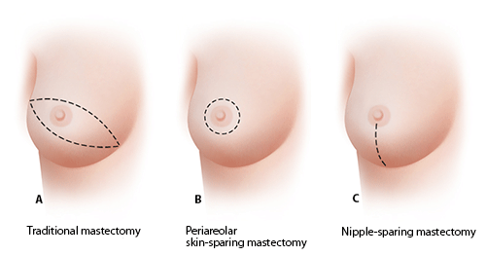

Slide 39
radical mastectomy
A modified radical mastectomy combines a simple mastectomy with the removal of the lymph nodes under the arm (called an axillary lymph node dissection).
Radical mastectomy In this extensive operation, the surgeon removes the entire breast, axillary (underarm) lymph nodes, and the pectoral (chest wall) muscles under the breast.
Double mastectomy
If a mastectomy is done on both breasts, it is called a double
it is often a risk-reducing surgery
for women at very high risk for getting breast cancer, such as those with a BRCA gene mutation.

Slide 40
Inductions for Mastectomy
If the Pt was unable to have radiation therapy
recurrence tumor post BCS
Multiple tumor in the same breast
Having a larger tumor (greater than 5 cm )
Have a genetic factor such as a BRCA mutation, which might increase your chance of a second cancer
Have a serious connective tissue disease such as scleroderma or lupus, which may make you especially sensitive to the side effects of radiation therapy
Have inflammatory breast cancer

Slide 41
Lymph Node Surgery for Breast Cancer
Sentinel lymph node biopsy (SLNB)
the surgeon finds and removes the first lymph node(s) to which a tumor is likely to spread
the surgeon injects a radioactive blue dye into the tumor (do breast massage for 15 minutes, up to 3 SLN are required to asses the status of axillary nodes, if positive we do LN dissection.
Axillary lymph node dissection (ALND)
about 10 to 40 lymph nodes are removed
Usually done at the same time as the mastectomy or breast-conserving surgery
Side effects :
Lymphedema This is less common after (SLNB) than (ALND).
Limited arm and shoulder movement is more common after ALND than SLNB
Numbness of the skin on the upper arm

Slide 42
Complications of axillary LN dissection
Side effects LN dissection :
Chronic | Acute
Chronic pain more than 2 weeks | Hematoma
Parestesia | Seroma
Lymph edema | Pain
 | Limited arm movement

Slide 43
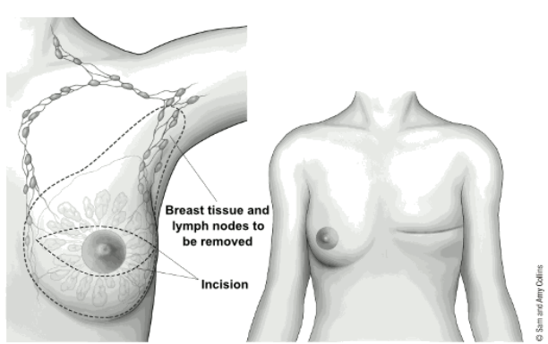
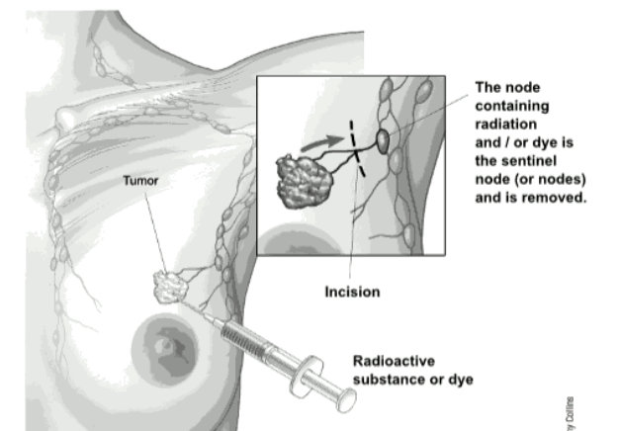
Axillary lymph node dissection (ALND)
Sentinel lymph node biopsy (SLNB)

Slide 44
Adjuvant and neo-adjuvant therapy
Adjuvant systemic therapy: After surgery (Chemotherapy and hormone therapy).
All node-positive patients should receive adjuvant chemotherapy
Neo-adjuvant therapy Before surgery ,
Patients with ER-positive tumors receive adjuvant hormonal therapy for 5 years.
Tamoxifen is given to premenopausal women, and
Aromatase inhibitors are given to postmenopausal women.

Slide 45
external beam Radiation therapy
External beam radiation is the most common type of radiation therapy
Breast radiation therapy – applied after a lumpectomy
Chest wall radiation therapy – applied after a mastectomy the mastectomy scar, and the places where any drains exited the body after surgery
Complications. Radiation to the chest wall can cause skin changes pain , hair loss , fatigue .
Infrequent complications include interstitial pneumonitis, spontaneous rib fracture, breast fibrosis, pericarditis, pleural effusion, and chest wall myositis. Radiation to the axilla can increase the incidence of lymphedema and axillary fibrosis.
Angiosarcoma can occur as a late

Slide 46
Brachytherapy
also known as internal radiation, is another way to deliver radiation therapy. Instead of aiming radiation beams from outside the body, a device containing radioactive seeds placed into the breast tissue for a short time in the area where the cancer had been removed.
For women who had (BCS), brachytherapy can be used along with external beam radiation.
Tumor size, location, and other factors may limit who can get brachytherapy.

Slide 47
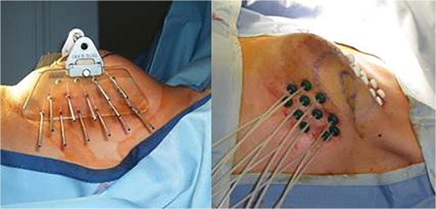
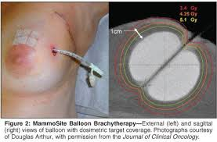
Types of brachytherapy
Interstitial brachytherapy: In this approach, multiple small catheters are inserted into the breast around the area where the cancer was removed and are left in place for several days.
it is not used as much anymore
Intracavitary brachytherapy (one drain only ) This is the most common type of brachytherapy for women with breast cancer. A device is put into the space left from BCS and is left in place until treatment is complete. There are several different devices available most of which require surgical training for proper placement

Slide 48
Chemotherapy
anti-cancer drugs that may be given IV or by mouth.
adjuvant chemotherapy : Adjuvant chemo is used to try to kill any cancer cells that might have been left behind or have spread but can't be seen
neoadjuvant chemotherapy can be used to try to shrink the tumor so it can be removed with less extensive surgery
For advanced breast cancer be used as the main treatment for women whose cancer has spread outside the breast and underarm area
cyclophosphamide, methotrexate and 5-fluorouracil (CMF) will achieve a 25 per cent reduction in the risk of relapse over a 10- to 15-year period.
Newer ‘biological’ agents will be used more frequently as molecular targets are identified – the first of these, trastuzamab (Herceptin), is active against tumours containing the growth factor receptor c-erbB2.
trastuzamab (Herceptin ) : using in HER2 subtype molecular
Side effect of trastuzamab : cardiotoxicity; we must do ECO

Slide 49
Side effect
Short – term side effects · Hair loss · Loss of appetite or increased appetite · Nausea and vomiting · A higher risk of infection · Stopping of menstrual periods · Easy bruising or bleeding · Being very tired
Long - term side effects
Menstrual changes: infertility
Nerve damage: pain, burning or tingling and sensitivity to cold or hot.
Heart damage

Slide 50
Hormone therapy
Some types of breast cancer are affected by hormones in the blood. ER-positive and PR-positive breast cancer1 cells have receptors (proteins) that attach to estrogen
adjuvant therapy VS neoadjuvant therapy
These drugs work by stopping estrogen from stimulating breast cancer cells to grow.
Tamoxifen has been the most widely used ‘hormonal’ treatment in breast cancer it has now been shown to reduce the annual rate of recurrence by 25 per cent
It is usually taken for at least 5 years
Tamoxifen: selective estrogen receptor:

Slide 51
Hormone therapy
the oral aromatase inhibitors (AIs) for postmenopausal women The latter group of compounds are now licensed for treatment of recurrent disease, in which they have been shown to be superior to tamoxifen. anastrazole to tamoxifen in the adjuvant setting has shown a beneficial effect for the aromatase inhibitor in terms of relapse-free survival, although no benefit for overall survival. There is an additional reduction in contralateral disease, which makes this drug suitable for a study of prevention, and the side-effect profile is different from that of tamoxifen. The AIs have been more expensive than tamoxifen but are all coming off patent protection and generic copies may allow more widespread use. There is an increase in bone density loss with patients on an AI and a bone density scan is advised prior to commencement with treatment of
underlying osteopenia or osteporosis.
-Prevent conversion of androgen to estrogen
-used in postmenopausal women
anti-estrogen on breast , but agonist on endometrium (so it increased the risk for endometrial cancer.)

Slide 52
Prognosis and survival rates :
According to stages we know the survival rates of breast cancer
Estimated five year survival rates:
stage I: ~87%
stage II: ~75%
stage III: ~46%
stage IV: ~13%

Slide 53
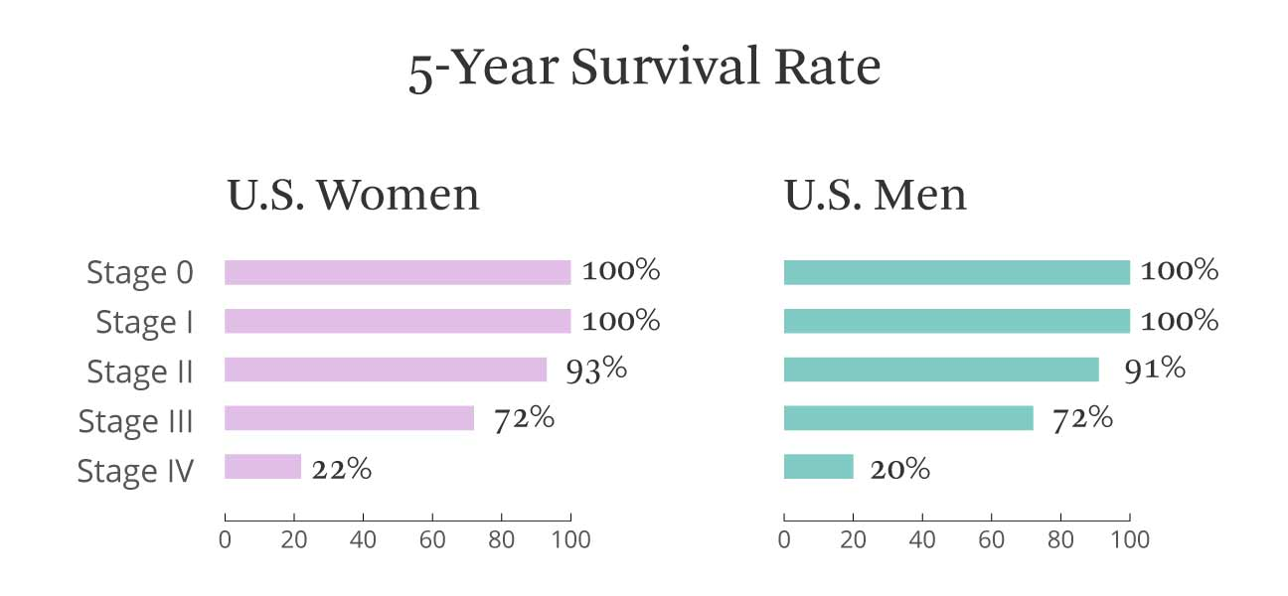
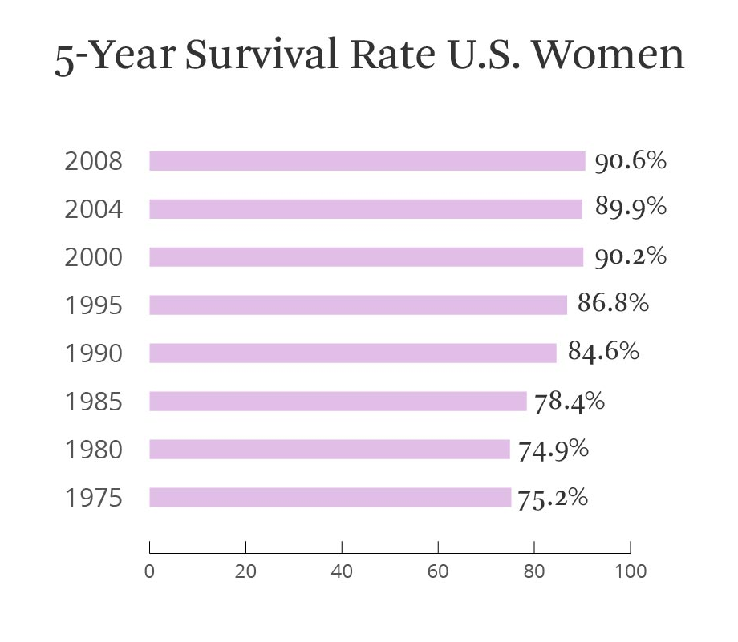
Prognosis
https://www.healthline.com/health/breast-cancer/survival-facts-statistics#1

Slide 54
Invasive breast carcinoma
Loay nasser alsurkhy
Abdulrahman saadeh

Slide 55
Invasive ductal carcinoma (IDC)
Characteristics
  Most common type of invasive breast cancer (∼ 80%) ^{[11]}
  Aggressive formation of metastases
Localization
  Unilateral
  Mostly unifocal

Slide 56
Medullary breast cancer
Characteristics
  Rare subtype of invasive ductal carcinoma
  Most common tumor associated with the BRCA1 mutation
  Well-circumscribed soft tumor with smooth borders (may appear benign)
  Usually triple-negative
  Lymphadenopathy
Differential diagnosis: fibroadenoma

Slide 57
Invasive lobular carcinoma (ILC)
Characteristics
  ∼ 10% of all invasive breast carcinomas
  Less aggressive than ductal carcinoma
Localization
  Bilateral in ∼ 20% of cases
  Frequently multifocal

Slide 58
Less common subtypes
Mucinous carcinoma (< 5%; more common in older women)
Mixed carcinoma (ductal/lobular)
Tubular carcinoma
Papillary carcinoma
Micropapillary carcinoma

Slide 59
Clinical features
Most commonly, individuals with breast cancer develop clinical symptoms in later stages of disease.
Early stages
In early stages, affected individuals may notice a palpable mass with the following characteristics:
Typically single, nontender, and firm
Poorly defined margins
Most commonly located in the upper outer quadrant (∼ 55%)

Slide 60
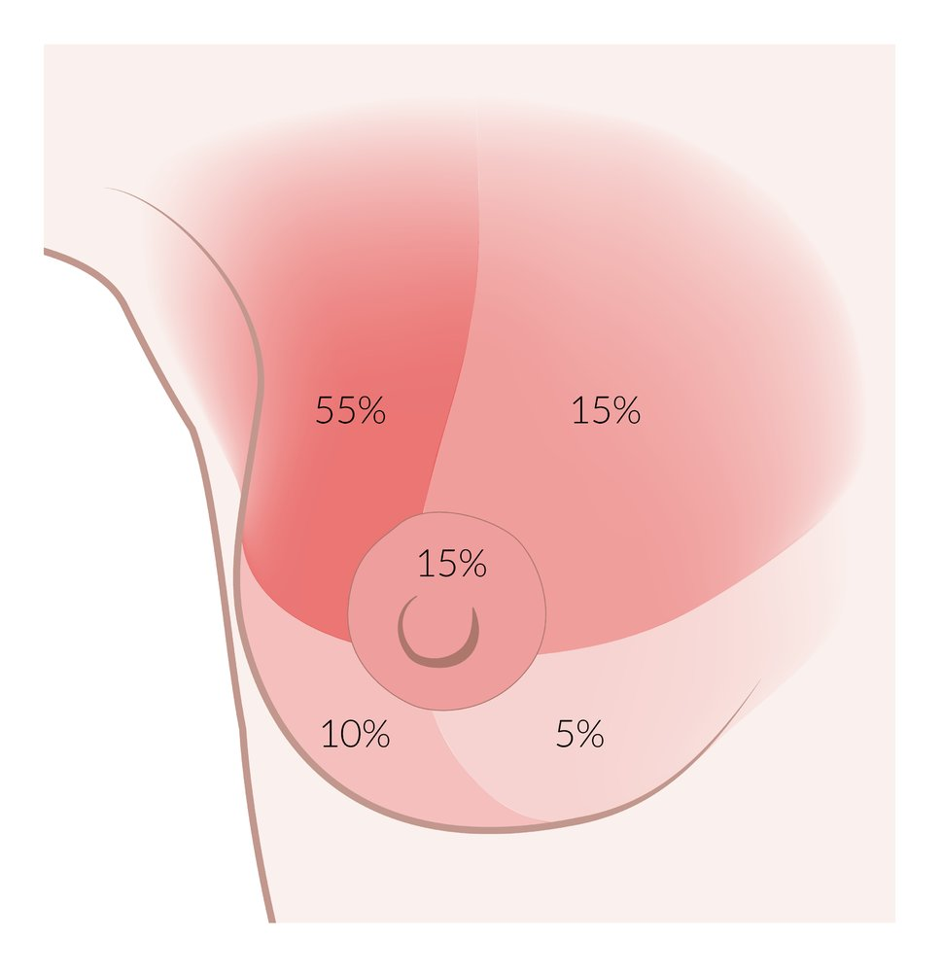

Slide 61
Locally advanced disease
Locally advanced disease is characterized by a number of changes affecting the appearance of the breast. These include:
Morphology: changes in size and/or shape → asymmetric breasts
Skin
  Retractions or dimpling (due to fixation to the pectoral muscles, deep fascia, Cooper ligaments, and/or overlying skin)
  Peau d'orange
Nipple
  Inversion
  Blood-tinged discharge

Slide 62
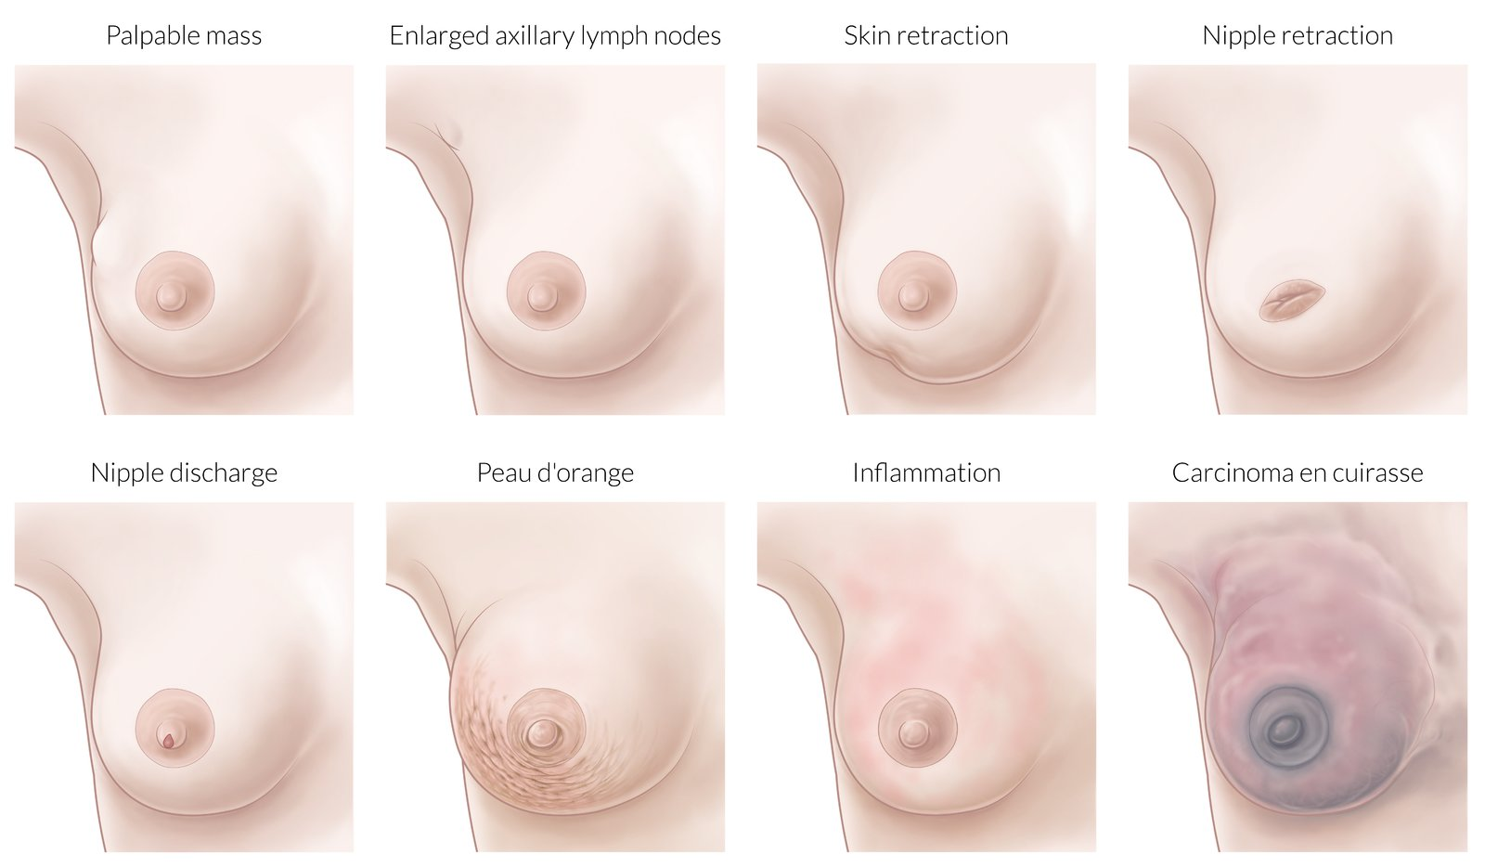
To make skin retractions more visible, it can be helpful to gently stretch the skin or elevate the patient's arm

Slide 63
Progressive disease
Ulcerations
Edema of the arm
Paget disease of the nipple

Slide 64
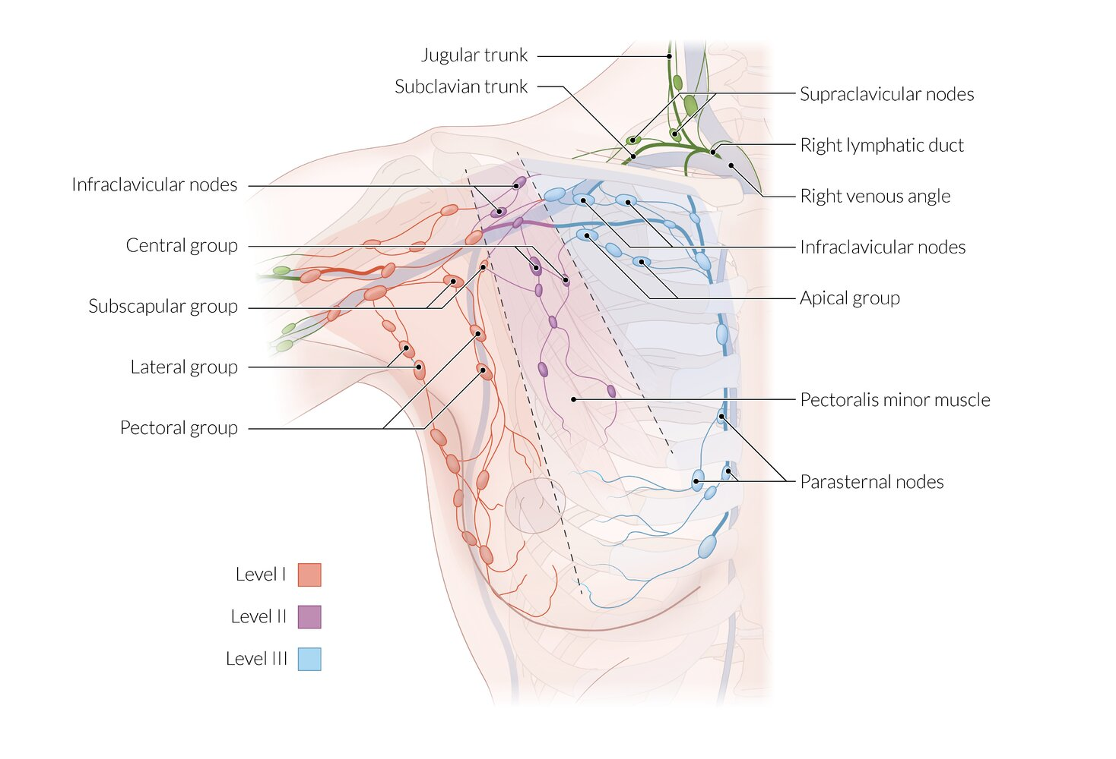
Signs of metastatic disease
Lymphatic spread
Lymphadenopathy Nontender, firm, enlarged lymph nodes (> 1 cm in size), that are fixed to the skin or surrounding tissue
Most commonly the axillary nodes and, in later stages, the supraclavicular and/or infraclavicular nodes

Slide 65
Hematogenous spread
Distant metastases of breast cancer can produce a number of heterogeneous symptoms.
Bone : pain pathological fractures , spinal compression
Liver : Abdominal pain., distention Nausea jaundice
Lung : cough hemoptysis dyspnea chest pain
Brain :headache seizures Cognitive deficits, focal neurological deficits

Slide 66
Invasive lobular carcinoma-
Malignant cells in lobules
Monomorphic cells in a single file pattern due to a decrease in E-cadherin expression
Absence of new duct formation
Often without desmoplastic response

Slide 67
Paget disease of the breast
Definition: a rare type of breast cancer that affects the lactiferous ducts and the skin of the nipple and areola
Pathogenesis
  Not fully understood
  The following two hypotheses have been postulated: ^{[14]}
    Migratory/epidermotropic theory: neoplastic ductal epithelial cells from an underlying DCIS or IDC move through the lactiferous ducts and invade the surrounding epidermis of the nipple.
    In situ malignant transformation of existing cells into Paget cells, meaning that the condition is a carcinoma in situ, without preexisting DCIS/IDC.

Slide 68
Paget disease of the breast
Clinical features Erythematous, scaly, or vesicular rash affecting the nipple and areola
Pruritus; burning sensation
Nipple retraction
Ulceration that causes blood-tinged nipple discharge
Diagnostics
  Punch/wedge or surface biopsy of nipple tissue: Paget cells confirm disease.
  Imaging to look for underlying DCIS/IDC (see “Diagnostics” below)
Differential diagnosis: mamillary eczema
Treatment
  Breast-conserving surgery with subsequent adjuvant whole-breast radiation (see “Treatment” below)
  Mastectomy

Slide 69
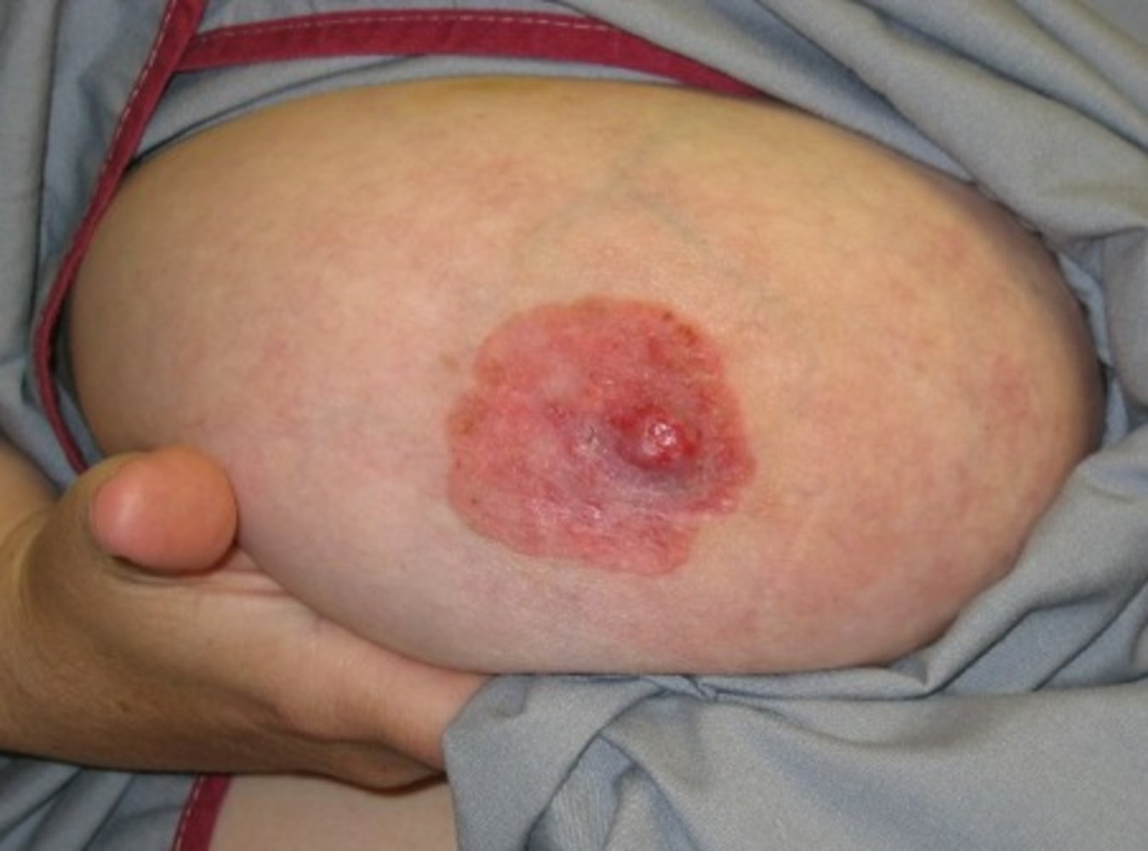

Slide 70
Inflammatory breast cancer (IBC) ^{[15]}
Definition: a rare form of advanced, aggressive invasive carcinoma characterized by dermal lymphatic invasion of tumor cells
Clinical features
  Peau d'orange
    Erythematous, warm, and edematous skin plaques with prominent hair follicles that resemble orange peel
    Caused by obstruction of the lymphatic channels due to tumor growth
  Tenderness, burning sensation
  Blood-tinged nipple discharge
  Signs of metastatic disease (e.g., axillary lymphadenopathy) ^{[16]}
  Usually no palpable mass

Slide 71
Inflammatory breast cancer (IBC) ^{[15]}
Diagnostics: based on clinical features and biopsy ^{[17]}Diagnostic criteria (all must be met)
  Rapid onset of breast erythema, edema, warmth, and peau d'orange, with or without palpable mass on breast examination
  Erythema involving at least one-third of the breast
  Symptoms have been present for < 6 months
  Core needle biopsy confirming the presence of invasive carcinoma
Skin punch biopsy: patients who meet the diagnostic criteria should undergo at least two full-thickness skin punch biopsies

Slide 72
Inflammatory breast cancer (IBC) ^{[15]}
Differential diagnosis
  Mastitis
  Paget disease of the breast
  Breast abscess
Treatment: chemotherapy (possibly in combination with targeted therapy) PLUS radiation PLUS modified radical mastectomy

Slide 73
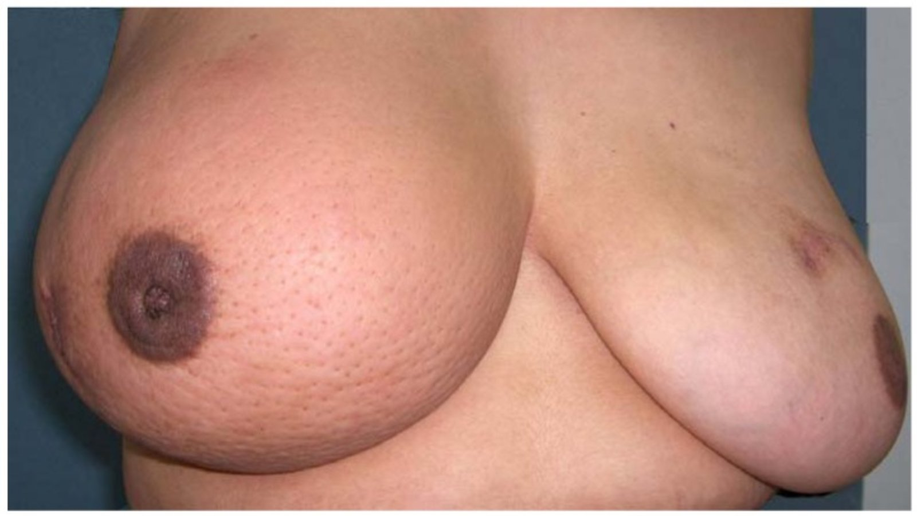
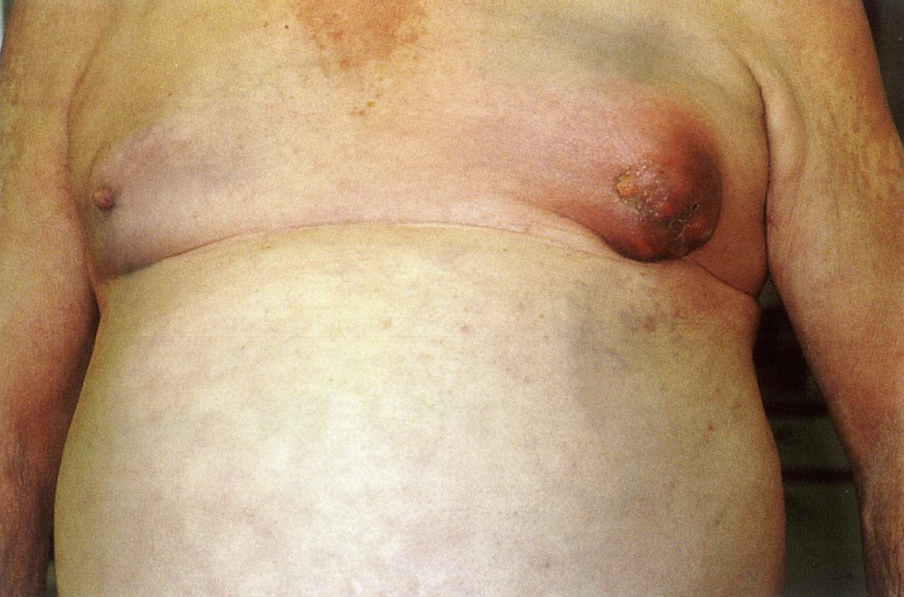
Inflammatory breast cancer is always classified as T4 because it involves the skin.

Slide 74
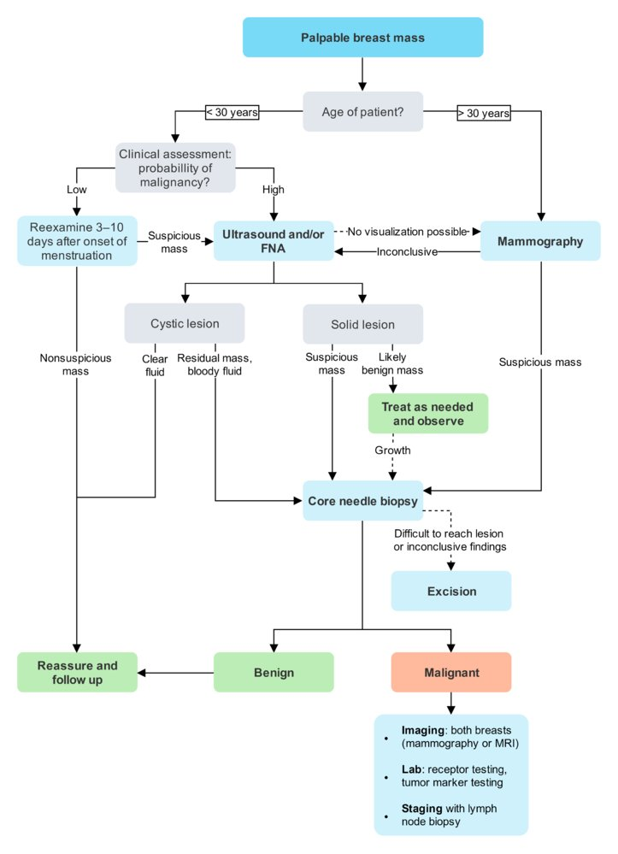
Approach to suspected breast cancer
Most patients are referred for assessment after abnormalities are detected on routine mammography screening. Alternatively, young women, who are not routinely screened, may present with a mass they have found during self-examination.

Slide 75
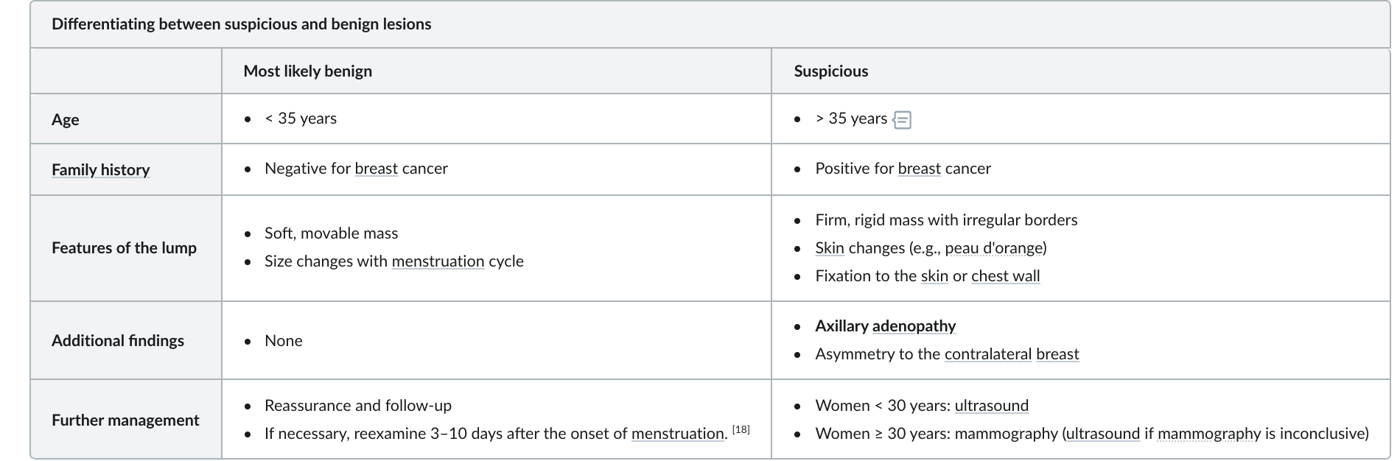
Clinical assessment

Slide 76
Radiographic imaging
Radiographic imaging
Women < 30 years of age should undergo breast ultrasound; higher breast tissue density makes detection of breast abnormalities with mammography more difficult.
Women ≥ 30 years of age should undergo mammography.
Breast ultrasound ^{[19]}
Allows solid lesions to be differentiated from benign cysts
Includes the evaluation of axillary, supraclavicular, and infraclavicular lymph nodes

Slide 77
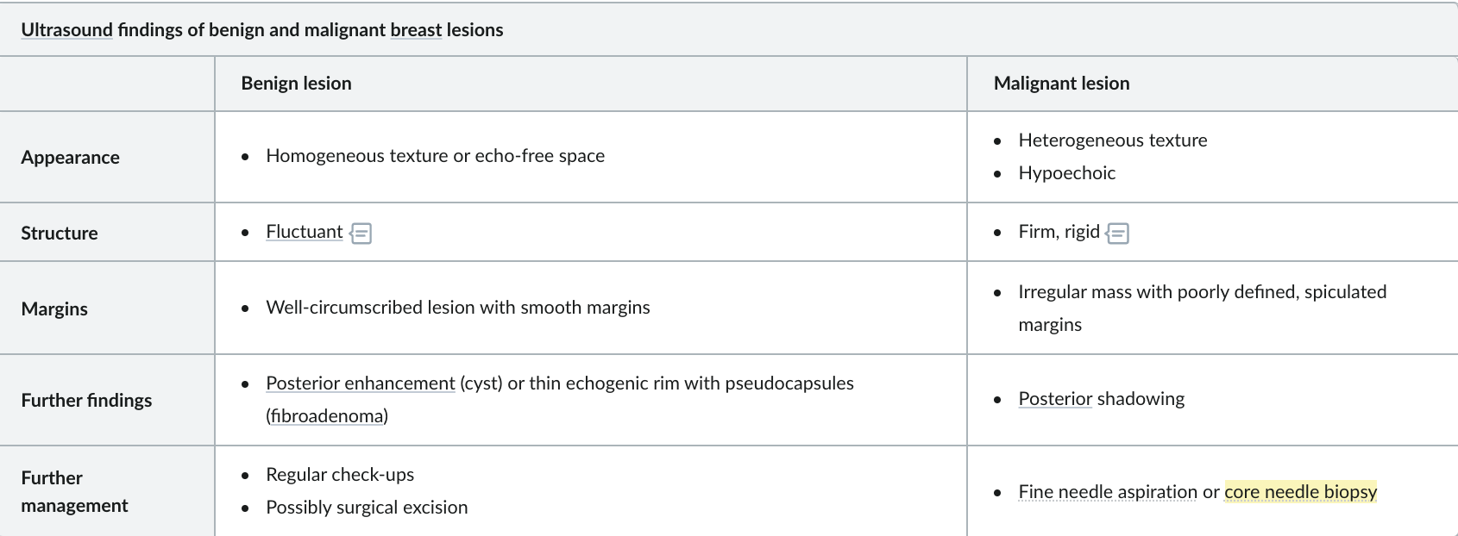
Radiographic imaging

Slide 78
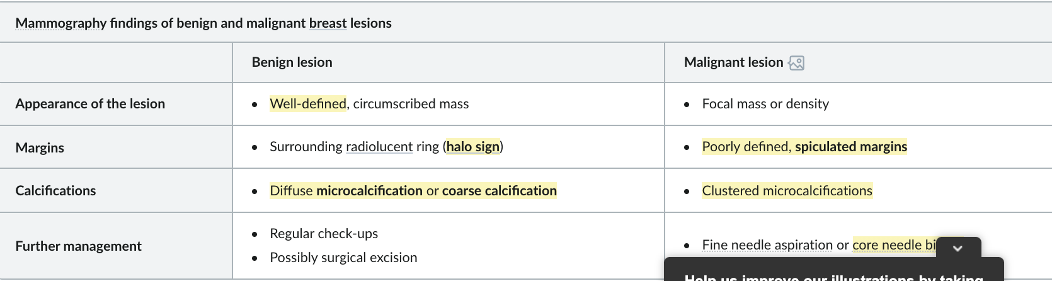
Mammography
Two low-dose x-rays of the breast are obtained (mediolateral oblique and craniocaudal) to screen for breast abnormalities.
Used for early detection of breast abnormalities: Mammography detects the majority of cancers and can detect lesions ∼ 2 years before they are clinically evident.

Slide 79
In postmenopausal women and women ≥ 40 years of age with a suspicious breast mass, mammography is preferred over ultrasound. In premenopausal women < 40 years of age, ultrasound is preferred, because the higher density of breast tissue decreases the diagnostic power of mammography.
Mammography has greatly improved the rate of early detection of noninvasive carcinomas.

Slide 80
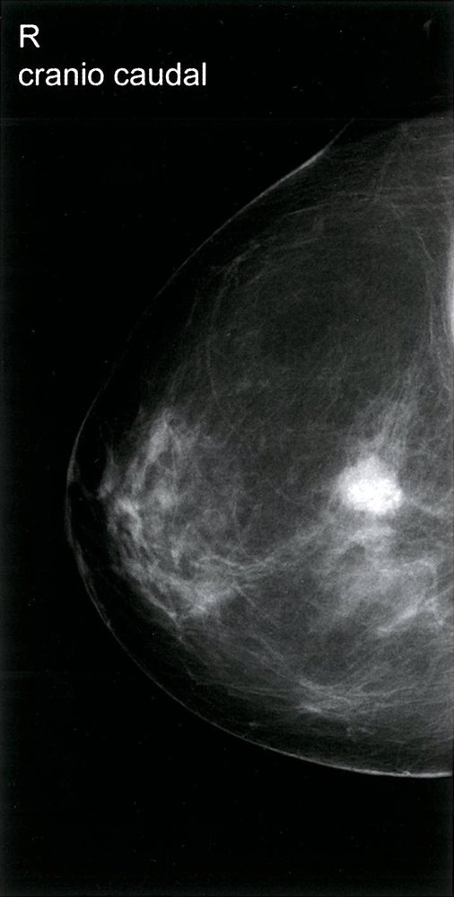
Suspicious breast mass
Mammography (right breast; craniocaudal view)
A mass (circled) with suspicious features, including high density and indistinct margins, is visible in the posterior third of the breast.

Slide 81
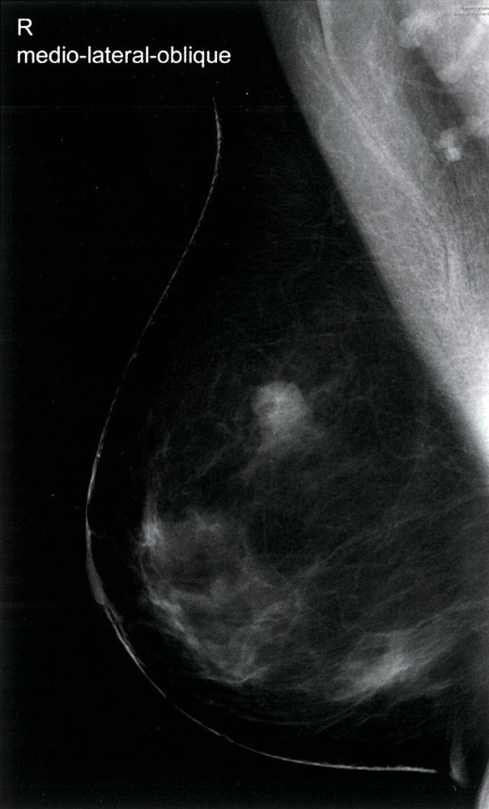
Mammography of the right breast (mediolateral oblique view)
A poorly defined lesion with radial protrusions is visible (green circular overlay). This finding is consistent with breast cancer.

Slide 82
Biopsy
Fine-needle aspiration (FNA)
Description: a procedure in which a thin, hollow needle is repeatedly inserted into a suspicious lesion to collect cell samples for analysis
Indication
  Preferred tool for assessing a breast mass with a low probability of being malignant
  May also be used for follow-up and assessment of response to treatment
  See “Benign breast conditions.”

Slide 83
FNA
Advantages
  Simple and fast technique
  Minimally invasive
  Especially suited for lesions close to the skin
  No anesthesia required
  Low risk of complications
Disadvantages
  Small sample are associated with a high false-positive rate.
  Cannot be used to distinguish between noninvasive and invasive carcinoma
  If cytology results indicate a potential for malignancy, a core needle biopsy is required to confirm the diagnosis. ^{[20]}

Slide 84
Core needle biopsy (CNB)
Description: a type of biopsy performed with a larger needle under image guidance using sonography, mammography, or MRI
Indication: preferred tool for assessing a suspicious breast mass on ultrasound or mammography
Advantages
  Can be used to confirm the diagnosis (preferred test)
  Used to distinguish between noninvasive and invasive carcinoma based on histology (see “Pathology” below)
  Allows testing for receptor status
Disadvantages
  Invasive procedure
  Local anesthesia required
  Higher risk of complications (e.g., hematoma, pain) compared to FNA

Slide 85
Surgical biopsy
Description
  Incisional biopsy: surgical removal of a part of the suspicious mass
  Excisional biopsy: The entire mass and potentially a safety margin with healthy tissue is surgically removed.
Indication
  Should only be used if CNB is not feasible or results of CNB are inconclusive
  Full-thickness skin biopsy (punch biopsy) should be performed if inflammatory breast cancer or Paget disease of the breast is suspected.
Advantages
  Provides a larger tissue sample for a more accurate diagnosis
  Immediate resection of the tumor is possible.
Disadvantages
  Highly invasive procedure
  General anesthesia required
  Highest risk of complications (e.g., bleeding, surgical site infection) compared to FNA or CNB

Slide 86
Work up for diagnosed breast cancer
Receptor testing
Overview
Refers to the determination of receptor overexpression in breast cancer biopsy samples
Receptor status is crucial in the development of treatment strategies because tumors with overexpression can be targeted directly with hormone therapy or biologics (see “Treatment” below).
Hormone receptors
Analysis involves immunohistochemical staining.
80% of breast cancers are positive for overexpression of at least one hormone receptor:
  ∼ 75% of breast cancers are estrogen receptor-positive (ER-positive).
  ∼ 65% of breast cancers are progesterone receptor-positive (PR-positive).
  ∼ 65% of breast cancers are positive for both receptors.
  ∼ 20% of breast cancers are negative for both receptors.

Slide 87
Human epidermal growth factor receptor 2 (HER2/neu, c-erbB2) ^{[23]}
An epidermal growth factor receptor with intracellular tyrosine-kinase activity that promotes cell growth and differentiation and inhibits apoptosis.
∼ 20% of breast cancers are HER2-positive.
Analysis involves immunohistochemical staining for HER2/neu and, in some cases, FISH.
HER2-positive breast cancer can be treated with therapeutic receptor inhibition, which can help to slow cancerous growth and decrease cancer mass (see “Trastuzumab” below).

Slide 88
Tumor markers
CEA
CA 15-3
CA 27-29
tumor markers can not be used to detect breast cancer because they lack sensitivity and specificity. In newly diagnosed breast cancer, however, they can be used for monitoring therapeutic success (e.g., the response to systemic therapy or success of surgical tumor removal).

Slide 89
treatment
Depends on the histopathologic classification and cancer stage
Involves a combination of surgical management and systemic therapy (chemotherapy, hormone therapy, targeted therapy)
Patient preference for more or less aggressive management plays a significant role in selecting the treatment approach.
Breast-conserving surgery (BCT)
Definition: a type of surgery that focuses on the removal of cancerous breast tissue only, in contrast to full-breast mastectomy
Contraindications
  Large tumor-to-breast volume ratio
  Multifocal tumors
  Fixation to the chest wall
  Involvement of the skin or nipple
  Subareolar location
  History of chest radiation
  Excision with negative tumor margins (> 2 mm) not guaranteed
  Clustered microcalcifications on imaging

Slide 90
Mastectomy
A mastectomy involves the removal of the entire breast and, depending on the specific procedure, possibly other structures, such as lymph nodes and muscles.
Total mastectomy
Skin-sparing mastectomy
Nipple-sparing mastectomy
Radical mastectomy

Slide 91
Radiation
Classically follows surgery
Indicated for patients with a high risk of local recurrence (e.g., positive lymph nodes, cancer in deep margin)

Slide 92
Chemotherapy
Overview
  Can be given as neoadjuvant or adjuvant chemotherapy
  Usually combination therapy
Indications
  Tumor size > 2 cm
  Triple-negative breast cancer and tumor size ≥ 0.5 cm
  HER-2 positive breast cancer and tumor size > 1 cm
  Positive lymph nodes
  Aggressive tumor histology
Regimens
  FEC-D: 5-fluorouracil PLUS epirubicin PLUS cyclophosphamide, followed by docetaxel
  CMF: cyclophosphamide PLUS methotrexate PLUS fluorouracil

Slide 93
Hormone therapy
Indication: all ER/PR-positive tumors
Goal: suppression of extraovarian hormone production and blockade of estrogen receptors in order to decrease the risk of breast cancer recurrence
Contraindication: pregnancy
Hormone-containing contraceptives are contraindicated in patients with breast cancer. Copper IUDs contain no hormones and are therefore the preferred contraceptive option.
Premenopausal
  Tamoxifen GnRH agonists
Postmenopausal: aromatase inhibitors
Preventive: raloxifene

Slide 94
Targeted therapy
Trastuzumab
Definition: humanized monoclonal antibody against the HER2 tyrosine kinase receptor that is used in the treatment of HER2-positive breast and gastric cancer
Mechanism of action: targets HER2/neu (c-erbB2) tyrosine kinase receptor → ↓ of HER2 initiated cellular signaling and ↑ antibody-dependent cytotoxicity → ↓ tumor growth
Indication: all HER2-positive tumors
Side effects
  Cardiotoxicity (e.g., dilated cardiomyopathy with systolic CHF): An echocardiogram is recommended prior to initiating treatment to evaluate cardiac function.
  Gastrointestinal symptoms (e.g., diarrhea, nausea)
Contraindication: pregnancy
Trastuzumab causes dilated cardiomyopathy: If you trust trustuzumub, it might break your heart.
For the most important indication of trastuzumab (breast cancer) and its target (HER2), think: Her two (HER2) breasts can be treated with trastwozumab.

Slide 95

Invasive lobular carcinoma
Louy alsurkhi

Slide 96
Introduction
Invasive lobular breast cancer (ILC) is the second most common histologic type of invasive breast cancer and accounts for 5%–10% of all breast cancer cases . ILC is hormonally mediated, more common in older age, tends to be multicentric, estrogen/progesterone receptor (ER/PR) positive and HER2-neu negative . These cancers also tend to present as larger tumors with ill-defined margins and have a unique metastatic pattern, with involvement of gastrointestinal and peritoneal sites . Bilateral breast involvement is also more common in ILC compared to invasive ductal carcinoma (IDC)

Slide 97
Pathogenesis
ILC is thought to be primarily mediated by the loss of E- cadherin , coded by the CDH-1 gene, located on chromosome 16q22 . E-cadherin is a calcium-dependent transmembrane protein that maintains tissue integrity, cell-to-cell adhesion, and prevents tissue invasion. These functions prevent tumor invasion, and thus the E-cadherin gene functions as a tumor suppressor gene. Mutation in CDH-1 is associated with hereditary diffuse gastric carcinoma, a rare form of gastric cancer that accounts for about 2% of cases.

Slide 98
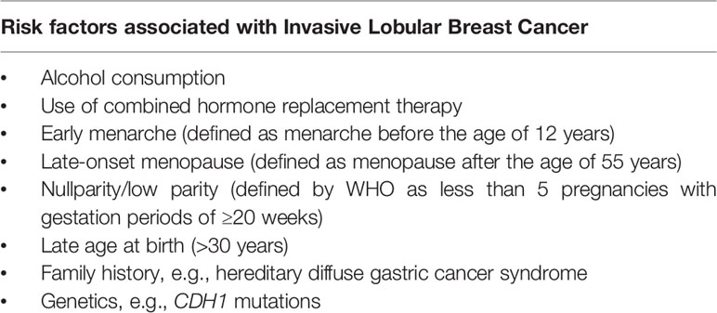
Risk factors

Slide 99
Subtypes
Classic invasive lobular carcinoma :4%–1 5% of infiltrating lobular carcinoma cases , Often associated with lobular carcinoma in situ, More likely multifocal with Risk of contralateral breast involvement: 0.5%–1%/y. 10%–20% bilateral
Invasive pleomorphic lobular carcinoma: has marked cellular atypia, nuclear pleomorphism, and increased mitotic range. These cancers also tend to be hormone receptor negative, larger and higher grade tumors that behave more aggressively, and thus have a poor prognosis
Signet ring carcinoma:] Clinically behaves aggressively and is associated with a poor prognosis Signet cell variant consists of signet ring cells with intracytoplas- mic mucin displacing the nucleus to one side of the cell
Solid variant
Alveolar and Tubulolobular carcinoma.

Slide 100
diagnosis
Mammogram
The sensitivity of mammogram in detecting ILC is about 57%–81%
Ultrasound
The sensitivity of ultrasound in detecting ILC is 68%–98%
MRI
the overall sensitivity of MRI is as high as 93%–96% for lobular breast cancer. MRI is also effective in detection of contralateral lesions and multifocal lesions, which is beneficial in lobular breast cancer

Slide 101
treatment
In early stages of breast cancer like stage I or II we tend to do the breast conservative surgery and sentinel lymph node biopsy followed by radiation therapy .
In locally advanced breast cancer neoadjuvant chemotherapy should be consederd with BCS or mastectomy with or without lymph node dissection depending on the patient and the doctor .
Adjuvant chemotherapy like tamoxifine is used commonly .

Slide 102
