Slide 1
Approach to upper GI bleeding
Rahaf Alnajjar -1635099

Slide 2
introduction
Acute gastrointestinal bleeding is a potentially life-threatening abdominal emergency that remains a common cause of hospitalization.
Upper GI bleeding is a bleeding in the GI tract which is proximally to the ligament of Treitz.
The ligament of Treitz, also known as the suspensory ligament of the duodenum, is a double fold of peritoneum suspending the duodenojejunal flexure from the retroperitoneum.
UGIB is 4 times as common as LGIB, with a higher incidence in males.

Slide 3
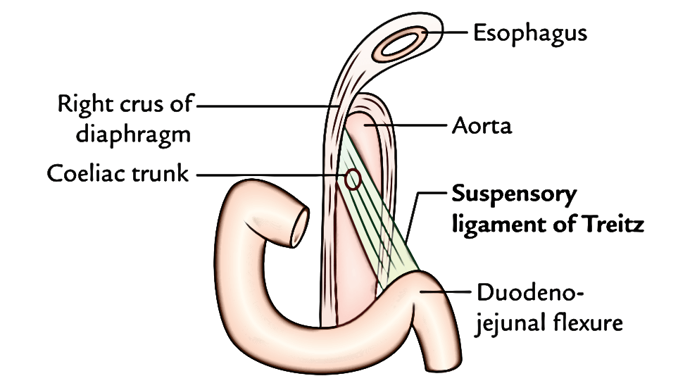

Slide 4
introduction
Patients with acute upper gastrointestinal (GI) bleeding commonly present with hematemesis (vomiting of blood or coffee-ground-like material) and/or melena (black, tarry stools).
The initial evaluation of patients with acute upper GI bleeding involves an assessment of hemodynamic stability and resuscitation if necessary.
Diagnostic studies (usually endoscopy) follow, with the goals of diagnosis, and when possible, treatment of the specific disorder.

Slide 5
Causes
Esophageal causes:
  Esophageal varices
  Mallory-Weiss tear
  Esophagitis
  Esophageal cancer
  Esophageal ulcers
Gastric causes:
  Gastric ulcer
  Gastric cancer
  Gastritis
  Gastric varices
  Dieulafoy's lesions
Duodenal causes:
  Duodenal ulcer
  Vascular malformation including aorto-enteric fistulae
  Hematobilia, or bleeding from the biliary tree
  Bleeding from the pancreatic duct
  Severe superior mesenteric artery syndrome
Notes:
Dieulafoy's lesion is a medical condition characterized by a large tortuous arteriole most commonly in the stomach wall (submucosal) that erodes and bleeds. It can present in any part of the gastrointestinal tract. It can cause gastric hemorrhage but is relatively uncommon.

Slide 6
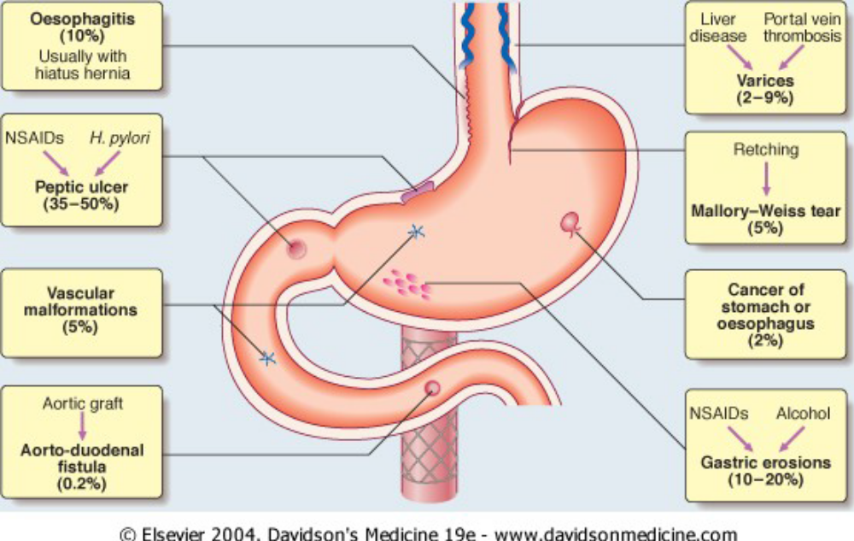

Slide 7
evaluation
The initial evaluation of a patient with a suspected clinically significant acute upper GI bleed includes a history, physical examination, laboratory tests, and in some cases, nasogastric lavage.
The goal of the evaluation is to assess:
  the severity of the bleed
  identify potential sources of the bleed
  determine if there are conditions present that may affect subsequent management

Slide 8
History
Hematemesis (either red blood or coffee-ground emesis) suggests bleeding proximal to the ligament of Treitz.
  The presence of frankly bloody emesis suggests moderate to severe bleeding that may be ongoing
  Coffee-ground emesis suggests more limited bleeding.
Melena: the majority of melena (black, tarry stool) originates proximal to the ligament of Treitz
  Melena may be seen with variable degrees of blood loss, being seen with as little as 50 mL of blood
Hematochezia (red or maroon blood in the stool) is usually due to lower GI bleeding.
However, it can occur with massive upper GI bleeding, which is typically associated with orthostatic hypotension.

Slide 9
History
Patients should be asked about symptoms as part of the assessment of the severity of the bleed and as a part of the evaluation for potential bleeding sources.
Symptoms that suggest the bleeding is severe include
  Orthostatic dizziness
  Confusion
  Angina
  Severe palpitations
  Cold/clammy extremities.

Slide 10
history
Specific causes of upper GI bleeding may be suggested by the patient's symptoms:
Peptic ulcer: Upper abdominal pain
Esophageal ulcer: Odynophagia, gastroesophageal reflux, dysphagia
Mallory-Weiss tear: Emesis, retching, or coughing prior to hematemesis
Variceal hemorrhage or portal hypertensive gastropathy: Jaundice, abdominal distention (ascites)
Malignancy: Dysphagia, early satiety, involuntary weight loss, cachexia

Slide 11
History
Past Medical History: Patients should be asked about prior episodes of upper GI bleeding, since up to 60 percent of patients with a history of an upper GI bleed are bleeding from the same lesion.
Potential bleeding sources suggested by a patient's past medical history include:
Varices or portal hypertensive gastropathy in a patient with a history of liver disease or alcohol abuse.
Aorto-enteric fistula in a patient with a history of an abdominal aortic aneurysm or an aortic graft.

Slide 12
Past medical history
Angiodysplasia in a patient with renal disease, aortic stenosis, or hereditary hemorrhagic telangiectasia.
Peptic ulcer disease in a patient with a history of Helicobacter pylori infection, nonsteroidal anti-inflammatory drug (NSAIDs) use, or smoking.
Malignancy in a patient with a history of smoking, alcohol abuse, or H. pylori infection

Slide 13
Past medical history
Comorbid illnesses may influence patient management in the setting of an acute upper GI bleed. Comorbid illnesses may:
Make patients more susceptible to adverse effects of anemia (eg, coronary artery disease, pulmonary disease).
Predispose patients to volume overload in the setting of vigorous fluid resuscitation or blood transfusions(eg, renal disease, heart failure).
Result in bleeding that is more difficult to control (eg, coagulopathies, thrombocytopenia, significant hepatic dysfunction).
Predispose to aspiration of GI contents into the lungs (eg, dementia, hepatic encephalopathy).

Slide 14
Medication history
Particular attention should be paid to drugs that:
redispose to peptic ulcer formation, such as aspirin and other NSAIDs, including COX-2 inhibitors
Are associated with pill esophagitis
Promote bleeding, such as antiplatelet agents (eg, clopidogrel) and anticoagulants (including the direct oral anticoagulants)
Have been associated with GI bleeding, including selective serotonin reuptake inhibitors (SSRI), calcium channel blockers, and aldosterone antagonists
May alter the clinical presentation, such as bismuth and iron, which can turn the stool black

Slide 15
Physical examination
The physical examination is a key component of the assessment of hemodynamic stability. Signs of hypovolemia include:
  Resting tachycardia. (less than 15% of blood volume lost)
  Orthostatic hypotension.(at least 15% of blood volume lost)
  Supine hypotension.(at least 40% of blood volume lost)
The presence of abdominal pain, especially if severe and associated with rebound tenderness or involuntary guarding, raises concern for perforation.

Slide 16
Laboratory data
Laboratory tests that should be obtained in patients with acute upper gastrointestinal bleeding include:
Complete blood count: chronic or subacute bleeding leads to anemia but the hemoglobin concentration may be normal after sudden, major bleeding until hemodilution occurs
Serum chemistries and KFTs
LFTs: these include PT, INR and serum albumin concentration. They may show evidence of chronic liver disease or anti-coagulated patients
Cross-matching: at least two units of blood should be cross-matched.

Slide 17
Nasogastric lavage
Whether all patients with suspected acute upper GI bleeding require nasogastric tube (NGT) placement is controversial.
More often, NGT lavage is used when it is unclear if a patient has ongoing bleeding and thus might benefit from an early endoscopy.
In addition, NGT lavage can be used to remove particulate matter, fresh blood, and clots from the stomach to facilitate endoscopy.
The presence of red blood or coffee ground material in the nasogastric aspirate also confirms an upper GI source of bleeding

Slide 18
Initial management
Hemodynamically unstable patients :
  ABC :(give Oxygen: )This should be given to all patients in shock.
Intravenous access :peripheral access should be attained with either two 18 gauge or larger intravenous catheters .
Fluid resuscitation: Crystalloid fluids should be given to raise the blood pressure
Transfusion — Patients with active bleeding and hypovolemia may require red blood cell transfusion despite an apparently normal hemoglobin, particularly if the patient remains hemodynamically unstable despite appropriate fluid resuscitation.
Patients without active bleeding who become hemodynamically stable with fluid resuscitation should receive a blood transfusion if the hemoglobin is <9 g/dL (90 g/L) for high-risk patients and if it is <7 g/dL (70 g/L) in low-risk patients

Slide 19
Initial management
Platelets :Patients with active bleeding and a low platelet count (<50,000/microL)
FFP — Patients with a coagulopathy that is not due to cirrhosis and with a prolonged prothrombin time with INR >2.0 should generally be transfused with FFP. We will perform upper endoscopy once the INR is <2.5

Slide 20
Initial management
Medications:
Acid suppression — (PPI)
Prokinetics — Both erythromycin and metoclopramide have been studied in patients with acute upper GI bleeding. The goal of using a prokinetic agent is to improve gastric visualization at the time of endoscopy by clearing the stomach of blood, clots, and food residue.
Antibiotics for patients with cirrhosis .
Vasoactive medications — Somatostatin, its analog octreotide, and terlipressin are used in the treatment of variceal bleeding

Slide 21
Diagnostic studies
Upper endoscopy — Upper endoscopy is the diagnostic modality of choice for acute upper GI bleeding.
Endoscopy has a high sensitivity and specificity for locating and identifying bleeding lesions in the upper GI tract.
In addition, once a bleeding lesion has been identified, therapeutic endoscopy can achieve acute hemostasis and prevent recurrent bleeding in most patients
Risks of endoscopy — Risks of upper endoscopy include pulmonary aspiration, adverse reactions to medications used to achieve conscious sedation, GI perforation, and increasing bleeding while attempting therapeutic intervention.

Slide 22
Evidence Supports Performing Early Endoscopy
Early endoscopy within first 24 hrs of acute GIB is associated with:
Decreased hospital stay
Decreased rate recurrent bleeding
Decreased need for surgery
50% reduction in mortality rates

Slide 23
Diagnostic studies
Other diagnostic tests — Other diagnostic tests for acute upper GI bleeding include angiography, which can detect active bleeding, deep small bowel enteroscopy, and rarely, intraoperative enteroscopy.
Upper GI barium studies are contraindicated in the setting of acute upper GI bleeding because they will interfere with subsequent endoscopy, angiography, or surgery

Slide 24
Triage
All patients with hemodynamic instability or active bleeding (manifested by hematemesis, bright red blood per nasogastric tube, or hematochezia) should be admitted to an intensive care unit for resuscitation and close observation with automated blood pressure monitoring, electrocardiographic monitoring, and pulse oximetry.
Other patients can be admitted to a regular medical ward, though we suggest that all admitted patients with the exception of low-risk patients receive electrocardiographic monitoring.
Outpatient management may be appropriate for some low-risk patients. Determining the appropriate site of care for a patient can be facilitated using risk stratification scores, such as the Glasgow-Blatchford score. Use of these scores is recommended in the International Consensus Group guideline

Slide 25
Risk stratification
Two commonly cited scoring systems are the Rockall score and the Blatchford score
The Rockall score is based upon age, the presence of shock, comorbidity, diagnosis, and endoscopic stigmata of recent hemorrhage
The Blatchford score (also known as the Glasgow Blatchford score), unlike the Rockall score, does not take endoscopic data into account and thus can be used when the patient first presents

Slide 26
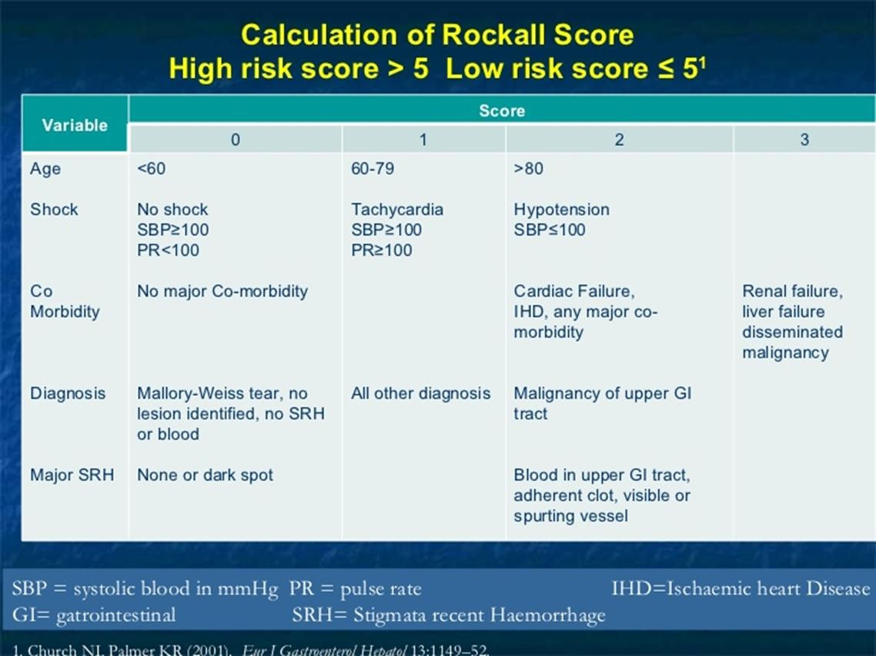

Slide 27
Blatchford score
The score is based upon the blood urea nitrogen, hemoglobin, systolic blood pressure, pulse, and the presence of melena, syncope, hepatic disease, and/or cardiac failure.
The score ranges from zero to 23 and the risk of requiring endoscopic intervention increases with increasing score .
A simpler version of the score, known as the modified Glasgow Blatchford score, is calculated using only the blood urea nitrogen, hemoglobin, systolic blood pressure, and pulse.

Slide 28
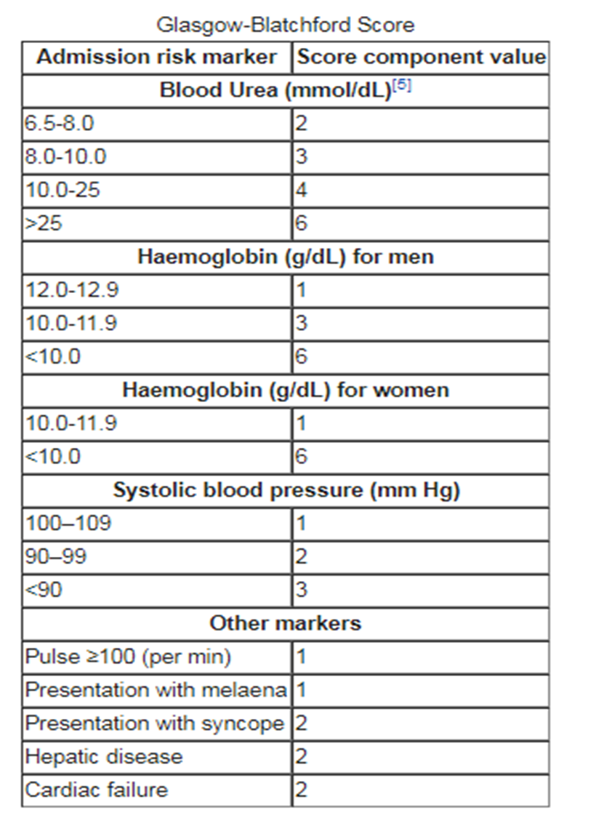

Slide 29
Treatment(ACCORDING TO THE CAUSE)
Indications for surgery :Only about 10% of patients will require surgery.
Exsanguinating hemorrhage. A patient with uncontrollable hemorrhage who is losing blood faster than it can be replaced must be sent to the operating room immediately for control of the site of bleeding.
Profuse bleeding, especially in association with hypotension. Patients should be treated surgically:
  If more than 4 Units of blood are required for initial resuscitation.
  If bleeding continues at a rate of more than 1 Unit every 8 hours.
  If a brief hypotensive episode could have catastrophic results, as in patients with coronary artery disease or cerebrovascular disease or in patients older than 60 years of age.

Slide 30
treatment
Recurrent bleeding after its initial cessation.
Pathologic features of the bleeding site that increase the risk of recurrent bleeding include:
  A posterior duodenal ulcer with the gastroduodenal artery visible in its base
  A giant gastric ulcer

Slide 31
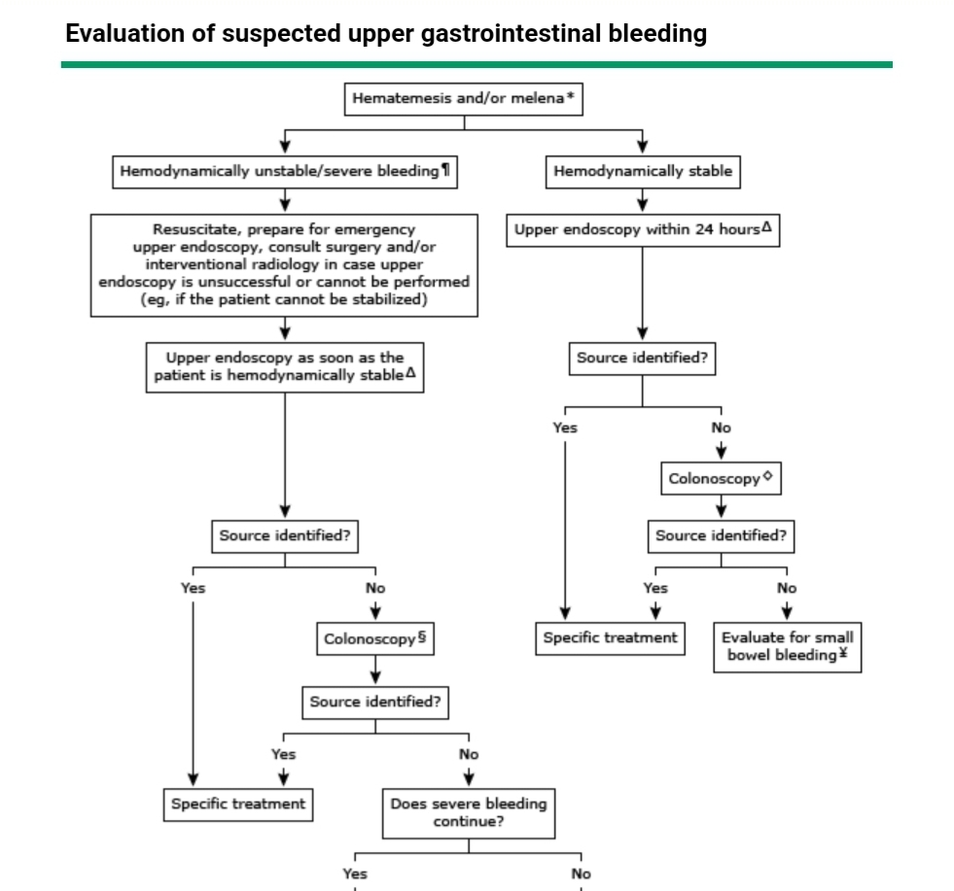

Slide 32
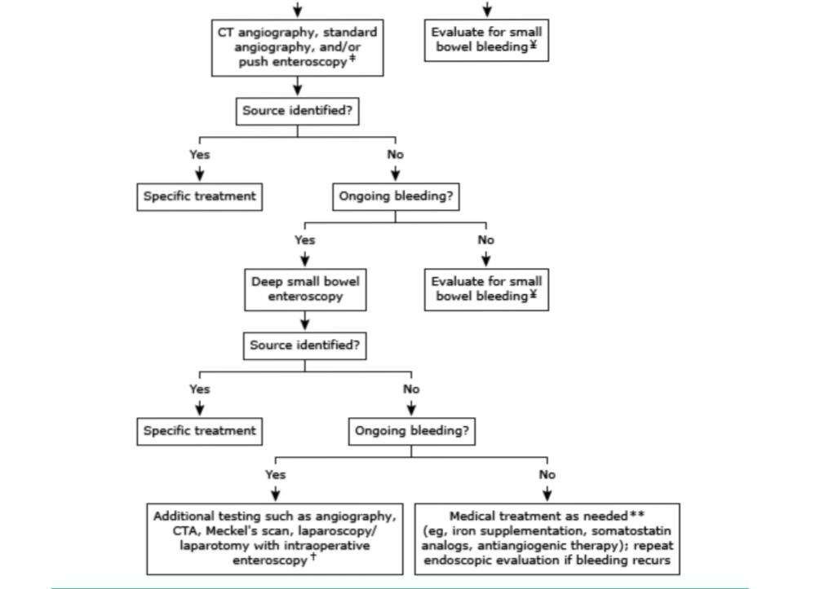

Slide 33
Chronic gi bleeding
Acute UGIB is more recognizable than chronic GI bleeding, it happens suddenly and can have very serious consequences.
Chronic UGIB is a slow, long term bleeding or occurs at an on/off pattern. It is more difficult to diagnose because the symptoms are not easily detected.

Slide 34
Management of chronic gi bleeding
Chronic UGIB usually does not present as an emergency. It is usually discovered due to signs and symptoms of anemia.
Management: includes resuscitation and identifying the underlying cause, and hence treatment depends on the cause itself.

Slide 35
references
UpToDate
Past seminars

Slide 36
Lower Gastrointestinal Bleeding
Eman Humaidat

Slide 37
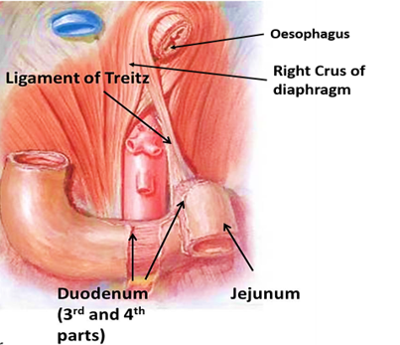
Definition
Lower gastrointestinal bleeding (LGIB): Refers to blood loss of recent onset originating from a site distal to the ligament of Treitz.
Note: The ligament of Treitz, also known as the suspensory ligament of the duodenum, is a double fold of peritoneum suspending the duodenojejunal flexure from the retroperitoneum.

Slide 38
Presentation
A patient with lower gastrointestinal (GI) bleeding typically reports haematochezia (passage of maroon or bright red blood or blood clots per rectum).
  Bleeding from the left colon >> usually bright red in colour
  Bleeding from the right >> usually dark or maroon coloured, may be mixed with stool. Rarely, may present with melena.
Symptoms range from:
  Occult bleeding
  Small amounts of blood on toilet paper
  Bloody stools
  Symptoms and signs of anaemia
  Signs of volume depletion (presents as pallor, dizziness, weakness, syncope, and signs of shock may be present).
  Nonspecific complaints: anorexia, dyspnoea, abdominal pain, chest pain, and fatigue.

Slide 39
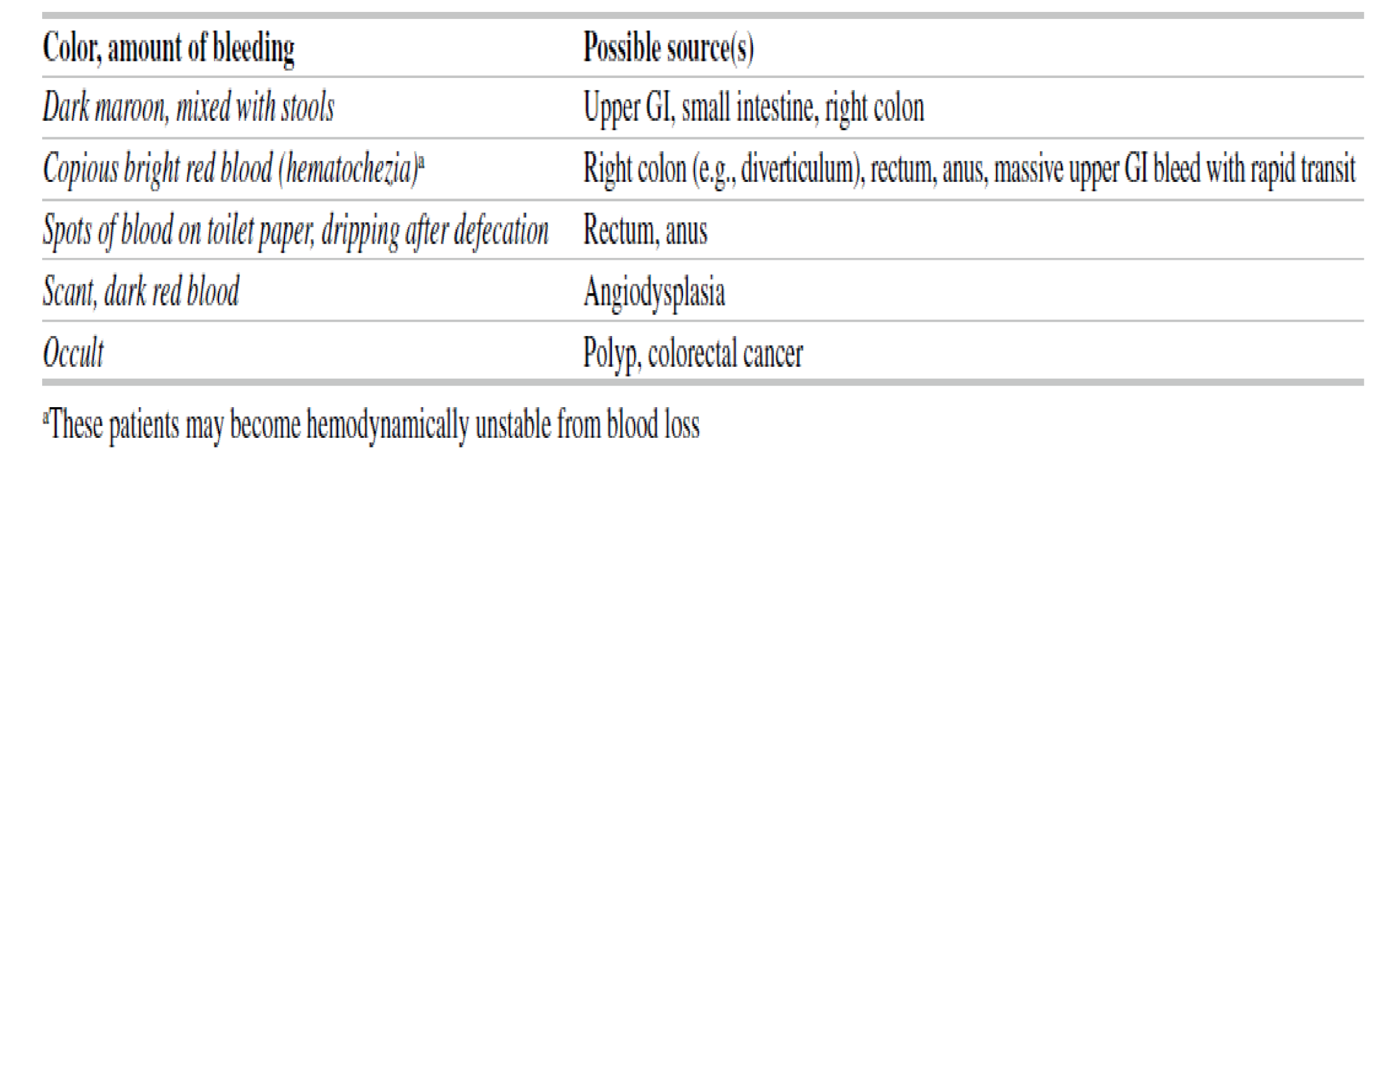

Slide 40
Initial Evaluation
History
Physical Examination
Age
Onset and duration
Colour and amount
Exacerbating and relieving factors (Antibiotics, stress, steroids, UC…)
Associated symptoms
PMH:
  Atrial fibrillation in children or atherosclerosis in elderly
  Prolonged hypotension: non occlusive ischemia
Family history
Social history
Medications
Vital signs, signs of anaemia, pallor, ecchymoses
Assess haemodynamic stability
Extraintestinal manifestation for IBD (eye skin joint)
Abdominal pain suggests the presence of an inflammatory bleeding source such as ischemic or infectious colitis or a perforation (e.g. a perforated peptic ulcer in a patient with severe upper GI bleeding)
DRE…

Slide 41
Cont.
Systemic symptoms (fever, bloody diarrhoea…) >> may indicate an infectious or inflammatory cause.
Weight loss >> should raise suspicion for malignancy, especially in older patients who have changes in bowel habits and/or iron- deficiency anaemia.
Iron-deficiency anaemia in a man or a postmenopausal woman should raise suspicion for malignancy (especially colorectal cancer, particularly if the patient has never had screening).
Bleeding that follows straining at stool >> suggests an anorectal cause.
Tenesmus, a sense of incomplete evacuation of stool >> most often seen with ulcerative colitis and infectious aetiologies.
Bleeding from diverticulosis and angiodysplasia tends to be painless.
Abdominal pain (especially in elderly patients) should raise suspicion for ischaemic colitis.

Slide 42
Initial Evaluation & Management
The first step is to place two large-bore IVs and order lab tests: CBC, chemistry, LFT and INR/ PTT. Send blood for type & cross-matching. Insert foley’s catheter
If the patient demonstrates evidence of significant blood loss, resuscitation should be instituted with crystalloid (normal saline or lactated Ringer’s) followed by packed red blood cells as needed.
General supportive measures: Patients should receive supplemental oxygen by nasal cannula and initially should receive nothing per mouth in the event urgent upper endoscopy is needed.

Slide 43
Consider an upper-GI source
Findings that are suggestive of UGIB
Findings that decrease the likelihood of UGIB
Haemodynamic instability
Orthostatic hypotension
Elevated BUN-to-creatinine or urea-to-creatinine ratio (>20 to 30:1 or >100:1, respectively)
Blood clots in the stool
The first thing to do is to insert an NGT.

Slide 44


NGT
Blood
EGD
Bile, no blood
Anoscopy / proctoscopy
Clear: no bile, no blood
EGD
Rx
> 1 mL/min
0.5-1 mL/min
< 0.5 mL/min
Rx
Rx
Depends on bleeding rate
Wait for bleeding to stop, then colonoscopy
Tagged RBCs
Angiogram

Slide 45
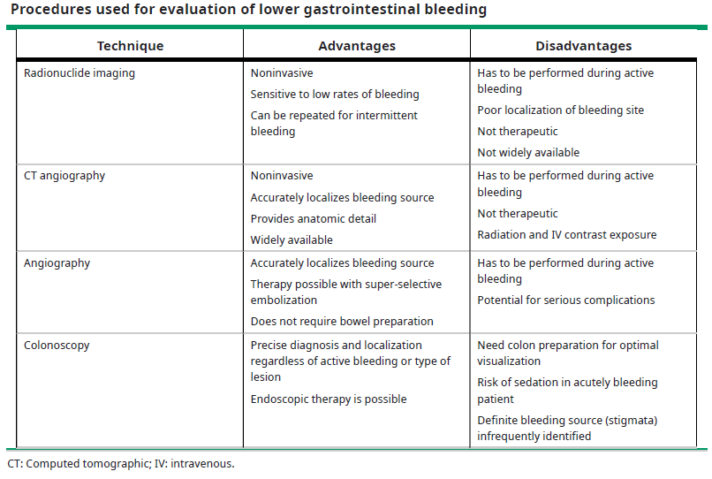

Slide 46
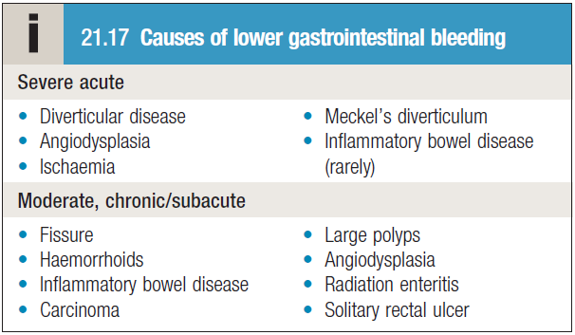
Aetiology of LGIB
The causes of LGIB may be grouped into:
Anatomic (diverticulosis)
Vascular (angiodysplasia, ischemic, radiation-induced)
Inflammatory (inflammatory bowel disease, infectious)
Neoplastic
  The most common causes of massive lower GI bleeding?
  Diverticulosis (usually right-sided is severe bleeding)
  Angiodysplasia

Slide 47
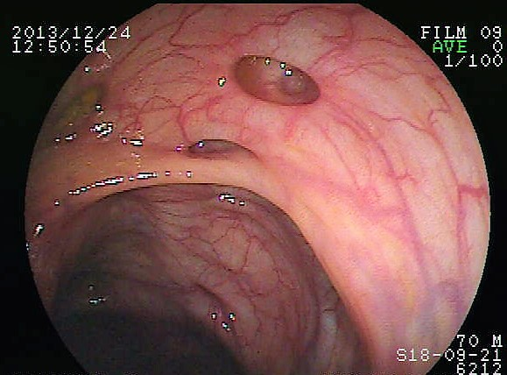
Diverticulosis
Condition in which diverticula can be found within the colon, (90% in sigmoid colon)
These are actually false diverticula in that only mucosa and submucosa herniate through the bowel musculature
Prevalence of diverticular disease is age-dependent, increasing from less than 20 percent at age 40 to 60 percent by age 60.
People with low-fibre diets, chronic constipation, and a positive family history have a higher risk
The high prevalence of diverticulosis explains why it is the most common cause of LGIB, even though bleeding is a rare complication of this common disease.

Slide 48
Diverticular bleeding may be massive and life-threatening since diverticula often form at the site of arterial vascular penetration.
The bleeding is usually painless except for mild abdominal discomfort and cramping due to colonic spasm from intraluminal blood.
Diverticular bleeding is self-limited in 70-80% of cases.
Risk factors for diverticular bleeding include the use of aspirin and NSAID

Slide 49
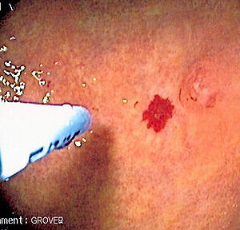
Angiodysplasia
Refers to dilated, tortuous submucosal vessels. It is the most common vascular abnormality of the GI tract.
Angiodysplasia may occur throughout the colon, although bleeding most often originates from the caecum or ascending colon.
Bleeding from angiodysplasia is venous in origin (in contrast to arterial bleeding with diverticula) and therefore tends to be less massive than diverticular bleeding.

Slide 50
Colitis
Infectious and ischemic colitis and inflammatory bowel disease can all present initially with haematochezia.
Mucosal inflammation (colitis) is the common response to acute injury, resulting in activation of the immune system and inflammatory cascade.
Infectious colitis — There are many infectious causes of colitis. A routine stool culture will identify Salmonella, Campylobacter, and Shigella.

Slide 51
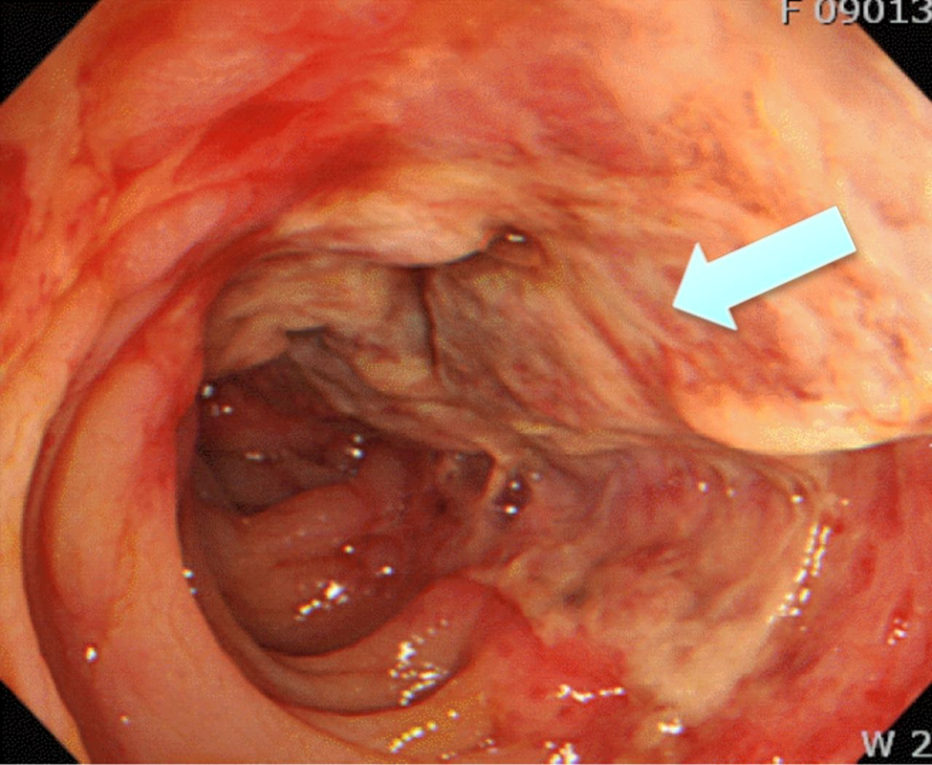
Ischaemic colitis —The pathophysiology is decreased blood flow to the colon, causing non-occlusive ischemic colitis.
The mucosa is affected first ,and depending on the severity progression may occur through all layers of the colon.
The most common areas to be affected are “watershed” areas which have relatively poor perfusion as they are in between two areas of the colonic blood supply (splenic flexure rectosigmoid junction)
CT imaging in IC can show oedema and air (pneumatosis} in the bowel wall.
Colonoscopy shows segments of cyanotic mucosa and haemorrhagic ulcerations. with a sharp transition from affected to unaffected mucosa.

Slide 52
Modalities of Treatment
1- Endoscopy therapy
  Thermal, sclerosing agent, mechanical
2- Angiography therapy
  Vasopressin, embolization
3- Surgery
  Persistent hemodynamic instability with active bleeding
  Transfusion of more than 4 units packed red bloods cells in a 24-hour period, with active or recurrent bleeding.

