Slide 1
Surgical Management of Obesity

Slide 2
Topic Outline
- Introduction
- What is the Bariatric Surgeries
- Operations & Selection
- Outcomes and complications
- Eligibility for Obesity Surgery

Slide 3
Obesity : is a multifactorial chronic metabolic disorder which essentially manifests it self as surplus of unexpended energy stores as fat.
Contributing Factors : genetic predisposition, eating disorders, psychological issues, poor diet, lack of exercise and comorbid conditions
Morbid Obesity : Body mass index (BMI) equal to or greater than 40 kg/m2

Slide 4
- Metabolic syndrome
- Type 2 DM
- High blood pressure
- Dyslipidemia
- Obstructive sleep apnea
- Venous and lymphatic stasis
- Osteoarthritis
- Decreased mobility
- Chronic respiratory hypoventilation
- Hypertrophic cardiomyopathy
- Poor quality of life
- Urinary stress incontinence
- GERD
Comorbidities associated with obesity

Slide 5
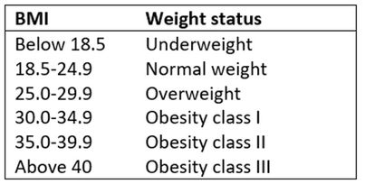
BMI
KG/M^2

Slide 6
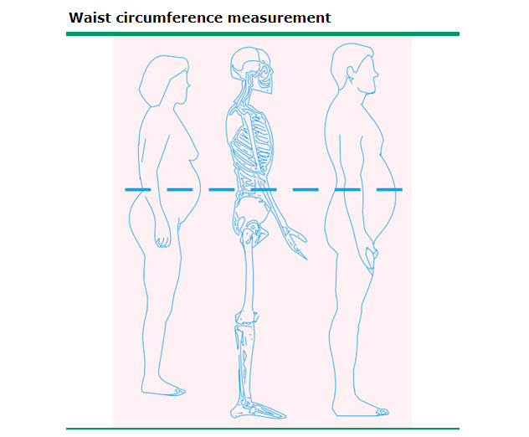
Waist circumference
Measurement of abdominal obesity.
Patients with abdominal obesity (also called central adiposity, visceral, android, or male-type obesity) are at increased risk for heart disease, diabetes, hypertension, dyslipidemia, and nonalcoholic fatty liver disease
abdominally obese : waist circumference greater than ≥35 in [88 cm] in women or ≥40 in [102 cm] in men

Slide 7
BMI ≥ 40, or BMI ≥ 35 and at least one or more obesity-related co-morbidities such as type II diabetes (T2DM), hypertension, sleep apnea
Between 30 and 35, and you have uncontrolled diabetes.
..etc.
-Minimum of 5 years obesity
- Failure of conservative management
- No alcoholism or major untreated psychiatric illness
- Avoid if likely to get pregnant within 2 years
- Age limits 18-55
- Acceptable operative risk on preoperative assessment
Selection criteria for obesity surgery

Slide 8
Bariatric surgery is an operation that helps you lose weight by making changes to your digestive system.
It is the most effective approach for achieving durable weight loss in the morbidly obese

Slide 9
Contraindications
● Glycemic or lipid control or CVS risk reduction independent of (BMI) parameters.
● Severe obesity > 270kg
● 18 y.o < Age > 65 y.o ( considered when comorbidity is severe )
● Uncontrolled and untreated eating disorders (eg, bulimia)
● Drug and alcohol abuse
● Anesthetic risks
● Severe coagulopathy
● Inability to comply with nutritional requirements including life-long vitamin replacement
● End stage organ function of heart, lungs, or both.
● Prader-Willi syndrome

Slide 10
Types of commonly performed bariatric operations by mechanism of action:
Combination
Primarily Malabsorptive
Primarily Restrictive

Slide 11
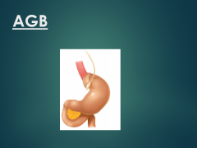
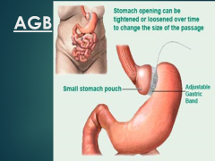
Restrictive procedures
- Adjustable Gastric Banding (AGB)
- Vertical Banded Gastroplasty (VBG)
-Gastric Balloon
- Sleeve Gastrectomy

Slide 12
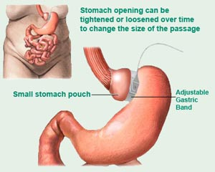
AGB

Slide 13
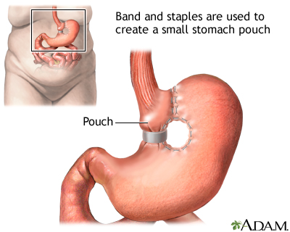
VBG

Slide 14
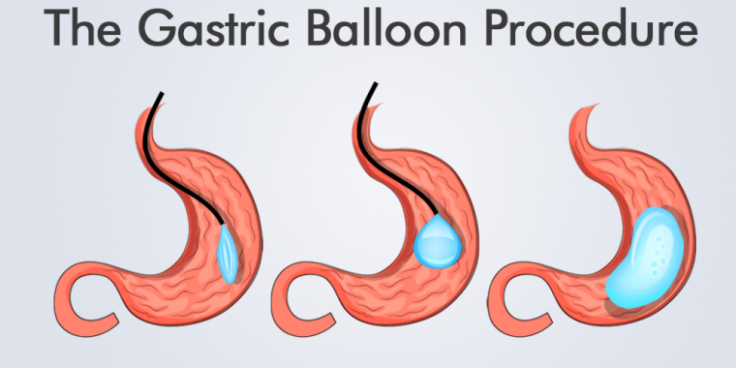

Slide 15
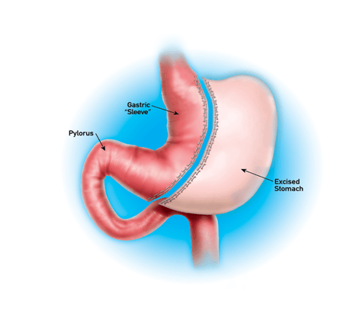
Sleeve Gastrectomy

Slide 16
Malabsorptive procedures
- Biliopancreatic diversion (BPD)
- Duodenal switch (DS)

Slide 17
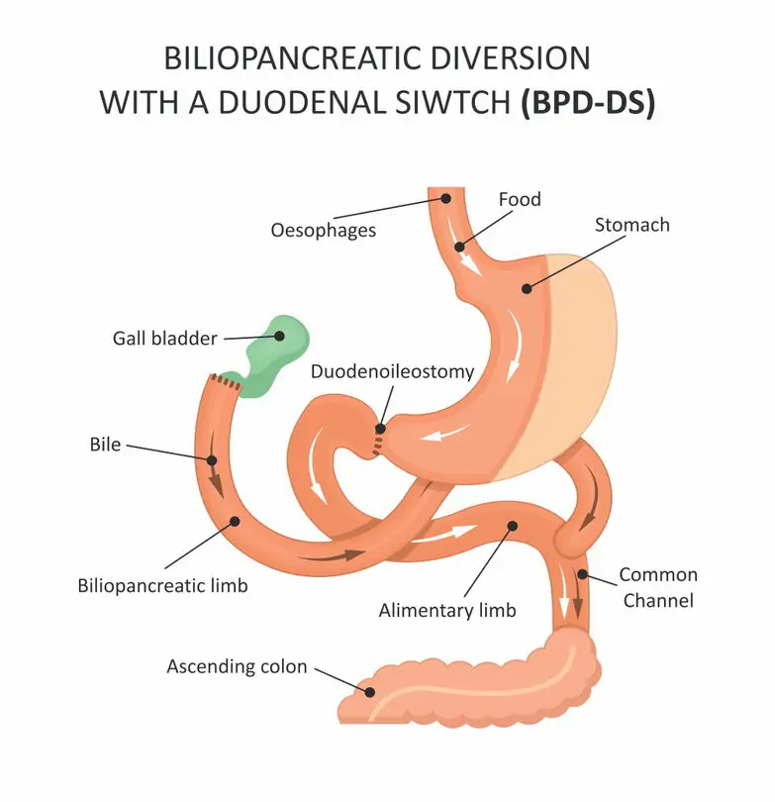
DS & BPD

Slide 18
Combination ( by two mechanisms)
-Roux-en-Y gastric bypass
-Mini gastric Bypass

Slide 19
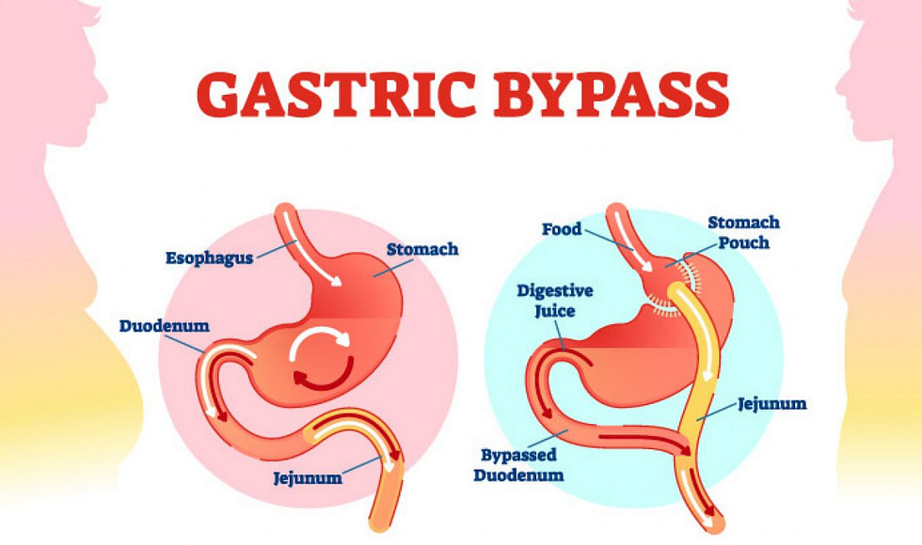

Slide 20
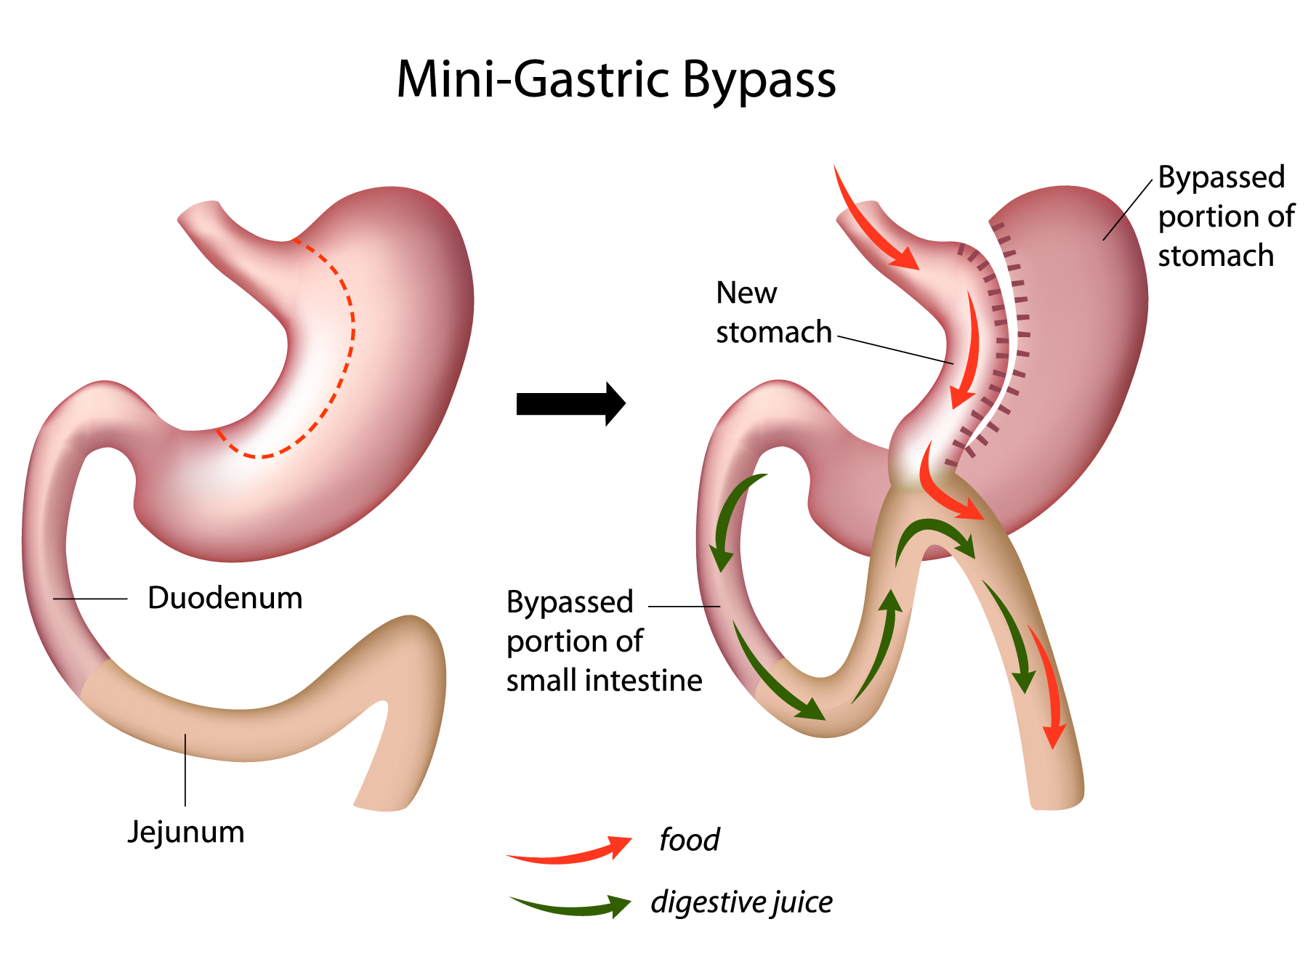

Slide 21
Which procedure to do ?

Slide 22
- All procedures can be effective in the treatment of morbid obesity
- They can be performed by open surgery and more recently by laparoscopy

Slide 23
Case.
Patient on multiple psychiatric medications , complains from obesity BMI 41 , has had multiple abdominal surgeries , what Bariatric surgery would you recommend ?

Slide 24
Thank you..

