Slide 1
Approach to jaundice

Slide 2
Jaundice refers to the yellowish discoloration of skin, sclerae, and mucous membranes that results from excessive deposition of bilirubin .in tissues It is generally held that jaundice develops when serum bilirubin levels rise above (2.5 .mg/dl)

Slide 3
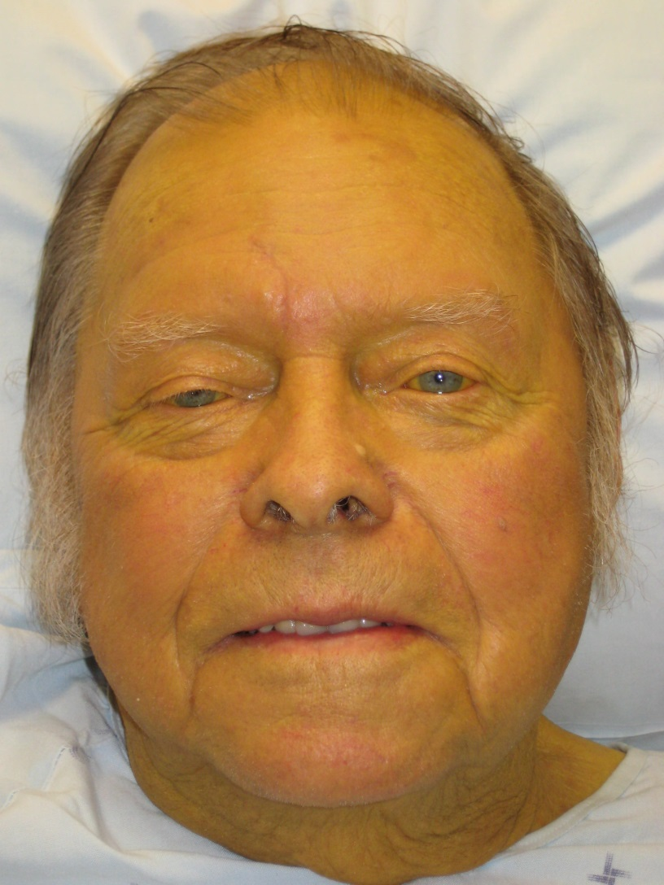

Slide 4
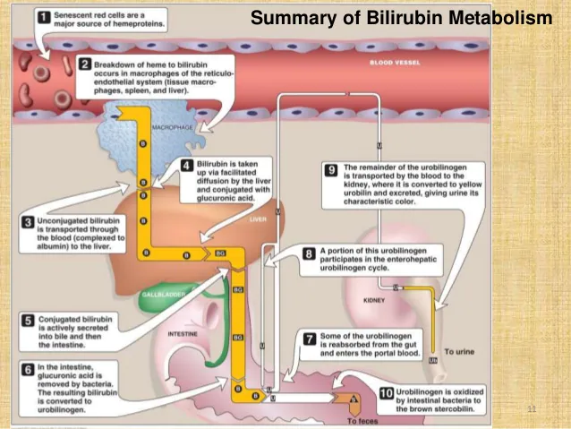

Slide 5
 | PRE-HEPATIC | INTRA-HEPATIC | POST-HEPATIC
PHYSIOLOGY | Excessive hemolysis leading to increased bilirubin delivered to the liver | Defective conjugation Impaired cellular uptake Abnormal secretion | Mechanical obstruction of bile flow causing impaired excretion
ELEVATED BILIRUBIN | Unconjugated | Conjugated and unconjugated is possible | Conjugated
URINE COLOR | Normal | Dark | Dark
STOOL COLOR | Normal | Normal | Acholic
PRURITUS | No | No | Yes

Slide 6
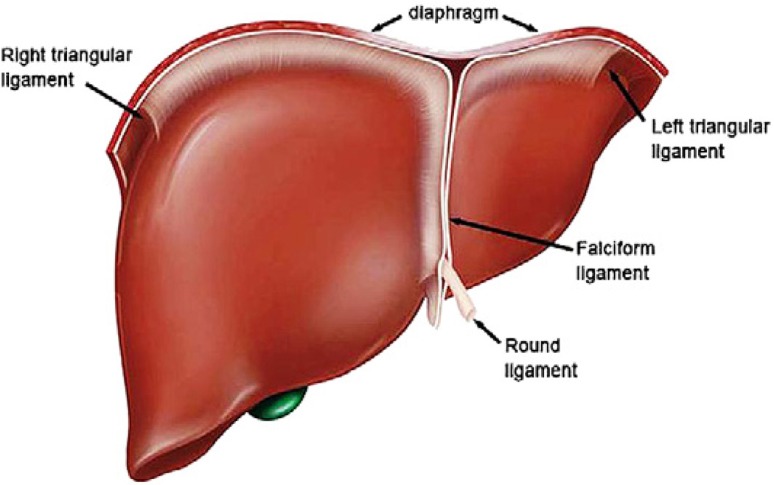
Anatomical Considerations of the Hepatobiliary system
1- Liver Ligaments: The Falciform ligament: at the base of the falciform ligament (cranial) the hepatic vein drains in the superior vena cava, and it DOES NOT (functionally) divide the liver to left and right lobes.

Slide 7
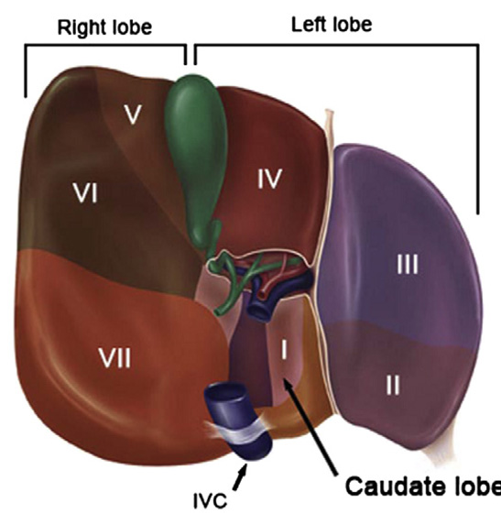
the ligamentum teres (round ligament), a remnant of the obliterated umbilical vein (ductus venosus) it is in continuity with the ligamentum venosum as it joins the left branch of the portal vein, In the presence of portal hypertension, the umbilical vein may recanalize to allow portasystemic collateralization through the abdominal wall, known as caput medusae.

Slide 8
the caval ligamentous contain components of the liver parencyhma including the portal triads and hepatocytes. Hence, during liver mobilization, these ligaments must be controlled in a surgical manner to avoid unnecessary bleeding or bile leakage during hepatic surgery
the duodenum and portal structures are in association with the liver through the hepatoduodenal ligament (inferior aspect of the lesser omentum) and porta hepatis.
Within the porta hepatis is the common bile duct, hepatic artery, and portal vein that course in a lateral, medial, and posterior configuration, respectively.

Slide 9
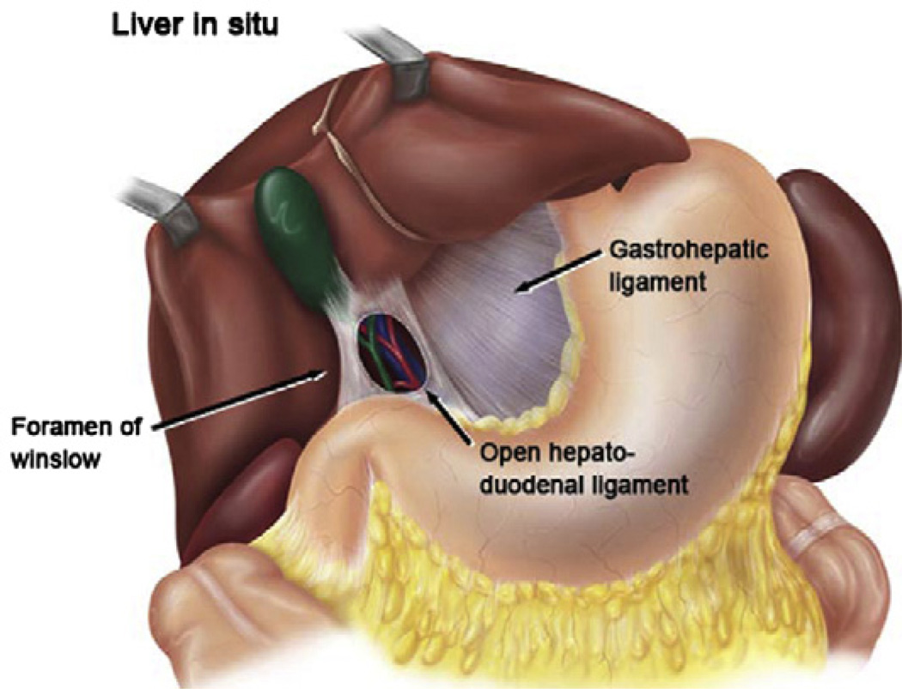

Slide 10
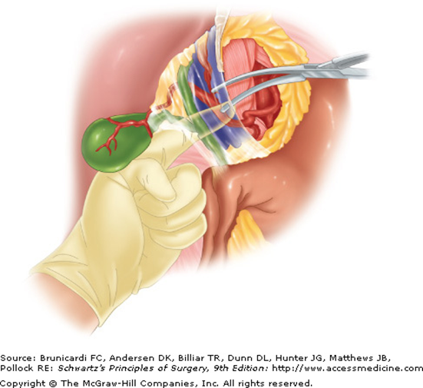
The hepatic pedicle is best clamped from the left side of the patient, by digitally dissecting a small hole in the lesser omentum, near the pedicle, and then placing a soft clamp over the pedicle from the left hand side, through the foramen of Winslow (Modified Pringle).
1hr if hemodynamically stable, 15 minutes if not

Slide 11
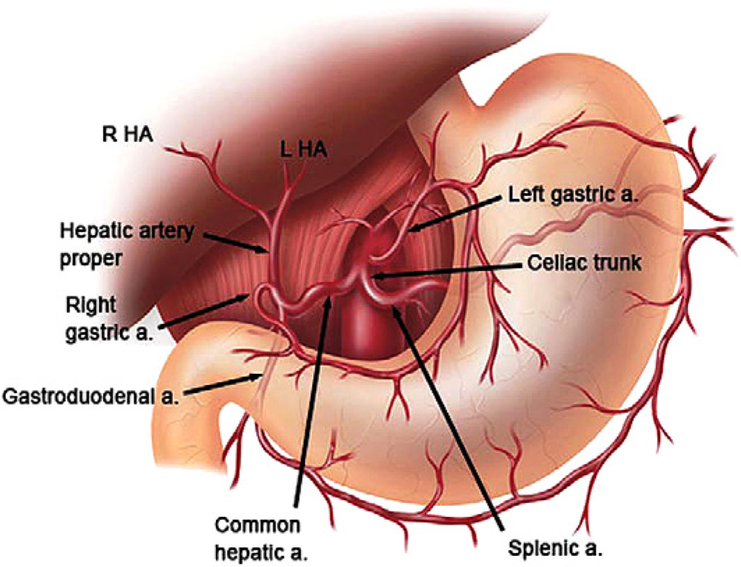
2- Hepatic Vasculature and variants

Slide 12
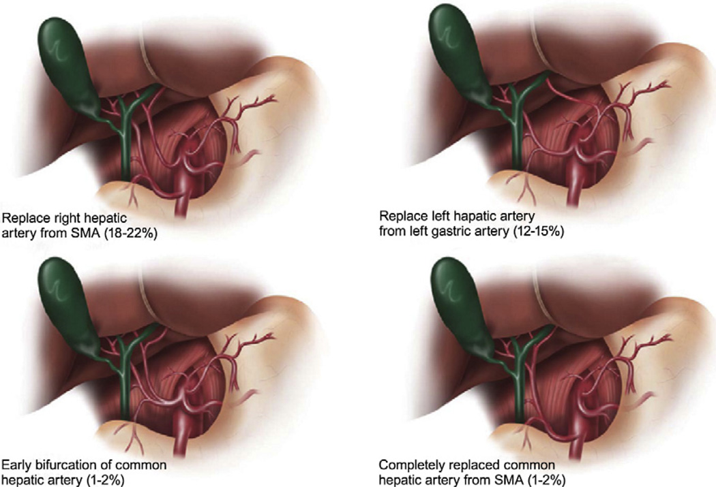

Slide 13
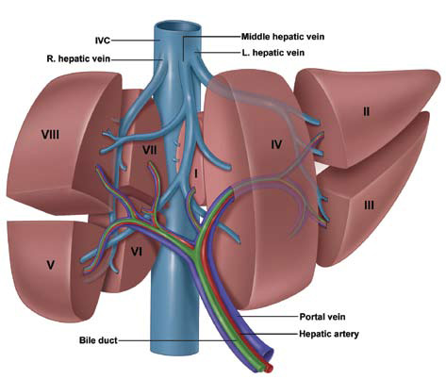
3- Hepatic & Portal Venous Systems

Slide 14
The portal vein provides the bulk of the nutritive blood supply to the liver, the portal vein forms from the confluence of the superior mesenteric vein and splenic vein behind the neck of the pancreas. Additional venous branches that drain into the portal vein include the coronary (left gastric) vein, cystic vein, and tributaries of the right gastric and pancreaticoduodenal veins.
The portal vein is valveless and is a low-pressure system with pressures typically 3 to 5 mm Hg.
Right Anterior & Posterior, Left Medial & Lateral

Slide 15
4- Billiary Tree
The intrahepatic biliary tree is comprised of multiple ducts that are responsible for the formation and transport of bile from the liver to the duodenum and typically follows the portal venous system. The right hepatic duct forms from an anterior sectoral duct from segments V and VIII and a posterior sectoral duct from segments VI and VII.
Ducts of Luschka are biliary ducts that lie in gallbladder fossa and connect directly between
liver and the gallbladder. These can result in bile leak after cholecystectomy.

Slide 16
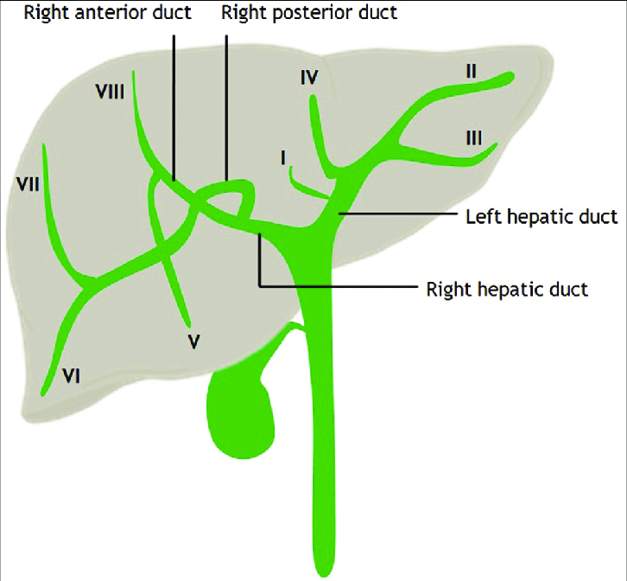

Slide 17
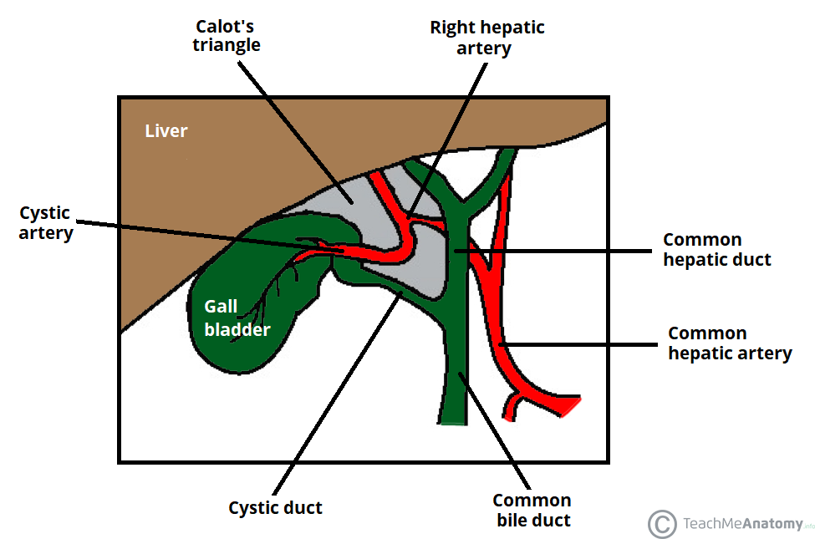
Also cystic artery and LNs of Lund and abberant LN

Slide 18
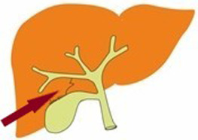

Slide 19
Surgical jaundice is suspected over medical jaundice in the following scenarios:
- History of abdominal pain and fevers
- Painless jaundice with weight loss, pruritus, and clay colored stools
- Conjugated bilirubinemia with elevation of alkaline phosphatase and GGT
- An enlarged gallbladder, abdominal mass, and/or lymph node in left supraclavicular
area is considered advanced disease

Slide 20
History
PP: Multiparous Females Above the age of 40 are at increased risk of gallbladder stones, non-painful obstructive jaundice mainly affect males above the age of 60
CC: Obstructive jaundice often produces pruritus, pale stools, and dark colored urine.
Abdominal pain along with fevers and jaundice is suggestive of obstruction with an associated infection known as cholangitis. A malignant source of obstruction more often presents with painless jaundice and weight loss.

Slide 21
HISTORY
PMH: Hx of IBD can be associated with hepatic stenosis, cholelithiasis, or primary sclerosing cholangitis, hx of pancreatitis can lead to billiary strictures, any iatrogenic intervention should be obtained
Social Hx: Alcohol consumption as well as risk factors for viral hepatitis
Also don’t forget symptoms of malignancy

Slide 22
PE
Charcot’s triad
Reynold’s Pentad
Courvoisier’s sign/law
Murphy’s sign
Scleral icterus
Caput medusae
Rectal varices
Signs of Liver Failure

Slide 23
PE
Vitals: Bile salts reduces cardiac contractility and HR and SVR, Ptn are more prone for shock in O.R
This along with increase PGE2 and vasoconstriction of renal vessels may lead to Renal Failure> further exacerbating the Cardiac Dysfunction with Electrolyte Dysfunctions

Slide 24
Increase in PTT as well as decrease absorption of ADEK Vit
Poor Wound Healing (may lead to post op wound dehiscence)

Slide 25
Benign:
Choledocholithiasis
Mirizzi syndrome
Bile duct stricture
• Chronic pancreatitis
• Primary sclerosing cholangitis
Choledochal cyst
Parasite: Ascaris, Chlonorcis.
Lymph Node Obstruction
Haemobilia

Slide 26
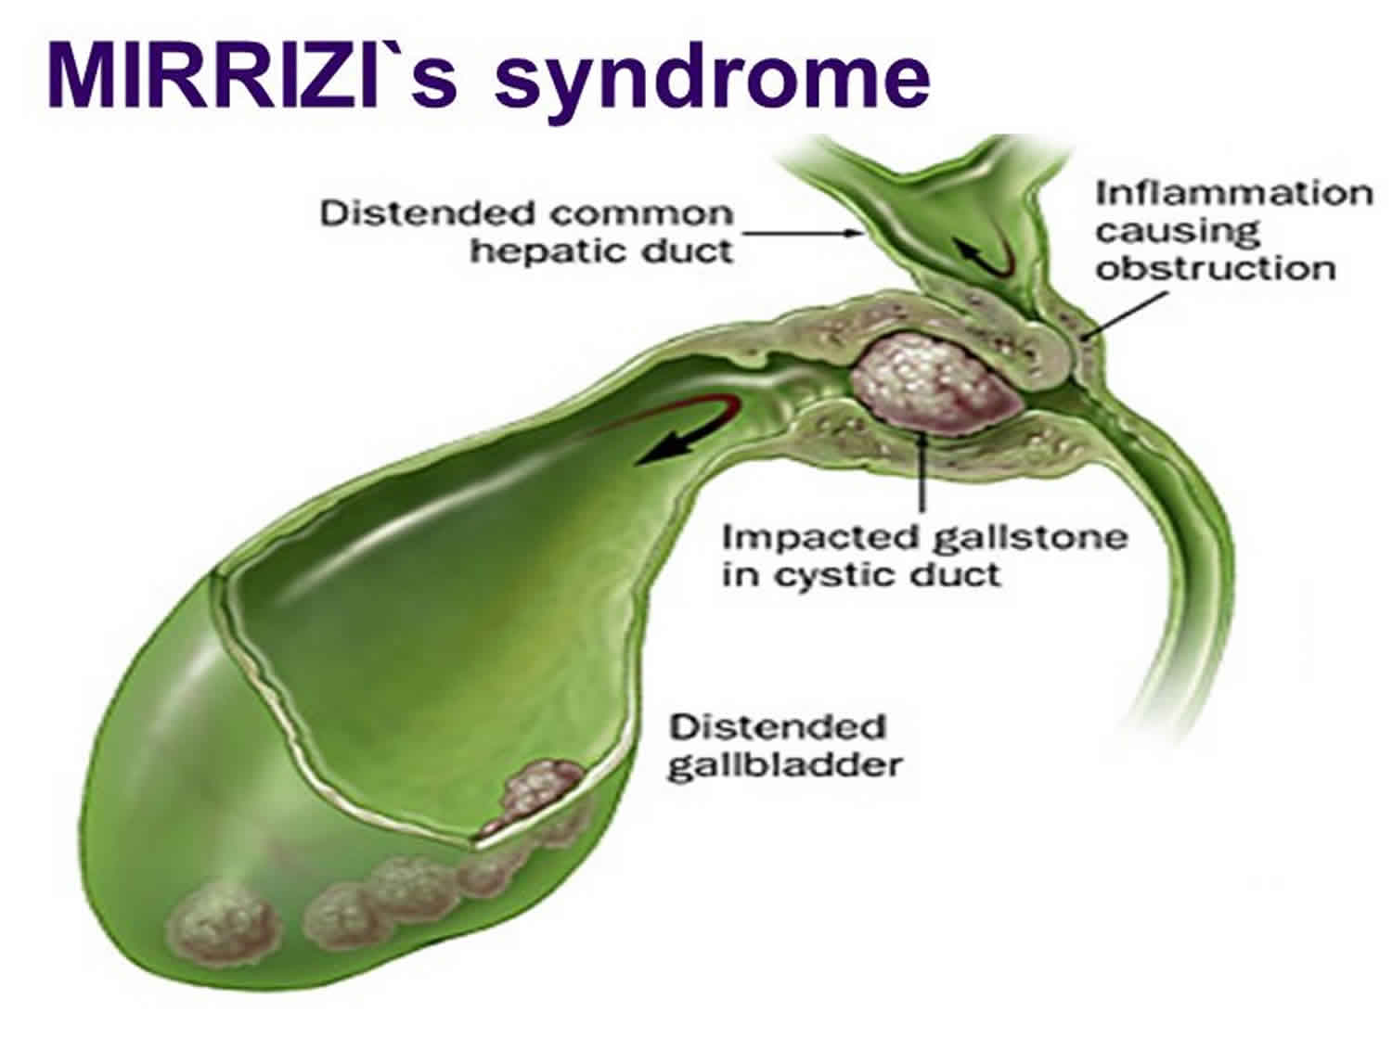

Slide 27
Malignant
Pancreatic
• Solid
• Cystic
Cholangiocarcinoma
• Klatskin tumor
Ampulla of Vat

Slide 28
Pediatric:
Biliary atresia
Caroli’s Syndrome
Choledocal Cyst
Primary Biliary Cirrhosis
Wilson
Alpha 1 Anti trypsin Def.
Dyskinesia of Sphinecter of Oddi
Iatrogenic:
CBD injury following laparoscopic cholecystectomy
Ischemic stricture from cautery or hepatic artery injury

Slide 29
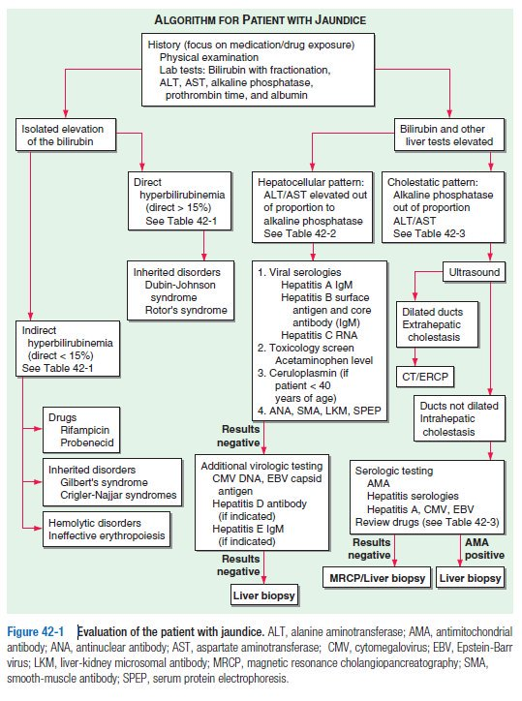

Slide 33
Investigations+
Imaging

Slide 34
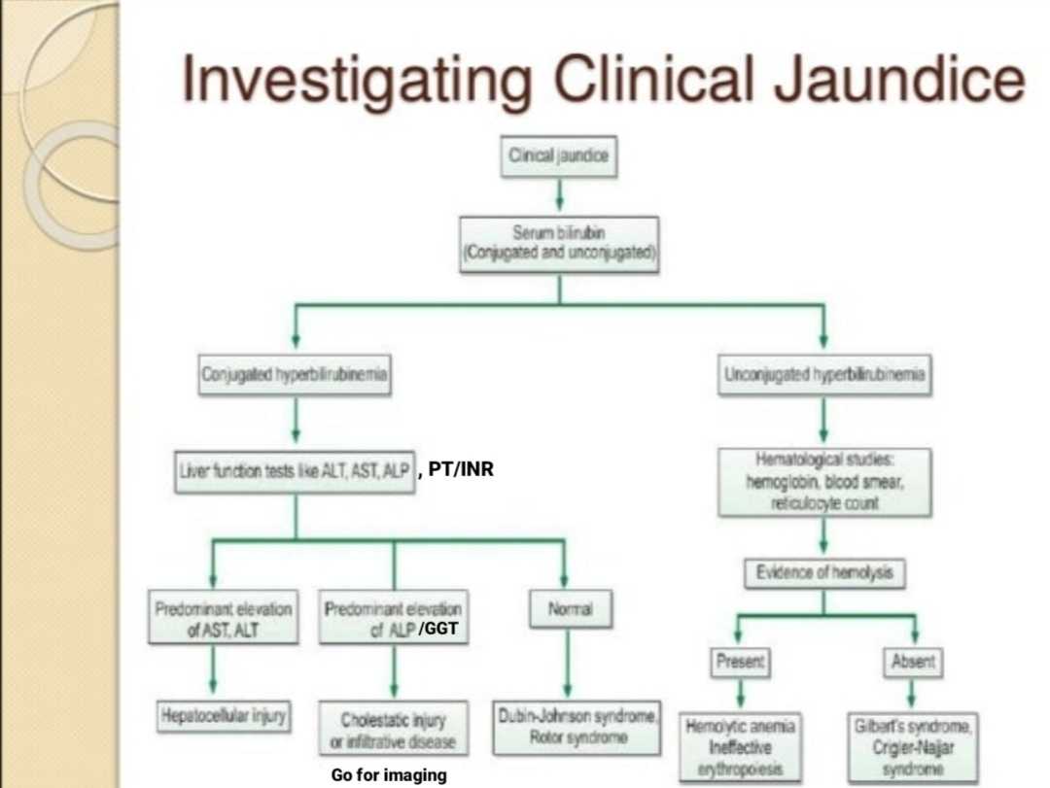

Slide 35
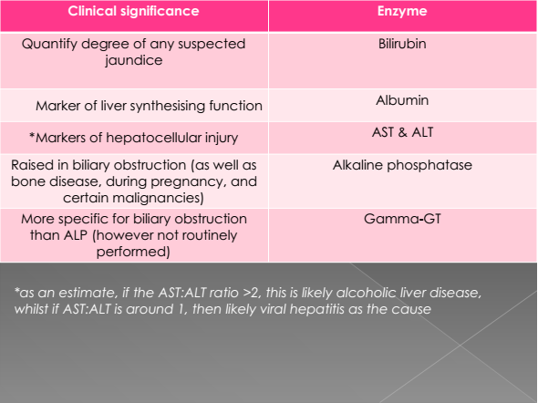

Slide 36
Evaluate for suspected hepatocellular injury
* In most liver diseases : ALT>AST
IF AST > ALT, think of
1/ Alcoholic liver disease
2/progression of non-alcoholic liver disease to fibrosis or
cirrhosis
Testing depends on the Hx and PE :
●Serologic tests for viral hepatitis
●Measurement of antimitochondrial antibodies (for primary biliary cholangitis)
●Measurement of antinuclear anti-smooth muscle and liver-kidney microsomal
antibodies (for autoimmune hepatitis)
●Serum levels of iron, transferrin, and ferritin (for hemochromatosis)
●Thyroid function tests
●Antibody screening for celiac disease
●Serum levels of ceruloplasmin (for Wilson disease)
●Measurement of alpha-1 antitrypsin activity (for alpha-1 antitrypsin deficiency)
●Testing for adrenal insufficiency

Slide 37
PT/INR
Elevated INR: should be corrected with vit K, if corrected it
suggests poor intestinal absorption that is compatible mostly
with obstructive jaundice. However, an elevated INR that
doesn’t correct with vit K suggests hepatocellular disease with
impaired synthetic function.

Slide 38
We may add KFT
Urine Test (UA&UC )& Blood culture in toxic pt (sys . Mainfestaions ) for septic shock
Bile culture (acute cholangitis )

Slide 39
imaging
Ultrasound
■Magnetic resonance cholangiopancreatography (MRCP)
■CT scan
■Radioisotope scanning
■Endoscopic retrograde cholangiopancreatography (ERCP)
■Percutaneous transhepatic cholangiography (PTC)
■Endoscopic ultrasound (EU)
■Intraoperative chlangiogram (IOC)
■Choledochoscopy

Slide 40
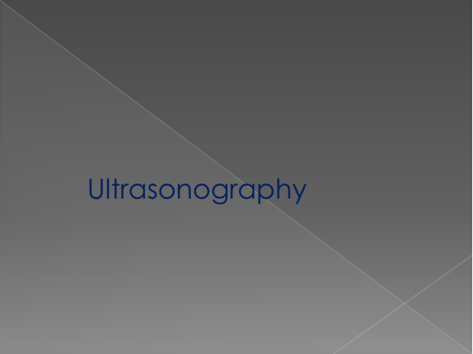

Slide 41
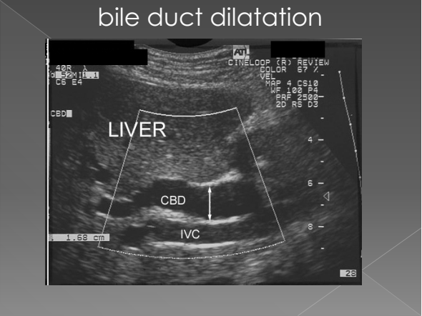

Slide 42
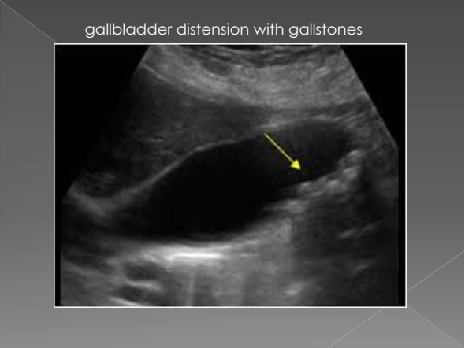

Slide 43
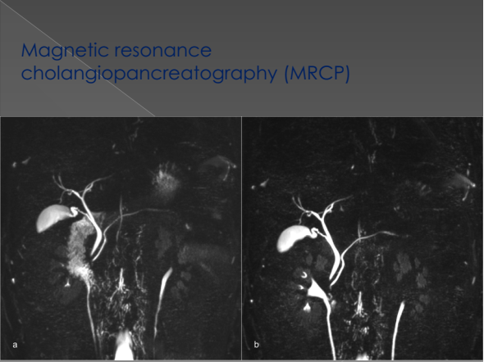

Slide 44
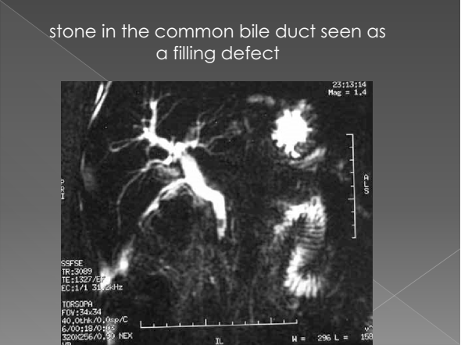

Slide 45
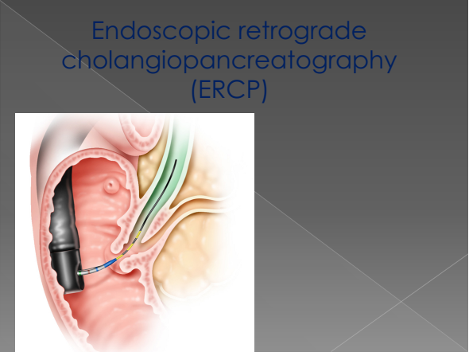

Slide 46
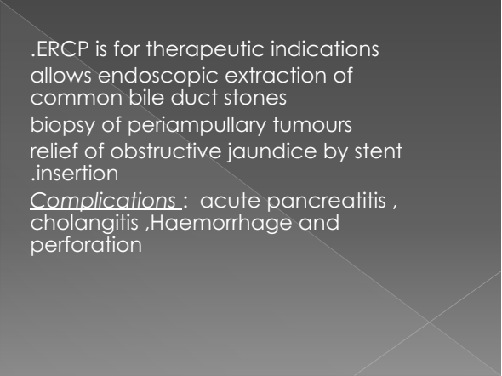

Slide 47
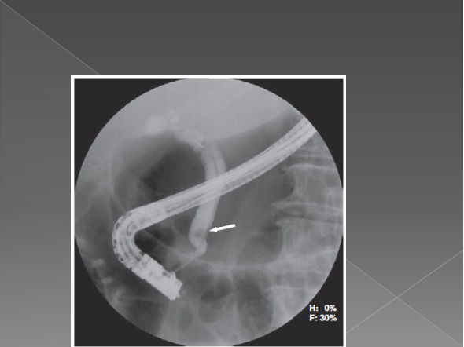

Slide 48
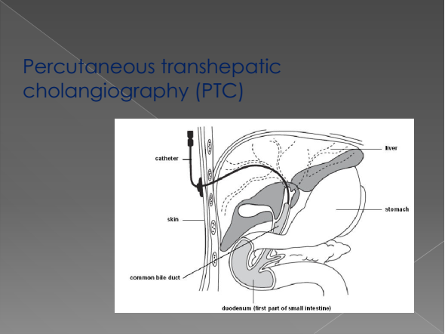

Slide 49
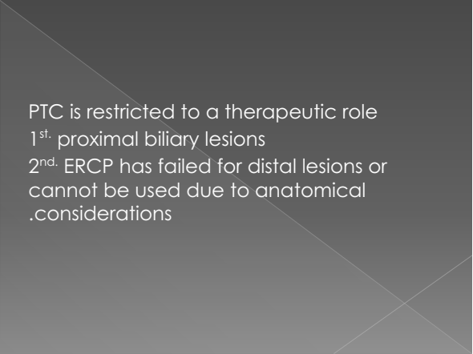

Slide 50
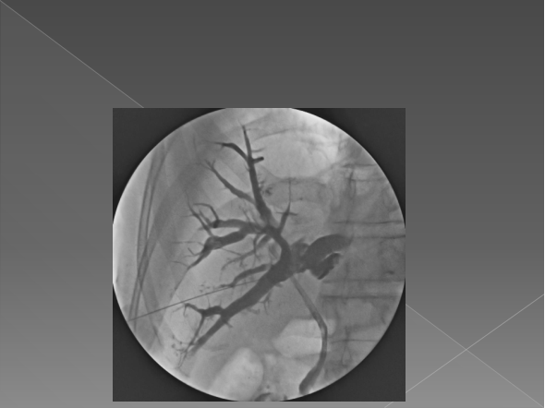

Slide 51
Medical treatment
(Supportive care)
IV fluids (In cases of dehydration)
Antibiotics (Infection, e.g. Cholangitis)
Antivirals (Viral infections e.g. Viral hepatitis)
Blood transfusions (Anemia)
Steroids (Autoimmune diseases, e.g. autoimmune hepatitis)

Slide 52
Medical treatment Cont.
Chemotherapy, radiation (Tumors, e.g. head of pancreas CA).
7 ADEK vitamins and ursodeoxycolic acid for obstructive jauindice .

Slide 53
Surgical treatment
(Post-hepatic jaundice)
The goal is to relieve obstruction
Definitive or temporary treatment, curative or palliative.
ERCP / PTC (endoscopic retrograde cholangeopancreatography / percutaneous transhepatic cholangiography) (To remove stones, apply stents or dilate strictures)

Slide 54
Surgical treatment Cont.
Cholecystectomy with bile duct exploration
Resection of obstructing tumor
Whipple’s procedure (Surgical procedure to remove cancerous head of pancreas, CBD tumors, duodenal papilla or duodenum near the pancreas)
Bypass of irresectable lesion

Slide 55
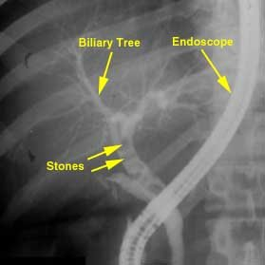
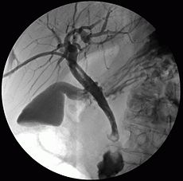
Treatment depends on the cause
1)Cholethiasis
ERCP followed by laproscopic cholecystectomy

Slide 56
2) Ca Head of Pancreas / Periampullary Carcinoma
Whipple resection

Slide 57
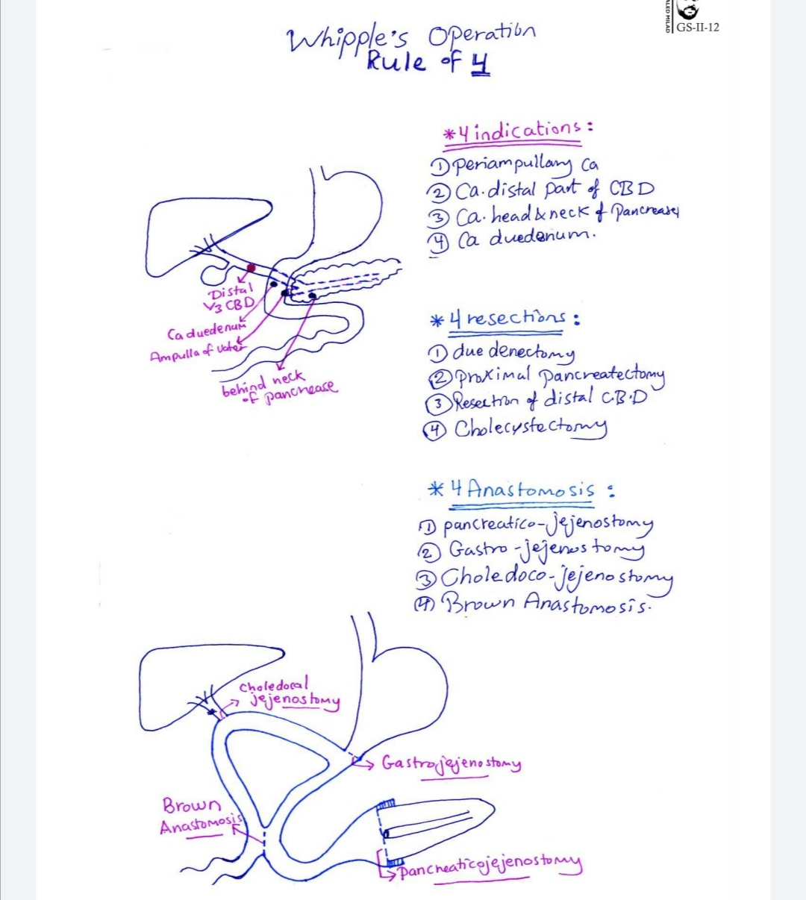

Slide 58
3)Choledocholithiasis (stones in the CBD)
Treatment of choice is stone extraction through ERCP and sphinctrectomy
4)Endoscopic stenting
it may be possible to relieve the blockage through stents through ERCP or PTC
strictures

Slide 59
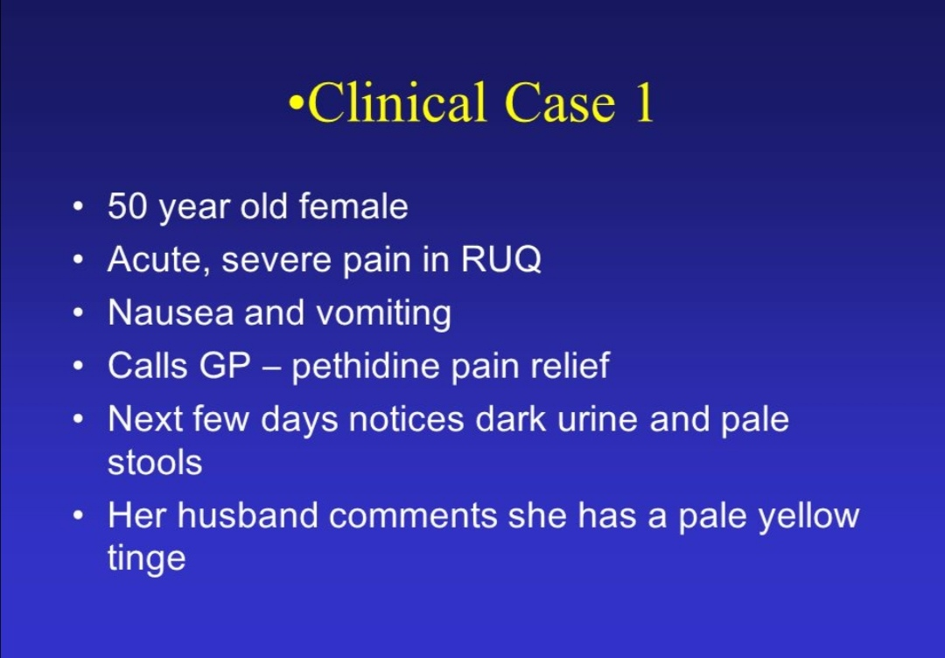

Slide 60
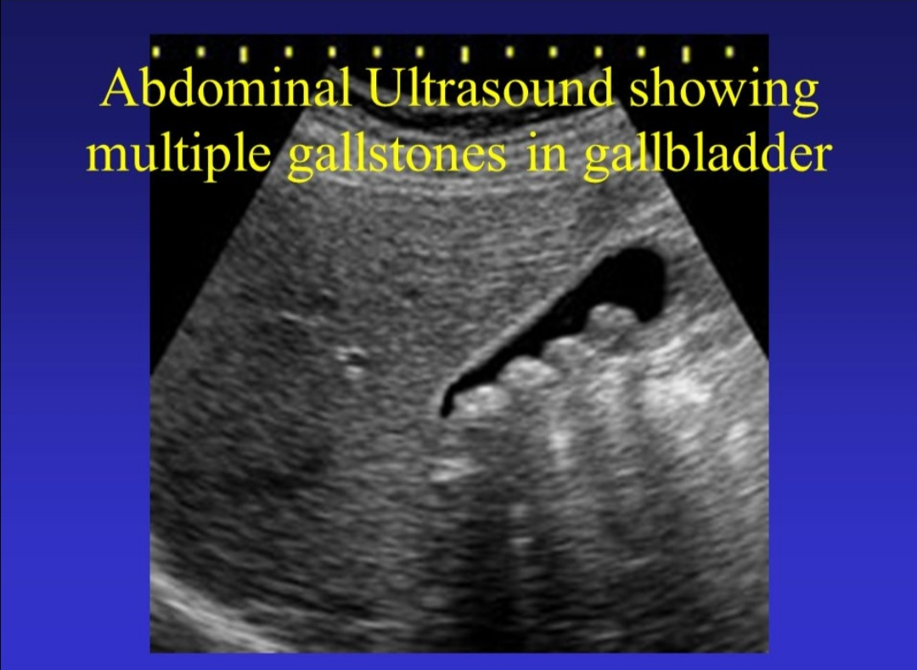

Slide 61
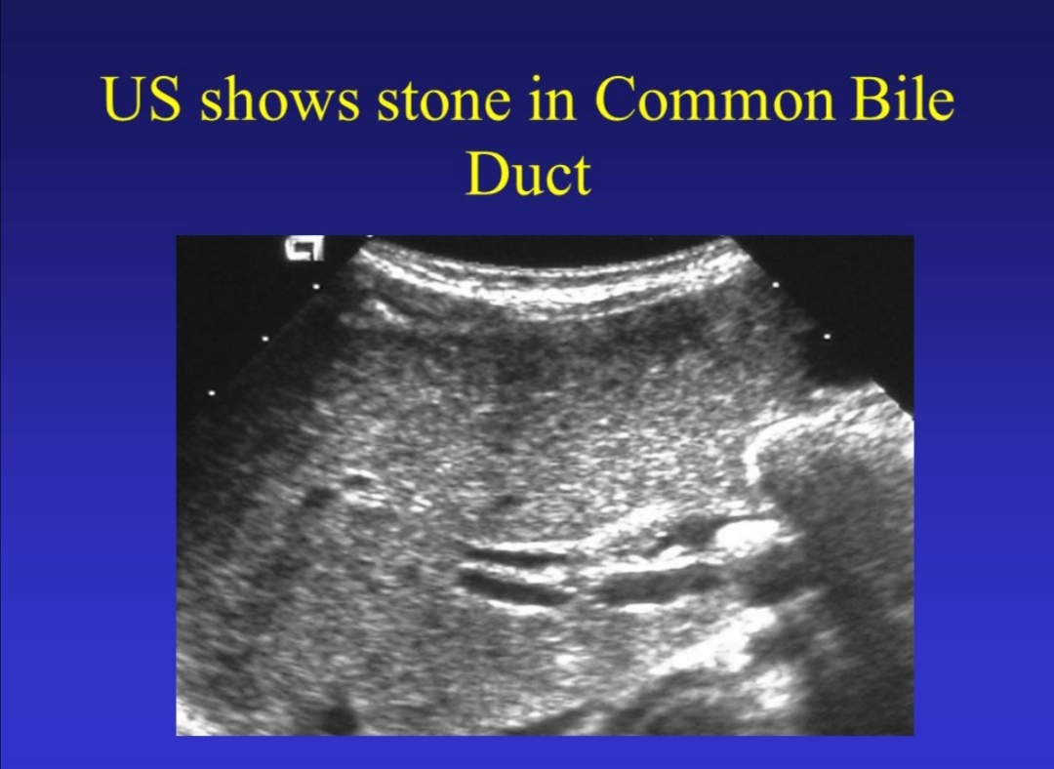

Slide 62
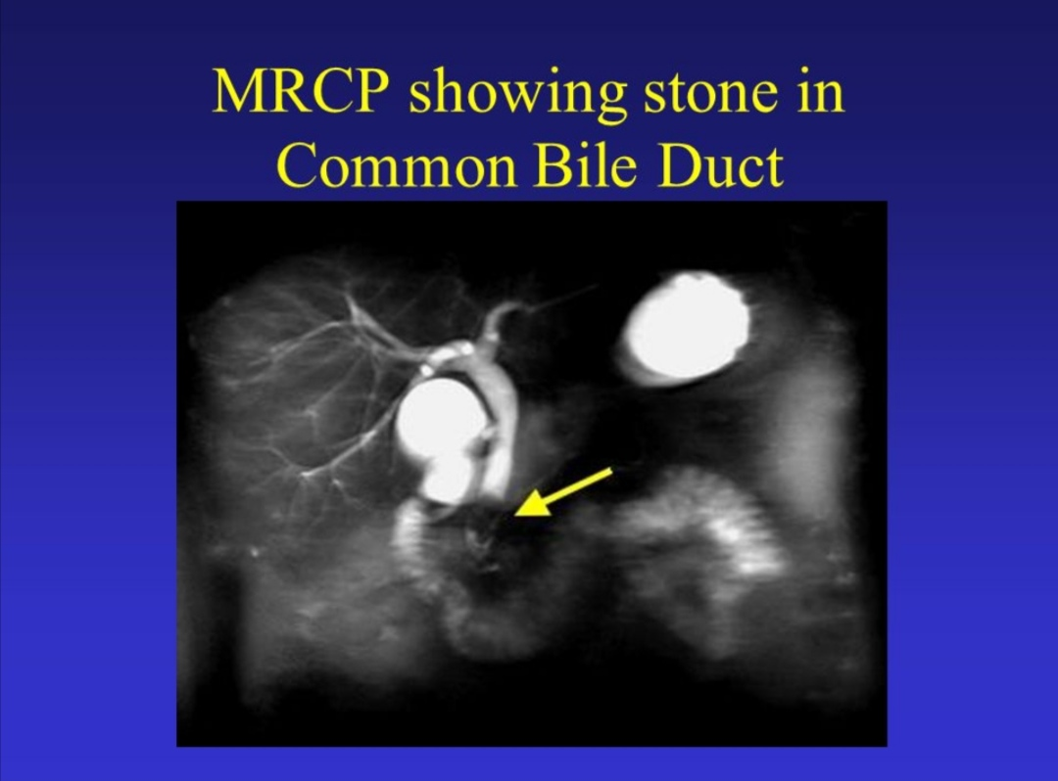

Slide 63
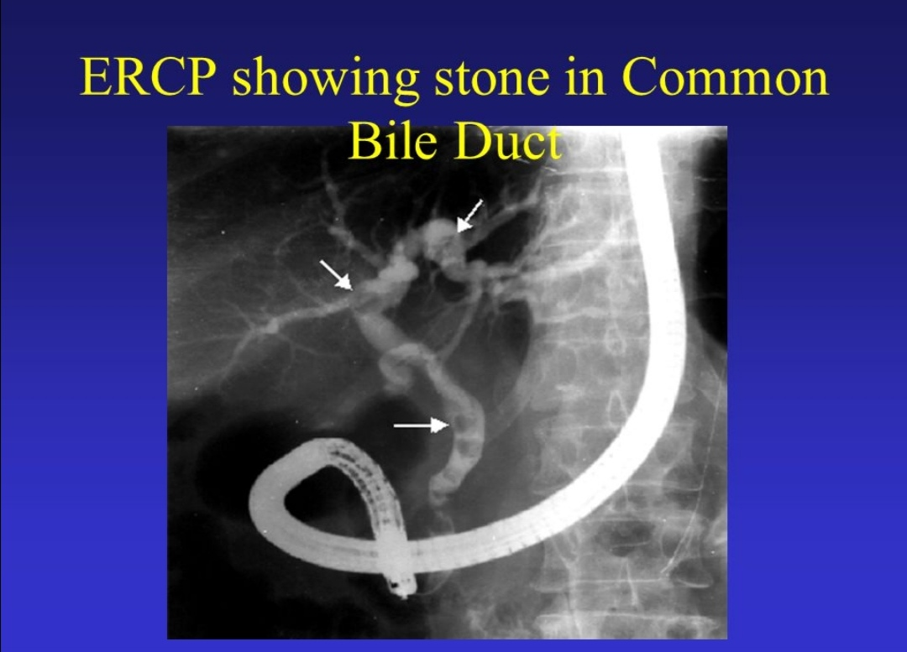

Slide 64
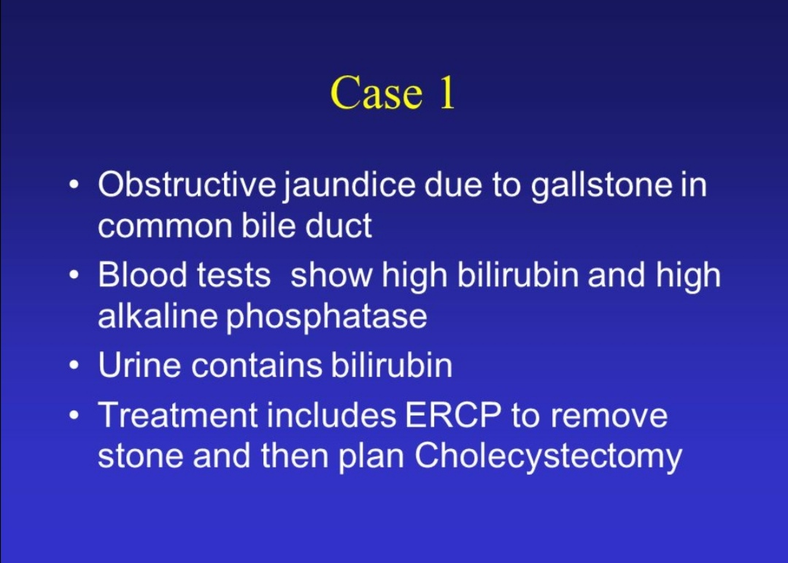

Slide 65
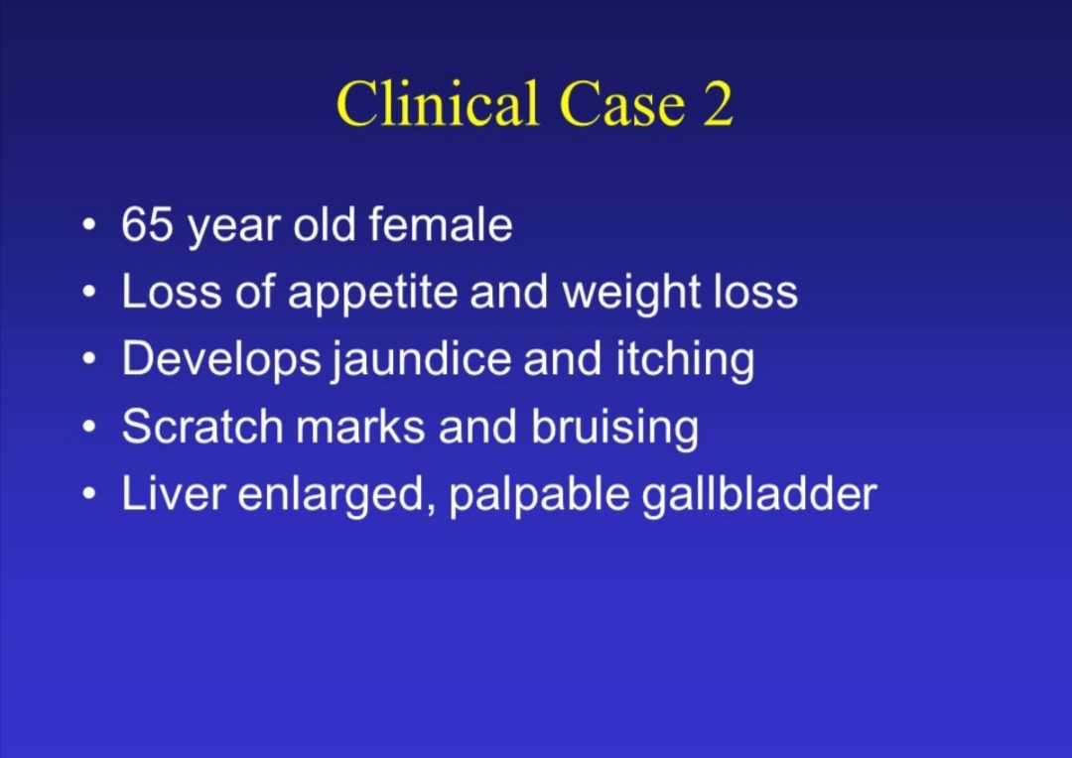

Slide 66
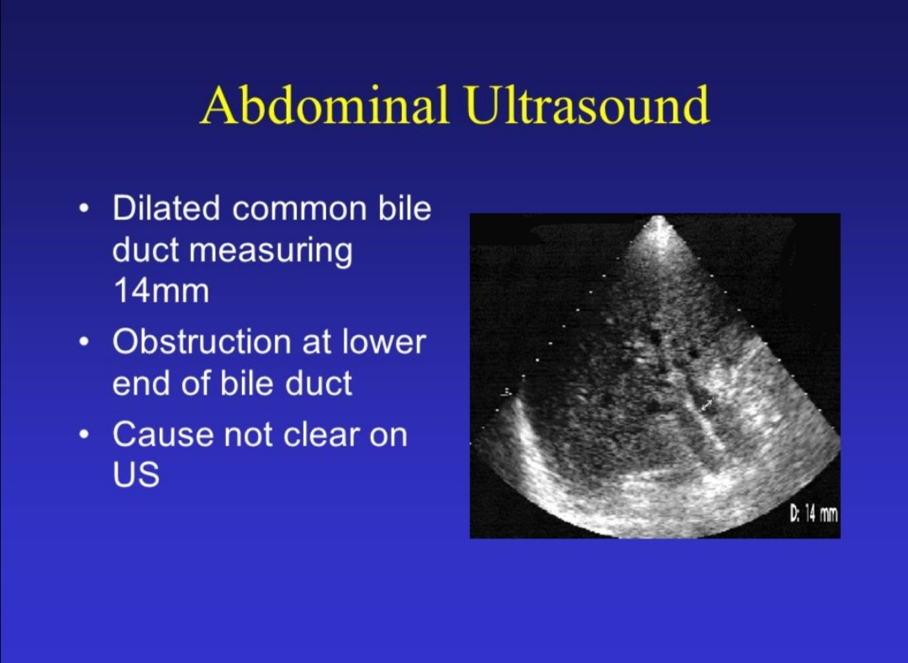

Slide 67
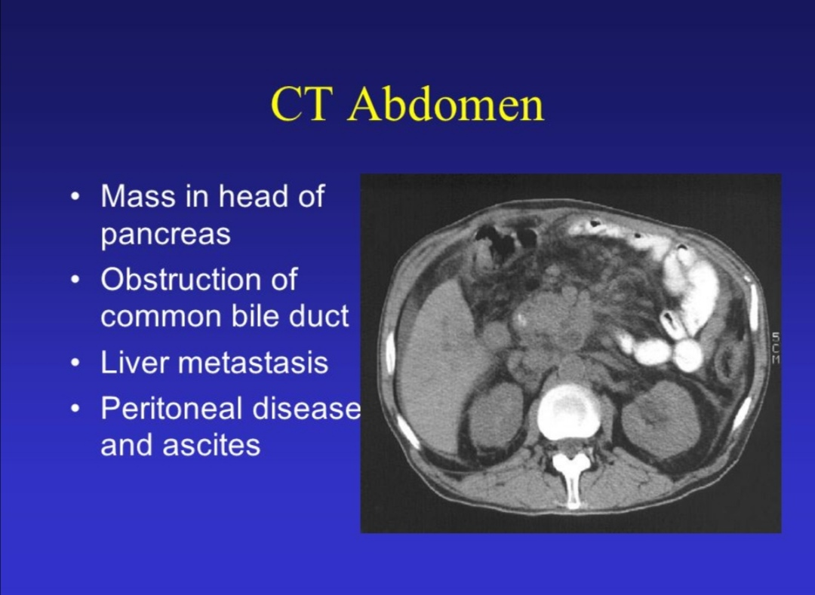

Slide 68
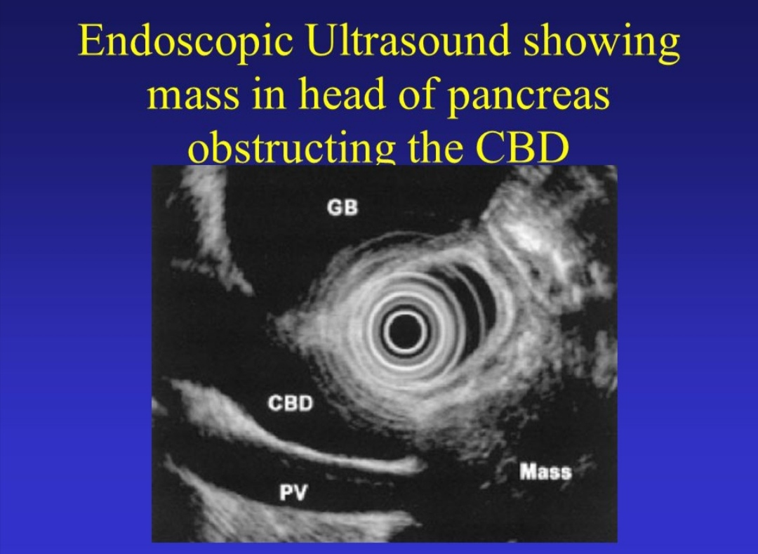

Slide 69
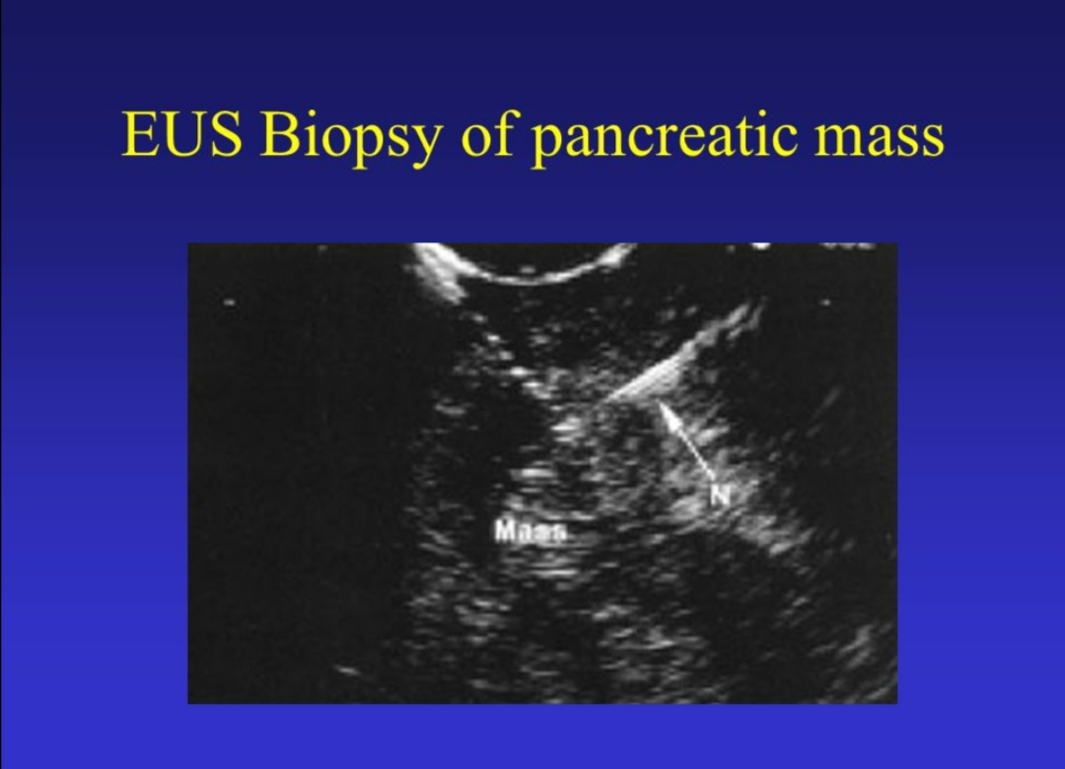

Slide 70
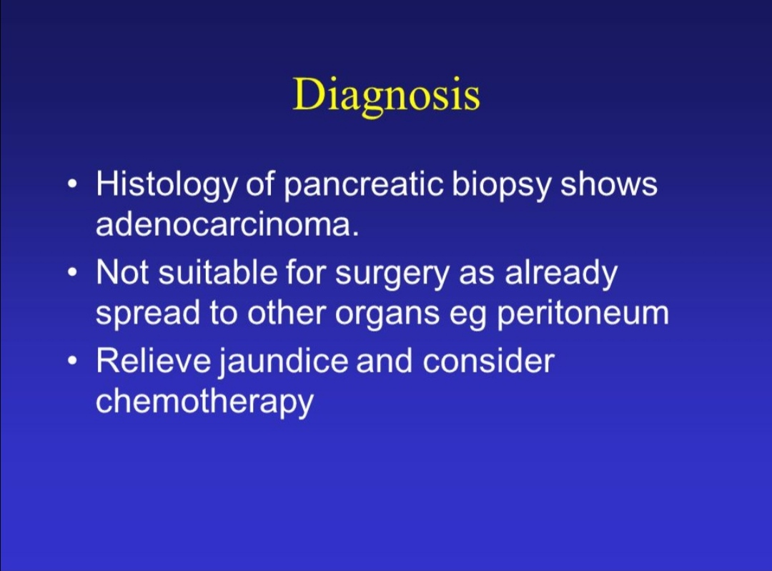

Slide 71
