Slide 1
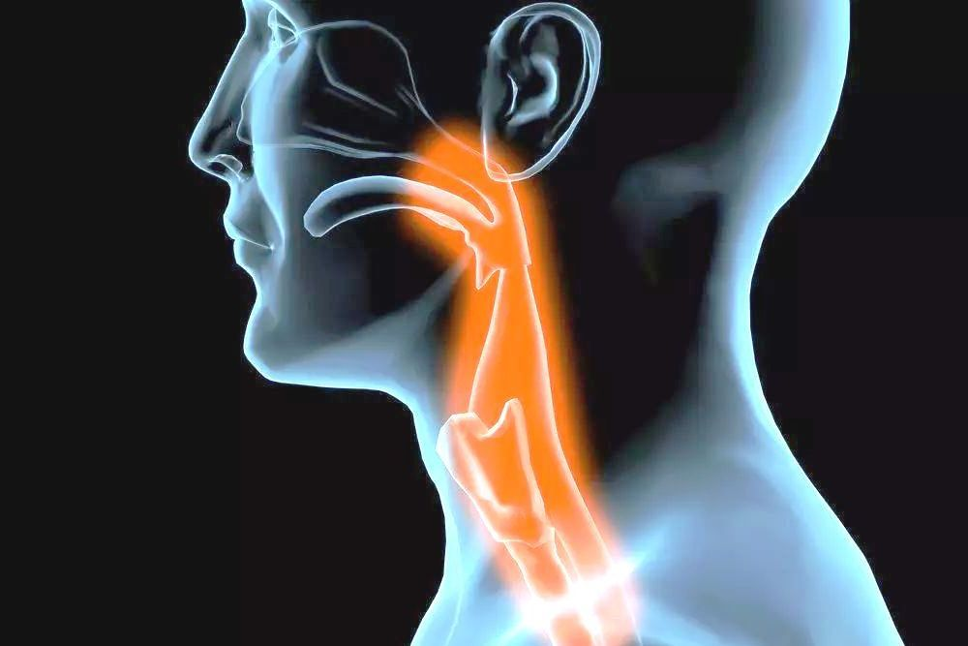
APPROACH TO DYSPHAGIA
Presented by:
Salsabeel Yousef
Reem hamad

Slide 2
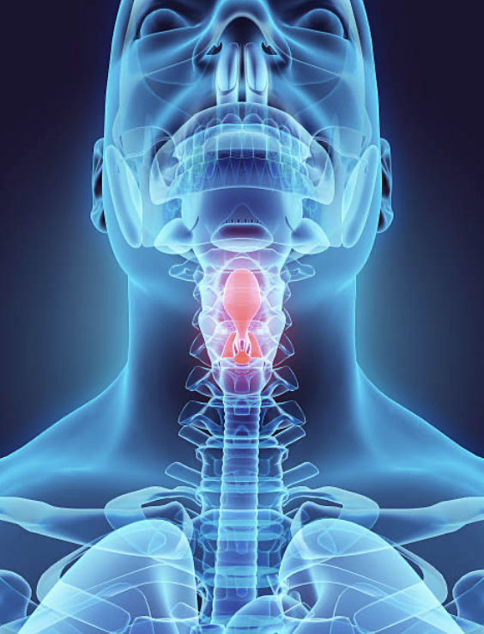
Outlines
Anatomy of Esophagus.
Blood supply and lymphatic drainage.
Definition of Dysphagia.
Classification and causes.
Clinical Approach.
Case discussion.

Slide 3
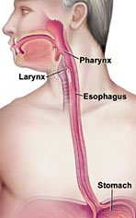
ESOPHAGUS
Hollow, highly distensible muscular tube, about 25 cm long, extends from epiglottis to the gastroesophageal junction.

Slide 4
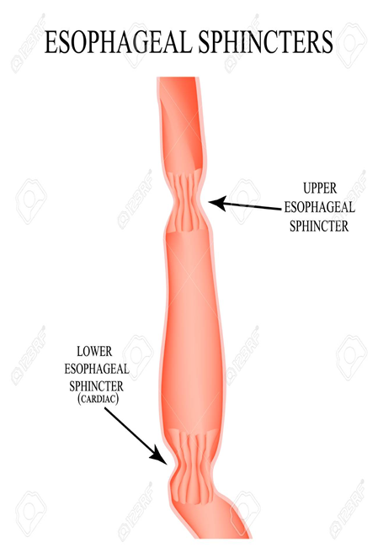
Esophageal sphincters
Upper Esophageal Sphincter
Lower Esophageal Sphincter
cricopharyngeus + inferior pharyngeal constrictor muscles.
Intrinsic esophageal muscles (tonic contraction)
Sling fibers of proximal stomach
The crura of the diaphragm
Phrenoesophageal ligament
The transmitted pressure of the abdominal cavity

Slide 5
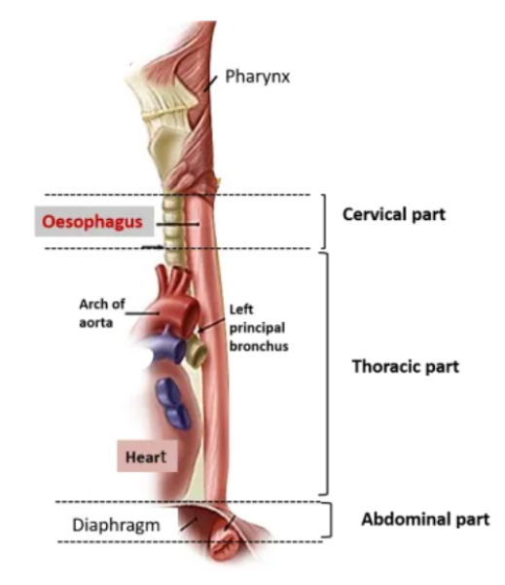
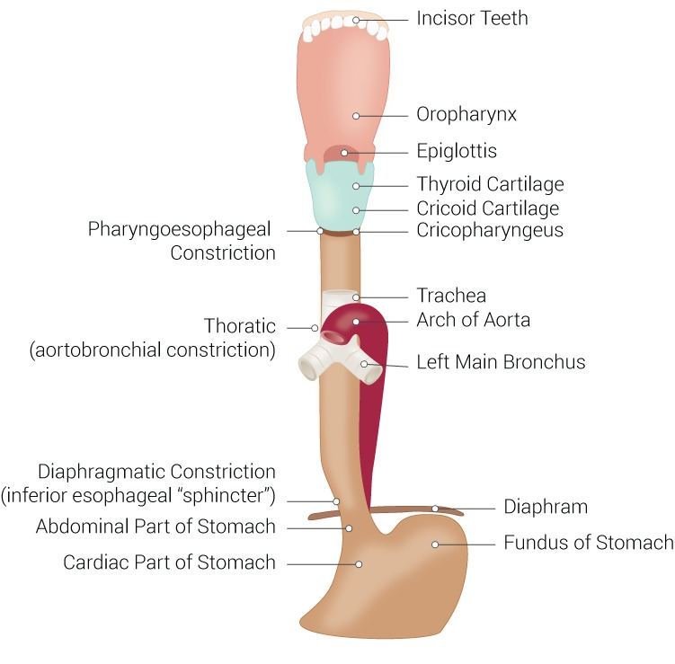
3 parts and 3 sites of constriction
Notes:
Cervical esophagus starts at inferior margin of cricoid cartilage that corresponds to corpus of 6th cervical vertebra, This level is marked by a carotid tubercula named “Chasseing tubercula,” which is an important landmark in cervical esophagectomy. Cervical esophagus ends at inferior edge of first dorsal vertebra that comes up to a horizontal plane of jugular incisura of sternum. The endpoint is the starting point of upper mediastinum, and from this point it is thoracic esophagus. Cervical esophagus is 5–6 cm long, and its luminal diameter is 1.4–1.5 cm at its narrowest point
cervical constriction: due to cricoid cartilage at the level of C5/6.
thoracic constriction: due to aortic arch at the level of T4/5.
abdominal constriction: at esophageal hiatus at T10/11

Slide 6
ARTERIAL SUPPLY
Cervical part is supplied by inferior thyroid arteries.
Thoracic part is supplied by esophageal branches of Descending thoracic aorta, and Bronchial arteries.
Abdominal part is supplied by esophageal branches of Left gastric artery, and Left inferior phrenic artery.

Slide 7
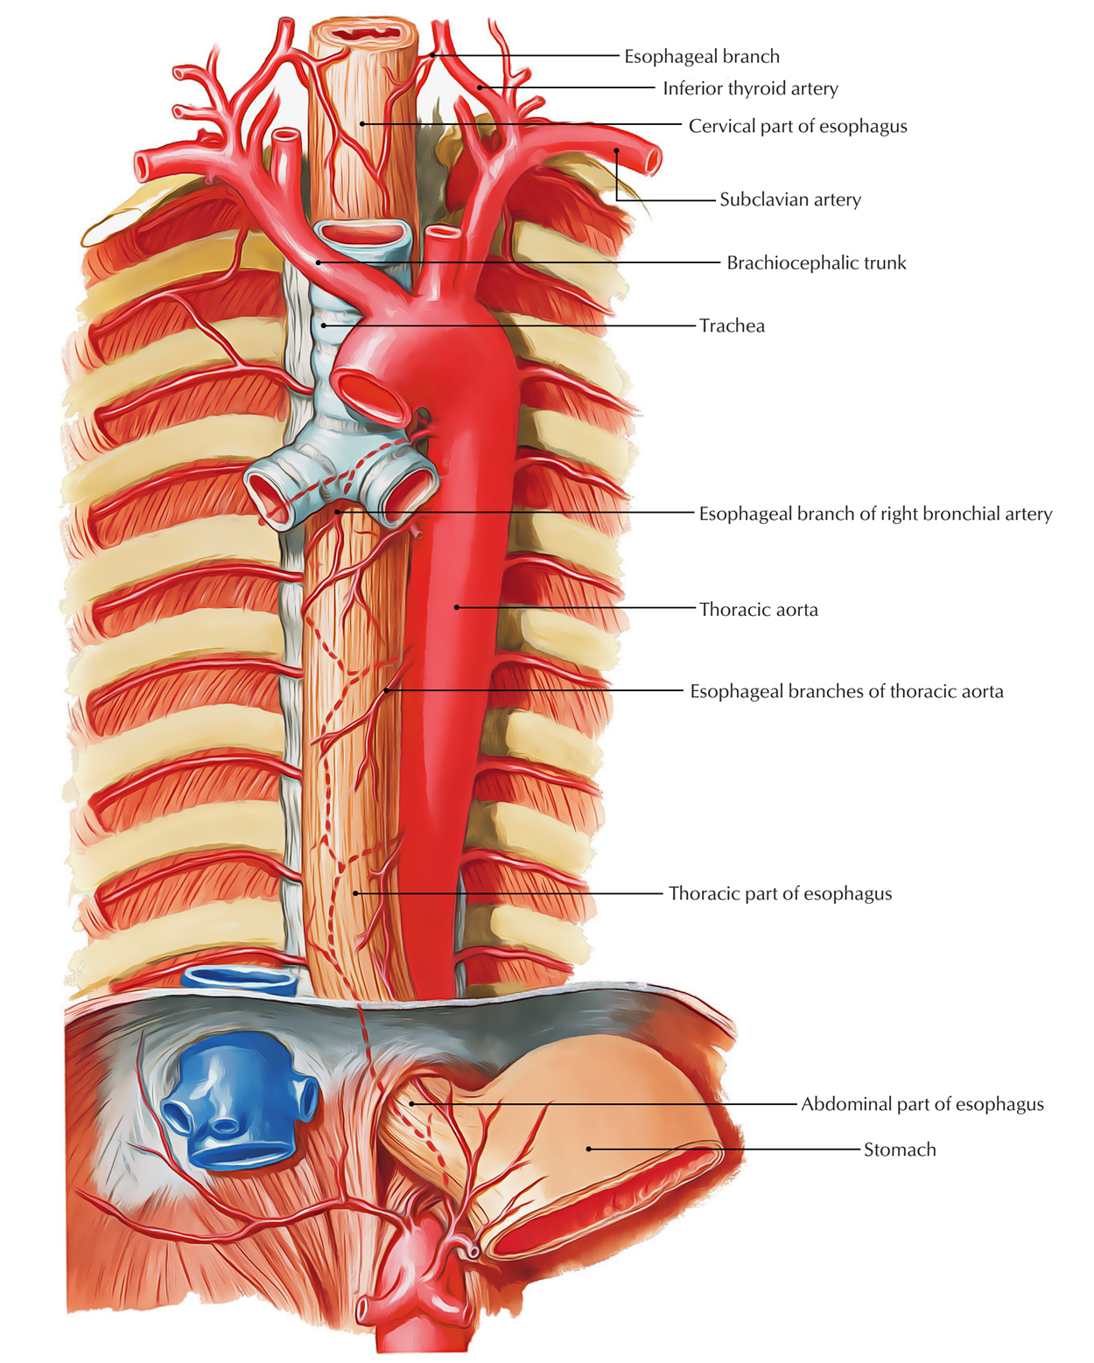
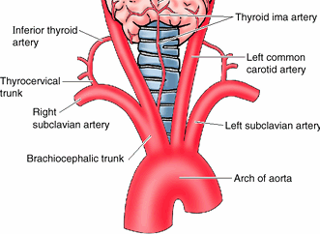
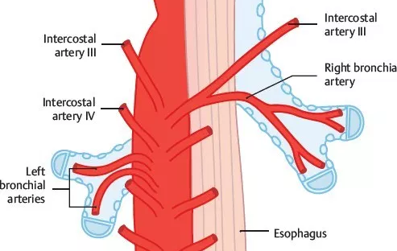

Slide 8
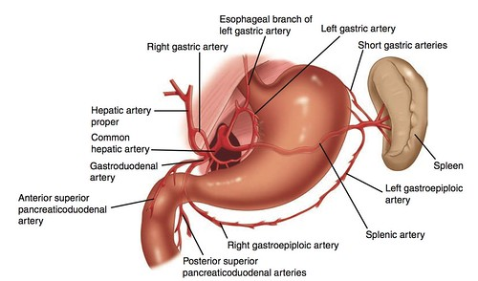
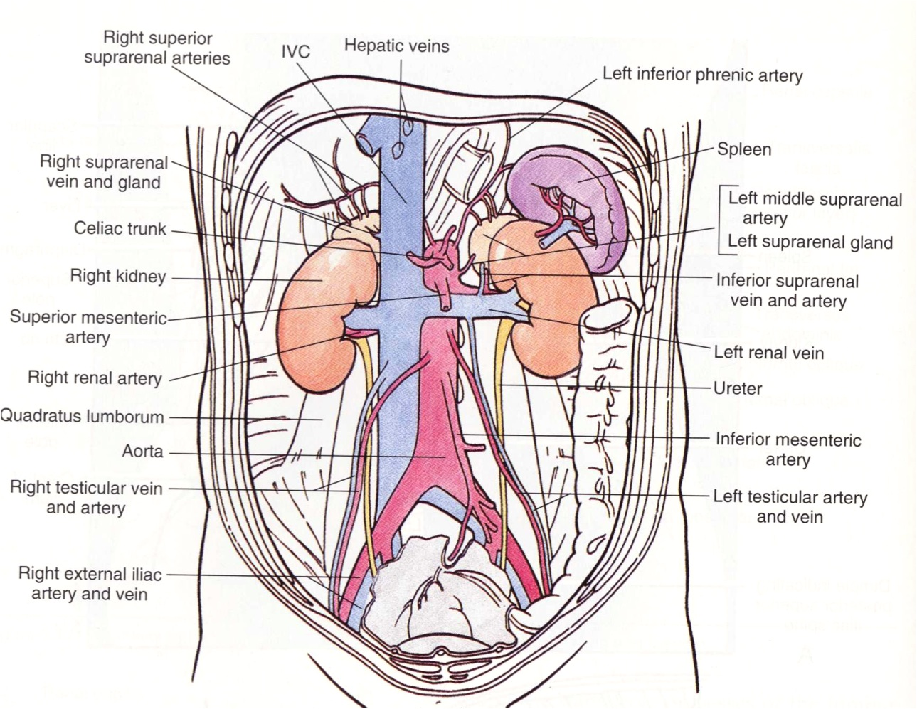

Slide 9
VENOUS DRAINAGE
Cervical part is drained by inferior thyroid veins.
Thoracic part is drained by azygos and hemiazygos veins.
Abdominal part is drained by 2 venous channels
hemiazygos vein, a tributary of inferior vena cava, and
left gastric vein, a tributary of portal vein.

Slide 10
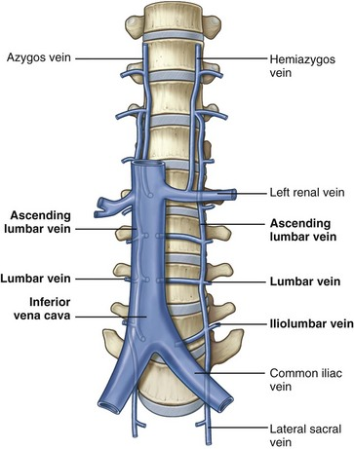
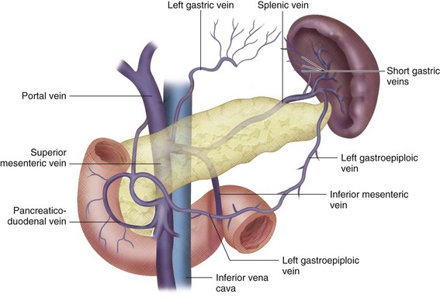

Slide 11
LYMPHATIC DRAINAGE
From cervical part, the lymph is drained into deep cervical lymph nodes.
From thoracic part, the lymph is drained into posterior mediastinal lymph nodes.
From abdominal part, the lymph is drained into left gastric lymph nodes.

Slide 12
Deglutition
the action or process of swallowing

Slide 13
STAGES OF SWALLOWING
Oral Phase
Food is chewed and mixed with saliva to form a soft consistency. The tongue then moves the bolus toward the back of the mouth.
Pharyngeal Phase
The vocal folds close to keep food. The larynx rises inside the neck and the epiglottis moves to cover it, providing even more airway protection.
Esophageal Stage
The bolus moves into the esophagus, the muscular tube that contracts to push the bolus into the stomach.

Slide 14
DEFINITION OF DYSPHAGIA
a subjective sensation of difficulty or abnormality of swallowing or transferring food from the mouth to the stomach.
Dysphagia can be oropharyngeal or esophageal.
Patients with oropharyngeal problems present with difficulty in initiating the swallow , as well as problems with aspiration , choking , nasopharyngeal regurgitation, and dysphonia .
Patients with esophageal causes of dysphagia present with difficulty in swallowing several seconds after initiating a swallow and frequently report that food sticks at a point in the chest or throat, esophageal dysphagia occurs in the involuntary phase and is characterized by a sensation of food sticking.
Dysphagia may occur acutely or in a chronic fashion, can affect solids and/or fluids and be intermittent or progressive.

Slide 15
History
-Patient profile
-Chief complain , duration
-History pf presenting illness:
-solid/fluid or both
as Dysphagia to both solid and liquid at the onset of symptoms is
characteristic for esophageal dysmotility disorders eg.achalasia,DES,nutkruker for long period of time
In cancer dysphagia starts to solid then progress to involve fluid
-Level of stuck (oropharyngeal vs esophageal)
- Pain (odenophagia)
-Progression over time

Slide 16
Associated symptoms
Achalasia
The hall mark is dysphagia (at onset) to both solid and liquid for a long
period of time.
- Post-prandial Regurgitation, commonly occur at night, may cause
aspiration, may cause weight loss.
- Retrosternal chest pain.
- Heartburn occur in 30% of patients which may be related to food
fermentation and lactic acid
diffuse esophageal spasm
-chest pain is the hall mark which may mimic angina due to
esophageal distension.
PUD
- indigestion
- heartburn
- regurgitation
- abd. Pain

Slide 17
GERD , Pharyngeal pouch (zenker's diverticulum) :
- heartburn
- hoarseness of voice
-when drinking → gurgle
-halitosis
Esophegeal cancer
-Weight loss
- early statiety
- fever , weight loss , loss of appetite
, fatigue .
-hematemesis , melena
Less often: Dyspnea, cough, hoarseness and pain in retrosternal, back or right upper abdominal
- Metastatic Disease: Lymphadenopathy (Virchow’s node),
hepatomegaly, ascites or pleural effusion

Slide 18
Plummer Vinson synd.
Hx. Of iron def. anemia
- glossitis (other iron deficiency anemia symptoms)
-( triad of dysphagia + esophageal web + iron def. anemia)
Esophagitis
-Hx of chronic
diseases like
DM , HIV ,
cancer , or on
steroids
(candida)

Slide 19
Risk factors and other association :
-Hx .of neck masses , goiter , lumps , L.N
-Hx of radiation
-Hx. Of NG tube , trauma , previous surgeries , previous Hx. Of corrosives ingestion .
- drug Hx.
- Hx. Of cardiac problems , palpitations , L.V enlargement .
- Hx. Of CVA , DM .

Slide 20
DRUG HISTORY​
mucosal injury : doxycycline, tetracycline, clindamycin , NAIDS , ferrous sulfate.​
reduce LES tone : theophylline , nitrates, Ca antagonists​
history of exposed to chemotherapy or radiotherapy.​
​
History of Ingestion of corrosive agents , foreign bodies

Slide 21
Investigations
Endoscopy should always be the first test.
-mainly to exclude malignancy (with biopsy is necessary for definitive diagnosis )
- Detect the presence of PUD
Barium Swallow
Bird’s beak sign- classic for achalasi
crockscrew – DES

Slide 22
Other investigations
Manometry is the most reliable diagnostic tool for motility disorders
Achalasia - hypertensive non-relaxing LES
HRM is required to differentiate between DES & Nutcracker
DES- no peristaltic simultaneous repetitive high pressure muscular contraction
Scleroderma - Hypotensive Esophagus/LES
CT-PET staging if cancer is detected
Endoscopic ultrasonography (provides the most reliable method of determining depth of cancer invasion.
ECG
H.Pylori investigations

Slide 23
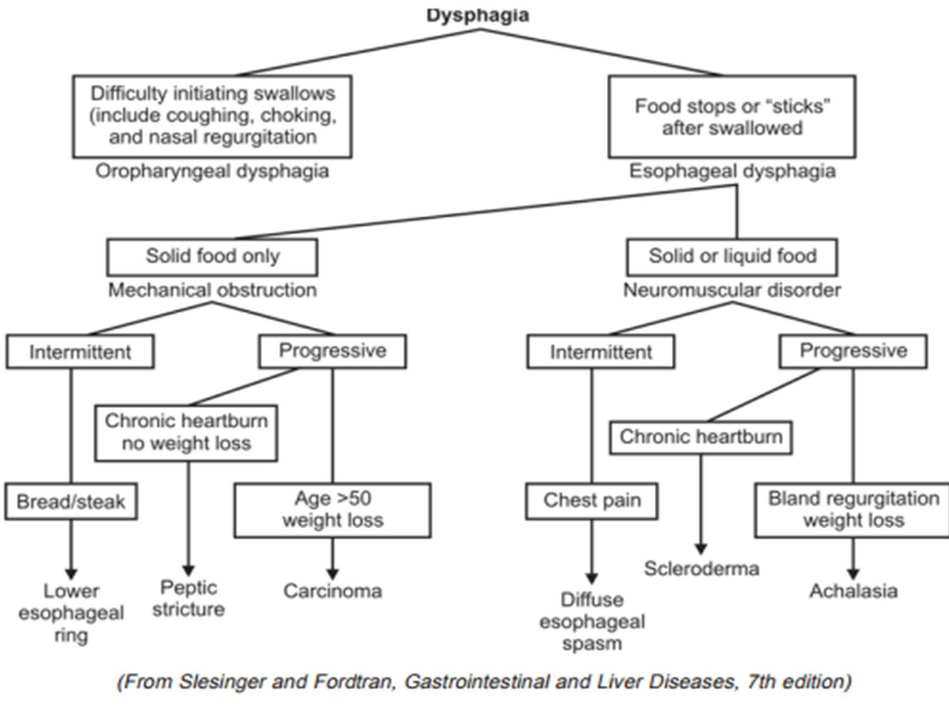
23

Slide 24
PHYSICAL EXAMINATION
Vital signs
General inspection: pallor (Anemia), jaundice, cachexia.
Neck : Cervical lymph nodes and Virchow's node
Lungs : infection
Heart failure “ high output failure secondary to anemia if GI bleeding occur.
Abdomen : mass , Sister Mary Joseph nodule

Slide 25
Oropharyngeal dysphagia
Inability to initiate the act of swallowing.
It is a transfer problem caused by
impaired ability to transfer food from mouth to upper esophagus
￮impaired oral preparatory phase
Clinical presentation:
￮food sticking in the throat
￮difficulty initiating a swallow
￮nasal regurgitation
￮coughing during swallowing
They may also complain of
￮dysarthria
￮nasal speech because of associated muscle weaknesses
￮Other Neurological clinical findings

Slide 26
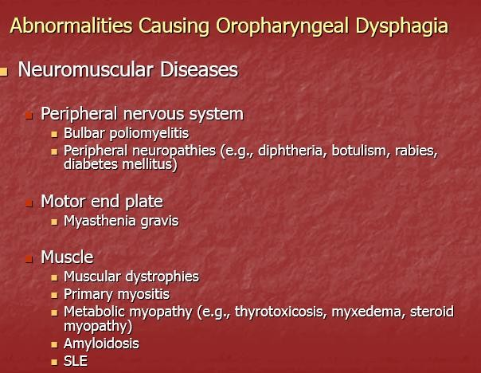
26

Slide 27
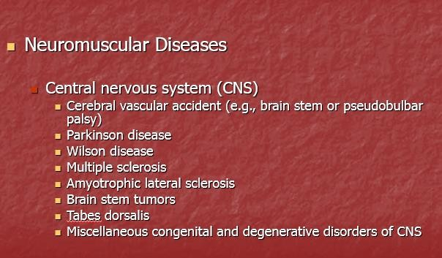
27

Slide 28
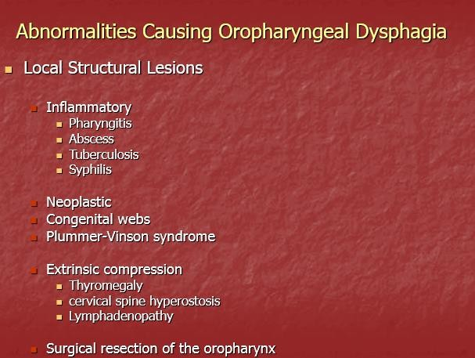
28

Slide 29
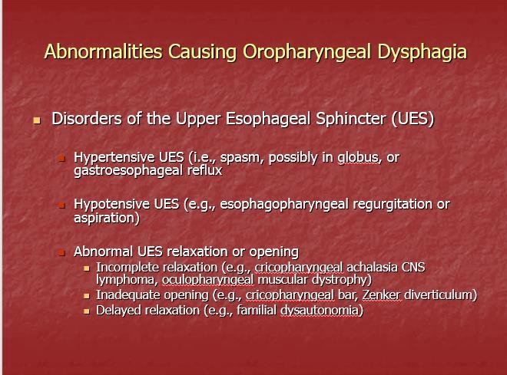
29

Slide 30
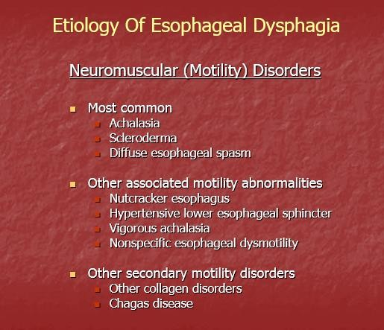
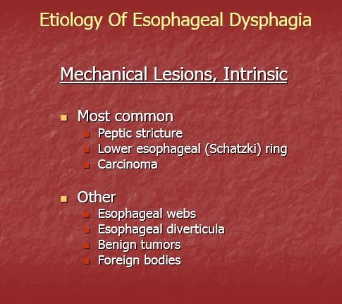
“

Slide 31
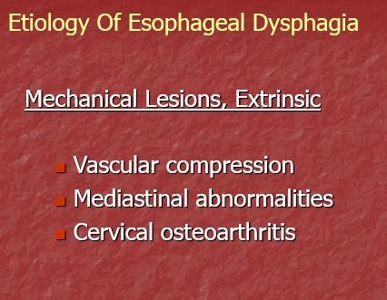
31

Slide 32
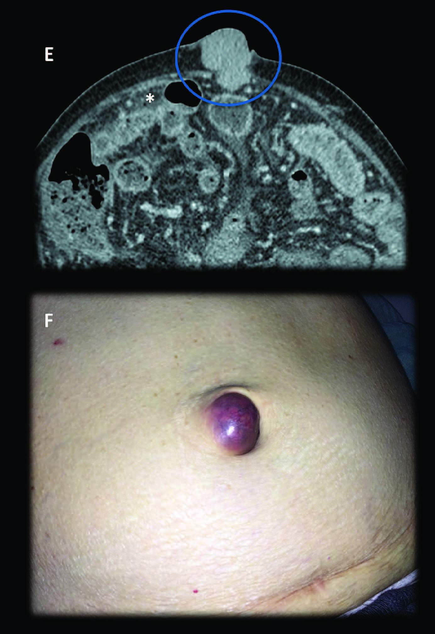
Mary Joseph Sister nodule , in case of gastric ca “ cardiac ca which cause dysphagia

Slide 33
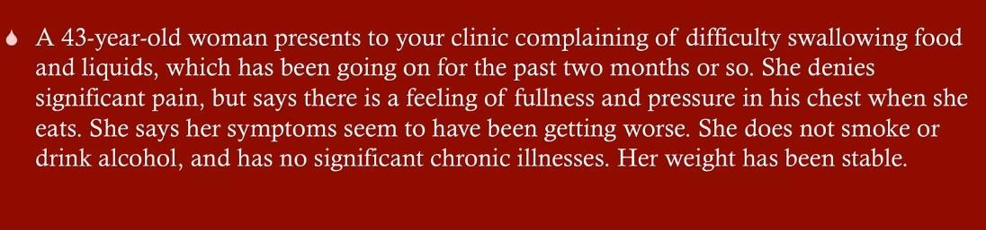
Case 1

Slide 34
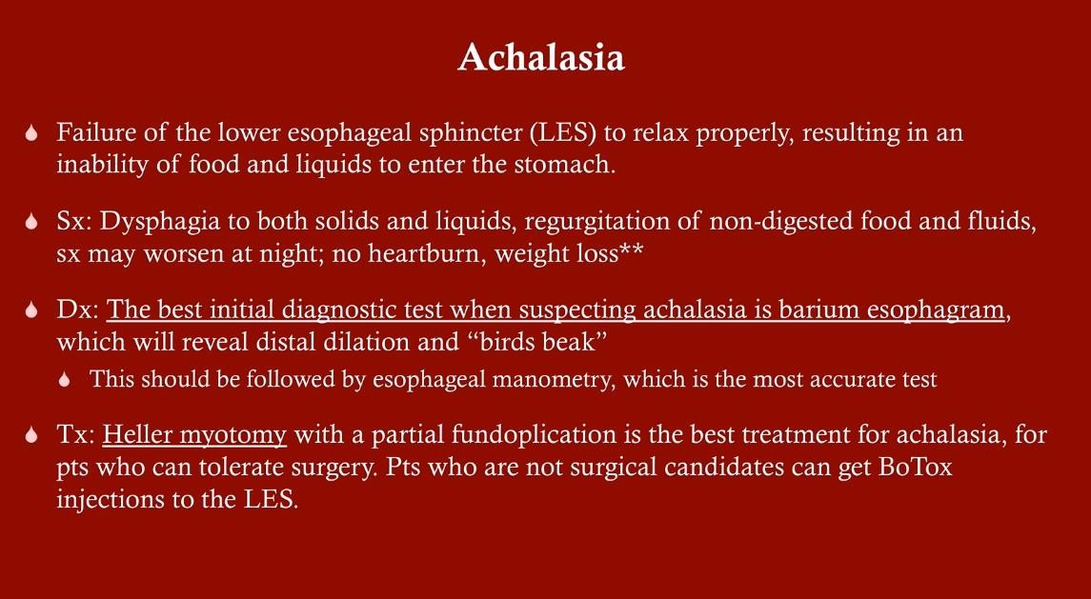

Slide 35
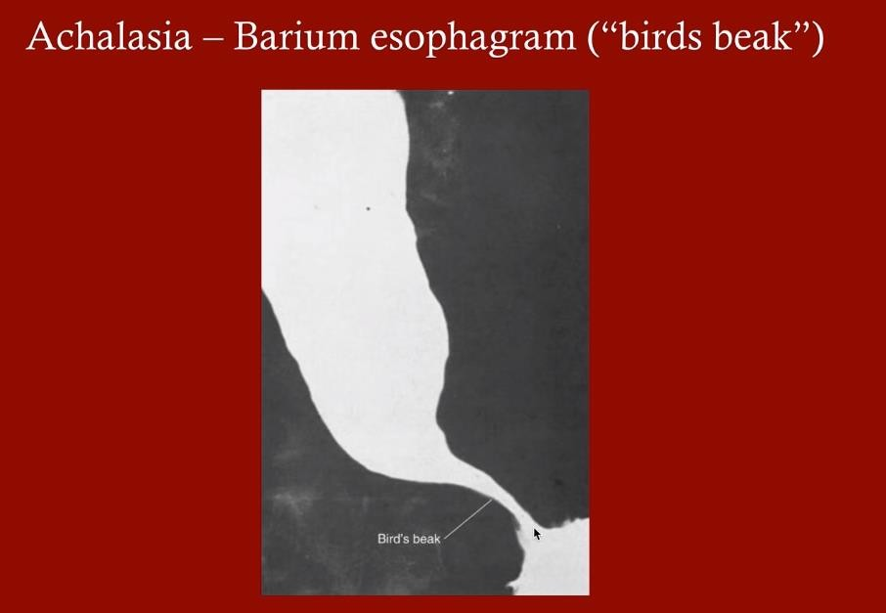
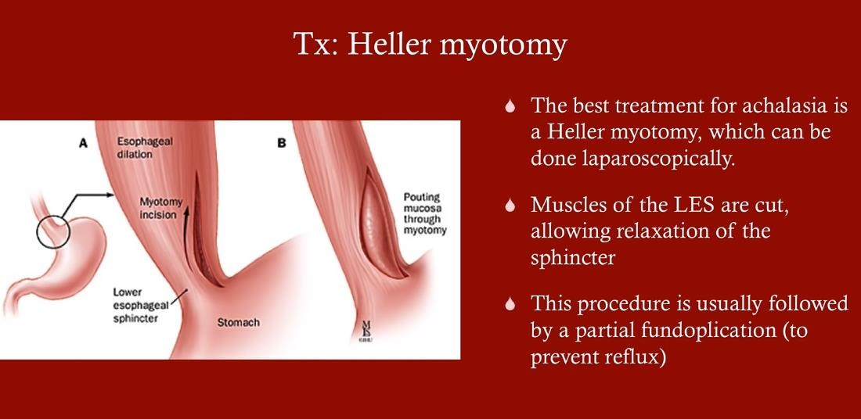

Slide 36
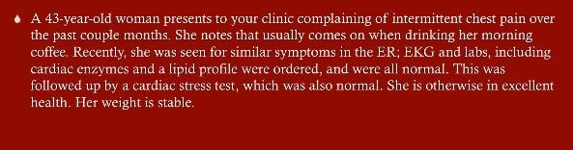
Case 2

Slide 37
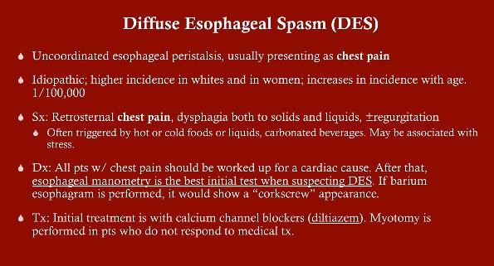

Slide 38
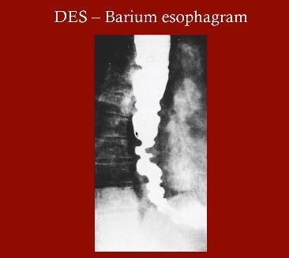
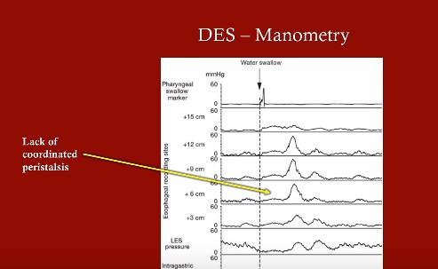
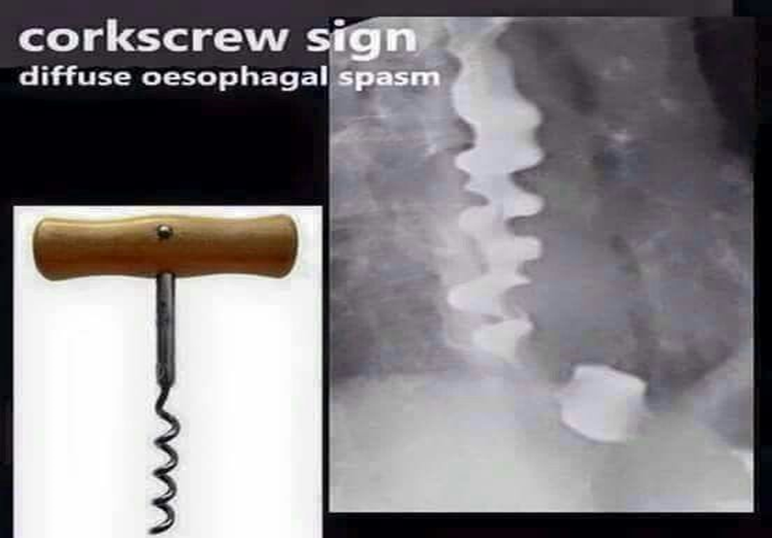

Slide 39
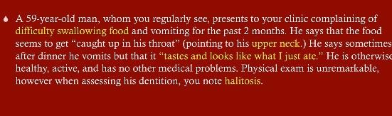
Case 3

Slide 40
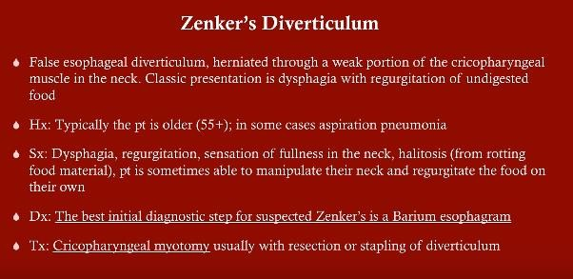

Slide 41
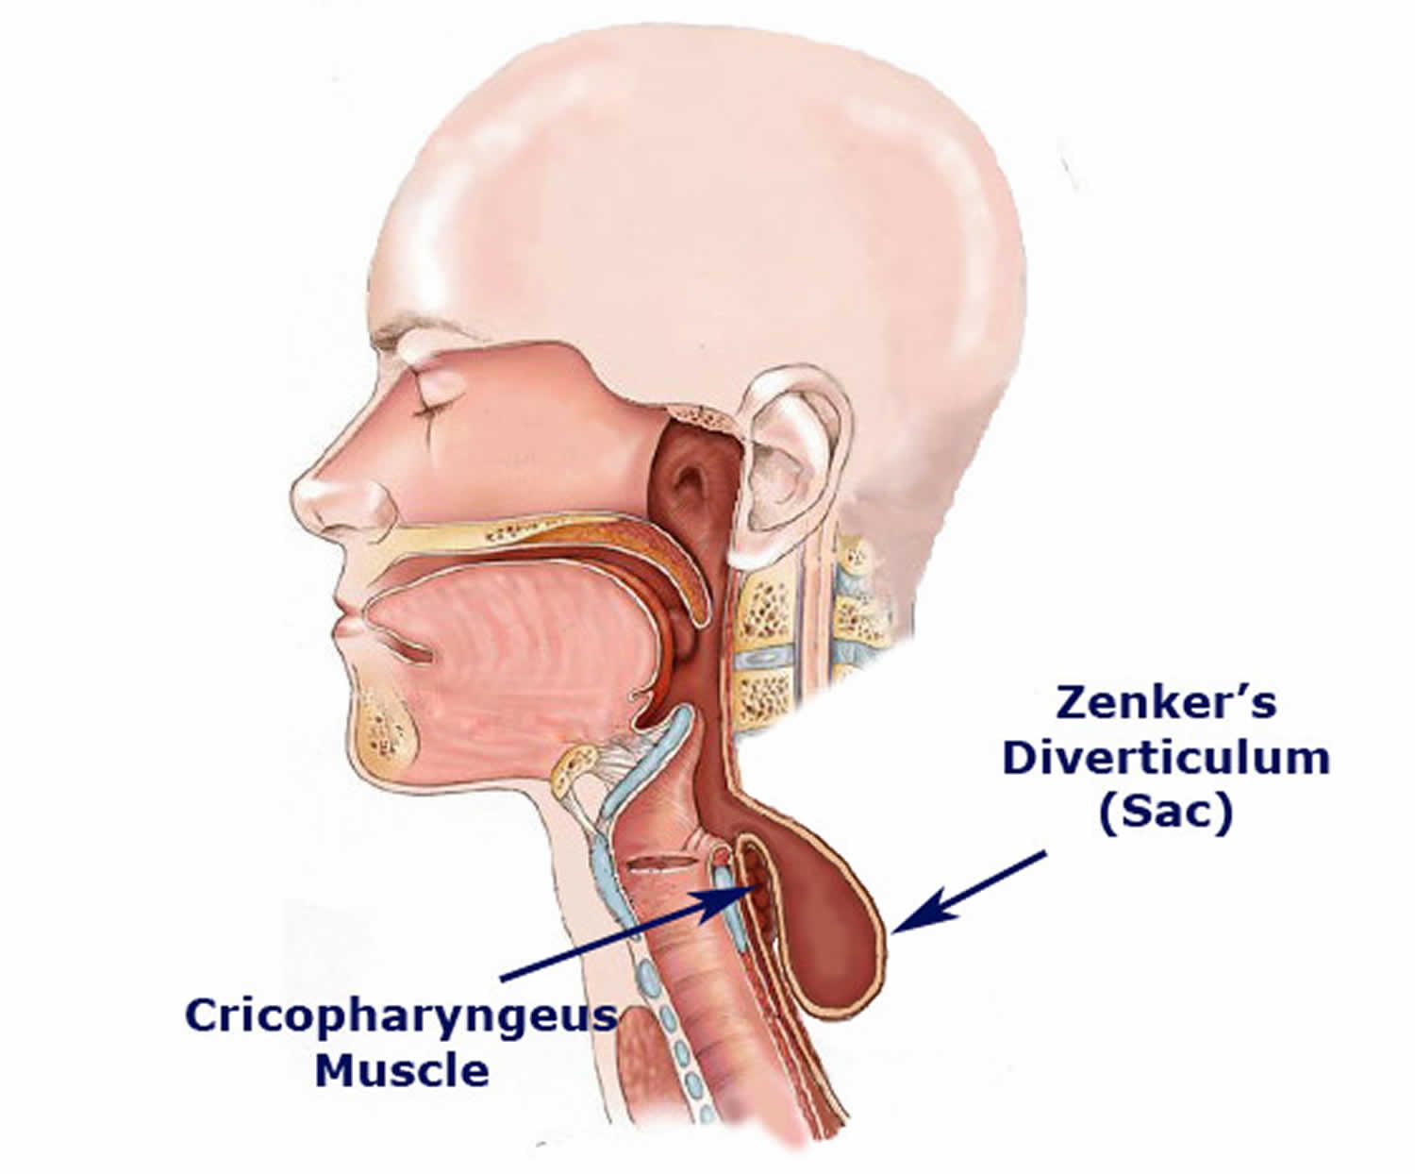

Slide 42
THANK YOU

