Slide 1
BENIGN ANO-RECTAL DISORDERS
Done by : Hamzah Alhamdan- 1636517

Slide 2
Anatomy of Rectum And Anus
The origin of the rectum to the level of the third sacral vertebra.
It descends along the curvature of the sacrum and coccyx and ends by passing through the levator ani muscles.
It measures 12–1 5cm in length and lacks a mesentery, sacculations, and appendices epiploicae.

Slide 3
The rectum describes three lateral curves: the upper and lower curves are convex to the right, and the middle is convex to the left.
On their inner aspect these infoldings into the lumen are known as the valves of Houston.

Slide 4
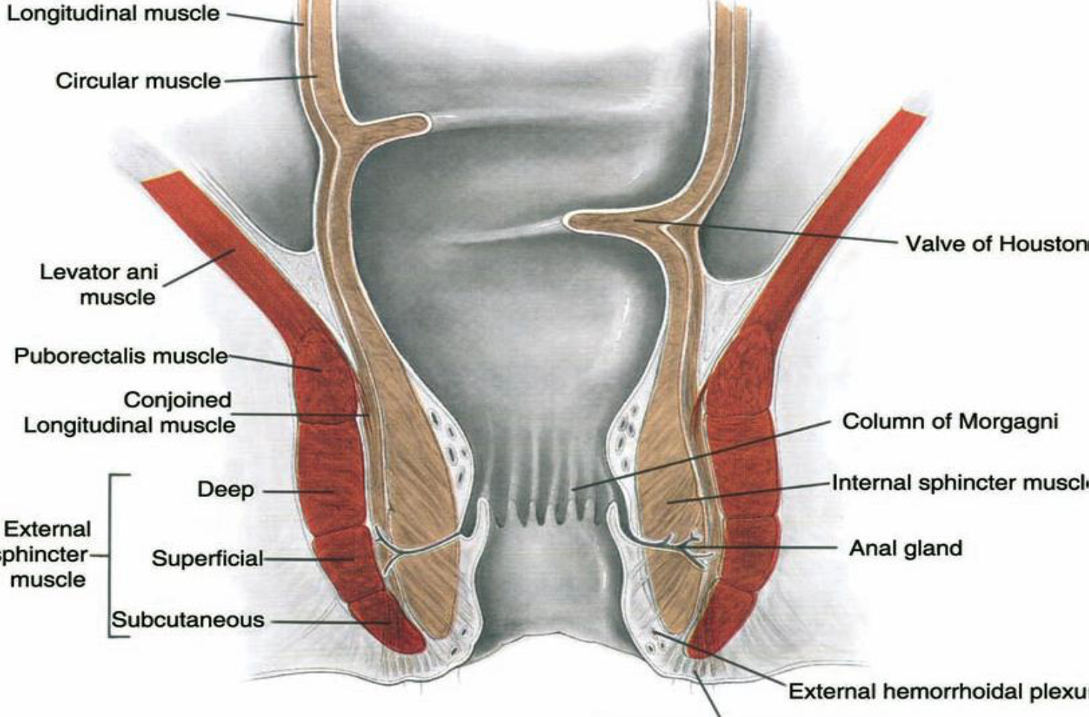

Slide 5
Anatomy of anal canal :
The anal canal may be defined in two ways, as follows:
1) Functional (or surgical) anal canal
2)Anatomic anal canal.

Slide 6
Cont.
The surgical anal canal is approximately 4 cm long, and
arises from: anorectal junction
terminates at: anal verge.
The anatomic anal canal is approximately 2 cm long,
begins from: pectinate line (dentate line)
terminates at : anal verge.

Slide 7
Cont.
The anal canal is divided into two unequal sections:
1) upper 2/3
2) lower 1/3
divided by dentate line

Slide 8
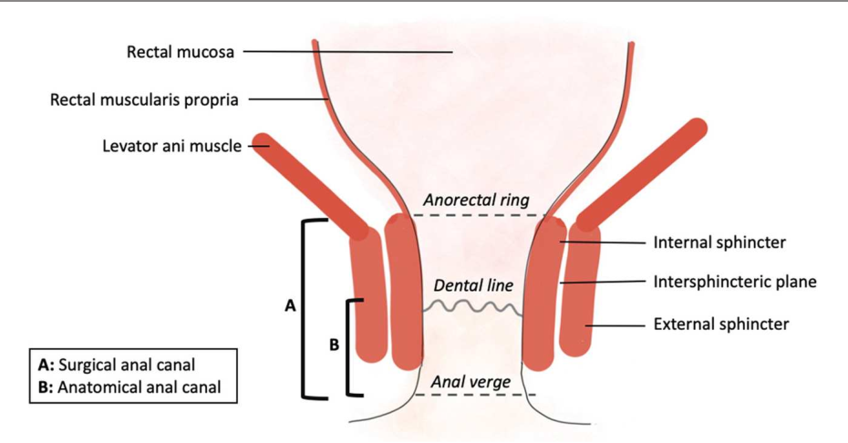

Slide 9
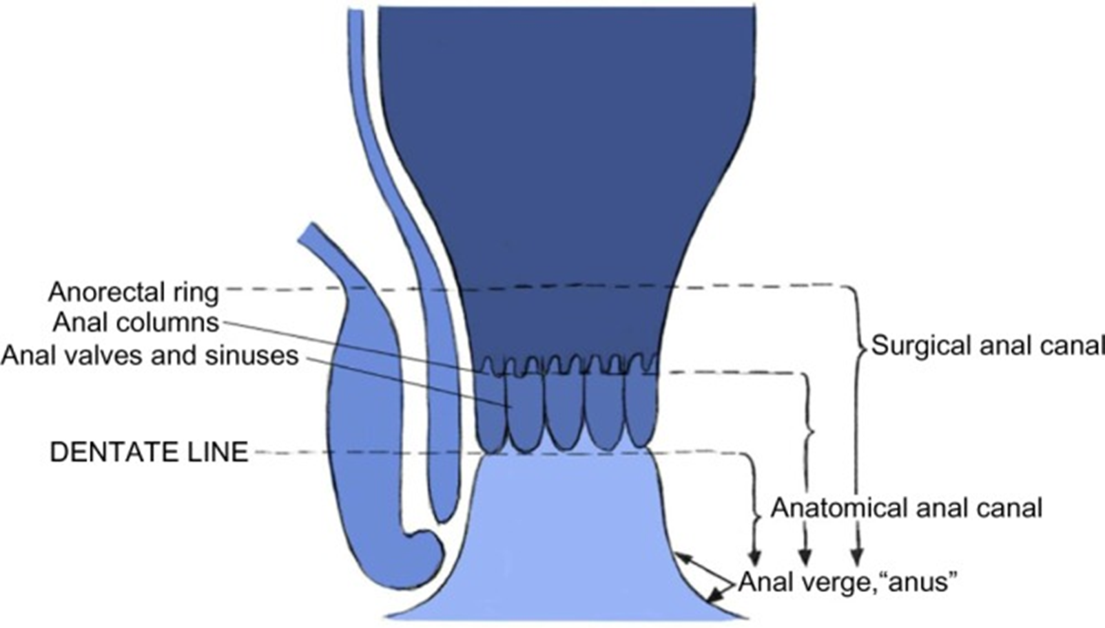

Slide 10
 | Above the dentate line | Below the dentate line
Epithelium | Columnar | Squamous
Color | Pink | Skin Colour
Nerve | Parasympathetic: painless | Spinal nerves: very painful
Blood supply | Superior rectal artery | Middle & inferior rectal artries
Venous Drainage | Portal System | Systemic-Ext iliac vein
Lymphatic Drainage | Para-aortic | Superficial & Deep inguinal LN

Slide 11
HEAMORRHOIDS
Haemorrhoids or piles are symptomatic anal cushions.
They are more common when intra-abdominal pressure is raised, e.g. in obesity, constipation and pregnancy
Classically, they occur in the 3, 7 and 11 o’clock positions
Symptoms of haemorrhoids:
bright-red, painless bleeding
mucous discharge
prolapse
pain only on prolapse

Slide 12
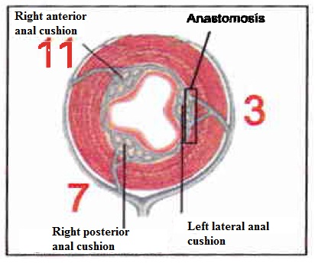
Anal cushions
Anal cushions are a part of normal human anatomy, There are three main cushions present in the normal anal canal These are located classically at left lateral, right anterior, and right posterior positions. They are composed of blood vessels called hemorrhoidal plexus, connective tissue, and smooth muscle. Because of their rich vascular supply, highly sensitive location and tendency to engorge and prolapse .
Function:
1) control & maintaining anal continence.
2) Aid in complete closure of anal canal at rest.
3) protect the internal and external anal sphincter muscles
during the passage of stool.

Slide 13
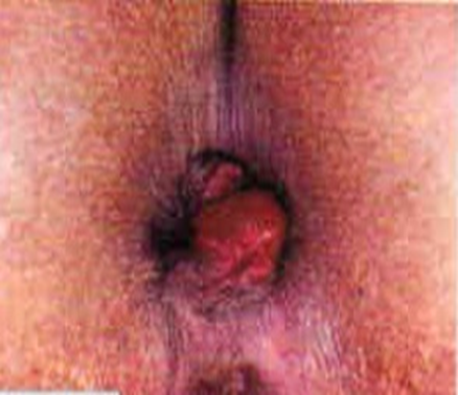
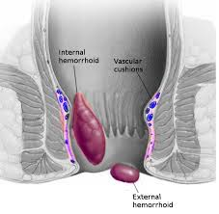
Pathophysiology:
Engorgement and dilatation of the blood vessels leading to stretching of overlying mucosa and formation of lumps that may prolapse and leading to rectal bleeding .

Slide 14
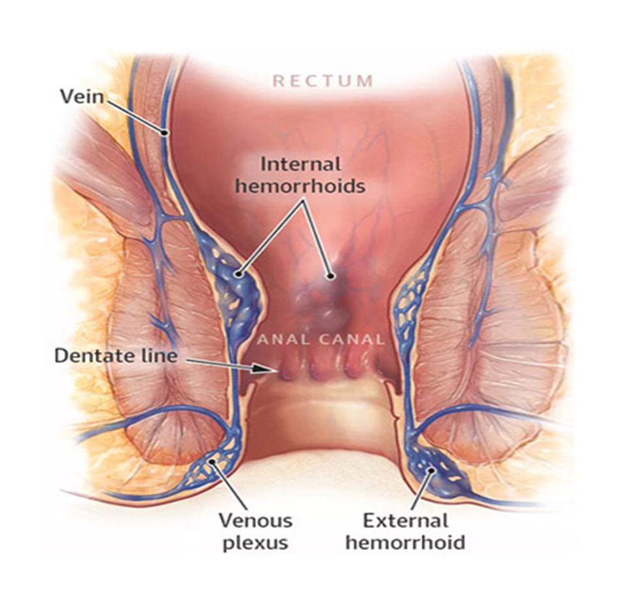
Types of hemorrhoids :
1-External hemorrhoids .
2-Internal hemorrhoids .
3-Combined internal and external .

Slide 15
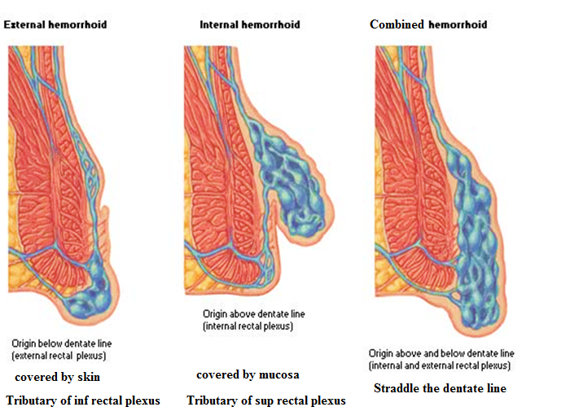

Slide 16
Complications of hemorrhoids:
■ Strangulation and thrombosis
■ Ulceration
■ Gangrene
■ Portal pyemia
■ Fibrosis

Slide 17
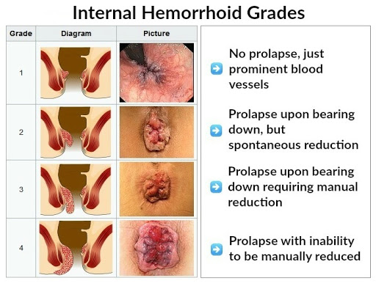

Slide 18
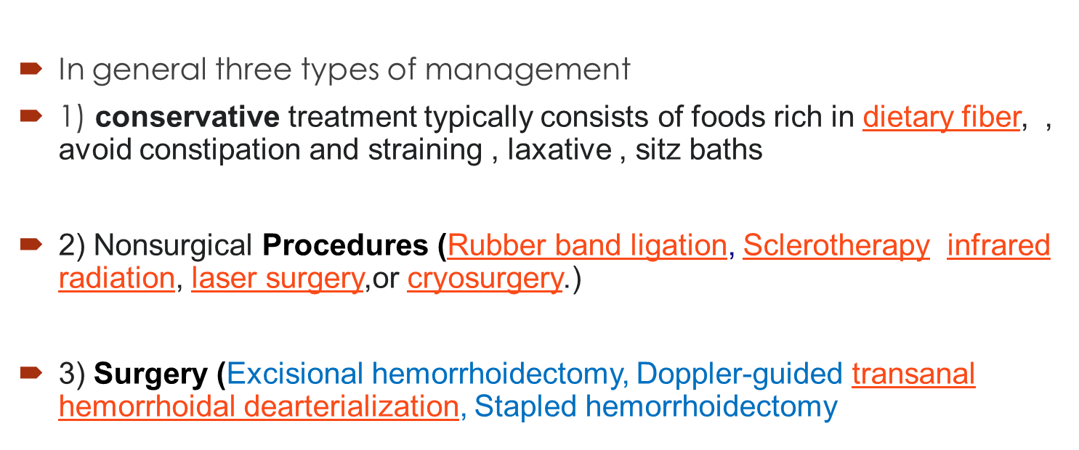
Management :

Slide 19
Pilonidal disease (PD)
Mohammad Saleh

Slide 20
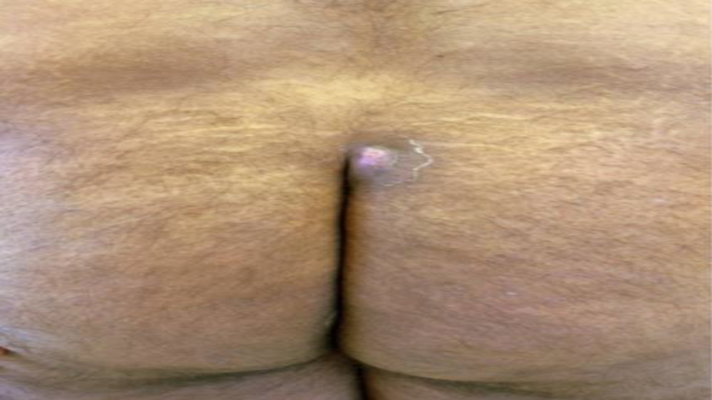

Slide 21
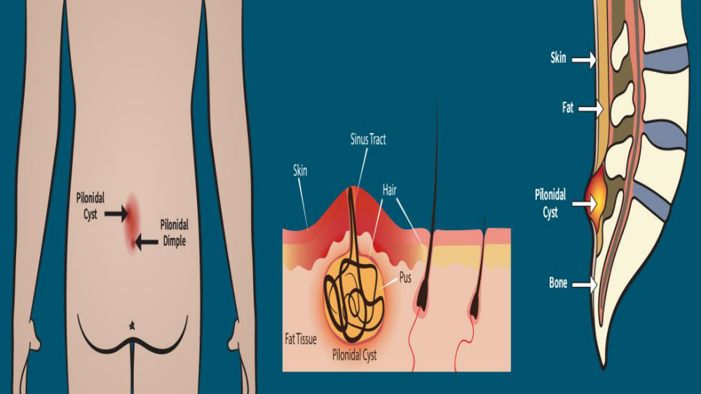

Slide 22
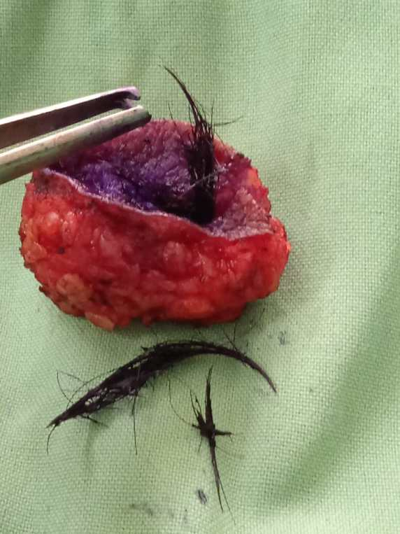

Slide 23
- Pilonidal sinus is a chronic subcutaneous abscess in the natal cleft, which spontaneously drains through the openings.
Etiology : Pilonidal disease most frequently affects males age 15-30 particularly obese individuals, those with sedentary lifestyles or occupations, and those with deep gluteal clefts.
- PD develops when an edematous, infected hair follicle in the intergluteal region becomes occluded. The infection spreads subcutaneously and forms an abscess, which can rupture and create a pilonidal sinus tract.
As the patient sits or stands, hair and debris are forced into the sinus tract, resulting in recurrent infections and foreign-body reactions.

Slide 24
- The most common presenting manifestations include a painful, mass 4-5 cm cephalad to the anus in the intergluteal region with associated mucoid, purulent, or bloody drainage.
- Treatment is drainage of abscesses and collected debris followed by excision of sinus tracts. Despite longer healing times, open closure is preferred due to decreased recurrence rates.

Slide 25
d Case
A 28-year-old man presents to the emergency department complaining of anal and lower-back pain for the previous 36 h. He has tried taking simple analgesics with no benefit. The pain is progressively getting worse and he is now finding it uncomfortable to walk or sit down. He is otherwise fit and well and smokes 10 cigarettes a day. On Examination Inspection of the anus reveals a 3*3 cm swelling at the anal margin. The swelling is warm, exquisitely tender and fluctuant. There is no other obvious abnormality.
What is the diagnosis?
Tenderness + Erythematous Induration +

Slide 26
Anorectal Abcess

Slide 27
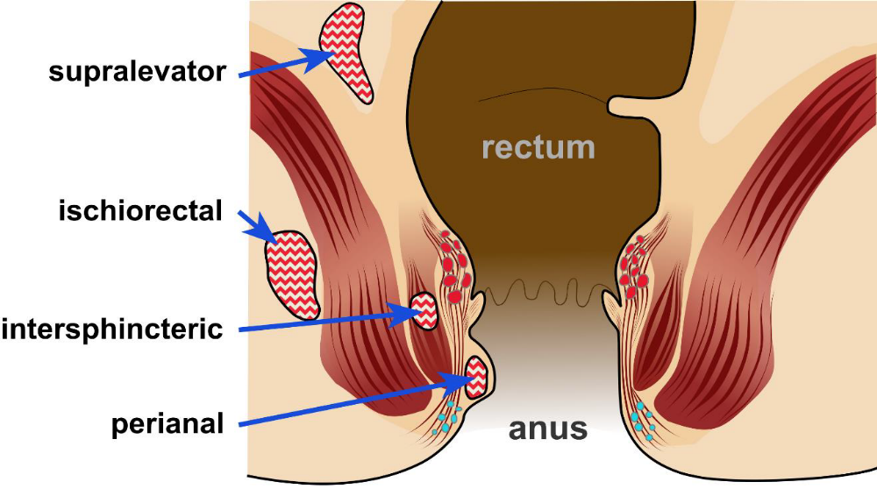

Slide 28
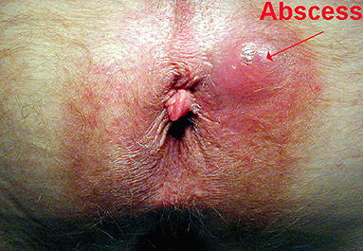

Slide 29
- It is due to occlusion of an anal crypt gland which allows for bacterial infection.
- Abscesses can form relatively acutely following gland obstruction due to the high levels of bacteria in the area.
- Anorectal abscesses are classified according to their anatomic location and the following are the most common types;
Perianal abscess, Ischiorectal abscess, Intersphincteric abscess and Supralevator
abscess.

Slide 30
Aetiology & Pathogenesis:
4-10 glands at dentate line.
Infection of the cryptglandular epithelium resulting from obstruction of the glands.
Ascending infection into the intersphincteric space formation of (intersphincteric abscess)
if the abscess remains there, the patients will present with ( interspinchteric abscess )
if the pus goes down the patient will present with ( perianal abscess )
if the pus goes up above levator ani muscle ( supralevator abscess )
if the pus can pass through the external sphincter to the ischiorectal space ( ischiorectal abscess )

Slide 31
perianal abscess
- The most common type of anorectal abscesses.
- Initially, a perianal abscess may cause pain only with defecation and mild pruritus, but as the infection
progresses → the pain becomes constant and can be associated with systemic manifestations such as
fever.
- Untreated perianal abscesses often progress to form anorectal fistulae communications between the
abscess and perirectal skin or nearby organs (fistula in ano).
- Early recognition followed by Incision and drainage of the perianal abscess is essential to avoid such
progression.

Slide 32
Clinical presentation
Perianal:Perianal pain, discharge (pus) and fever,Tender, fluctuant, erythematous subcutaneous lump.
Ischio-rectal:Chills, fever, ischiorectal pain,Indurated, erythematous mss, tender.
Intersphincteric:Rectal pain, chills and fever, discharge
Supralevator:PR tender. Difficult to identify are. EUA needed

Slide 33
Treatment
The primary treatment of anorectal abscess is Incision and drainage under local anesthesia
There is a chance around 50% of recurrence and 50% of fistula formation, even after we drain the abscess
Antibiotics are prescribed after drainage to patient with:
1- Extensive perianal/perineal cellulitis
2- Signs of systemic infection
3- Diabetes
4- Valvular heart disease
5- Immunosuppression

Slide 34
FISTULA-IN-ANO
Mosab Abu Shqeer

Slide 35
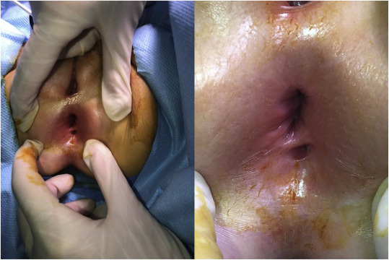
Definition
Is a chronic abnormal communication, usually lined to some degree by granulation tissue, which runs outwards from the anorectal lumen (the internal opening) to an external opening on the skin of the perineum or buttock (or rarely, in women, to the vagina).

Slide 36
Aetiology
* The majority are due to anal gland infection >> abscess >> draining into a fistula.
* May be found in association with specific conditions, such as Crohn’s disease, tuberculosis, lymphogranuloma venereum, actinomycosis, rectal duplication, foreign body and malignancy.

Slide 37
Clinical presentation
- Intermittent purulent discharge (which may be bloody)
- Pain which increases until temporary relief occurs when
the pus discharges).
- Itching
- History of Abscess

Slide 38
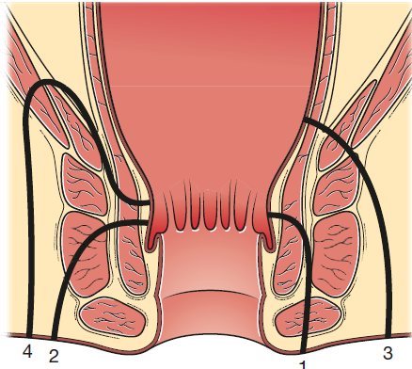
Parks’ classification of anal fistulas
Defines the type of fistula which influences management.
Types of anal fistula:
1- intersphincteric (45%)
2- trans-sphincteric (40%)
3- suprasphincteric
4- extrasphincteric primary tracks.

Slide 39
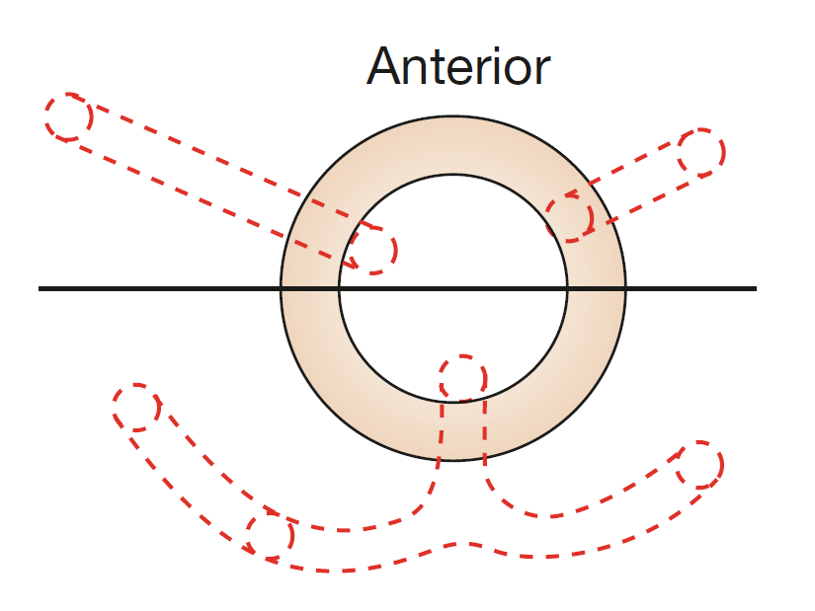
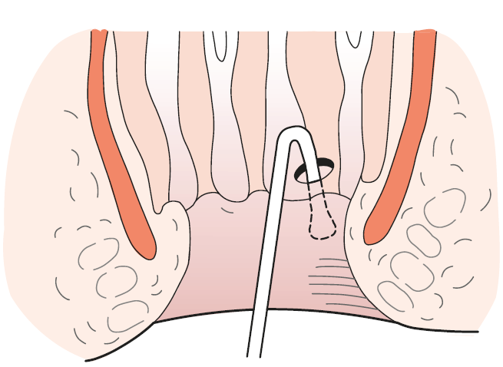
Goodsall’s rule
To indicate the likely position of the internal opening according to the position of the external opening(s), is helpful but not infallible
Full examination under anaesthesia should be repeated before surgical intervention. gentle use of probes

Slide 40
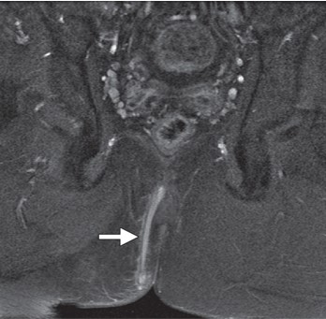
Special investigations
MRI is the ‘gold standard’ for fistula imaging

Slide 41
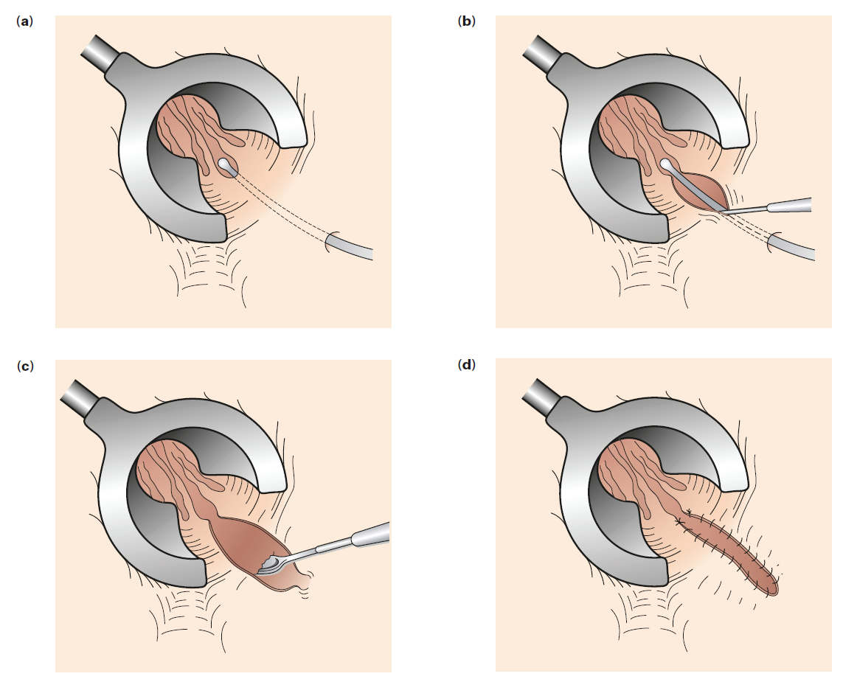
Surgical management
Fistulotomy (Laying open) is the surest method of eradication, but
sphincter division may result in incontinence.
Seton
Advancement flap
Laser

Slide 42
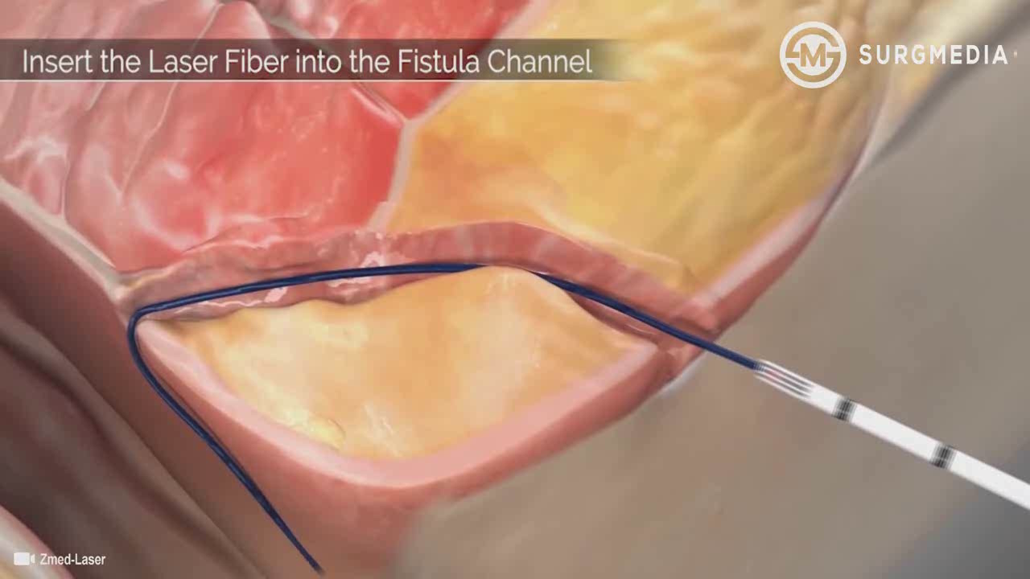

Slide 43
Anal Fissure
Mosab Abu Shqeer

Slide 44
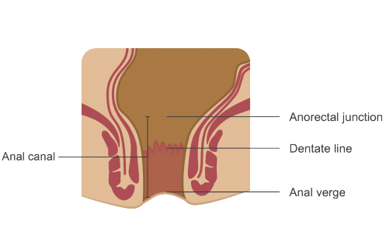
Definition
Is a longitudinal split in the anoderm of the distal anal canal, which extends from the anal verge towards, but not beyond, the dentate line.

Slide 45
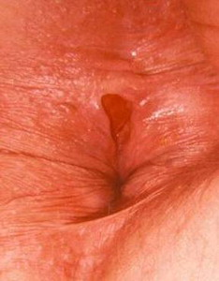
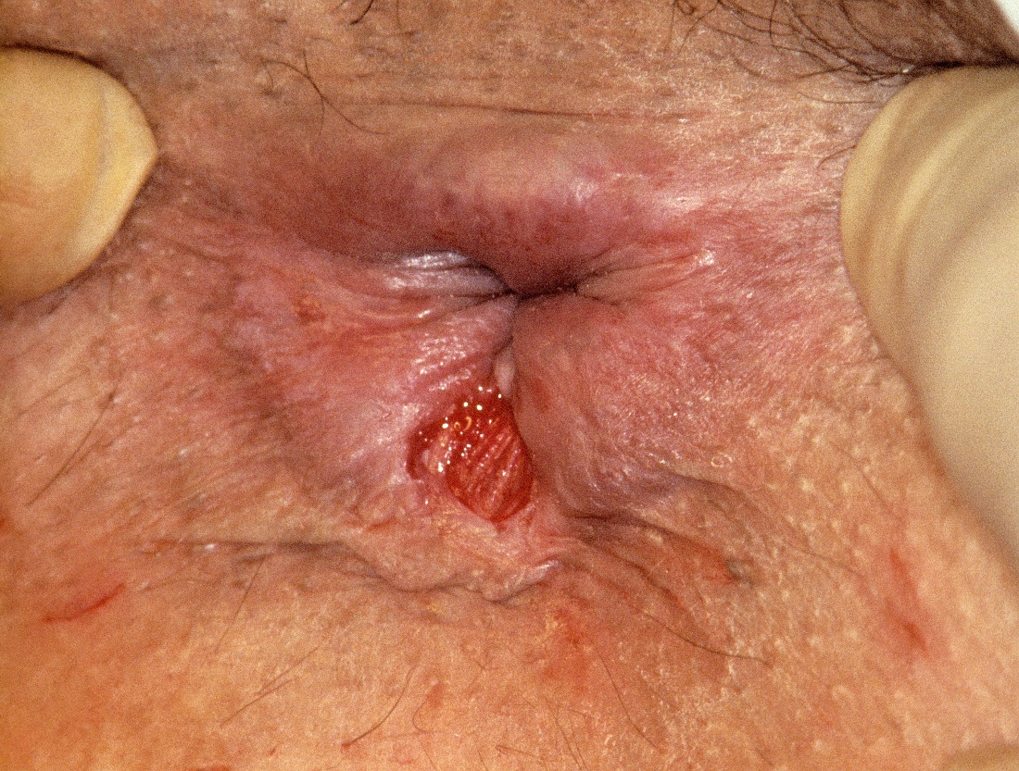

Slide 46
Aetiology
Posterior midline
Anterior
Ectopic (lateral)
Most of cases
Usually in females
Other causes
Constipation
After vaginal delivery
Crohn's disease
Repeated diarrhoea
Cancer

Slide 47
Clinical presentation
Pain on defaecation
Bright-red bleeding
Mucous discharge
Constipation

Slide 48
Management
Conservative
Fiber diet, adequate water intake, laxatives, topical local anaesthetic, topical pharmacological agents to relax the internal sphincter
Botox injection
Operative measures
lateral internal Sphincterotomy
Anal advancement flap

