Slide 1


Colorectal Polyps
Done by: Muath Abdeen
Under supervision of : Dr Raed Tayyem

Slide 2
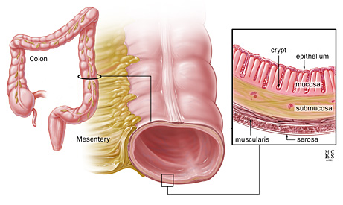
Anatomy
The wall of the colon and rectum comprise five distinct layers: mucosa, submucosa, inner circular muscle, outer longitudinal muscle, and serosa.
In the colon, the outer longitudinal muscle is separated into three teniae coli , which converge proximally at the appendix and distally at the rectum, where the outer longitudinal muscle layer is circumferential.

Slide 3
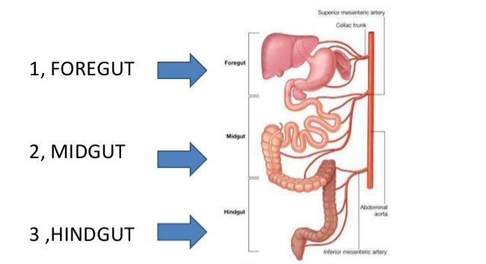
Embryology

Slide 4
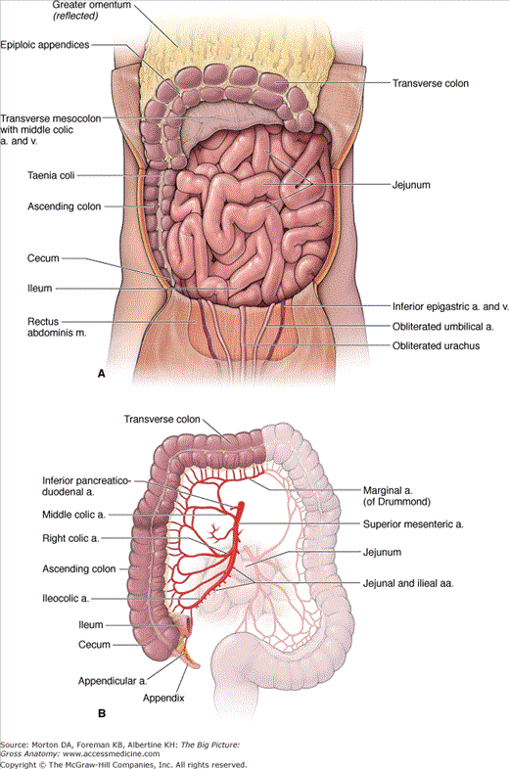
Blood supply
Till the distal transverse colon (midgut), it is supplied by superior mesenteric artery.
Distal to it (hindgut), it is supplied by inferior mesenteric artery

Slide 5
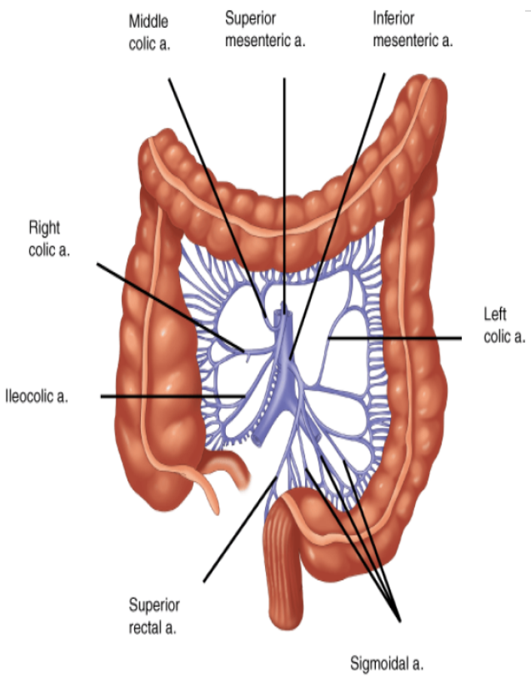
Venous and lymphatic drainage
It is follow the arterial supply and as for the small intestine system, venous drainage is into the portal system.

Slide 6
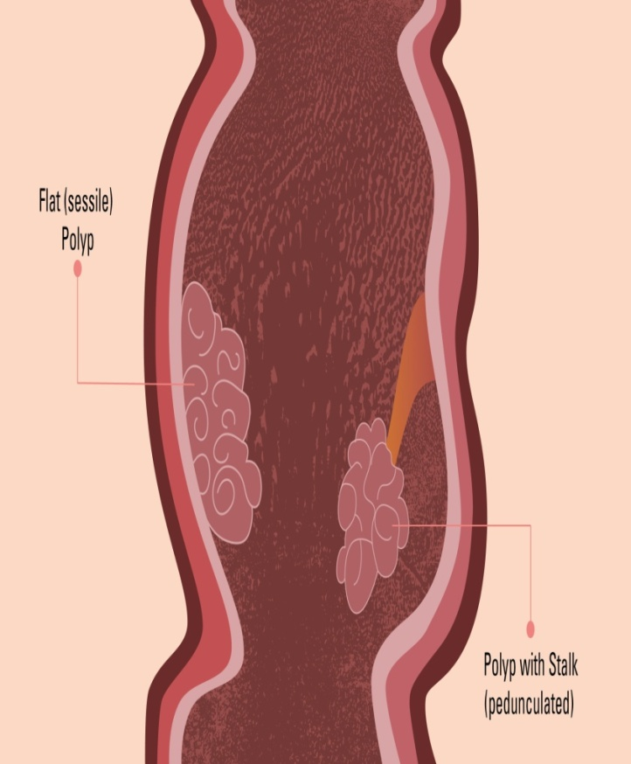
Polyps
Any projection from the surface of the intestinal (colorectal) mucosa into the lumen regardless of the histological nature.
Can either be pedunculated (with a stalk) or sessile (flat).
Approximately 50% occur in the
rectosigmoid region, and
50% are multiple

Slide 7
Classification of polyps
Polyps
Hamartomas
Hyperplastic
Adenoma
Inflammatory
Tubular
Tubulovillous
Villous
*Juvenile polyps
*Peutz-Jegher polyp
*Cronkhite-Canada syndrome
*Cowden’s syndrome

Slide 8
Hyperplastic polyps
the most common non-neoplastic polyps in the colon.
They are typically located in the rectosigmoid and are less than 5 mm in size.
They have low malignant potential
Small hyperplastic polyps are typically removed (biopsied) because they can be difficult to distinguish from adenomatous polyps

Slide 9
they must be distinguished from sessile serrated adenoma / polyp that may demonstrate very similar histopathologic features and are considered to have malignant potential.
Sessile serrated polyps: these polyps are bigger and are located on the right side can turn into cancer somewhat quickly.

Slide 10
Inflammatory Polyps
Non-Neoplastic
Occur most commonly in the context of inflammatory bowel disease, but they may also occur after amebic colitis, ischemic colitis.
Usually smaller than 2 cm
Management do not require excision unless they cause symptoms (eg, bleeding, obstruction). Because they cannot be distinguished from adenomatous polyps based on gross appearance, they should be removed (biopsied).

Slide 11
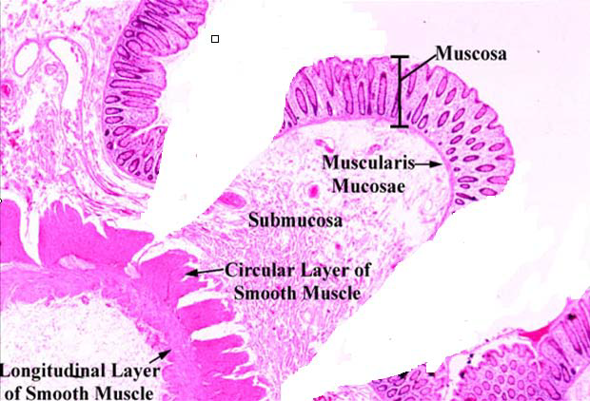
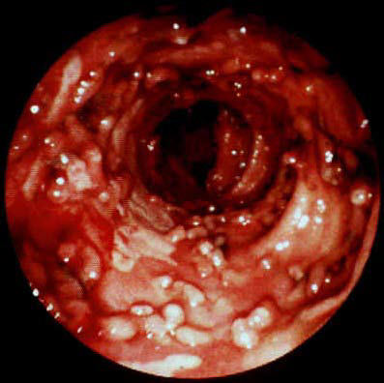

Slide 12
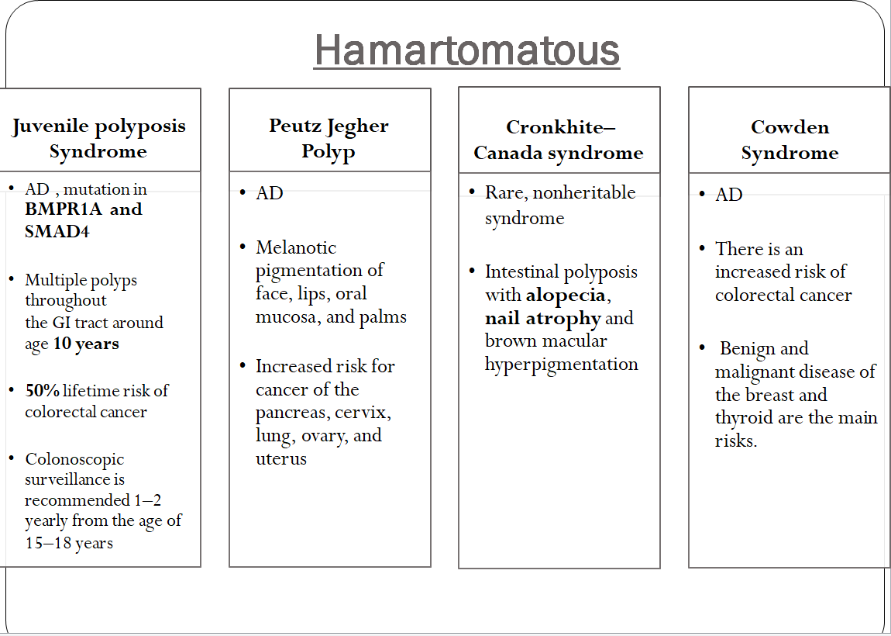

Slide 13
Juvenile polyposis Syndrome
AD , mutation in BMPR1A and SMAD4
Multiple polyps throughout the GI tract around age 10 years
• Juvenile polyps are not pre-malignant but patients have an overall increased risk of colon cancer (50% lifetime risk of colorectal cancer )
Colonoscopic surveillance is recommended 1–2 yearly from the age of 15–18 years

Slide 14
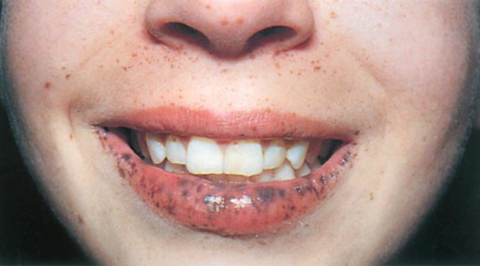
Peutz-Jeghers syndrome
AD
LKB1 / STK1 mutations
It is characterized by:
polyposis of the small intestine and, to a lesser extent, polyposis of the colon
Melanotic pigmentation of face, lips, oral mucosa, and palms
Increased risk of both gastrointestinal and nongastrointestinal cancers including breast cancer.
No indication for prophylactic surgery
• Managed with close surveillance and polypectomy or surgical resection as needed

Slide 15
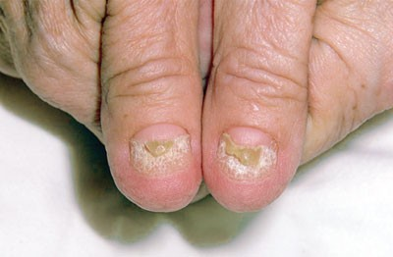
Cronkhite–Canada syndrome
Rare, nonheritable syndrome
Sporadic
Characteristic cutaneous lesions (oncyholysis , alopecia and hyperpigmentation) , chronic diarrhea , protein-losing enteropathy and gastrointestinal polyps
Diarrhea is common and often dictates therapy

Slide 16
Cowden Syndrome
AD
Germline mutation in PTEN
Multiple gastrointestinal hamartomas
Multiple trichilemmomas
There is an increased risk of colorectal cancer
Benign and malignant disease of the breast and thyroid are the main risks.

Slide 17
Adenoma
Adenomatous polyps are common, occurring in up to 25% of the population older than 50 years of age in the United States they are the most prevalent neoplastic polyps in the colon.
Adenomas are generally asymptomatic and are most often detected by colon cancer screening tests.
Based on their gross appearance adenomas may be pedunculated or sessile.

Slide 18
Adenoma
Histologic features
Tubular
75%
Rectosigmoid in 20%
Tubulovillous
15%
Both tubular and villous features
Villous
10%
Rectosigmoid in 80%
33% malignancy risk
7% malignancy risk
Mostly pedunculated
Mostly sessile
20% malignancy risk

Slide 19
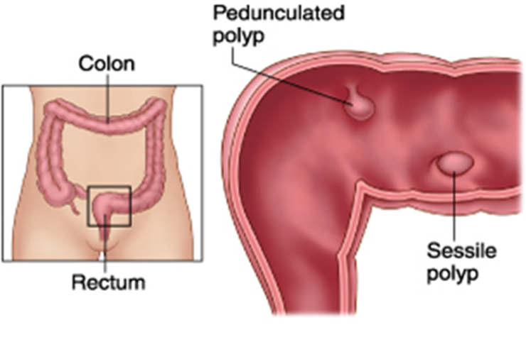
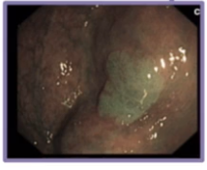
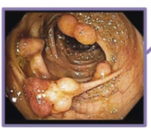
Neoplasic (Adenomatous)
Premalignant
Divided into
- Tubular
- Tubulovillous
- Villous
Morphology
- Sessile (flat & firmly attached to mucosa), more likely to be malignant
- Pedunculated (rounded and attached to mucosa by a long thin neck (attached to the colon by a stalk )

Slide 20
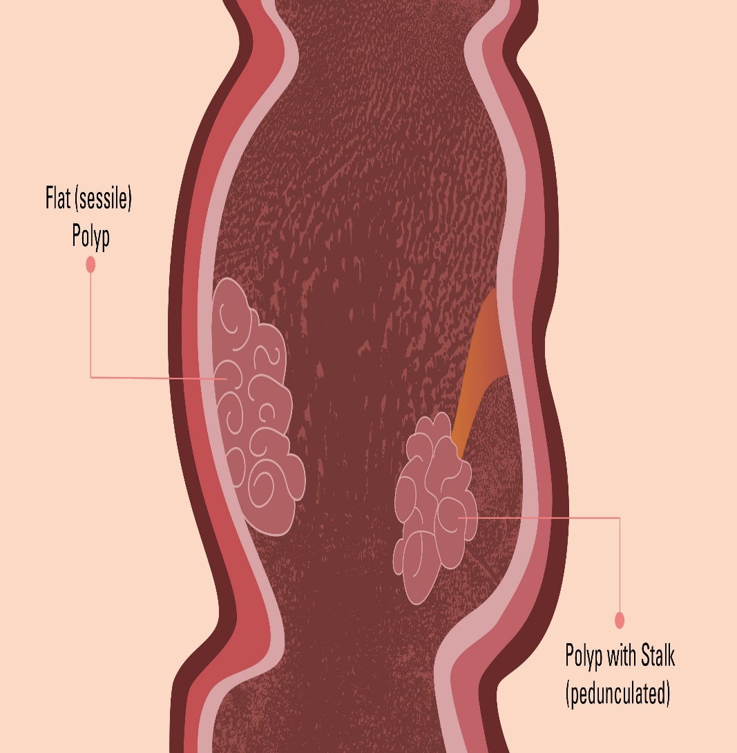
Adenoma
Tubular and tubulovillous adenomas are more commonly pedunculated
Villous adenomas are more commonly sessile.

Slide 21
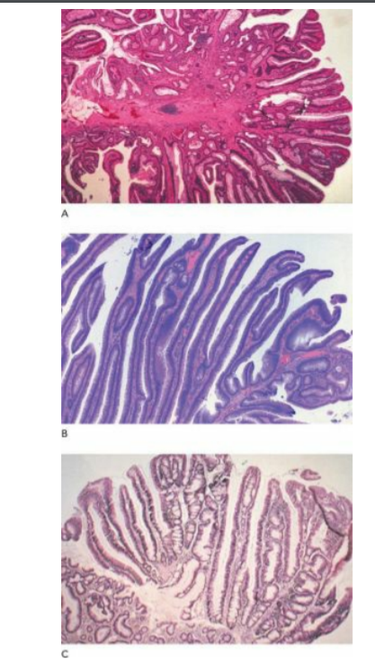
Histology of
(A) tubular
(B) villous
(C) tubulovillous adenomas

Slide 22
Polyps Clinical Presentation
Usually asymptomatic
Occasionally bleed
Most commonly detected during routine endoscopic surveillance
Patients with family history of polyps usually they seek endoscopic screening

Slide 23
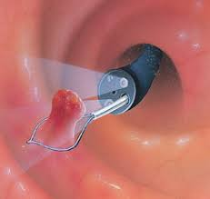
Polyps Treatment
Treatment of adenomatous polyps involves colonoscopic polypectomy.
If some cannot be safely removed colonoscopically, biopsy should be performed and a segmental resection of the colon done if the lesion is:
  Villous adenoma or
  Large, ulcerated, dysplastic, or
  Indurated.

Slide 24
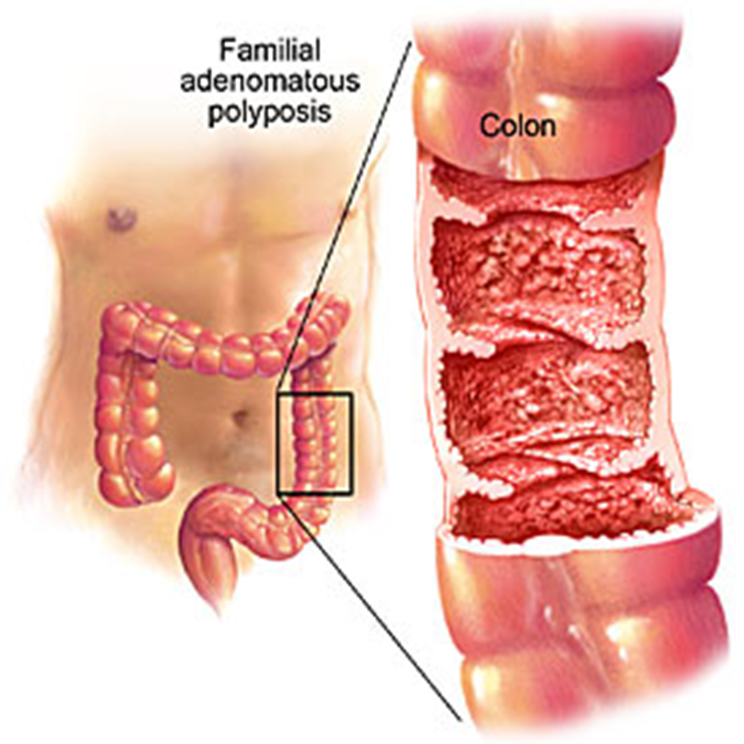
Polyps Treatment
For disease conditions that are characterized by extensive polyposis (familial polyposis syndrome FAP or Gardner’s syndrome), the operation most commonly performed is total colectomy and ileoanal pull-through or pouch.

Slide 25
Colorectal Polyps and carcinoma
Done by: Saif A. El-Dahabreh
Under supervision of : Dr Raed Tayyem

Slide 26
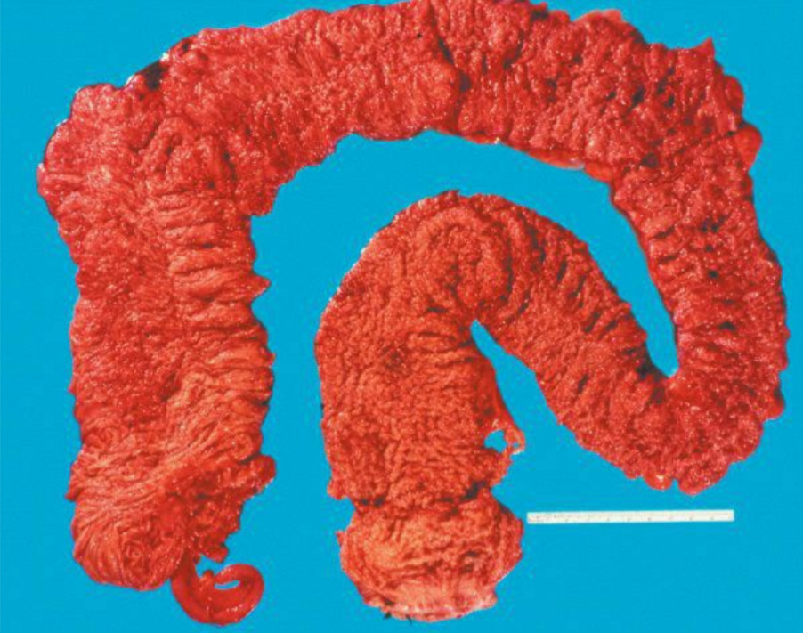
Colon of a patient with familial adenomatous polyposis (FAP)

Slide 27
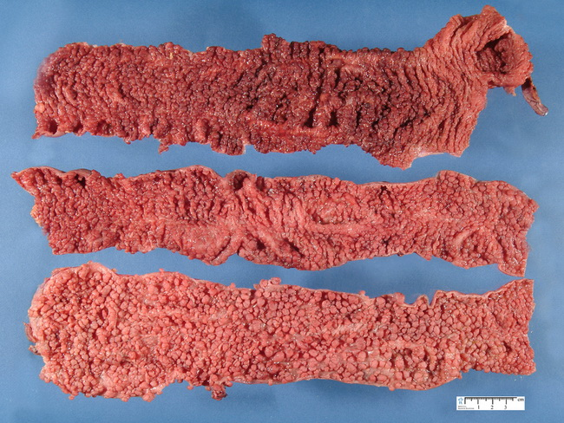

Slide 28
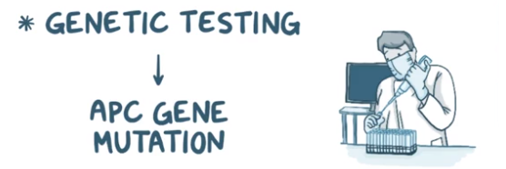
Familial adenomatous polyposis (FAP)
Autosomal dominant, germline mutation in APC gene
100-1000s of polyps
An attenuated form of FAP (AFAP) caused by a mutation in 5´ end of APC gene manifests with fewer polyps and later onset of cancer
MYH-associated polyposis is caused by an autosomal recessive mutation in the MYH gene, but patients present similarly with multiple adenomatous polyps in the colon

Slide 29
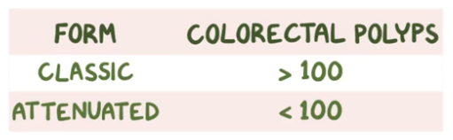
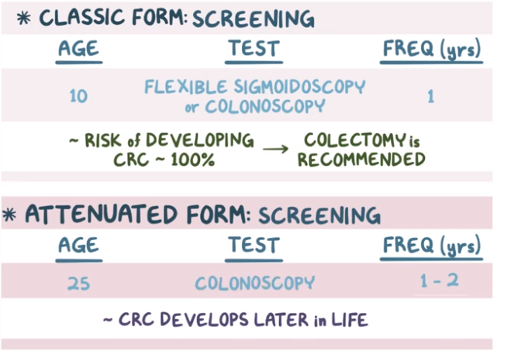

Slide 30
Familial adenomatous polyposis (FAP)
Hundreds to thousands of polyps in the colon Polyps begin on average in the mid-teens but can appear as early as age 7.
Mutation carriers are screened annually by sigmoidoscopy starting at age 10 to 12
Full colonoscopy should be performed when polyps identified
Without intervention, mutation carriers develop colorectal cancer by age 40

Slide 31
Familial adenomatous polyposis (FAP)
If left untreated, 100 % of patients develop cancer by the fourth or fifth decade of life.
Definitive treatment for FAP is total proctocolectomy with ileal pouch and anal anastomosis
Mucosectomy of the rectum is controversial—if not performed, strict surveillance of remnant rectal mucosa is required

Slide 32
Familial adenomatous polyposis (FAP)
Prophylactic proctocolectomy is performed
Immediately for profuse polyposis, multiple adenomas >1 cm, or adenomas with villous
histology or high-grade dysplasia
Patients with sparse, small (<5 mm) adenomas can be followed endoscopically with surgery to accommodate school and work schedules
Proctocolectomy should be performed by age 20 for all patients

Slide 33
Familial adenomatous polyposis (FAP)
Extra-intestinal manifestations
1. Congenital hypertrophy of the retinal pigment epithelium
2. Osteomas of skull or mandible (Gardner’s syndrome)
3. Supernumerary teeth

Slide 34
Familial adenomatous polyposis (FAP)
• FAP-associated tumors
• Desmoid tumors (#1)
• Periampullary tumors
• Medulloblastomas (Turcot syndrome)
• Hepatoblastoma
• Small bowel cancer
• Thyroid cancer
• Adrenal cancer

Slide 35
• Concurrent duodenal polyps are common ~95% incidence
• Endoscopic screening for polyps should be performed starting at age 25 and every 2 to 3 years thereafter
• Surgery may be required for extensive duodenal polyps, rapid polyp growth, or a lesion demonstrating high-grade dysplasia or ulceration

Slide 36
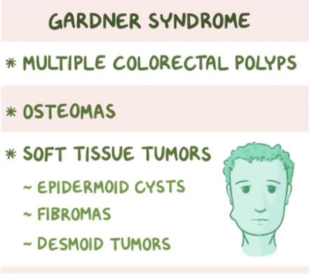
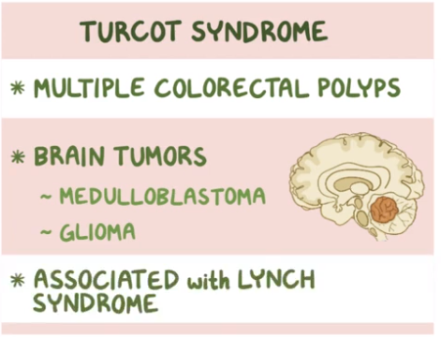
Variant of FAP

Slide 37
Question ??
A patient with FAP underwent prophylactic proctocolectomy 4 years ago and now has a 7 cm mass in the small bowel mesentery. Biopsies have been non-conclusive. What is the most likely diagnosis?

Slide 38
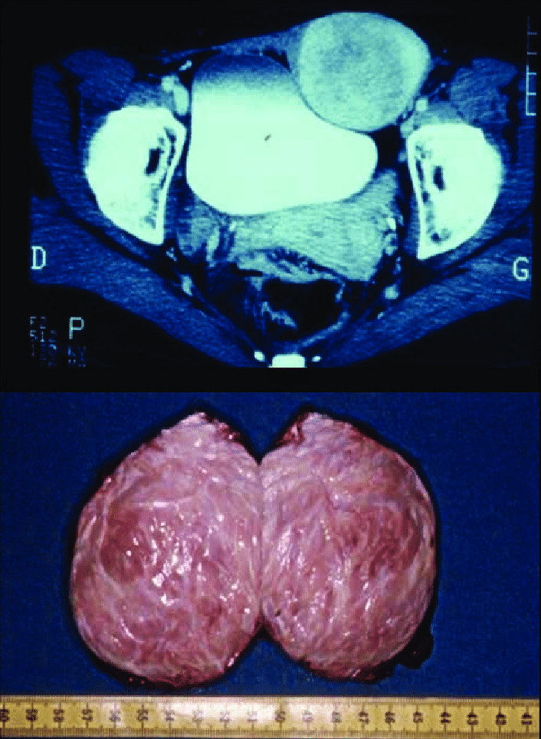
Desmoid tumors

Slide 39
Hereditary nonpolyposis colorectal cancer (HNPCC) or Lynch syndrome
Autosomal dominant
The genetic defects associated with Lynch syndrome arise from errors in DNA mismatch repair genes. ( MLH or MSH)
Lynch type 1 results in more colonic cancers, often on the right side and typically in the 4th decade of life.
Lynch type 2 results in more extracolonic cancers.

Slide 40
Hereditary nonpolyposis colorectal cancer (HNPCC) or Lynch syndrome
Usually right-sided cancers
Associated with endometrial, ovarian, gastric, and small bowel cancers
Increased risk of synchronous cancers: Consider subtotal colectomy ± hysterectomy with oophorectomy
Colon cancers associated with HNPCC still arise from adenomas, but the adenomas tend to be flat.
Also, the adenomas associated with HNPCC are more likely to become malignant and to do so more rapidly (within 2 or 3 years)

Slide 41
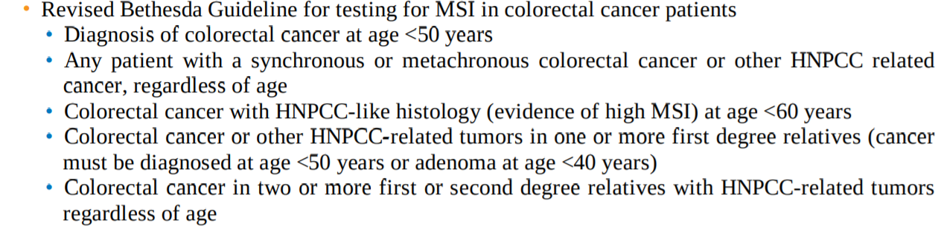
Hereditary nonpolyposis colorectal cancer (HNPCC) or Lynch syndrome
Amsterdam criteria
• Three affected relatives (one must be a first-degree relative of one of the others)
• Two generations affected
• One diagnosed before age 50 years

Slide 42
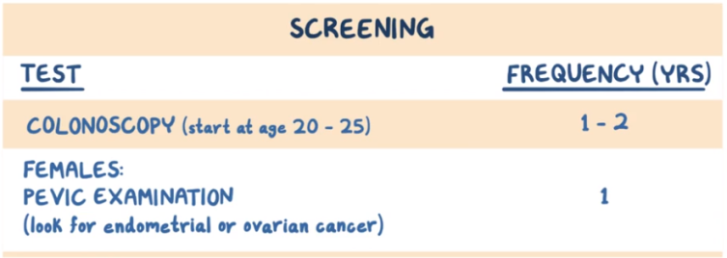
Hereditary nonpolyposis colorectal cancer (HNPCC) or Lynch syndrome
Surveillance colonoscopy is recommended every 1 to 2 years starting at age 20 to 25 years and annually after age 40 years
• Women should also undergo an annual transvaginal ultrasound, endometrial biopsy, and CA125 level
• Women should consider TAHBSO after child bearing is complete
• Patients can also develop sebaceous tumors (Muir-Torre syndrome)

Slide 43
The name “hereditary nonpolyposis colorectal cancer” is misnomer since cancer still arises from adenomatous polyps.

Slide 44
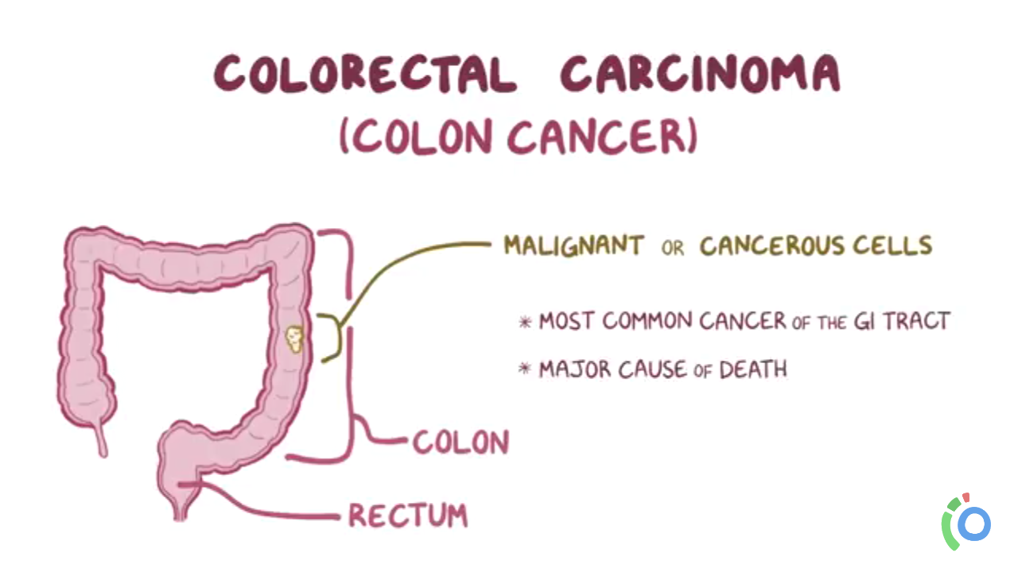
Epidemiology
Colorectal Cancer
The most common GI cancer
3th most common cancer (after lung& prostate/after lung & breast)
2nd most common cause of cancer death (lung canccer is most common)
Nearly equal incidence in both sexes. Some statistics show slight male predominance.
Peak incidence is 60-70 years of age
95% are adenocarcinomas • Other types include squamous cell, lymphoma, sarcoma, and carcinoid tumors
• Must perform colonoscopy to rule out synchronous lesions
Notes:
Sigmoid more common than cecum, but rectum is more common than sigmoid

Slide 45
Carcinoma of Colon & Rectum
Cancer of the colon and rectum is a major cause of death worldwide.
Although a large number of factors are associated with the development of this disease, theories about its etiology center on the impact of intraluminal chemical carcinogenesis.
There are various theories as to whether these carcinogens are ingested or are the result of biochemical processes that occur intraluminally from existing substances that are found normally in the fecal stream.

Slide 46
Epidemiology
Approximately 80% 0f colorectal cancers occur sporadically, while 20% arise in patients with a known family history of colorectal cancer.
Genetic defects and molecular abnormalities associated with the development and progression of colorectal adenomas and carcinoma
Mutation causing
(1)activation of oncogenes (K-ras) and/or
(2)inactivation of tumor suppressor genes (APC, DCC, p53)

Slide 47
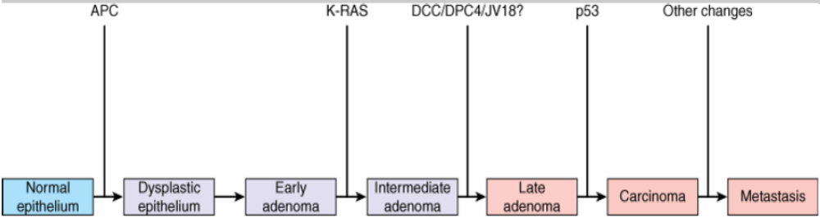
Epidemiology
Adenomatous polyposis coli (APC) gene responsible for FAP
Colorectal carcinoma is though to develop from adenomatous polyps due to accumulation of these mutations

Slide 48
Which one of the following is the correct sequence of mutations which lead to colon cancer?
APC --- K-ras --- TP53
TP53 --- APC --- K-ras
K-ras --- TP53 --- APC
K-ras --- APC --- TP53
APC --- TP53 --- K-ras

Slide 49
Epidemiology
Certain health agencies promote a low-fat, high-fiber diet as protective against cancer of the colon and rectum.
Chemoprevention by ingestion of such agents as carotenoids and other antioxidants has been suggested, but the efficacy of this measure is unproven.
There is good evidence that prostaglandin inhibitors such as aspirin and sulindac significantly lower the risk of polyp formation and colon cancer when taken on a regular basis.

Slide 50
Epidemiology
Synchronous (simultaneously occurring) tumors develop in 5% of patients, whereas 3% to 5% of patients have metachronous tumors (a second tumor developing after resection of the first).
A family history of colon cancer is an important risk factor for colon cancer in first-degree relatives.

Slide 51
Epidemiology
Familial polyposis syndrome FAP, Gardner’s syndrome, and the cancer family syndrome (hereditary nonpolyposis colon cancer [HNPCC]) clearly show that certain patient subsets are genetically predisposed to cancer of the colon.
Other predisposing diseases include ulcerative colitis, Crohn’s colitis, lymphogranuloma venereum, and certain polyps (described previously).
The peak incidence of colon cancers occurs at approximately 70 years of age, but the incidence begins to increase in the fourth decade of life.

Slide 52
10 years, involving the whole colon
Ulcerative colitis
Screening at age of 50
Polyps
Age
Low fiber diet, refined carbs, high animal fat
Risk Factors
Alcohol & smoking
Hereditary conditions
FAP
Family history
HNPCC
Notes:
FAP with >90%chance of colorectal cancer by the third or fourth decade without prophylactic colectomy. Because of effective surgical prophylaxis, FAP now accounts for less than 0.2% of all cases of colorectal cancer in the UK.
Familial polyposis syndrome FAP, Gardner’s syndrome, and the cancer family syndrome (hereditary nonpolyposis colon cancer [HNPCC]) clearly show that certain patient subsets are genetically predisposed to cancer of the colon

Slide 53
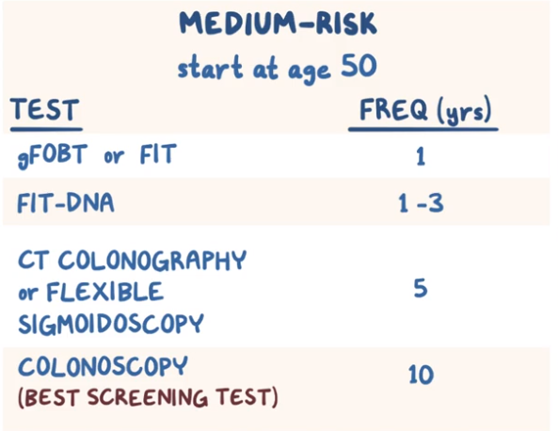
Screening

Slide 54
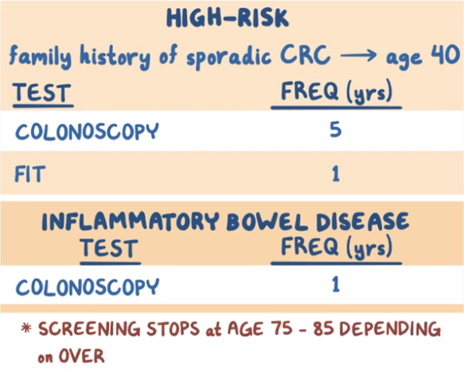

Slide 55
TUMOR MARKERS
Carcinoembryonic antigen (CEA) may be elevated in 60 to 90% of patients with colorectal cancer.
Despite this, CEA is not an effective screening tool for this malignancy.
Many practitioners follow serial CEA levels after curative intent
surgery to detect early recurrence of colorectal cancer. However, this tumor marker is nonspecific, and no survival benefit has yet been proven.
Other biochemical markers (ornithine decarboxylase, urokinase) have been proposed, but none has yet proven sensitive or specific for detection, staging, or predicting prognosis of colorectal carcinoma.

Slide 56
Clinical Presentation
Get the point
Left sided lesions are more likely to present with symptoms of obstructions such as constipation or decrease stool caliber (Pencil-shaped stool) >>change in bowel habits
Right sided lesions are more commonly present with bleeding , Macroscopic or Microscopic Or Iron deficiency anemia
The reason that right-sided lesions do not cause obstruction is that the diameter of the right colon is greater than the left and the stools have increase water content.

Slide 57
Investigations
Total Colonoscopy lies in its ability to detect the 3% to 5% of patients with synchronous colon cancers, allowing better planning of surgical therapy.
CT of the abdomen is frequently performed before surgery.
Preoperative blood tests should evaluate the patient’s overall nutritional status and should include liver function tests (particularly alkaline phosphatase) and carcinoembryonic antigen (CEA) study as a baseline for follow up post op

Slide 58
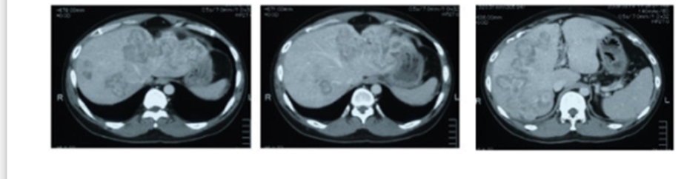

Slide 59
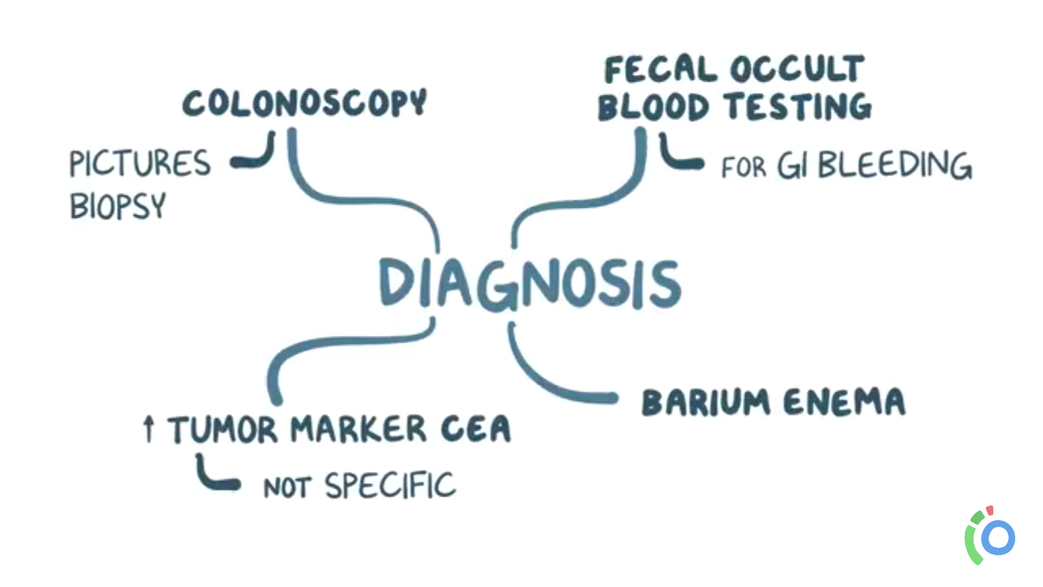
Investigations
CBC (ANEMIA DUE TO IDA FROM BLOOD LOSS) , LFT (ALT,AST : ELEVATAED WITH LIVER METS)
BUN+CREATININE : ASSES RENAL FUNCTION DUE TO COMPRESS MASS
Fecal occult Blood test.
Barium enema. (APPLE CORE SIGN )
CT colongraphy (virtual colonography)
Lower Endoscopy/ colonoscopy/ sigmoidoscopy
Endorectal US for rectal Ca
CEA Tumor marker. “Follow up & recurrence”
CT OF THE CHEST , ABDOMEN , PELVIS (LYMPH NODE INVOLVEMTN OF ANY METS) , MRI (TO LOOK FOR LIVER LESIONS ), Chest X-ray, PET scan “metastasis”

Slide 60
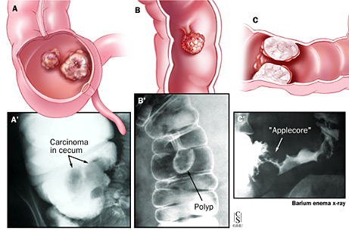
Barium Enema
filling defects
apple core appearance

Slide 61
Staging and Treatment of Colorectal carcinoma
Done by: Mohammad Sanwar
Under supervision of : Dr Raed Tayyem

Slide 62
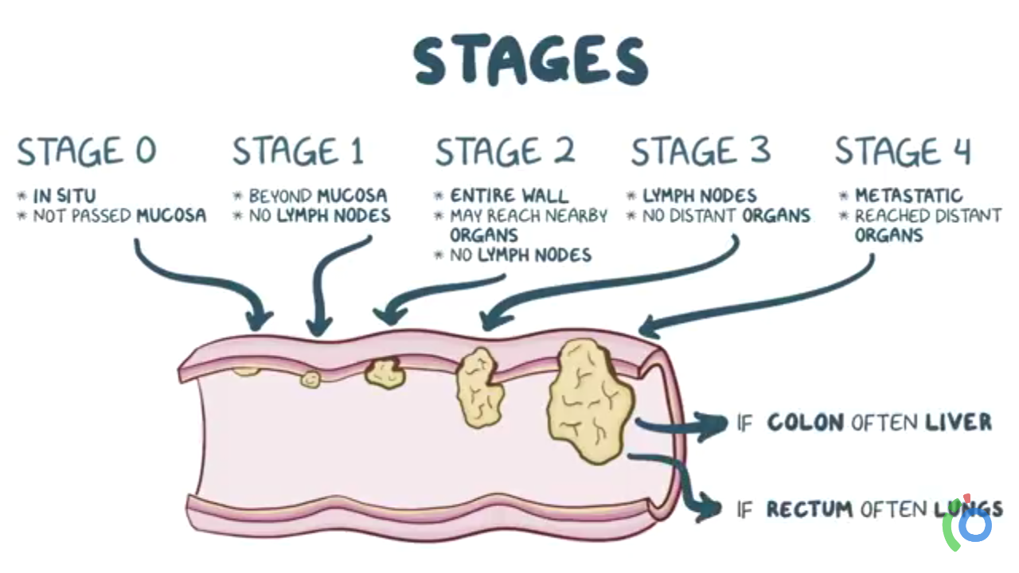
Staging
TNM
- Dukes’
- modified Dukes
Notes:
important information on prognosis, helps inform surgical,strategy and indicates the need for adjuvant radiotherapy for rectal,cancer and adjuvant postoperative chemotherapy,, All patients with colon or rectal cancer should undergo CT of the chest, abdomen and pelvis,, CT. For rectal cancer, digital examination and rigid sigmoidoscopy should be undertaken to assess the degree of tumour fixity,, Pelvic MRI is essential to assess the degree of local invasion of rectal cancer. Endoanal ultrasound may also be useful for local staging of rectal cancer

Slide 63
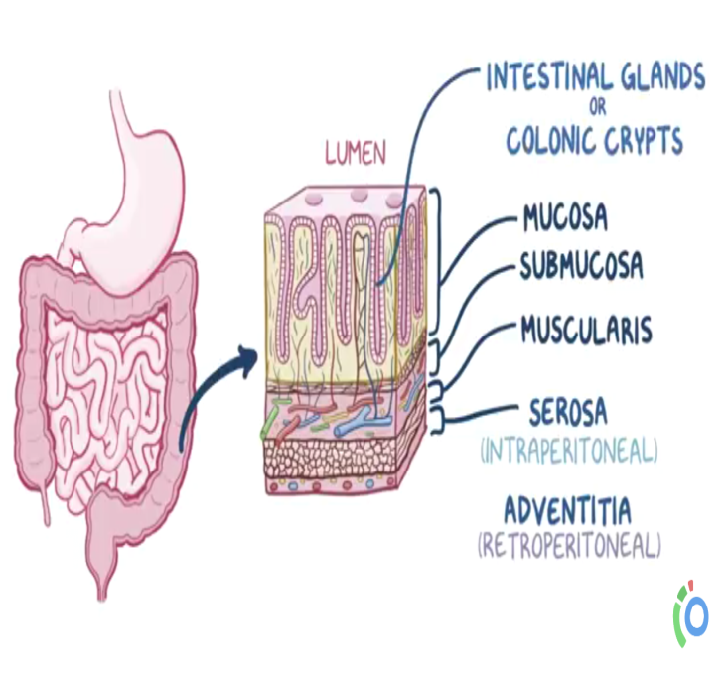
TNM Staging
Primary tumor (T)
TX - Primary tumor cannot be assessed
T0 - No evidence of primary tumor
Tis - Carcinoma in situ: intraepithelial or invasion of lamina propria
T1 - Tumor invades submucosa
T2 - Tumor invades muscularis propria
T3 - Tumor invades through the muscularis propria into the subserosa or into
nonperitonealized pericolic or perirectal tissues
T4 - Tumor directly invades other organs or structures, and/or perforates visceral peritoneum
Regional lymph nodes (N)
NX - Regional lymph nodes cannot be assessed
N0 - No regional lymph-node metastasis
N1 - Metastasis in 1 to 3 regional lymph nodes
N2 - Metastasis in 4 or more regional lymph nodes
Distant metastasis (M)
MX - Distant metastasis cannot be assessed
M0 - No distant
                M1 - Distant metastasis

Slide 64
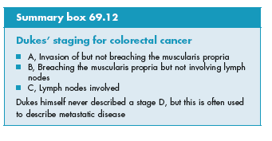
Dukes staging
A: tumor within the wall.
B: tumor through the whole wall.
C: involvement of lymph nodes (C1,C2)
D: metastatic spread.

Slide 65
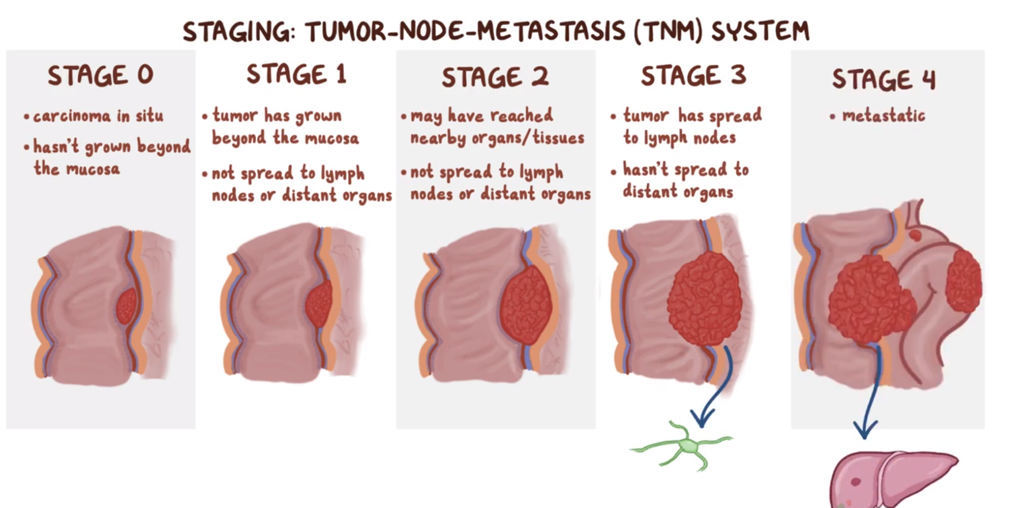

Slide 66
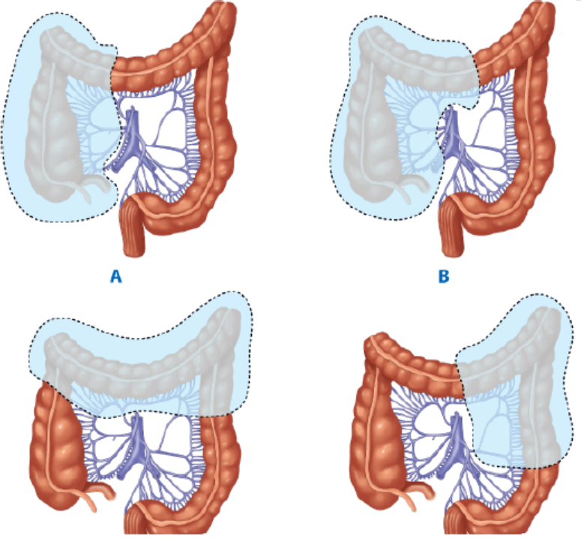
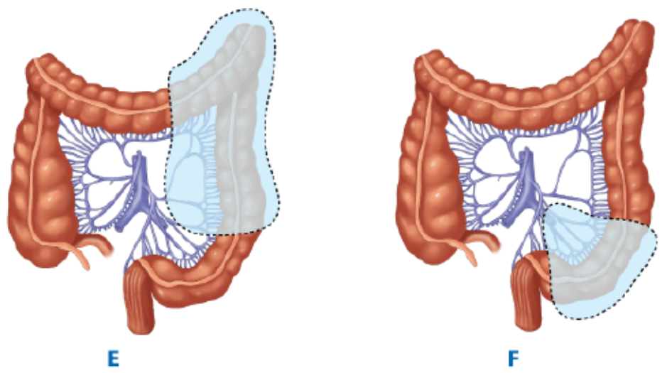
Treatment
The surgical treatment used by most surgeons includes adequate local excision of the tumor, with a length of normal bowel on either side, and resection of the potentially involved lymph node draining basin found in the mesentery that is determined by the vascular supply.

Slide 67
Treatment
Removal of the lymphatics that drain the tumor region should be part of the operation because nodal involvement is present in more than 30% of specimens.
Colorectal cancer may also spread hematogenously, intraluminally, or by direct extension or peritoneal seeding (Blumer’s shelf on rectal examination).
The most common organ involved in distant colorectal metastases is the liver followed by lung.

Slide 68
Treatment
The use of adjuvant therapies in the treatment of colon and rectal carcinoma generated considerable research
5-FU used in combination with levamisole or leucovorin lowers the mortality rate in patients with Stage III tumors.

Slide 69
Treatment
The recent development of a new chemotherapeutic agent, oxaliplatin, appears to be twice as effective as 5-FU alone in reducing cancer recurrence in high-risk patients as well as treating patients with metastatic colorectal cancer.
FOLFOX (5-FU, leucovorin and oxaliplatin) is the standard treatment regimen currently.

Slide 70
Treatment
Because of their significant rate of recurrence (20%) despite the most radical surgical procedure, rectal tumors that have completely penetrated the rectal wall, with or without lymph node metastases, are treated additionally by radiation combined with 5-FU.
Neoadjuvant chemoradiotherapy is advised for rectal cancer especially in the presence of lymph nodes.

Slide 71
Treatment
Endorectal ultrasound or MRI is used to stage the depth of penetration of the tumor in the rectal wall.
Preoperative chemoradiation (neoadjuvant therapy) is generally accepted as the best time to give therapy. This allows shrinkage of the tumor leading to a more complete resection and reduces the complications from postoperative radiation.
Occasionally, it also causes enough tumor shrinkage in a very low rectal cancer to allow sphincter preservation.

Slide 72
Treatment
A number of new biologic agents show promise in achieving even better results especially with hepatic metastases (bevacizumab, cetuximab).

Slide 73
Prognosis
The most important prognostic variable is lymph node involvement.
Other prognostic factors (e.g., tumor markers, size of the lesion and depth of invasion)

Slide 74
Follow up
A frequently used approach is a visit every 3 months for 2 years, every 6 months for 3 years, and then yearly until 5 or 10 years postresection.
Visits include physical examination and measurement of carcinoembryonic (CEA) levels. Colonoscopy is usually performed at 1 and 2 years postoperatively and then every 2 to 3 years after.
Most recurrences occur in the first 18 to 24 months.

Slide 75
Follow up
The use of CEA is well established, with recurrence suggested not only by the absolute level of this antigen, but also by a progressive rise.
A progressive rise mandates a complete evaluation of the patient, colonoscopy, including CT of the chest, abdomen, and pelvis.

Slide 76
Surgery
The primary treatment.
Curative or palliative.
Resection & re- anastomosis as one stage.
Stoma
Types of surgeries
Right hemicolectomy
Left hemicolectomy
Total colectomy
sigmoidectomy
Anterior resection ( removal of the rectum )
Abdominoperineal resection (removal of the rectum and the anal canal )
Put colostomy (permanent or temporary )
Put ileostomy
Put any other stomy

Slide 77
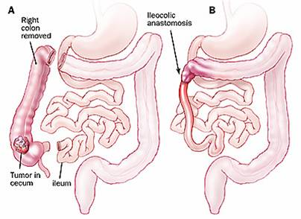
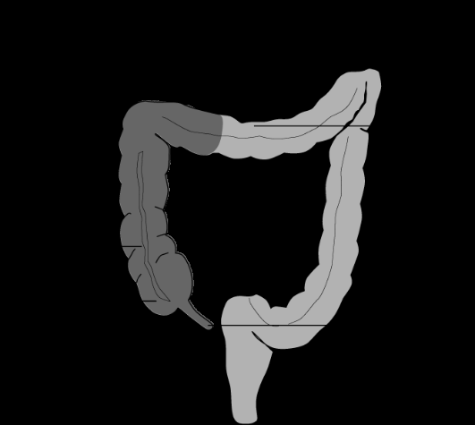
Right Hemicolectomy and ileocolic anastomosis
for Cecal / Right Colon Cancer
Notes:
resected material: terminal ileum + cecum + ascending colon +proximal transverse colon
➢ Plus, resection of right colic artery + iliocecal artery +- middle colic artery
➢ Plus, removal of fat and lymph node

Slide 78
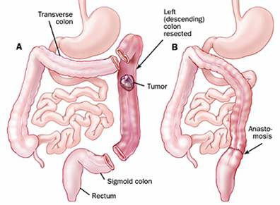
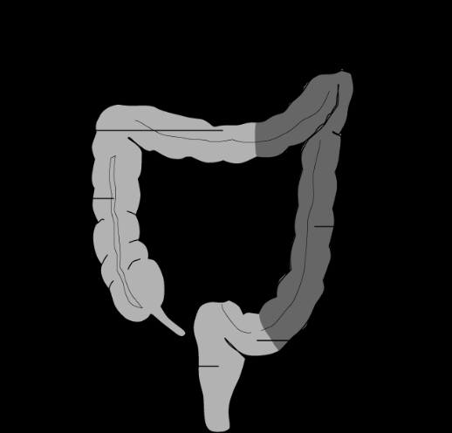
Left Hemicolectomy and anastomosis of colon and rectum for Left Colon Cancer

Slide 79
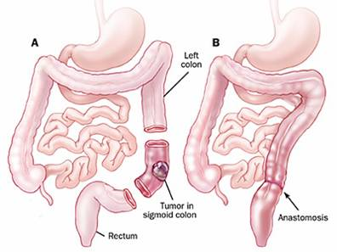
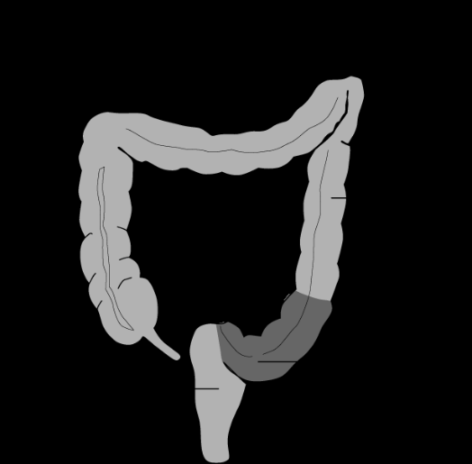
Sigmoid Colectomy and anastomosis of colon and rectum for Sigmoid Cancer

Slide 80
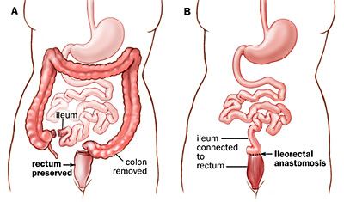
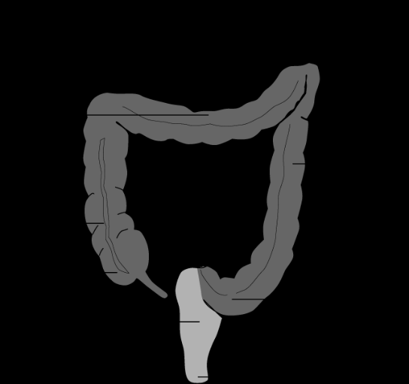
Total colectomy needs to be considered for multiple ^{tumors}

Slide 81
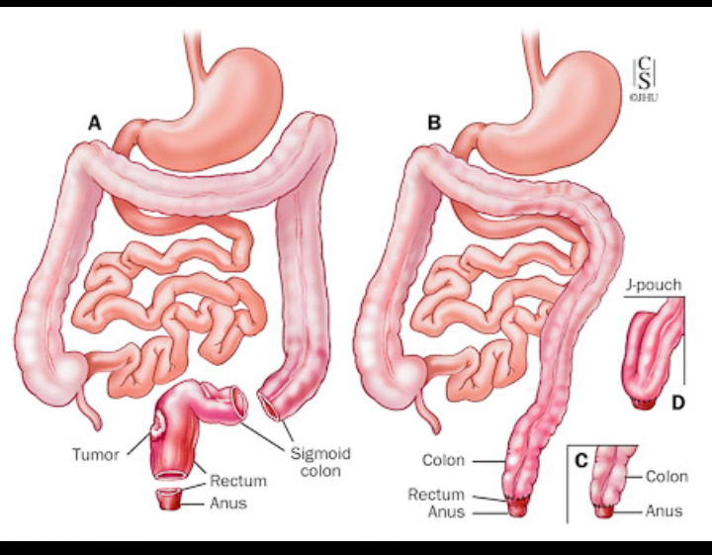
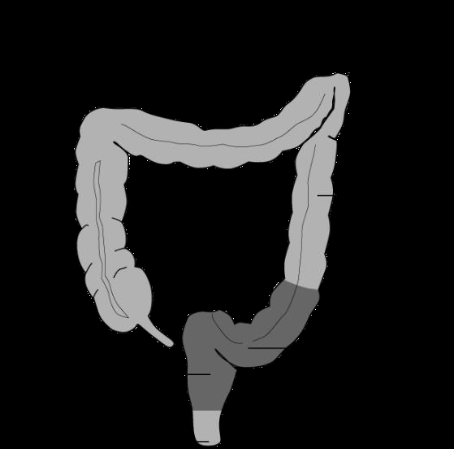
Anterior resection and anastomosis of colon and rectum
for upper and middle rectal tumors
Notes:
Complications: incontinence , urinary dysfunction , sexual dysfunction , anastomotic leak(5-10% ), stricture (5-20%)

Slide 82



Abdominoperineal resection – resection of anus rectum and part of segmoid colon and leave a permanent colostomy for lower rectal tumors
Notes:
compilations: stenosis , retraction or prolapse of ostomy , perianal wound infections
Colostomy : usually on LIF ,, flat/flush with skin ,, content semi/solid ,, 200-300ml/day

Slide 83


Slide 84

Anal Canal
The epithelium
The pink columnar epithelium lining the rectum extends through the anorectal ring into the surgical anal canal.
Passing downwards, the mucous membrane becomes cuboidal and redder in colour, whereas above the anal valves it is plum coloured. Just below the level of the anal valves there is an abrupt, albeit wavy, transition to stratified squamous epithelium, which is the colour of parchment. This wavy junction constitutes the dentate line.
The dentate line is a most important landmark both morphologically and surgically, representing the site of the crypts of Morgagni (synonym: anal crypts, sinuses).
Notes:
The crypts are small pockets between the inferior extremities of the columns of Morgagni through which anal ducts that communicate with deeper placed anal glands open into the anal lumen.
The squamous epithelium lining the lower anal canal is thin and shiny and is known as the anoderm; it differs from the true skin in that it has no epidermal appendages, i.e. hair and sweat glands.
At the dentate line, the anoderm is attached more firmly to deeper structures. The mucosa and submucosa above the dentate line is uneven and thrown into folds, the so-called anal cushions.

Slide 85

Anal Canal
Lymphatic drainage
Lymph from the upper half of the anal canal flows upwards to drain into the postrectal lymph nodes and from there goes to the para-aortic nodes via the inferior mesenteric chain.
Lymph from the lower half of the anal canal drains on each side first into the superficial and then into the deep inguinal group of lymph glands.
However, if the normal flow is blocked, e.g. by tumour, the lymph can be diverted into the alternative route

Slide 86
Anal Cancer
Rare (0.65/100000)
<2% of all large bowel cancers. The crude incidence rate is 0.65
Those arising below the dentate line are usually squamous:
Associated with human papilloma virus (HPV),
More prevalent in patients with HIV infection
Notes:
SCC is the most common anal cancer

Slide 87
Adenocarcinomas are the next most common (usually extension from above dentate line).
Other tumours include melanoma (usually affects the anal verge), lymphoma and sarcoma.

Slide 88
Anal Cancer
Lymphatic spread is to the inguinal lymph nodes
Treatment is by chemoradiotherapy in the first instance
Major ablative surgery (APR) is required if the above fails

Slide 89

Thank you..

