Slide 1
Approach to Pediatric Cardiac Emergencies
Done by: Noura Muhaidat, Hadeel Shalabi, Abdullah Khalil and Moutaz AbuSeini
Supervised by: Dr. Hamzeh Al-Momani

Slide 2
Case 1:History
Saif Ahmad, a male full-term newborn presents with cyanosis an hour after his birth and is transferred to the NICU.
Saif is a male, full term baby, product of a normal vaginal delivery, no complications during delivery, weighed 3,000 grams.

Slide 3
Physical Examination
Growth Parameters:
HC= 34 cms length= 50 cms weight= 3 kgs
Vitals:
RR= 65 breaths/min HR= 180 bpm
BP= 60/40 mmHg BT= 37 degree C
O2 sat= 70% (pre-ductal and post-ductal)
Physical signs: cyanosis, tachypnea, no flaring, no retractions, no grunting, no visible palpitations, no skin lesions or rashes, no neonatal cataract, no hepato-splenomegaly, no fever.
A single loud S2 is heard and no audible murmur.

Slide 4
DDx of Neonatal Cyanosis
Cardiac vs Respiratory vs Metabolic vs CNS?
Cardiac: TGA, TOF, TAPVR,TA, Truncus Arteriosus, Ebstein’s anomaly, Single ventricle, hypoplastic left heart.
Respiratory: TTN, pneumonia, pulmonary anomaly, pulmonary hemorrhage
CNS: seizures, toxins, IVH, ischemia
Infections: Pneumonia, meningitis, sepsis
Others: inborn errors of metabolism, hypoglycemia, anemia/polycythemia

Slide 5
Investigations:
Hyperoxia test: doesn’t respond to oxygen inhalation and no improvement in oxygen saturation. (PaO2 before 30 and after 50)
ECG: there is rightward QRS axis and RVH.
Chest x-ray: narrow mediastinum + cardiomegaly + increased pulmonary markings + egg on string shape.
Echocardiography: PSD, ASD, and VSD can be seen. Also transposition of the arteries.
Cardiac Catheterization

Slide 6
Hyperoxia Test
10 mins after administration of 100% O2, the PaO2:
more than 200 mmHg: cardiac disease is unlikely
50-150 mmHg: cardiac disease ( mixing lesions as TA and Truncus Arteriosus)
less than 50 mmHg: two circuits with mixing ( TGA)

Slide 7
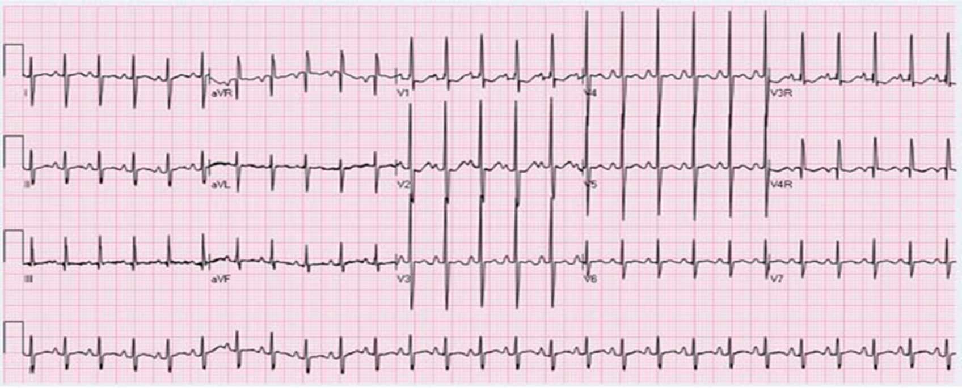
Righward QRS axis
RVH

Slide 8
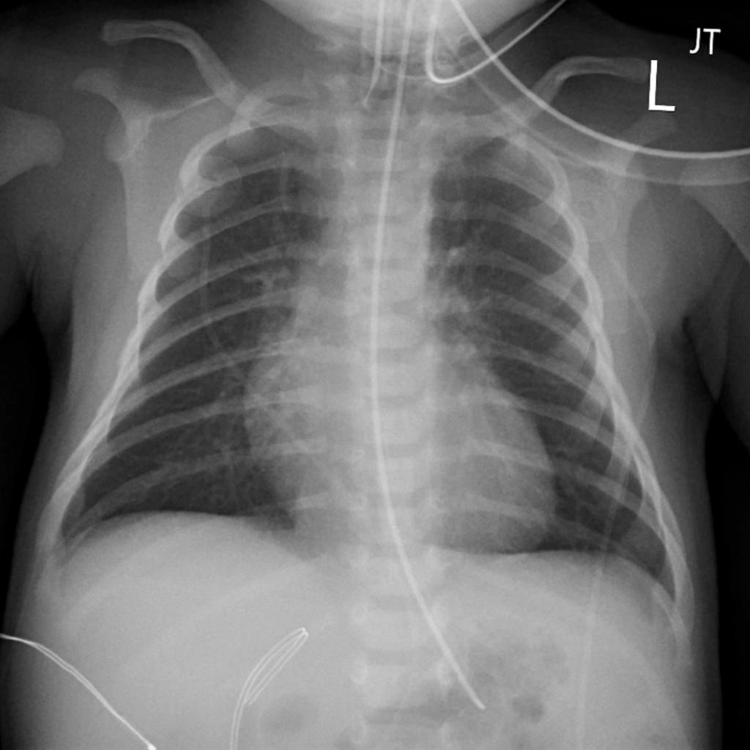
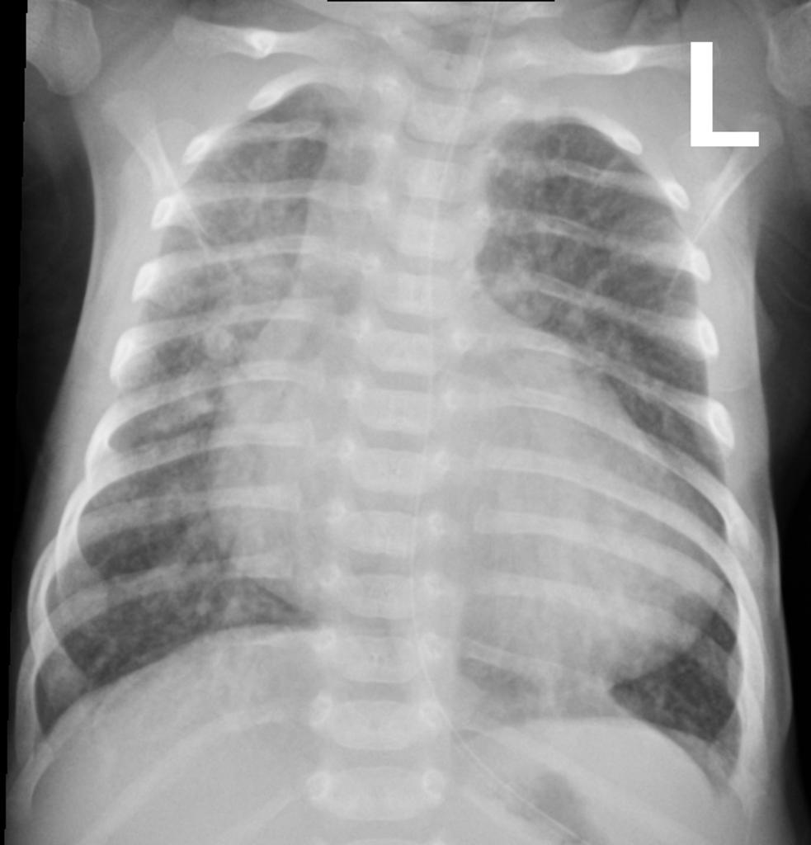
Chest x-ray at day 3
Mild cardiomegaly
No increased pulmonary markings
Chest x-ray at day 7
Severe cardiomegaly
Increased pulmonary markings

Slide 9
Management Plan
Fix metabolic acidosis
PGE1 infusion
Oxygen
digoxin and diuretics if CHF supervenes
Rashkind procedure (balloon arterial septostomy) in case mixing sites are insufficient
Surgery: arterial switch procedure
Diagnosis: TGA

Slide 10
CASE 2:
Sarah Ahmad, 7 month old admitted to the ER today (8th September 2021)
History taken from mother
Mother complains of bluish discoloration of her daughter after feeding, associated with difficulty of breathing and loss of consciousness.

Slide 11
Physical findings:
Weight: 7 kilograms
Height: 67 cm
Head circumference: 42cm
Vitals:
RR= 60 breaths/min Pulse – 120/min, regular, no radio-radial or radio femoral delay • BP – 84/60 mmHg
O2 sat= 65% (pre-ductal and post-ductal) - Afebrile.
Physical signs: cyanosis, (lips, tongue, fingers), no retractions, no grunting.
No Clubbing No Oedema No Lymphadenopathy Neck veins – not engorged
A single loud S2 is heard and no audible murmur.

Slide 12
Physical findings:
CARDIOVASCULAR SYSTEM
Inspection
Precordium normal on inspection •
No visible apical impulse •
No visible pulsation
No scars
Parasternal heave
Palpation
Apex
Palpable at left 5th ICS, 1 cm lateral to the mid-clavicular line
Thrill palpable at left 2nd & 3rd ICS along the sternal border
Auscultation
S1 , S2 audible
ejection Systolic murmur, grade IV, best heard at left upper sternal border harsh in quality. Not radiating to back/axilla

Slide 13
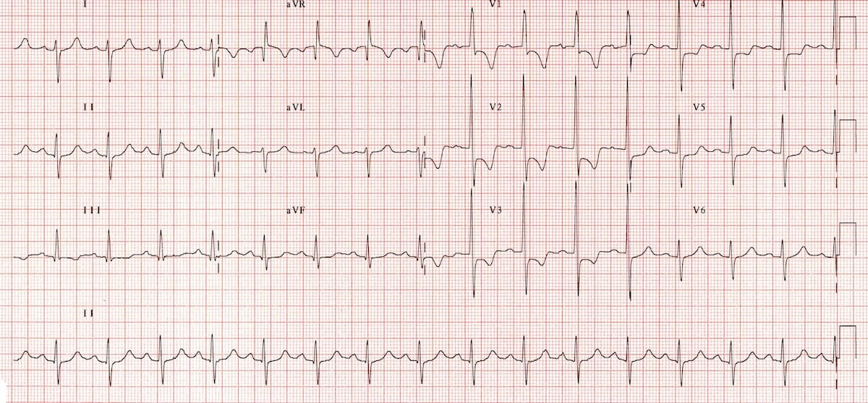
ECG : Right axis deviation. RVH.
P wave : peaked .

Slide 14
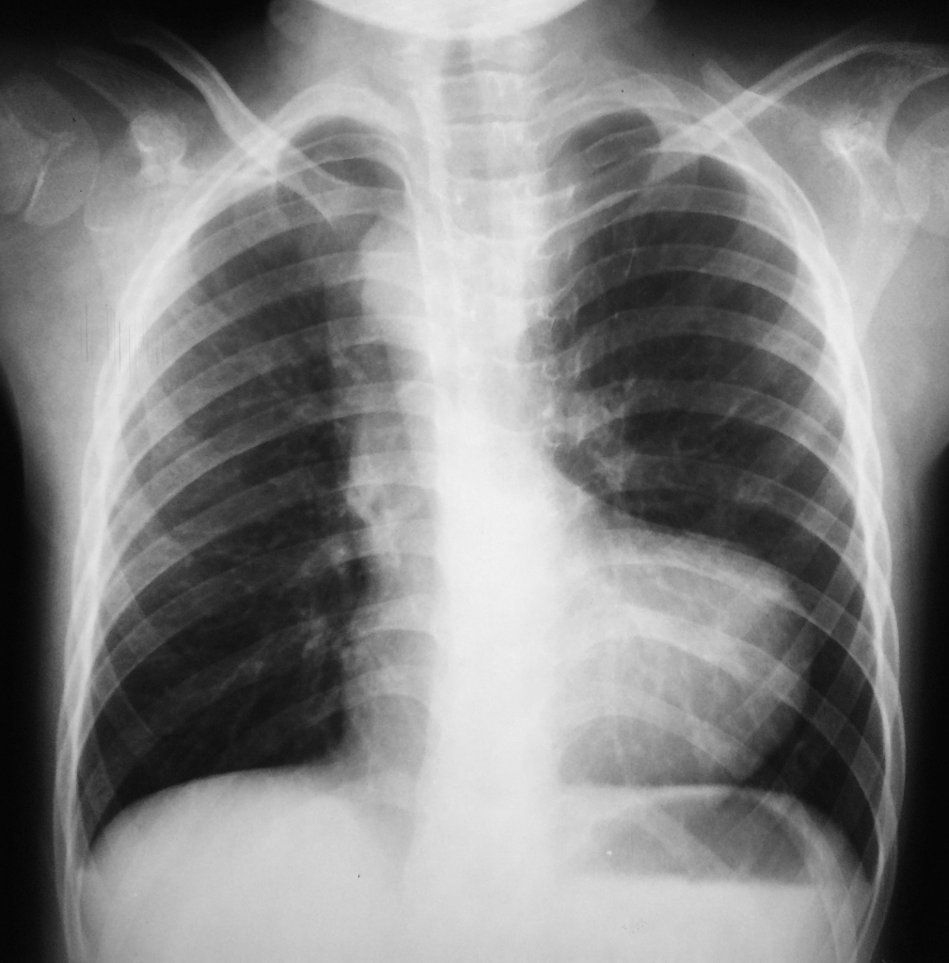
Investigations
CBC & blood gases.
CXR- boot shaped heart/ oligemic lungs/large aorta.
ECG – tall or bifid p waves + RVH/RAD.
Echocardiogram – multiple pathologies:
Pulmonary stenosis+ RVH + Overriding aorta + VSD.

Slide 15
Tetralogy of Fallot.
This is a known case of tetralogy of Fallot, presenting to the ER during a tet-spell.
Children usually present with increased bluish discoloration and dyspnea, post crying or feeding or any added exertion.

Slide 16
Management:
Stabilization of child by:
1- Calming/ Knee-chest position
2- 100% O2.
3- IV fluid bolus
4- correct metabolic acidosis (NaHCO3)
5- Morphine sulfate, 0.2 mg/kg SC or IM. (suppresses the respiratory center and abolishes hyperpnea.)
6- phenylephrine (vasoconstriction)
7- ketamine (increases SVR + sedative)
8- propranolol (decreases HR)

Slide 17
CASE 3:
History: Taleen Mustafa is a 3 year old female inpatient in PHH. She’s a known case of pneumonia.
The mother called the nursing team after her daughter was playing with Lego then suddenly started chocking and coughing. Code blue was requested.
Physical examination: pallor, no breathing, heart beats non-audible, non palpable pulse.

Slide 18
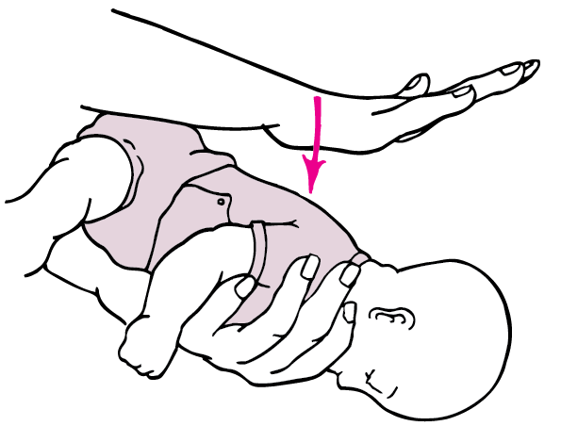

Management:
Can they cough?
If yes -→ keep coughing.
If the person is choking and cannot talk, cry or laugh forcefully, the Red Cross recommends a "five-and-five" approach to delivering first aid:
1) Give 5 back blows. For a child, kneel down behind. Place one arm across the person's chest for support. Bend the person over at the waist so that the upper body is parallel with the ground. Deliver five separate back blows between the person's shoulder blades with the heel of your hand.
2) Give 5 abdominal thrusts. Perform five abdominal thrusts (also known as the Heimlich maneuver).
3) Alternate between 5 blows and 5 thrusts until the blockage is dislodged.
If the patient is arrested follow the PALS cardiac arrest logarithm.

Slide 19
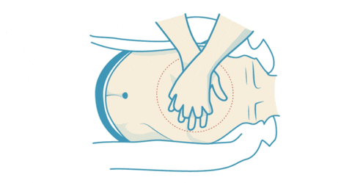
CPR Quality:
Push hard and fast, at least one-third anteroposterior (AP) chest diameter and 100-120 compressions per minute.
Allow complete chest recoil.
Minimize interruptions in compressions.
Avoid excessive ventilation.
Rotate compressor every 2 minutes or if fatigued.
Compression-to-ventilation ratio is 30:2 for a single rescuer, 15:2 for multiple rescuers.
Continuous compressions if advanced airway present, asynchronous ventilation (children) or timed ventilation (infants).

Slide 20
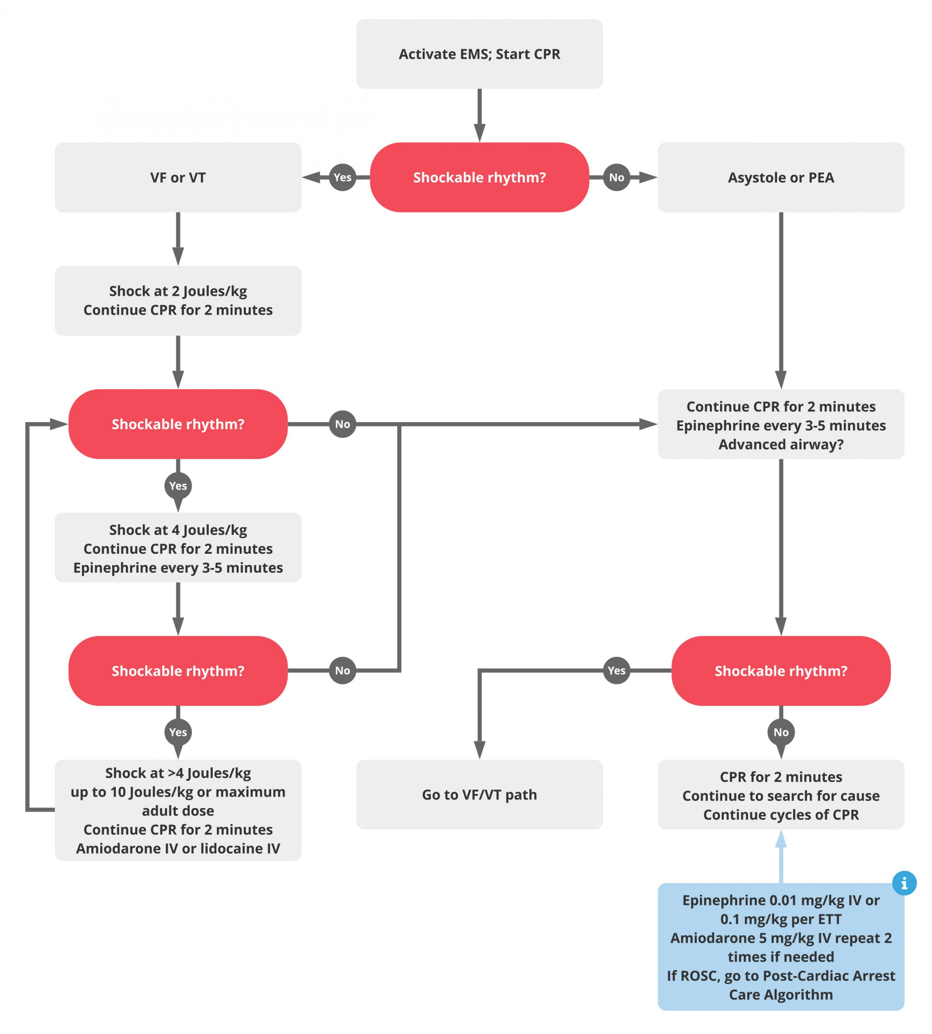
PALS Cardiac Arrest Algorithm

Slide 21
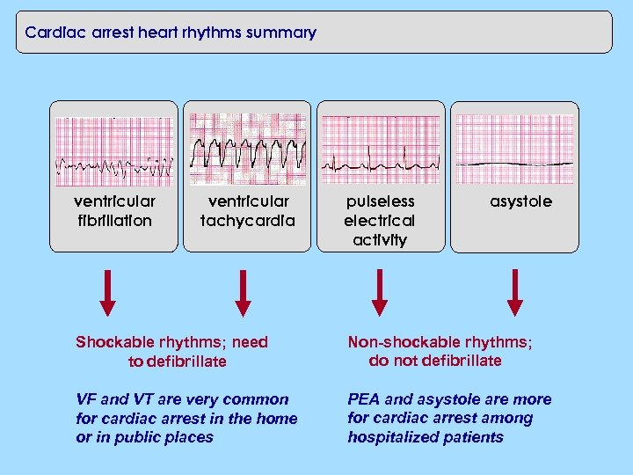

Slide 22
CASE 4

Slide 23
CASE study
6 year old male admitted via ER department on 8th September 2021at 10pm.
History taken from her mother
Cc:
palpitation since 2 hr .

Slide 24
HOPI
The patient seen in the ER department with a palpitation since 2 hr and the 2 day’s history of palpitation during this period; he has also become restless and chest discomfort. He has no cough or wheeze, he has no fever. Free surgical, medical or family history and he is on no medication.

Slide 25
Physical examination
The patient was conscious and alert and his oxygen saturation is 94%. The heart rate is 220 beats/min, blood pressure is 90/55 mmHg, No added heart sounds or murmur and femoral pulses are palpable. The peripheral capillary refill is 2s. Respiratory rate is 24 breaths/min and the chest is clear. The liver is not palpable . There are no other signs.

Slide 26
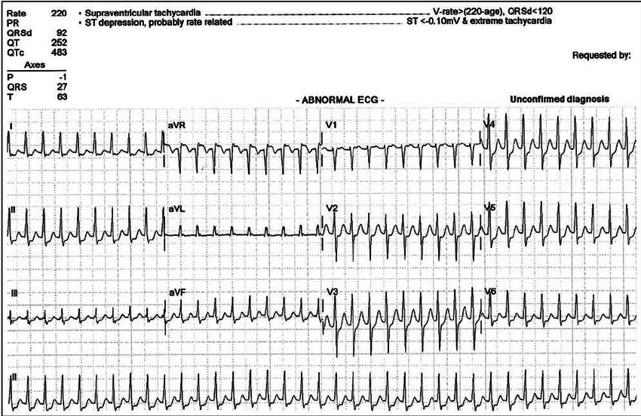
ECG
The ECG shows a narrow QRS complex tachycardia with a rate of approximately 220 beats/min. There are no P waves.

Slide 27
ddx
Sinus tachycardia
Ectopic atrial tachycardia
Atrioventricular nodal reentrant tachycardia
AVRT with orthodromic conduction
permanent junctional reciprocating tachycardia(pjrt)

Slide 28
management
Initial treatment in this emergency follows the standard resuscitation guidelines and the baby should have oxygen.
HYMODINAMICALLY STABLE :
VAGAL MANUVER
IV ADENOSINE
IV ESMOLOL
IV VERAPAMIL
IV AMIODARONE
DC CARDIOVERSION
HYMODINAMICALLY UNSTABLE :
IV ADENOSINE
DC CARDIOVERSION

Slide 29
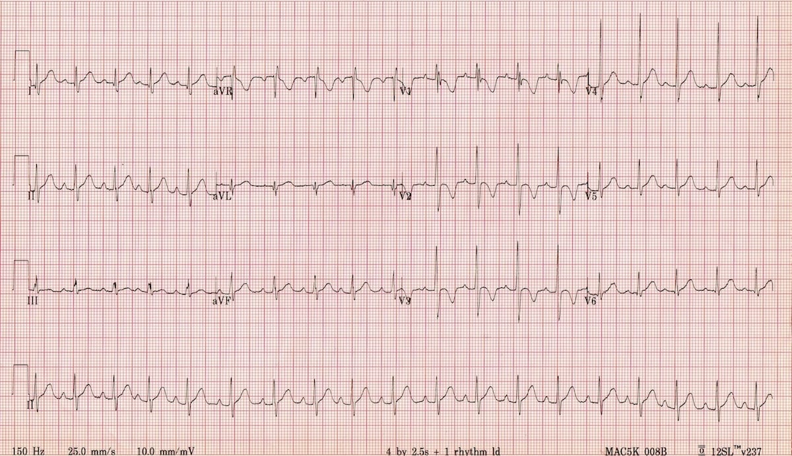
ECG AfTER STABILIZation and management

Slide 30
investigation
cbc
Hemoglobin 12.8 g/dL N(10.5–13.5 g/d)
White cell count 7.0 *109/L N(4.0–11.0 * 109/L)
Platelets 323 * 109/L N(150–400 * 109/L )
Sodium 138 mmol/L N (135–145 mmol/L )
Potassium 3.9 mmol/L N(3.5–5.0 mmol/L)
Urea 6.4 mmol/L N (1.8–6.4 mmol/L)
Creatinine 60 µmol/LN( 20–80 µmol/L )
C-reactive protein 5 mg/L N( <6 mg/L)
echo
TSH

Slide 31
Case 5
A 5 day old full term male patient presents to the hospital due to poor feeding, hypoactivity and pallor that started 3 hours ago with rapid deterioration. The patient was born vaginally with no complications and no admission to the NICU.
Notes:
Sx occur due to rapid closure of the PDA

Slide 32
Physical exam
  On inspection patient was pale with dusky coloured lower limbs, there was also mottling of the skin.
  Patients vitals were as follows:
HR: 140
BP: Right upper 70/50
Lower limb 55/30
O2 sat: Right arm 93
Lower limb 75
RR: 80 breaths per minute - Tachypneic
Patient has mild subcostal and intercostal retractions.
Examination of pulses showed brachiofemoral delay and a weak femoral pulse.
Capillary refill in lower limbs was 5 seconds.
Crepitations where heard on chest auscultation.
Liver was palpable on examination.
Notes:
Norm HR
Lowe limb BP is low
neonate with severe CoA may present with heart failure and/or shock when the PDA closes

Slide 33
Differential Diagnosis
Left side obstructive lesion such as:
Coarctation of the aorta
Critical Aortic stenosis
Hypoplastic left heart syndrome
Interrupted aortic arch
Fulminant sepsis
Notes:
How to differentiate
In Hypoplastic left heart syndrome
Critical aortic stenosis
Fulminant sepsis
BP is low all over
And all pulses are weak while in Coarctation of the aorta weak pulses and lower blood pressure in lower limbs only
Interrupted aortic arch diagnosed usually early in new born

Slide 34
Work up
CBC – Normal
ABGS – Metabolic acidosis
KFT – Impaired
Electrolytes - Hyponatremia
Chest Xray – Cardiomegaly and pulmonary edema
Increased pulmonary vascular markings
ECG – Right ventricular hypertrophy – neonatal form
Repolarization changes
Echo – Diagnostic test
Notes:
Significant coarctation leads to circulatory shock with renal insufficiency (oliguria or anuria) and metabolic acidosis
CBC to rule out sepsis

Slide 35
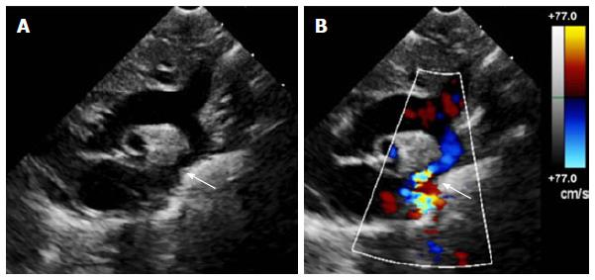

Slide 36
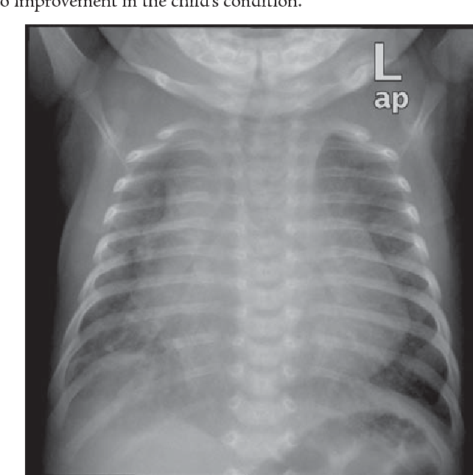

Slide 37
Management
Monitor: Vitals
Electrolytes
Urine output
Prostaglandin E1
Inotropic drugs
Diuretics
Bicarbonate

Slide 38
Neonatal Coarctation of the Aorta
Coarctation of aorta infantile type is a preductal lesion – narrowing occurs proximal to ductus arteriosum.
Heart failure is due to sudden increase in afterload.

Slide 39
THANK YOU

