Slide 1
HYPERTENSION IN children
Done by: Rand Dawoud
Abdulrahman Saadeh
Louy Alsurkhi
Supervised by: Dr. Saiel Sarhan

Slide 2
Introduction
Hypertension in children is a growing problem.
Prevalence: 1-4% in young children and 3-8% among adolescents.
Multifactorial in origin.
Early intervention prevents development and progression of target organ damage.

Slide 3
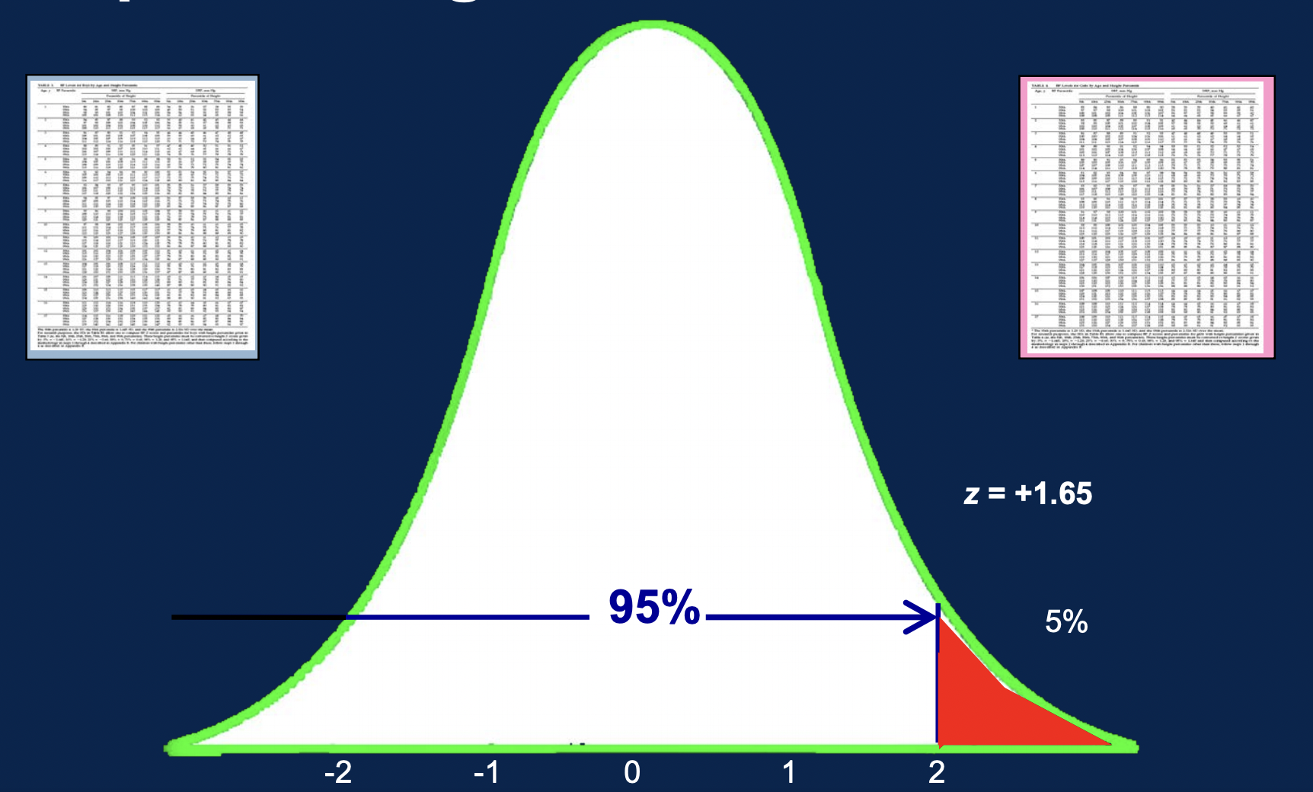
Definition
Hypertension (HTN) in children is defined as blood pressure (BP) greater than the 95th percentile for age, gender, and height on at least three different occasions.
The context of the blood pressure measurement (e.g., cuff size, pain, anxiety) should be taken into consideration.

Slide 4
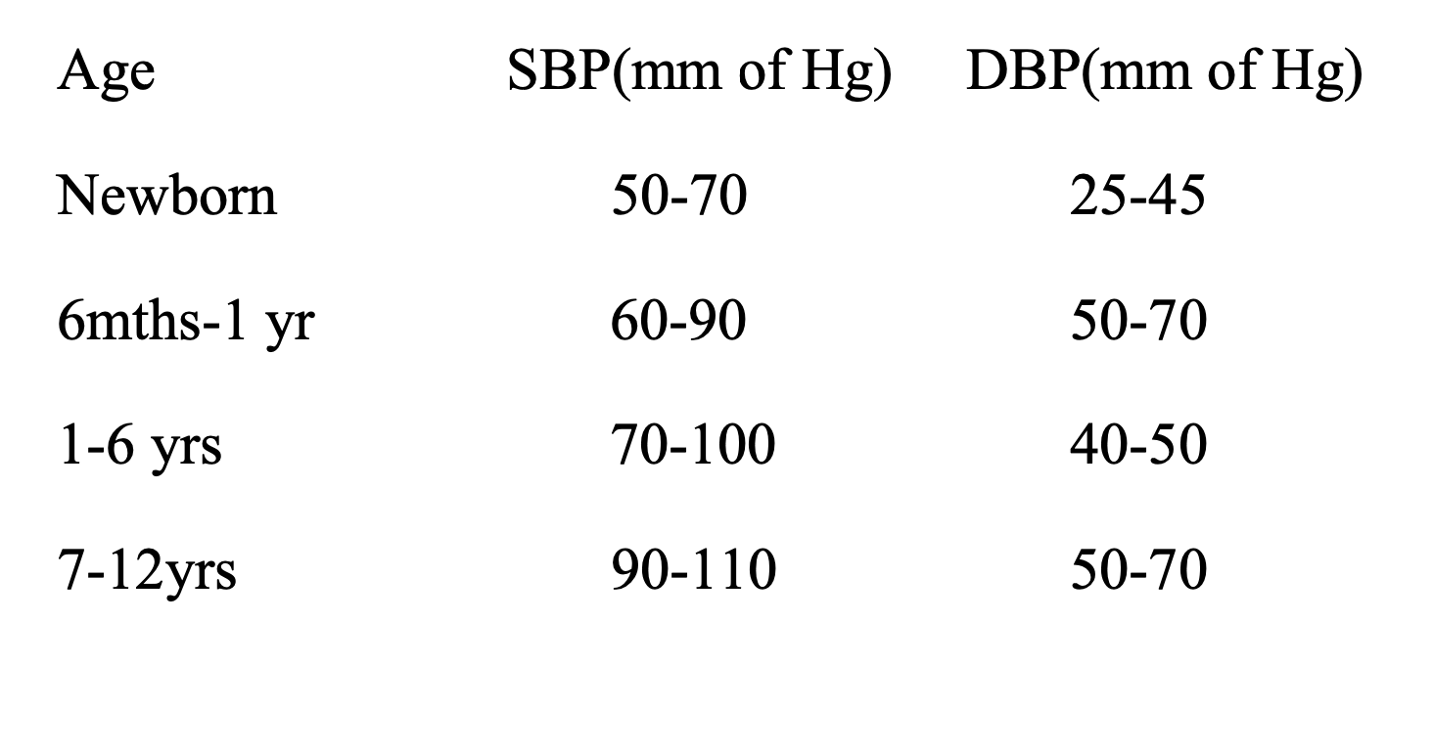
Normal blood pressures in children

Slide 5
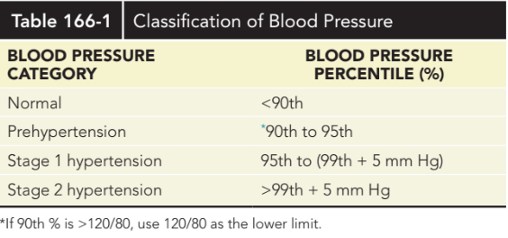
CLASSIFICATION OF BLOOD PRESSURE IN CHILDREN

Slide 6
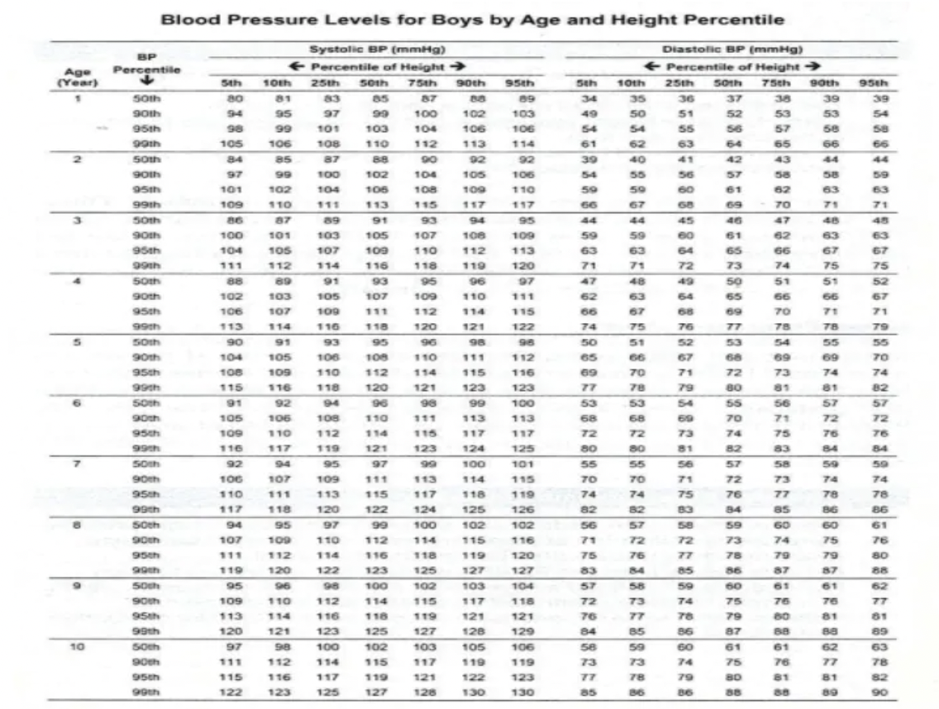
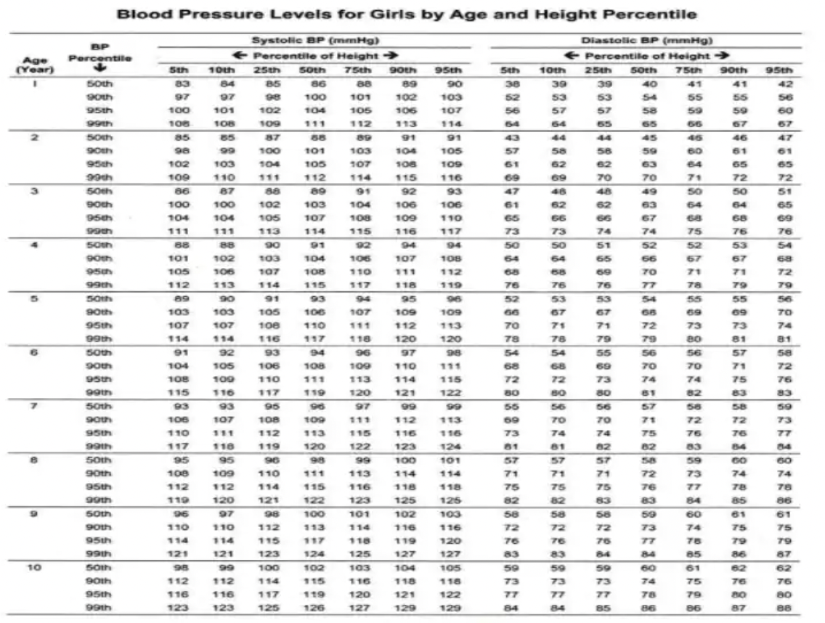
CLASSIFICATION OF BLOOD PRESSURE IN CHILDREN (CONTINUED)

Slide 7
WHO SHOULD HAVE his/HER BLOOD PRESSURE MEASURED?
Children ≥3 years old should have BP measured annually
Children ≥3 years at every health care encounter if medications/conditions increase risk for HTN
Children < 3 years should have BP measured under special circumstances

Slide 8
Special Circumstances for Children < 3 years old
Prematurity
Congenital heart disease
Renal disease or urologic malformation
Malignancy
Treatment with medications known to raise BP
Systemic illnesses
Evidence of elevated intracranial pressure

Slide 9

How should blood pressure be measured in children?
The child should be calm and free of anxiety.
The child should have been sitting quietly for 5 minutes.
The child should be sitting with back supported, both feet on the floor and right cubital fossa supported at heart level.

Slide 10
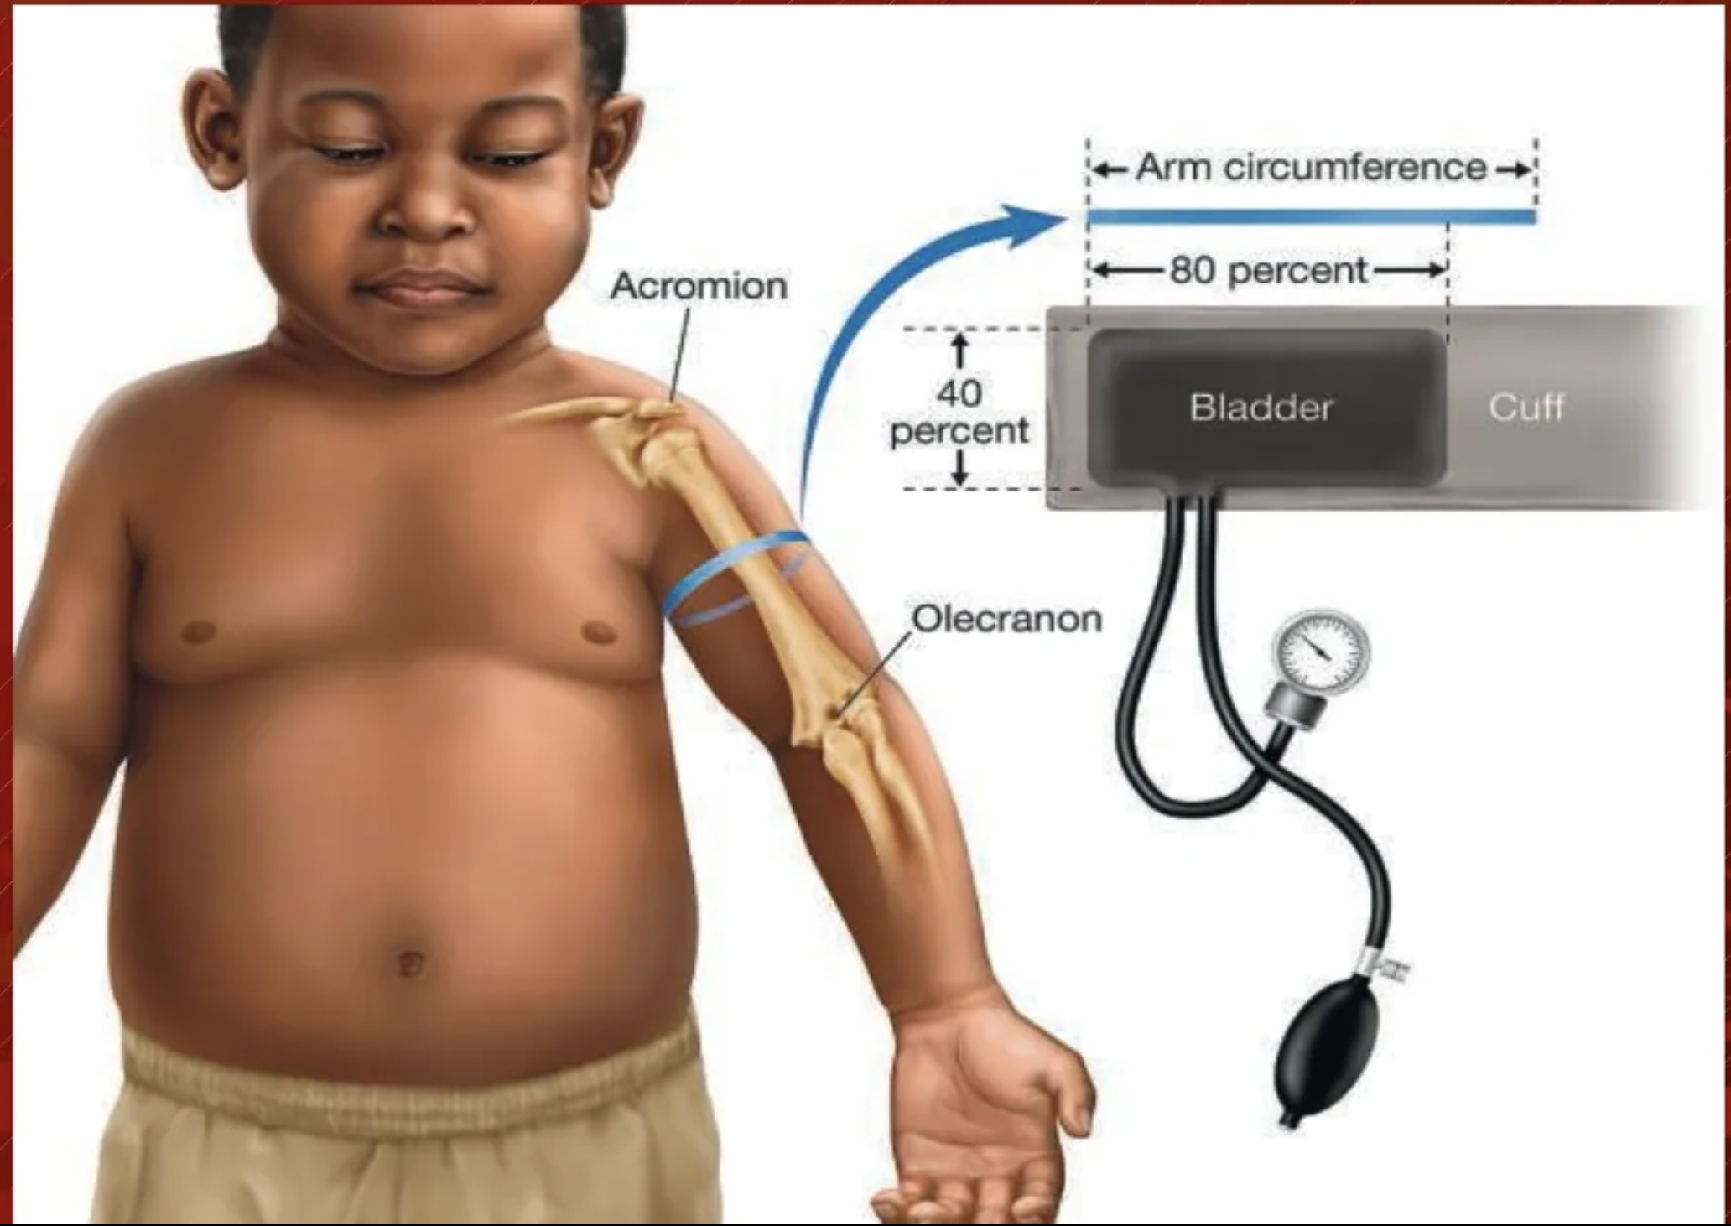
Proper CUFF SIZE
The cuff width should cover ~70% of the distance between the acromion and olecranon.
The cuff bladder length should be 80 to 100% of the arm circumference, and the cuff bladder width should be at least 40% of the arm circumference at the midpoint of the acromion-olecranon distance.

Slide 11
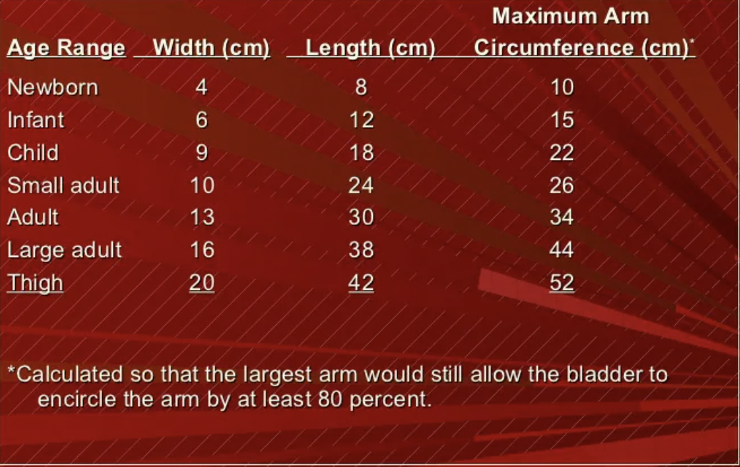
RECOMMENDED DIMENSIONS FOR BLOOD PRESSURE CUFF BLADDERS

Slide 12
TYPES , CAUSES & CLINCAL PRESENAION

Slide 13
Types
Secondary hypertension is most common in infants and younger children. It
is most often caused by renal abnormalities; additional etiologies include
cardiovascular disease and endocrinopathies.
Younger age, severely elevated BP, and symptomatic hypertension make a secondary cause of hypertension more likely.
Many childhood diseases can be responsible for chronic hypertension or acute/intermittent hypertension
The most likely cause varies with age, Hypertension in the premature infant is sometimes
associated with umbilical artery catheterization, renal artery thrombosis, or
bronchopulmonary dysplasia. Hypertension during early childhood may be
caused by renal disease, coarctation of the aorta, endocrine disorders, or
medications.

Slide 14
Conditions associated with chronic HTN in pediatrics
Renal
Recurrent pyelonephritis/renal scarring
Chronic glomerulonephritis
Congenital dysplastic kidney
Polycystic kidney disease
Renal tumors
Systemic lupus erythematosus (other connective tissue diseases)

Slide 15
Endocrine
Hyperthyroidism
Congenital adrenal hyperplasia (11β-hydroxylase and 17-hydroxylase
defect)
Cushing syndrome
Primary hyperaldosteronism
Pheochromocytoma
neuroblastoma

Slide 16
Vascular
Coarctation of thoracic or abdominal aorta
Renal artery lesions (stenosis, fibromuscular dysplasia, thrombosis, aneurysm)
Neurofibromatosis (intrinsic or extrinsic narrowing for vascular lumen)
Renal vein thrombosis

Slide 17
Conditions Associated With Transient or
Intermittent Hypertension in Children
Renal
Acute post infectious glomerulonephritis
Henoch-Schönlein purpura with nephritis
Hemolytic-uremic syndrome
Acute kidney injury
After renal transplantation (immediately and during episodes of rejection)

Slide 18
Renovascular
Renal disease (e.g., chronic glomerulonephritis, reflux , polycystic kidney disease, congenital anomalies of the kidney and urinary tract) and renovascular hypertension account for approximately 90% of children with secondary hypertension.

Slide 19
Renal angiogram in 7 yrs old boy with hypertension. Right renal artery is visible with a string-of-beads appearance characteristic of fibromuscular dysplasia

Slide 20
endocrinopathies
Several endocrinopathies are associated with hypertension, usually those involving the thyroid, parathyroid, and adrenal glands. Systolic hypertension and tachycardia are common in hyperthyroidism; DBP is not usually elevated.
Hypercalcemia , whether secondary to hyperparathyroidism or other causes, often results in mild elevation in BP because of an increase in vascular tone.

Slide 21
Adrenocortical disorders
aldosterone-secreting tumors, sodium-retaining congenital adrenal hyperplasia, (Cushing syndrome) may produce hypertension in patients with increased mineralocorticoid secretion. It is important to consider conditions associated with real or apparent mineralocorticoid excess and thus a suppressed renin level (with or without hypokalemia) form of secondary hypertension
hypercortisolism → stimulation of aldosterone receptors in high concentrations) and ↑ potassium excretion → ↑ blood pressure
↑ Aldosterone → ↑ Na⁺ reabsorption and retention → water retention → hypertension

Slide 22
Pheochromocytomas
Pheochromocytomas are catecholamine-secreting tumors that give rise to hypertension because of the cardiac and peripheral vascular effects of epinephrine and norepinephrine.
Tumors arise from chromaffin cells, which are derived from the neural crest.
Localization ^{[2]}
  ∼ 90% adrenal medulla (physiologically activated by acetylcholine)
  ∼ 10% extra-adrenal in the sympathetic ganglia
  ∼ 10% at multiple locations
Children with pheochromocytoma usually have sustained rather than intermittent or exercise-induced hypertension

Slide 23
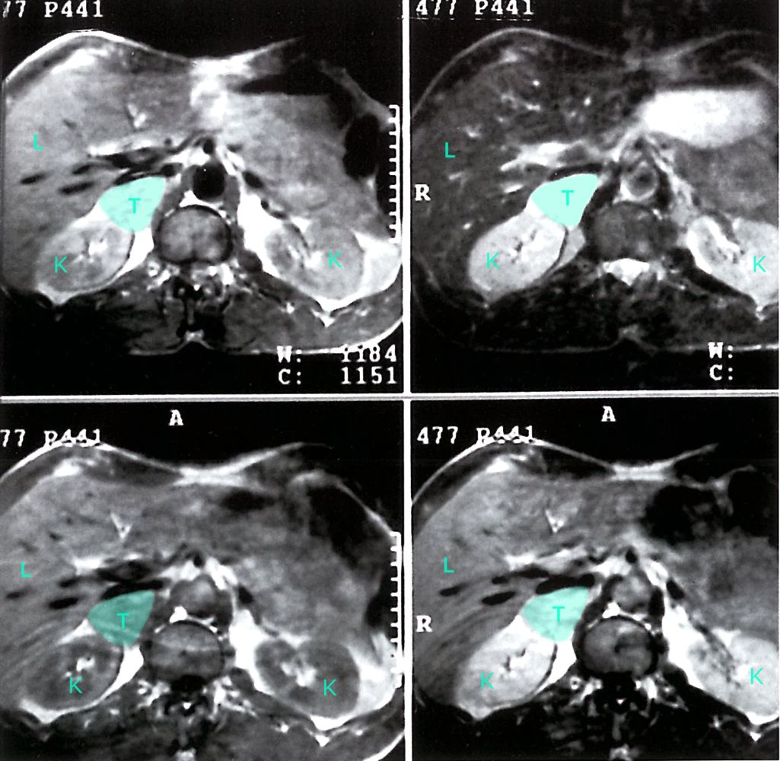
Pheochromocytoma
MRI of the upper abdominal region
There is evidence of a tumor (T, green overlay) in the right adrenal gland. (K = kidney; L = liver)

Slide 24
Primary hypertension
- In older school-age children and adolescents, primary hypertension becomes
increasingly common. These patients often are overweight, have a strong family
history of hypertension, and have BP values at, or only slightly above, the 95th
percentile for age.
Isolated systolic hypertension is also more consistent with
primary hypertension, whereas diastolic hypertension may suggest a secondary
cause.

Slide 25
primary hypertension
Children and adolescents with 1ry htn are usually asymptomatic; characterized by mild or Stage 1 hypertension.
No identifiable cause can be found.
Less common than Secondary HTN.
Hereditary factors, Diet, Stress and Obesity Plays a role in it’s development
associated with a positive family history of hypertension or cardiovascular disease (CVD).

Slide 26
Target Organ damage
As Essential HTN is Asymptomatic, Doctors should always assess for Target Organ damage whenever they diagnose it.
Target-organ abnormalities are commonly associated with hypertension in children and adolescents.
1. Left ventricular hypertrophy (LVH) is the most prominent evidence of target organ damage.
LVH has been reported in 34–38 percent of children and adolescents with mild, untreated BP elevation.
Pediatric patients with established Hypertension should have echocardiographic assessment of left ventricular mass at diagnosis and periodically thereafter.
The presence of LVH is an indication to Initiate Or intensify antihypertensive therapy

Slide 27
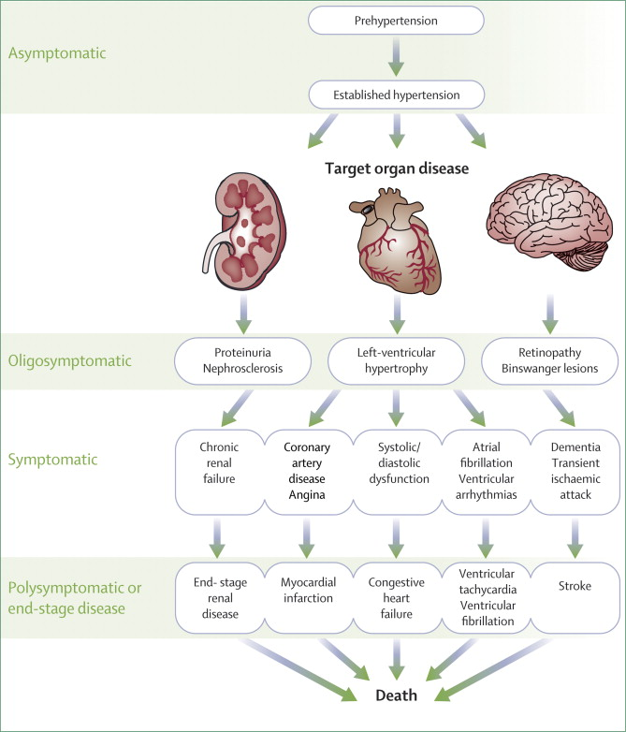
2. hypertensive retinopathy
3. Renal damage
4.atherosclorsis

Slide 28
Patient history
Symptoms of high BP: failure to thrive, fatigue, visual disturbance,
headache, nausea, and vomiting.
Symptoms of renal disease: e.g. polyuria, dysuria, or enuresis;
Symptoms of phaeochromocytoma, e.g. palpitations, flushing.
Sleep history ( OSA)
Drug History : amphetamines, cocaine, cyclosporine, …
• Family history
Essential hypertension, other familial hypertension.
Sudden death, renal failure, heart attacks, or stroke.
Liddle Syndrome
Gordon Syndrome
Prenatal/ natal/postnatal history
preterm birth, low birth weight, use of an umbilical artery catheter, history of an abnormal prenatal ultrasound
HISTORY

Slide 29
Findings to Look for on Physical Examination in Patients
With Hypertension

Slide 32
Investigations
Evaluation for identifiable causes :
CBC : R/O anemia consistent with chronic renal disease.
SERUM RENIN AND ALDOSTERONE
Bun, creatinine, electrolytes, urinalysis, urine culture: r/o renal disease, chronic pyelonephritis
Target organ investigations are ECG , CXR , ophthalmologic examination .

Slide 33
Evaluation for comorbidity :
Fasting lipid panel, fasting glucose.
Drug screen: to identify substances that cause hypertension.
Polysomnography : identify sleep disordered breathing.
Evaluation for target-organ damage :
Echocardiogram : for cardiac involvement and left ventricular Hypertrophy.
Retinal exam : To identify retinal vascular changes (hypertensive retinopathy).

Slide 34
We can use ABPM (to identify white coat hypertension).
Renovascular imaging (MRA or CTA) to identify renovascular disease.
Intra-arterial angiography can be helpful identifying intrarenal vascular stenosis.
Plasma and urine catecholamines to identify catecholamines mediated hypertension.

Slide 35
Treatment
Asymptomatic mild hypertension without target-organ damage may be treated with lifestyle-modification and dietary changes.
In patients with obesity-related hypertension; weight loss may be helpful.
In addition to diet, aerobic physical activity for at least 30-60 min on most days is recommended.

Slide 36
Indications for pharmacological treatment :
Symptomatic hypertension.
Stage 2 hypertension without modifiable risk factors.
Hypertension with comorbidities such as DM or CKD.
Persistent hypertension despite non-pharmacological measures.

Slide 37
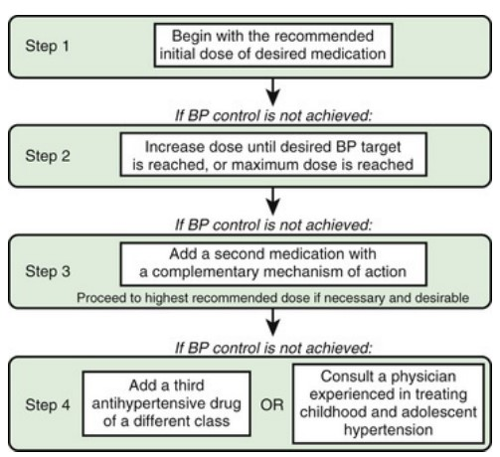

Slide 38
We can start treating patients with one of these drugs as initial agents :
ACEi
- Common side effects : cough, angioedema, hyperkalemia, decrease GFR, thrombocytopenia or loss of taste.
ARB’s
- Common side effects like: ACEi except for cough.
ACE-I and ARBS are recommended in patients with DM and CKD.
Calcium channel blockers (CCB)
- Common side effects : headache, flushing, dizziness, peripheral edema, chest pain, tachycardia, N/V or constipation.
Thiazide diuretics.

Slide 39
Other agents include :
α- and β-adrenergic antagonist.
Vasodilators (such as hydralazine)
Central α-agonist.
Aldosterone receptor antagonist
BP goal is <90th percentile in patients with complicated hypertension and <95th percentile in uncomplicated hypertension.

Slide 40
Hypertension Urgency
It is severe hypertension (BP exceed 2nd stage hypertension) associated with symptoms like headache, dizziness, N/V, without target-organ damage.
Treatment :
Oral agents such as clonidine (central α-agonist) and isradipine (CCB)
IV agents such as labetalol (contra-indicated in asthma and heart failure) ,and hydralazine (direct vasodilator)

Slide 41
Hypertension Emergency
Severe hypertension: associated with headache, dizziness, N/V, retinopathy, encephalopathy, cardiac failure, renal injury and seizures.
Generalized or posterior reversible encephalopathy syndrome (hypertensive encephalopathy) presentation is headache, vomiting, fever, visual disturbance, ataxia, decreased level of consciousness, imaging abnormalities and seizures.

Slide 42
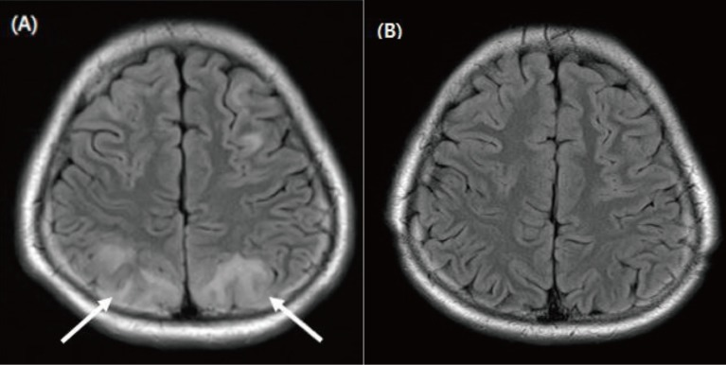
The patient may also have decreased vision, papilledema, CHF or accelerated deterioration of renal function.

Slide 43
Treatment
The patient should be admitted to ICU and treated with IV agents slowly (no reduction of BP more than 25% in 1st 8 hrs).
IV agents are labetalol, nicardipine, sodium nitroprusside and hydralazine.

Slide 44
Treatment of secondary hypertension
Treat the underlying cause.
Treatment of renovascular stenosis includes antihypertensive medications, angioplasty and surgery.
ACEi and ARB’s are contraindicated in bilateral renovascular stenosis.
Pheochromocytoma : phenoxybenzamine (α-blocker) and surgery.
1ry aldosteronism : spironolactone (for 4 weeks) then surgery.

Slide 45
Thank You

