Slide 1
PHYSICAL SIGNS OF NEONATE
Supervised by: Dr Thikra
Done by
Tala sultan
Rashed talal
Qusai odeh

Slide 2
Definition and timing
Skin
Initial assessment
Head, Face, and neck
Detailed assessment
Chest, Abdomen, and Genitalia
Extremities

Slide 3
Definion : Assessment of recently born infant at various points within the timeframe of first 6-8weeks after birth including head to toe examination to look for any pathology.
TIMING :
Initial exam immediately after birth and any resuscitation
Full and detailed assessment within 48hours and always prior to discharge
Follow up 5-7 days and 6weeks.

Slide 4
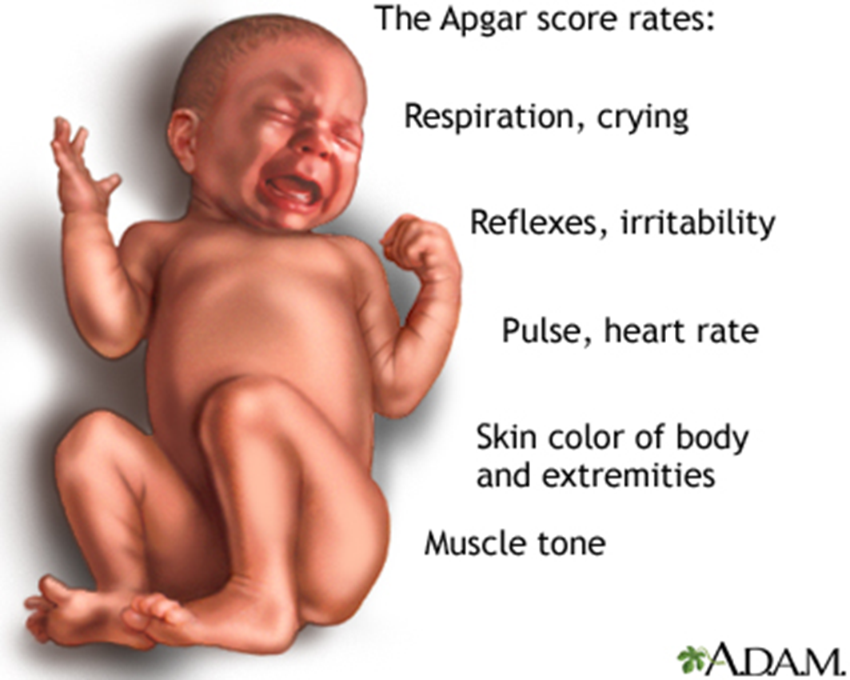
Initial assessment rapid scoring system based on physiologic responses to the birth process, is a good method for assessing the need to resuscitate a newborn.
The 1-minute score determines how well the baby tolerated the birthing process. The 5-minute score tells the health care provider how well the baby is doing outside the mother's womb

Slide 5
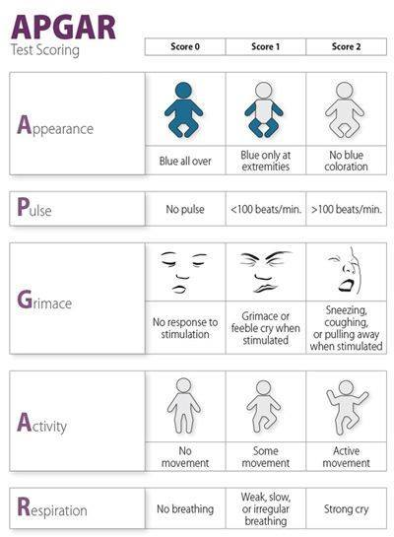
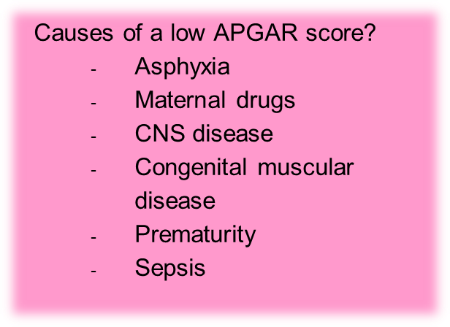
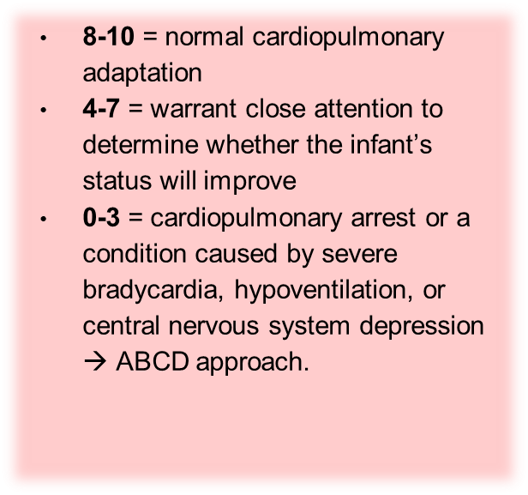

Slide 6
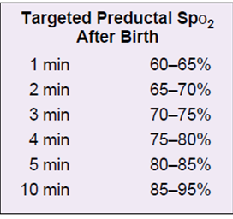
Detailed assessment
Detailed assessment
2)Vitals
1) Gestational age, Based on:
Menstrual periods
Date of conception
Fetal U/S
Physical parameters after birth (Ballard score)
Pre-term (<37 weeks)
Full term (37-42 weeks)
Post-term (>42 weeks)
Temperature
Heart rate (120-160)
Respiratory rate (30-60)
Blood pressure
SpO₂
Capillary refill
3) Growth parameters :
Head circumference
Body length
weight
6

Slide 7
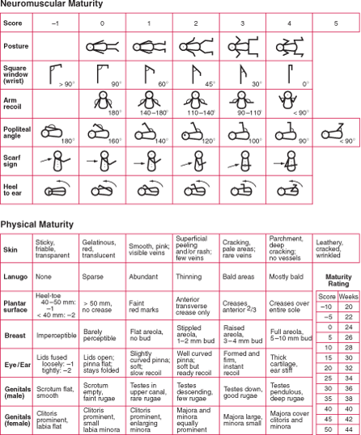
Ballard score

Slide 8
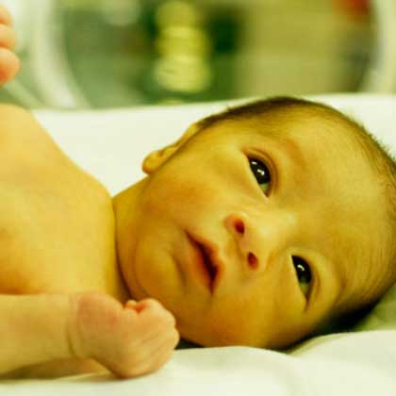
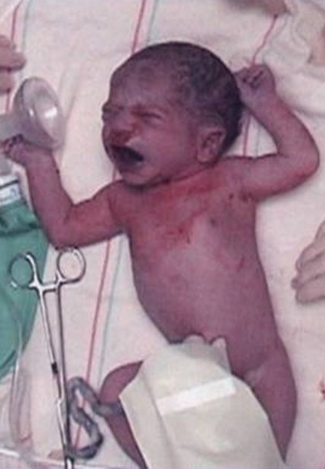
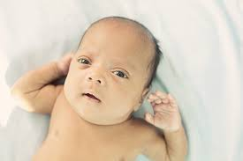
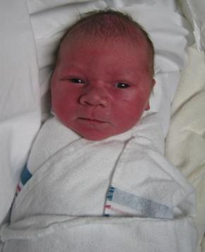
Detailed assessment/Appearance
pallor
plethora
jaundice
color
(anemia, poor perfusion, shock, asphyxia, PDA)
jaundice
(polycythemia: large placental twin to twin transfusions, hypoxia, IUGR, perinatal asphyxia)
Generalized cyanosis
TORCH INFECTION, hemolytic disorders
(g6pd, spherocytosis)
Occult hematoma
Methaemaglobinaemia, or significant hypoxemia.

Slide 9
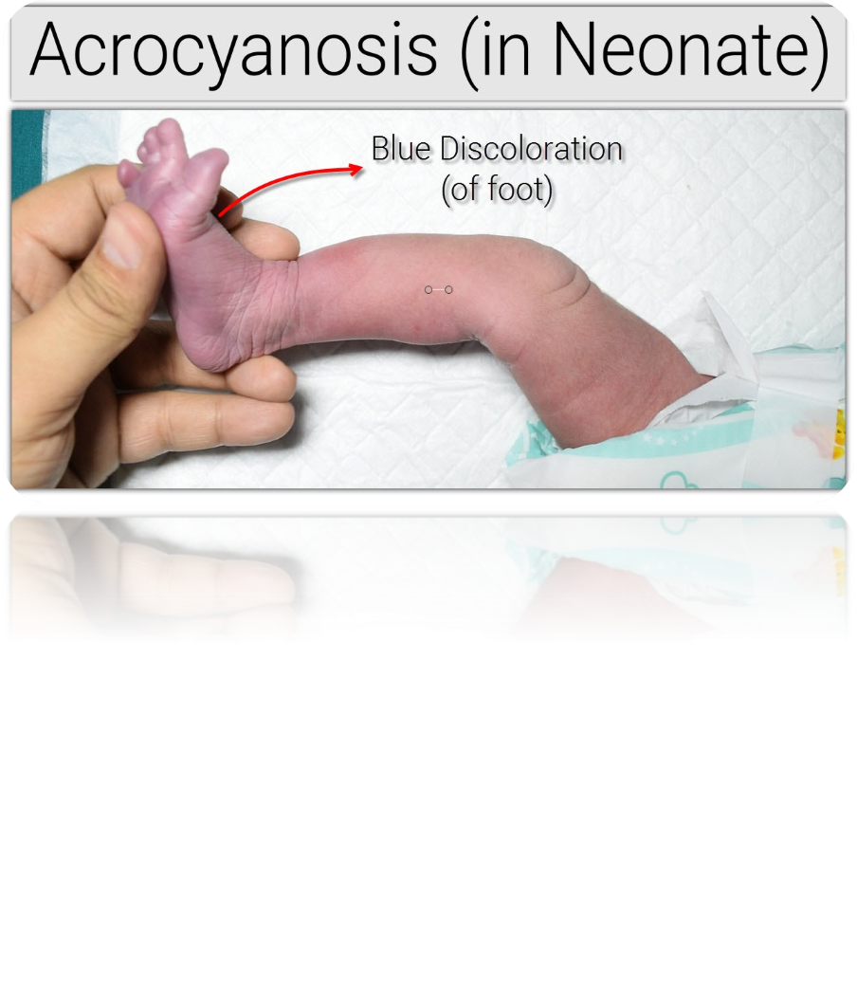
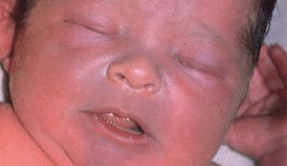
Detailed assessment
Central cyanosis
Vasomotor instability with cutis marmorata, telangiectasia, phlebectasia (intermittent mottling with venous prominence), and acrocyanosis (feet and hands) is normal in a premature infant.
Acrocyanosis is a bluish-purple discoloration of the hands and feet and, when the newborn is centrally pink, is a normal finding.
Cyanotic Heart Diseases
Respiratory → RDS, Choanal atresia, → Diaphragmatic hernia
CNS ➔ Respiratory center depression
Blood ➔ Methemoglobinemia
Metabolic ➔ hypothermia

Slide 10
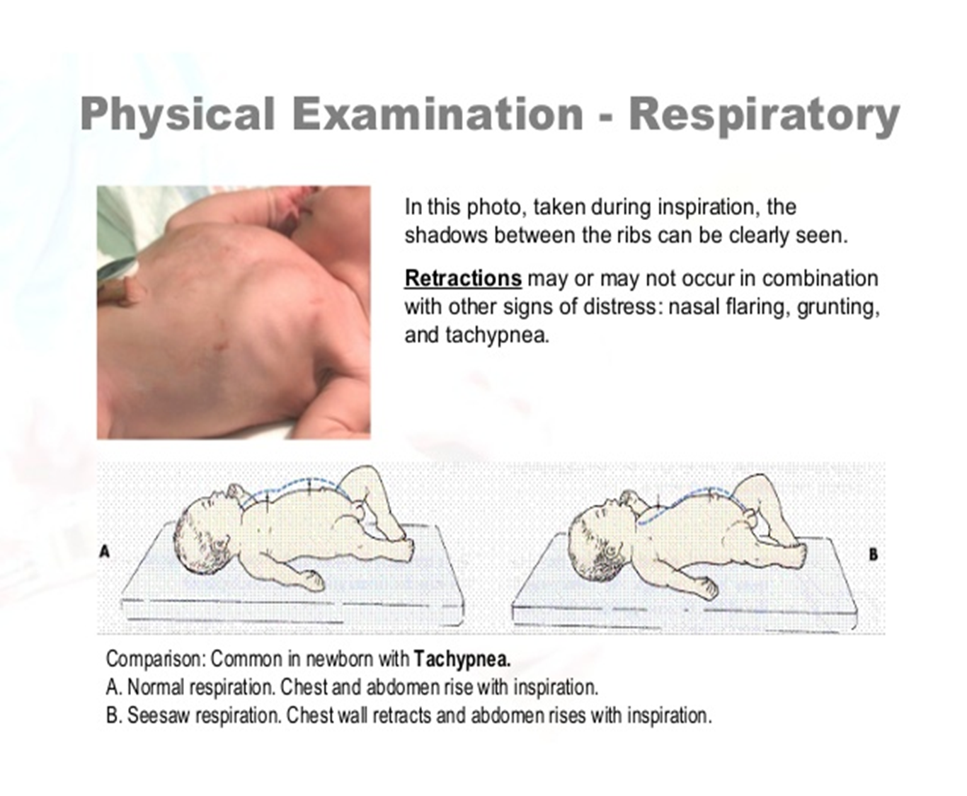
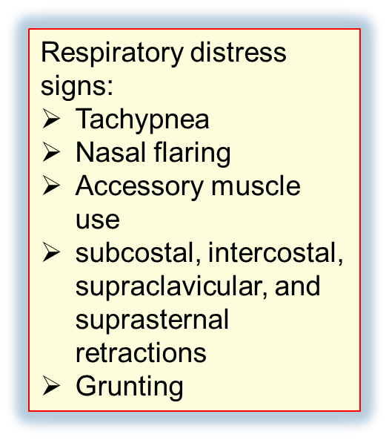

Slide 11
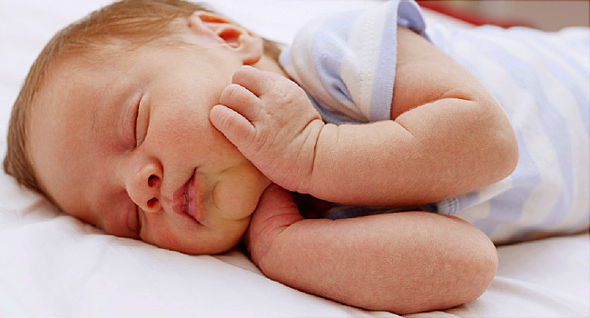
Neonatal skin vs adult’s skin
Thinner
Less hairy
More proliferation >> more desquamation
Less glands secretions
This makes the neonatal skin more susceptible for infections, irritants.

Slide 12
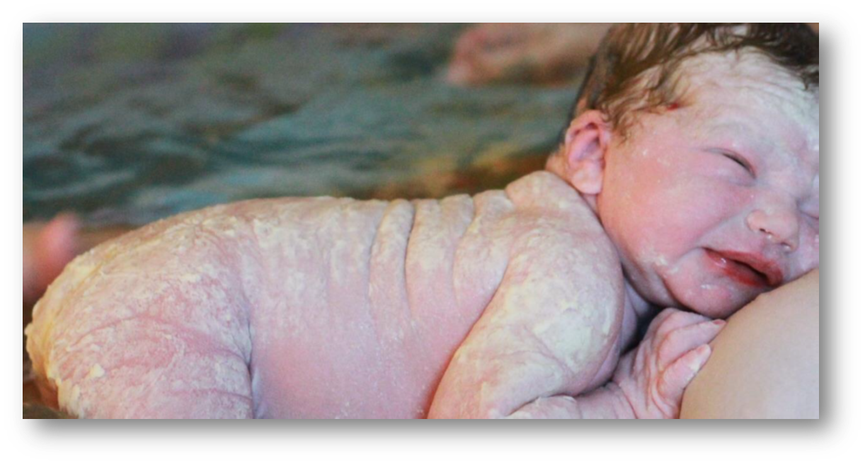
Normal findings The skin may look normal, dry, wrinkled or vernix covered in healthy babies. There may be meconium staining of the skin and nails

Slide 13
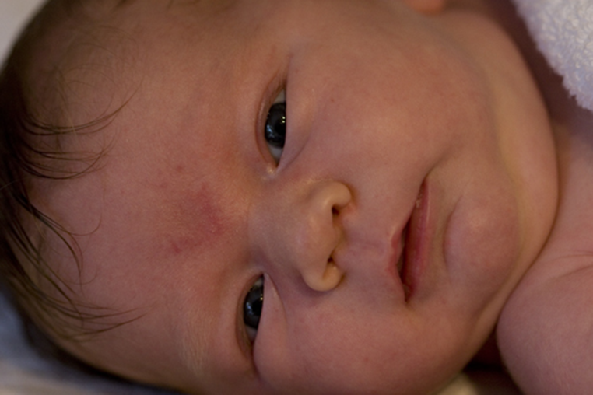
Strok’s beak marks
. Prominent capillaries commonly cause pink areas called ‘stork’s beak marks’ at the nape of the neck, the eyelids and the glabella .The facial ones fade without treatment over subsequent months. Marks on the neck often persist.

Slide 14
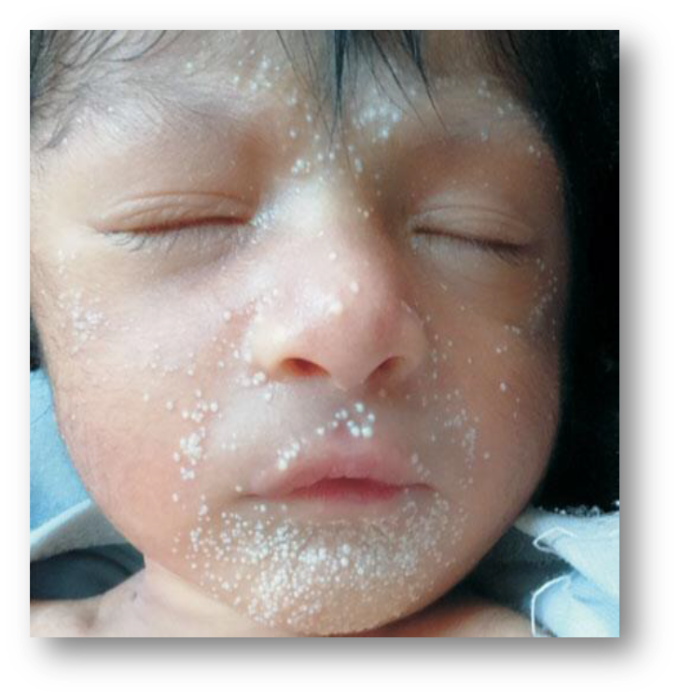
Milia- Milk spots yellow-white epidermal cysts of the pilosebaceous follicles that are noted on the nose) small firm white papules, 1-2mm in size. Disappear spontaneously during first 3-4 weeks

Slide 15
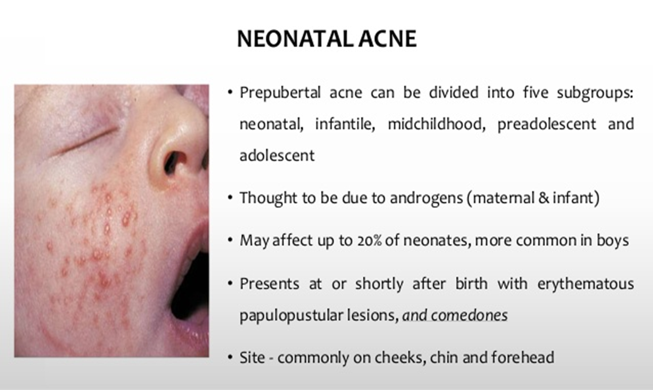






Slide 16
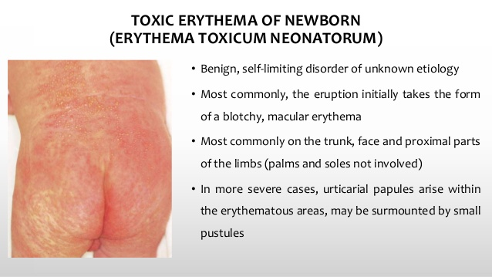




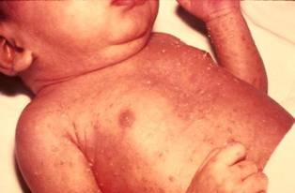
2nd day >>> 1 week
Sterile culture [only eosinophils]

Slide 17
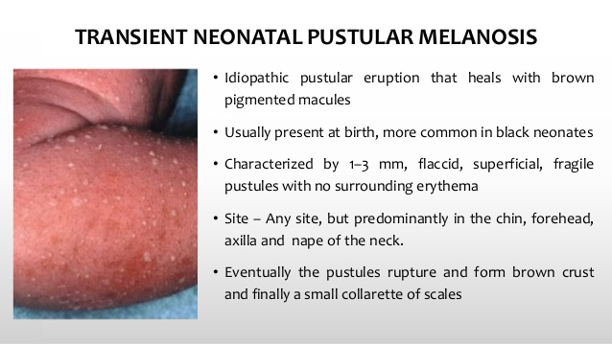



Birth >> 2 days
Sterile culture [neutrophils, slight eosinophils]

Slide 18
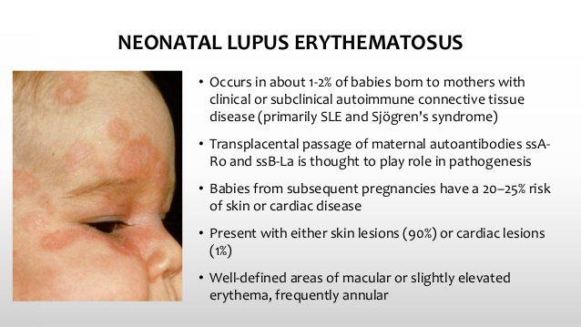


Slide 19
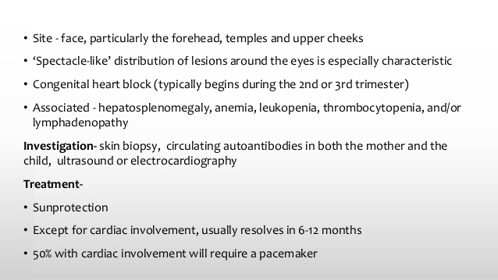

Slide 20
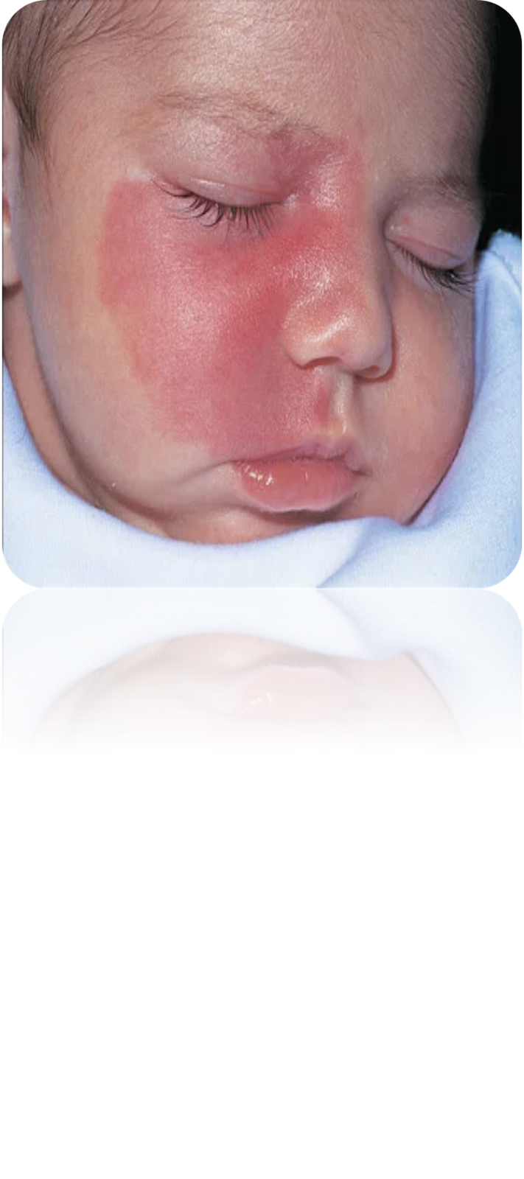
Abnormal findings Document any trauma, e.g. scalp cuts, bruising. Dense capillary haemangiomas (port wine stains) will not fade. Laser treatment may help. Around the eye they may indicate Sturge–Weber syndrome (a facial port wine stain with an underlying brain lesion associated with risk of later seizures, cerebral calcification and reduced cognitive function).

Slide 21
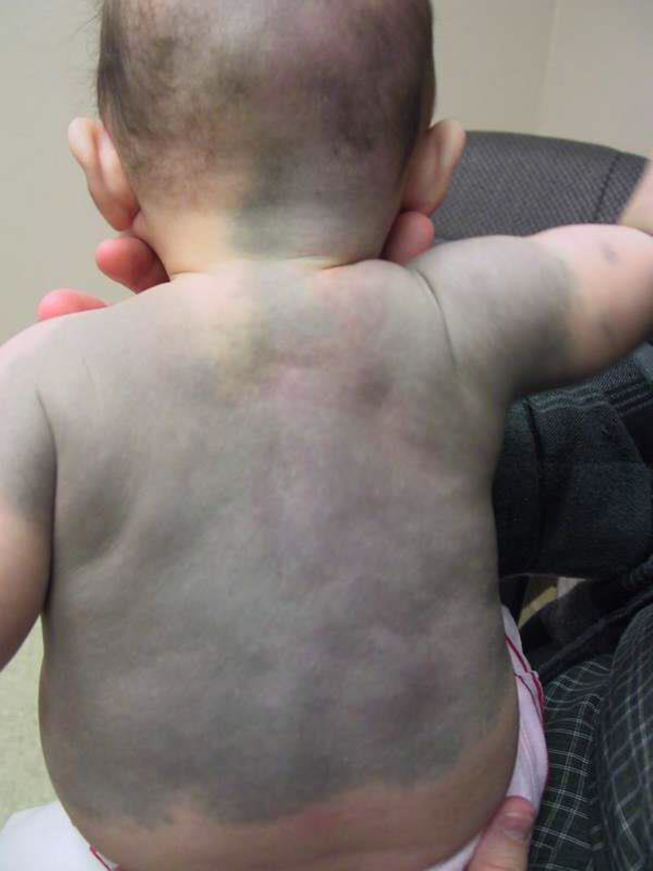
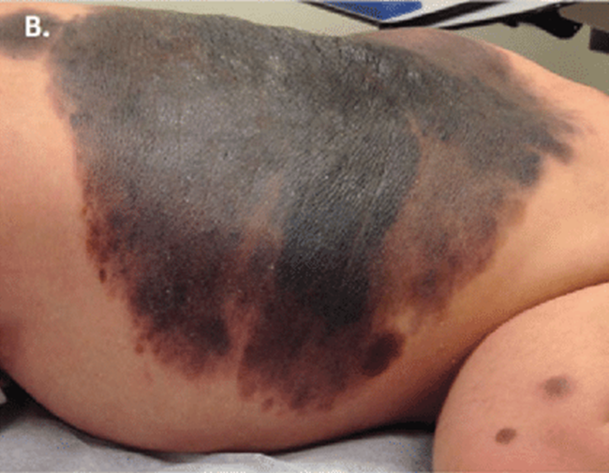
A mongolian blue spot ,is an area of bluish discoloration over the buttocks, back and thighs. Easily mistaken for bruising, it usually fades in the first year
Melanocytic naevi require follow-up and treatment by a plastic surgeon or dermatologist.

Slide 22
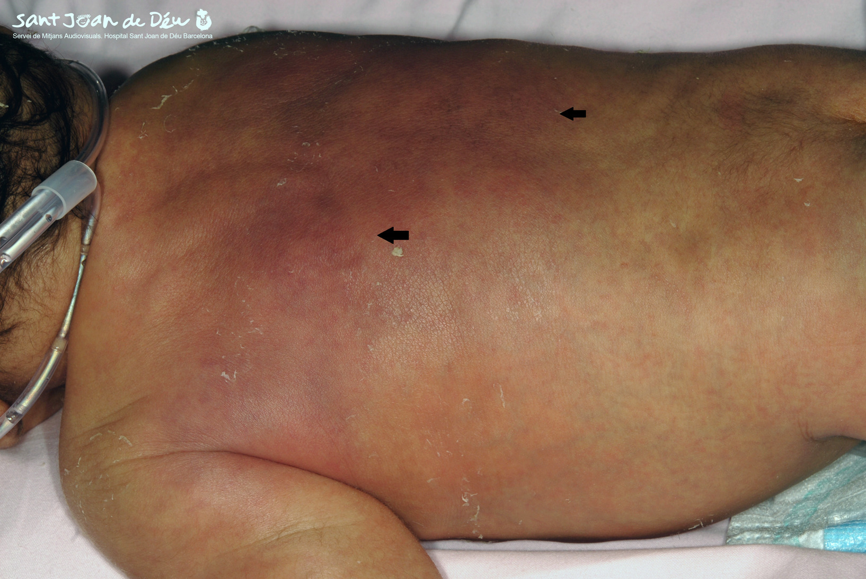
Subcutaneous fat necrosis causes palpable firm plaques, often with some erythema under the skin, over the body. If extensive, there can be associated hypercalcaemia that may require treatment. Blisters or bullae are usually pathological; causes include infection and significant skin disease

Slide 23
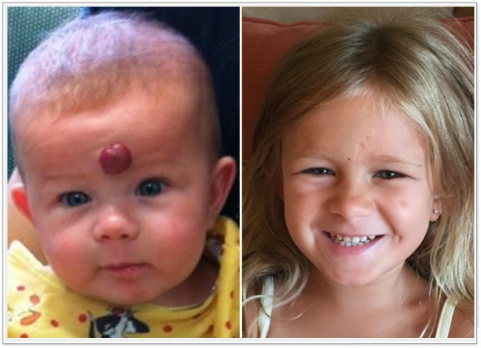
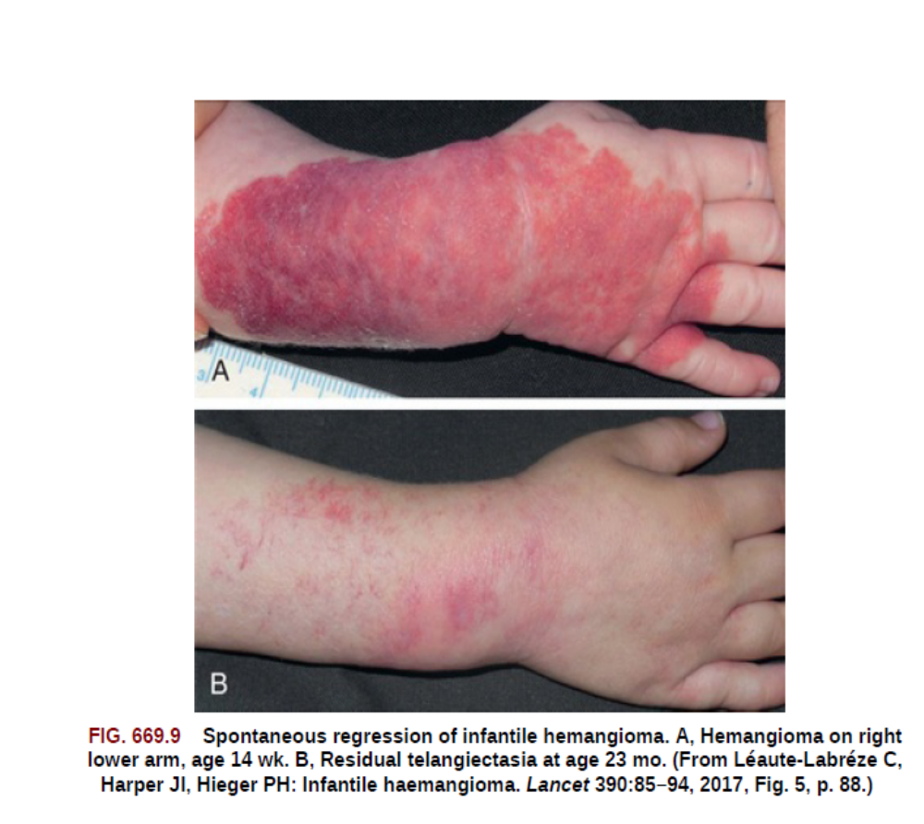
Hemangioma
proliferative, benign vascular tumors of vascular endothelium that may
be present at birth or, more commonly, may become apparent in the 1st or 2nd week of life, predictably enlarge, and then spontaneously involute. IHs are the most common tumor of infancy, occurring in 5% of newborns
classified as superficial, deep, or mixed
Risk factors include prematurity, low birthweight, female sex, and white race

Slide 24
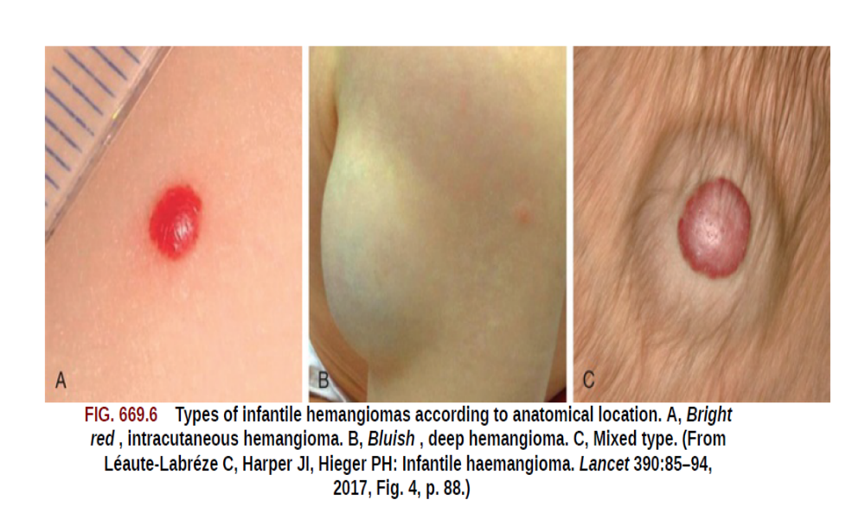
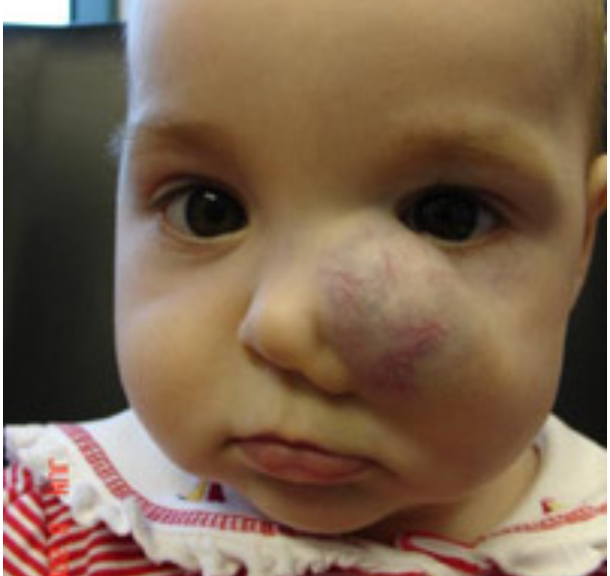
Cavernous hemangioma (cavernous angioma)
Most IHs are mixed
phase of rapid expansion, followed by a stationary period and finally
by spontaneous involution

Slide 25
Infections

Slide 26
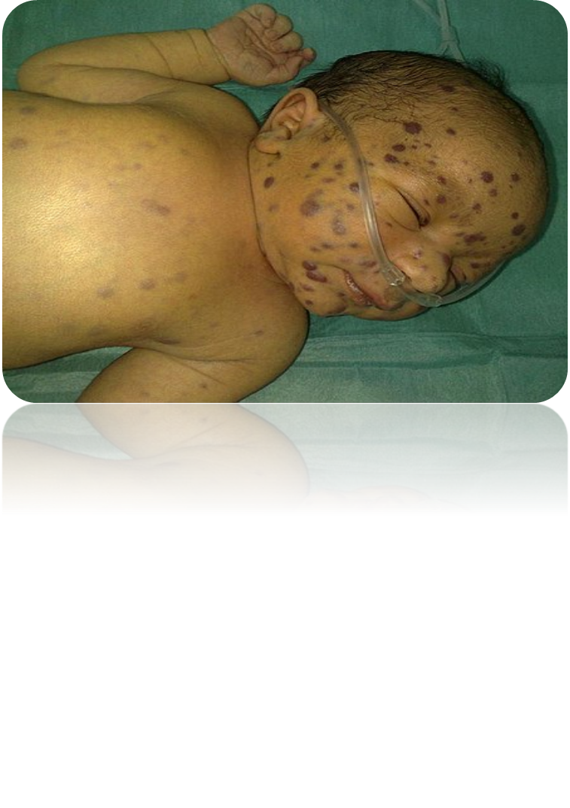
TORCH
Rubella
Intrauterine growth restriction, microcephaly, microphthalmia, cataracts, glaucoma, “salt and pepper” chorioretinitis, hepatosplenomegaly, jaundice, PDA, deafness, blueberry muffin rash, anemia, thrombocytopenia, leukopenia, metaphyseal lucencies, B-cell and T-cell deficiency Infant may be asymptomatic at birth
CMV
Sepsis, intrauterine growth restriction, chorioretinitis, microcephaly, periventricular calcifications, blueberry muffin rash, anemia, thrombocytopenia, neutropenia, hepatosplenomegaly, jaundice, deafness, pneumonia Many asymptomatic at birth

Slide 27
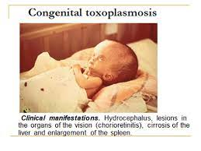
Toxoplasma gondii
Hydrocephalus, abnormal spinal fluid, intracranial calcifications, chorioretinitis, jaundice, hepatosplenomegaly, fever Many infants asymptomatic at birth

Slide 28
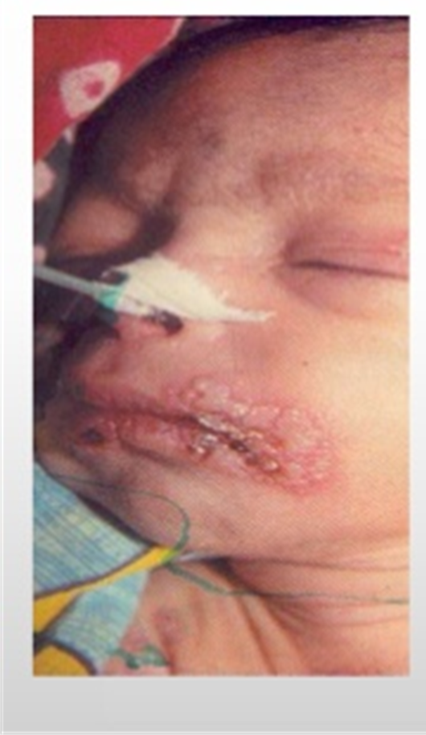
Herpes simplex type 2 or 1 virus
Intrauterine infection: chorioretinitis, skin lesions, microcephaly
Postnatal: encephalitis, localized or disseminated disease, skin vesicles, keratoconjunctivitis

Slide 29
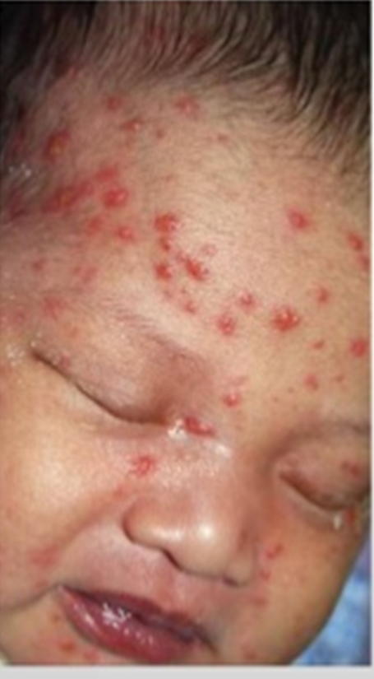
Varicella-zoster virus
Microphthalmia, cataracts, chorioretinitis, cutaneous and bony aplasia/hypoplasia/atrophy, cutaneous scars Zoster as in older child.

Slide 30
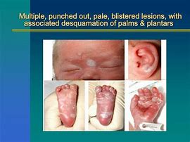
Treponema pallidum (syphilis)
Presentation at birth as nonimmune hydrops, prematurity, anemia, neutropenia, thrombocytopenia, pneumonia, hepatosplenomegaly Late neonatal as snuffles (rhinitis), rash, hepatosplenomegaly, condylomata lata, metaphysitis, cerebrospinal fluid pleocytosis, keratitis, periosteal new bone, lymphocytosis, hepatitis

Slide 31
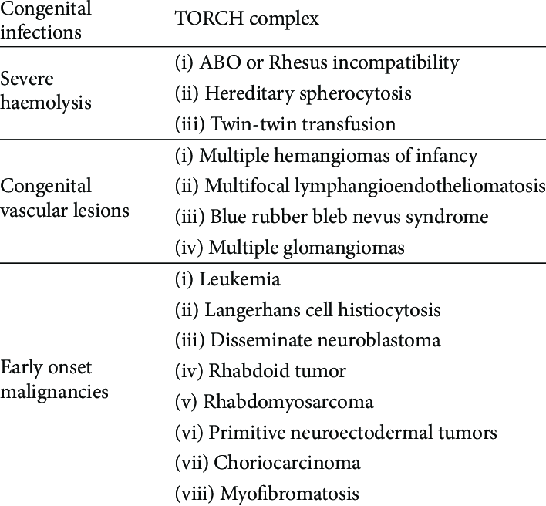
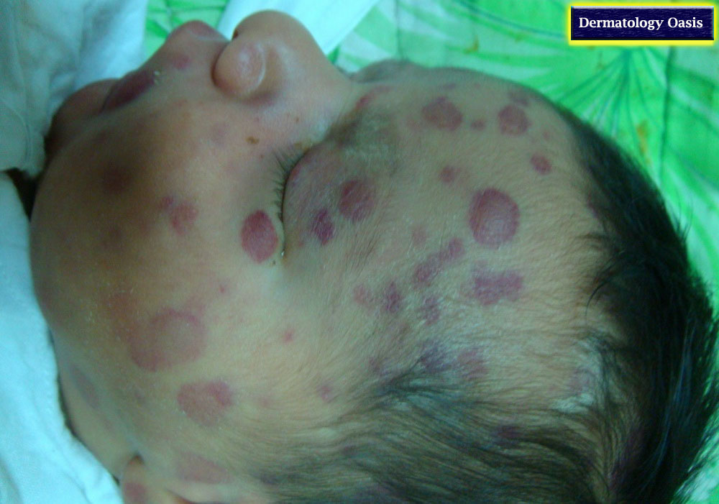
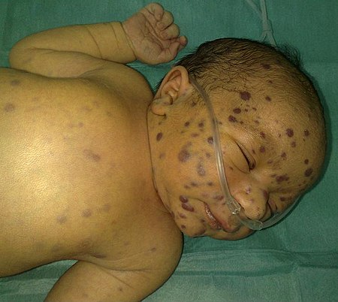
Blueberry muffin Baby

Slide 32
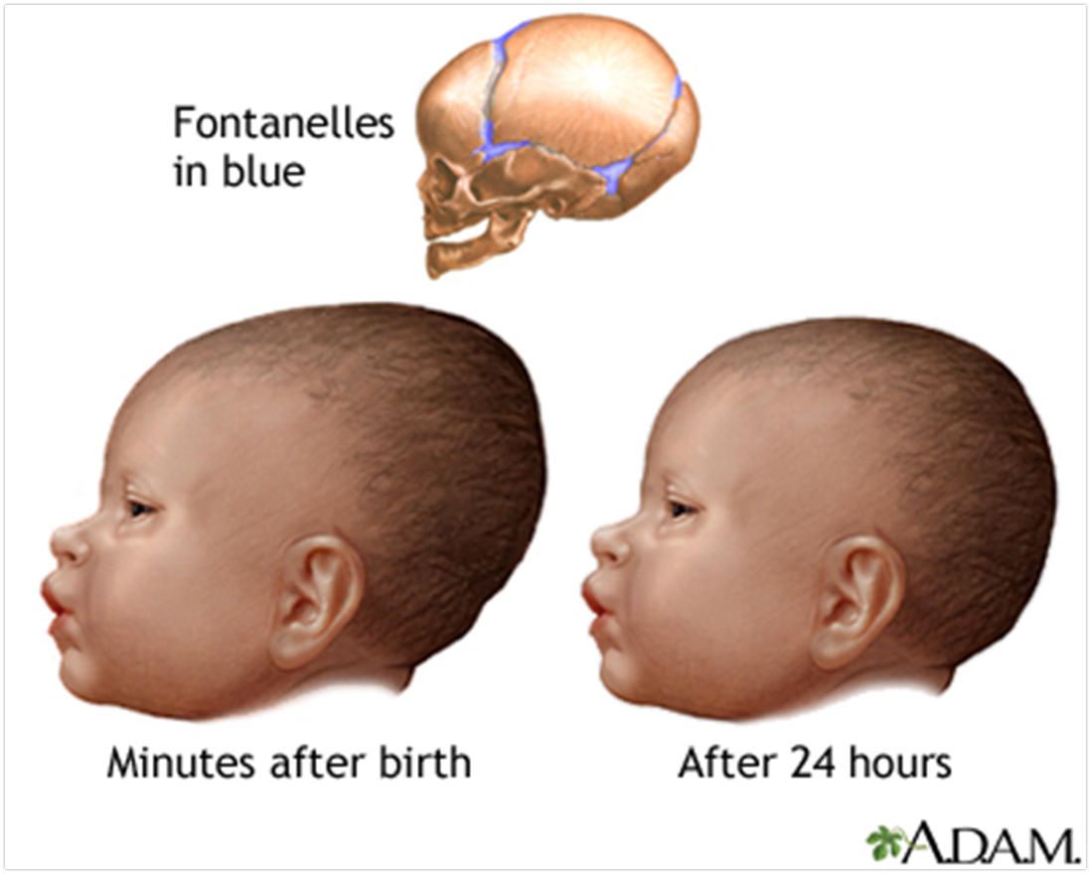
Head:
Normal findings Head moulding is common after birth, The cranial sutures may be overriding, giving a palpable step.
Head shape varies depending on the type of birth- vertex, breech, or C-section.
Vertical elongation of the head is common with vertex deliveries.
The head of an infant born by cesarean section or from a breech presentation is characterized by its roundness.

Slide 33
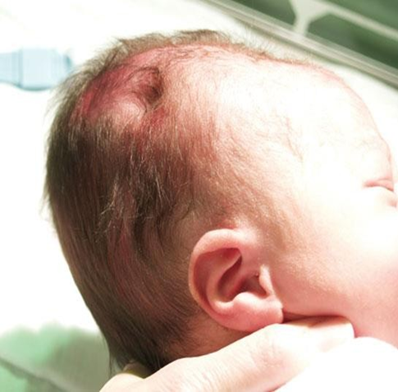
. Caput succedaneum is soft-tissue swelling over the vertex due to pressure in labour.

Slide 34
Abnormal findings Cephalhaematoma is a firm, usually parietal swelling due to a collection of blood under the periosteum of a skull bone. It may be bilateral and is not mobile. Periosteal reaction at the margins gives the feeling of a raised edge. No treatment is required. Do not confuse this with the boggy, mobile, poorly localised swelling of subgaleal (beneath the flat sheet of fibrous tissue that caps the skull) haemorrhage which can conceal a large blood loss capable of causing life-threatening shock if unrecognised. Separated cranial sutures with an obvious gap are due to raised intracranial pressure.
In rare cases the cranial sutures are prematurely fused (synostosis), producing ridging, and the head shape is usually abnormal.

Slide 35

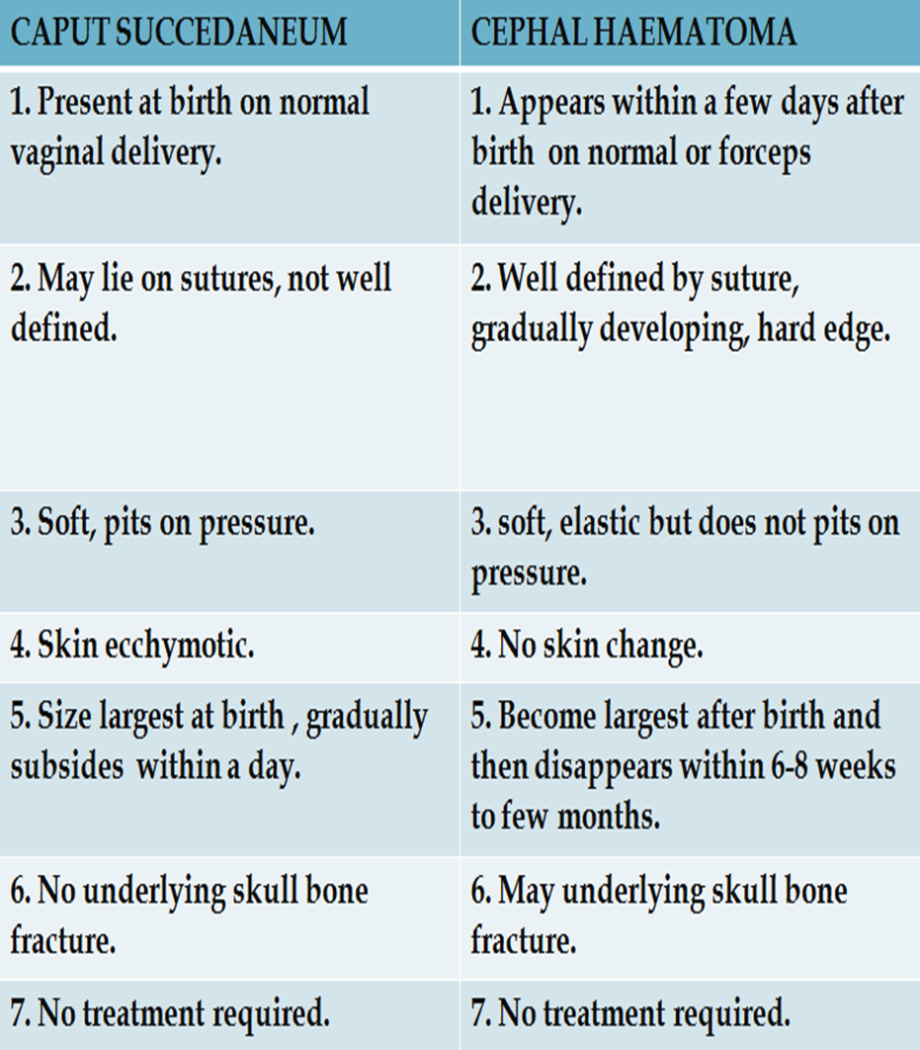
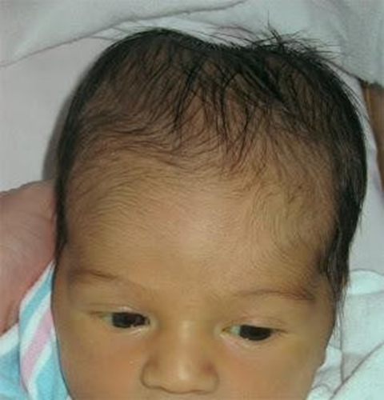
Caput succedaneum / cephalohematoma
Caput succedaneum
Cephalohematoma

Slide 36
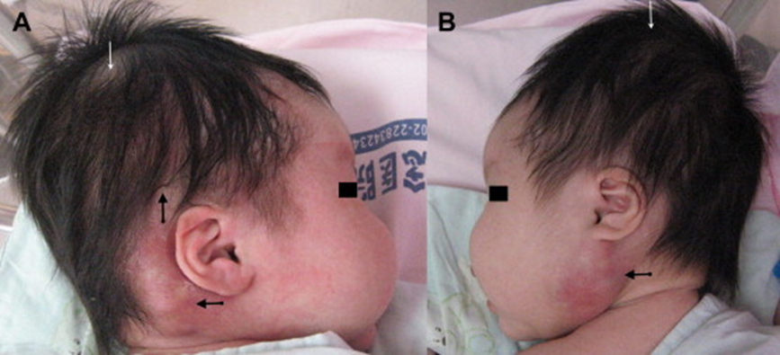
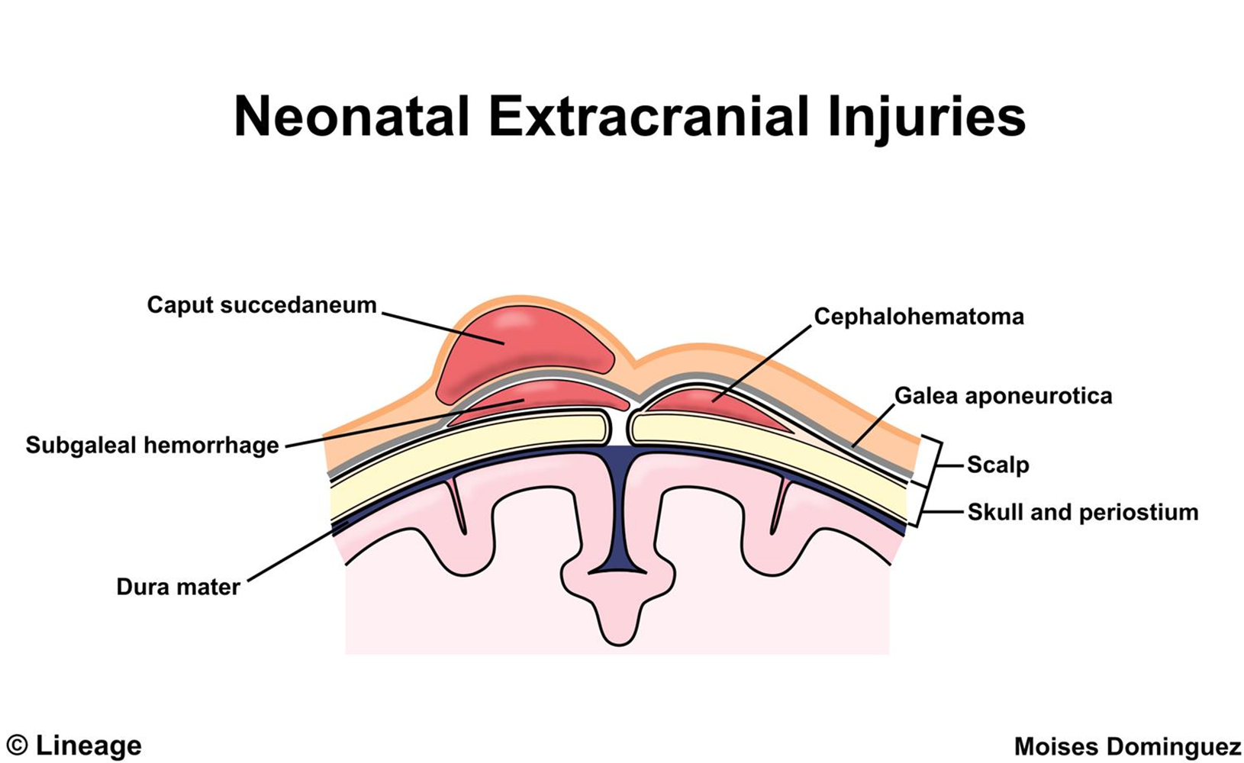
Subgaleal hemorrhage
Bleeding between the scalp aponeurotica and the periosteum of the outer surface of the skull.
Presents as a firm, fluctuant swelling over the scalp, extending posteriorly to the neck or in front of the ears.
Associated with repeated vaccum assisted delivery attempts or coagulopathy

Slide 37
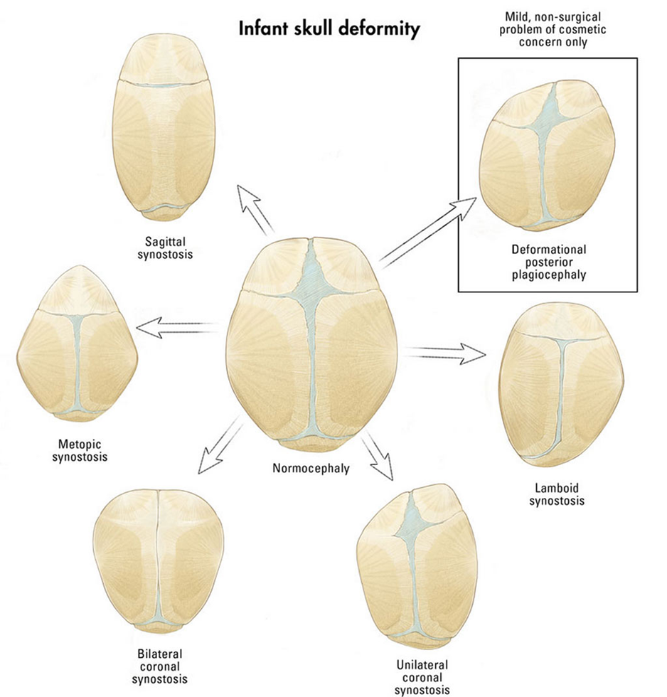
Craniosynostosis is the premature closure of >1 sutures of the skull resulting in an abnormally shaped head.
The earliest sign is increased bone density along the suture
Around two years of age, a child's skull bones begin to join together because the sutures become bone.

Slide 38
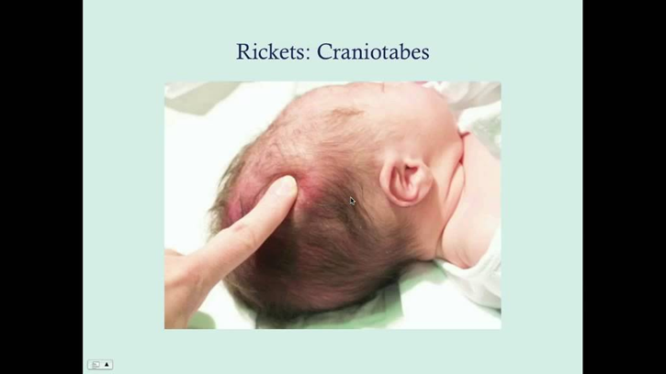
Fontanells
The anterior fontanelle is normally open, soft, and flat at birth; it’s mean diameter is < 3.5 cm. it usually closes between 9 and 18 months of age.
The posterior fontanelle is often only a fingertip in size, or just barely open, closes by 1-2 months of age.
A large fontanelle can result from hydrocephalus, hypothyroidism, or rickets.
Persistently small fontanels suggest microcephaly, craniosynostosis, congenital hyperthyroidism, or wormian bones; presence of a third fontanel suggests trisomy 21, but is seen in preterm infants.
Soft areas (craniotabes) are occasionally found in the parietal bones at the vertex near the sagittal suture; they are more common in preterm infants and in infants who have been exposed to uterine compression. Is also seen in hydrocephalus, rickets, and syphilis.

Slide 39
Head shape Description
Microcephalic (small-headed) Small cranial vault
Megalencephalic (large-headed) Large cranial vault
Hydrocephalic (water-headed) Large cranial vault due to enlarged ventricles
Brachycephalic (short-headed)
Dolichocephalic (long-headed)
Plagiocephalic (oblique-headed) Asymmetrical skull

Slide 40
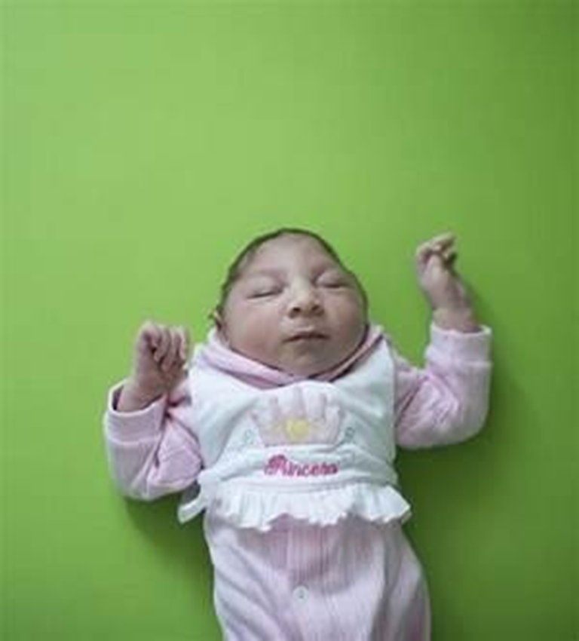
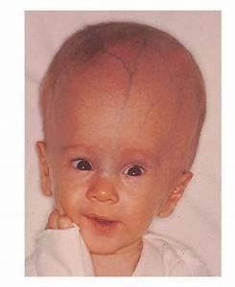
Macrocephaly
Familial with Autosomal Dominant inheritance
Hydrocephalus
Other conditions
  Achondroplasia (skeletal dysplasia)
  Sotos' Syndrome (Cerebral Gigantism)
  Alexander's Disease
  Canavan's Disease
  Gangliosidoses
  Neurofibromatosis Type I
Microcephaly
Familial
Trisomy 13
Trisomy 18 (Edward Syndrome)
Trisomy 21 (Down Syndrome)
Teratogen Exposure
  Fetal Alcohol Syndrome
  Radiation exposure in utero (<15 weeks gestation)
  Fetal Hydantoin
TORCH Virus congenital infection
  Cytomegalovirus
  Rubella
  Toxoplasmosis

Slide 41





Eyes
Red reflex testing is vital for early detection of visual abnormalities such as cataracts, glaucoma, retinoblastoma, and colobomas of the iris (a defect in the iris inferiorly that gives the pupil a keyhole appearance) . They can be associated with a syndrome as CHARGE syndrome and other syndromes
Leukocoria a white pupillary reflex can be due to cataracts, chorioretinitis, retinopathy of prematurity, or retinoblastoma.
Congenital ptosis (drooping eyelids).
Congenital microphthalmia occurs with congenital abnormalities and is either AD or AR.

Slide 42



Proptosis should prompt additional investigation for mass lesions or retrobulbar hemorrhage.
Congenital glaucoma presents as enlarged cornea > 11mm that becomes progressively cloudy.
hemorrhages can all be seen following birth trauma.
Conjuctivitis within the first 2-5 days of life is most often caused by Neisseria gonorrhoeae. Chlamydia trachomatis is the most likely cause of conjunctivitis at 5-14 days of age.(its normal to find yellow crusting without inflammation after birth in infant with narrow lacrimal duct )

Slide 43


Nose:
Check that the nostrils are patent.
Anatomic obstruction of the nasal passages secondary to
unilateral or bilateral choanal atresia results in respiratory distress
Hemorrhagic, thick, purulent nasal discharge ( snuffles ) is seen in congenital syphilis.

Slide 44


Mouth
Normal findings Epstein’s pearls are small white mucosal cysts on the palate that disappear spontaneously. White coating on the tongue which is easily scraped off with a swab is due to curdled milk.
Epsteins pearls

Slide 45



Abnormal findings Macroglossia (a large protruding tongue) occurs in Beckwith–Wiedemann syndrome.
Ankyloglossia (tongue tie) is when the lingual frenulum which joins the midline of the tongue to the floor of the mouth is abnormally short. Consequently the tongue cannot move freely, interfering with feeding.
A white coating on the tongue, not easily removed and which may bleed when scraped, is due to the fungus, Candida albicans (thrush).
Cleft palate may involve the soft palate or both hard and soft palates. It can be midline, unilateral or bilateral and may involve the gum (alveolus). Cleft lip can appear in isolation or in association with it. Refer affected infants early to a specialist multidisciplinary team.
A ranula is a mucous cyst on the floor of the mouth related to the sublingual or submandibular salivary ducts. Congenital ranulas may resolve spontaneously but sometimes require surgery. Teeth usually begin to erupt at around 6 months but can be present at birth.

Slide 46




Ranula a benign mass originating in the floor of the mouth. A translucent to bluish, nonblanching, fluctuant swelling lateral to the midline of the lower mouth.
High arched/narrow palate often seen in Marfan syndrome and Ehlers-Danlos syndrome.
A normal-sized tongue protrudes through a small mouth in Down’s syndrome (glossoptosis).
Protruding tongue causes include hemangioma, isolated macroglossia, hypothyroidism, or Beckwith-Wiedemann syndrome.
Micrognathia (a small jaw) is sometimes associated with cleft palate in the Pierre Robin syndrome with posterior displacement of the tongue (glossoptosis) and upperairway obstruction.

Slide 47

Ears:
Examination sequence ■ Note the size, shape and position. ■ Check that the external auditory meatus looks normal. ■ Otoscopic examination is not required for the newborn but is indicated in young infants to exclude otitis. A carer should hold the child to keep the head still
Newborn Hearing Screening (performed before discharge after delivery
Congenital Ear Anomaly
  Low Set Ears
    Caused by several congenital disorders (e.g. Trisomy 21, Trisomy 18)
    Associated with hearing deficits (obtain Newborn Hearing Screening) and genitourinary anomalies (obtain renal Ultrasound)
  Microtia
    May occur in isolation or due to underlying condition (e.g. CHARGE
Syndrome, Goldenhar Syndrome, Treacher-Collins Syndrome)
    May be associated with hearing deficit
  Pre-auricular Skin Tags, ear pits, fissures or sinuses
    Associated with hearing deficits (obtain Newborn Hearing Screening)
    Renal Ultrasound not indicated unless other dysmorphic
features, Teratogen Exposure, deafness Family History or maternal diabetes

Slide 48




NECK
Cervical masses can be caused by a goiter, cavernous hemangioma, or cystic hygroma. Associated karyotypic abnormalities are found in up to 70% of children with cystic hygroma, including turner, klinefelter syndrome, and trisomies 13, 18, and 21.
Branchial cleft abnormalities are cysts or sinuses that occur along the anterior margin of the sternocleidomastoid muscle due to improper closure during embryonic life.
Thyroglossal duct cyst are located in the ventral midline and can extend to the base of the tongue and move vertically with swallowing and tongue protrusion.

Slide 49


Torticollis occurs when one of the sternocleidomastoid muscles tightens and the other is absent or atretic, resulting in head tilt.
Edema and webbing ( redundant tissue ) of the neck, are common findings in Turner or Noonan syndrome. Posterior nuchal thickening is characteristic of trisomy 21.

Slide 50




Dysmorphic features

Slide 51
Chest, Abdomen, Genitalia, and Anus

Slide 52



Chest
Note chest shape, symmetry of movement.
Fractures of the clavicles, identified on physical examination by crepitus during palpation along the clavicle.
Supernumerary nipples
Widely spaced nipples with a shield-like chest are common manifestations of Turner and Noonan syndromes.
Breast hypertrophy is common in both males and females; small amounts of fluid are sometimes discharged in the first few days then it usually resolves.
100

Slide 53
Lungs
Count the respiratory rate and listen for additional noises with breathing
The respiratory rate is generally 30-50 breaths/minute (term neonate) and 40-60 (preterm) but can normally be as high as 60 breaths/ minute. Newborns normally have irregular breathing patterns with short ( < 15-20 sec ) respiratory pauses ( periodic breathing ).
look for signs of respiratory distress.
Retractions are visible when the tissues between the ribs are sucked in during inspiration. They are normal during the first few minutes after birth; however, if they occur later it indicates airway obstruction, surfactant deficiency, or infection.
Asynchronous chest wall movement.
Coughing is extremely unusual in neonates and can indicate a serious abnormality as pneumonia.

Slide 54
Percussion of the newborn’s chest:: not useful
Auscultation: by diaphragm, anteriorly, laterally, posteriorly
assess: air entry on each side , any crackles?, wheezes?
*Breath sounds in the healthy newborn have a bronchial quality compared to the older individual.
*stridor (mainly inspiratory) and on day 2-3 of life: laryngomalacia

Slide 55
Heart
Inspection: pallor, cyanosis, sweating.
The point of maximal impulse is along the left side of the sternum at the 4th to 5th interspace, just medial to the midclavicular line. A displaced PMI can be due to a tension pneumothorax, dextrocardia, cardiomegaly, or diaphragmatic hernia.
Heart rates are generally 100-140 bpm (term neonate) and 120-160 (preterm) in the first few hours of life. A sustained heart rate of <80 is concerning.
Tachycardias >180 bpm can indicate fever, hypovolemia, drug withdrawal, congenital heart disease, anemia, hyperthyroidism.
Causes of bradychardia ?

Slide 56
Feel the femoral pulse on the mid inguinal points while abducting the hips.
In coarctation of aorta, the femoral pulses are diminished or absent and the upper extremity pressure is > 20mmHg higher. (radiofemoral delay in adults)
PDA causes a wide pulse pressure and bounding pulses. At birth it causes a short systolic murmur, later develops to machinery continuous murmur
Palpate for parasternal heave and thrills
Auscultate the apex by the bell, then use the diaphragm for all positions looking for high-pitched sounds and murmurs.

Slide 57



Slide 58
Murmurs
-heard in 2% of neonates, only a minority have a structural heart problem.
-Echo is needed for a structural diagnosis, before discharge
-Delayed Echo?? 5 indications.
-Investigate any murmur that is present immediately after birth, accompanied by cyanosis, evidence of poor perfusion, louder than grade 2, with tachypnea, and persistent after the 2nd day of life.
- Innocent murmurs ?

Slide 59


Slide 60
-Do not measure BP for healthy babies.
-In ill babies: cuff measurements overestimates values compared to invasive ones. cuff width at least ⅔ of the distance from elbow to shoulder tip
-Palpate for hepatomegaly.

Slide 61
Abdomen
-Remove the nappy
-Inspect: abdomen, umbilicus, groins, notice swelling
-Palpate superficially then deeply
-Palpate the spleen: how??
-Liver: you can feel the liver edge, if you feel more than the edge, measure the distance in the mid clavicular line of the costal margin to the liver’s edge.
-Inspect the anus, present? patent?, normal position?
-Digital Rectal Examination: unnecessary, it causes anal fissure.
Iand done with your little finger.

Slide 62
In the newborn, the liver is normally palpated 1-2 cm below the right costal margin.. The kidneys are sometimes palpated, especially if enlarged or if the infant is preterm. If more than 2 cm is palpable, suspect hydronephrosis, cystic lesions, neoplasm, or renal vein thrombosis.
Abdominal masses commonly arise from the GU system ( hydronephrosis, polycystic kidney disease, multicystic kidney). Less common origins include GI and neoplasms ( Wilms tumor, neuroblastoma ).

Slide 63






Abnormalities of the abdominal wall are fairly common and usually benign. Examples :
Diastasis recti is characterized by a midline gap between the abdominal rectus muscle.
Umbilical hernias, small defects in the periumbilical musculature of the anterior abdominal wall. common, easily reduced, low risk and close spontaneously.
Omphalocele is formed by abdominal contents that pass through a periumbilical defect near the umbilical cord. Covered with a membrane that encloses the viscera.
Gastroschisis an abdominal wall defect located above and to the right of the umbilicus and not involving the cord.
Bladder exstrophy.
Prune belly syndrome characterized by the absence of anterior abdominal wall musculature, UT anomalies, and cryptorchidism.

Slide 64




Umbilical abnormalities :
Single –artery umbilical cord , up to 1% of newborns have a single artery; 15% of those have at least 1 other abnormality ( Trisomy 18 is one of the more frequent abnormalities ).
Persistent vitelline duct can communicate with the umbilicus, with mucoid drainage visible from the umbilicus.
Delayed umbilical cord separation, typically the umbilical cord falls off within 10-14 days, but its normal to take > 3 weeks. Delayed separation > 1 month occur in infants with leukocyte adhesion deficiency.
109

Slide 65



Umbilical granulomas are common lesions that persist after the detachment of the umbilical cord.
Omphalitis presents as redness around the umbilicus. This is potentially serious condition. The infection can spread along the umbilical vein to the portal venous sinus of the liver. Common causative organisms include S.aureus, group A Streptococcus, E.coli, Klebsiella pneumoniae, and Proteus mirabilis.
110

Slide 66

112

Slide 67


female Genitalia
The size and location of the labia, clitoris, meatus, and vaginal opening should be assessed.
The labia minora should be separated to detect whether the hymen, which normally has some opening, is imperforate. An imperforate hymen or other causes of vaginal obstruction may result in hydrometrocolpos and a lower abdominal mass.
A whitish vaginal discharge is normal and can persist for up to 2 months.
In up to 10% of newborns, a hymenal tag is visible just at the vaginal orifice. Its characterized by flesh-colored, smooth surfaced, redundant hymenal tissue that protrudes from superior or inferior portions of the vagina.

Slide 68


Male genitalia
Testes, size of the penis, appearance of the scrotum, and the position of the urethral opening should be evaluated.
In term boys, the penis is 3-4 cm in stretched length, and the scrotum is pigmented and has rugae. A stretched penile length < 2cm is abnormal and requires endocrine evaluation.
The prepuce is normally tight and adherent; it should not be forcibly retracted.
Hypospadias is relatively common, ranging from a small ventral cleft at the distal end of the shaft to a major ventral defect along the length of the penis.
Epispadias ( urethral opening in the dorsum of the penis ) is less common than hypospadias.

Slide 69




Chordee, a ventral bend in the penis, often associated with hypospadias and tethering of the foreskin.
Scrotal hydroceles are common at birth and resolve gradually. If it changes in size or persists it indicates an indirect inguinal hernia.
Testicular torsion can occur in infancy and manifests as a painful, firm, and enlarged testis with overlying discoloration of the scrotum.

Slide 70


Slide 71


ambiguous genitalia
It requires immediate further investigation.
The difficulty occurs in differentiating between a very enlarged clitoris with pigmented, fused labia vs. a very small penis with extensive hypospadias and a bifid scrotum.
Generally, this is a cause for emergent genetic and endocrine consultations. In particular, CAH in a genotypic female can present as a phenotypic male.

Slide 72


Anus
The anus is inspected for its location and patency.
Imperforate anus is one of the most common and important abnormalities to identify. It can be associated with fistula, which opens ventral to the normal anus.
The presence of meconium does not rule out imperforate anus because it can pass through the fistula.
It can be associated with other anomalies such as VACTERL.
Most infants pass meconium within the first 24 hours of birth; 99% within by 48 hours.
Impaction of meconium can lead to intestinal obstruction ( meconium ileus ) and is often due to cystic fibrosis. Its also seen in small bowel atresia.

Slide 73
Extremities and spinal cord

Slide 74


Extremities
1) Hips
Newborns often have physiologic laxity of the hip due to maternal estrogen effect and immaturity of the acetabulum during first several weeks; the laxity resolves and the acetabulum proceeds to develop normally.
If the hips are flexed to 90, the legs normally can be abducted until the knees touch or nearly touch the table. If this is not possible investigate for DDH.
Specific maneuvers to examine for DDH include :
1- Barlow 2- Ortolani 3- Galeazzi

Slide 75

2) Palsies
Erb palsy occur when there is significant lateral traction during delivery, resulting in damage to the upper part of the brachial plexus where C5 and C6 roots; if C7 involved its referred to as Erb palsy plus. The arm is held alongside the body in internal rotation ( waiter’s tip ) position. It accounts for up to 50%. Ipsilateral clavicular fractures are common. Infants are at risk of associated phrenic nerve involvement leading to diaphragmatic paralysis.

Slide 76


Slide 77

Klumpke palsy occurs when the lower part of the brachial plexus is damaged. It involves C8 and T1 nerves, resulting in a clawlike posturing of the hand. Injury to the sympathetic fibers of the T1 nerve causes Horner syndrome. Its mostly seen with breech deliveries.

Slide 78





3) Limbs
Hemihypertrophy usually associated with Wilms tumor, hepatoblastoma, and adrenal carcinoma.
Phocomelia is an abnormal shape of the limb and was once common in infants of mothers who took thalidomide during pregnancy.
Short limbs also occur with achondroplasia.
Arthrogryposis multiplex congenita is characterized by severe contractures of multiple joints.
Syndactyly and polydactyly are common.

Slide 79






Clenched hands with overriding index finger and rocker bottom foot are seen in Trisomy 18.
Simian crease seen in Down syndrome.
Thumb hypoplasia is a common clinical feature of Fanconi anemia.
Bilateral absent radii in TAR syndrome.
Amniotic bands wrap tightly around a limb and result in sharp, deep creases or depressions.

Slide 80


Spinal Column
Midline abnormalities include a small dimple, tufts of hair, or pilonidal sinuses. Observe these carefully for a seepage of fluid. It can indicate an occult spina bifida or tethered cord.
Neural crest defects include meningoceles, myelomeningoceles, and rachischisis. These defects are common among infants born in the late fall and early winter and far less frequent when women receive folic acid supplementation.
Spinal tumors at birth are almost always due to teratoma.

Slide 81



Slide 82

Neurological examination This includes tone, posture, movement and primitive reflexes
■ Look for asymmetry in posture and movement and for muscle wasting.
■ To assess tone, pick the baby up and note if he is stiff or floppy. Note any difference between each side.
■ Power is difficult to assess and depends on the state of arousal. Look for strong symmetrical limb and trunk movements and grasp.
■ Tendon reflexes are only of value in assessing infants with neurological or muscular abnormalities.
■ Check sensation by seeing whether the baby withdraws from gentle stimuli. Do not inflict painful stimuli or use a pin or needle.
■ Check eyesight by carrying the alert baby to a dark corner where she may open her eyes wide. If moved to a bright area she will then screw up her eyes.
■ Test hearing by noting the startle response to a sound. Ideally electronic audiological screening should be performed in the newborn period.

Slide 83



Slide 84
Normal findings
Movements should be equal on both sides.
Tone varies and may be floppy after a feed.
Reflexes are brisk in term infants, often with a few
beats of clonus.
The plantar reflex is normally extensor in the newborn.
Abnormal findings
Hypotonic infants may have a ‘frog-like’ posture with
abducted hips and extended elbows. Causes include
Down’s syndrome, meningitis and sepsis.
Increased tone may cause back and neck arching and limb extension; the baby feels stiff when picked up.
Causes include meningitis, asphyxia and intracranial haemorrhage.

Slide 85
Primitive reflexes
The primitive reflexes are lower motor neurone
responses present at birth but which disappear by
4–6 months as they become suppressed by higher
centres. They may be absent in infants with neurological
depression or asymmetrical in infants with nerve injuries. Persistence into later infancy may indicate neurodevelopmental abnormality .

Slide 86
Primitive reflexes
Grasp responses :Gently stimulate the palm or sole with your finger to produce a palmar or plantar grasp.
Ventral suspension/pelvic response to back stimulation: Hold the baby prone and look for neck extension. Stroke the skin over the vertebral column to produce an extensor response with pelvic elevation.
Place-and-step reflexes : *Hold the baby upright and touch the dorsum of their foot against the edge of a table. The baby will flex the knee and hip, placing their foot on the table *Lower the upright baby towards the table surface. When the feet touch the surface, a walking movement occurs.
Moro reflex :Support the supine baby’s trunk and head in a semi-upright position. Let their head fall backwards slightly. The baby will quickly throw out both arms and spread their fingers .
Root-and-suck responses :Gently stroke the baby’s cheek. The baby turns to that side and their mouth opens, as though looking for a nipple. This is ‘rooting’. If you place your finger in a healthy infant’s mouth, they will suck it vigorously.
Asymmetric tonic neck reflex : Turn the supine infant’s head to the side. The arm and leg on the same side will extend and the arm and leg on the opposite side will flex. This reflex is present at term and maximal at 1 month .

Slide 87


Slide 88

The spine
The spine is divided into the cervical, thoracic, lumbar
and sacral segments. Most spinal diseases affect
multiple segments, causing alteration in the posture or
function of the whole spine. Spinal disease may occur
without local symptoms and present with pain, neurological symptoms or signs in the trunk or limbs. Accurate diagnosis depends on knowing the underlying
bony and neurological anatomy , a careful
history, and eliciting signs and symptoms to differentiate between mechanical (non-inflammatory) and inflammatory causes

Slide 89
THANK YOU

