Slide 1
FEVER OF UNKNOWN ORIGIN
Dr.Marwan Al-Shalabi
Done by : Othman Badran ,Roa’a Ghanem
Aya Hassan

Slide 2
Definition:
(FUO) is best reserved for children temperature>38°C (100.4°F) of at least eight days' duration
Most FUO result from atypical presentations of common disease.
FUO lasting longer than 6 mo is uncommon in children.
Drug fever is usually isolated.

Slide 3
Etiology
Infectious diseases (most common)
Inflammatory diseases (20%)
Malignancies (10%)
Unknown or miscellaneous (15%)

Slide 4
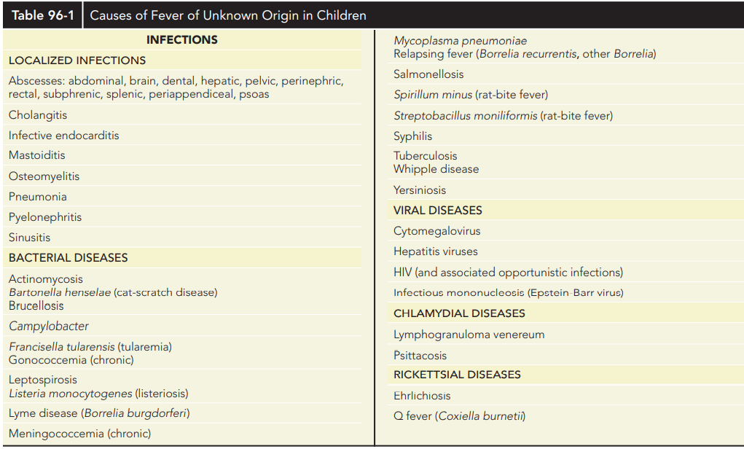
Infectious diseases:

Slide 5
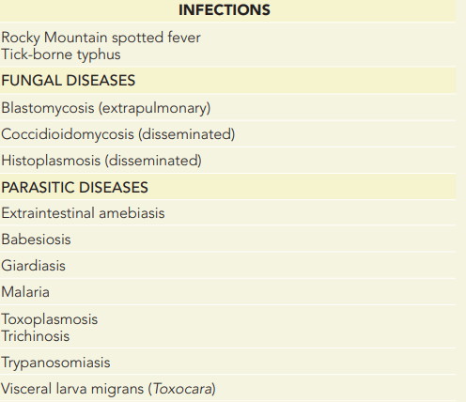

Slide 6
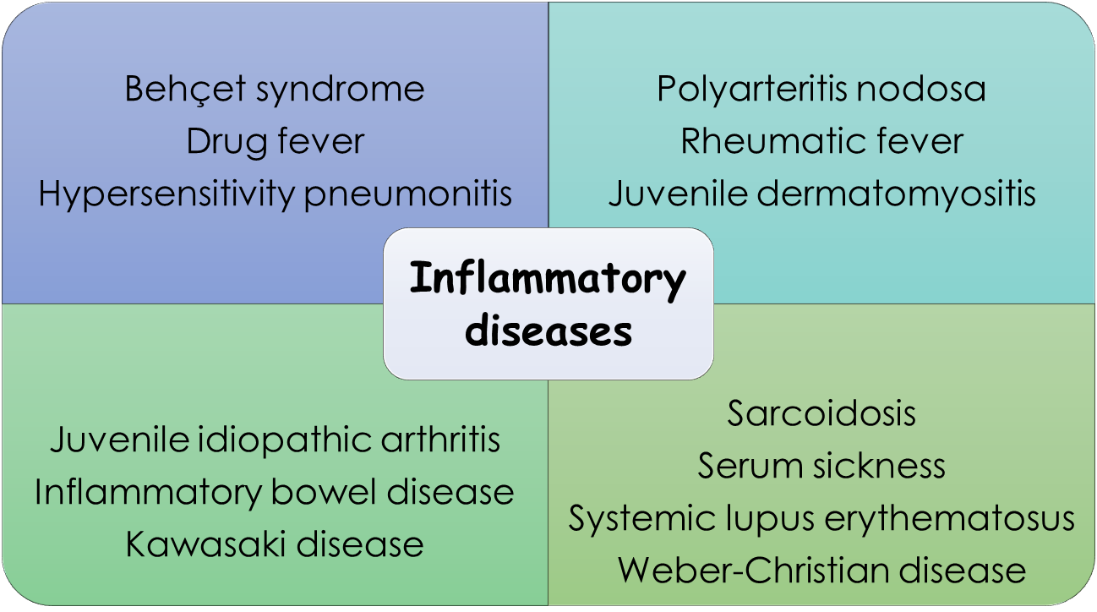

Slide 7
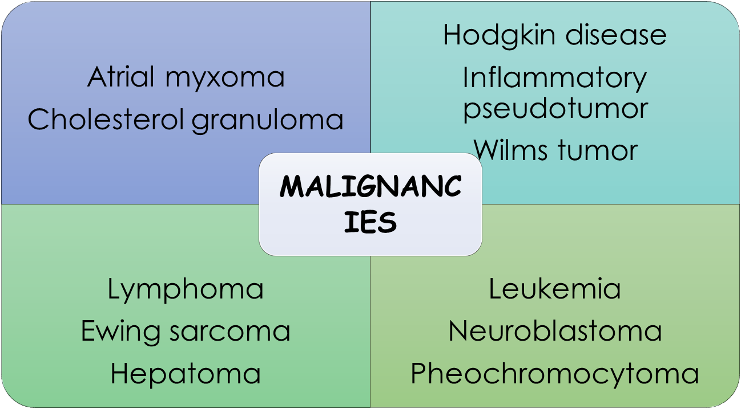

Slide 8
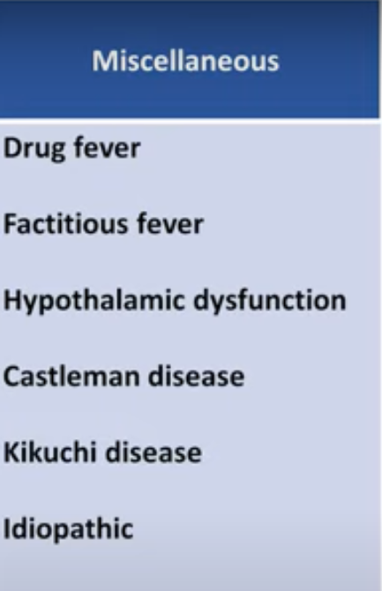

Slide 9
Infectious
Bacterial:
1. Cat scratch disease:
  Bartonella henselae
  is one of the most common causes of FUO in children
  isolated lymph node involvement,rashes,constitutional symptom.
  hepatosplenic involvement is the hallmark of CSD associated with FUO.
  High-resolution abdominal ultrasonography revealing the multiple hepatic or splenic filling defects that are characteristic of granulomata can provide a provisional diagnosis.
  Serology or biopsy of lesions in lymph nodes, liver, or bone marrow can lead to a definitive diagnosis of B. henselae infection
  Self limited or use azithromycin.

Slide 10
2. Brucellosis :
  Main way of transmission is ingestion of unpastarilized diary product.
  Fever ,arthralgia , hepatosplenomegally ,mild elevation of liver enzyme , lymphocytopenia .
  Blood and bone marrow culture (brucella titer)

Slide 11
Rx
< 8 years: | Rifampicin + TMP/SMX | Add IV Gentamycin for hospitalized patient
> 8 years: | Rifampicin + Doxycycline | Add IV Gentamycin for hospitalized patient

Slide 12
3. Salmonellosis (typhoid):
contaminate a number of food products, especially poultry and eggs, and can be transmitted through contact with reptiles or animal feces.
normal pulses or even Bradycardia in association with high fevers , diarrhea.
The diagnosis can be made with blood and stool cultures, which should be repeated if initially negative and fevers persist.
Serologic testing is not recommended

Slide 13
Inflammation :
Kawasaki disease (KD):
an acute, necrotizing vasculitis of unknown etiology. The condition primarily affects children under the age of five.
The disease is characterized by a high fever, desquamative rash, conjunctivitis, mucositis (e.g., “strawberry tongue”), cervical lymphadenopathy, as well as erythema and edema of the distal extremities.
However, coronary artery aneurysms are the most concerning possible manifestation as they can lead to myocardial infarction or arrhythmias.
Kawasaki disease is a clinical diagnosis, further supported by findings such as elevated ESR or evidence of cardiac involvement on echocardiography.
Treatment with IV immunoglobulins and high-dose aspirin is essential and should be initiated immediately after diagnosis.

Slide 14
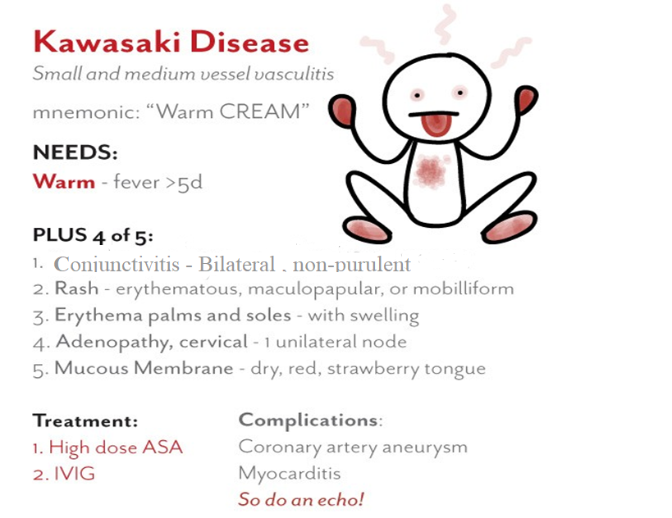
NOTE : Exclude other diseases with similar findings

Slide 15
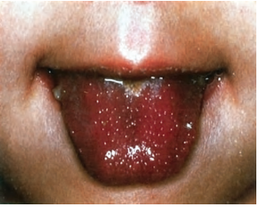
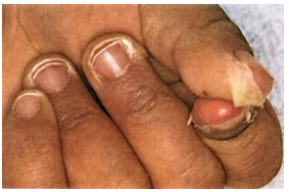
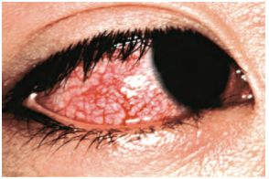

Slide 16
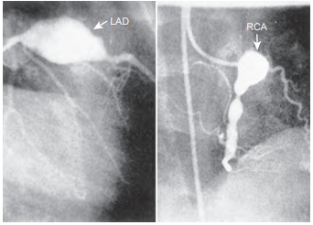
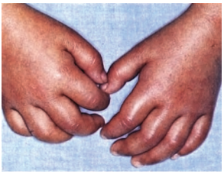

Slide 17
APPROACH TO FUO IN PEDIATRICS

Slide 18
DIAGNOSIS
The evaluation of FUO requires a thorough history and physical examination supplemented by a few screening laboratory tests, and additional laboratory and radiographic tests as indicated by the history or abnormalities found on examination or initial screening.

Slide 19
History
A detailed fever history including:
Onset
Frequency
Duration of fever
Response or nonresponse to therapy
Recurrence
The impact the fever has on the child’s health and activity
Weight loss
Associated symptoms should be obtained.

Slide 20
History
Clues from the general history including:
Age (children > 6 years , adolescents)
Medication History
Genetic Background
Social History (exposure to domestic animals , Pica, eating habits)
Recent surgical procedure or dental work
Hx of chronic infection

Slide 21
Physical Examination
The child’s general appearance including:
Sweating
The general activity of the patient and the presence or absence of rashes
Tenderness to tapping over the sinuses or the upper teeth suggests sinusitis.
Recurrent oral candidiasis may be a clue to various disorders of the immune system.
Rectal examination
Muscles and bone examination
Ophthalmic examination

Slide 22
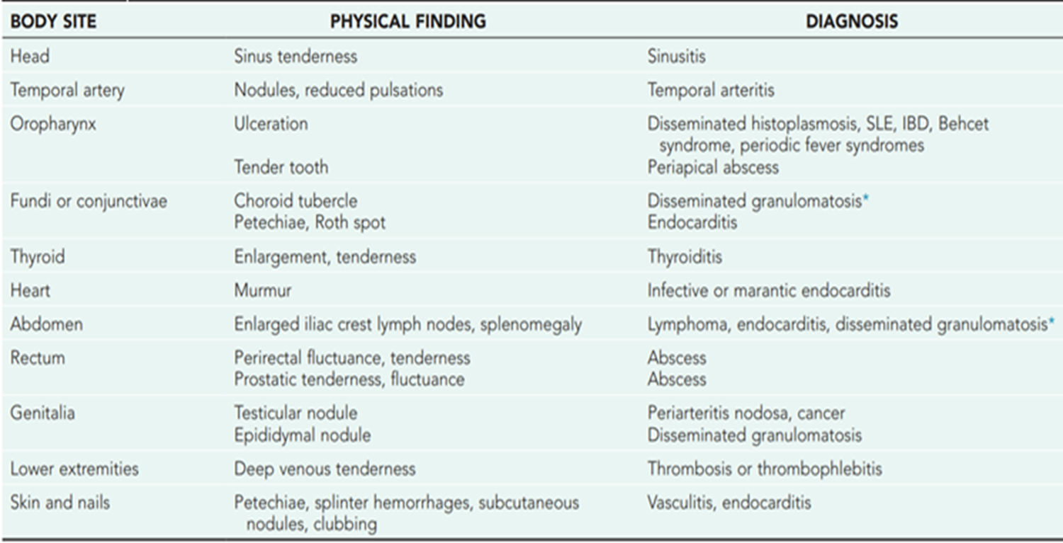

Slide 23
Laboratory findings
A CBC with a differential WBC count and a urinalysis should be part of the initial laboratory evaluation.
patients with a PMN count of >10,000/μL or a nonsegmented PMN count of >500/μL have a high likelihood of having a severe bacterial infection.
ESR and CRP : non specific indicator of tissue inflammation.

Slide 24
Blood cultures: Multiple or repeated blood cultures may be required to detect bacteremia associated with infective endocarditis, osteomyelitis, or deep-seated abscesses.
Urine culture should be obtained routinely.
Tuberculin skin testing (TST)
Serologic tests may aid in the diagnosis of infectious mononucleosis, CMV infection, toxoplasmosis

Slide 25
Radiographic examination of the chest, sinuses or gastrointestinal tract
Total body CT and MRI
Endoscopy or Colonoscopy
Radionuclide scan may be helpful in detecting abdominal abscesses as well as osteomyelitis
Bone marrow biopsy for cytology and culture

Slide 26
TREATMENT
antimicrobial agents should not be used as antipyretics, and empirical trials of medication should generally be avoided.
An exception may be the use of anti tuberculous treatment in critically ill children with suspected disseminated tuberculosis.
Empirical trials of other antimicrobial agents may be dangerous and can obscure the diagnosis of infective endocarditis, meningitis, parameningeal infection, or osteomyelitis.
The ultimate treatment of FUO is tailored to the underlying diagnosis.

Slide 27
Prognosis
Children with FUO have a better prognosis than do adults. The outcome in a child depends on the primary disease process, which is usually an atypical presentation of a common childhood illness.

Slide 28


