Slide 1
Fever
Done by: Saba’ Abushamma, Wasan
Aldalabeeh, Lulwa Othman
Supervised by Dr Marwan Alshalabi

Slide 2
Outline
Fever
Fever without localizing signs (FWLS)
Periodic fever
  Familial Mediterranean fever

Slide 3
Fever
Fever, a physiologic response characterized by an elevation of body temperature above normal daily variation.
Normal range of body temperature is 36.6-37.9°C rectally.
Fever is defined as a rectal temperature ≥38°C (100.4°F).
Hyperpyrexia = a value >40°C (104°F).

Slide 4
Body temperature assessment
Rectal: for 3 min
Most accurate
Measured reading - 0.5 °C
Oral: for 1 min
Axillary: for 3 min
Measured reading + 0.5 °C
Tympanic
Skin

Slide 5
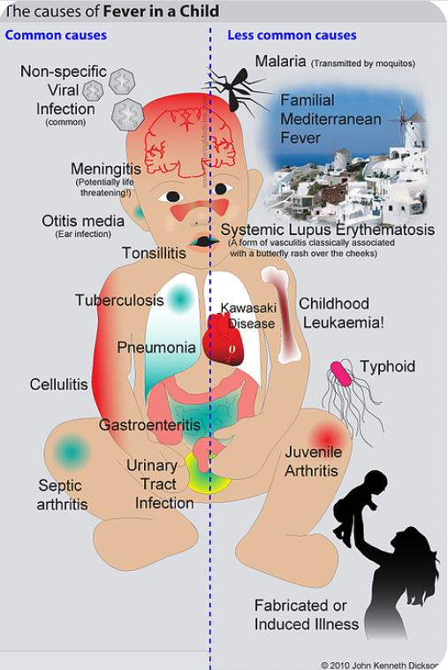

Slide 6
Fever Without a Focus
Refers to a rectal temperature of 38°C or higher as the only presenting feature without other presenting S&S.
There are 2 subcategories of fever without a focus:
1. Fever without localizing signs (FWLS).
2. Fever of unknown origin (FUO).

Slide 7
Fever Without Localizing Signs
(FWLS)
Fever of acute onset with duration of <1 wk and without localizing signs. It’s a common diagnostic dilemma in children <36 months of age.
The etiology and evaluation depends on the age with 3 age groups considered:
1. Neonates or infants to 1 mo of age.
2. Infants >1 mo to 3 mo of age.
3. Children >3 mo to 36 mo of age (3 yr).

Slide 8
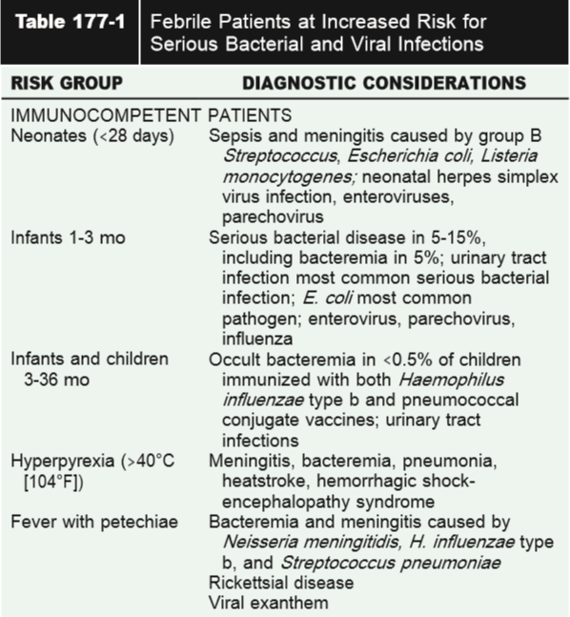
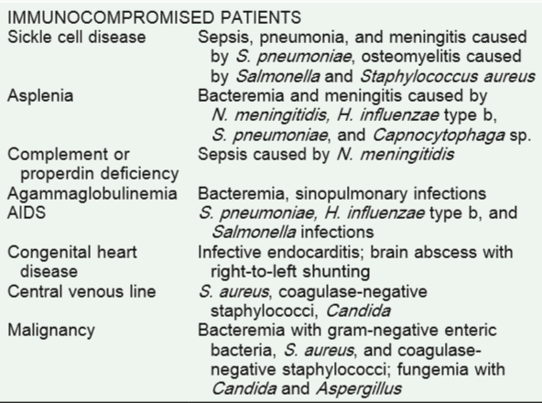

Slide 9
Neonates

Slide 10
Fever is significant in this age group, because they have an immature immune responses as well as that they display limited signs of infection.
In general, neonates who have a fever and do not appear ill have a 7% risk (and is heightened in the infant born prematurely) of having a serious bacterial infection (SBI) which include:
UTI (MC)
Bacteremia Meningitis
Pneumonia Enteritis
Osteomyelitis Septic Arthritis

Slide 11
Etiology
Common pathogens in this age group include:
Bacterial: GBS, E. coli & listeria monocytogenes.
2. Perinatally acquired HSV infection.

Slide 12
Approach to febrile neonates
1. History and Physical examination
(unreliable physical signs)
2. Hospital admission
All febrile neonates should be hospitalized.

Slide 13
3. Investigations (Sepsis workup):
CBC with differential
Inflammatory markers (ESR/CRP)
Blood culture
Urine analysis & culture
LP (CSF analysis & culture)
Stool culture (in infants with diarrhea or stool containing blood or mucus)
CXR

Slide 14
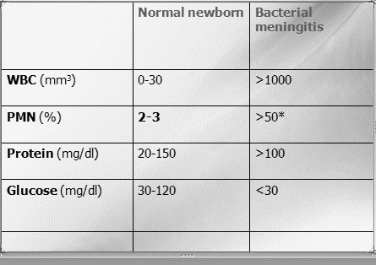
CSF Analysis should include:
1. Cell counts
2. Glucose
3. Protein
4. Gram stain and culture
5. HSV and enterovirus PCR.

Slide 15
4. Empirical intravenous Antibiotics
Combination antibiotics, such as ampicillin and cefotaxime or ampicillin and gentamicin, are recommended.
Acyclovir should be included if HSV infection is suspected.

Slide 16
1-3 months of age

Slide 17
The majority of cases are viral and the have seasonal variation.
In winter→ RSV and influenza A
In summer and fall → enterovirus and parechovirus

Slide 18
But always consider bacterial infections
MCC of bacteremia in infants from 1-3 months:
E. coli, Group B Streptococcus followed by S. aureus
Pyelonephritis is the MC presentation especially in uncircumcised infant boys and infants with urinary tract anomalies.
Other bacterial diseases in this age group:
-UTI most common
-otitis media
- pneumonia
- omphalitis
-mastitis

Slide 19
Ill-appearing (toxic) febrile infant
hospitalization
cultures of blood, urine, and CSF
immediate parenteral antimicrobial therapy

Slide 20
obtain urine studies (urine WBC, leukocyte esterase, nitrite, and culture) for
all girls <24 mo
all boys <6 mo old
all uncircumcised boys <2 yr
all children with recurrent urinary tract infection

Slide 21
Investigations for ill looking baby (sepsis workup)
After History , physical examination and admission →
1- CBC , ESR, CRP .
2- blood, urine, and CSF culture (take the samples before giving antibiotics)
3- urinalysis. (Urinalysis may be negative in infants <2 mo. of age with pyelonephritis)
4- chest x-ray (if respiratory symptoms are present)
5- Stool study (if has diarrhea)
+viral diagnostic studies

Slide 22
Manegmant of Ill-appearing (toxic) febrile infant
Immediate parenteral antimicrobial therapy
Ampicillin (L. monocytogenes and Enterococcus) plus either ceftriaxone or cefotaxime.
This regimen is effective against the usual bacterial pathogens causing sepsis, urinary tract infection, and enteritis in young infants.
If meningitis is suspected, add vancomycin for possible penicillin-resistant S. pneumonia

Slide 23
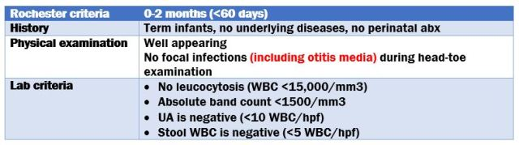
If the infant looks well but has fever…
use the Rochester Criteria or similar criteria is used to determine his risk for bacterial or viral infection as pyelonephritis may be seen in well-appearing infants who have fever without a focus.
Investigations: CBC, with differential, CRP, Blood culture, Urinalysis and culture

Slide 24
Low risk criteria
1. Uncomplicated medical history
2. Normal physical examination
3. Normal laboratory studies
4. Urine: negative leukocyte esterase, nitrite and <10 WBC/HPF
5. Peripheral blood: 5,000-15,000 WBC/mm3; <1,500 bands or band: total neutrophil ratio <0.2
If done
1- Stool studies if diarrhea (no RBC and <5 WBC/HPF)
2- CSF cell count (<8 WBC/µL) and negative Gram stain
3- Chest radiograph without infiltrate

Slide 25
If child fulfills all low-risk criteria :
-Treat as an out patient but ensure follow-up or the ability to arrive at ER (do not give antibiotics).
-If child deteriorates or any cultures are positive, return the child for further evaluation and treatment.

Slide 26
If child does not fulfill all low-risk criteria (even if looks well)
hospitalize .
Give IV empirical antibiotics until culture results are back, then change the antibiotic according to the results

Slide 27
3-36 months of age

Slide 28
MCC are viral.
Also serious bacterial infections do occur (except for the perinatally acquired infections.) ,MCC are S. pneumoniae, N. meningitidis, and Salmonella .
H. influenzae type b (not seen commonly due to vaccine).
Important bacterial infections among children 3-36 months of age include otitis media, sinusitis, pneumonia, enteritis, urinary tract infection, osteomyelitis, and meningitis.

Slide 29
What suggests it’s a bacterial infection?
1) temperature ≥39°C (102.2°F)
2) WBC count ≥15,000/µL
3) elevated absolute neutrophil count
4) band count
5) erythrocyte sedimentation rate (ESR) or C-reactive protein
The higher the T° and WBC count the more it likely to be bacterial

Slide 30
Child appearance
well
Toxic
Full sepsis workup
Admit and start empirical antibiotic
Temperature>39
Temperature<39
Immunized
Not immunized
carefully observed without empirical administration of antibiotic
1. order blood culture then administering empirical antibiotics
OR
take a blood culture but without empirical antibiotic therapy
Virla infection
Manage as an outpatients without performing diagnostic tests or administering antimicrobial agents, only supportive treatment

Slide 31
After history and physical, then depending on the temperature of the infant and his general look
If the infant looks toxic → Do a full sepsis workup, admit him and start empirical antibiotics
If T is <39°C (102.2°F) and does not appear toxic→ most likely viral infection , Manage as an outpatients without performing diagnostic tests or administering antimicrobial agents, only supportive treatment.
But advise return with persistence of fever, temperatures >39°C (102.2°F), and new signs and symptoms

Slide 32
For nontoxic-appearing infants with a rectal temperature of ≥39°C (102.2°F)
Determine the immunization status
If received conjugate pneumococcal and Hib vaccines, then he is at much lower risk of occult bacteremia and meningitis. →this pt is carefully observed without empirical administration of antibiotic

Slide 33
If pneumococcal and Hib vaccines are not taken (can be handled in two ways ) →
First order blood culture then administering empirical antibiotics (ceftriaxone, a single dose of 50 mg/kg, not to exceed 1 g) till culture results are back
take a blood culture but without empirical antibiotic therapy, with return for reevaluation within 24 hr. (out pt treatment)

Slide 34
If S. pneumoniae is isolated from the blood, the child should return to the hospital and a second blood culture should be obtained, the child should be treated with 7-10 days of oral antimicrobial therapy.
If the child appears ill at the time of follow-up, or if H. influenzae or N. meningitidis is present→
1- admit to the hospital
2- repeat blood culture and evaluate for meningitis (including lumbar puncture)
3- start iv antibiotics

Slide 35
Periodic fever

Slide 36
PERIODIC FEVER SYNDROMES
Periodic fever syndromes are a group of diseases characterized by episodes of fever with healthy intervals between febrile episodes.
Disorders in which a child has recurrent episodes of fever over time .Each episode of fever lasts roughly the same length of time
Disorders can be hereditary and non-hereditary(infectious, non-infectious, neoplastic…)

Slide 37
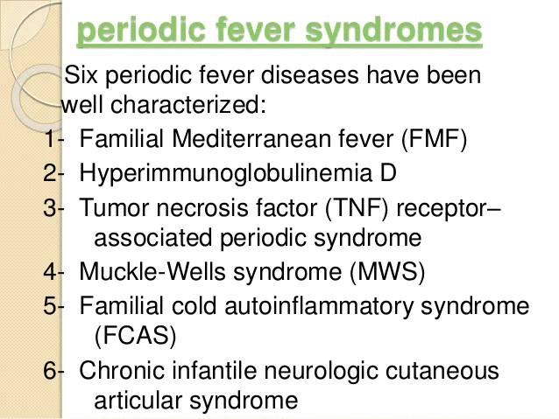

Slide 38
FAMILIAL MEDITERRANEAN FEVER
An auto inflammatory genetic disorder that causes recurrent fevers and serosal inflammation of the abdomen, lungs, and joints leading to severe pain. The first attack frequently occurs in childhood, and it usually begins before the age of 20 years.
Also known as 'periodic peritonitis,' 'familial paroxysmal polyserositis

Slide 39
AR inheritance
Mutation in MEFV gene which is located in chromosome 16
FMF mutations lead to a gain-of-function and IL-1 dependent inflammation.
Autoinflammatory disease:
Recurrent self-limited fever
Serositis
Arthritis
Rash
AA amylodiosis

Slide 40
FMF
EPIDEMIOLOGY
Ethnic groups of Mediterranean ancestry
Jews, Turks, Arabs, and Italians
FMF is more severe in Sephardic (North African) than Ashkenazi (East European) jewish population.

Slide 41
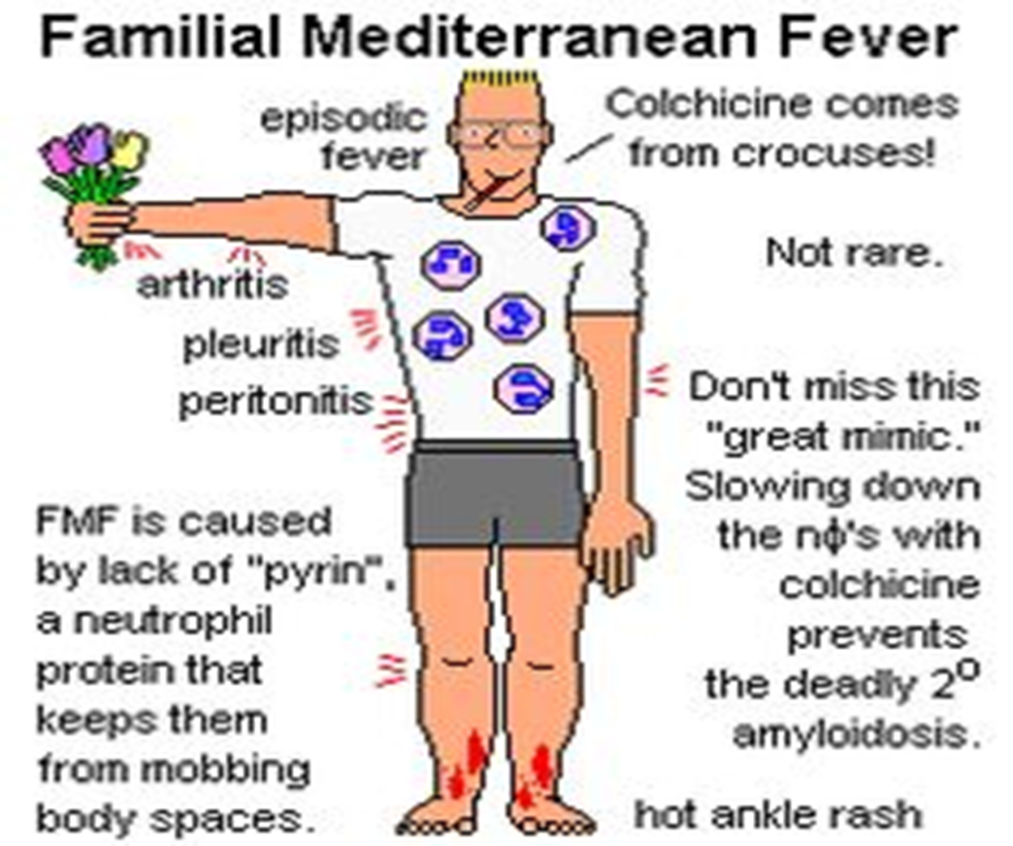
Clinical manifestations
FEVER; recurrent 1-3 day self-limited episodes of fever
SEROSITIS :
- Pleuritic chest pain; unilateral
- Abdominal pain; generalized
or localized to 1 quadrant (acute )
ARTHRITIS
Mono or pauci- articular arthritis
Large joints
Large, neutrophil-rich effusions
Nonerosive and nondestructive.

Slide 42
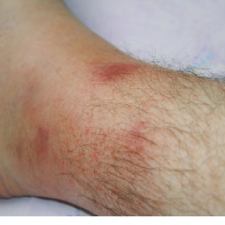
RASH
- Erysipeloid erythematous rash on the ankles and dorsum of foot.
SCROTAL PAIN; inflammation of tunica vaginalis
FEBRILE MYALGIA
VASCULITIS ; “HSP”
AMYLOIDOSIS: (AA AMYLOIDOSIS)
- Serious complication
- Increased serum AA acute phase reactant at high levels during attacks
- Kidneys, GIT, spleen, lungs, testes, thyroid and adrenals.
- Rarely cardiac amyloidosis
- Dx by renal or rectal biopsy.

Slide 43
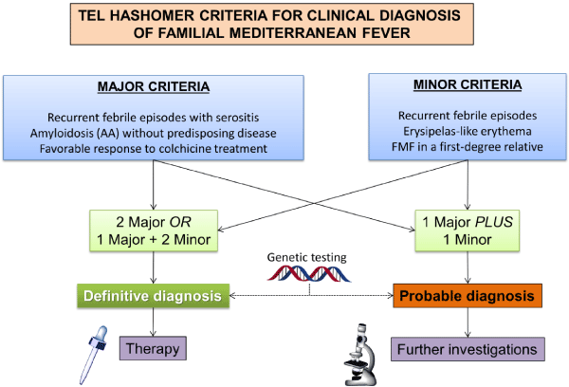

Slide 44
DIAGNOSIS
Clinical diagnosis based on history and symptoms and family history.

Slide 45
TREATMENT
Attacks are self-limiting and require analgesia and NSAIDS
- COLCHICINE :
Prophylactic daily oral colchicine decreases the frequency, duration and intensity of flares.
Prevents the development of AA Amyloidosis
S\E:
abdominal pain, diarrhea
Lactose intolerance in some patients

Slide 46
Thank you

