Slide 1
HEADACHE
Aamal Alhami
Razan Rahahleh
Aya Abdullah

Slide 2

Headache is a common complaint in children and adolescents. Headaches can be a primary problem or occur as a symptom of another disorder, representing a secondary problem.
Headache influences children and adolescents of all ethnic and socioeconomic groups. It is common worldwide, occurring in up to 60% of children and adolescents aged between 2 and 18 years [4]. Headaches are a common complaint in childhood and adolescence and cause serious distress and disability in children and their families, resulting in reduced quality of life.
Headaches in children usually can be treated with over-the-counter pain medications and healthy habits such as a regular schedule for sleeping and eating.

Slide 3
  classification
  Approach
  HX
  PE

Slide 4
The international classification of headache disorder
1. The primary headaches
1. Migraine
2. Tension-type headache
3. Trigeminal autonomic cephalalgias
4. Other primary headache disorders

Slide 5
The secondary headaches
Headache attributed to trauma or injury to the head and/or neck
Headache attributed to cranial and/or cervical vascular disorder
Headache attributed to non-vascular intracranial disorder
Headache attributed to a substance or its withdrawal
Headache attributed to infection
Headache attributed to disorder of homoeostasis
Headache or facial pain attributed to disorder of the cranium, neck, eyes, ears, nose, sinuses, teeth, mouth or other facial or cranial structure
Headache attributed to psychiatric disorder

Slide 6
Primary headaches
Primary headaches are most often recurrent, episodic headaches.
The most common forms of primary headache of childhood are migraine and tension-type headaches.
Other forms of primary headache, including the trigeminal autonomic cephalalgias, occur much less commonly.

Slide 7
Migraine
Is the most frequent type of recurrent headache, migraine is characterized by:
episodic attacks that may be moderate to severe in intensity
focal in location on the head, have a throbbing quality
may be associated with nausea, vomiting, light sensitivity, and sound sensitivity.
pediatric migraine is shorter in duration compared to adult and has a bilateral, often bifrontal, location.
Migraine can also be associated with an aura that may be typical (visual, sensory, or dysphasic) or atypical (i.e., hemiplegic, “Alice in Wonderland” syndrome)
In addition, a number of migraine variants have been described and, in children, include abdominal related symptoms without headache, and components of the painless periodic syndromes of childhood.

Slide 8
EPIDEMIOLOGY:
Up to 75% of children report having a significant headache by the time they are 15 yr old.
Recurrent headaches are less common, but remain highly frequent.
Migraine has been reported to occur in up to 10.6% of children between the ages of 5 and 15 yr, and up to 28% of older adolescents. When the headaches become frequent, they convert into chronic daily headaches in up to 1% of children. When headaches are occurring more than 15 days a month the risk of conversion to a daily headache becomes more prominent.
Migraine can impact a patient’s life through school absences, limitation of home activities, and restriction of social activities. As headaches become more frequent, their negative impact increases in magnitude. This can lead to further complications including anxiety and school avoidance, requiring a more extensive treatment plan

Slide 9
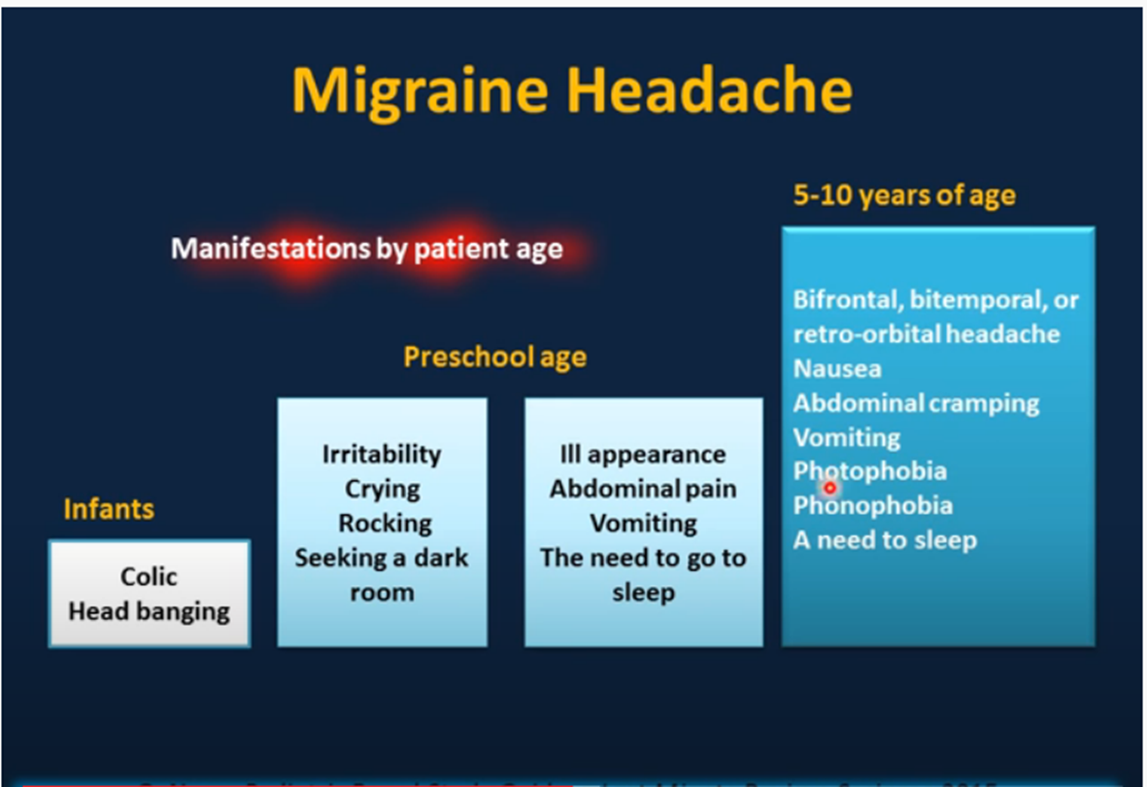
Clinical manifestations may vary depending on the age of the child:

Slide 10
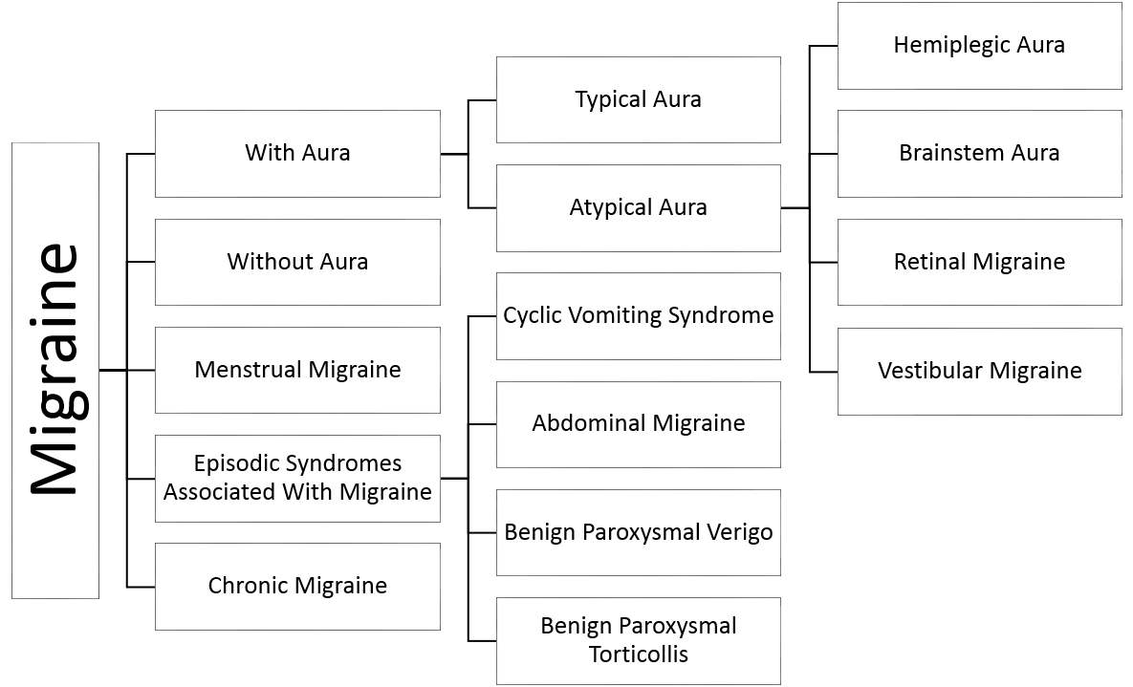
CLASSIFICATION AND CLINICAL MANIFESTATIONS

Slide 11
Migraine Without Aura
Migraine Without Aura is the most common form of migraine in both children and adults. The ICHD-3 beta , requires this to be recurrent (at least 5 headaches that meet the criteria, but there is no time limit over which this must occur). The recurrent episodic nature helps differentiate this from a secondary headache, as well as separates migraine from tension-type headache, but may limit the diagnosis in children as they may just be beginning to have headaches.

Slide 12
Diagnostic criteria:
A. At least five attacks fulfilling criteria B–D
B. Headache attacks lasting 4–72 hours (when untreated or unsuccessfully treated)
C. Headache has at least two of the following four characteristics:
1. unilateral location
2. pulsating quality
3. moderate or severe pain intensity
4. aggravation by or causing avoidance of routine physical activity (e.g.walking or climbing stairs)
D. During headache at least one of the following:
1. nausea and/or vomiting
2. photophobia and phonophobia
E. Not better accounted for by another ICHD-3 diagnosis.

Slide 13
Migraine with Aura (15-30%)
The aura associated with migraine is a neurologic warning that a migraine is going to occur. In the common forms this can be the start of a typical migraine or a headache without migraine, or it may even occur in isolation. For a typical aura, the aura needs to be visual, sensory, or dysphasic, lasting longer than 5 min and less than 60 min with the headache starting within 60 min. The importance of the aura lasting longer than 5 min is to differentiate the migraine aura from a seizure with a postictal headache, while the 60 min maximal duration is to separate migraine aura from the possibility of a more prolonged neurologic event such as a transient ischemic attack.

Slide 14
Diagnostic criteria:
A. At least two attacks fulfilling criteria B and C
B. One or more of the following fully reversible aura symptoms:
1. visual
2. sensory
3. speech and/or language
4. motor
5. brainstem
6. retinal
C. At least three of the following six characteristics:
1. at least one aura symptom spreads gradually over 5 minutes
2. two or more aura symptoms occur in succession
3. each individual aura symptom lasts 5–60 minutes
4. at least one aura symptom is unilateral
5. at least one aura symptom is positive
6. the aura is accompanied, or followed within 60 minutes, by headache
D. Not better accounted for by another ICHD-3 diagnosis.

Slide 15
Types of typical aura :-
Visual aura: the most common type of visual aura in children and adolescents is photopsia (flashes of light or light bulbs going off everywhere). They are often multicolored and when gone, the child may report not being able to see where the flash occurred. Less commonly fortification spectra ( brilliant white zigzag lines resmebling g a starred pattern castle) or scotmoa ( sometimes described as a shining spot that grows )
Sensory auras are less common. They typically occur unilaterally. Many children describe this sensation as insects are worms crawling from their hand, up their arm to their face with a numbness following this sensation. Once the numbness occurs, the child may have difficulty using the arm as they have lost sensory input, and a misdiagnosis of hemiplegic migraine may be made.
Dysphasic auras are the least-common type of typical aura and have been described as an inability or difficulty to respond verbally. The patient afterwards will describe an ability to understand what is being asked, but cannot answer back.

Slide 16
Much less commonly, atypical forms of aura can occur, including
1. Hemiplegic migraine(true weakness, not numbness)
This transient unilateral weakness usually lasts only a few hours but may persist for days, both familial and sporadic forms have been described. The familial hemiplegic migraine is an autosomal dominant disorder.
Diagnostic criteria:
Attacks fulfilling criteria for 1.2 Migraine with aura and criterion B below
B. Aura consisting of both of the following:
1. fully reversible motor weakness2
2. fully reversible visual, sensory and/or speech/ language symptoms
2. distortion (“Alice in Wonderland” syndrome).
characterized by distortions of visual perception, the body image, and the experience of time.
Whenever these rarer forms of aura are present, further investigation is warranted.

Slide 17
3. Basilar-type : was formerly considered a disease of the basilar artery. Some of the symptoms described include vertigo, tinnitus, diplopia, blurred vision, scotoma, ataxia, and an occipital headache. The pupils may be dilated, and ptosis may be evident.
Diagnostic criteria :
A. Attacks fulfilling criteria for 1.2 Migraine with aura and criterion B below
B. Aura with both of the following:
1. at least two of the following fully reversible brainstem symptoms:
a. dysarthria
b. vertigo
c. tinnitus
d. hypacusis
e. diplopia
f. ataxia not attributable to sensory deficit
g. decreased level of consciousness (GCS 13)
2. no motor or retinal symptoms.

Slide 18
4. Retinal migraine : Repeated attacks of monocular visual disturbance, including scintillations, scotomata or blindness, associated with migraine headache
Diagnostic criteria:
A. Attacks fulfilling criteria for 1.2 Migraine with aura and criterion B below
B. Aura characterized by both of the following:
fully reversible, monocular, positive and/or negative visual phenomena (e.g. scintillations, scotomata or blindness) confirmed during an attack by either or both of the following:
a. clinical visual field examination
b. the patient’s drawing of a monocular field defect (made after clear instruction)
2. at least two of the following:
a. spreading gradually over 5 minutes
b. symptoms last 5–60 minute
c. accompanied, or followed within 60 minutes, by headache
C. Not better accounted for by another ICHD-3 diagnosis, and other causes of amaurosis fugax have been excluded.

Slide 19
Chronic migraine
Headache occurring on 15 or more days/ month for more than three months, which, on at least eight days/month, has the features of migraine headache.
Diagnostic criteria:
Headache (migraine-like or tension-type-like1 ) on 15 days/month for >3 months, and fulfilling criteria B and C
B. Occurring in a patient who has had at least five attacks fulfilling criteria B–D for Migraine without aura and/or criteria B and C for Migraine with aura
C. On 8 days/month for >3 months, fulfilling any of the following
criteria C and D for 1.1 Migraine without aura
2. criteria B and C for 1.2 Migraine with aura
3. believed by the patient to be migraine at onset and relieved by a triptan or ergot derivative
D. Not better accounted for by another ICHD-3 diagnosis.

Slide 20
management
A- Management of acute attack:
This mainly includes 2 groups of medicines: (NSAIDs) and triptans.
NSAID as Ibuprofen tend to be effective when used at the onset of the headache attack with appropriate doses (7.5-10.0 mg/kg) however, acetaminophen (15 mg/kg) can be effective in those with a contraindication to NSAIDs. Special concern for the use of NSAIDs includes ensuring that the children can recognize and respond to onset of the headache.
Other NSAID that can be used include: Naproxen sodium and Aspirin is also a reasonable option but is usually reserved for older children (older than age 15 yr).
The goal of the primary acute medication should be headache relief within 1 hr with return to function.

Slide 21
When NSAID alone is not sufficient, a Triptan may be considered.
Triptan as Almotriptan (ages 12-17 yr) and Rizatriptan (in children as young as age 6 yr) can be used to treat migraine in the pediatric population.
The most effective way to administer abortive treatment is to use NSAIDs first in mild to severe cases, restricting their use to fewer than 2-3 attacks per week to prevent the transformation of the migraines into medication overuse headaches, and adding the triptan for moderate to severe, or attacks that have failed NSAID use, restricting to not more than 4-6 attacks per month

Slide 22
Other measures in management of acute attack:
1- Ergot alkaloids: They are used in moderate – severe cases They cause Constriction of cerebal blood vessels and they decrease inflammation and extravastion. Ex. Erogtamine, Dihydroergotamine.
2- Fluid hydration
3- Antiemetics that can be used for acute treatment of the nausea and vomiting include: prochlorperazine and metoclopramide have the best efficacy.
4- Sleep is the best immediate therapeutic action. Place the patient in a quiet, dark room where he or she can rest with a cool, wet cloth across the forehead.

Slide 23
Inpatient Management of Intractable Migraine and Status Migrainosus
Six percent to 7% of patients fail acute treatment in the emergency department. These patients are usually admitted for a 3-5 day stay and receive extensive parenteral treatment. A child should be admitted to the hospital for a primary headache
The child is in status migrainous >72 h
has an exacerbation of a chronic severe headache
is in an analgesic rebound headache.
The goal of inpatient treatment is to control a disabling headache that has been unresponsive to other abortive therapy and is disabling to the child.
- Treatment protocols include the use of DHE, antiemetics, sodium valproate and other drugs.

Slide 24
B- Prophylactic Therapy:
Indication:
1- headaches are frequent (more than 1 headache/wk).
2- more than 1 disabling headache a month (missing school, home, or social activities).
3- PedMIDAS score higher than 20
The goal of this therapy should to be to reduce frequency (1-2 headaches or fewer per month) and disability (PedMIDAS score <10)

Slide 25
Prophylactic agents are given for at least 4-6 mo at an adequate dose and then weaned over several weeks.
The most commonly used preventive therapy for headache and migraine is Tricyclic antidepressants (Amitriptyline). Typically, a dose of 1 mg/kg daily at dinner or in the evening is effective. However, this dose needs to be reached slowly (i.e., over weeks: with an increase every 2 wk until goal is reached) to minimize side effects and improve tolerability. The most common side effect are sleepiness.
Other prophylactic agent include: Calcium channel blocking agent (flunarizine), Antiepileptic medications (topiramate, valproic acid, levetiracetam and gabapentin), β-Blockers (Propranolol), and Antihistamines (cyproheptadine).

Slide 26
C- Biobehavioral Therapy:
1- Include teaching the patient about the triggers as skipping meals, inadequate or irregular sleep, dehydration and weather changes, stress, physical activity, and recognition a pattern (associated with menstrual periods in adolescents). So they should get adequate fluid intake without caffeine, regular exercise, not skipping meals and making healthy food choices, and adequate (8-9 hr) sleep on a regular basis.

Slide 27
2- Avoiding triggering food as cheese, processed meats, chocolate, nuts, pickles, and monosodium glutamate.
3- Behavior therapies such as relaxation techniques, stress management, and biofeedback have proved efficacious.

Slide 28
TENSION-TYPE HEADACHE IN CHILDREN

Slide 29
PREVALENCE
• Tension headaches are by far the most common headache >> TTH is 2-3 times more common than migraine.
• The mean age of onset for episodic TTH was 7 years.
• Those having a combination of migraine and TTH around 20%.

Slide 30
Definition:
**Based upon criteria from the ICHD
• Site : bilateral = more distributed in frontal region.(May be associated with neck and shoulder pain)
• Character: non-throbbing head pain = dull + tightness.(Bandlike sensation around the head)
• Association: Either photophobia or phonophobia may be present (but not both).
• is not accompanied by nausea or vomiting.
• Duration: lasting 30 minutes to seven days.
• Timing : more at the end of the day.
• Exacerbating : is not aggravated by routine physical activity.
• Severity: mild to moderate intensity.

Slide 31
CLASSIFICATION
The ICHD-3 beta subclassifies TTHs as infrequent (<12 times/yr) frequent (1-15 times/mo), and chronic (>15 headaches/mo)
They can further be separated into headaches with or without pericranial muscle tenderness.
Infrequent episodic (<1 headache day per month on average = occurring <12 days per year).
Frequent episodic (1 to 14 headache days per month on average = occurring ≥12 and <180 days per year).
• Chronic (≥15 headache days per month or ≥180 days (6m) per year).

Slide 32
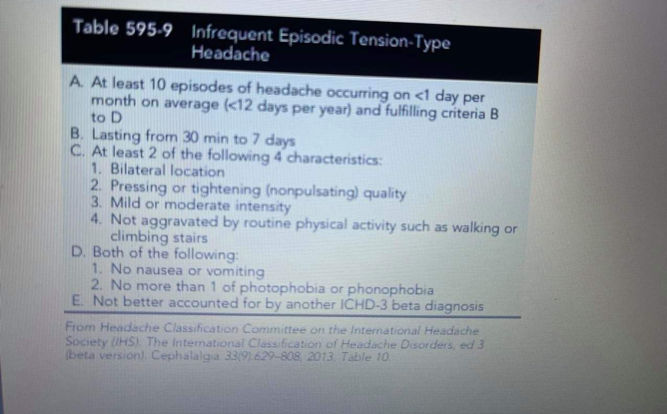

Slide 33
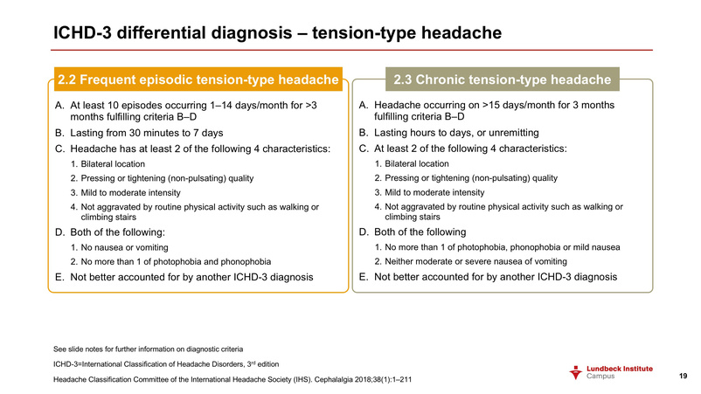

Slide 34
PATHOPHYSIOLOGY
The term "tension-type headache" replaces the previous terms "muscle contraction headache“
Heightened sensitivity of pain triggered by stress or emotion suggests activation of nociceptive pathways in the central nervous system.
It is often suspected that there may be underlying psychologic stressors (hence the misnomer as a “stress” headache), but this is often difficult to identify in children, and although it may be suspected by the parents, it cannot be confirmed in the child.
>> So investigate the possibility of an underlying emotional cause : bullying , poor self esteem or depression.
Also remember that heavy backpacks can lead to tension headache.

Slide 35
TREATMENT
Studies of and conclusive evidence to guide the treatment of TTH in children are lacking, but the same general principles and medications used in migraine can be applied to children with TTHs
simple analgesics (ibuprofen or acetaminophen) can be effective for acute treatment
Tricyclic antidepressants, may be helpful if simple analgesics are ineffective
Amitriptyline has the most evidence of effective prevention of TTH
biobehavioral intervention, including biofeedback-assisted relaxation training and coping skills, can be useful as well.

Slide 36
Cluster headache
neurological disorder characterized by recurrent severe headaches on one side of the head, typically around the eye. There is often accompanying eye watering, nasal congestion, or swelling around the eye on the affected side. Horner’s syndrome may develop after the attack. These symptoms typically last 15 minutes to 3 hours and occur in cyclical patterns or cluster periods, often waking the patient more than once at night. It is one of the most painful types of headache.
Age of onset is 20-60 years.

Slide 37
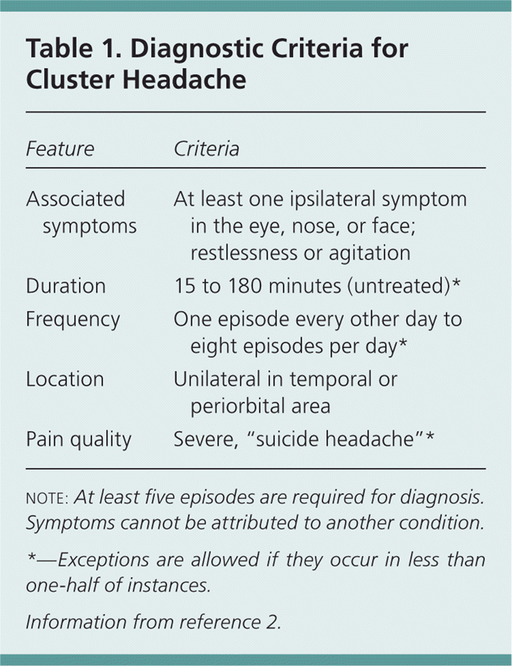

Slide 38
Treatment
For acute attack:
1- High flow 100% oxygen therapy.
2- sumatriptan , ergotamine or corticosteroid.
To prevent recurrence of cluster:
verapamil or pizotifen

Slide 39
OTHER PRIMARY HEADACHE DISORDERS
OTHER PRIMARY HEADACHE DISORDERS
Primary cough headache
Primary exercise headache
Primary thunderclap headache
Cold-stimulus headache (external application, ingestion, or inhalation)
External-pressure headache
External-compression headache
External-traction headache
Primary stabbing headache
Nummular headache
Hypnic headache
New daily persistent headache (NDPH)

Slide 40
SECONDARY HEADACHE
Secondary headaches are caused by an underlying condition.
Also include exacerbation of primary headaches by an underlying condition.
a secondary headache has a specific cause and should
resolve once this cause is treated. If the headache persists, the diagnosisand treatment should be questioned as either the diagnosis, which may
include a primary headache, and/or treatment may be incorrect.

Slide 41
Important note
DON’T think in 2ndry causes when you have a pt. with headache >> Common is common (BUT ALWAYS remember the red flags and be attention when you hear it)
1st = Infection is the most typical cause of headache seen in the emergency department (due to meningitis , pharyngitis , otitis media , sinusitis)
2nd = Exclude the 1ry causes >> Tension headaches are by far the most common headache >> TTH is 2-3 times more common than migraine
3rd = NOW you can look for 2ndry causes

Slide 42
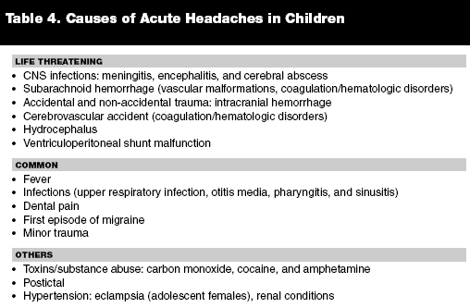

Slide 43
1ST : ACUTE FEBRILE ILLNESS
Infection is the most typical cause of headache seen in the emergency department (due to meningitis , pharyngitis , otitis media , sinusitis)
Is one of the most common causes of secondary headaches.
Sinus headache is the most overdiagnosed form of recurrent headaches. Although no studies have evaluated the frequency of misdiagnosis of an underlying migraine as a sinus headache in children, in adults, it has been found that up to 90% of adults
diagnosed as having a sinus headache by either themselves or their physician appear to have migraine.
When headaches are recurrent and respond within hours to analgesics, migraine should be considered first. In the absence of purulent nasal discharge, fever, or chronic cough, the diagnosis of sinus headache should not be made.

Slide 44
2ND: INTRACRANIAL HEMORRHAGE
Common causes or suspected causes of secondary headaches in children include the sequelae of head trauma (subdural OR epidural hemorrhage) Posttraumatic headaches sometimes occur in children who have not had a prior history of headaches and are temporally related to the initiating head injury
May be Spontaneous as in the acute subarachnoid hemorrhage which usually presents with a sudden severe headache.
The head injury may be minor or major
and the subsequent headache may be acute (resolves within 3 mo, most typically within 10 days) or chronic (longer than 15 days per month for more than 3 mo). Bed rest appears to be the most effective treatment for acute posttraumatic headache; magnesium supplementation
and migraine prophylaxis may also be effective. When a child has a history of episodic headaches, the head trauma or the overuse of daily medications may lead to status migrainosus or chronic migraine.

Slide 45
3RD : INCREASED INTRACRANIAL PRESSURE
1.This can be caused by a mass (tumor, vascular malformation) CLUES :
Severity and frequency increase over time
Poor response to analgesics
Awake the child from the sleep OR occur soon after awaking (worse at morning and improve as the day progress.)
Associated with projectile vomiting which temporarily relive the pain
Papilledema or focal neurological deficits

Slide 46
idiopathic intracranial hypertension also known as pseudotumor cerebri)
It is a condition in which there is an increased intracranial pressure with no
apparent reason >> normal CSF composition, and no other cause of intracranial hypertension evident on neuroimaging or other evaluations.
The etiology of idiopathic intracranial hypertension may be the intake of excessive amounts of fat-soluble compounds (e.g., vitamin A, retinoic acid, and minocycline), hormonal changes (increased incidence in females) or blockage of venous drainage (as with inflammation of the transverse venous sinus from mastoidtis).
When increased pressure is suspected, either by historical suspicion or the presence of papilledema, an MRI with magnetic resonance angiography and magnetic resonance venography should be performed, followed by a lumbar puncture if no mass or vascular anomaly is noted. The lumbar puncture can be diagnostic and therapeutic of idiopathic intracranial hypertension but must be performed with the patient in a relaxed recumbent position with legs extended.

Slide 47
IDIOPATHIC INTRACRANIAL HYPERTENSION (IIH)
Diagnosis of IIH (All the following Dandy criteria should be met) :
  Signs and symptoms of increased ICP
  No abnormal neurological finding on exam (except for papilledema and 6th CN palsy )
BUT The S&S isn’t specific >>> SO you should exclude other cause of ICP
  No etiology(mass , abscesses , cerebral venous sinus thrombosis ) found on MRI
  Normal CSF composition and increased ICP on LP
  Normal MRI and MR venography

Slide 48
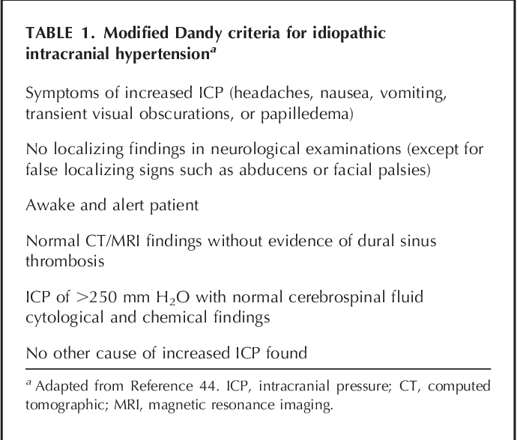

Slide 49
COULD LEAD TO VISION LOSS
If left un treated could result in vision loss >> SO your management :
1.Discontinuing the offending drugs (Vit. A) and treat the underling systemic disease.
2.Medication:
Carbonic anhydrase inhibitors
Migraine medications
3. Still not relived >>> Surgery :
Optic nerve fenestration
CSF shunting

Slide 50
NOTE : VISUAL REFRACTIVE ERROR
Headache attributed to visual refractive error is included as a type of secondary headache. However, in contrast to the secondary causes of headache listed above, definitive evidence that visual refractive errors cause headaches in children is lacking.

Slide 51
Approach to the Patient With Headache

Slide 52
Evaluation of headache focuses on
Determining whether a secondary headache is present
Checking for symptoms that suggest a serious cause

Slide 53
Don't miss Headache red flags!
1- History taking
2- Physical examination
3- Investigation
When to refer to a Specialist ?

Slide 54
History taking
Patient profile
- Age
Chief complaint
Duration
HOPI
- SOCRATES

Slide 55
SOCRATES

Slide 56
SOCRATES
Site
Onset
Character
Radiation
Associated symptoms
Timing
Exacerbating and relieving factors
Severity

Slide 57
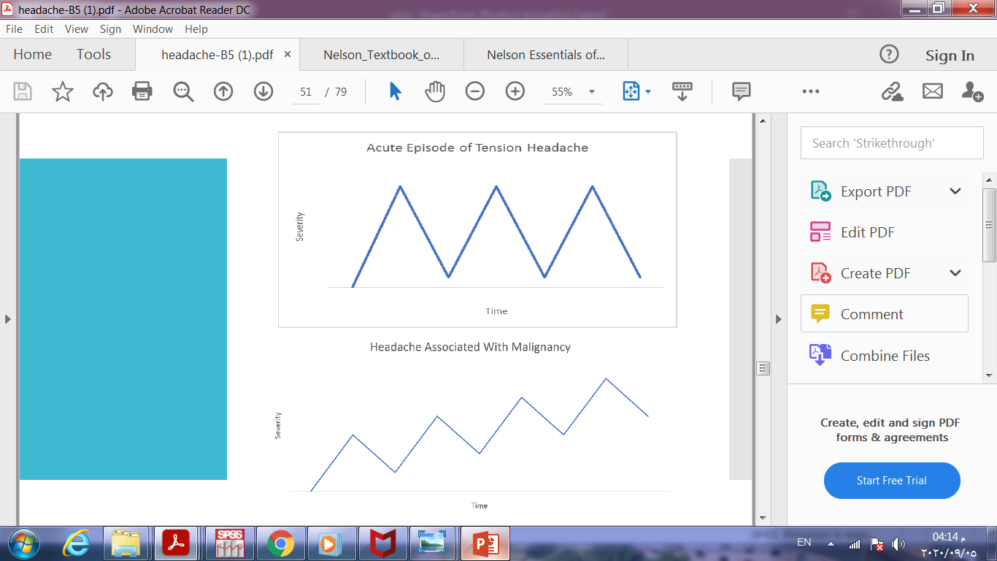

Slide 58
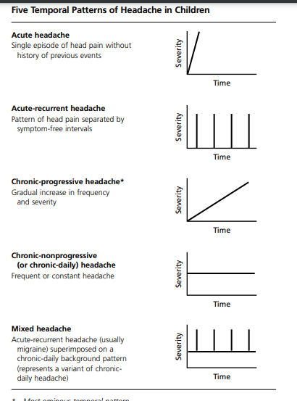

Slide 59
HOPI
+ - special attention to any new headache or significant change in existing headache

Slide 60
Review of systems

Slide 61
Vomiting: Migraine or increased intracranial pressure
Fever: Infection (eg, encephalitis, meningitis, sinusitis)
Red eye and/or visual symptoms (halos, blurring): Acute angle-closure glaucoma
Visual field deficits, diplopia, or blurring vision: Ocular migraine, brain mass lesion, or idiopathic intracranial hypertension
Lacrimation and facial flushing: Cluster headache
Rhinorrhea: Sinusitis
Pulsatile tinnitus: Idiopathic intracranial hypertension
Preceding aura: Migraine
Focal neurologic deficit: Encephalitis, meningitis, intracerebral hemorrhage, subdural hematoma, tumor, or other mass lesion
Seizures: Encephalitis, tumor, or other mass lesion
Syncope at headache onset: Subarachnoid hemorrhage
Myalgias and/or vision changes (in people > 55 years): Giant cell arteritis

Slide 62
Past medical and surgical history
Drug history
Family history
Social history
Impact on life of the child

Slide 63
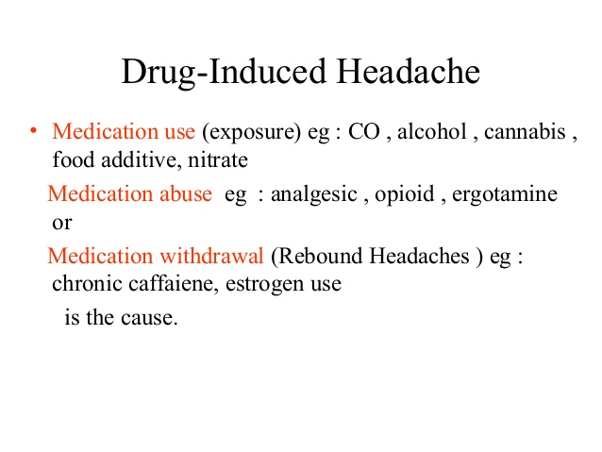

Slide 64
Medication-Overuse Headache (MOH)
Ergotamine-overuse headache
Triptan-overuse headache
Simple analgesic–overuse headache
Paracetamol (acetaminophen)-overuse headache
Acetylsalicylic acid–overuse headache
Other nonsteroidal antiinflammatory drug–overuse headache
Opioid-overuse headache
Combination analgesic–overuse headache
Headache Attributed to Substance Withdrawal
Caffeine-withdrawal headache
Opioid-withdrawal headache
Estrogen-withdrawal headache

Slide 65
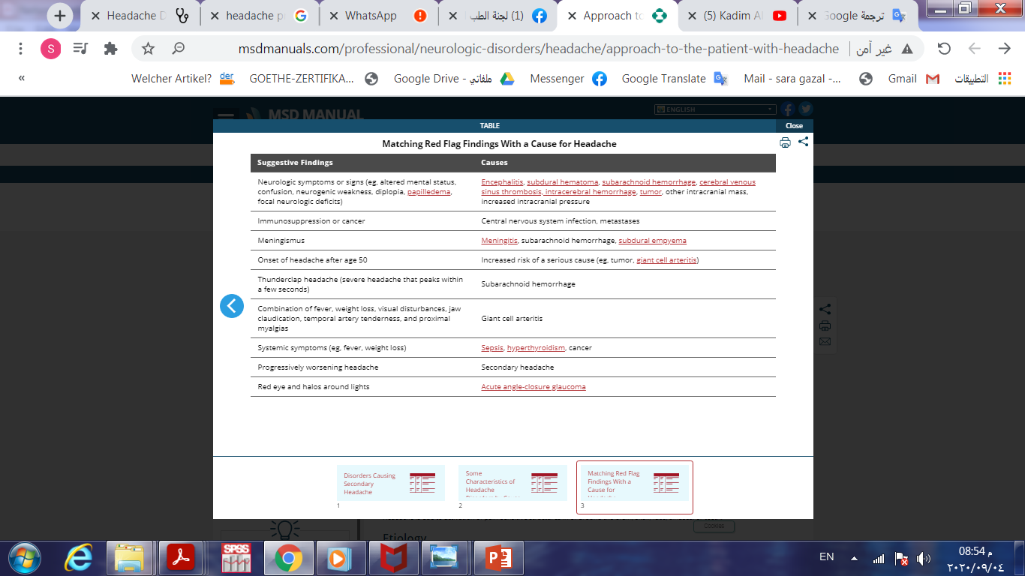

Slide 66
is it a tumor?
Some historical features are high-yield in screening for signs or symptoms consistent with a space occupying lesion.:
Progression and worsening of symptoms over time
Associated vomiting
Pain only in the occiput
Headache that is worse with Valsalva – ask if coughing, urinating, or defecating affects the headache
Does this headache wake the child from sleep?
Is it worse in the morning just after getting up?
No family history of migraine
No associated aura with the headache.

Slide 67
Arteriovenous malformation (AVM) is the hemorrhage we fear the most.
We really don’t know enough about arteriovenous malformations in the brain to say what is the typical presentation. They may be completely asymptomatic, until they rupture. Even the headache presentation is variable.
Think, headache PLUS.
New headache plus…vomiting.
Headache plus…it’s unilateral and new for the patient.
Headache plus…a new seizure.
Headache plus…focal neuro deficits, that may be transient, due to a vascular steal phenomenon

Slide 68
2- Physical examination
+ It is mandatory if secondary headache suspected
General Appearance:
• Altered mental status may indicate meningitis, encephalitis, intracranial
hemorrhage, elevated intracranial pressure, hypertensive encephalopathy.
vitals:
• Hypertension may cause headache or be a response to increased intracranial
pressure
• Fever suggests infection (most commonly upper respiratory infection) but may
occur with intracranial hemorrhage or central nervous system malignancy

Slide 69
Head circumference:
Macrocephaly may indicate slowly progressive increases in intracranial pressure.
Palpation of the head and neck:
Localized scalp tenderness may occur in migraine and tension-type headaches
• Scalp swelling may indicate head trauma
• Sinus tenderness may indicate sinusitis
• Temporomandibular joint (TMJ) and/or masseter tenderness suggests TMJ
dysfunction
• Nuchal rigidity may indicate meningitis
• • goiter may indicate thyroid dysfunction

Slide 70
Visual fields:
● Visual field abnormalities may indicate increased intracranial pressure and/or a space-occupying lesion.
Fundoscopy:
● Papilledema may indicate increased intracranial pressure
● Funduscopic examination is normal in primary headache
Otoscopy:
May demonstrate otitis media; hemotympanum may indicate trauma
Oropharynx:
● Signs of pharyngitis, dental decay or abscess

Slide 71
Neurological exam:
● Abnormal neurologic examination (particularly mental status, eye movements,
papilledema, asymmetry, coordination disturbance, abnormal deep tendon
reflexes) may indicate intracranial pathology but also may occur with migraine
headache.
Skin exam:
● Signs of neurocutaneous disorders (e.g., neurofibromatosis, tuberous sclerosis
complex, which are associated with intracranial neoplasms)
● trauma (bruises, abrasions, etc).
Spine:
● Signs of occult spinal dysraphism (e.g., midline vascular of pigment changes)

Slide 72
3- Investigation
When it is indicated ???

Slide 73
When it is indicated ???
Investigations are not routinely indicated, but neuroimaging should be considered in :
1- children whose headaches do not meet the criteria for one of the primary headache syndromes
2- in those with an abnormal neurological examination, recent onset of severe headache, change in the type of headache.

Slide 74
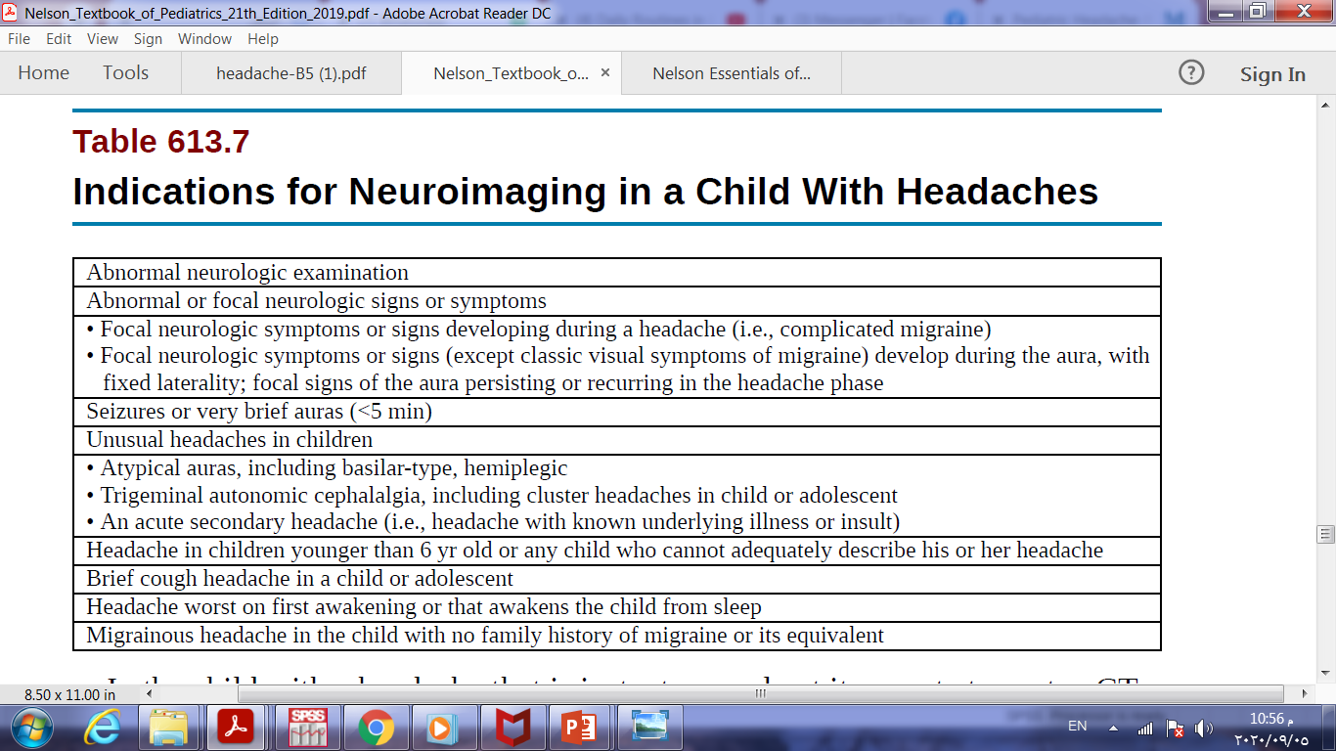
Neuroimaging is indicated in:
● Children with abnormal neurological exam
● Children who have worrisome features for an intracranial process
● Children with severe headache who have an underlying disorder that predisposes to intracranial pathology
● Child with occipital headache (debatable)
● Child with acute head trauma
● Child suspected to have an infection (complicated rhinosinusitis, encephalitis,
some cases of bacterial meningitis)

Slide 75
MRI is the imaging method of choice because :
it provides the highest sensitivity for detecting posterior fossa lesions
does not expose the child to radiation

Slide 76
In the child with a headache that is instantaneously at its worst at onset, a CT scan looking for blood is the best initial test; if it is negative, a lumbar puncture should be done looking especially for xanthochromia of the CSF.
There is no evidence that laboratory studies or an electroencephalogram is beneficial in atypical migraine without aura or migraine with aura.

Slide 77
When to refer to a Specialist ?

Slide 78
Diagnostic uncertainty, including unclassifiable, atypical headache
Diagnosis of any of the following:
• Chronic migraine (patients who have failed at least one preventative agent)
• Cluster headache
• SUNCT - severe unilateral neuralgiform headache with conjunctival injection + tears
SUNA - severe unilateral neuralgiform headache with autonomic features
• Persistent idiopathic facial pain
• Hemicrania continua/chronic paroxismal hemicranias
• Trigeminal neuralgia
3. Suspicion of a serious secondary headache (Red flags)

Slide 79
4- New headache:
• Presenting as thunderclap (intense headache with “explosive”/abrupt onset)
• In a patient ≥ 50 years, check ESR/CRP and refer
• New daily persistent headache (and no prior history of headache)
• In a patient with risk factors for immunodeficiency or cancer
• In a patient with family history of glaucoma
Headache with atypical aura, especially - prolonged (lasting> 1 hour) or including significant prolonged motor weakness - new aura without headache in the absence of a prior history of migraine
5- Headache not responding satisfactory to management in primary care
6- Comorbid disorders requiring specialist management

Slide 80
References
Nelson textbook edition 21
https://www.msdmanuals.com/professional/neurologic-disorders/headache/approach-to-the-patient-with-headache
https://www.tuh.ie/Departments/Neurology/Headache-Pathway.pdf
https://www.ncbi.nlm.nih.gov/pmc/articles/PMC4710107/
https://www.ncbi.nlm.nih.gov/pmc/articles/PMC2661331/
https://pemplaybook.org/podcast/pediatric-headache-some-relief-for-all/

Slide 81
Thank you
Any Question ?

