Slide 1
Approach to developmental delay
Emad Bawaneh
Laith Abughoush
Shahem Al-Boni

Slide 2
Child`s development
Child development can be defined as the process by which a child changes over time. It covers the whole period from conception to an individual becoming a fully functioning adult.
The processes of growth and development are intertwined.
However, it is convenient to refer to growth as the increase in
size and development as an increase in function of processes
related to body and mind.

Slide 3
Principles of child`s development
humans develop through a dynamic sequential process since the early days of life as embryo and the process continues after birth
Development is continuous process from conception to maturity
Sequence of development is same in all children but rate varies
Development intimately related to maturation of CNS
Proceeds in a cephalocaudal direction

Slide 4
Normal development
Developmental milestones
Primitive reflexes

Slide 5
Developmental mile stones
Definition : a set of functional skills or age-specific tasks that most children perform within a certain age range.
They include the following domains :
- Gross motor - Fine motor
- Language - Social
- Emotional - Self-help
- Cognitive

Slide 6
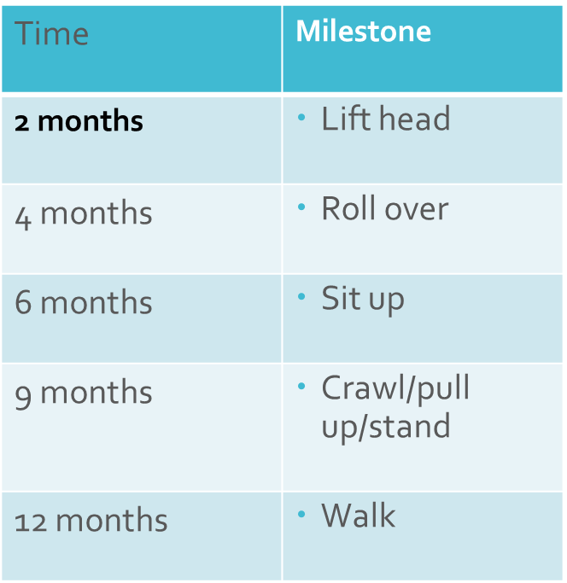
GROSS MOTOR
Goal first year: walk
• Newborn babies lie face down
• Motor development proceeds
from top down (Head before legs)

Slide 7
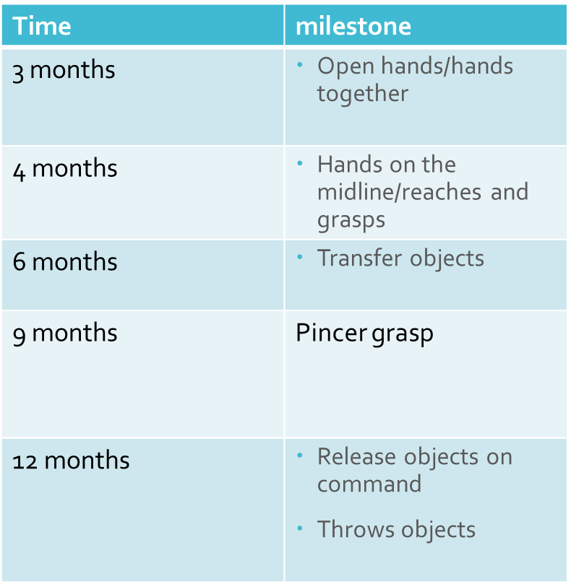
FINE MOTOR
• Goal first year: pincer grasp
and throw objects
• Newborns: hands in fists < 3 months
10 months

Slide 8
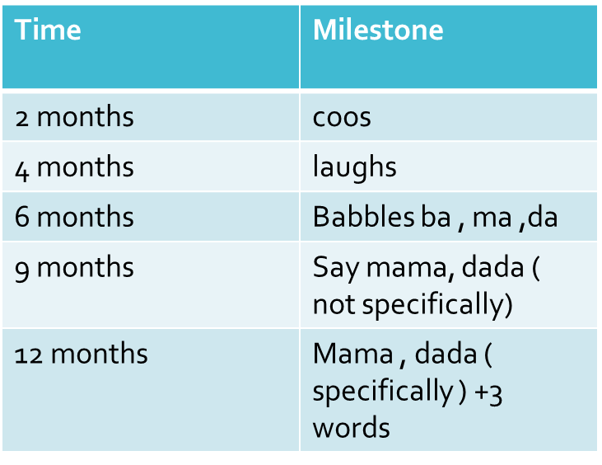
LANGUAGE
• Requires hearing
• Goal first year: say word
with meaning “mama” and “dada”

Slide 9
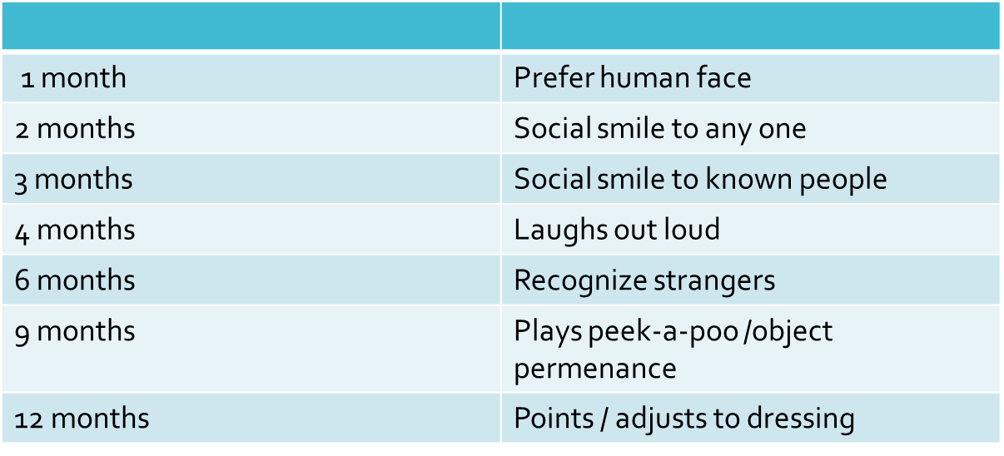
SOCIAL

Slide 10
2-years old
Run and climb two steps ( goes upstairs/downstairs )
Eat with spoon without missing
• Two-word phrase
• Two-step commands
• Stacks 6 blocks
• listen to stories
• Copy a line

Slide 11
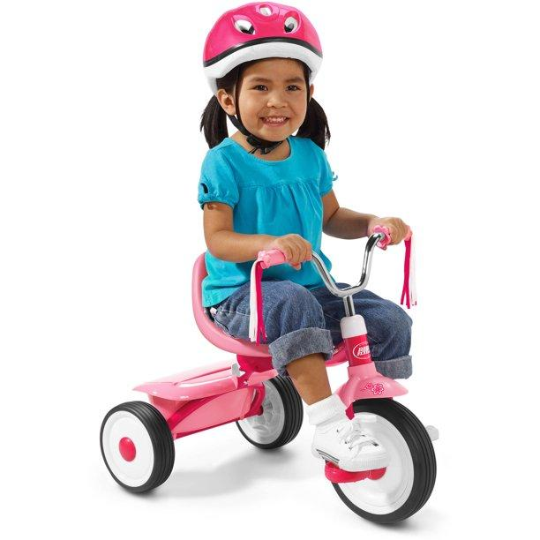
3-years old
Ride a tricycle
Three-word sentences/ counts 3 objects
play with others
Copy a circle

Slide 12
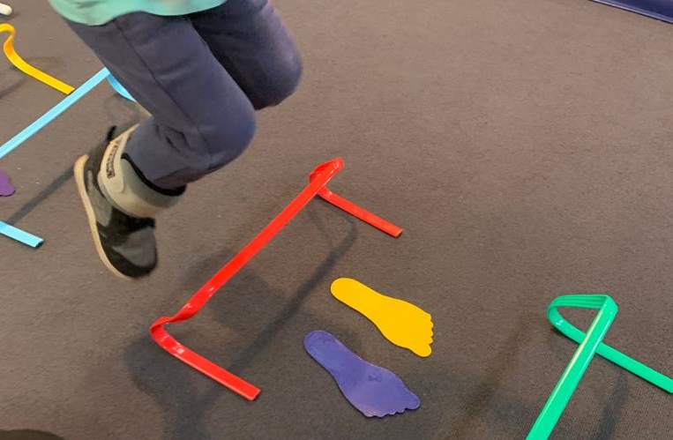
4-years old
Hop
Copy a cross
Tells detailed stories

Slide 13

5-years old
Skip
Ties shoes
Names 4 colors /prints name
Copy a triangle

Slide 14
Primitive Reflexes
Primitive reflexes : are reflexes that are normally present during infancy and disappear with the development of inhibitory pathways to the subcortical motor areas (usually within the 1st year of life).
Primitive reflexes persistence:
In children; : indicates impaired brain development
In adults; : suggests frontal lobe lesions .

Slide 15
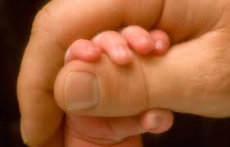
Hand Grip
Grasps object placed in palm / 5-6 m

Slide 16
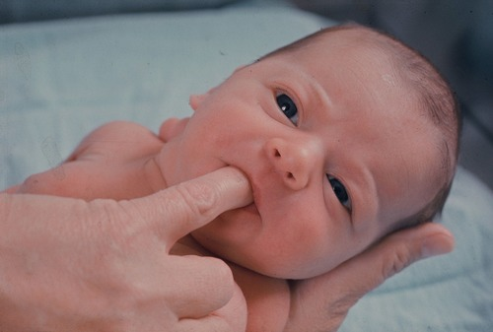
Sucking reflex
Suck when roof of mouth Is touched / 4 m

Slide 17
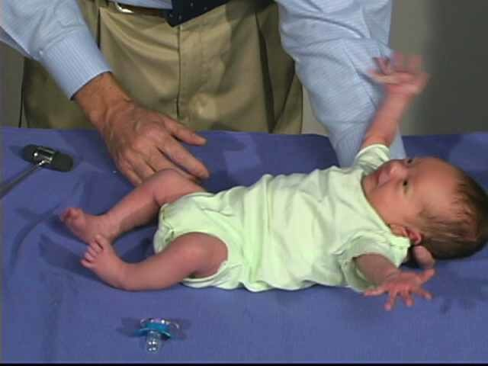
Moro reflex
Extend arms when startled/ 5-6 m

Slide 18
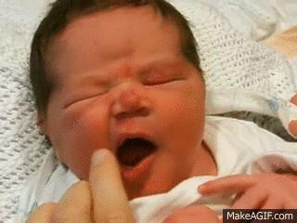
Rooting reflex
Turn heard toward side of cheek stimulus / 2-3 m

Slide 19
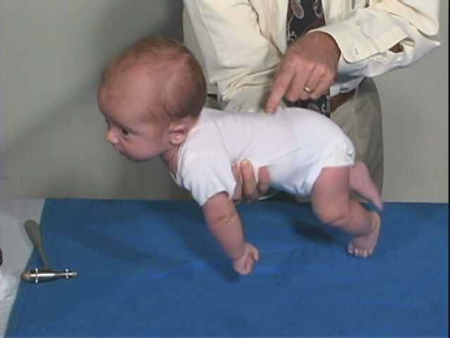
Galant reflex
Stroke spine on side, baby swings torso toward touch / 2-6 m

Slide 20
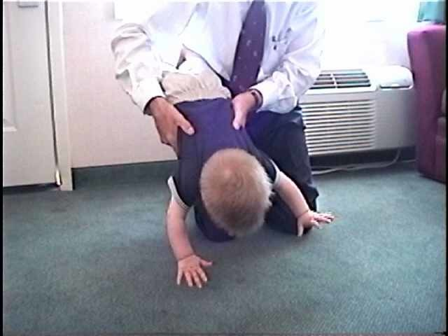
Parachute reflex
when the child is held upright and the baby's body is rotated quickly to face forward (as in falling),The baby will extend their arms forward as if to
break a fall / (6-9)1 Y

Slide 21

Landau reflex
when held in a horizontal prone position, the infant maintains a convex arc with the head raised and the legs slightly flexed/ 12 – 24 m.

Slide 22

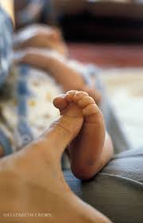
Planter reflex VS Planter grasp reflex

Slide 23
Developmental Delay
Definition : failure to get the milestone at the limit age.
Limit age : age at which a skill should have been achieved, - 2 SD from the mean.
Developmental regression is loss of already acquired skill

Slide 24
Developmental delay can be :
1- delay in a specific domain vs global developmental delay (significant delay in 2 or more areas of development).
2- transient vs persistent

Slide 25
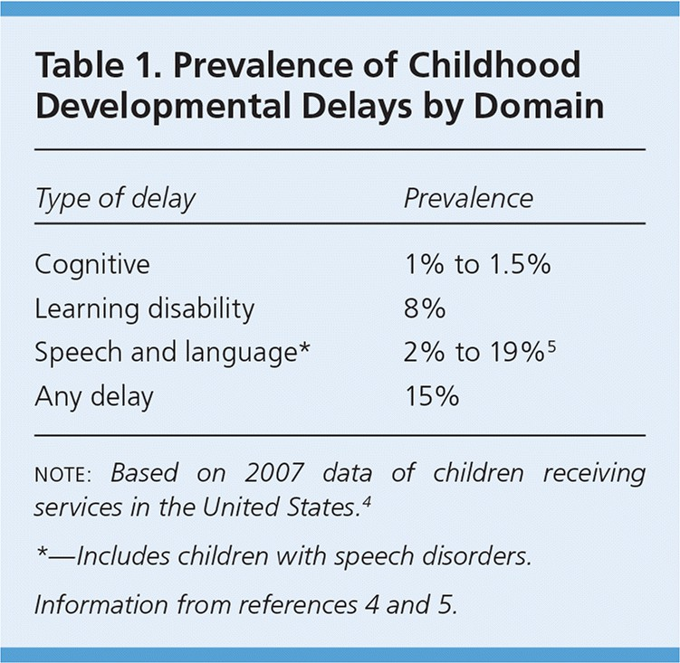
Prevalence
Developmental delays are common in childhood, occurring in 10%–15% of preschool children. Global developmental delays are less common, occurring in 1%–3% of preschool children.

Slide 26
Red flags
0-3m :
persistent fisting after 3m - failure to respond to environmental stimuli, evaluate for hearing loss.
4-6m :
poor head control, evaluate for hypotonia
failure to reach for objects by 5m, evaluate for motor or visual deficit

Slide 27
6-12m :
Persistent of primitive reflexes
Absent babbling by 6m
Inability to recognize sounds by 10m

Slide 28
12-24m :
Hand preference before 18 m.
Inability to walk up and down stairs by 24m.
Advanced non communicative speech, e.g. Echolalia, evaluate for pervasive developmental disorders.
- Delayed language development require hearing assessment in all ages.

Slide 29
Causes of Global Developmental Delay
Global developmental delay can be the presenting feature of a huge number of neurodevelopmental disorders.
Careful evaluation and investigation can reveal a cause in 50-70% of cases.
This leaves a large minority where the cause is not determined.

Slide 30
Why finding a cause ?
The family gains understanding of the condition, including prognostic information.
Lessens parental blame.
Ameliorates or prevents co-morbidity by identifying factors likely to cause secondary disability that are potentially preventable e.g. surveillance of other systems such as vision and hearing.

Slide 31
Appropriate genetic counselling about recurrence risk for future children and the wider family.
Accessing more support
To address concerns about possible causes e.g. events during pregnancy or delivery.
Potential treatment for a few conditions.

Slide 32
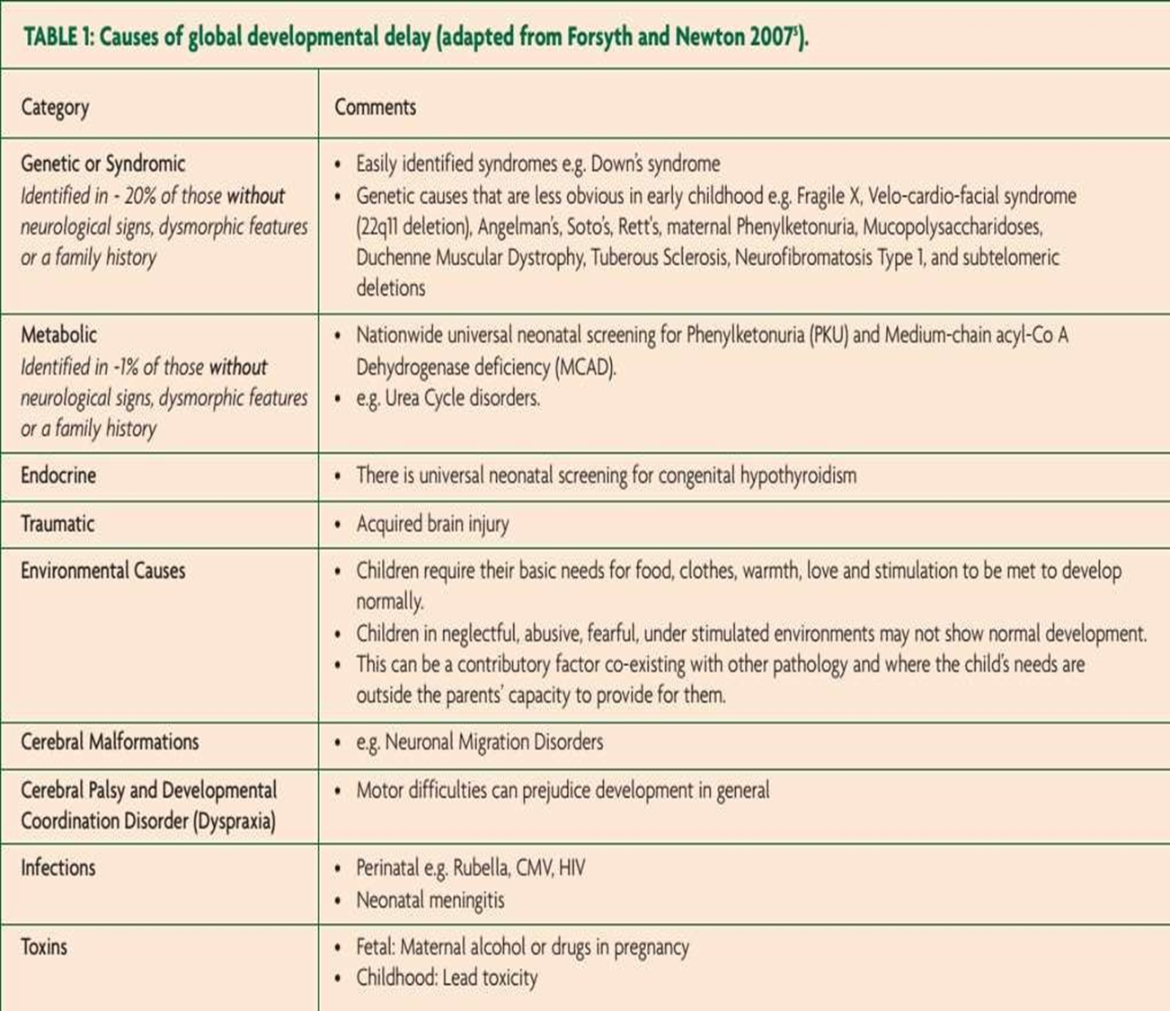

Slide 33
Examples of disorders with developmental delay
Down syndrome(trisomy 21)
The most common viable chromosomal disorder & most common genetic cause of intellectual disability.
developmental delay, hypotonia, poor Moro reflex.
Developmental impairment becomes apparent in the first year of life. In general, the average age of sitting (11 months), creeping (17 months), and walking (26 months) is approximately twice the typical age.

Slide 34

Down syndrome presents with :
Intellectual disability
Flat facies
Prominent epicanthal folds
Single palmer crease
Incurved 5th finger
Bushfield spots
Gap between 1st & 2nd toes
Duodenal atresia
Hirschsprung disease
Congenital heart disease (ASD)

Slide 35
Rett syndrome
almost exclusively females.
develop normally initially, then gradually loose speech, purposeful hand use after 18 months of age.
deceleration in head growth.
mutation in MECP2 gene.
After Down syndrome, Rett syndrome is believed to be the most common cause of developmental delay in females.

Slide 36
Fragile X – syndrome
X-linked dominant trinucleotide repeat expansion disease.
The most common inherited cause of ID & 2nd most common cause of genetically associated mental deficiency (after down syndrome).
- May show genetic anticipation.
- Self – mutilation is common.

Slide 37

Fragile x syndrome may presents with :
Post-pubertal marcroorchidism
Long face with large jaw
Large everted ears
Autism
Mitral valve prolapse
Hypermobile joints

Slide 38
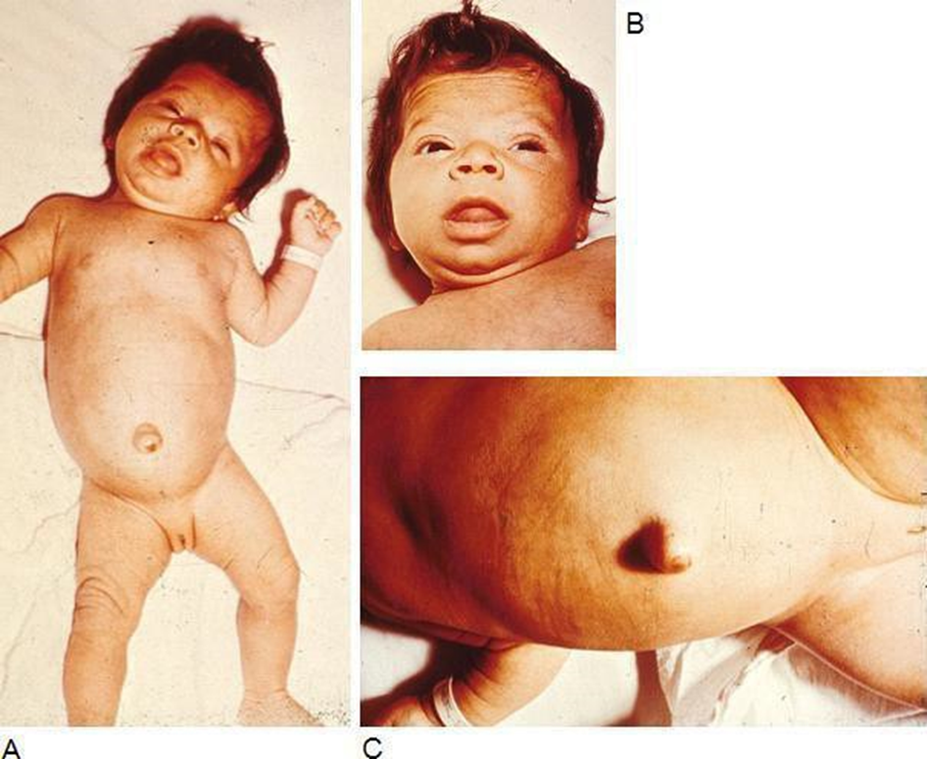
Congenital Hypothyroidism
They have coarse facies and retardation of physical and mental development.
Signs & Symptoms:
Birthweight and length are normal
Sleepiness.
Feeding difficulties
Respiratory difficulties
Prolonged jaundice.
Goitre.

Slide 39
Large abdomen
Umbilical hernia.
Dry, cold and mottled skin
Wide posterior and anterior
fontanels.
The mouth is open, and the thick, broad tongue protrudes
The neck is short and thick
The hands are broad and the fingers are short.
The muscles are usually hypotonic
The hairline reaches far down on the forehead
Sexual maturation may be delayed

Slide 40
Approach to a Child with Developmental Delay
1-Developmental screening
2-Detailed History
3-Physical Examination
4- Investigations
The approach is mainly clinical.

Slide 41
Developmental screening
all children should be screened for developmental delay and disabilities at well child doctor visit at:
9 months
18 months
24 or 30 months
Additional screening might be needed if a child is at high risk for developmental problem, e.g. : preterm, low birth weight and others to reassure if normal development pattern and timings.

Slide 42
Developmental screening
• Spot regression
• Any genetic disorder to make?
• Identify those with specific areas of impairment or global concerns
Allows early support or interventions eg. hearing aids, physiotherapy

Slide 43
Developmental screening
Two major categories
  Developmental
  Behavioral
Two mechanisms of administration
  Parental : Age and Parent’s evaluations of developmental status
  Provider : Denver
  fine and gross motor, language, and social skills

Slide 44
Obstetrical History
Prenatal Hx :
- Any Complications
- Prenatal diagnoses made (eg. Down Syndrome)
- Infections (eg. TORCH)
- gestational DM

Slide 45
Obstetrical History
Perinatal & Neonatal Hx :
- Prematurity, LBW, obstetric complications ,
encephalopathy, hyperbilirubinemia.
- APGAR scores
- trauma
- Infections (eg. Group B Strep)
- Seizures ,hearing test performed
- Newborn screening performed

Slide 46
Family History & Social history
consanguinity, inherited disorders,Relatives with developmental delay, genetic abnormalities, syndromes.
Evidence of neglect or abuse which may have a negative influence on development.

Slide 47
Behavior
Behavioral disturbances, aggression, self injury, defiance, inattention, anxiety, depression, sleep disturbances, stereotypic behaviors, poor social skills, hyperactivity, difficult temperaments.

Slide 48
Physical Examination
physical examination is important in the assessment of a developmentally delayed child.
Characteristic findings on physical exam may provide clues as to the cause of the developmental delay.
General, growth parameters,(HC), dysmorphic features, neurologic exam
child placed in different postures
Hearing and vision

Slide 49
Physical Examination
Muscle tone, landau reflex.
Primitive reflexes.
Consider the corrected age in preterm babies.
Prerequisites : Infant or child in a good temper
Should not be hungry , tired, had convulsion prior or under effect of sedative drugs.

Slide 50
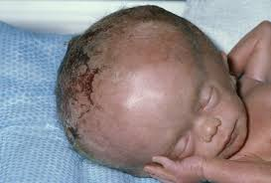
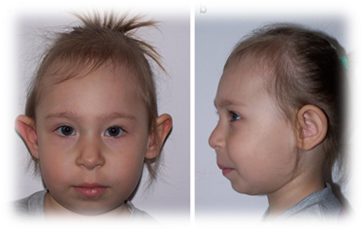
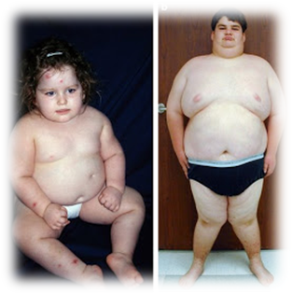
Growth Parameters
Head Circumference
- Macrocephaly : eg in hydrocephalus
Microcephaly: eg in Rett’s Disorder
Length
- short stature: Turner syndrome, William's syndrome
Weight
Obesity: Beckwith - Wiedemann syndrome

Slide 51
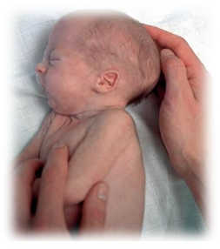
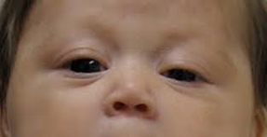
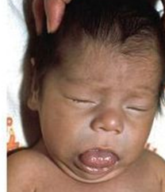

Dysmorphic features, any abnormalities
Flat occiput: Down syndrome
Prominent occiput: trisomy 18
Low nasal bridge: Down syndrome
Webbed neck: Turner syndrome
Macroglossia : congenital hypothyroidism
Clinodactyly: trisomies including Down syndrome
Café au lait spots: Neurofibromatosis

Slide 52
Neurological Exam
Cranial nerves
Specific vision tests: red reflex, response to visual stimuli, field of vision
Specific auditory tests: response to auditory stimuli
language delay
Abnormal speech
Persistently present Babinski response (older than 2 years of age)
Hyper- or Hypotonia

Slide 53
Neurological Exam
Sensory
Motor strength
Gait
Deep tendon reflexes
Primitive reflexes

Slide 54
Investigations
Genetics: Karyotyping to assess for chromosomal abnormalities
TSH, free T4
Metabolic screening – glucose, electrolytes, serum lactate,, liver function tests, albumin...
EEG
Head CT
Brain MRI

Slide 55
References
Nelson textbook of pediatrics 20th edition
Amboss
First Aid
PubMed

Slide 56

Thank You

