Slide 1
VIRAL EXANTHEMS
Prepared and presented by:
Rahaf Abuaisheh
Ahmad Khader
Leen Eser
Supervised by : Dr.Marwan Shalabi

Slide 2
Lecture outline:
What are exanthems ??
What are the most common exanthems ??
1-Erythema infectiosum (fifth disease)
2-Roseola infantum(sixth disease)
3-Chicken Pox
4- Hand foot and mouth disease
5- Measles(Rubeola)
6- Rubella(German Measles)
What is the etiology , epidemiology, pathogenesis , clinical presentation , diagnosis and management for each ??

Slide 3
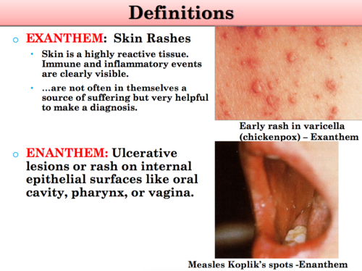
What are exanthems ?
• It is any eruptive skin rash that may be associated with fever or other systemic symptoms.
Causes include :
1- infectious pathogens which is the most common cause in children
2- medication reactions .
• Enanthemas : It is mucous membrane eruption

Slide 4
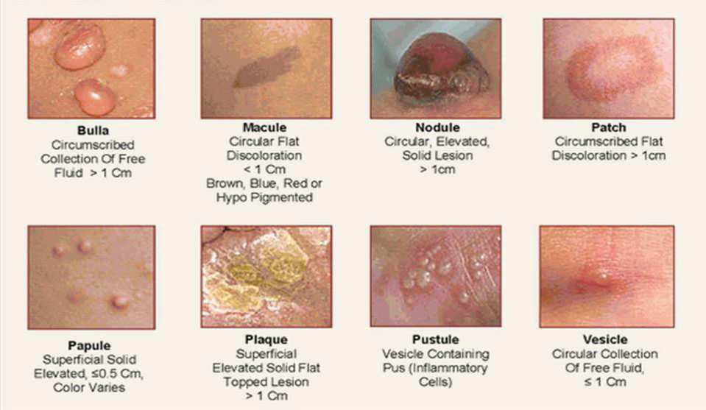

Slide 5
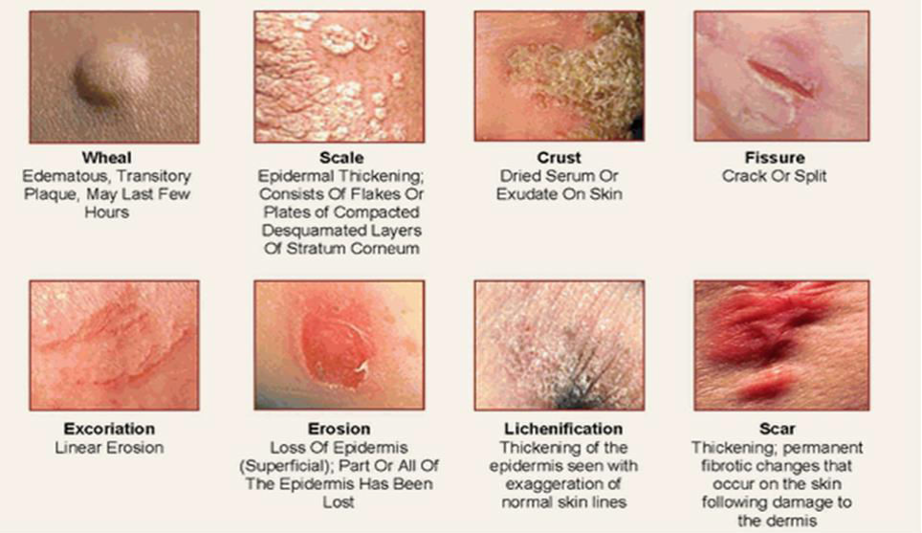

Slide 6
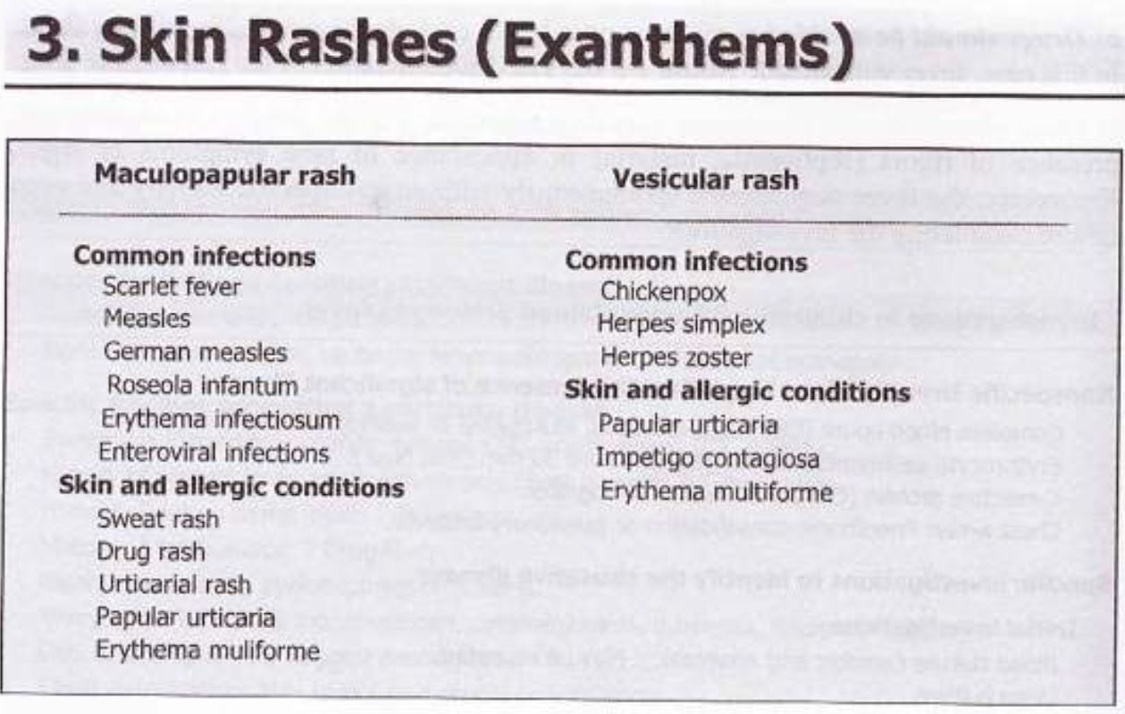

Slide 7
Erythema Infectiosum (Fifth disease)
Erythema infectiosum (fifth disease) is caused by the human parvovirus B19, a single-stranded DNA virus.
The cell receptor for parvovirus B19 is the erythrocyte P antigen
infects RBC precursors and endothelial cells RBC destruction leading to hydrops fetalis and death in fetus, pure RBC aplasia and rheumatoid arthritis–like symptoms in adults

Slide 8
Epidemiology
Erythema infectiosum is common.
most prevalent in school-age children (70% of cases occur in patients between 5 and 15 yr of age
usually occur in the spring.
The virus is transmitted by respiratory secretions and by blood product transfusions.

Slide 9
Clinical Manifestations
The incubation period is typically4-28 days (average: 16-17 days).
Parvovirus B19 infections are usually benign with a mild nonspecific illness characterized by fever, malaise, myalgias, and headache.
In adolescents and adults It usually present with myalgia, significant arthralgia or arthritis

Slide 10
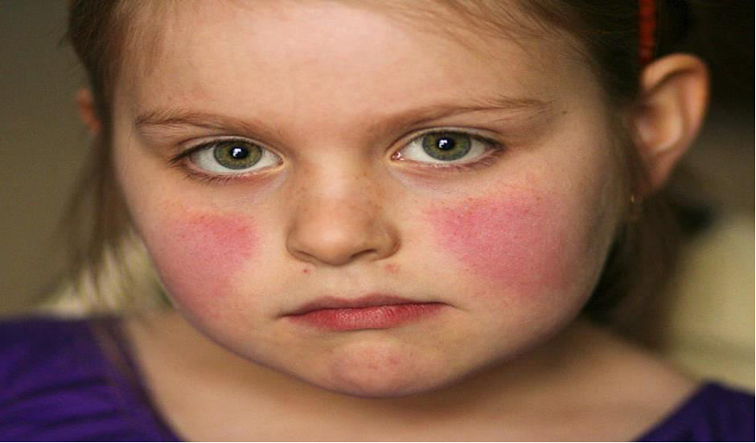
Erythema infectiosum is manifested by rash, low-grade or no fever, and occasionally pharyngitis and mild conjunctivitis.
The rash appears in three stages:
The initial stage is typically a “slapped cheek” rash with circumoral pallor.

Slide 11
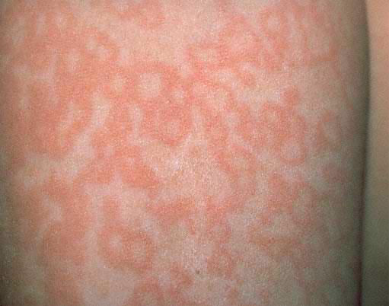
2. An erythematous symmetric maculopapular rash appears 1-4 days later.
3. Then fades as central clearing takes place giving rise to the distinctive lacy, reticulated rash that lasts 2-40 days ( mean 11 days ), this rash may be pruritic but does not desequamate

Slide 12
Diagnosis
Serology:
Detection of serum parvovirus B19-specific IgM antibody is the preferred diagnostic test last for 6 to 8 weeks
PCR for tissue or fluids.

Slide 13
Treatment
Immunocompetent: Self limited.
Immunocompromised with severe anemia or chronic infection:
IVIG (400 mg/kg daily for 5 days)
Aplastic crises: blood transfusions
congenital parvovirus B19 infection.:
1- In utero Blood Transfusion
2- IVIG

Slide 14
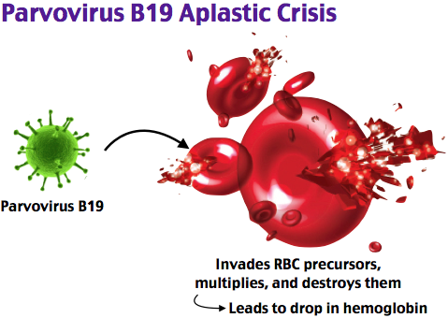
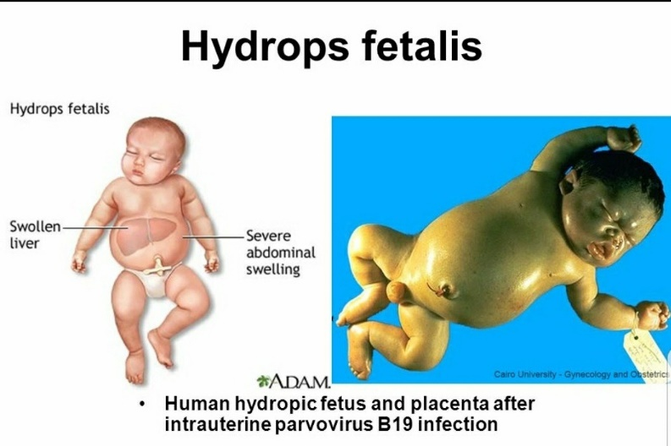
Complications
aplastic crises :
Children with shortened erythrocyte life span (e.g., sickle cell disease) may develop a transient aplastic crisis, ineffective erythroid production typically lasting 7-10 days.
Hydrops fetalis:
In utero infection of fetal erythroid cells may result in fetal heart failure, hydrops fetalis, and fetal death.

Slide 15
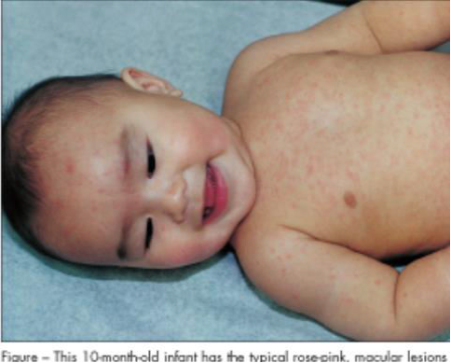
Roseola infantum (sixth disease)
Xanthem Subitum
Caused by Human Herpesvirus 6 (HHV-6)
Mode of transmission unknown (possibly from nasopharyngeal secretions)
Children 6 months – 4 years.
Most common exanthem before age 2.
No vaccine.

Slide 16
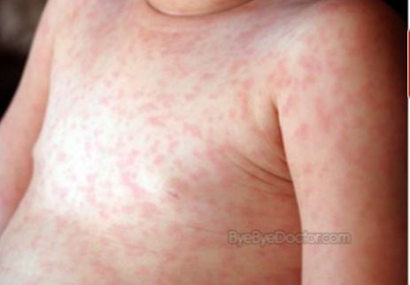
Epidemiology
The incidence of infection increases as maternally derived antibody level decline.
By 12 months of age, approximately 60-90% of children have antibodies to HHV-6, and essentially all children are seropositive by 2-3 years of age.

Slide 17
Clinical Manifestations
Roseola is characterized by high fever (often >40°C) with an abrupt onset that lasts 3-5 days. A maculopapular, rose-colored rash.
Upper respiratory symptoms.
Roseola is associated with approximately one third of febrile seizures.
Starts on trunks then spreads to the extremities

Slide 18
Reactivation of HHV-6 following bone marrow transplantation may result in bone marrow suppression, hepatitis, rash, and encephalitis.

Slide 19
Diagnosis & Treatment
Diagnosis:
Mainly Clinical.
PCR
Treatment:
Supportive.
anti viral : Ganciclovir or Foscarnet in immunocompromised.

Slide 20
Complications & Prognosis
The prognosis for roseola is excellent.
A few deaths have been attributed to HHV-6, usually in cases complicated by encephalitis or virus-associated hemophagocytosis syndrome.

Slide 21
CHICKENPOX
Caused by VARICELLA ZOSTER virus
PEOPLE WHO GET THE VIRUS OFTEN DEVELOP A RASH OF SPOT THAT LOOKS LIKE BLISTERS ALL OVER THEIR BODIES.
THE BLISTERS ARE SMALL AND SIT ON AN AREA OF RED SKIN THAT CAN BE ANYWHERE AND THEY ARE OF VARYING SIZE

Slide 22
A PERSON WITH CHICKENPOX IS CONTAGIOUS 1-2 DAYS BEFORE THE RASH APPERS AND UNTIL ALL BLISTERS HAVE FORMED SCABS.
IT MAKES FROM 10-21 DAYS AFTER AN INFECTED PERSON FOR SOMEONE TO DEVELOP CHICKENPOX.

Slide 23
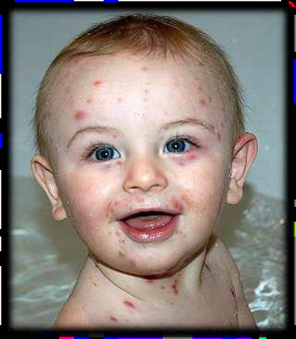
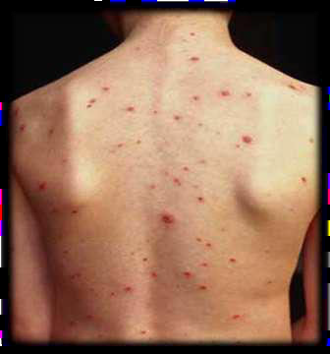
also known as HHV-3
MOST COMMON IN WINTER AND SPRING

Slide 24
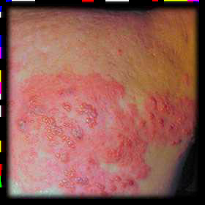
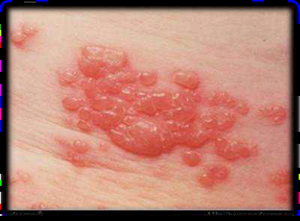
Etiology
VARICELLA ZOSTER VIRUS CAN CAUSE TWO DISTINCT LESIONS :
CHICKENPOX – PRIMARY LESION
HERPES ZOSTER – REACTIVATED LESION

Slide 25
INCUBATION PERIOD IS 2 WEEKS
MOST CONTAGIOUS
LESS SEVERE THAN SMALL POX
YOUNG CHILDREN GENERALLY HAVE EITHER NO OR A VERY MILD EFFECT

Slide 26
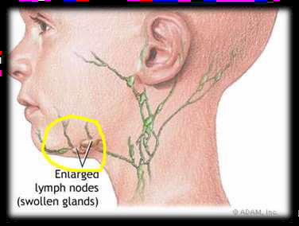
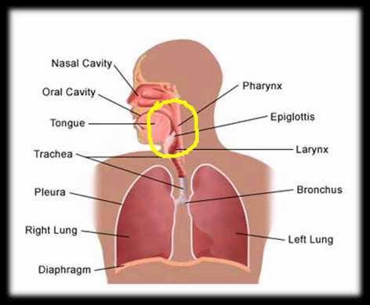
PATHOGENESIS
DAY 0-3
INFECTION OF CONJUCTIVAE AND MUCOSA OF THE UPPER RESPIRATORY TRACT.
VIRAL REPLICATION IN REGIONAL LYMPH NODES

Slide 27
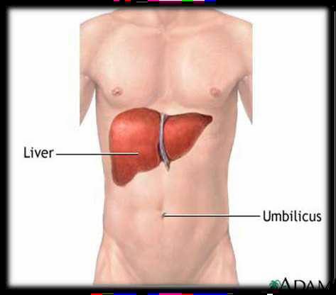
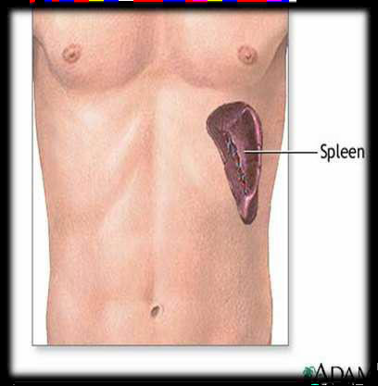
DAY 4-6
- PRIMARY VIREMIA,VIRAL INFECTION IN LIVER,SPLEEN AND OTHER ORGANS

Slide 28
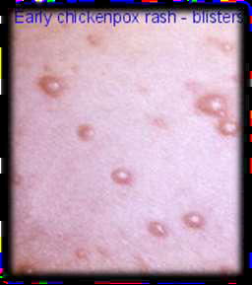
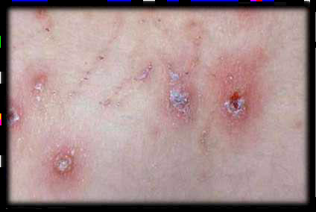
DAY 10-12
SECONDARY VIREMIA
DAY 14
- INFECTION OF SKIN AND APPERANCE OF VESICULAR RASH EXCORIATION

Slide 29
Symptoms
LOSS OF APETITE
COLD
FEVER
ABDOMINAL PAIN
HEADACHE
GENERAL FEELING OF lLLNESS
RASH
FATIGUE
SORE THROAT
FEVER MAY BE HIGH FOR FIRST FEW DAYS

Slide 30
Lab Diagnosis
-IgM Serology Test
- Isolation from Vesicular Fluid
-Stained Smear from Scrapings
-ELISA is also helpful

Slide 31
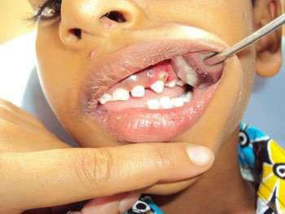
THESE LESIONS ARE NOT PARTICULARLY PAINFUL

Slide 32
Complications
BACTERIAL INFECTION OF LESIONS
PNEUMONIA
HOSPITALIZATION: 3 PER 1000 CASES
DEATH: 1 PER 60000
CNS INVOLVEMENT LEADS TO ENCEPHALITIS,TRANSVERSE MYELITIS
MYOCARDITIS,NEPHRITIS,ARTHRITIS

Slide 33
INCREASED RISK OF COMPLICATION:
- NORMAL ADULTS
- IMMUNO COMPROMISED PERSON
- PREGNANT WOMEN

Slide 34
Treatment
DRUGS USED IN THE TREATMENT OF CHICKENPOX ARE:
ANTIVIRAL DRUGS ,ANTIHISTAMINES & ANTIPYRETICS.
COMMOLNLY USED DRUG IS ACYCLOVIR
ANTIVIRAL MEDICINES CAN BE TAKEN ORALLY, INTRAVENOUSLY OR APPLIED ON THE SKIN.
THESE ARE PRESCRIBED TO PEOPLE WITH LONG TERM ILLNESS AND IMPAIRED IMMUNE SYSTEM & PREGNANT WOMEN.
ALSO OTHER DRUGS ARE GIVEN TO REDUCE FEVER, COLD, ITCHING, IRRITATION OF THE RASH , SORE THROAT etc.

Slide 35
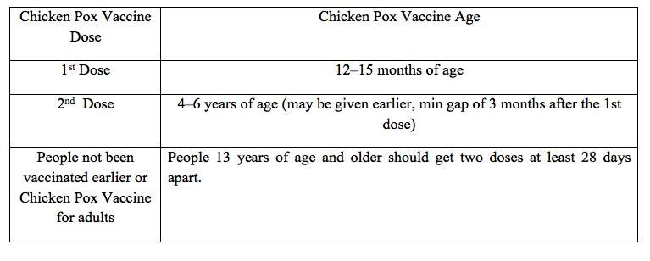

Slide 36
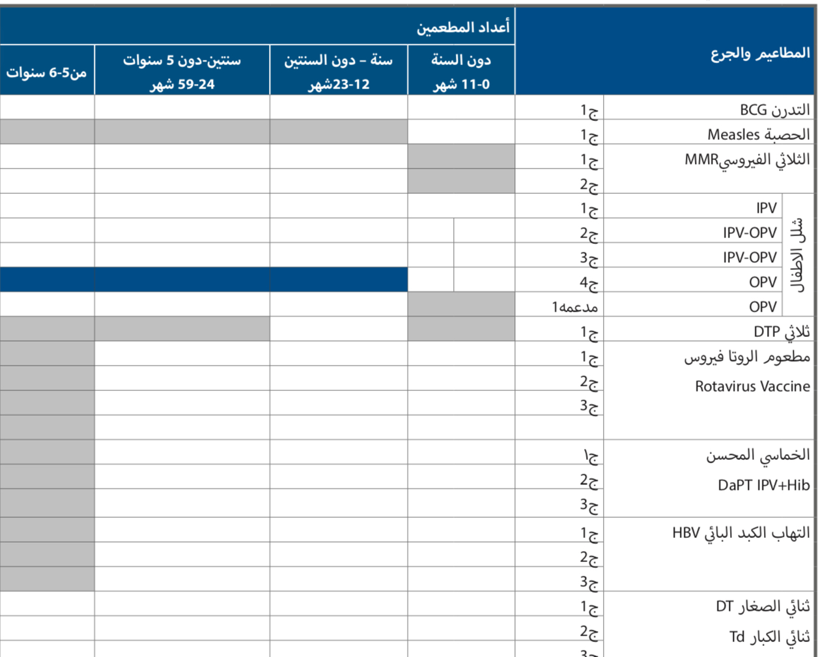

Slide 37
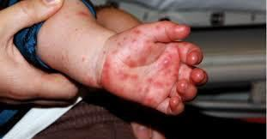
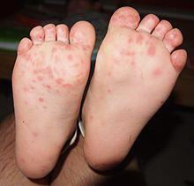
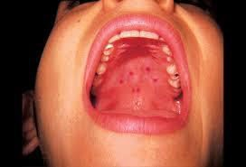
Hand-foot-and-mouth disease

Slide 38
Etiology is most frequently caused by coxsackie virus A16 entero virus 71but more severe
Clinical manifestation fever, nausea, vomiting, feeling tired, generalized discomfort, loss of appetite, and irritability

Slide 39
The oropharynx is inflamed and contains scattered vesicles (These may ulcerate)
Maculopapular, vesicular, and/or pustular lesions may occur on the hands and fingers, feet, and buttocks and groin
the hands are more commonly involved than the feet
Lesions on the hands and feet are usually tender, 3-7 mm vesicles that occur more commonly on dorsal surfaces.

Slide 40
Vesicles resolve in about 1 wk.
Buttock lesions do not usually progress to vesiculation.
Disseminated vesicular rashes may complicate preexisting eczema.

Slide 41
Coxsackievirus A16 also can occasionally be associated with complications such as
encephalitis
acute flaccid paralysis
myocarditis
pericarditis
shock
Onychomadesis (nail shedding) has been observed following coxsackievirus A6 and other coxsackievirus infections

Slide 42
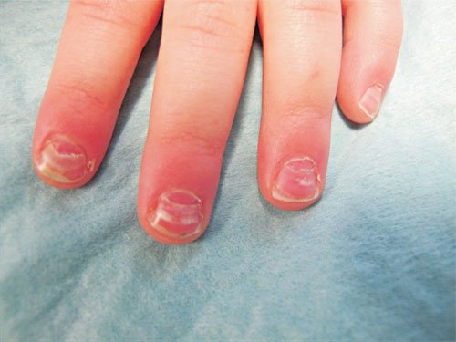

Slide 43
Coxsackievirus A6 is also responsible for atypical hand-foot-and-mouth disease (and herpangina), including fever, generalized rash , pain, dehydration

Slide 44
Diagnosis
Clinically
RT-PCR
Tx
No antiviral use supportive care is the mainstay of treatment.
If fever occur , check if there any systemic illness and treat it if needed.

Slide 45
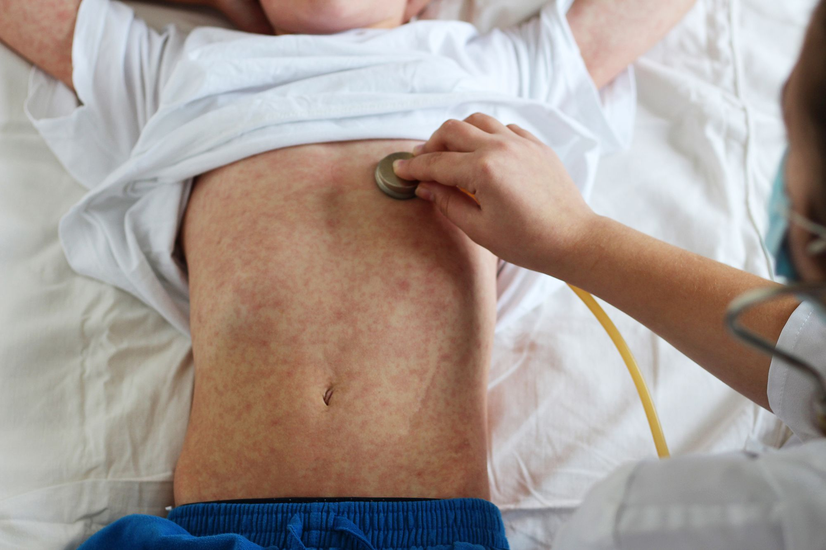
Measles (RUBEOLA)

Slide 46
It is an acute viral infection infects the upper respiratory tract and regional lymph nodes final stage with maculopapular rash
Definition

Slide 47
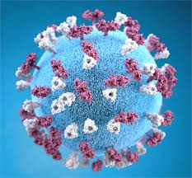
Etiology
Humans are the only hosts
single-stranded, lipid-enveloped RNA virus Paramyxoviridae.

Slide 48
Measles remains endemic in regions of the world where measles vaccination is not available
Most young infants are protected by transplacental maternal antibody until the end of their first year.
Epidemiology

Slide 49

Transmission highly contagious contact with droplets
1 to 2 days before onset of symptoms
5 days before to 4 days after the appearance of rash

Slide 50
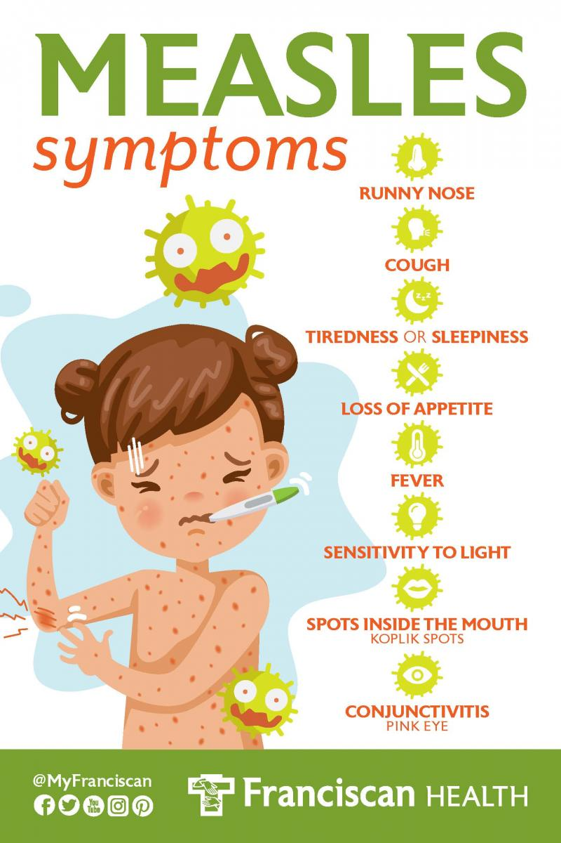

Slide 51
Measles consists of 4 phases
Incubation 8 to 12 days
Prodromal (catarrhal) 3-day
Exanthematous (rash) secondary viremia
Recovery

Slide 52
3-day prodromal period cough, coryza, conjunctivitis (photophobia)
Koplik spots that last 12 to 24 hours
Stimson line (transverse line of inflammation along the eyelid margin)

Slide 53
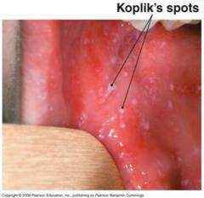
Koplik spots
pathognomonic sign of measles, appearing 1-4 days prior to the onset of the rash .

Slide 54
Exanthematous phase high fever macular rash (cephalad to caudal) black measles
Cervical lymphadenitis, splenomegaly, and mesenteric lymphadenopathy with abdominal pain (rarely)

Slide 55
describes mild cases of measles occurring in persons with partial protection against measles persons vaccinated before 12 months of age persons receiving immunoglobulin
Modified Measles

Slide 56
- Clinically
- Serology
IgM antibodies (1 to 2 days of the rash and persist for 1 to 2 months)
PCR not routinely
- LEUKOPENIA
Diagnosis

Slide 57
AGE RISK GROUP
1- patients younger than 5 yr of age (especially <1 yr of age) and older than 20 yr of age
2- pregnant women
3- Severe malnutrition
4-immunocompromised
Complications

Slide 58
- Otitis media (most common complication )
- Pneumonia
- Encephalomyelitis
- Diarrhea

Slide 59
- Pneumonia is the most common fatal complication of measles in children
-the most common complication overall in adults.
-The most common bacterial pathogens are Streptococcus pneumoniae, Haemophilus influenzae, and Staphylococcus aureus

Slide 60
Treatment
supportive
includes maintaining adequate hydration
and antipyretics
High-dose vitamin A supplementation
Uncomplicated measles is self limited, lasting for 10-12 days

Slide 61
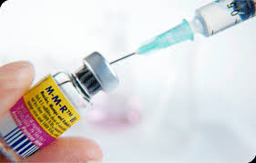
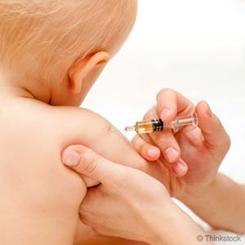
PREVENTION
Vaccination :
MMR
Post exposure Prophylaxis :
The vaccine is effective in prevention or modification of measles if given within 72 hr of exposure.
Immune globulin: may be given up to 6 days after exposure to prevent or modify infection.
Immune globulin is indicated :
- infants younger than 6 mo of age .
- pregnant women .
- immunocompromised persons.

Slide 62
MMR Vaccine
Children receive 2 doses of MMR vaccine.
- 1st dose(12-15 mon).
- 2nd dose( 4-6 years).
Children not received the 2nd dose by time should receive it as soon as possible but no later than (11-12 years)
Women who receive the vaccine should be counseled not to become pregnant within 28 days of vaccine administration

Slide 63
Rubella
( German measles / 3 day measles )
is a mild, often exanthematous disease of infants and children
more severe and associated with more complications in adults
Its major clinical significance the transplacental infection and fetal
damage as part of the congenital rubella syndrome (CRS).

Slide 64
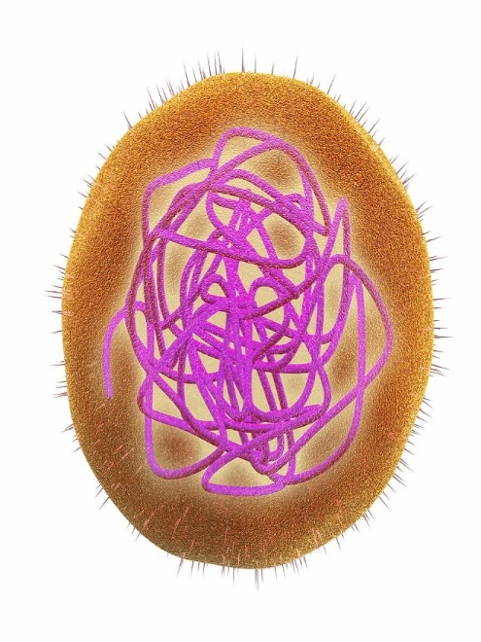
Etiology
Rubella virus is a member of the
Family : Togaviridae
Genus : Rubivirus.
It is a single-stranded RNA virus .
Humans are the only known host.

Slide 65
epidemics occurring in cycles of every 6 to 9 years unvaccinated populations
20 cases of rubella now occur annually in the United States.
Transplacental antibody is protective during the first 6 months of life.
Epidemiology

Slide 66
Rubella virus invades the respiratory epithelium and disseminates via a primary viremia then spreads to regional lymph nodes virus can be isolated from peripheral blood monocytes, cerebrospinal fluid, and urine.
The period of highest communicability 2 days before until 5 to 7 days after rash onset.
Pathogenesis

Slide 67
Clinical manifestation
Postnatal infection with rubella is a mild disease not easily discernible from other viral infections, especially in children.
incubation period 14-21 days.
prodromal phase:
consisting of low-grade fever( usually not higher than38 C
sore throat, red eyes with or without eye pain, headache, malaise, rhinorrhea , cough, anorexia
The characteristic signs of rubella are retroauricular, posterior cervical and posterior occipital lymphadenopathy

Slide 68
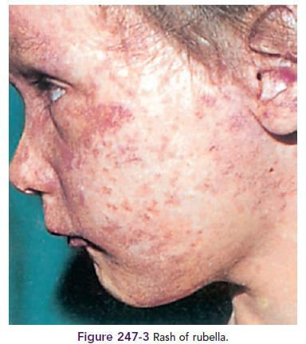
Exanthematous phase :
-Pruritic, pink to red macules and papules which begin on face ,neck and spread to trunk & extremities
Within 24 hours )Cephalocaudal(
-It then begins to fade on the face on the 2nd day and
disappears throughout the body by the end of 3rd day.

Slide 69
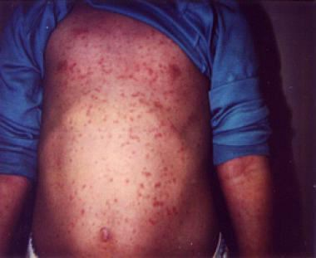
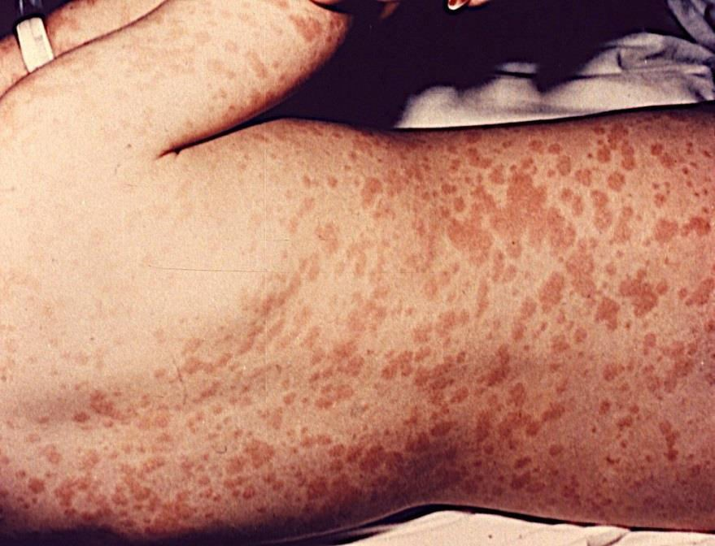

Slide 70
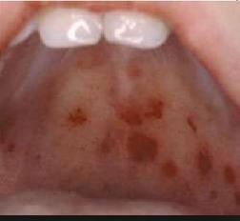
Subclinical infections are common, and 25- 40% of children may not have a rash.
About the time of onset of the rash, examination of the oropharynx may reveal tiny, rose-colored lesions (Forchheimer spots) or petechial hemorrhages on the soft palate.
It last for 3 days without desquamation .

Slide 71
Diagnosis
Clinical picture
Laboratory tests :
-The white blood cell count usually is normal Leukopenia, neutropenia, and mild thrombocytopenia can be found .
-The diagnostic test is Rubella immunoglobulin (Ig)M enzyme immunosorbent assay
CRS cases can have detectable IgM until 3 months of age

Slide 72
There is no specific therapy for rubella. Routine supportive care includes maintaining adequate hydration and antipyretics.
Treatment

Slide 73
Complications
Complications following postnatal infection with rubella are infrequent and generally not life-threatening.
Postinfectious thrombocytopenia
occurs in approximately 1 in 3,000 cases of rubella and occurs more frequently among children and in girls.
It manifests about 2 wk following the onset of the rash as petechiae, epistaxis, gastro-intestinal bleeding and hematuria.
It is usually self-limited.

Slide 74
Arthritis
more commonly among adults ,especially women.
It begins within 1 wk of onset of the
exanthem and classically involves the small
joints of the hands.
It also is self-limited

Slide 75
is the most serious complication of postnatal rubella.
It occurs in 2 forms: a postinfectious syndrome following acute rubella
Progressive rubella panencephalitis (PRP) is extremely rare manifesting as neurodegenerative disorder years following rubella..
Other neurologic syndromes rarely reported include Guillain-Barré syndrome and peripheral neuritis
Encephalitis

Slide 76
Congenital Rubella Syndrome
congenital rubella is rare in developed countries
The most important risk factor for severe congenital defects is the stage of gestation at the time of infection.
Maternal infection during the 1st 8 wk of gestation results in the most severe and widespread defects.

Slide 77
Pathophysiology
Fetal infection occurs transplacentally during the maternal viremic phase.
The occurrence of congenital defects approaches 85% if infection is acquired during the first 4 weeks of gestation; close to 40% spontaneously abort
If infection occurs during weeks 13 to 16, 35% of infants can have abnormalities
after 4 months’ gestation does not seem to cause disease.

Slide 78
the most common characteristic abnormalities associated with congenital rubella include ophthalmologic (cataracts,retinopathy, and glaucoma) cardiac (patent ductus arteriosus and peripheral pulmonary artery stenosis) auditory (sensorineural hearing loss)
Clinical Manifestation

Slide 79
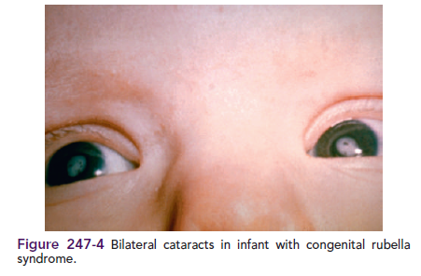

Slide 80
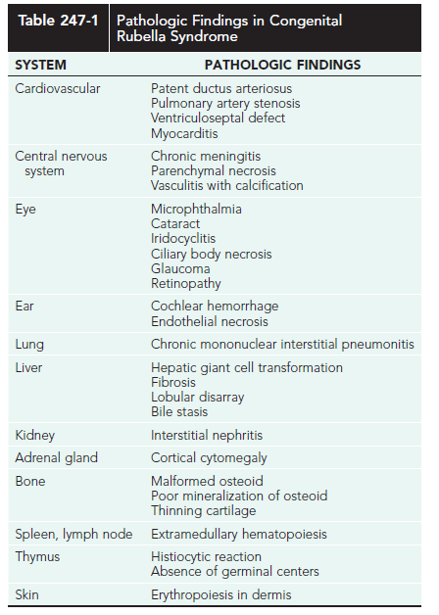

Slide 81
Treatment
There is no specific treatment available for either acquired rubella or CRS.
SUPPORTIVE CARE
Intravenous immunoglobulin or corticosteroids can be considered for severe, nonremitting thrombocytopenia

Slide 82



Prevention
ISOLATION
Standard plus droplet precautions are recommended for hospitalized patients.
VACCINATION

Slide 83
• The prognosis of postnatal rubella is good with full recovery, while
CRS may have a poor outcome with severe multiple-organ damage
Prognosis

Slide 84
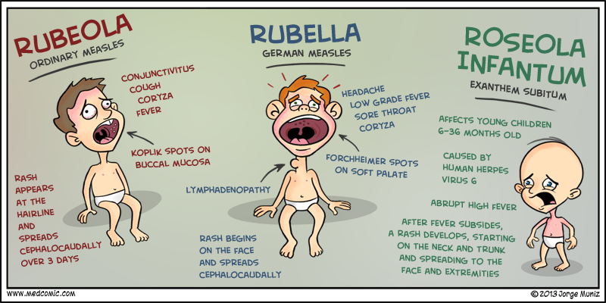

Slide 85
Thank You

