Slide 1
Cerebral Palsy
Esra’a Omar, Saba Alshurman, Rahaf Alkhateeb

Slide 2
DEFENITION: CEREBRAL PALSY (CP) IS A HETEROGENOUS GROUP OF DISORDERS AFFECTING THE MUSCLE TONE AND THE DEVELOPMENT OF MOVEMENT AND POSTURE. CP RESULTS FROM A NON-PROGRESSIVE (IT IS STATIC , SYMPTOMS AND FUNCTIONAL ABILITY CONTINUE TO EVOLVE AS THE NERVOUS SYSTEM MATURES) DAMAGE TO MOTOR PATHWAYS IN THE DEVELOPING BRAIN ( SO PRESENT EARLY IN LIFE ) USUALLY THEY HAVE TRUNCAL HYPOTONIA AND EXTREMITY SPASTICITY. BASICALLY THEY HAVE MOTOR DISORDERS, AND THEY MAY OR MAY NOT HAVE OTHER SYMPTOMS:
LEARNING DIFFICULTIES 60%
EPILEPSY 30%
OPHTHALMOPLEGIA , SQUINT 30%
HEARING PROBLEMS 20%
SPEECH PROBLEMS PAIN 60%
BLADDER PROBLEMS 60%
SLEEPING DISORDER 20%

Slide 3
EPIDEMOLOGY :
The timing of the injury may be prenatal or perinatal, or it may occur during the first few years of life.
Most common motor disability in children
Approx. 2/1000 live births in developed countries
The prevalence of CP is far higher in preterm compared with term infants and increases with decreasing gestational age (GA) and birth weight
Most children with CP, except in its mildest forms, are diagnosed in the first 18 months of life when they fail to attain motor milestones or show abnormalities such as asymmetric gross motor function, hypertonia, or hypotonia

Slide 4
ETIOLOGY :
The etiology of CP is often Multifactorial; CP results from static injury or lesions in the developing brain, occurring prenatally, perinatally, or postnatally.
Ten percent of children with CP have acquired CP, developing at later ages, Meningitis and head injury (accidental and nonaccidental) are the most common causes of acquired CP.
Nearly 50% of children with CP have no identifiable risk factors.
CP is not inherited, but its causes might be inherited.

Slide 5
RISK FACTORS :
1- Prematurity and LBW
2-TORCH infection”
3-Perinatal asphyxia “ A lack of oxygen supply shortly before, during, or after delivery can result in hypoxic-ischemic encephalopathy, which is linked to the development of cerebral palsy “
4-Interaventricular hemorrhage
5-Structural abnormality of the brain
6-Neonatal seizures
7-Kernicterus
8-Postnatal infection
9- stroke
10 genetic susceptibility

Slide 6
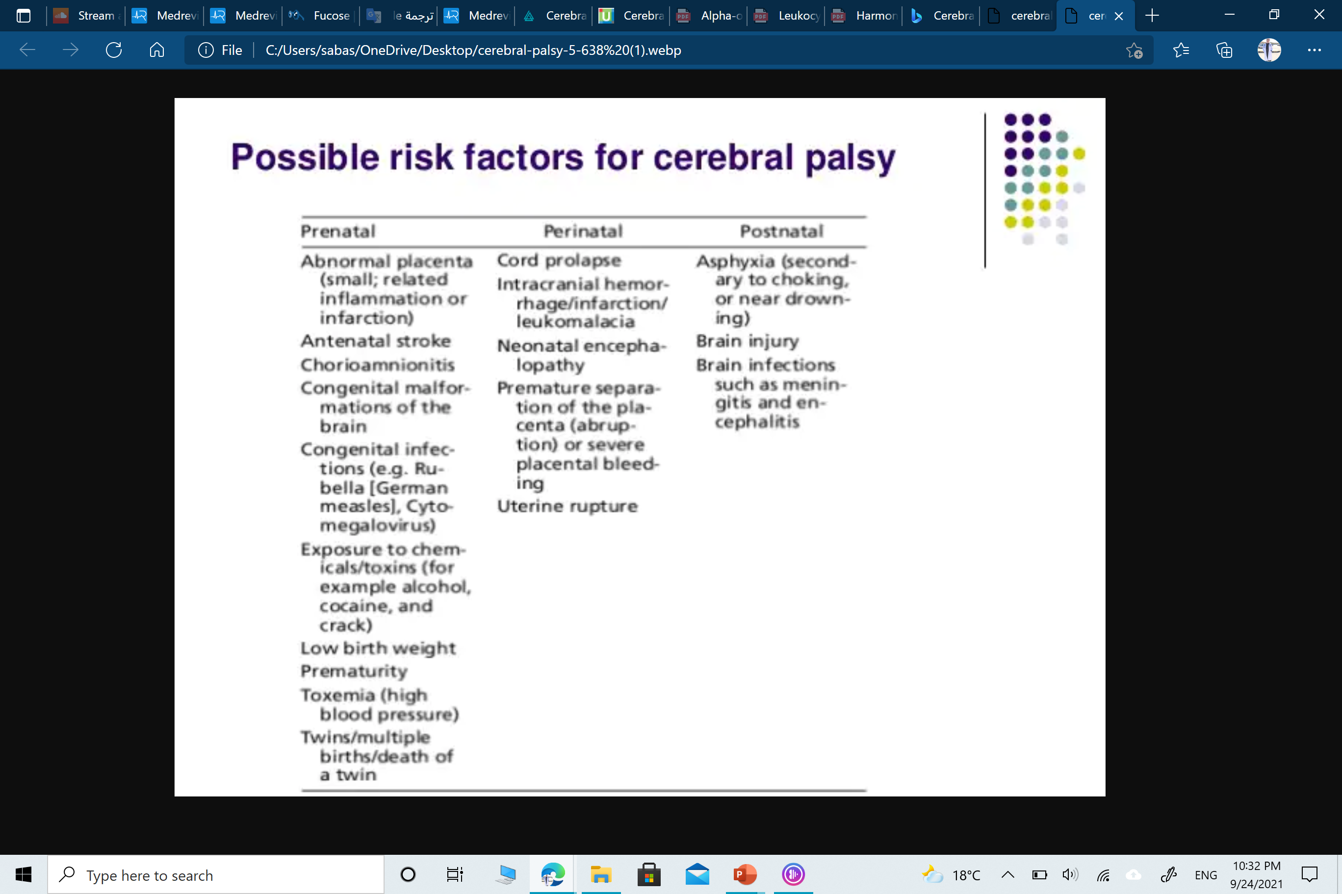

Slide 7
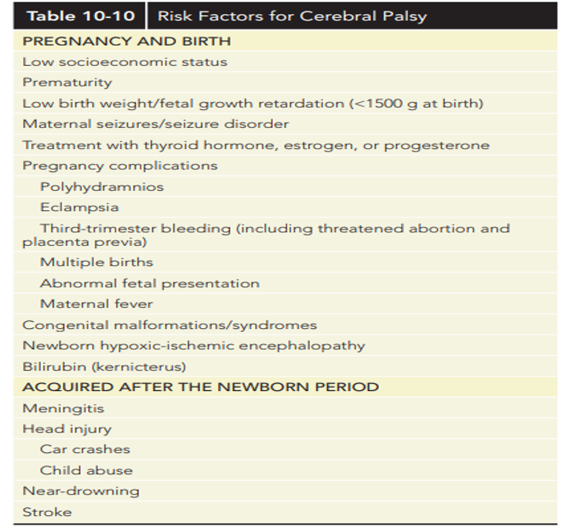

Slide 8
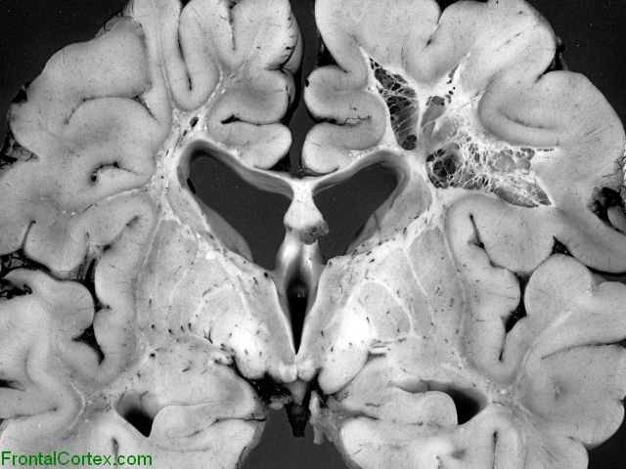
Prematurity :
Conditions that affect preterm infant and may lead to CP :
Periventricular leukomalacia (PVL) – PVL refers to injury of cerebral white matter that occurs in a characteristic distribution and consists of periventricular focal necrosis, with subsequent cystic formation, and more diffuse cerebral white matter injury.
PVL is the major form of brain white matter injury that affects premature infants.
CP develops in approximately 5 to 15 percent of surviving preterm very low birth weight (VLBW; BW <1500 g) infants, In this population, CP is often associated with PVL
Intraventricular hemorrhage (IVH) – Severe IVH, periventricular hemorrhagic infarction, and posthemorrhagic hydrocephalus (a potential complication of IVH) may lead to CP.
Bronchopulmonary dysplasia (BPD) – The risk of motor impairment is greater in preterm infants affected by BPD. The mechanism is not known but may involve the use of corticosteroids to improve lung disease.
Notes:
Periventricular leukomalacia (PVL) is a type of brain injury that affects premature infants. The condition involves the death of small areas of brain tissue around fluid-filled areas called ventricles. The damage creates "holes" in the brain. "Leuko" refers to the brain's white matter. "Periventricular" refers to the area around the ventricles.

Slide 9
Intracranial hemorrhage (ICH)
Intracranial hemorrhage (ICH) in term infants is unusual but frequently results in neuromotor abnormalities.
Most are recognized because of the sudden and dramatic onset of symptoms, including seizures, abnormal movements, apnea, lethargy, irritability, vomiting, and bulging fontanelle.
Diagnosis is made by cranial imaging

Slide 10
Perinatal hypoxic-ischemic encephalopathy
In the term infant, severe perinatal asphyxia can cause parasagittal cortical injury and infarction in the brainstem and basal ganglia and lead to the development of spastic quadriparesis.
Neonates with severe intrapartum hypoxia-ischemia may have seizures, coma, hypotonia, dysfunction of other organ systems, a persistently low Apgar score, and evidence of profound metabolic acidosis.
On magnetic resonance imaging (MRI), two main patterns of hypoxic-ischemic injury are seen: basal ganglia/thalamic-predominant pattern and a watershed-predominant pattern

Slide 11
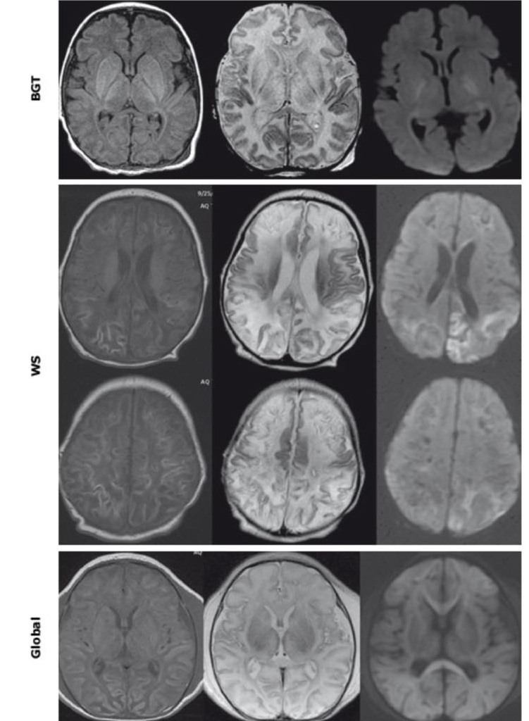
Patterns of brain injury in neonates with hypoxic-ischemic encephalopathy on T1-weighted, T2-weighted, and DWI.
MRI: magnetic resonance imaging; DWI: diffusion-weighted images; BGT: basal ganglia/thalamic-predominant injury; WS: watershed with cortical laminar necrosis and subcortical white matter injury; Global: global pattern with total cerebral injury

Slide 12
Genetic Susceptibility
Genetic disorders were historically thought to be uncommon causes of CP, but with the advent of next-generation genetic testing techniques, they are increasingly recognized as playing an important role in the etiology of CP.
The aggregation of CP in groups with high consanguinity and observations of increased familial risk for CP suggests a genetic contribution to CP risk.
Several genetic polymorphisms have been associated with susceptibility for CP, including apolipoprotein E , genes associated with thrombophilia (eg, prothrombin G20210A mutation), and genes involved with inflammation (eg, inducible nitric oxide synthetase, lymphotoxin alpha, and certain cytokines). However, only the association with prothrombin G20210A mutation was confirmed by a subsequent large study.

Slide 13
Multiple Births
The risk of CP is increased among multiple births, Causes that may contribute to this risk include low BW, prematurity, congenital anomalies, cord entanglement, and abnormal vascular connections.
Death of a co-twin greatly increases the risk of CP, The mechanism may include release of thromboplastin and emboli from the dead twin, causing injury to the survivor.
Postnatal death also increases the risk of CP in the surviving co-twin, and monozygosity appears to influence this risk.

Slide 14
Brain malformations
In some children, CP results from brain malformations. The biologic basis of most of these is unknown.

Slide 15
Stroke
Stroke in the perinatal period contributes to CP, especially spastic hemiparesis.
Thromboembolism and prothrombotic disorders contribute to the etiology of this disorder.
Lesions typically are identified by cranial imaging studies following a neonatal seizure, However, some newborns with stroke are asymptomatic until hemiparesis or other abnormalities develop later in infancy or childhood.

Slide 16
Intrauterine infection
Intrauterine infection is associated with an increased risk of CP. Congenital infections with organisms such as cytomegalovirus, syphilis, Zika virus, varicella virus, and toxoplasmosis play a role [TORCH infections].
Bacterial infections are also associated with CP.
Maternal chorioamnionitis is associated with an increased risk of CP in term infants.
In preterm infants perinatal infection appears to play a key role in the pathogenesis of PVL and subsequent CP.

Slide 17
Acquired postnatal causes
While most cases are due to prenatal or perinatal factors, CP can also result from insults to the developing brain acquired during infancy and early childhood. Approximately 10 to 18 percent of cases of CP are acquired after the neonatal period.
Most of these patients have spastic CP.
Stroke
Trauma
Severe hypoxic events such as near-drowning.
Sepsis or meningitis.
Kernicterus

Slide 18
EARLY SIGN :
The diagnosis of CP is typically made between the age of 12 to 24 months, though earlier diagnosis is becoming increasingly common . Suggestive signs and symptoms may be present in infancy. Presentation generally points to a specific CP subtype, though there is substantial overlap in the clinical features of these subtypes
Motor milestones: Not sitting by eight months, not walking by 18 months, early asymmetry of hand function (hand preference) before one year
-Definite hand preference before 1 year of age, suggests a one-sided muscle weakness and is a red flag for hemiplegia!
- Neurobehavioral signs: The baby often is irritable, sleeps poorly, vomits frequently.
- Developmental reflexes: delay in the disappearance or exaggeration of a developmental reflex may be an early indication of motor disability.
- Motor tone and posture: Persistent or asymmetric fisting may be present, poor head control,

Slide 19
CLASSIFICATION
Spastic 75-80%
1- MONOPLEGIA (Rare)
2- DIPLEGIA
3- HEMIPLEGIA
4- QUADRIPLEGIA
Dyskientic 10-15%
1- Chorioathetoide
2- Athetoid
3- Dystonic
Ataxic 1%
Mixed 10%

Slide 20
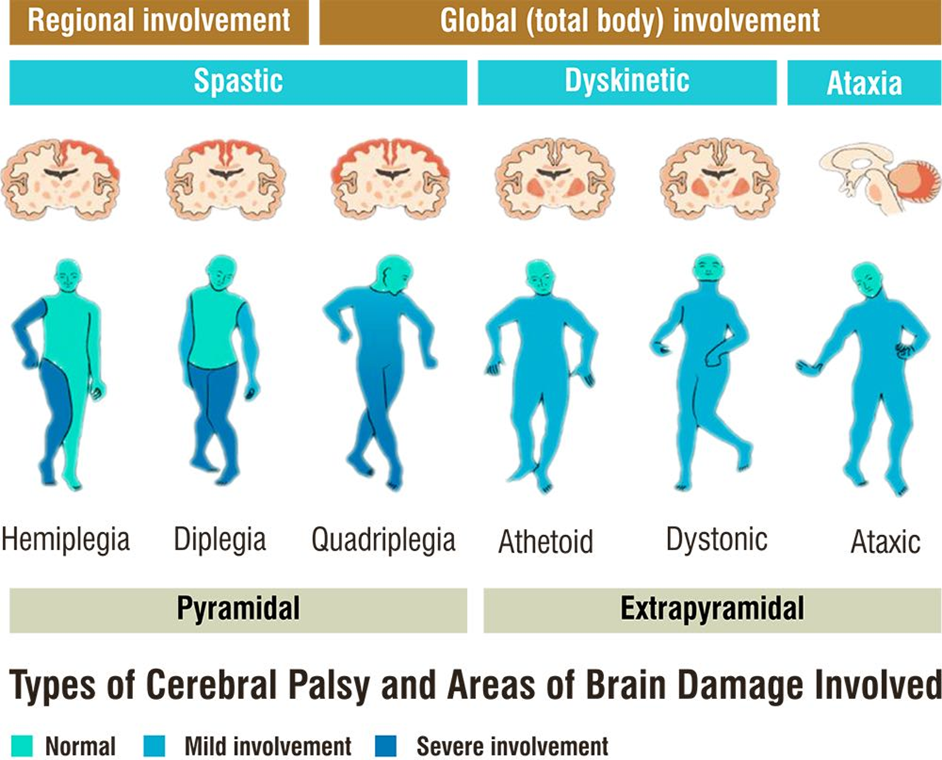

Slide 21
Spastic
Most common type (80%)
the problem in the cerebral cortex
stiff and difficulty moving

Slide 22
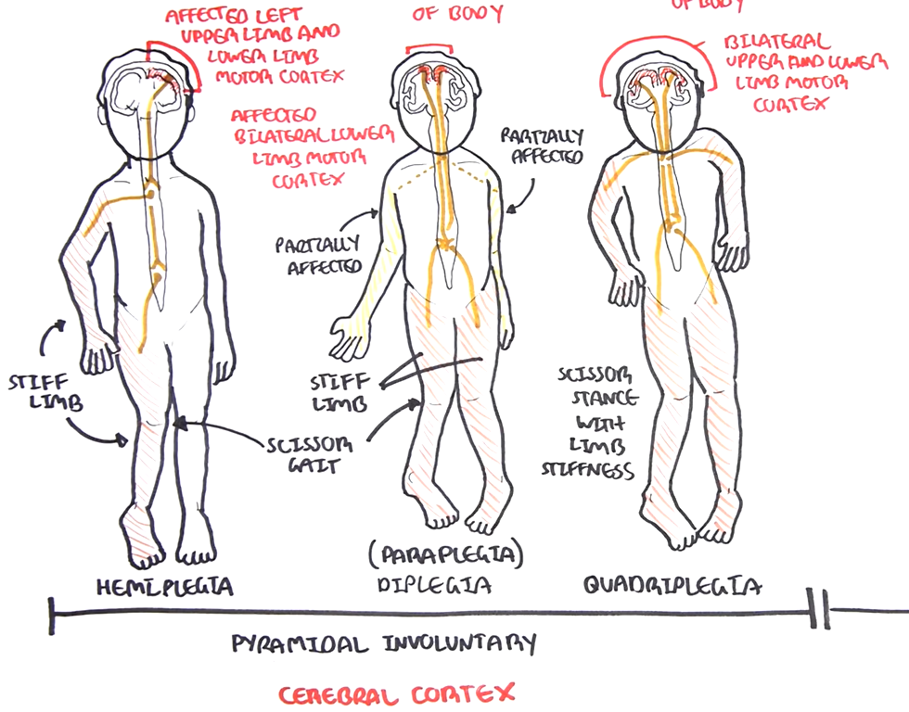

Slide 23
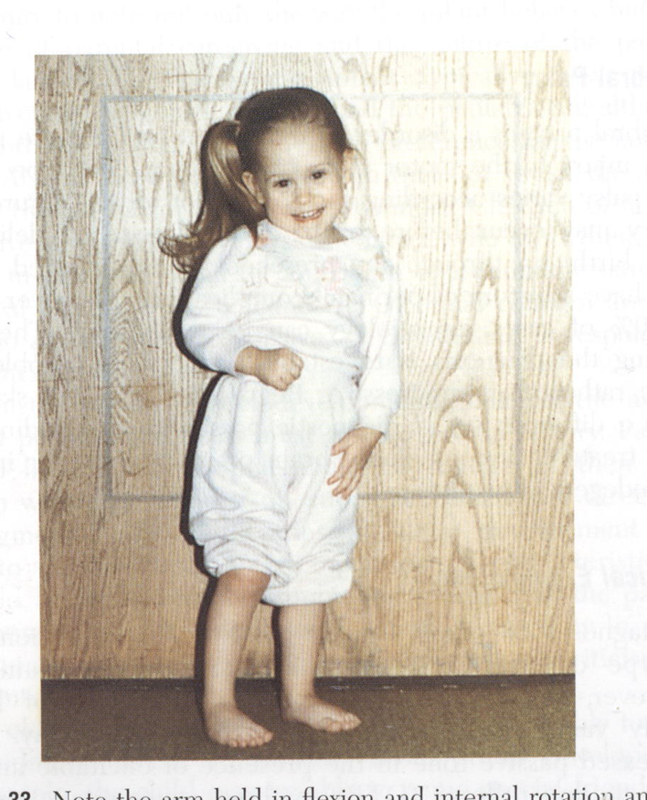
Spastic hemiplegia
21 to 40% of CP cases.
Typically affect term infants of normal birth weight.
One side of the body is affected.
The arm typically is more affected than the leg.
Early (before age 12 months) hand dominance.
The arm is adducted at the shoulder
and flexed at the elbow, the forearm is pronated,
and the wrist and fingers are flexed with the hand closed.
The hip is partially flexed and adducted,
and the knee and ankle are flexed;
the foot may remain in the equinovarus or
calcaneovalgus position.

Slide 24
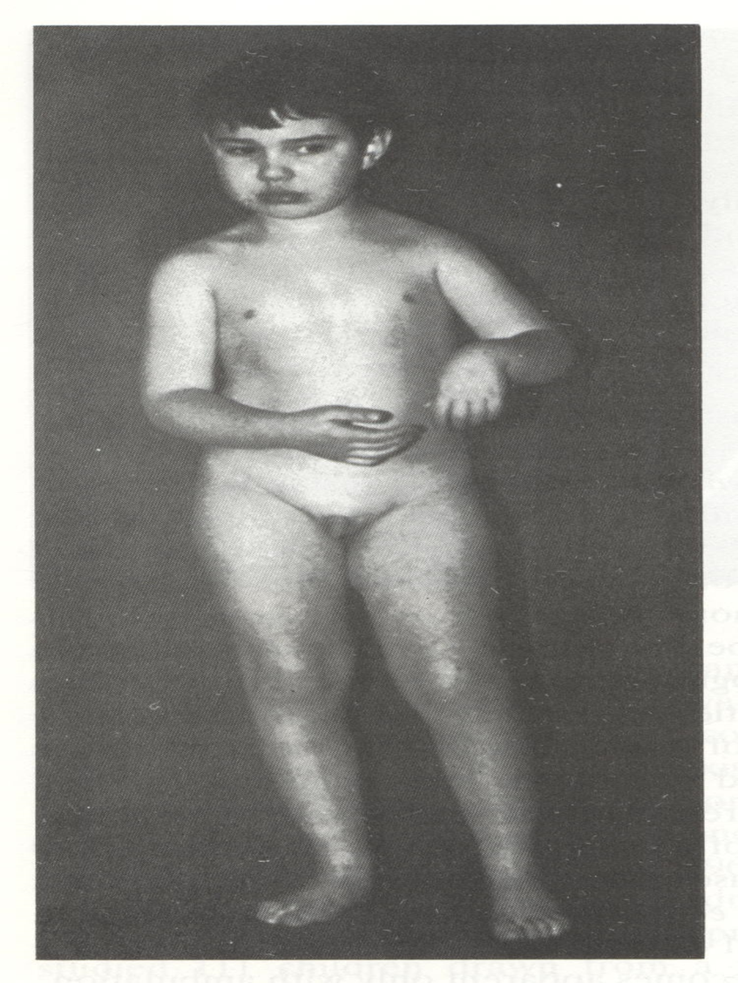
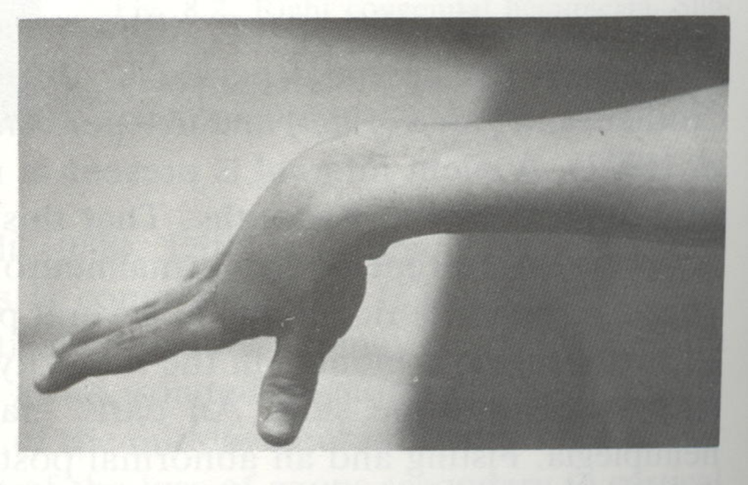
In mildly affected patients, postural abnormalities are more apparent during walking or running; however, unless severe intellectual disability is present, independent walking usually occurs at the appropriate age or is only slightly delayed.
Delayed walk 18-24 months
Circumductive gait
Tip toe walk affected leg
DTR exaggerated

Slide 25
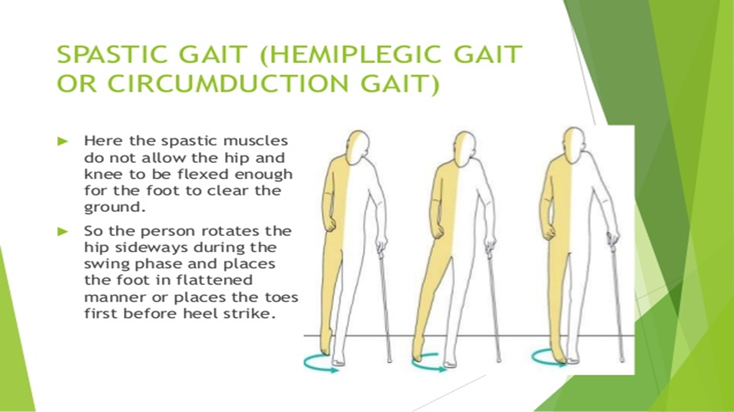

Slide 26
Spastic diplegia
13 to 25% of CP cases
Preterm infants.
Risk increases with decreasing gestational age
First few months – Hypotonia of the lower limbs with delayed functional maturation.
Crawling drag the legs behind
Delayed walking tip toe walking
Scissoring posture
In Children >5 years old:
Lower limbs are more affected than the upper limbs
Affected patients have flexion, adduction, and internal rotation of the hips with contractures of the hip flexors and hamstring muscles.
Reduced limb length and muscle bulk in lower extremities

Slide 27
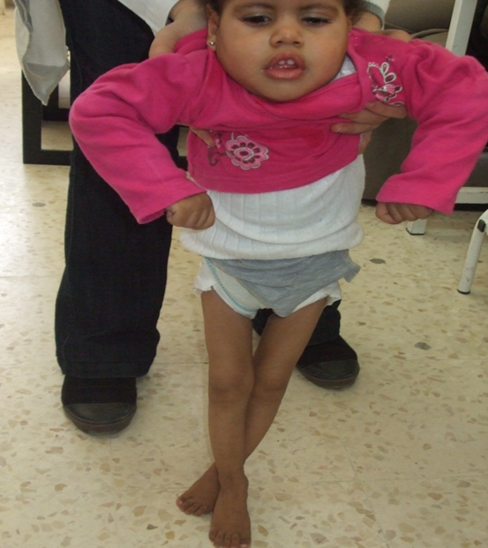
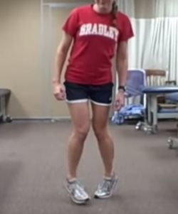

Slide 28
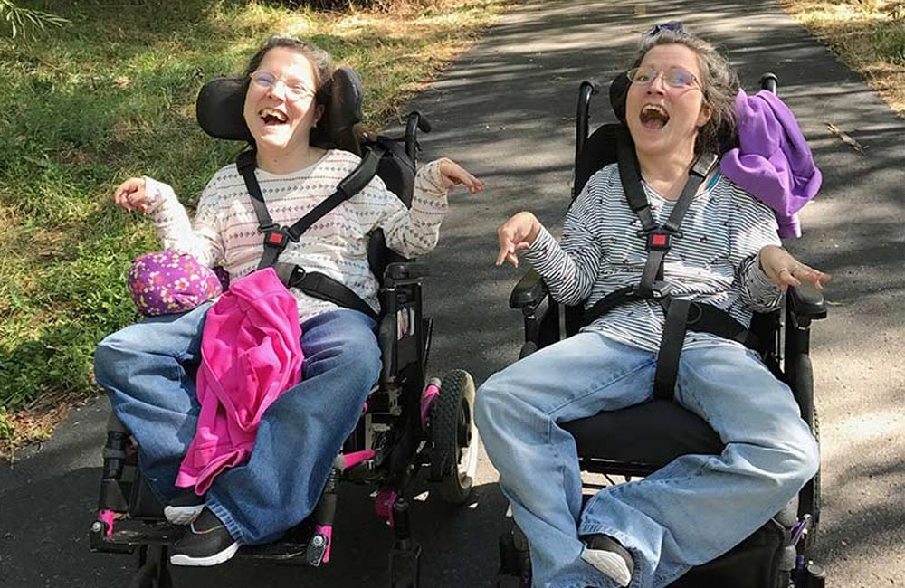
SPASTIC QUARIPLEGIA
20 to 43% of CP cases.
The most severe form of CP
Most commonly term SGA infants,
but can also occur in preterm infants.
All limbs are affected.
Upper limbs may be equally or
more involved than lower limbs.
Moderate or severe psychomotor delay.
Poor head control..
Adduction of the thighs results in typical scissoring of the legs.
By 9 to 10 months of age, infants when pulled to sitting
are unable to flex the legs and have poor truncal balance.
Children often are severely handicapped

Slide 29
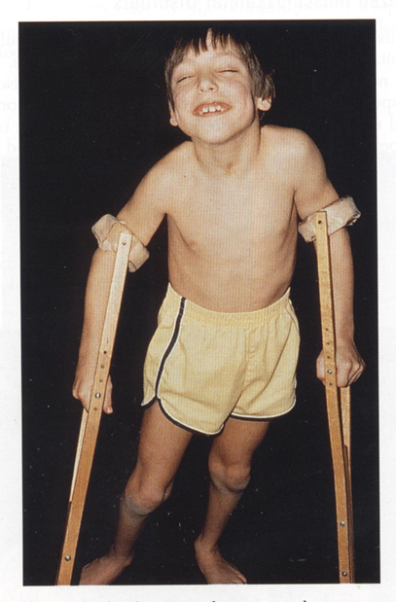
Associated :
- Mental Retardation
-chronic respiratory insufficiency
- seizures
- swallowing difficulties
- aspiration pneumonia
- speech
- visual abnormalities

Slide 30
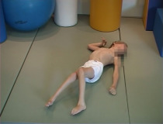
Dyskinesia
Most cases are caused by severe perinatal asphyxia resulting in injury to the thalamus, basal ganglia, hippocampus, reticular formation, and/or cerebellum.
Predominantly term infants.
In early infancy:
Reduced spontaneous movement.
Persistence of primitive reflexes
Involuntary grimacing
Drooling
Delayed psychomotor development

Slide 31
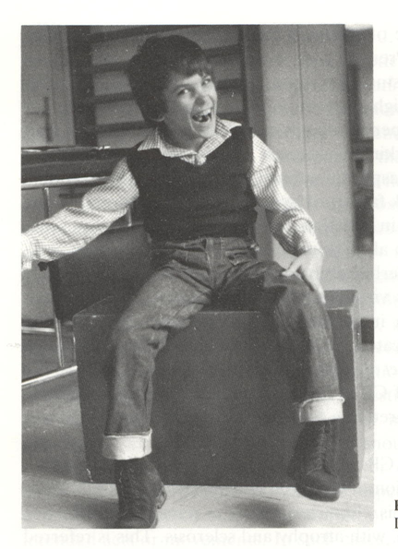
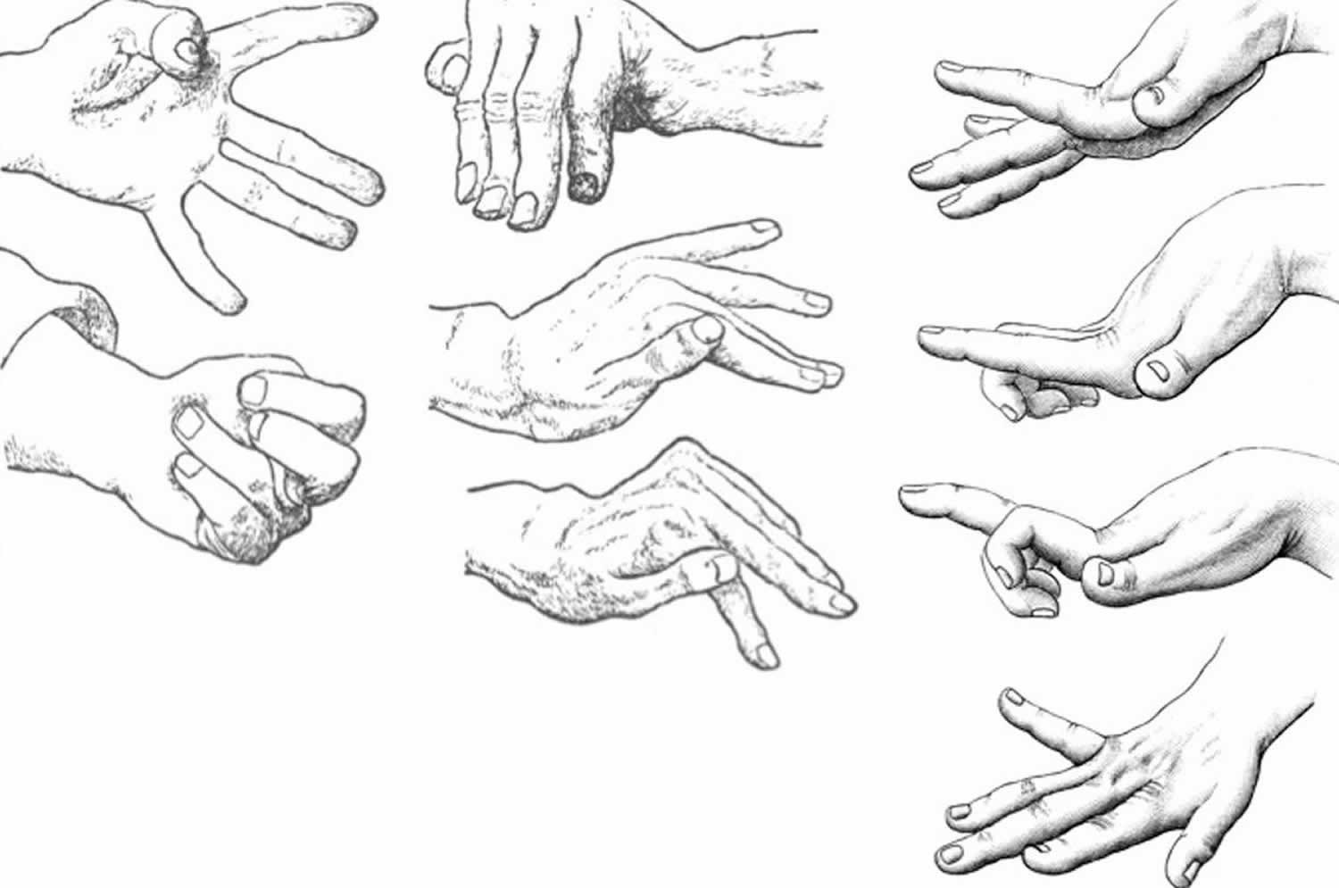
Age 2 to 3 years:
Involuntary movements are apparent
Abnormal posturing:
Extension patterns in the supine position
Flexion with shoulder retraction in the prone position
Head usually is persistently turned to one side
Variable degree of dysarthria and intellectual disability.

Slide 32
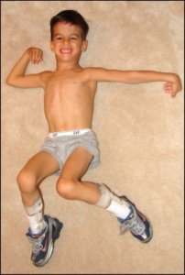
Choreoathetotic CP:
Chorea consists of rapid, irregular, unpredictable contractions of individual muscles or small muscle groups that involve the face, bulbar muscles, proximal extremities, and fingers and toes.
Athetosis consists of slow, smooth, writhing movements that involve distal muscles.
Movements may be induced or accentuated by emotion or change in posture.
Athetosis is most apparent during reaching
Stress, excitement, or fever may exacerbate chorea
Primitive reflexes often are retained
Oropharyngeal difficulties occur commonly
Speech affected
Seizures are common
ASSOCIATED; Asphyxia and hyperbilirubinemia

Slide 33
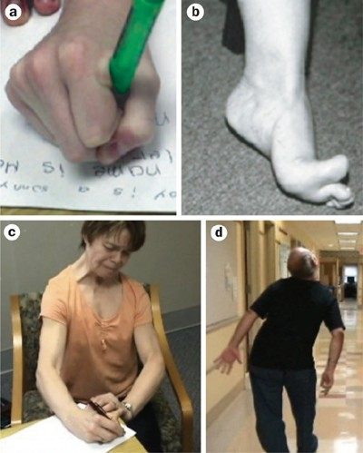
Dyskinetics (dystonia):
Dystonia — The second category of dyskinetic CP is characterized by dystonia, although tension and persistent neonatal reflex patterns often occur.
Repetitive, patterned, twisting, and sustained movements
of the trunk and limbs that may be either slow or rapid.
"Tension," a sudden involuntary increase in tone
affecting both flexor and extensor muscles,
may occur during attempted movement or with emotion.
Tendon reflexes are normal or may be difficult to elicit.
Clonus and extensor plantar responses are absent.
Affected patients usually are severely disabled in
all four limbs, the trunk, and pharyngeal muscles.

Slide 34
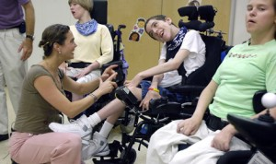
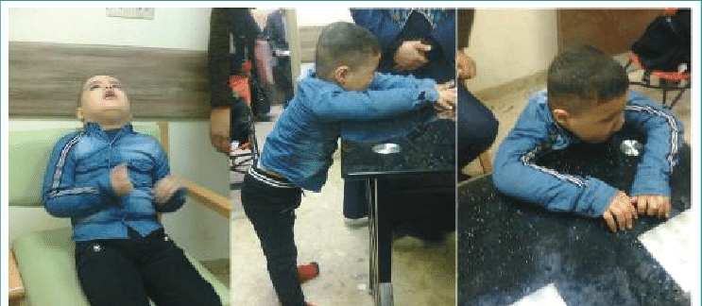
ATAXIC CP
4 to 13% of CP cases
Most cases are caused by early prenatal events.
Some cases have genetic causes, including:
Cerebellar hypoplasia , Granule cell deficiency,
Joubert syndrome.
Acquired cases --- hydrocephalus
Term infants.
Hypotonia and incoordination
Motor milestones and language skills typically are delayed.
Ataxic movements.
Ataxia usually improves with time.
Speech typically is slow, jerky, and explosive.
Wide based gait.

Slide 35
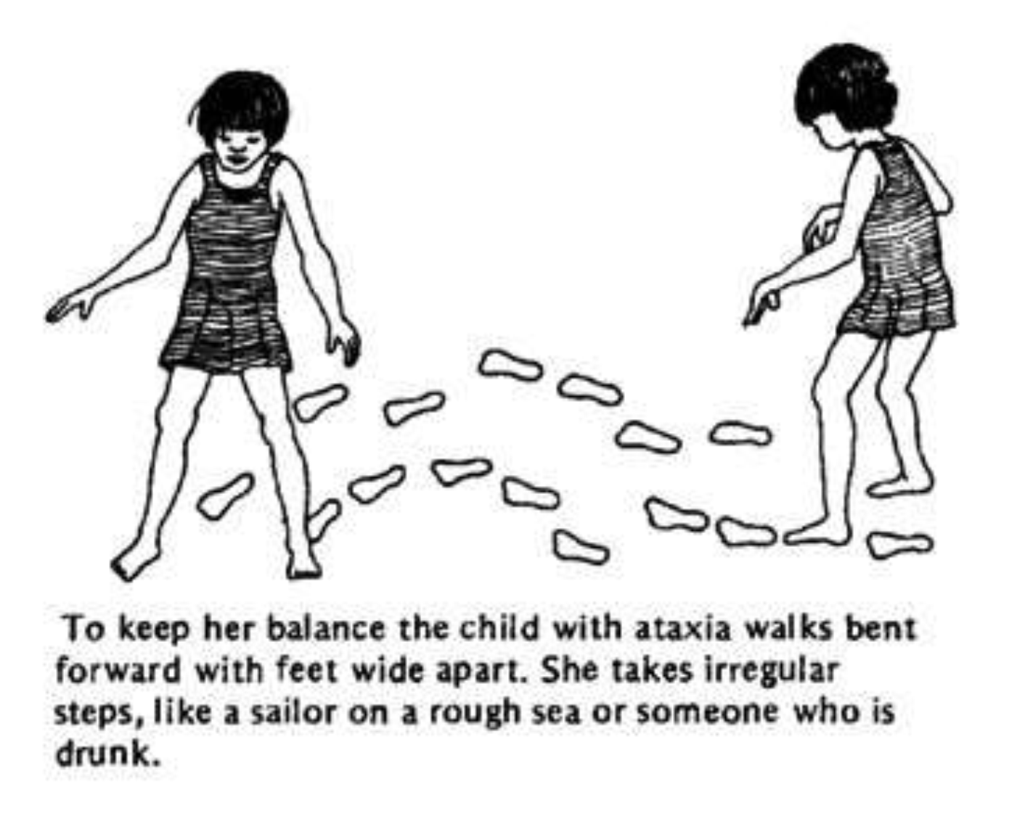

Slide 36
MIXED FORMS CP
Presence of athetoide movement in one limb and hemiplegia in the other or presence of ataxia and spasticity.
Functional analysis of individual patient is the bases of therapy.

Slide 37
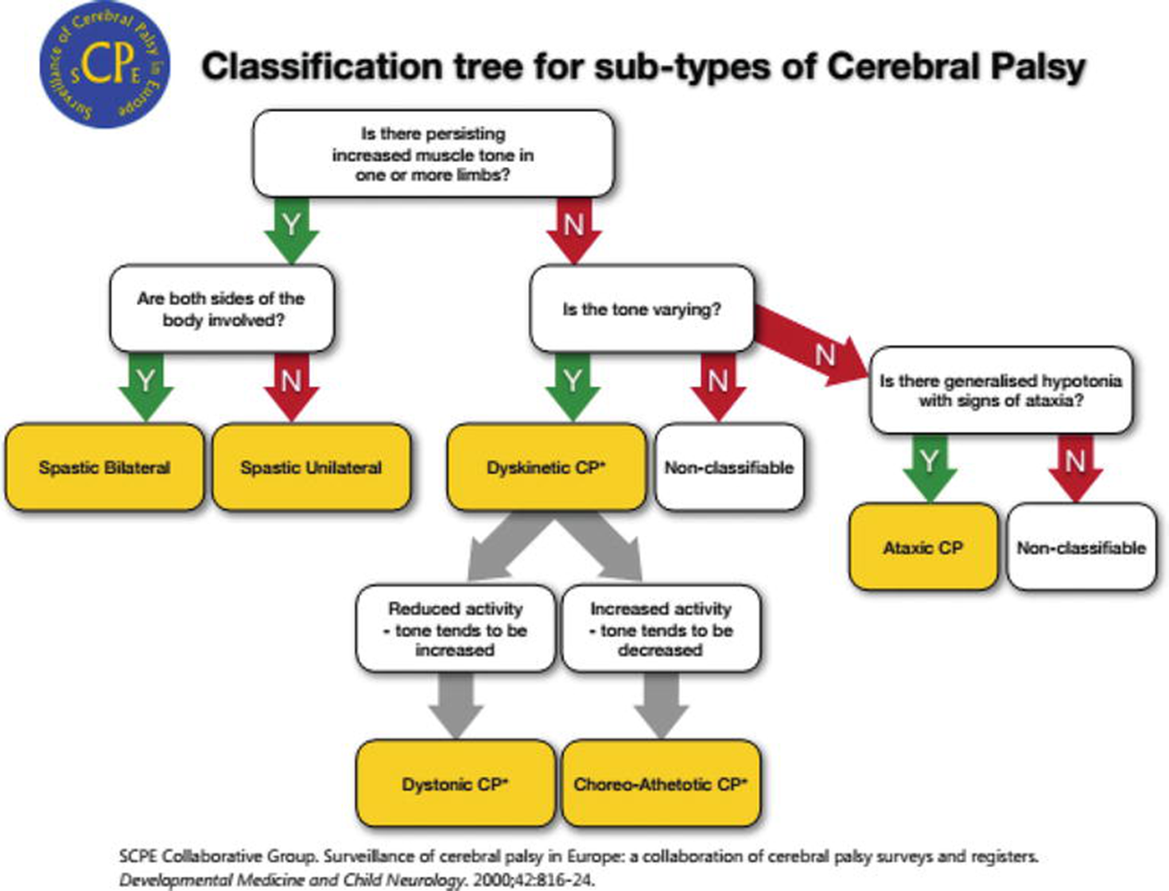

Slide 38
The Gross Motor Function Classification System
The Gross Motor Function Classification System (GMFCS) is used to categorize functional motor impairment in children with CP. Coupled with the child's CP subtype and cause, the GMFCS level allows providers to quickly grasp a global impression of a child's presentation.
The Gross Motor Function Classification System (GMFCS) levels I to V are the following:
LEVEL I - Walks without Limitations
LEVEL II - Walks with Limitations
LEVEL III - Walks Using a Hand-Held Mobility Device
LEVEL IV - Self-Mobility with Limitations; May Use Powered Mobility
LEVEL V - Transported in a Manual Wheelchair

Slide 39
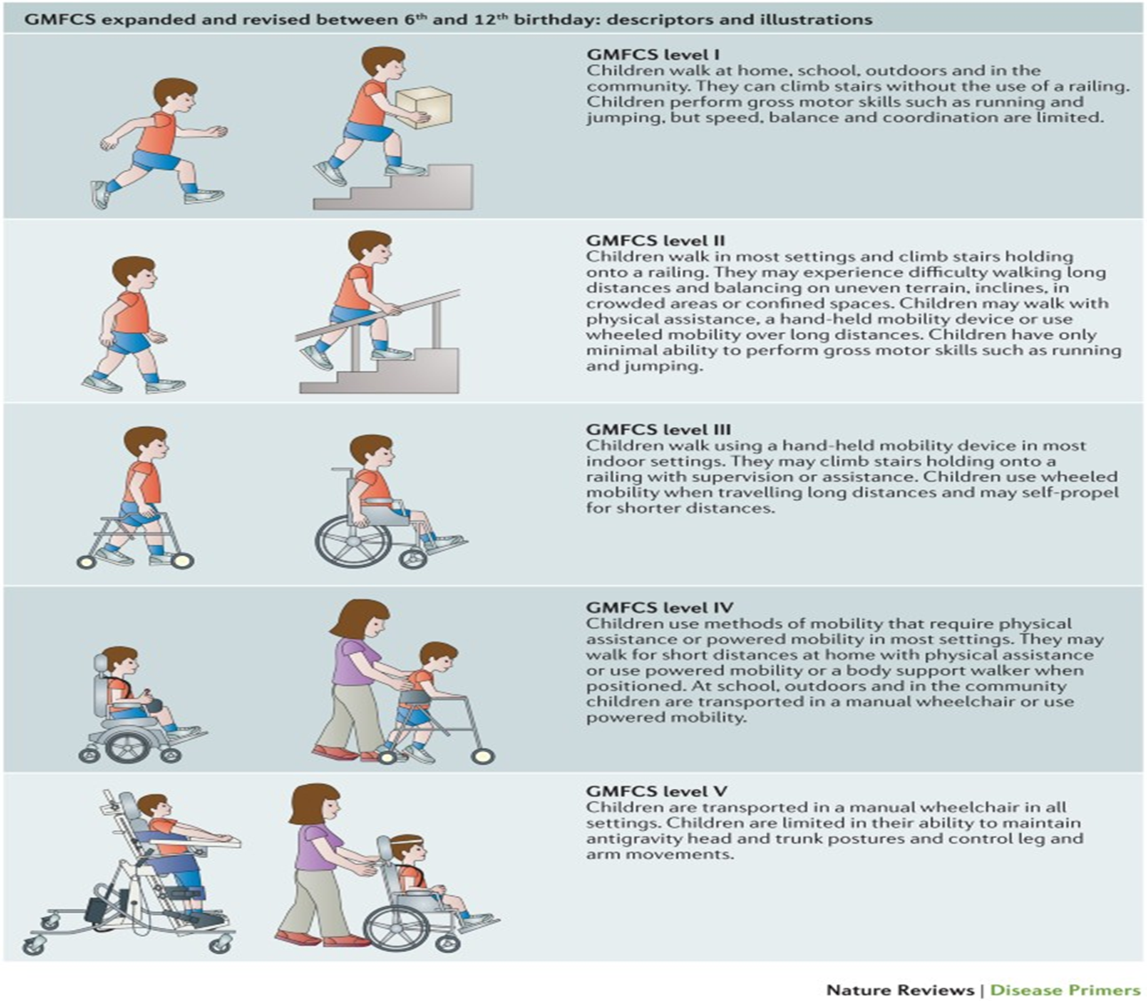

Slide 40
Approach and diagnosis

Slide 41
Diagnosis is primarily clinical supported by imaging.
Examination includes assessment of active and passive range of motion, motor power, selective voluntary motor control, muscle tone, and sensation of the limbs.
Further testing is individualized based on the history and examination findings.

Slide 42
The goals of the history and physical examination are to:
Identify the clinical features and suspected classification of the type of CP, which may provide clues as to the underlying etiology and have implications regarding the likelihood of associated conditions.
Rule out clinical suspicion of a progressive or neurodegenerative condition.
Establish treatment goals and priorities.

Slide 43
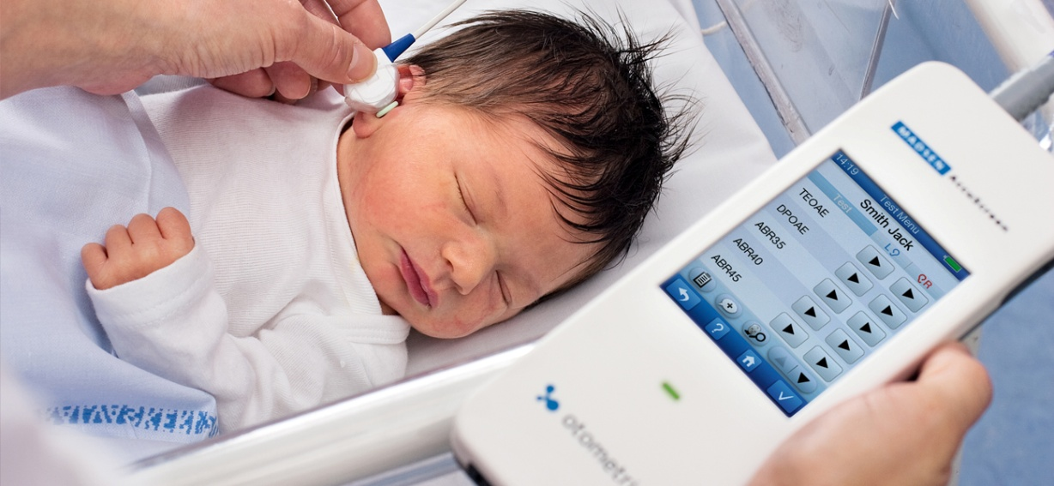
History
Review of prenatal and birth history, which can identify risk factors for CP. Look for the risk factors mentioned earlier.
Review of the newborn screening results, including newborn hearing test results and ophthalmologic evaluation if the child was in the NICU

Slide 44
Review of the family history – Relatives with any of the following should raise suspicion for a genetic cause of CP :
    Intellectual disability/developmental disabilities
    Seizures
    CP
    Neuromotor/movement disorders
    Neurobehavioral disorders
    Joint contractures/stiffness
    Thromboses/vascular accidents
    Congenital anomalies
    Infertility
    Recurrent miscarriages
    Stillbirths
    Adult-onset neurodegenerative conditions

Slide 45


Assessment of development (delay in milestones)(motor, cognitive, primitive reflexes, speech) (key diagnostic factor)
Poor feeding/frequent vomiting.
Irritability.
Screening for attention, behavioral, communication, and/or cognitive concerns
Assessment of growth
Evaluation of motor tone, posture, and coordination

Slide 46

Physical examination
Motor development exam ex. Poor head control after 3 months in cp patients
Growth parameters (essential and may facilitate early identification of children with microcephaly, macrocephaly, and growth impairments)
Neuromotor exam : ventral suspension (c shape), using one side of the body or only arms to crawl, primitive reflexes, deep tendon reflexes
look for :
spasticity/clonus
Floppy or limp body posture
Toe walking/knee hyperextension
Scissoring
Crouched gait: excessive dorsiflexion
Contractures
Muscle weakness
Joint instability/dislocation
Ataxia
Chorea, athetosis

Slide 47
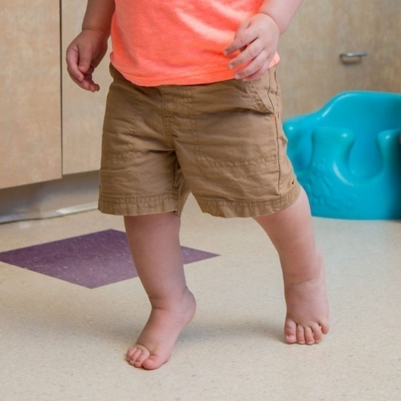
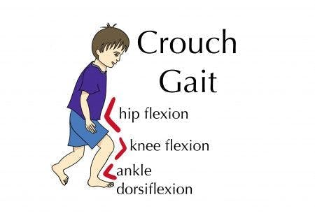
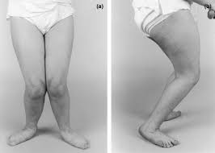
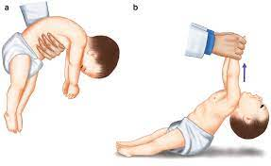
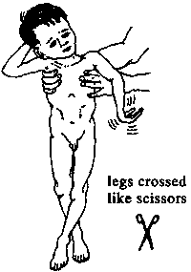
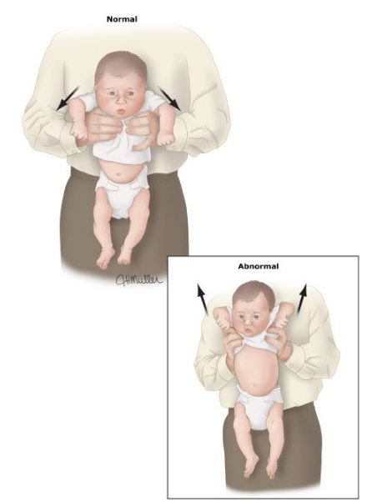
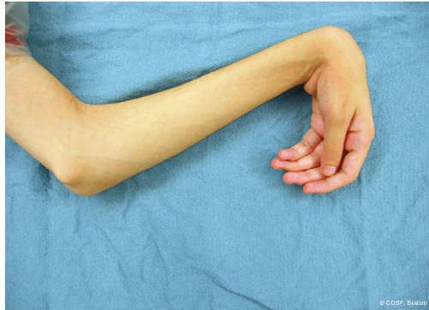

Slide 48
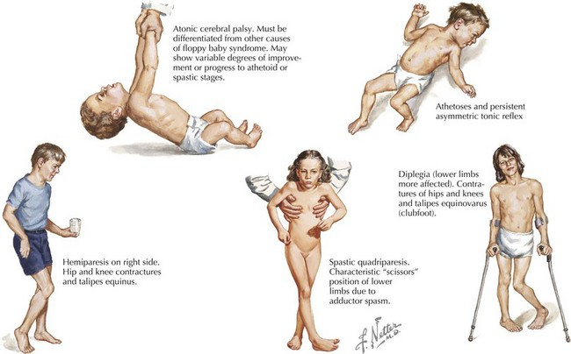

Slide 49
Diagnostic tests
The diagnosis of CP is made clinically. No specific test confirms or excludes the diagnosis of CP. However, a diagnostic evaluation should be performed in all children with CP to identify the underlying cause of CP when possible and to exclude other conditions.
Neuroimaging MRI for all patients that suspected to have CP
  MRI findings in CP patients include evidence of hypoxic ischemia (eg, periventricular leukomalacia), cortical malformations, and lesions of the basal ganglia
Other testing is dependent on clinical and historic concerns and may include:
  Metabolic and genetic testing if there are atypical symptoms, atypical MRI findings or if no etiology is identified by clinical history and neuroimaging.
  Electroencephalogram (EEG) if seizure activity is suspected.
  Infectious work-up (TORCH titers) if pre- or perinatal history is suggestive
  Thrombophilia testing is not necessary for most patients with known or presumed perinatal stroke; however, testing may be warranted if there is a strong family history of thrombosis or if the stroke occurred outside of the perinatal period.

Slide 50
Other imaging tests:
Brain CT : can be helpful in urgent settings such as intracranial hemorrhage
Cranial Ultrasound: can be used in neonates and young infants who have an open anterior fontanel. Ultrasonography can identify hemorrhage, periventricular leukomalacia, and hydrocephalus, but it is not sensitive for white matter injury.
Screening for associated conditions (see next slide)

Slide 51
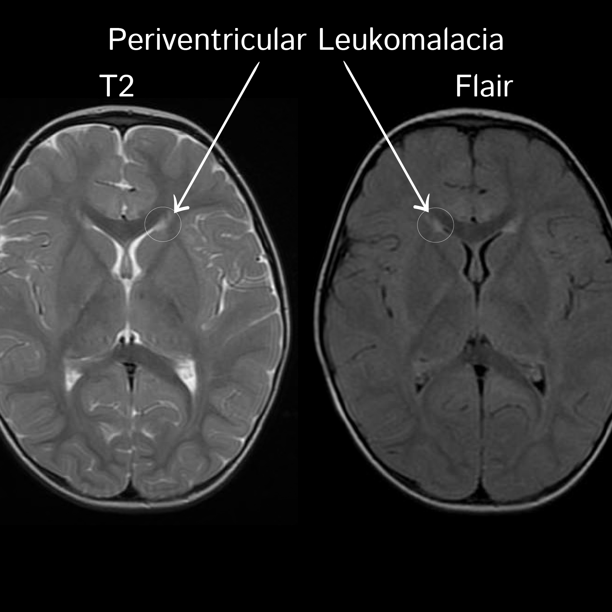

Slide 52
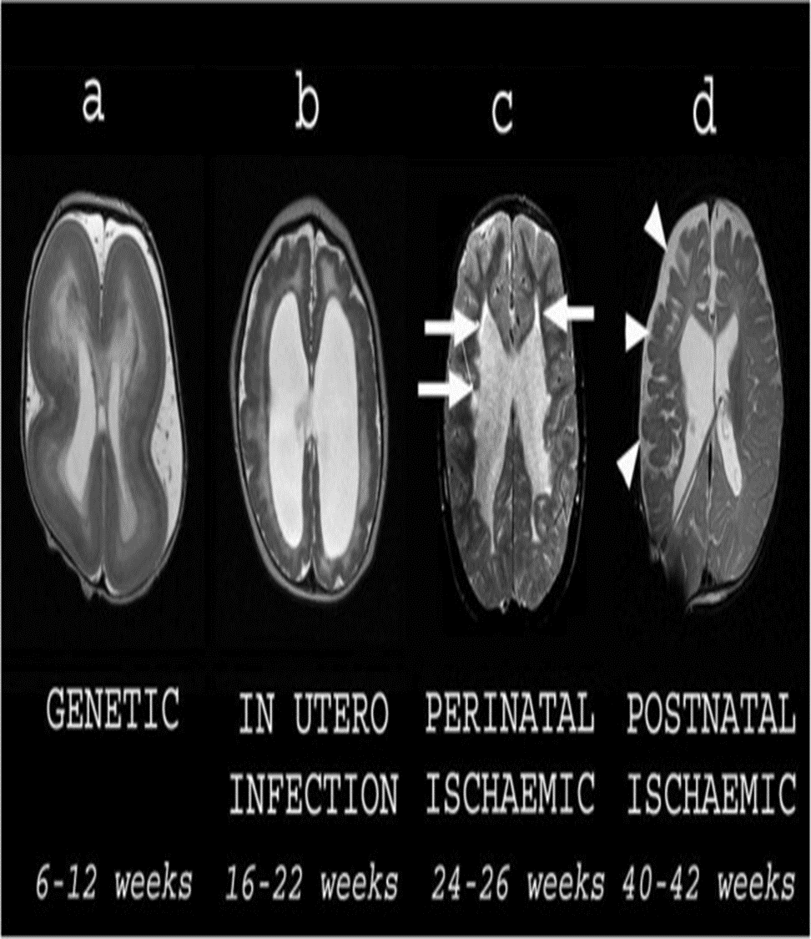

Slide 53
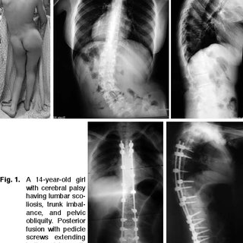

Slide 54
Associated conditions
Children with CP should be evaluated for other conditions that are commonly associated with CP.
Intellectual disability
Seizures
Vision impairment
Hearing impairment
Speech and language impairment
Growth faluire

Slide 55
Prevention :
There are no way to fully prevent CP , however there is ways can aid in preventing CP .
Antenatal measures — Antenatal measures to reduce the likelihood of CP include provision of routine prenatal care, including measures to reduce the likelihood of preterm birth. "Prenatal care: Initial assessment" and "Prenatal care: Second and third trimesters" and "Preterm birth: assess of risk factors, interventions for risk reduction, and maternal prognosis".)
Magnesium sulfate — There is increasing evidence from clinical trials that antenatal administration of magnesium sulfate to women at risk for preterm birth decreases the incidence and severity of CP in their offspring without affecting mortality.
Intrapartum measures — Delaying umbilical cord clamping for at least 30 to 60 seconds after birth in vigorous infants has been shown to reduce the risk of intraventricular hemorrhage (IVH) in preterm infants and may be associated with improved neurodevelopmental outcomes.
Postnatal measures : Supportive measures and Therapeutic hypothermia

Slide 56
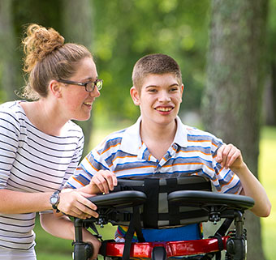
Management
GOAL : Interventions for CP focus on maximizing the child's functional abilities and independence while reducing the extent of disability. Psychologic development, communication, and education are also important priorities. Management includes interventions that specifically address the child's motor impairment (eg, spasticity treatments, orthotics, physical and occupational therapies, orthopedic surgery) and optimal treatment of medical comorbidities.

Slide 57
MANAGEMENT OF ALTERED MOTOR FUNCTION
Physical and occupational therapy
Although its effectiveness in advancing physical function is uncertain, PT has an important role in promoting range of motion, strength, positioning, stamina, and coordination, all of which can directly impact mobility and, with more severe forms of CP, transfers. Occupational therapy (OT) is equally important and focuses on fine motor skill development and improving capacity for self-care or caregiver support of tasks of daily living. As such, targeted activities include skills such as feeding, toileting, dressing, personal hygiene, and fine motor tasks which are important for school success.
PT/OT are typically started early and continued by the parents or caregivers at home between sessions

Slide 58


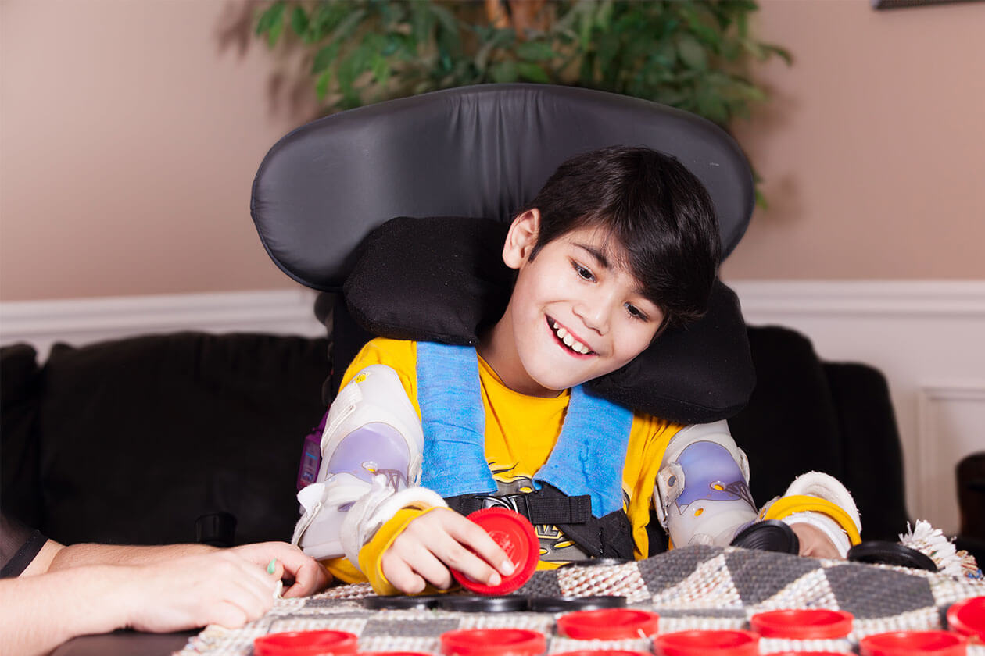

Slide 59
Orthotics and other devices
These include braces, orthotics, standers, seating systems, and mobility devices.
help promote function, mobility, and participation for children with CP.
Many children with CP benefit from bracing to enhance musculoskeletal alignment, promote function, and delay or prevent joint contractures. Ankle-foot orthotics are the most commonly used devices, but orthotics for the knee, hip, and hands can also be useful. Some braces are intended to be worn with specific activities, such as walking, using a gait trainer, or weight bearing in a stander, while others are intended to be used in sleep to promote joint alignment. Devices that use functional electrical stimulation via foot drop stimulation (eg, Bioness, Walkaide) have been shown to improve gait performance in adult patients with hemiplegia secondary to stroke, and they may be helpful to children with hemiplegic CP

Slide 60
Mobility devices
For the child who is unable to ambulate independently or for long distances, mobility devices are critical. Wheelchairs can be introduced as early as two or three years. Most children who need a wheelchair start with a manual chair that allows another person to push them. Over time, if the child has the cognitive, visual, and motor abilities to steer a chair independently, an electric version may be appropriate and provide the child with more autonomy. There are numerous adaptations which allow a child who might have motor difficulty manipulating a joy stick to steer, including knee and head controls. Lightweight adaptive strollers are less cumbersome than wheelchairs and are useful for quick transportation in the community and easier to accommodate in most vehicles.

Slide 61
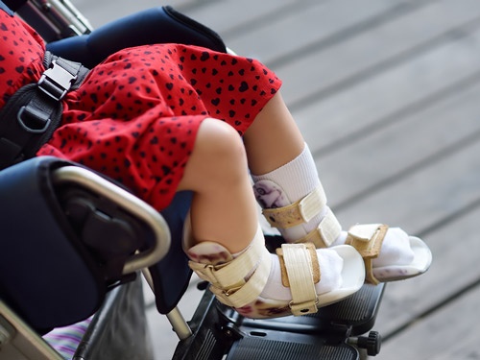
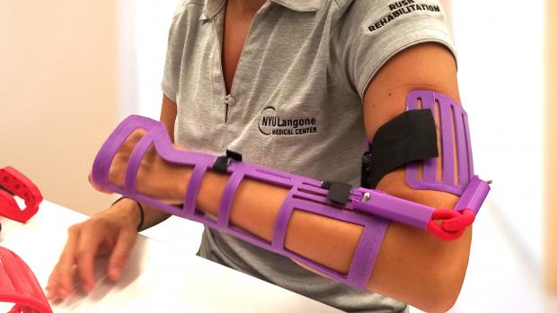
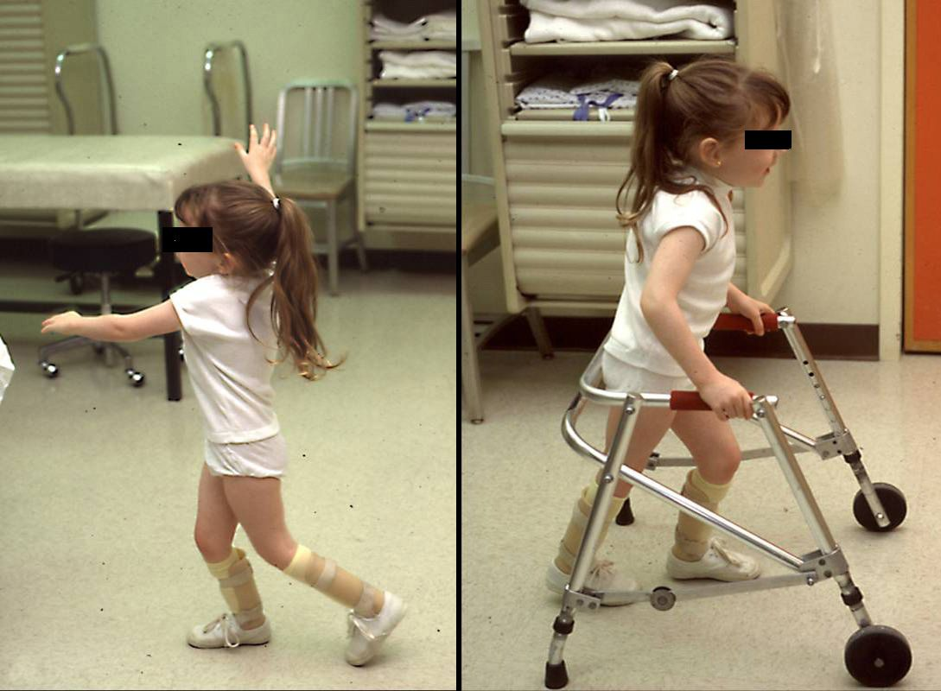
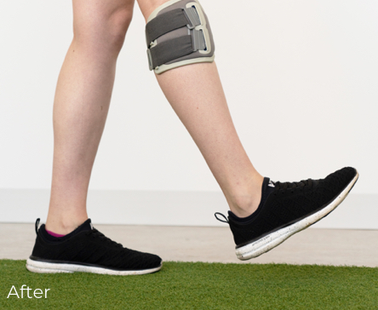

Slide 62
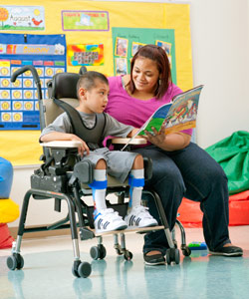
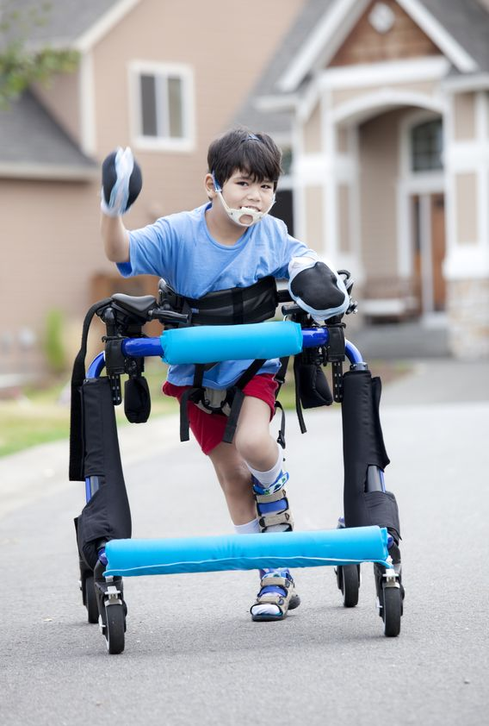
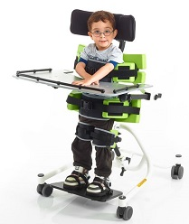
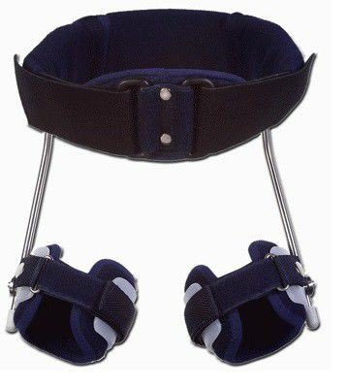

Slide 63
Pharmacological
Antispasticity drugs: First line agents to treat spasticity in children with CP.
  Baclofen: may potentiate seizures. Given orally or intrathecally via pump, but it should be followed up, suitable for severe forms of spacticity (eg. quadriplegic cp) and reduces clonus
  Diazepam: good for transient use for acute spasms, post-surgery. The patient may develop dependence and it should be discontinued slowly.
  Dantrolene: acts peripherally on muscle fibers. The use of this drug is limited because of hepatotoxicity and fatal hepatitis (rare).
  Tizanidine: alpha-2 adrenergic agonist agent which decreases spasticity by increasing presynaptic inhibition. Liver injury ranges from hepatitis to acute liver failure.

Slide 64
  Botulinum toxin: produced by the bacteria Clostridium botulinum. Injection of BoNT into affected muscles blocks the presynaptic release of acetylcholine from motor endplates of the lower motor neuron at the myoneural junction and decreases tone by limiting muscle contraction.
  Phenol block: Phenol is a neurolytic agent that when given as a motor point injection provides temporary reduction in spasticity , it can be used in conjunction with BoNT injections since the combination may achieve better results and the effect may last longer than either treatment alone. Phenol blocks can also be used as an alternative for patients in whom BoNT is poorly tolerated or ineffective. Neurolysis is most often performed with ethanol and phenol. It’s used specifically for nerves with only motor function to avoid the discomfort of neurolysis near sensory nerves.

Slide 65
Intrathecal baclofen (ITB): An implanted, titratable, and programmable pump delivers baclofen to the spinal cord via a catheter within the thecal space. ITB is more effective than oral baclofen with fewer systemic side effects, although risk of baclofen overdose and withdrawal exist. Location of catheter tip and a diffusion gradient with drug dilution at the brain level are important.
Recommended to decrease spasticity, improve endurance, and reduce fatigue associated with spasticity.
Before implantation, a trial dose is administered via lumbar puncture and if effective then you can start the treatment.
Baclofen withdrawal can be caused by failure of the pump or battery; failure to refill drug before scheduled alarm date; or a leak, a disconnection, or breakage in the catheter.
Withdrawal can result in exaggerated rebound spasticity, rhabdomyolysis, and multiple organ failure.

Slide 66
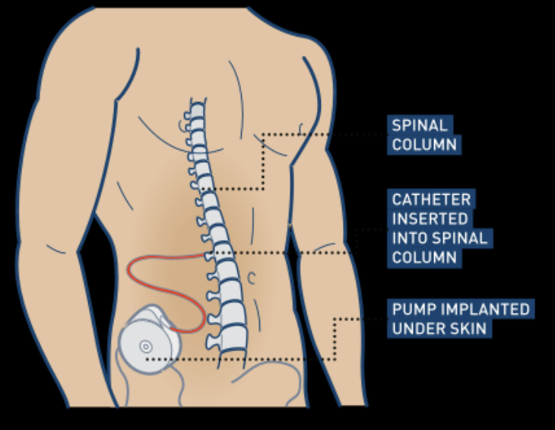

Slide 67
Surgical management
Selective posterior (dorsal) rhizotomy (SPR, SDR): SPR is a one-time, irreversible treatment to ameliorate spasticity. It is occasionally also used in severe refractory cases to enhance care and relieve pain. The principle of SPR is to balance the loss of inhibition from higher centers in the brain by decreasing sensory stimulation coming from the periphery. It should be combiened with physiotherapy and the patient should have neuro-workup prior to operation because its permanent, and it requires a multidiscplanrey team.

Slide 68
SPR is done by dividing selected posterior nerve rootlets from L2- S2 within the dural sheath (25% to 60% are typically ablated); selection of rootlet is based upon abnormal electromyogram responses. Postoperative weakness is common and patients require long-term, aggressive physiotherapy. Ankle-foot orthoses are recommended postoperatively for at least 6 months to protect weak plantar flexor muscles from overstretch.

Slide 69
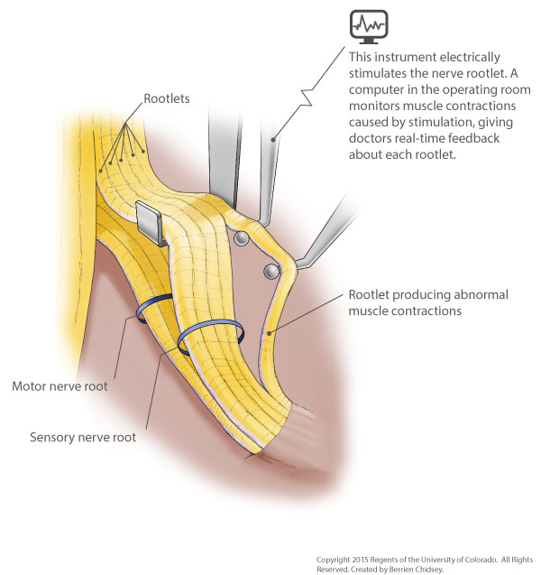
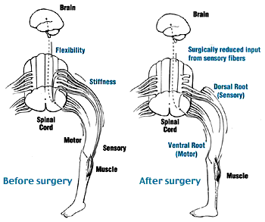

Slide 70
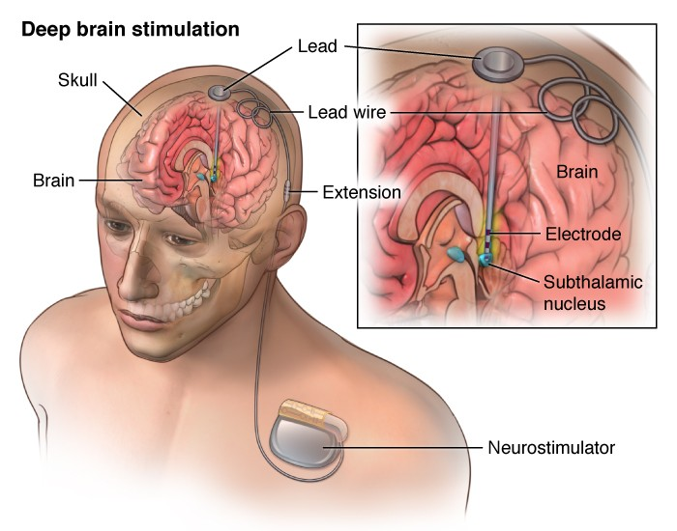
Deep Brain Stimulation (DBS): DBS is the use of electrical stimulation by electrodes placed in the posteroventral lateral Globus pallidus internus to decrease extrapyramidal movement disorders. This treatment has been successful in patients with primary (or genetic) dystonia, and some evidence suggests it may be successful in patients with secondary dystonia.

Slide 71


Gastrotomy: Sometimes a gastrostomy is used with children with significant eating, drinking and swallowing difficulties to ensure they receive enough food and drink. An increased risk for aspiration pneumonia in cp + dehydration + poor weight gain ( due to inability to eat or drink), so gastrostomy is protective against it .

Slide 72
Orthopedic Surgery
The goals of surgery are to prevent progressive deformity and remove mechanical or anatomic barriers to maximize mobility and function. Single-event multilevel surgery to minimize total recovery time is recommended rather than 'birthday surgery' (a procedure nearly every year).
The hips should be reduced with early (age 2-5 years) tendon releases.
Example: Tendon transfers to improve wrist and finger/ thumb extension, along with first web-space release and flexion contracture release, can improve hand function.

Slide 73



Slide 74
Dystonia
Pharmacologic treatment:
  Dopamine-responsive dystonia is also know as Segawa's disease. Diagnosis is not made by one definitive test, but by a series of clinical observations and specific biochemical assessments. Defining the exact cause may not be possible. High-protein foods slow the absorption of this drug.
  Levodopa/Carbidopa : A trial of carbidopa/levodopa is often given to assess for dystonia due to an alternative diagnosis of dopamine-responsive dystonia, in which patients show a dramatic response. In many cases, full physical functionality including walking, running, speaking, and writing is restored or preserved.
  Neuroleptic Therapy / With Athetosis: Haloperidol, pimozide, tetrabenazine
Deep brain stimulation

Slide 75
TONE MANAGEMENT
Pharmacologic and/or surgical intervention may help to reduce the altered tone associated with CP, although they do not improve weakness or difficulties with coordination
Spasticity:
  For children with generalized spasticity, oral antispasticity drugs are usually the first-line treatment (eg, baclofen or benzodiazepines)
  For treatment of localized or segmental spasticity, botulinum neurotoxin (BoNT) injections are appropriate. Phenol block can be used in conjunction with BoNT or as an alternative for patients who do not tolerate or respond to BoNT, but there is less evidence to support its use.

Slide 76
  For patients with spastic diplegia who have mild to moderate motor impairment, no significant weakness, and are cognitively able and willing to participate in post-surgery rehabilitation, selective dorsal rhizotomy (SDR) may be performed as an alternative to or along with antispasticity therapy to improve gait.
  For severely affected children, who have significant side effects with oral antispasticity drugs or who do not achieve adequate response despite maximal dose, an intrathecal baclofen pump may achieve better control of spasticity. SDR is an alternative option for nonambulatory children to treat spasticity, provide comfort, and promote participation in activities of daily life

Slide 77
REFERANCE
UpToDate
Nelson textbook
Amboss

Slide 78
THANK YOU

